Slide 1
Mobilizing a Collaborative Approach to Onboarding Staff
Jody Hendry, MCCSS
Steve Snider, Christian Horizons

Slide 2
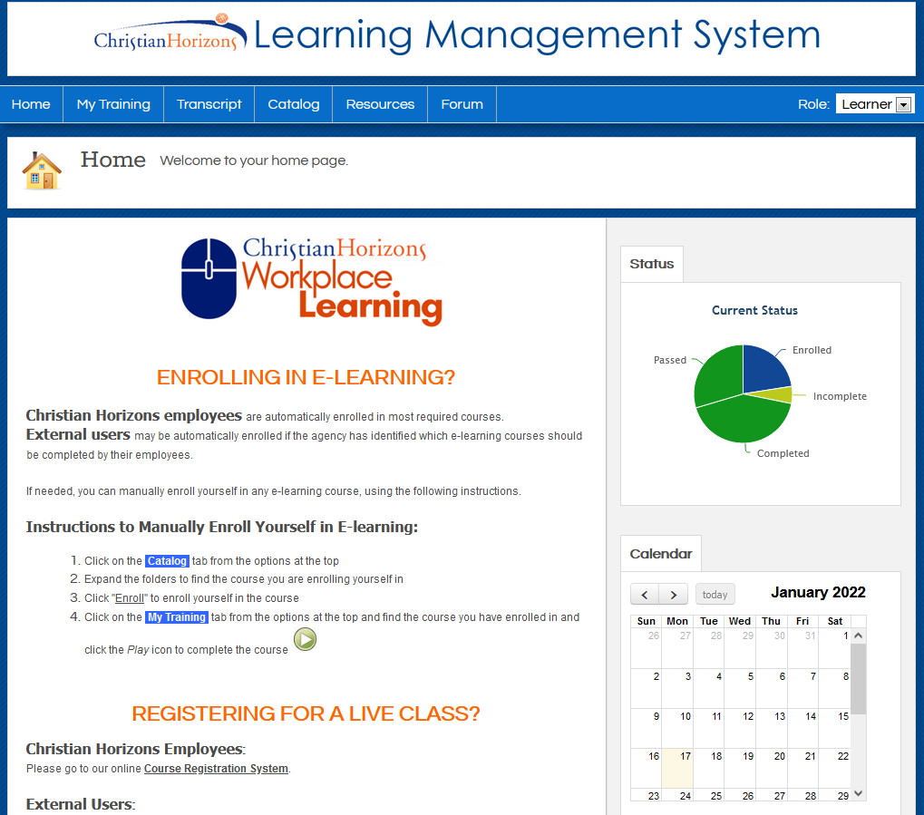
Christian Horizons is pleased to provide access to our Learning Management System.
We will post step by step instructions on our website.
Employees will be able to self enroll in e-learning courses available from our virtual catalogue.

Slide 3
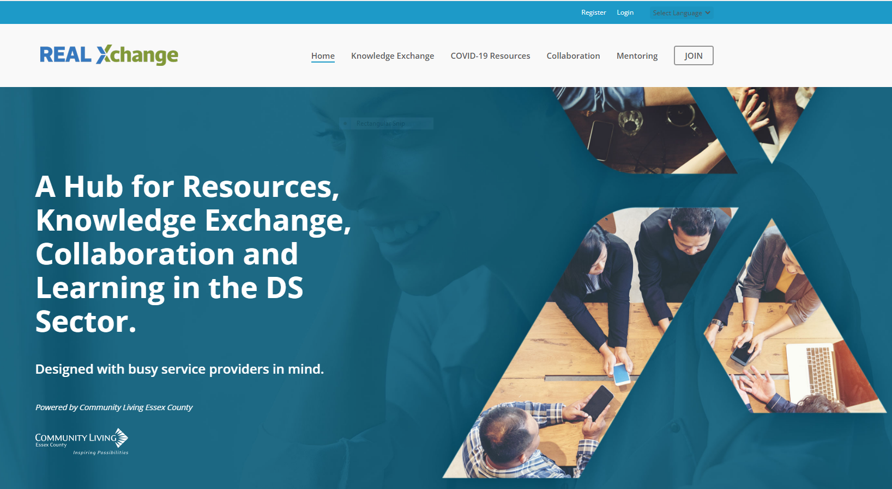
We will also explore opportunities to directly post a link on the REAL Xchange site.

Slide 4
They can also review our schedule of two live, virtual courses.
3.5 - hour courses
Currently, these courses are scheduled every two weeks. If courses fill up, we will add more sessions to meet demand.

Slide 5
We appreciate the support of MCCSS as Ministry staff are prepared to facilitate training as needed.
Additionally, agencies may contact MCCSS directly at DSCompliance@ontario.ca for supplementary support, where necessary.
We are in this TOGETHER!!!

Slide 6
Certificates are generated upon completion.
Additional access to reports can be provided.

Slide 7
We will also share our list of on-site orientation items to help new hires prioritize on-site learning.

Slide 8
Questions?
Please email
learning@christian-horizons.org.

