Slide 1
CORONAVIRUS (COVID-19)
If I Become Sick with Coronavirus

Slide 2
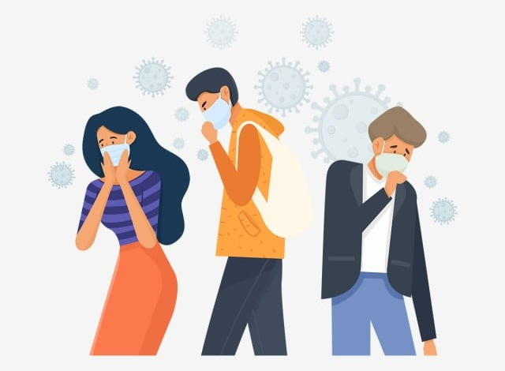
The coronavirus is similar to a flu or cold virus
and spreads very easily.

Slide 3
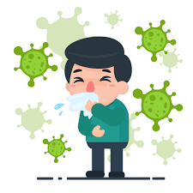
Many people will become sick with the coronavirus.
I may become sick with the coronavirus.

Slide 4
Every person who becomes sick with the coronavirus
will have their own unique experience.
While I can not know for sure what my experience with
coronavirus will be, there are some things I can expect.

Slide 5
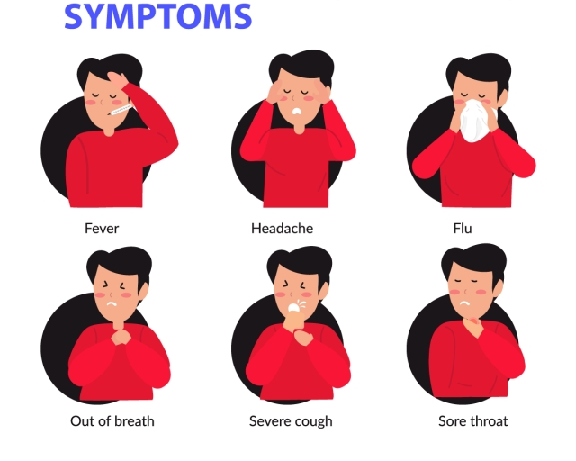
If I become sick with the coronavirus, I may feel unwell.
I could have a fever, sore throat, cough, shortness of breath
or feel very tired.

Slide 6
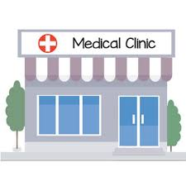
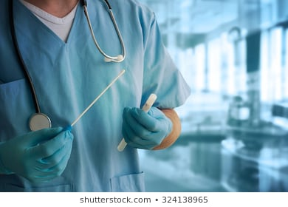
If I become sick with coronavirus, I will need to get tested.
Nose Swab
I will go to a special clinic to get tested.
The test may feel uncomfortable but it will be over with quick.

Slide 7
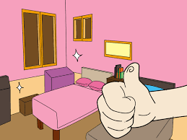
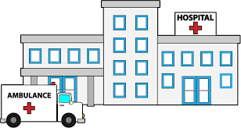
If I become sick with coronavirus, I will need to self – isolate
- away from others - to avoid the spread of germs.
Self-isolation could happen in my bedroom, a special area in my house, a new place away from my home, or the hospital.

Slide 8
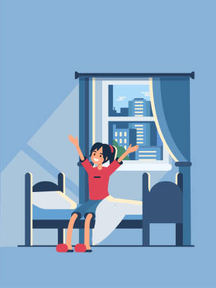
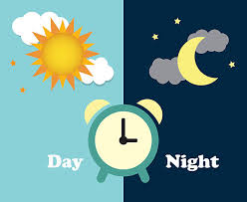
Self - isolation means that I will stay in one area at all times throughout the day and night, until I am better.

Slide 9
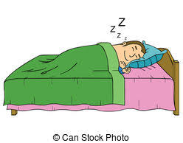
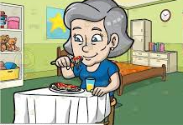
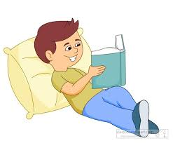
This means that I will sleep in this area, eat in this area and do all my daily activities in this area.
Sleeping
Eating
Daily Activities

Slide 10
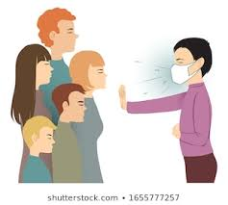
This also means that I will not be able to spend time with my family, friends or housemates.
It is important that I stay away from other people so that I don’t get anyone sick.

Slide 11
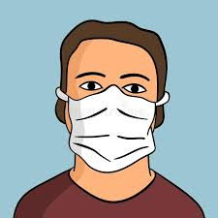
If I become sick with coronavirus, I will need to wear a mask that covers my nose and mouth.

Slide 12
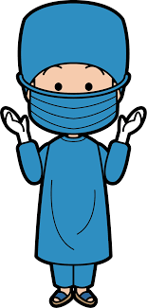
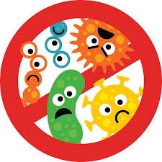
When staff come to support me, they will wear a mask that covers their nose and mouth.
They may also wear other items, like a gown, gloves and goggles. This will help to prevent the spread of germs.

Slide 13
If I become sick with coronavirus, I have supports in place to make sure that I am safe and as comfortable as possible.
I don’t know how long I will be sick with coronavirus but I know that I will be well taken care of.

Slide 14
Learning about what may happen if I become sick with coronavirus might make me feel different emotions.
It is okay to feel this way.

Slide 15
I have people in my life who are here to support me.
If I have questions or need support I can talk to them.

