Slide 1
CORONAVIRUS (COVID-19)
My Housemate has Coronavirus

Slide 2
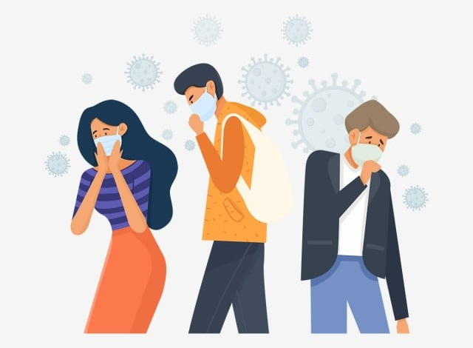
The coronavirus is similar to a flu or cold virus
and spreads very easily.

Slide 3
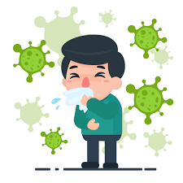
Many people will become sick with the coronavirus.
Someone I know or live with may become sick with coronavirus, like my housemate.

Slide 4
Every person who becomes sick with the coronavirus
will have their own unique experience.
While I can not know for sure what my housemate’s experience will be with the coronavirus, there are some things I can expect.

Slide 5
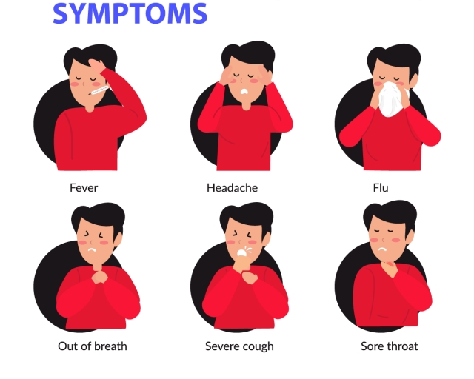
If my housemate becomes sick with coronavirus, they may feel unwell.
They could have a fever, sore throat, cough, shortness of breath
or feel very tired.

Slide 6
If my housemate becomes sick with coronavirus, they will need to get tested at a special medical clinic.
Nose Swab
Because the virus spreads so easily I may also need to get tested for coronavirus to see if I have it as well.

Slide 7
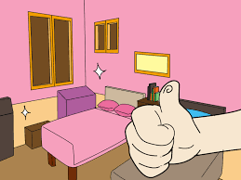
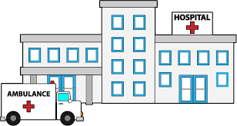
If my housemate becomes sick with coronavirus, they will need to self - isolate to avoid the spread of germs.
Self-isolation could happen in their bedroom, a special area in our home, a new place away from home, or the hospital.

Slide 8
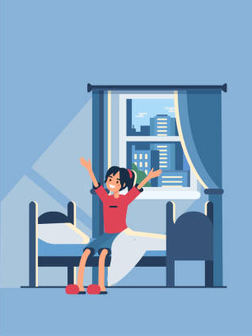
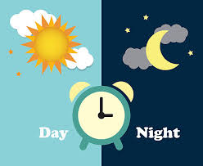
Self - isolation means that my housemate will stay in one place – away from others - at all times throughout the day and night.
They will stay in this place until they are better.

Slide 9
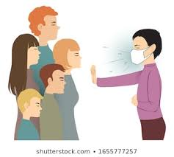
This means that I will not see or spend time with my housemate for awhile.
It is important that I stay away from my housemate to keep everyone else in the house safe.

Slide 10
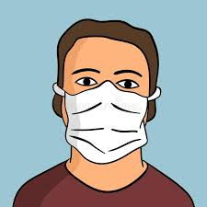
If my housemate becomes sick with coronavirus,
they will need to wear a mask that covers their nose and mouth.

Slide 11
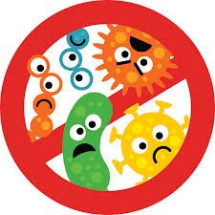
Staff in the home will wear a mask to cover
their nose and mouth.
Staff may also wear other items, like a gown, gloves and goggles. This will help to prevent the spread of germs.

Slide 12
If my housemate becomes sick with coronavirus,
supports are in place to keep everyone in the home safe.
I don’t know how long my housemate will have the coronavirus
but I know that everyone will be well taken care of.

Slide 13
Learning about what may happen if my housemate becomes sick with coronavirus might make me feel different emotions.
It is okay to feel this way.

Slide 14
I have people in my life who are here to support me.
If I have questions or need support I can talk to them.

