Slide 1
CORONAVIRUS (COVID-19)
Safety in the Community

Slide 2
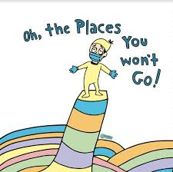
Many people have been staying at home to avoid getting sick
from the coronavirus or spreading germs to others.
This means that many places in the community were closed.

Slide 3
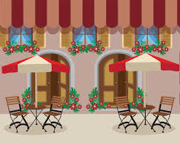
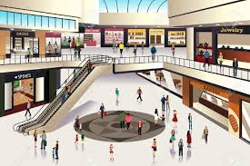
Over the past several months, a lot of work has gone
into making the community safe.
This means that more places in the community are now open
and people will be spending more time outside of their homes.
.

Slide 4
When I leave my house and go to places in the community,
it is important that I am as safe as possible to avoid becoming sick or spreading germs to others.

Slide 5
When I go out, I need to follow some rules to make sure that
I and the people around me are safe.
Every place has different rules and I will need to listen to my staff or read the signs to understand what I am supposed to do.

Slide 6
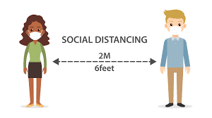
I can be safe by:
Pool Noodle = 6 feet in length
Social distancing.
This means keeping 2 meters/6 feet distance from others
OR the length of 1 pool noodle apart.

Slide 7
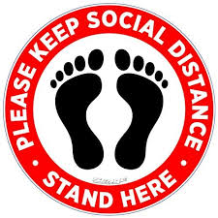
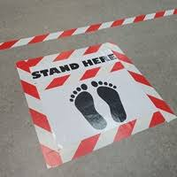
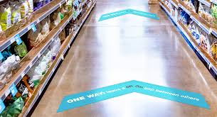
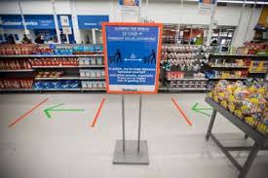
This also means following the signs that places are using to show people where to stand or what direction to walk in.
Signs on the ground tell me where to stand to keep distance from others.
Arrows or lines on the floor tell me what direction to walk in to keep distance from others.

Slide 8
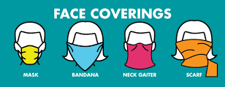
Wearing a mask or face covering that covers
my nose and mouth.
This is especially important when it is difficult to physical distance from others, such as on transit, in an elevator or when shopping.

Slide 9
Staying away from crowds and other people by:
Moving to the other side of the street when others are on the
sidewalk.
Choosing to go somewhere else if there is a line-up.
Waiting to go into a room until others have left.
Greeting others from a distance with a wave or nod.

Slide 10
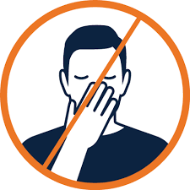
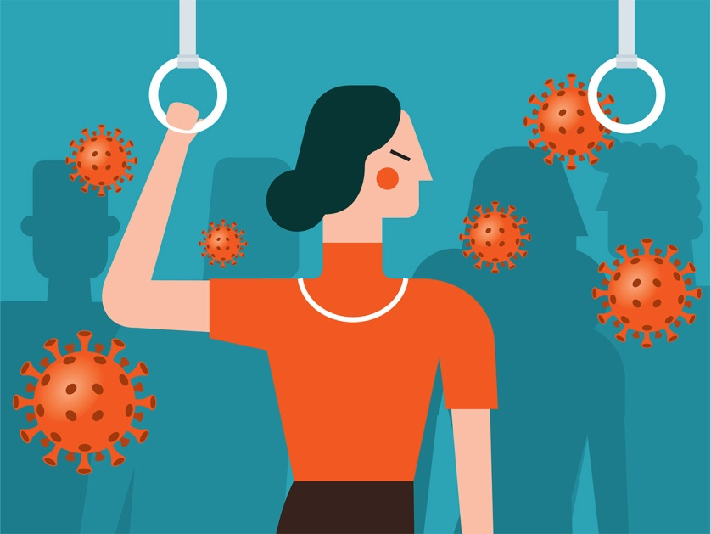
Avoiding touching my face with unwashed hands
or touching public surfaces.

Slide 11
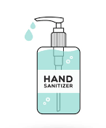
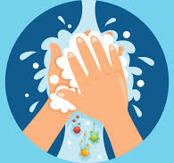
Cleaning my hands often using soap and water or hand-sanitizer
(if soap and water is not available).

Slide 12
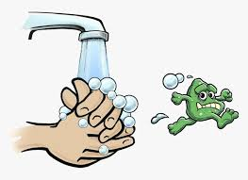
I should wash my hands when:
I come in from outside.
After I have touched a surface
or item from outside.
Before I touch my face.
Before I eat.

Slide 13
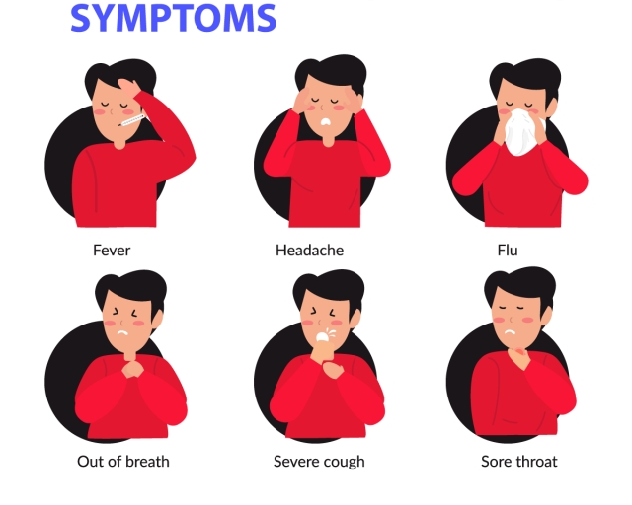
Staying home if I am feeling sick.

Slide 14
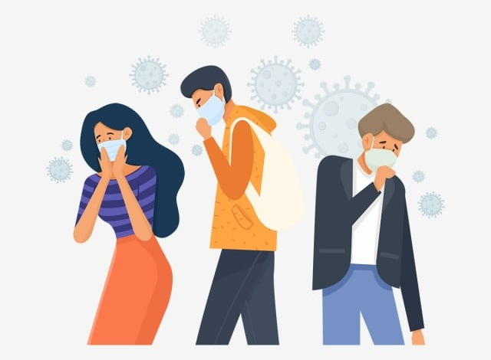
While more places in the community are now open,
I know that the coronavirus is still around and spreads easily.
This means that when I go out in the community I could
get the coronavirus or I could pass on germs to my housemates and staff, even if I am as safe as possible.

Slide 15
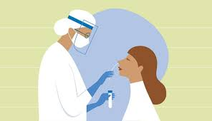
If I am in close contact with someone who has coronavirus
OR if I visit a place in the community where there are coronavirus cases, I will need to get tested.
.

Slide 16
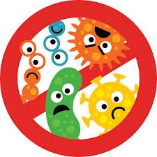
I may also have to self-isolate in a place away from my housemates, family and the community for a period of time - to keep everyone safe.

Slide 17
I also know that places in the community that are open now
could become closed again AND that people going out in the community now may be asked to stay at home again
(to keep everyone safe).

Slide 18
Learning that more places in the community are open and
how to stay safe if I choose to go out, might make me feel different emotions.
It is okay to feel this way.

Slide 19
I have people in my life who are here to support me.
If I have questions or need support I can talk to them.

