Slide 1
CORONAVIRUS (COVID-19)
What I Need to Know for Fall/Winter 2020

Slide 2
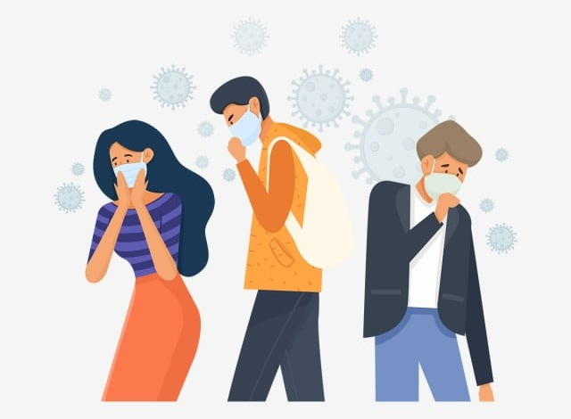
The coronavirus is similar to a flu or cold virus
and spreads very easily.

Slide 3
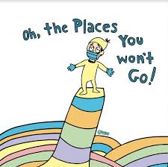
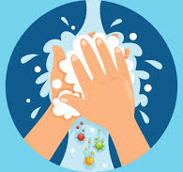
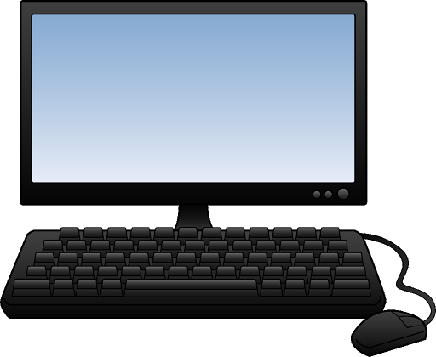
Many people have made big changes to how they live their lives
to avoid getting sick from the coronavirus or spreading germs to others, such as:
(1) Staying home, (2) Avoiding places in the community, (3) Washing hands often, (4)Wearing a face mask and (5) Seeing friends/families virtually (instead of in person).

Slide 4
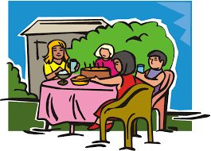
.
In the summer, the chances of getting sick from
the coronavirus were low.
This meant that places in the community were open
and people were spending more time outside of their homes.

Slide 5
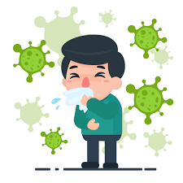
Now that the weather is colder and we are going into winter,
the coronavirus is spreading more.
This means the chances of getting sick from the coronavirus
is higher right now and in the months to come.

Slide 6
There are new rules in place to avoid spread of
the coronavirus. It is important that I follow these rules to
help keep myself as safe as possible.

Slide 7
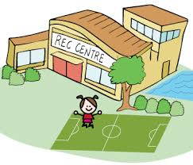
To keep safe, it is important that I stay away from places in the community.
The only places I will go to is work, school or medical appointments (if these are part of my everyday activities).

Slide 8
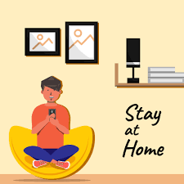
This means that I will spend most of my time at home.

Slide 9
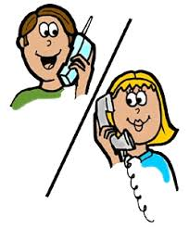
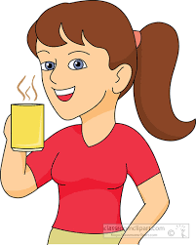
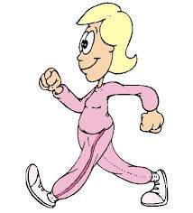
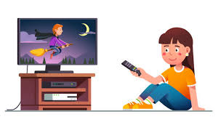
There are many activities I can do at home that I enjoy.

Slide 10
To keep safe, there will be new rules for visitors coming in to my home.
Visitors will not be allowed inside the house.
This means that if my family or friends visit, we will see
each other outside of the house.

Slide 11
To keep safe, it is important that I get the Flu shot.
This will help protect my body from the flu and keep my body strong.

Slide 12
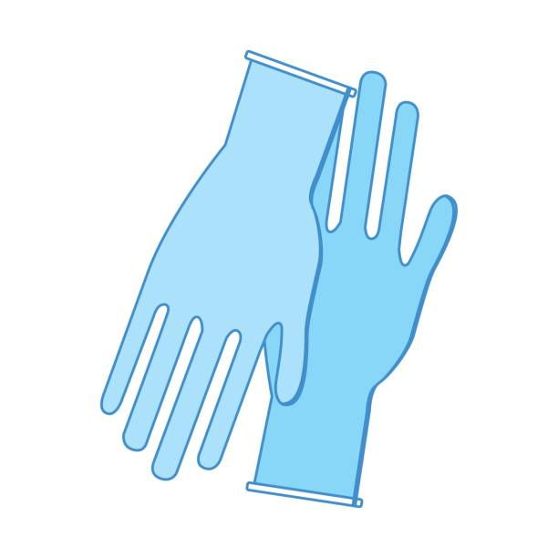
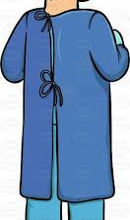
To keep safe, my staff will wear personal protective equipment,
such as gloves, face masks and gowns (if needed).
They may also wear equipment that is new to me, such as a face shield.

Slide 13
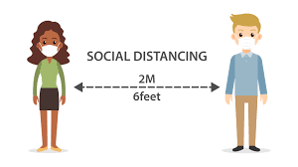
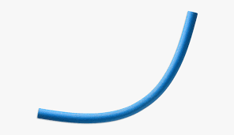
To keep safe, I can continue to do things that I have been doing so well, such as social distancing.
Pool Noodle = 6 feet in length
This means keeping 2 meters/6 feet distance from others
OR the length of 1 pool noodle apart.

Slide 14
Wearing a mask or face covering that covers
my nose and mouth.
This is especially important when it is difficult to physical distance from others, such as going to a medical appointment
or in my home.

Slide 15
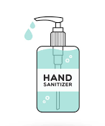
Cleaning my hands often using soap and water or hand-sanitizer
(if soap and water is not available).

Slide 16
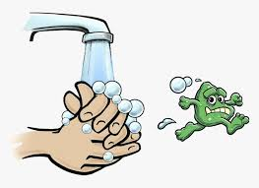
I should wash my hands when:
I come in from outside.
After I have touched a surface
or item from outside.
Before I touch my face.
Before I eat.

Slide 17
Learning about the new rules I have to follow because of
the coronavirus, might make me feel different emotions.
It is okay to feel this way.

Slide 18
I have people in my life who are here to support me.
If I have questions or need support I can talk to them.

