Slide 1
Preparing to get the Covid-19 Vaccine:
Some Strategies To Help If You Are Nervous About Needles

Slide 2
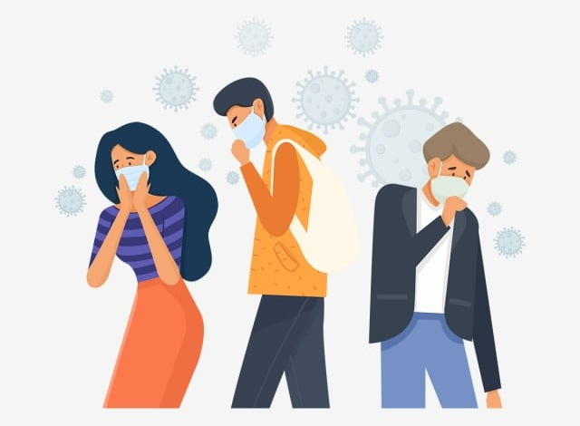
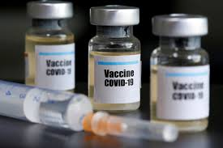
A vaccine is available to help keep myself and others safe from covid-19.
It is like how flu vaccine keeps me safe from getting the flu.

Slide 3
BEFORE GETTING THE VACCINE

Slide 4
Before going to the clinic to get the vaccine, I must complete the following steps:
Eat a small snack
Have on a short sleeve t-shirt or sleeves that are easy to roll up
Pack my health card and immunization card and if I need it, an item that makes me feel happy or calm (e.g., iPad to play videos or a stress ball to squeeze)
Wash my hands
Put on my winter clothes and mask

Slide 5
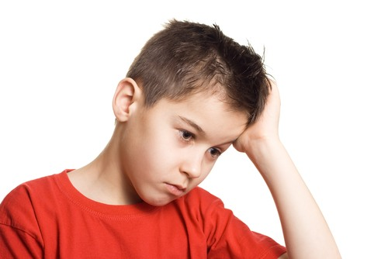
If I feel anxious or scared before going to the clinic, that's OK. There are strategies I can use to make me feel better.
I can also let my staff or caregiver know and they will help me relax before we go.

Slide 6
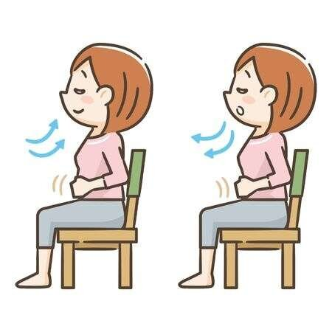
These are the deep breathing steps I can follow. Breathing makes me feel better.
My caregiver or staff can do these with me.
Sit comfortably in a chair
Put one hand on your belly and other hand on your chest
Deep breath through your nose. The belly pushes the hand on your belly out
Breathe out through your mouth. The hand on belly moves in as you breath out
Repeat steps 1-4 as many times as you need to feel relaxed

Slide 7
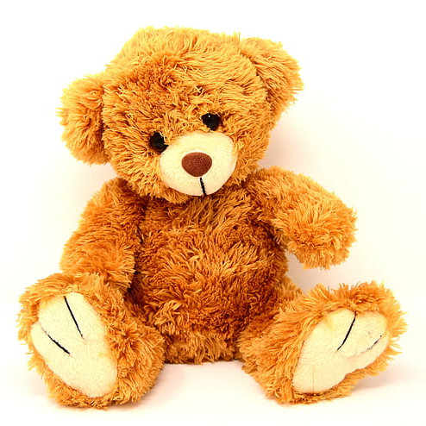
I can also find something special to bring to the clinic with me that makes me happy or relaxed.
My caregiver or staff may have some good ideas about what I can bring.

Slide 8
AT THE CLINIC: WAITING FOR THE VACCINE

Slide 9
Once I enter the clinic, I must complete the following steps:
I will sanitize or wash my hands and keep my mask on
The person at the clinic will ask me questions, such as, do I have a cold, cough, runny nose, fever and/or, body pain. This is to make sure that the vaccine is safe for me
My staff or caregiver can help me answer these questions
I will stay 6ft apart from others in the waiting area
When it is my turn, my name will be called, and I will go sit with the doctor, nurse or pharmacist who will give me the vaccine

Slide 10
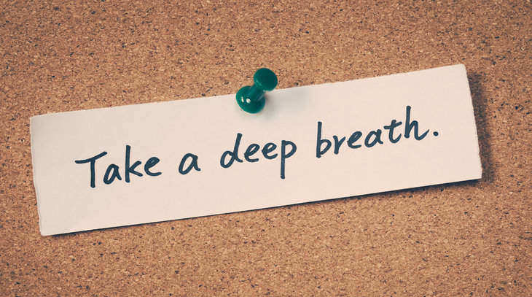
If I feel anxious or scared while I wait for my turn, that's OK. I can practice deep breathing and think about something that makes me happy.
Using the item I brought can help too.
I can let my caregiver or staff know and they will help me relax.

Slide 11
These are the deep breathing steps I can follow. Breathing makes me feel better.
My caregiver or staff can do these with me.
Sit comfortably in a chair
Put one hand on your belly and other hand on your chest
Deep breath through your nose. The belly pushes the hand on your belly out
Breathe out through your mouth. The hand on belly moves in as you breath out
Repeat steps 1-4 as many times as you need to feel relaxed

Slide 12
Getting the Vaccine

Slide 13
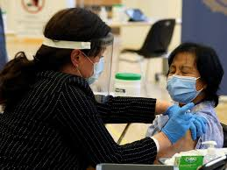
When it is my turn, I will be asked to go sit down in a different area with the doctor, nurse or pharmacist.
If I want, my caregiver or staff can be there to support me when I get the vaccine.

Slide 14
Once I am sitting down, I must do these things before getting the vaccine:
Remove my winter jacket
Roll up my sleeve or, t-shirt sleeve
The doctor, nurse or pharmacist will get the needle ready

Slide 15
If I am feeling nervous when I see the needle, I can:
Take a deep breath
Look away from the needle or close my eyes
Ask my caregiver or staff to hold my arm or hand
Ask my caregiver or staff to show me my favourite video, sing a song or tell a joke
Ask my caregiver or staff for my special activity or item

Slide 16
When it is time to get the vaccine:
The doctor/nurse/pharmacist will apply an alcohol swab on my upper arm to clean the area
I will sit still. The needle is put in my upper arm, this will pinch
Once I get the needle, I will wait for 15 minutes in the waiting area. After 15 minutes, I can go home
I did a good job! I am proud of myself. My caregiver/staff will let me know how proud they are of me

Slide 17
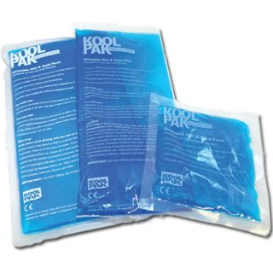
When I get home my arm may feel sore. I can apply ice pack on my arm to make me feel better.

Slide 18
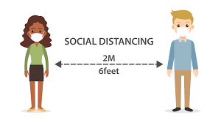
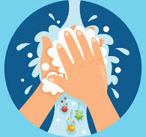
Even though the COVID-19 vaccine is here and many people will be getting vaccinated, life will not go back to normal right away.
It is going to take a long time for everyone to get fully vaccinated. This means COVID-19 rules will be around for a while.
After I am vaccinated, I will still need to follow all the Covid-19 rules to keep myself and the people around me safe.

Slide 19
PRACTICE

Slide 20
It is important to practice deep breathing while I am calm, so that I know what to do when I am nervous. I should practice deep breathing every day before getting my vaccine.
My caregiver or staff can do these with me to help me practice.
Sit comfortably in a chair
Put one hand on your belly and other hand on your chest
Deep breath through your nose. The belly pushes the hand on your belly out
Breathe out through your mouth. The hand on belly moves in as you breath out
Repeat steps 1-4 as many times as you need to feel relaxed

Slide 21
Sometimes it is helpful to practice before going to the clinic so that I know what will happen when I get there.
I can practice with my caregiver or staff the steps of going to the clinic to get a vaccine.
I will sit in a chair
I will roll up my sleeve
My staff will show me a pretend needle that will touch my arm
I will have to sit still as the pretend needle goes into my upper arm
My staff will remove the pretend needle and let me know they are proud of me!

Slide 22
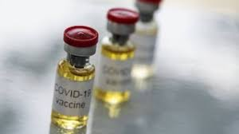
If I feel anxious or scared when practicing with my caregiver or staff, that's OK. I will let my staff know and we will try deep breathing or stop practicing.
My caregiver or staff will help me practice more before I have to get the vaccine.

