Slide 1
Resilience, Adaptation, and Reopening:
Rapid Antigen Testing

Slide 2
Resilience, Adaptation, and Reopening:
Rapid Antigen Testing
12:00 – 12:05 Welcome & opening remarks - James Janeiro
12:05 – 12:15 Central West Specialized Developmental Services
12:15 – 12:20 Community Living Parry Sound
12:20 – 12:30 Christian Horizons
12:30 – 12:40 Pooran Law
12:40 – 12:50 MCCSS
12:50 – 1:00 Question & answer period

Slide 3
Dr. Fiona O’Sullivan
fosullivan@cwsds.ca
Sylvia Fattore
sfattore@cwsds.ca

Slide 4
Introduction to CWSDS
Central West Specialized Developmental Services (CWSDS) is a registered, not-for-profit organization, funded by the Ministry of Children, Community and Social Services (MCCSS) CWSDS.
Comprised of various services and supports including onsite and community supported living homes, day services, and community services to help people with intellectual and developmental disabilities and complex needs.
Dr. Fiona O’Sullivan
fosullivan@cwsds.ca
Sylvia Fattore
sfattore@cwsds.ca

Slide 5
Why Rapid Antigen Screening?
Testing and screening, in combination with personal public health measures and vaccination, are important tools to protect Canadians and help limit the spread of COVID-19. Some studies suggest that up to 50% of COVID-19 transmission could be caused by people without symptoms.
Rapid antigen tests are easy to administer, and produce results in as little as 15 minutes.
Dr. Fiona O’Sullivan
fosullivan@cwsds.ca
Sylvia Fattore
sfattore@cwsds.ca

Slide 6
Why Rapid Antigen Screening?
They are most effective at identifying those with high viral load and high transmission potential.
A positive rapid antigen test result should be confirmed with a diagnostic polymerase chain reaction (PCR) test by local public health authorities.
Dr. Fiona O’Sullivan
fosullivan@cwsds.ca
Sylvia Fattore
sfattore@cwsds.ca

Slide 7
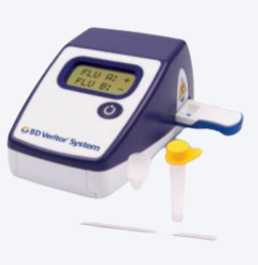
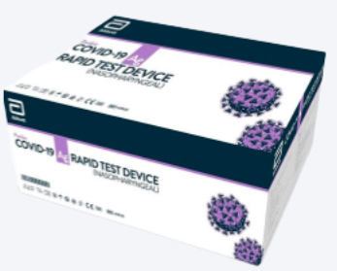
Rapid Antigen Screening & Acknowledgement
Dr. Fiona O’Sullivan
fosullivan@cwsds.ca
Sylvia Fattore
sfattore@cwsds.ca
PanbioTM Rapid Antigen Screening Pilot
December 2020 – March 2021
BD VeritorTM Rapid Antigen Screening Program
Mid-June 2021 – present
COVID-19 Resources - The Real Xchange (communitylivingessex.org)

Slide 8
Rapid Antigen Screening Method
Encouraged participation from all employees (1 – 2 times per week)
For employees working from both home and office it is recommended once per week.
Employees who provide direct support or are in the office full-time, will be encouraged to complete Antigen Screening twice per week.
Screening occurs in the work environment
Asymptomatic employee may participate
Dr. Fiona O’Sullivan
fosullivan@cwsds.ca
Sylvia Fattore
sfattore@cwsds.ca

Slide 9
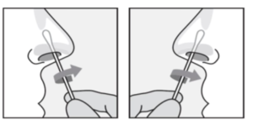
Rapid Antigen Screening Method (cont’d)
Rapid Antigen Testing (BD Veritor™)
The Ministry of Health has confirmed that supervised self-swabbing is now an acceptable method of specimen collection for Point of Care Tests (POCT), which include Rapid Antigen Screening Tests.
The BD Veritor™ COVID-19 Antigen Rapid Screening Test consists of self-swabbing by inserting one swab into each nostril at a depth of 2.5 cm.
Diagram- Nasal Swab Collection Method
Insert swab about 2.5 cm (1 in) inside nares
Roll the swab 5 times along the mucosa inside the nostril.
Using same swab, repeat for other nostril.
Dr. Fiona O’Sullivan
fosullivan@cwsds.ca
Sylvia Fattore
sfattore@cwsds.ca

Slide 10
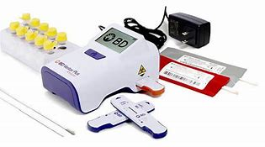
Overview of BD Veritor™ Rapid Testing Method
Self –swabbing of nostrils
Process swab specimen in processing tube
Add 3 drops of the sample fluid to the Test Device Sample Well
Set the timer and wait 15-20 minutes
Insert Test Device into the BD Veritor ™ Analyzer Machine and the result will be displayed in 3 seconds!
Dr. Fiona O’Sullivan
fosullivan@cwsds.ca
Sylvia Fattore
sfattore@cwsds.ca

Slide 11
Antigen Screening Method
Dr. O’Sullivan and the Health Services Nurses facilitated training of all employees at CWSDS utilizing the Train the Trainer model.
Training included oversight of self-swabbing, how to operate the test device, PPE requirements and how to safely dispose of waste.
A designated screening area was identified within each work environment (19 in total).
Quality Control Training was also facilitated.
Dr. Fiona O’Sullivan
fosullivan@cwsds.ca
Sylvia Fattore
sfattore@cwsds.ca

Slide 12
Antigen Screening Method
Each employee is responsible to immediately enter their results on the screening document via the screening QR code.
Medical Administrative Assistant is responsible for data entry into the Ontario Health Portal.
Disposal of biohazardous materials through Stericycle.
Dr. Fiona O’Sullivan
fosullivan@cwsds.ca
Sylvia Fattore
sfattore@cwsds.ca

Slide 13
BD Veritor™ Training Resources
CWSDS provided the following resources for all staff:
Memorandum- Enhanced Screening
Consents as applicable (Employee, People We Support and Family)
Agreement of Understanding
Rapid Antigen Testing Policy and Addendums (BD Veritor™ Kits, Performing the Test, Reading and Certifying Results)
Quality Control Tracker
Safety Information and Troubleshooting
BD Veritor™ Training video developed by Dr. Fiona O’Sullivan
Ministry Of Health links to training videos
Dr. Fiona O’Sullivan
fosullivan@cwsds.ca
Sylvia Fattore
sfattore@cwsds.ca

Slide 14
BD Veritor™ Data
Total # of Participants 102
Total # of BD Veritor™ Rapid Antigen tests completed 255
CWSDS engaged in a graduated start to ensure comprehensive BD Veritor™ training for all staff members.
Dr. Fiona O’Sullivan
fosullivan@cwsds.ca
Sylvia Fattore
sfattore@cwsds.ca
Data reflects the time frame of June 14 – July 9
*Tests that were confirmed negative through PCR tests

Slide 15
Staff Questions & Feedback
As our approach at CWSDS to antigen screening is messaged as ” highly encouraged” and is voluntary, we did not encounter significant resistance to participation.
Dr. Fiona O’Sullivan
fosullivan@cwsds.ca
Sylvia Fattore
sfattore@cwsds.ca
As the BD Veritor™ Rapid Antigen Screening test is less sensitive and specific than lab-based PCR tests, results are not as accurate…Why are we using it? …Would it not be favorable to receive a PCR test, which is more reliable?
If a result is positive for COVID-19 and retesting via PCR is negative, will staff be compensated for their time off?
What is the frequency of supportive living staff to be screened and how will this be monitored?
How will it be addressed if not followed?

Slide 16
Jo-Anne Demick
jdemick@clps.ca

Slide 17
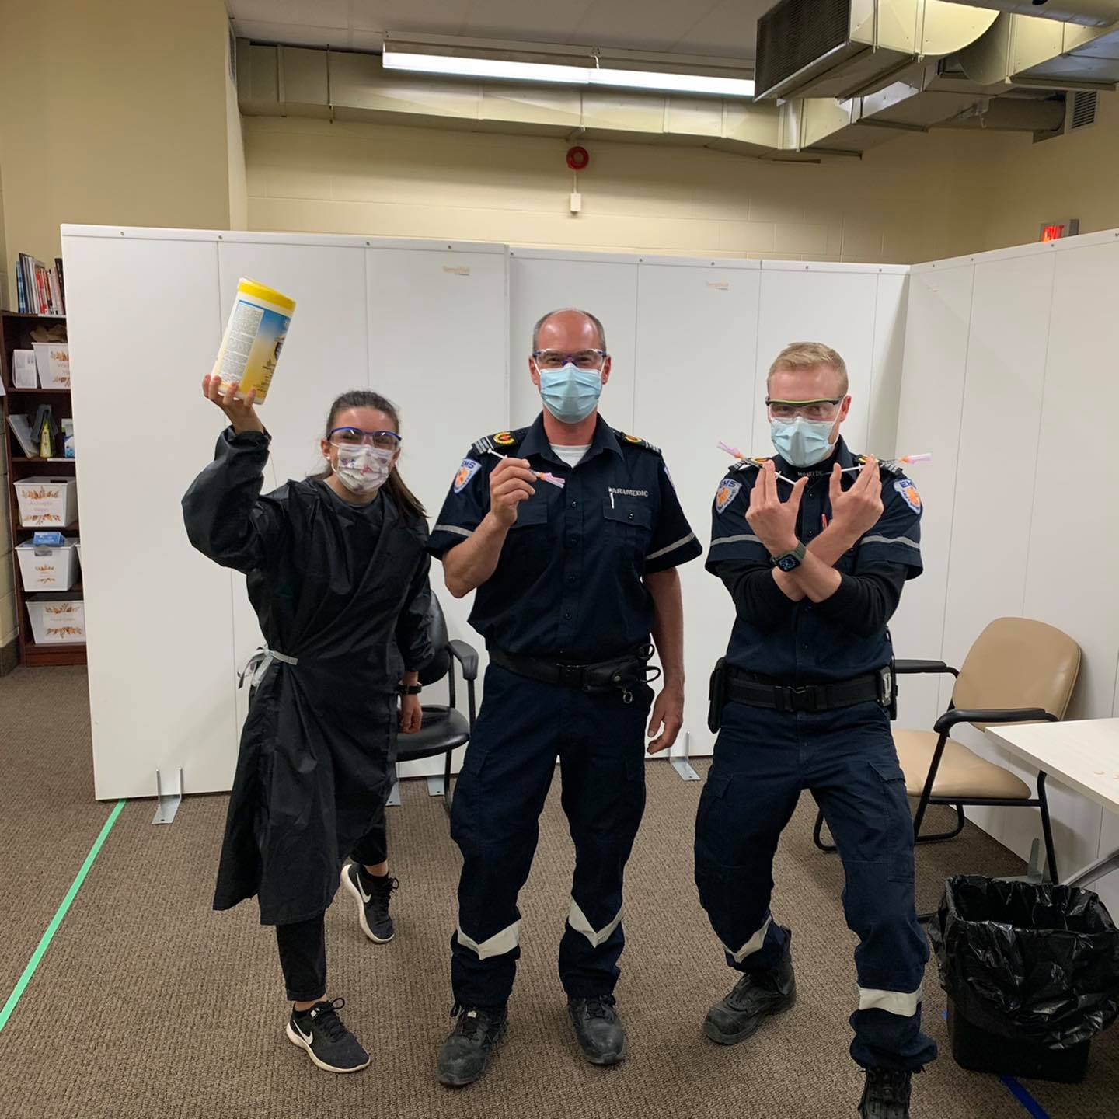
Jo-Anne Demick
jdemick@clps.ca

Slide 18
Gregory Crunican
gcrunican@christian-horizons.org

Slide 19
Rapid Antigen Screening Pilot Program
RANT screening vs. testing
Our approach for testing over large geographical area
Training
Waste management
Data collection
Gregory Crunican
gcrunican@christian-horizons.org

Slide 20
Cheryl Wiles Pooran
cwpooran@pooranlaw.com

Slide 21
Testing in the Workplace: Case Law Update
December 2020 Caressant Care Nursing Homes v. C.L.A.C.
Upheld employer’s decision to institute bi-weekly surveillance testing in retirement home (following a government recommendation).
Policy used a bi-weekly nasal swab for all workers, with medical exceptions. Employees who refused the test would be held out of work without pay until they took the test.
Arbitrator upheld policy as reasonable infringement on employee privacy given the risk of COVID-19.
Employer did not have to wait until an outbreak occurred to show that the policy was needed – they could implement it proactively.
Key implications for vaccination policies – indicates an openness to intrusive employer policies that increase health and safety related to COVID-19.
Cheryl Wiles-Pooran
cwpooran@pooranlaw.com

Slide 22
Testing in the Workplace: Case Law Update
June 2021 Ellisdon Construction Ltd. v Labourers’ International Union of North America, Local 183
The union challenged twice-weekly rapid antigen testing as being an unreasonable intrusion on employee privacy
In dismissing the grievance the Arbitrator cited the following reasons:
Severe and ongoing threat of COVID-19 in the province
Employer had minimized the intrusion by only swabbing the lower nose and throat
Measures taken by the employer to ensure employee safety and privacy while the tests were being taken
Cheryl Wiles-Pooran
cwpooran@pooranlaw.com

Slide 23
Kelly Huntington
kelly.huntington@ontario.ca
Ashley Chilvers
ashley.chilvers@ontario.ca

Slide 24
Provincial Antigen Screening Program (PASP)
In collaboration with the Ministry of Health (MOH) and stakeholders, Ministry of Children, Community and Social Services (MCCSS) continues to support voluntary participation in the PASP in accordance with the program eligibility requirements determined by MOH.
PASP supports enhancing public health and safety through the provision of rapid antigen screening tests to proactively identify potential cases of COVID-19 among asymptomatic individuals that may otherwise go undetected by routine screening measures (e.g. symptom screening).
Kelly Huntington
kelly.huntington@ontario.ca
Ashley Chilvers
ashley.chilvers@ontario.ca

Slide 25
Provincial Antigen Screening Program (PASP)
PASP is intended to be an added screening tool for service providers to enhance their existing Infection Prevention and Control measures for individuals living, participating and working in congregate settings or receiving in-person services.
Participation by MCCSS service providers is voluntary and participants have flexibility in how they implement the program within their setting(s) so long as they adhere to the parameters outlined by the Ministry of Health.
Kelly Huntington
kelly.huntington@ontario.ca
Ashley Chilvers
ashley.chilvers@ontario.ca

Slide 26
Provincial Antigen Screening Program (PASP)
Rapid antigen tests are used for asymptomatic screening purposes only and should not be used for diagnosis of COVID-19 infection in symptomatic individuals or individuals with known contact with a positive COVID-19 case.
MCCSS administrates a separate onboarding and distribution system for rapid antigen tests outside of MOH’s central PASP system.
As of July 15, 2021, there are approximately 80 agencies with over 350 locations are participating using ~13,300 tests per week (at scale).
Kelly Huntington
kelly.huntington@ontario.ca
Ashley Chilvers
ashley.chilvers@ontario.ca

Slide 27
Provincial Antigen Screening Program (PASP)
There have also been 30 preliminary positive asymptomatic cases of COVID-19 identified in MCCSS participant organizations through the PASP program.
Service providers that are interested in participating in the PASP may submit an expression of interest here.
For more information on the PASP please go to the Provincial Guidance for Antigen Screening in Ontario.
Kelly Huntington
kelly.huntington@ontario.ca
Ashley Chilvers
ashley.chilvers@ontario.ca

Slide 28
Resilience, Adaptation, and Reopening:
Rapid Antigen Testing

