Slide 1

bridging to resilience
Mental wellness for charity Leaders During Covid-19
SESSION #1
Tuesday, November 24th, 2020
10:00 am – 12:00 pm
WELCOME!
DISCOVERING YOUR RESILIENCE AND GRIT: PERSPECTIVE IS EVERYTHING …

Slide 2

Session calendar
SESSION #1
Tuesday, November 24th
10:00 a.m. to 12:00 p.m.
SESSION #2
Tuesday, December 1st
10:00 a.m. to 12:00 p.m.
SESSION #3
Tuesday, December 8th
10:00 a.m. to 12:00 p.m.
SESSION #4
Tuesday, December 15th
10:00 a.m. to 12:00 p.m.

Slide 3

Goals of our sessions
Process Goals:
Identify triggers that impact behaviour and limit functionality during stressful times.
Understand how connecting with and regulating emotions can be a strategic advantage in leadership.
Learn emotional resilience techniques and skills to cope during stress and crisis.
Connect with others experiencing similar concerns and reduce potential senses of isolation, helplessness, and hopelessness.
Understand physical components that support mental and emotional well-being.
Outcome Goals:
Identify individual needs and best practices for emotional resilience, to create new life skills.
Establish personal goals and coping strategies for mental and emotional well-being during crisis.
Discover inherent resilience already residing within.

Slide 4

Goals of today’s session
Introductions
Cultivating Perspective
What’s Important to You
Gaining Clarity on Resilience
Understanding Stress, Worry, and Anxiety
Explore Your Window of Tolerance (WOT)
Creating a Resilient Place (RP) *
Early connecting to a Growth Mindset *
* Topics might be for second session.

Slide 5

Bridging perspectives

Slide 6
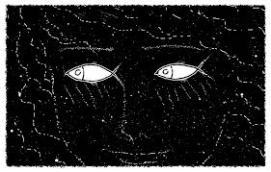
P
E
R
S
P
E
C
T
I
V
E
P
E
R
S
P
E
C
T
I
V
E

Slide 7
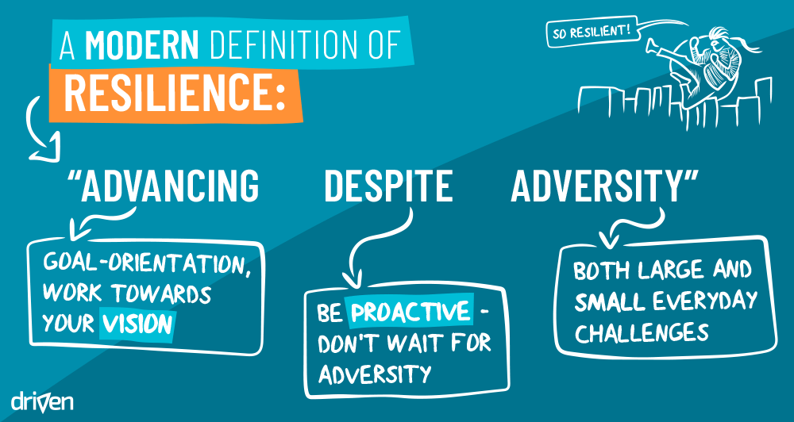

Slide 8
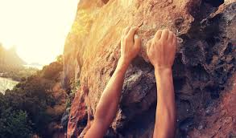

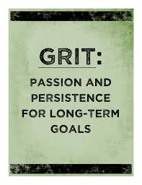
definitions
GRIT is about sustained, consistent effort toward a goal even when we struggle, falter, or temporarily fail.
RESILIENCE is our ability to bounce back after we have struggled, faltered, or failed. It is being able to pick ourselves up, dust ourselves off, take a moment or two to collect ourselves, and get back to the business of pursuing our goal. It involves optimism.
BUT, bouncing back can be about moving towards who you are becoming rather than who you were …

Slide 9

Pre-session feedback

Slide 10
My Concerns Right Now
ORGANIZATION:
  stakeholders x 6
  staff (running on fumes, stress) and managing others in the unknown x 4
  Having enough staff to cover shifts
  financial
FAMILY:
  Supporting family
  Trying to ensure I do not infect my family
PERSONAL:
  isolation from colleagues, friends
  demand exceeding capacity to deliver on expectations
  looking after myself – high risk of burnout due to always looking after others
  challenge of virtual form of communicating

Slide 11
How concerns affect mind, body, emotions
MENTAL-EMOTIONAL Ruminating, obsessing about the pandemic and its effects (stakeholder engagement and fundraising, where I go) x 4 Tired at end of day and difficult to relax/shut down at home; fatigue/exhaustion x 3 Difficulty focusing and desire for work Low frustration tolerance for people’s fears after months of trying to reassure/support x 3 Struggling with emotions Feeling of overwhelming responsibility Fighting desire to just quit Moody Stressful x 2 | PHYSICAL Difficulty sleeping x 3 More physical tension in my body, difficulty concentrating, headaches, aches/pains, TMJ, sore neck, carpel tunnel x 2 Lack of exercise Weight gain/overeating x 2 OTHER Difficulty taking care of self Less family time Exciting because of thinking outside the box

Slide 12
top emotions you are feeling
Anxious – 6-7/10 x 3
Stress – 6/10
Worry – 7-8/10 x 4
Exhausted 8/10 x 3
Frustration/Anger – 6/10
Sadness – 6/10

Slide 13
Your coping strategies
COGNITIVE-EMOTIONAL To learn new things CALM app PHYSICAL Eating Healthy eating Exercise/walking x 4 Herbs for sleep Personal time for activities I enjoy | MIND BODY Meditation x2 Yoga (uncertain if it helps) x 2 RELATIONAL Surround myself with people who are positive and can help with the work Therapist Social restrictions limit usual social coping strategies Talking to support system | OTHER Keeping busy Disengage from work when at home TV (tuning out) Virtual live performances (helps me feel connected and engaged) None – plowing through NONE Plowing through
OTHER
Working more and noting hours (ineffective).
NONE
X 2

Slide 14

Desired personal outcomes
Information and ideas of how others are coping and what works for them x 5
Resilience and relaxation techniques, coping strategies for self and sharing x 7
Connectedness and not struggling alone x 4

Slide 15

Other thoughts
HOPE!
For a vaccine, ability to connect again, elderly, looking forward to something

Slide 16
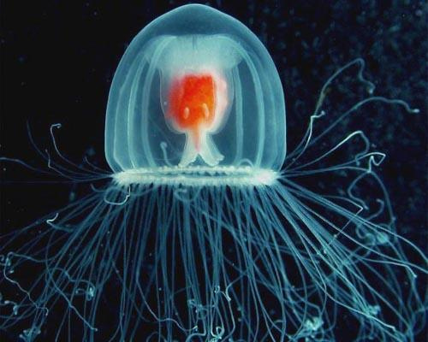
Turritopsis Nutricula
Jellyfish have the unique
ability to technically live forever, hence their name “The Immortal Jellyfish”.
They extend their lifespan in a different way from their immortal worm friends. Once turritopsis nutricula reach maturity they revert back to polyp status and begin their lives again. That’s equivalent to us living until we are 50 years old and then reverting back to being a baby.
WHAT’S YOUR PERSPECTIVE ON RESILIENCE?

Slide 17
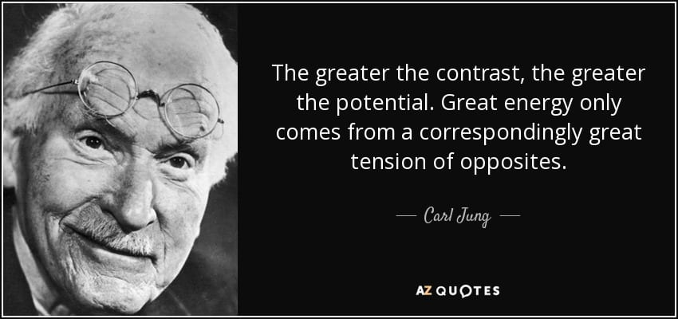
The power of paradoxical thinking
https://www.bbc.com/worklife/article/20201109-why-the-paradox-mindset-is-the-key-to-success
The need to cultivate perspective!
Practising holding the tension of opposites …

Slide 18

Your image of resilience

Slide 19

Resilience and The world around you

Slide 20
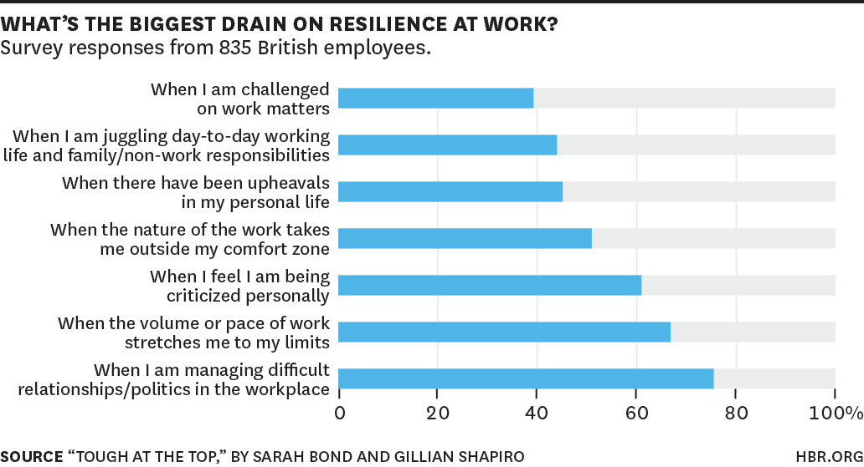
Pressures can be universal
– LOOK FAMILIAR?

Slide 21
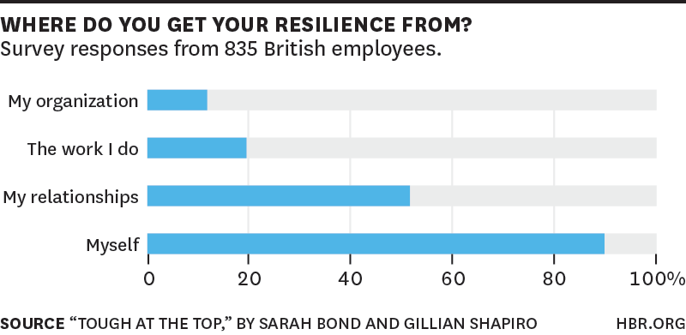
Internal perspective is everything

Slide 22
American Psychological association on resilience
The Good News:
Research has shown that resilience is ORDINARY, not extraordinary. People commonly demonstrate resilience.
Being resilient does not mean that a person doesn't experience difficulty or distress. Emotional pain and sadness are common in people who have suffered major adversity or trauma in their lives. In fact, the road to resilience is likely to involve considerable emotional distress.
Resilience is not a trait that people either have or do not have. It involves behaviors, thoughts and actions that can be learned and developed in anyone.

Slide 23
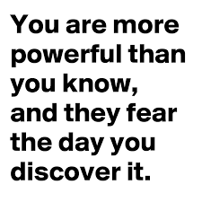
American Psychological association: factors of resilience
The Primary Factor in Resilience: having caring and supportive relationships within and outside the family. Relationships that create love and trust, provide role models and offer encouragement and reassurance help bolster a person's resilience.
Other Factors:
The capacity to make realistic plans and take steps to carry them out.
A positive view of yourself and confidence in your strengths and abilities.
Skills in communication and problem solving.
The capacity to manage strong feelings and impulses.
The Big Question:
Who is THEY?

Slide 24
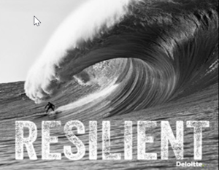
What do you feel when you see this picture?
What’s moving? surfer or wave?

Slide 25

Bridging to understanding

Slide 26
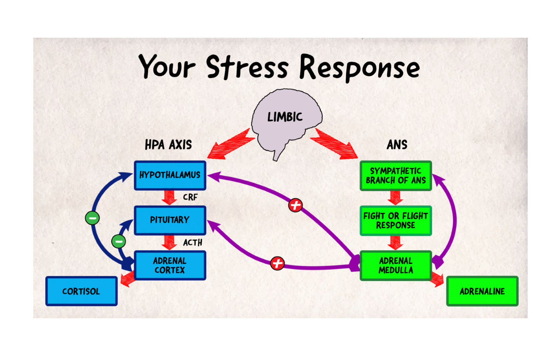
Understanding stress
Stress is the body's reaction to any change that requires an adjustment or response. The body reacts to these changes with physical, mental, and emotional responses. Stress is a normal part of life. You can experience stress from your environment, your body, and your thoughts. (Cleveland Clinic.)
No universally agreed upon definition. What is stressful for one person may be pleasurable to another or have little effect. We all react differently to stress.

Slide 27
Stress, worry or anxiety?
STRESS (BODY) Normal defence mechanism; physiological response connected to external event Reaction to environmental changes or forces that exceed an individual’s resources Fires up limbic system, releasing adrenaline and cortisol to activate brain to respond. (Rapid heart rate, clammy palms, shallow breathing.) Acute versus chronic stress key – staying fight or flight mode, linked to digestive issues, heart disease, weakening immunity | WORRY (MIND) Dwelling on negative thoughts, uncertain outcomes, things that could go wrong Tends to be repetitive and obsessive (the cognitive component of anxiety). Worry happens in the head and not the body Worry helps by stimulating the brain and calms it, causes us to problem solve/take action to keep you safe | ANXIETY (MIND & BODY) Over-estimation of threat and under-estimation of ability to cope No threat (hair on back of neck test) Excessive fear that results in behavioural manifestations, physical symptoms, sleeping and eating issues, etc. Stress and worry are symptoms and anxiety the culmination One of first signs of anxiety: inability to take care of self and/or home; difficulty taking care of daily tasks

Slide 28
Stress, worry, and anxiety: coping
STRESS Exercise. Helps body to recover from increase levels of adrenaline and cortisol. Get clear on what you can and can’t control. Then focus energy on what you can control and accept what you can’t. Don’t compare your stress with anyone else’s stress. Different people respond differently to stressful situations. | WORRY “Worry “budget,” an amount of time allowing yourself to worry about a problem. When that time is up (start with 20 minutes), consciously redirect your thoughts When worried about something, push yourself to come up with a next step or to take action. Write worries down. Research shows eight to 10 minutes of writing can calm obsessive thoughts. | ANXIETY Limit sugar, alcohol, caffeine. Because anxiety is physiological, stimulants may have a significant impact. Check your toes. How do they feel? Wiggle them. This kind of refocusing can calm you and break the anxiety loop. Middle of anxiety episode: talking or thinking about it will not help. Distract self with your senses: Listen to music, jump rope for five minutes, or rub Velcro or velvet.
Simple (not easy) first steps to help regulate symptoms: Get enough sleep; eat regular, nutritious meals; and move your body.
https://www.nytimes.com/2020/02/26/smarter-living/the-difference-between-worry-stress-and-anxiety.html

Slide 29
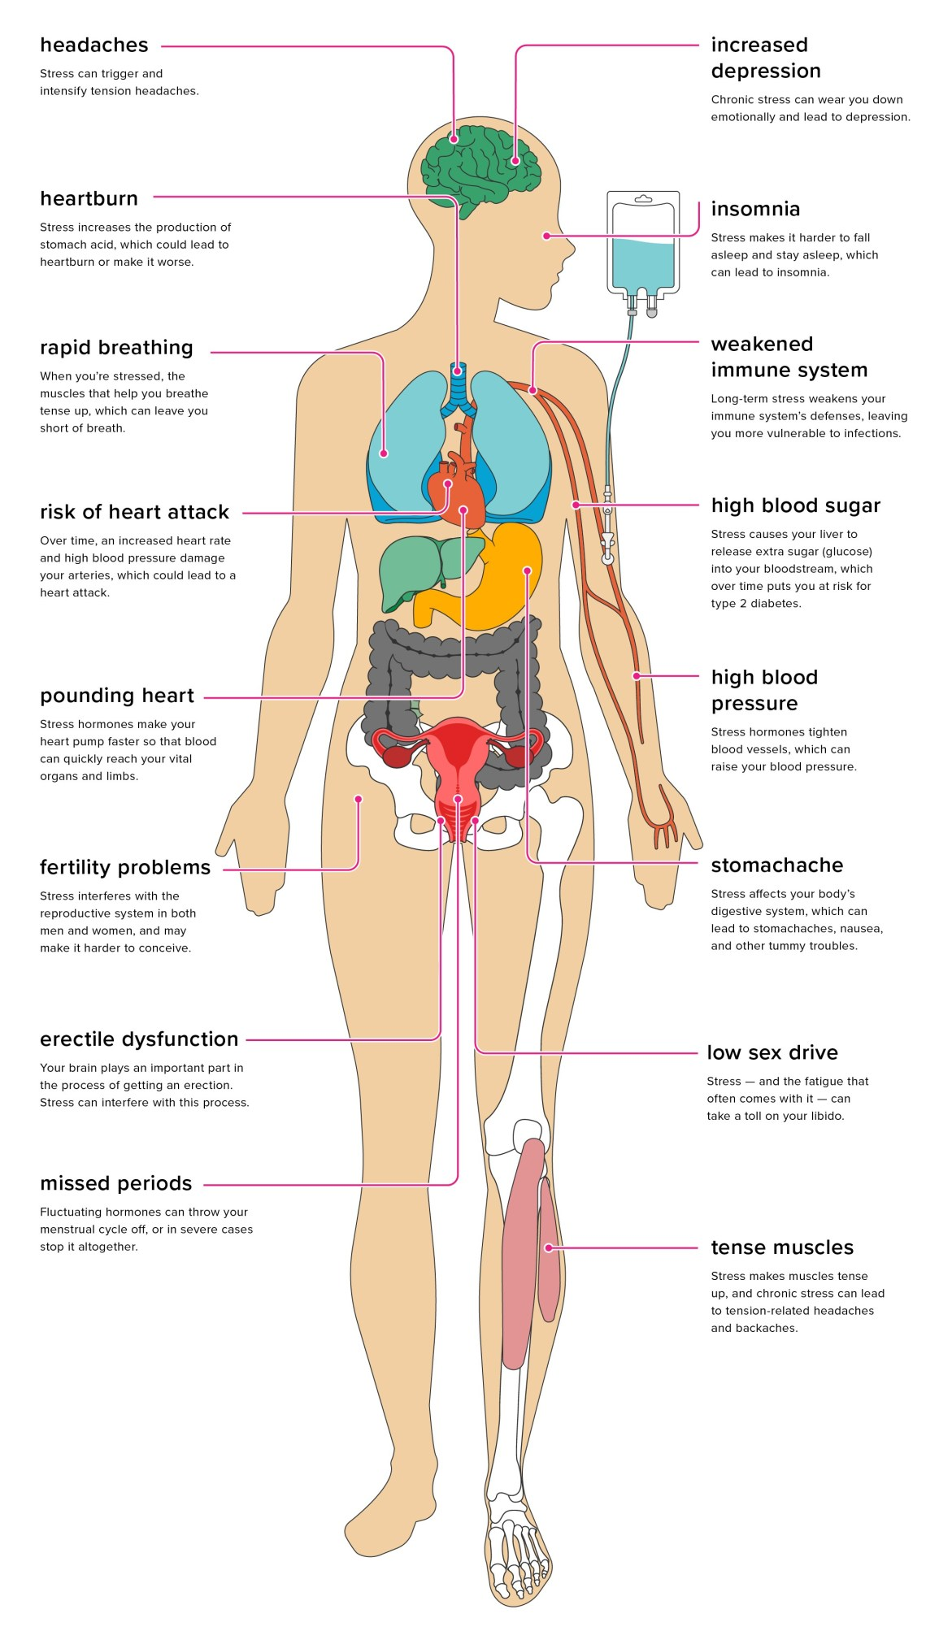
How stress affects the body
Need to support serotonin neurotransmitters
Calming the nervous system supports sleep and digestion
Using adaptogens that have a sedentary rather than stimulating effect is important, e.g. Ashwagandha, German Chammomile, Lemon Balm, Valerian, Passive Flora (https://drdavidbrady.com/)
https://www.healthline.com/health/stress/effects-on-body#1

Slide 30
MIND-BODY techniques
Splashing cold water on your face; ice on back of neck (as long as no heart condition)
Butterfly hug https://www.youtube.com/watch?v=KKJ7PNOzsHU
5-4-3-2-1
  5 things you can see
  4 things you can hear
  3 things you can feel/touch
  2 things you can smell
  1 thing you can taste
  1 positive thing about yourself
Ear massage
Toe wiggling
Exercise on the spot
Paced breathing
Thought stopping
Becoming the observer
“Name it and tame it”
  See it
  Say it
  Sense it
  Relax into it
  Breathe
  Reconnect with reality
  Reframe experience more objectively
  Become present again

Slide 31
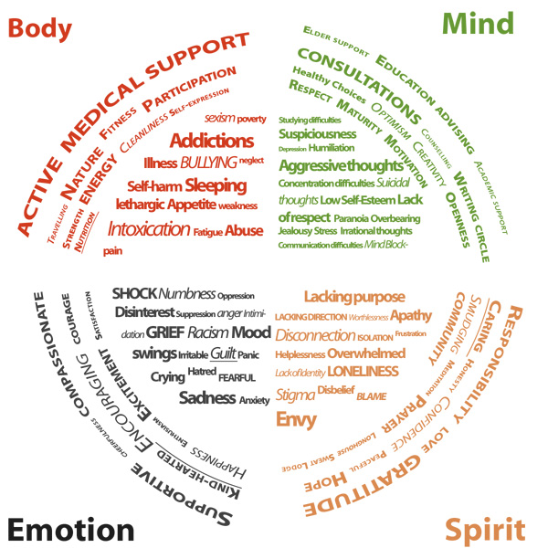

Getting Started- personal triage

Slide 32
Three types of resilience
Physical
Emotional
Mental

Slide 33
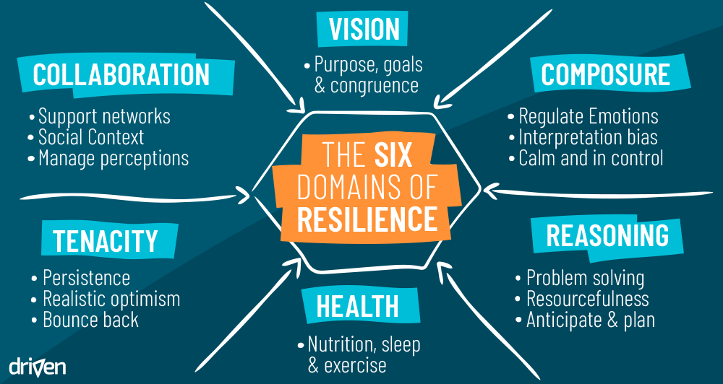

Slide 34
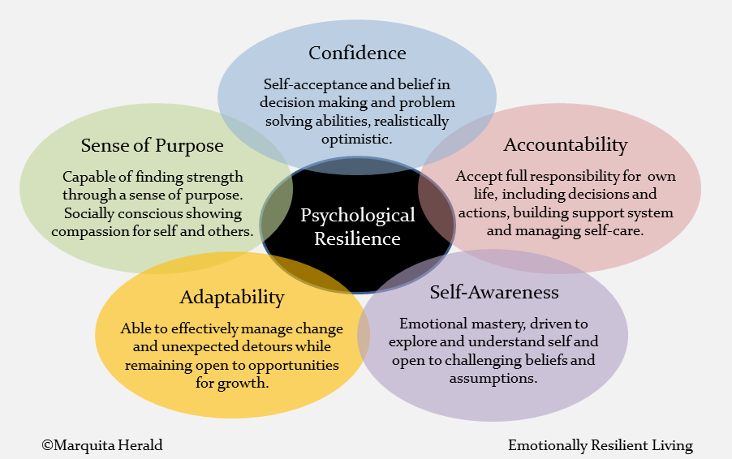

Slide 35

Bridging to you

Slide 36
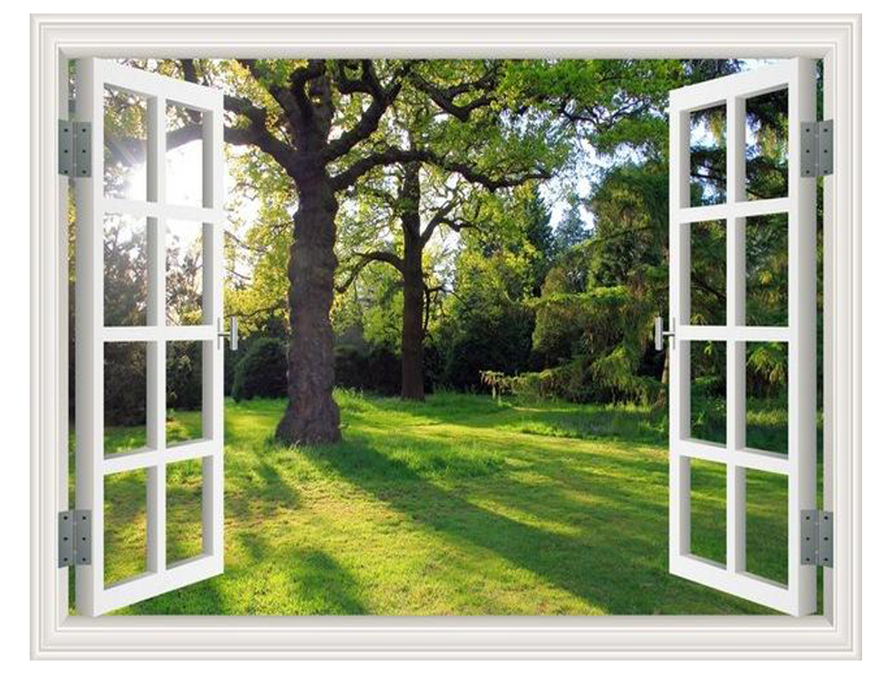
What the wot??
Getting to know your WINDOW OF TOLERANCe
This is where things feel just right, where you are best able to cope with the lemons that life throws at you. You’re calm yet alert, and you can think clearly and rationally.
SIGNS YOU ARE IN YOUR WOT
You:
Are aware of boundaries (yours and others)
Have feelings of empathy
React in a way that suits the situation
Can handle your feelings
Feel safe
Are in the present moment
Feel open and curious
Positive Psychology – Window of Tolerance Exercise

Slide 37
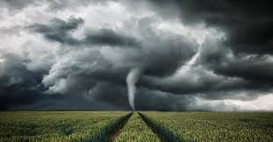
hyperarousal- above the window
This is when you feel extremely anxious, angry, or even out of control. Unfamiliar or threatening feelings can overwhelm you, and you might want to fight or run away.
SIGNS YOU ARE HYPERAROUSED
You:
Feel overwhelmed
Are shaking or trembling
React heavily to emotions
Have a lot of negative thoughts
Act on impulses
Act defensively
Feel unsafe
Feel anger or rage
Positive Psychology – Window of Tolerance Exercise

Slide 38

hypoarousal- below the window
This is when you feel extremely zone out and numb, both emotionally and physically. Time can go missing. It might feel like you’re completely frozen.
SIGNS YOU ARE HYPORAROUSED
You:
Experience very little sensation
Feel numb
Have little or no energy
Feel disconnected (from self and others)
Feel empty
Do not feel like physically moving
Find it hard to think
Positive Psychology – Window of Tolerance Exercise

Slide 39
Wot exercise
 | SIGNS I AM HERE | THINGS I CAN DO TO RETURN TO MY WOT
 | SIGNS I AM HERE | THINGS THAT KEEP ME IN MY WOT
 | SIGNS I AM HERE | THINGS I CAN DO TO RETURN TO MY WOT

Slide 40

Exercise
(might need to be for session #2)
Creation
of a
“resilient place”

Slide 41

Bridging to next weeks session!

Slide 42
Growth mindset (carol dweck)
“Fixed mindset” assumes character, intelligence, creative ability are static givens which we can’t change meaningfully and success is the affirmation of that inherent intelligence, an assessment of how those givens measure up against an equally fixed standard; striving for success and avoiding failure at all costs become a way of maintaining the sense of being smart or skilled.
“Growth mindset” thrives on challenge and sees failure not as evidence of unintelligence but as a heartening springboard for growth and for stretching our existing abilities.
Out of these two mindsets, which we manifest from a very early age, springs a great deal of our behavior, our relationship with success and failure in both professional and personal contexts, and ultimately our capacity for happiness.

Slide 43
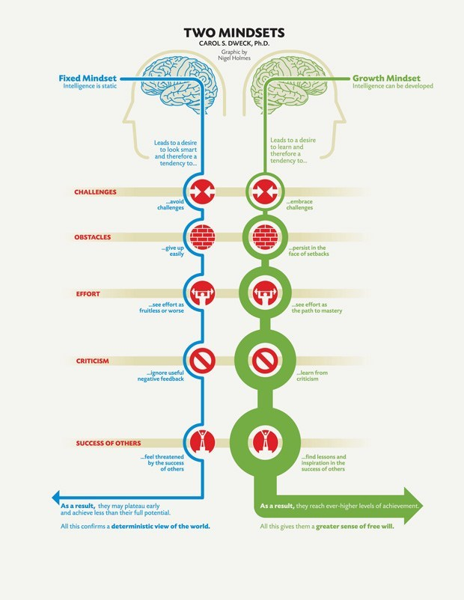
Growth mindset based on belief your basic qualities can be cultivated through your efforts. Everyone can change and grow through application and experience.
Growth mindset creates a passion for learning rather than a hunger for approval. Hallmark is the conviction human qualities like intelligence, creativity, relational capacities like love and friendship, can be cultivated through effort and deliberate practice. Not only are people with this mindset not discouraged by failure, but they don’t actually see themselves as failing in those situations — they see themselves as learning.
Believing that your qualities are carved in stone — the fixed mindset — creates an urgency to prove yourself over and over. If you have only a certain amount of intelligence, a certain personality, and a certain moral character — well, then you’d better prove that you have a healthy dose of them. It simply wouldn’t do to look or feel deficient in these most basic characteristics.

Slide 44
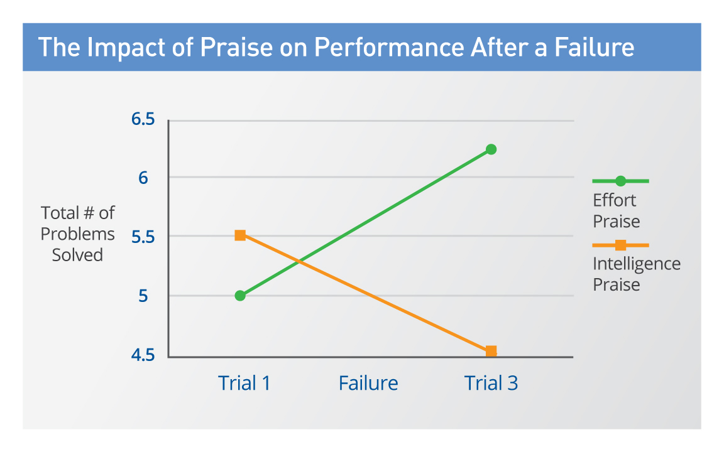
The proof and the inspiration
https://www.brainpickings.org/2014/01/29/carol-dweck-mindset/
The passion for stretching yourself and sticking to it, even (or especially) when it’s not going well, is the hallmark of the growth mindset. This is the mindset that allows people to thrive during some of the most challenging times in their lives. (Dweck)

Slide 45

And one partner …

