Slide 1

bridging to resilience
Mental wellness for charity Leaders During Covid-19
SESSION #2
Tuesday, December 1st, 2020
10:00 am - Noon
You’re doin’ it!

Slide 2

Session calendar
SESSION #1
Tuesday, November 24th
10:00 a.m. to 12:00 p.m.
SESSION #2
Tuesday, December 1st
10:00 a.m. to 12:00 p.m.
SESSION #3
Tuesday, December 8th
10:00 a.m. to 12:00 p.m.
SESSION #4
Tuesday, December 15th
10:00 a.m. to 12:00 p.m.

Slide 3

Goals of today’s session
Check-in: Self Care activities – Your “Resilient Place” and Paradoxical Thinking
Complete Our Understanding of Stress, Worry, and Anxiety
Connecting to a Growth Mindset
Explore Your Window of Tolerance (WOT)
Exploring Dual Awareness
Getting to Know and Nurturing Your Defence Team

Slide 4
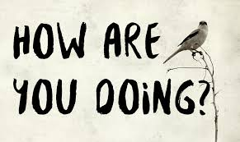
Checking in

Slide 5

Bridging to Resilience
FOUNDATION
Perspective
Dual Awareness
Emotional Regulation
Whole Self Versus Parts
Resourcing
Values
Our Current Group Strategy #1:
Building the Foundation of the Bridge

Slide 6

P
E
R
S
P
E
C
T
I
V
E
P
E
R
S
P
E
C
T
I
V
E

Slide 7
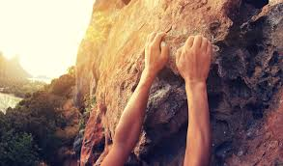
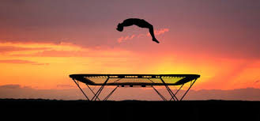
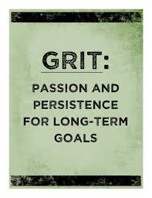
definitions
GRIT is about sustained, consistent effort toward a goal even when we struggle, falter, or temporarily fail.
RESILIENCE is our ability to bounce back after we have struggled, faltered, or failed. It is being able to pick ourselves up, dust ourselves off, take a moment or two to collect ourselves, and get back to the business of pursuing our goal. It involves optimism.

Slide 8

Self-care
“Self-care is giving the world the best of you, instead of what’s left of you.” Katie Reed
“Talk to yourself like you would to someone you love.” Brene Brown

Slide 9
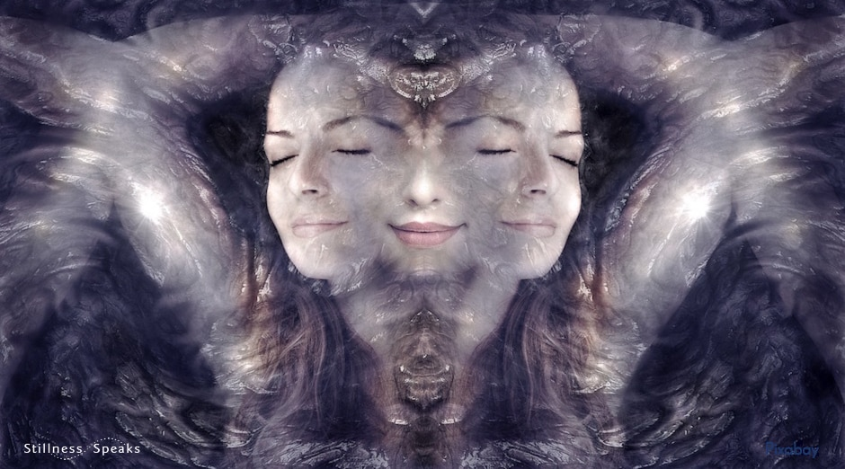
Self-care
What is your chosen activity? RP and/or something else?
How easy or difficult was it to do this week?
What enabled doing self-care or what was in the way of doing self-care?
What was it like to have a self-care pal?
PERSPECTIVE on self-care?

Slide 10

Bridging to understanding
Stress, worry, anxiety; growth mindset

Slide 11
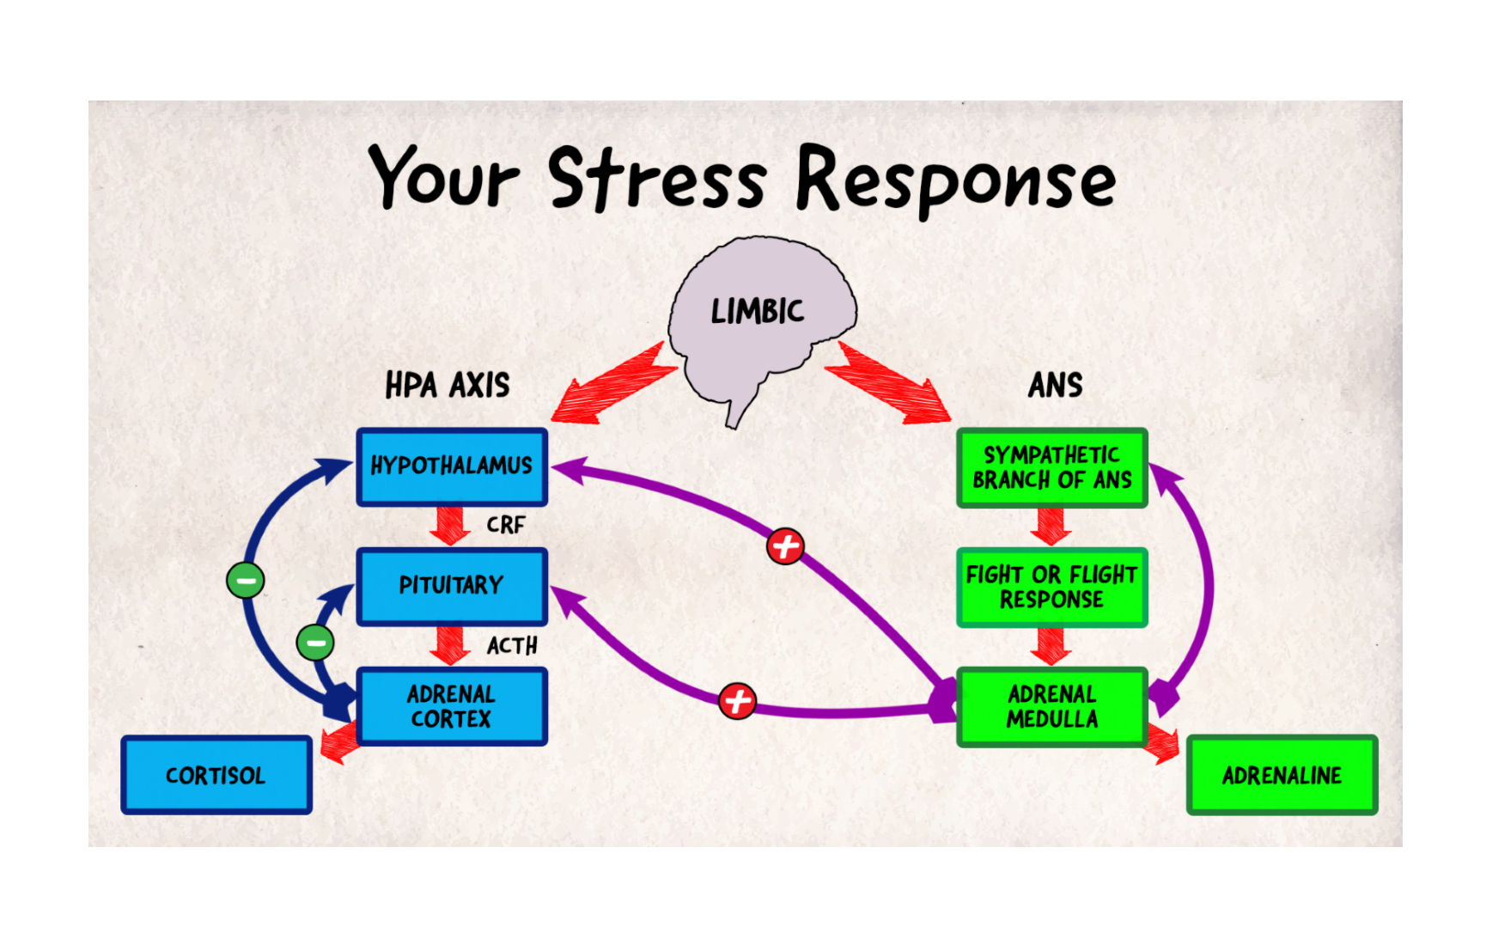
Understanding stress
Stress is the body's reaction to any change that requires an adjustment or response. The body reacts to these changes with physical, mental, and emotional responses. Stress is a normal part of life. You can experience stress from your environment, your body, and your thoughts. (Cleveland Clinic.)
No universally agreed upon definition. What is stressful for one person may be pleasurable to another or have little effect. We all react differently to stress.

Slide 12
Stress, worry or anxiety?
STRESS (BODY) Normal defence mechanism; physiological response connected to external event Reaction to environmental changes or forces that exceed an individual’s resources Fires up limbic system, releasing adrenaline and cortisol to activate brain to respond. (Rapid heart rate, clammy palms, shallow breathing.) Acute versus chronic stress key – staying fight or flight mode, linked to digestive issues, heart disease, weakening immunity | WORRY (MIND) Dwelling on negative thoughts, uncertain outcomes, things that could go wrong Tends to be repetitive and obsessive (the cognitive component of anxiety). Worry happens in the head and not the body Worry helps by stimulating the brain and calms it, causes us to problem solve/take action to keep you safe | ANXIETY (MIND & BODY) Over-estimation of threat and under-estimation of ability to cope No threat (hair on back of neck test) Excessive fear that results in behavioural manifestations, physical symptoms, sleeping and eating issues, etc. Stress and worry are symptoms and anxiety the culmination One of first signs of anxiety: inability to take care of self and/or home; difficulty taking care of daily tasks

Slide 13
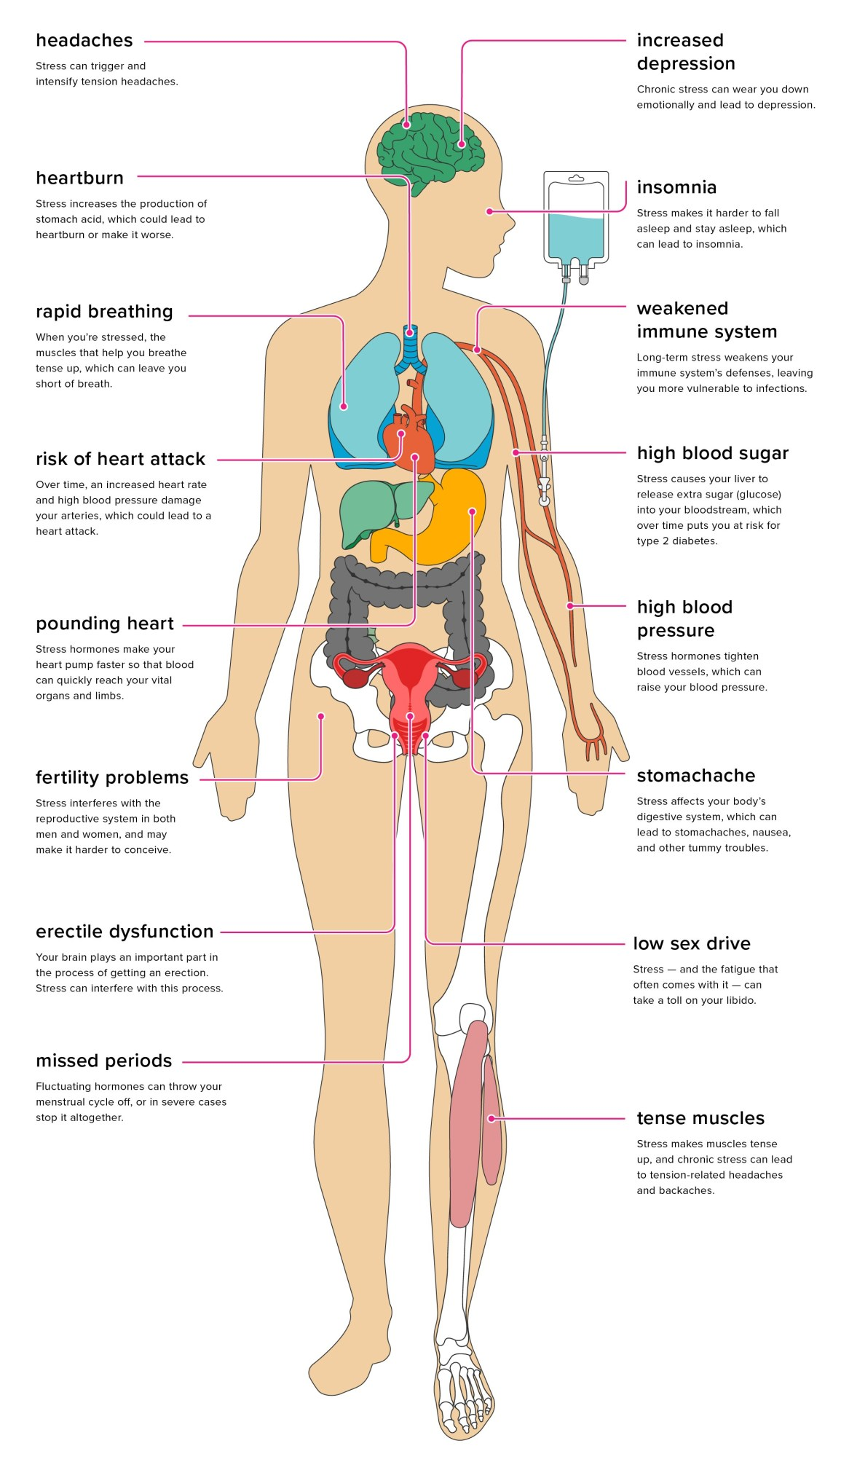
How stress affects the body
Need to support serotonin neurotransmitters
Calming the nervous system supports sleep and digestion
Using adaptogens that have a sedentary rather than stimulating effect is important, e.g. Ashwagandha, German Chammomile, Lemon Balm, Valerian, Passive Flora (https://drdavidbrady.com/)
(Check with doctor to ensure no contraindications with blood pressure or other medications.)
STRESS TAKES US OUT OF AWARENESS!
https://www.healthline.com/health/stress/effects-on-body#1

Slide 14
MIND-BODY techniques
Splashing cold water on your face; ice on back of neck (as long as no heart condition)
Butterfly hug https://www.youtube.com/watch?v=KKJ7PNOzsHU
5-4-3-2-1
  5 things you can see
  4 things you can hear
  3 things you can feel/touch
  2 things you can smell
  1 thing you can taste
  1 positive thing about yourself
Ear massage
Toe wiggling
Exercise on the spot
Paced breathing
Thought stopping
Becoming the observer
“Name it and tame it”
  See it
  Say it
  Sense it
  Relax into it
  Breathe
  Reconnect with reality
  Reframe experience more objectively
  Become present again

Slide 15
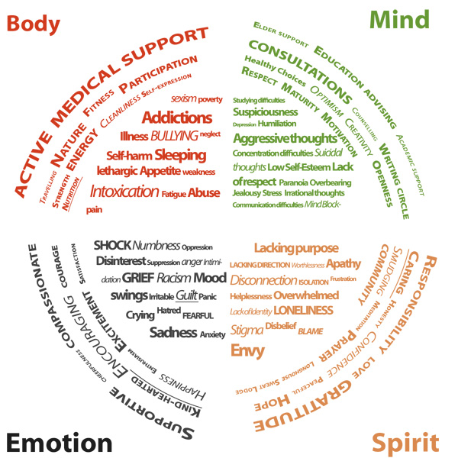
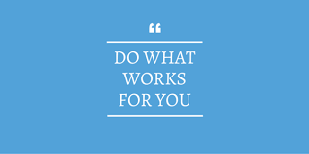
Getting Started- personal triage

Slide 16
Growth mindset (carol dweck)
“Fixed mindset” assumes character, intelligence, creative ability are static givens which we can’t change meaningfully and success is the affirmation of that inherent intelligence, an assessment of how those givens measure up against an equally fixed standard; striving for success and avoiding failure at all costs become a way of maintaining the sense of being smart or skilled.
“Growth mindset” thrives on challenge and sees failure not as evidence of unintelligence but as a heartening springboard for growth and for stretching our existing abilities.
Out of these two mindsets, which we manifest from a very early age, springs a great deal of our behavior, our relationship with success and failure in both professional and personal contexts, and ultimately our capacity for happiness.

Slide 17
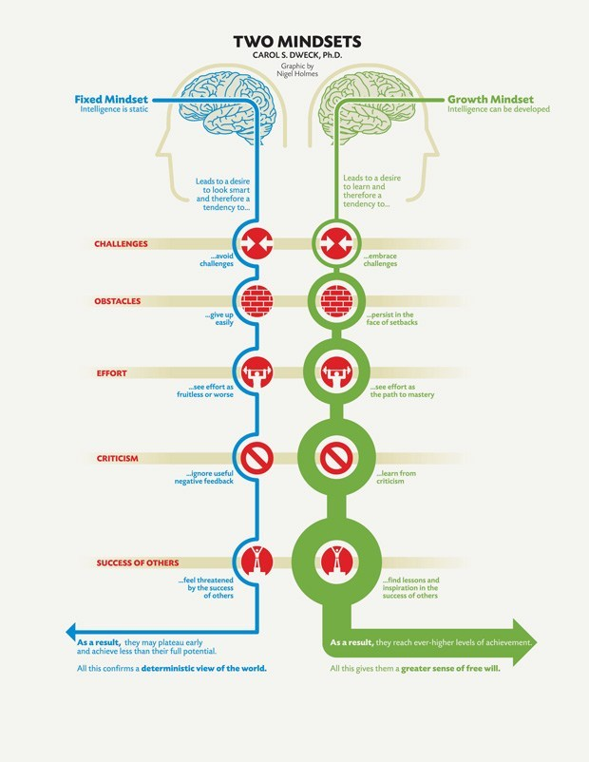
Growth mindset based on belief your basic qualities can be cultivated through your efforts. Everyone can change and grow through application and experience.
Growth mindset creates a passion for learning rather than a hunger for approval. Hallmark is the conviction human qualities like intelligence, creativity, relational capacities like love and friendship, can be cultivated through effort and deliberate practice. Not only are people with this mindset not discouraged by failure, but they don’t actually see themselves as failing in those situations — they see themselves as learning.
Believing that your qualities are carved in stone — the fixed mindset — creates an urgency to prove yourself over and over. If you have only a certain amount of intelligence, a certain personality, and a certain moral character — well, then you’d better prove that you have a healthy dose of them. It simply wouldn’t do to look or feel deficient in these most basic characteristics.

Slide 18
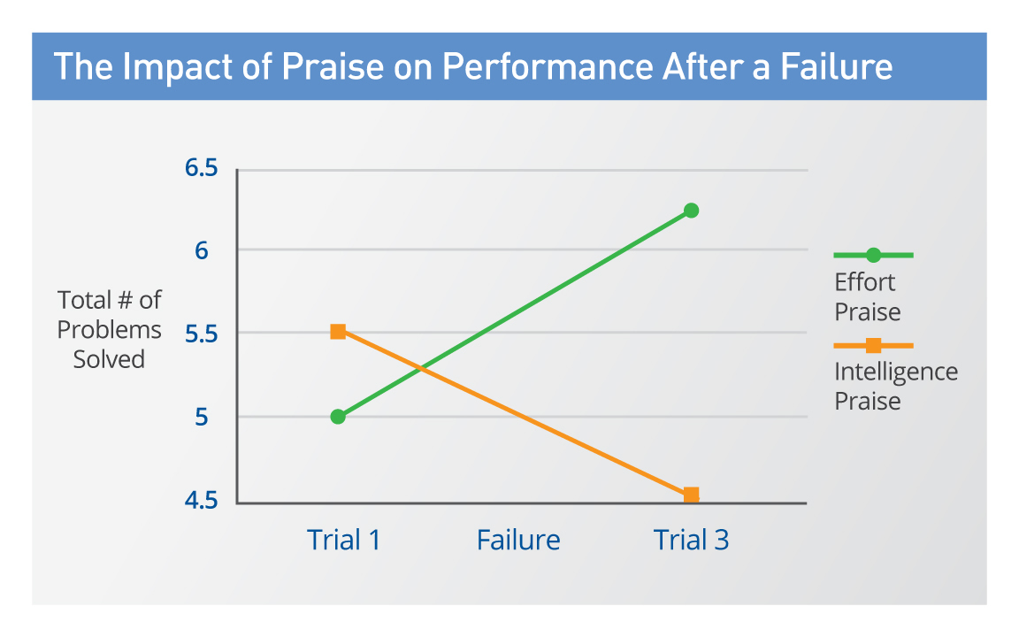
The proof and the inspiration
https://www.brainpickings.org/2014/01/29/carol-dweck-mindset/
The passion for stretching yourself and sticking to it, even (or especially) when it’s not going well, is the hallmark of the growth mindset. This is the mindset that allows people to thrive during some of the most challenging times in their lives. (Dweck)

Slide 19
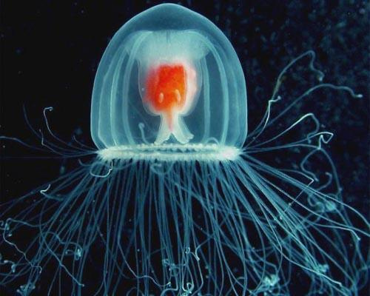
Turritopsis Nutricula
Jellyfish have the unique
ability to technically live forever, hence their name “The Immortal Jellyfish”.
They extend their lifespan in a different way from their immortal worm friends. Once turritopsis nutricula reach maturity they revert back to polyp status and begin their lives again. That’s equivalent to us living until we are 50 years old and then reverting back to being a baby.
WHAT’S YOUR PERSPECTIVE ON RESILIENCE?

Slide 20
American Psychological association on resilience
The Good News:
Research has shown that resilience is ORDINARY, not extraordinary. People commonly demonstrate resilience.
Being resilient does not mean that a person doesn't experience difficulty or distress. Emotional pain and sadness are common in people who have suffered major adversity or trauma in their lives. In fact, the road to resilience is likely to involve considerable emotional distress.
Resilience is not a trait that people either have or do not have. It involves behaviors, thoughts and actions that can be learned and developed in anyone.

Slide 21
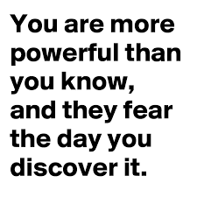
American Psychological association: factors of resilience
The Primary Factor in Resilience: having caring and supportive relationships within and outside the family. Relationships that create love and trust, provide role models and offer encouragement and reassurance help bolster a person's resilience.
Other Factors:
The capacity to make realistic plans and take steps to carry them out.
A positive view of yourself and confidence in your strengths and abilities.
Skills in communication and problem solving.
The capacity to manage strong feelings and impulses.
The Big Question:
Who is THEY?

Slide 22
Three types of resilience
Physical
Emotional
Mental

Slide 23
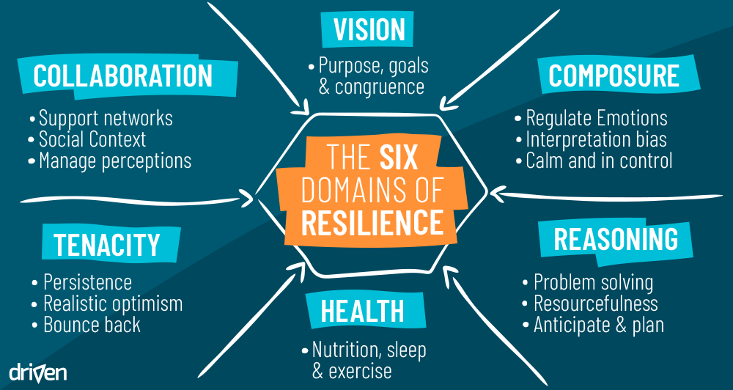

Slide 24
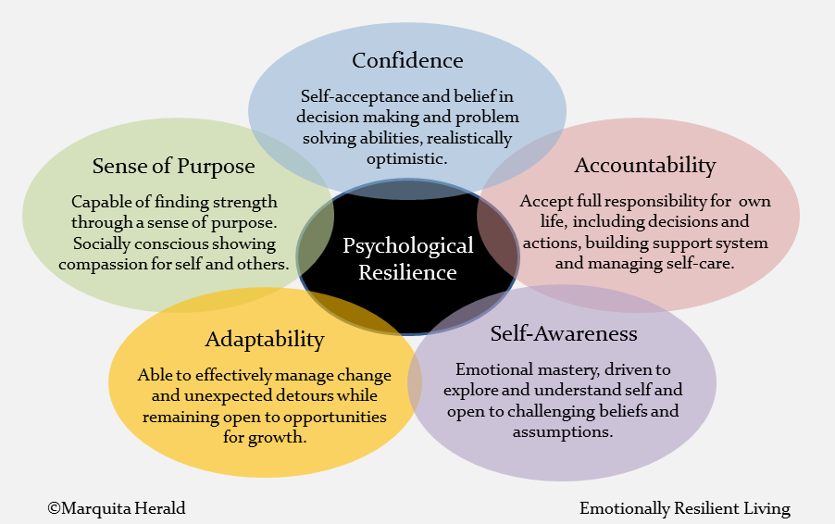

Slide 25
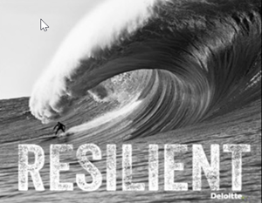
What do you feel when you see this picture?
What’s moving? surfer or wave?

Slide 26

Bridging to you

Slide 27
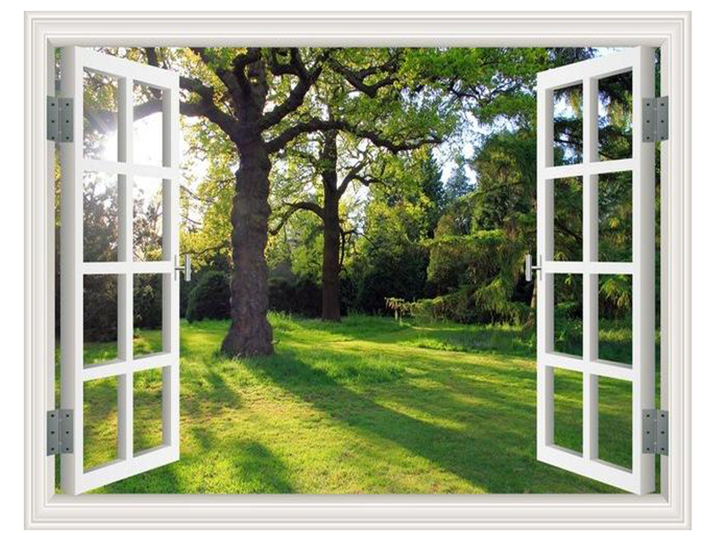
What the wot??
Getting to know your WINDOW OF TOLERANCe
This is where things feel just right, where you are best able to cope with the lemons that life throws at you. You’re calm yet alert, and you can think clearly and rationally.
SIGNS YOU ARE IN YOUR WOT
You:
Are aware of boundaries (yours and others)
Have feelings of empathy
React in a way that suits the situation
Can handle your feelings
Feel safe
Are in the present moment
Feel open and curious
Positive Psychology – Window of Tolerance Exercise

Slide 28
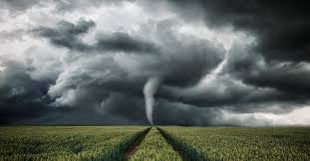
hyperarousal- above the window
This is when you feel extremely anxious, angry, or even out of control. Unfamiliar or threatening feelings can overwhelm you, and you might want to fight or run away.
SIGNS YOU ARE HYPERAROUSED
You:
Feel overwhelmed
Are shaking or trembling
React heavily to emotions
Have a lot of negative thoughts
Act on impulses
Act defensively
Feel unsafe
Feel anger or rage
Positive Psychology – Window of Tolerance Exercise

Slide 29

hypoarousal- below the window
This is when you feel extremely zone out and numb, both emotionally and physically. Time can go missing. It might feel like you’re completely frozen.
SIGNS YOU ARE HYPORAROUSED
You:
Experience very little sensation
Feel numb
Have little or no energy
Feel disconnected (from self and others)
Feel empty
Do not feel like physically moving
Find it hard to think
Positive Psychology – Window of Tolerance Exercise

Slide 30
Wot exercise
 | SIGNS I AM HERE | THINGS I CAN DO TO RETURN TO MY WOT
 | SIGNS I AM HERE | THINGS THAT KEEP ME IN MY WOT
 | SIGNS I AM HERE | THINGS I CAN DO TO RETURN TO MY WOT

Slide 31
Bridging two types of awareness

Slide 32
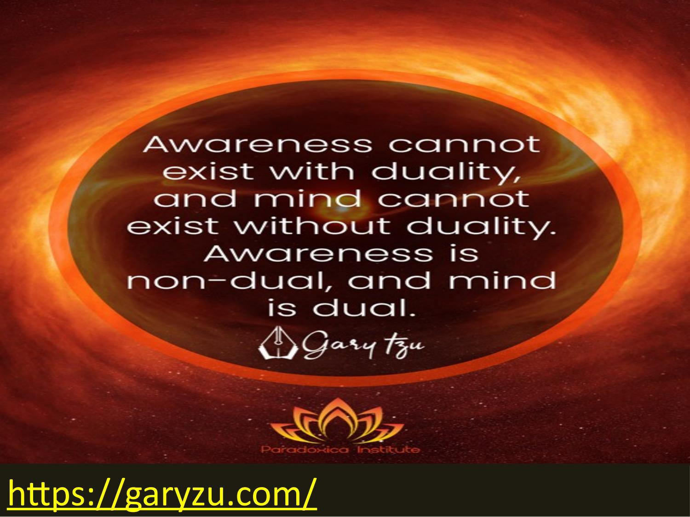
What is Dual awareness?
Being aware of the past and present at the same time
The process of being able to pay attention to one or more experiences simultaneously and helps contain overwhelming feelings, thoughts and body sensations.
Developing an observing self, while we are having an experience of something, even when that experience is a difficult memory
Ability to recognize that, “I’m feeling upset right now, BUT I am still safe!”
(https://amindfulemergence.com/what-is-dual-awareness/)

Slide 33
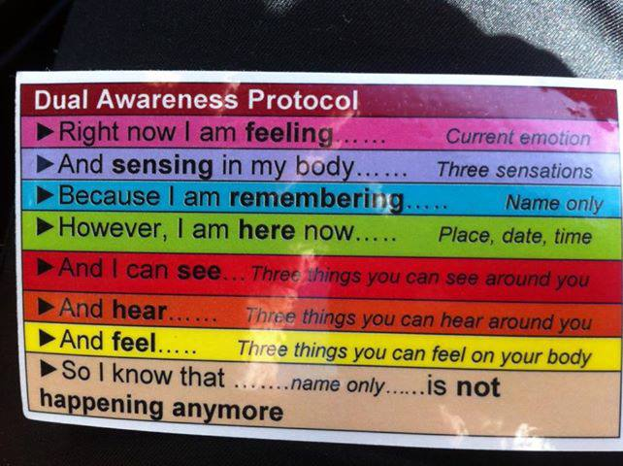
how to activate dual awareness
https://imgur.com/r/dbtselfhelp/l1IfLb7

Slide 34
Awareness and mindfulness
Mindfulness is described through systematic mental training that develops meta-awareness (self-awareness), an ability to effectively modulate one's behavior (self-regulation), and a positive relationship between self and other that transcends self-focused needs and increases prosocial characteristics (self-transcendence)
This framework of self-awareness, -regulation, and -transcendence (S-ART) illustrates a method for becoming aware of the conditions that cause (and remove) distortions or biases.
https://www.frontiersin.org/articles/10.3389/fnhum.2012.00296/full
Metaconsciousness: the difference between being the thought and having the thought. Between content and process.

Slide 35
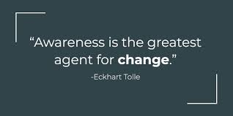
DUAL AWARENESS EXERCISE: the whole self and emotional parts

Slide 36
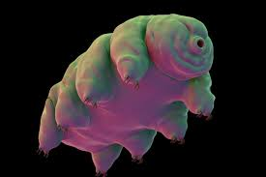
THE
TARDIGRADE. The most resilience animal on earth
Can survive -273C (absolute zero), or 150C. Can resist 6X the pressure at the deepest ocean levels, 1,000X more radiation than humans, go without water for 100 years, and survive in space.
The “Water Bear”.

Slide 37
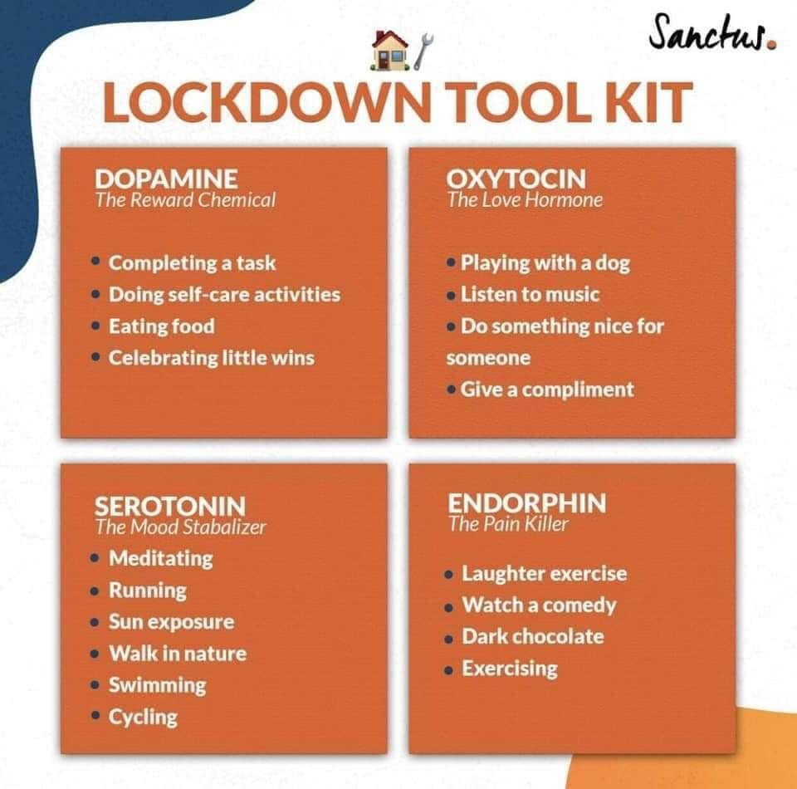
Support your hormones!

Slide 38

Bridging to next week’s session!

Slide 39
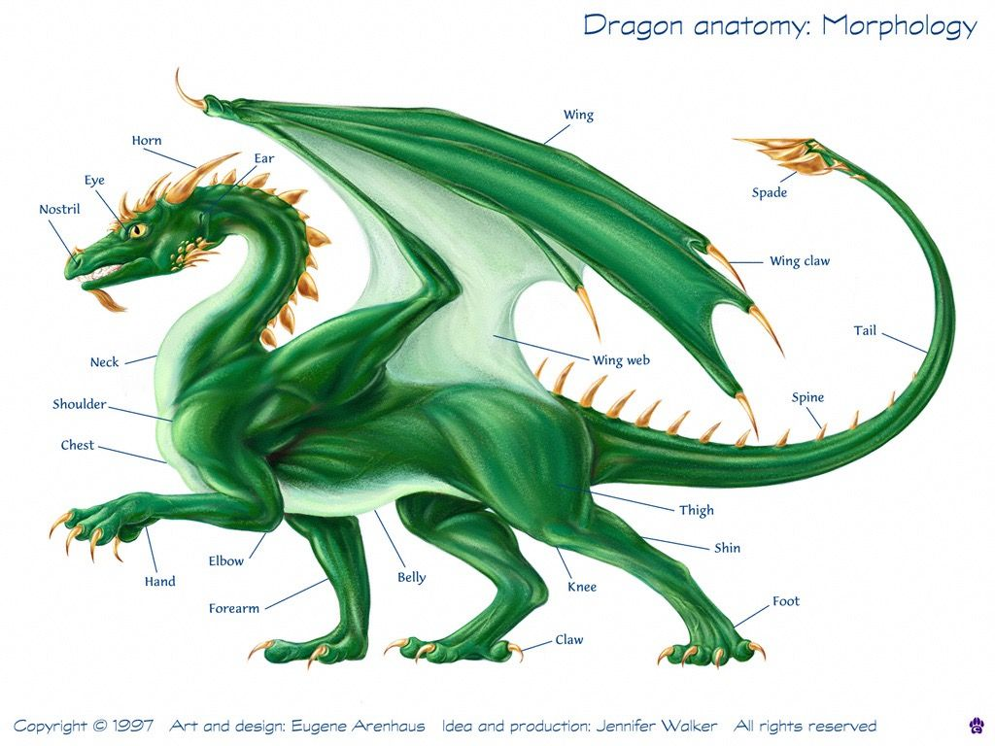
Our “Parts”
Why do we get to know our body parts but not our psychology parts??

Slide 40

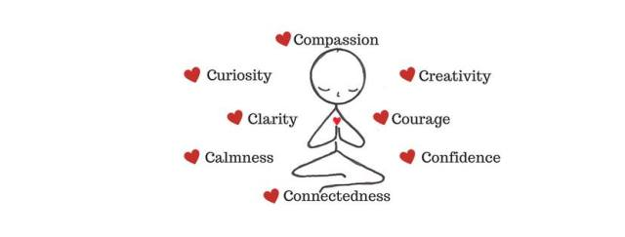
Getting to Know and Nurturing Your Defense Team
Using dual awareness to connect with the WHOLE YOU and PARTS OF YOU

Slide 41
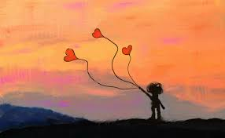
Getting to know “a part”…
Follow the Feeling …

Slide 42
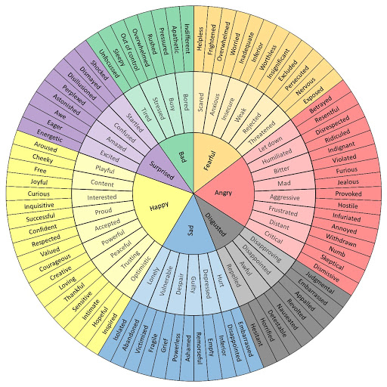
The Emotions Wheel

