Slide 1

bridging to resilience
Mental wellness for charity Leaders During Covid-19
SESSION #3
Tuesday, December 8th, 2020
10:00 am - Noon
You’re doin’ it!

Slide 2

Session calendar
SESSION #1
Tuesday, November 24th
10:00 a.m. to 12:00 p.m.
SESSION #2
Tuesday, December 1st
10:00 a.m. to 12:00 p.m.
SESSION #3
Tuesday, December 8th
10:00 a.m. to 12:00 p.m.
SESSION #4
Tuesday, December 15th
10:00 a.m. to 12:00 p.m.

Slide 3

Goals of today’s session
Check-in: Self Care activities – WOT, Dual Awareness
Continuing to Explore Dual Awareness
Getting to Know and Nurturing Your Defence Team
Discovering How Hope IS A Strategy!
Delving Deeper Into Resilience Building:
  The Four Foci
  Discussion and Exercises:
    Attention
    Thoughts
    Action
    Motivation

Slide 4
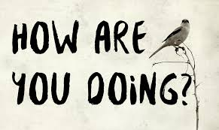
Checking in

Slide 5

Bridging to Resilience
FOUNDATION
Perspective
Dual Awareness
Emotional Regulation
Whole Self Versus Parts
Resourcing
Values
Our Current Group Strategy #1:
Building the Foundation of the Bridge

Slide 6

P
E
R
S
P
E
C
T
I
V
E
P
E
R
S
P
E
C
T
I
V
E

Slide 7

Bridging to dual awareness
The whole you and parts of you

Slide 8
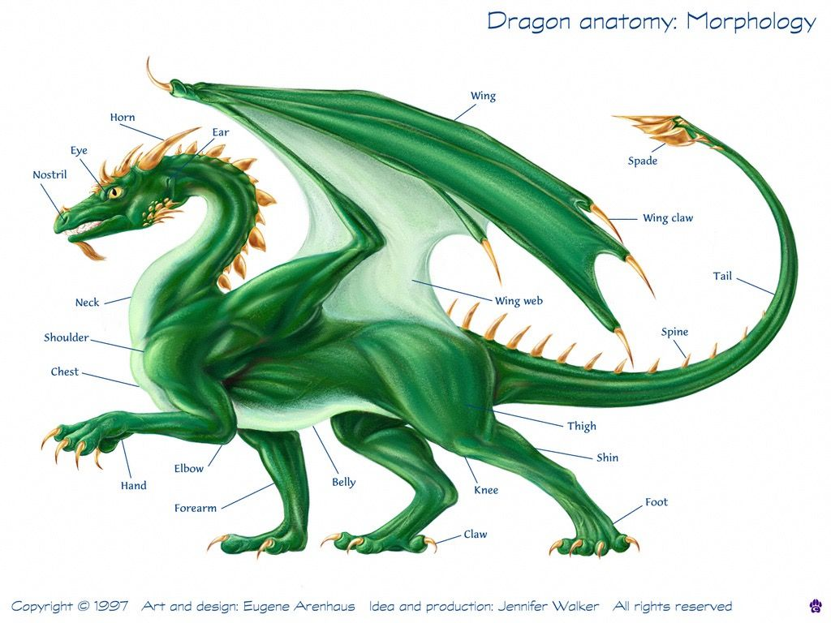
Our “Parts”
Why do we get to know our body parts but not our psychology parts??

Slide 9

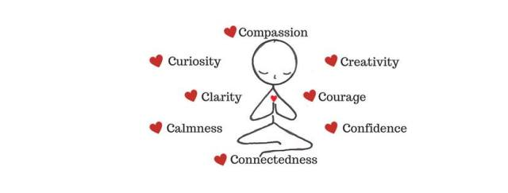
Getting to Know and Nurturing Your Defense Team
Using dual awareness to connect with the WHOLE YOU and PARTS OF YOU

Slide 10
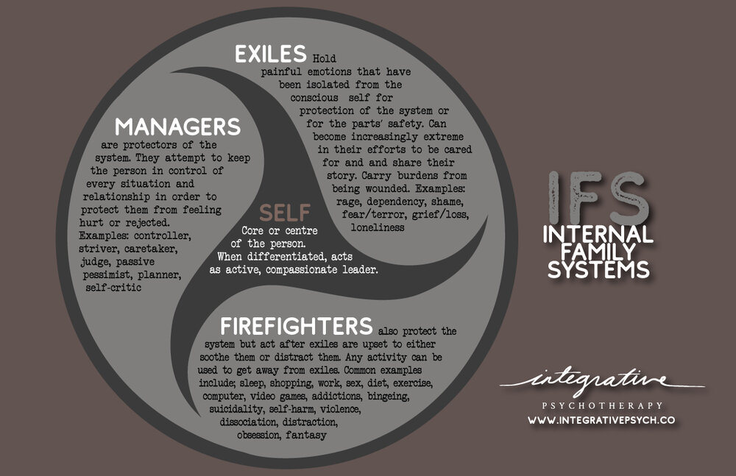
What parts came through?

Slide 11
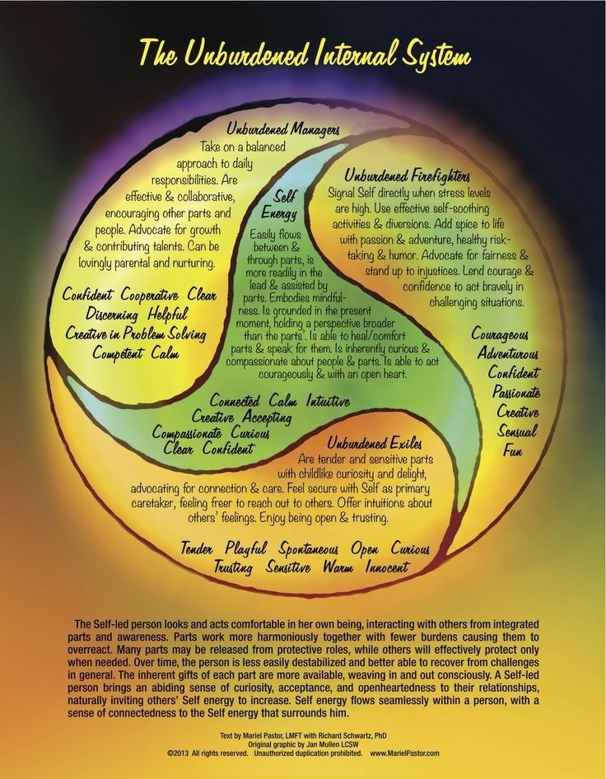
What the parts want to be …

Slide 12
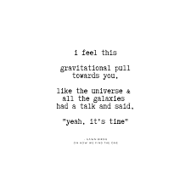
How do you feel towards …

Slide 13
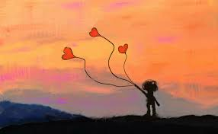
Getting to know “a part”…
Follow the Feeling …

Slide 14
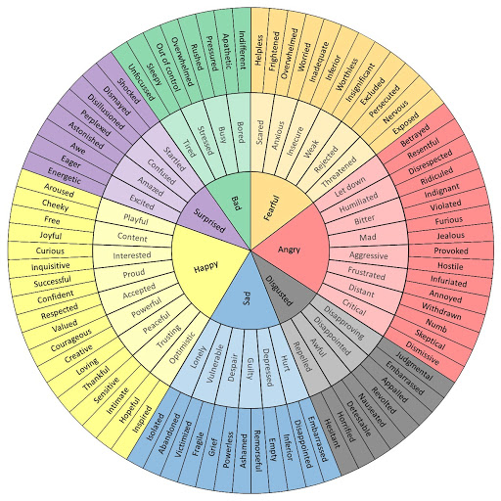
The Emotions Wheel

Slide 15
Let’s talk about hope, unhappiness, and happiness
The science of hope shows that how we think about the future is a key determinant of our success in work, school and life. With all other conditions being equal, high hope leads to an increase in workplace outcomes (Reichard, Avey, Lopez, Dollwet & Marques, 2013), and gains in academic performance (Lopez, Reichard, Dollwet & Marques, 2014)
Why is this? When we see a direct connection between the future we want and our behaviours and attitudes today, effort and commitment soar. Traditional goal setting relies on clarity in the specifics that we are trying to achieve (think SMART goals) and the willpower to achieve. While we can rely solely on willpower to achieve our goals, these efforts at self-control can become exhausting and ignores the psychological force that we activate when we tap into the motivating energy of hope (Alarcon, Bowling & Khazon, 2013).
Hope theory encompasses not only willpower (agency) but also the waypower (pathways) to achieve goals (Snyder, 2000). Lyubomirsky’s (2007) proposition is that working towards a goal is as important to wellbeing as the attainment of the goal itself. Committed goal pursuit provides purpose and feeling of control over our lives, assisting us to feel efficacious and reinforces autonomy.

Slide 16

“Happy-ology” and
“non-happy-ology”
(positive Psychology terms)
DUAL AWARENESS RECAP
Whole you and parts
Current and past
Adversity today and overall good/ability/coping/history of success
Happy and unhappy

Slide 17
Hope IS a strategy – your resilience hope
(RH) factor

Slide 18

What is your resilience hope?
Your “RH” factor!!

Slide 19
Delving deeper into resilience building – the four foci

Slide 20

where do we focus to build resilience?
Attention
    Thoughts
          Action
              Motivation
From Positive Psychology, 2020

Slide 21

1. attention
How do you direct attention to negative and positive events? (Particularly given we are hard-wired for negative bias?)
People tend to dwell on things that have gone wrong in their lives—a mistake they made at work, saying the wrong thing in a social setting, or an evening that did not go as planned. People may even think about a negative event or experience like this so frequently that their lives seem filled with mishaps and disappointments. Focusing on negative experiences too much, however, can have a detrimental impact on one’s life and wellbeing, and even be associated with depressive thinking (Nolen-Hoeksema, 2000).
From Positive Psychology, 2020

Slide 22

Discussion #1: where does your attention go?

Slide 23
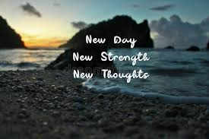
2. Thoughts
Benefit Finding: Rather than thinking about what you did wrong (which may lead to further negative thinking), think about what you could do differently, and perhaps better, next time (which may cascade into positive, hopeful thinking). This change in mindset is known as “finding the silver lining.” Looking on the bright side even when things go wrong is a key component of optimism. In a study that examined the effect of finding silver linings (and another optimism exercise known as goal visualization) on a daily basis for three weeks, participants experienced greater engagement in life and less dysfunctional thinking (e.g., believing that making a mistake is a sign of weakness), (Sergeant & Mongrain, 2014). Participants who were more pessimistic at the outset of the study experienced greater benefits, showing fewer depressive symptoms afterward.
Appraisal Theory: the theory that emotions are extracted from our evaluations (appraisals or estimates) of events that cause specific reactions in different people. Essentially, our appraisal of a situation causes an emotional, or affective, response that is going to be based on that appraisal.
Explanatory Style: While resilience is typically associated with the ability to effectively deal with negative life events, resilience can also result from effective dealing with positive events (Bryant & Smith, 2015). Research shows that a higher capacity to savor the moment predicts lower levels of work-family conflict (Camgoz, 2014), suggesting that savoring may support coping with work and family demands. During stressful events, the positive emotions that emerge from savoring can help offset the experience of negative emotions (Zautra, Affleck, Tennen, Reich, & Davis, 2005). Savoring positive experiences has been suggested to be the most beneficial for people who experience fewer daily positive events (Hurley & Kwon, 2013; Jose, Lim, & Bryant, 2012).
From Positive Psychology, 2020

Slide 24
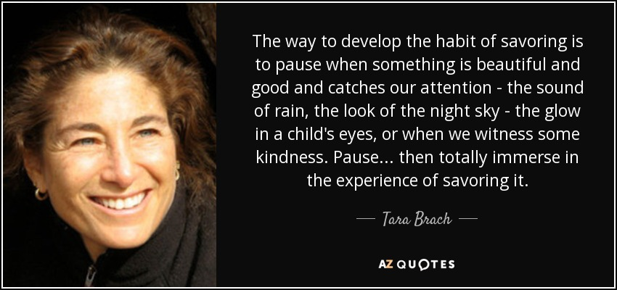
Exercise #1: savoring

Slide 25
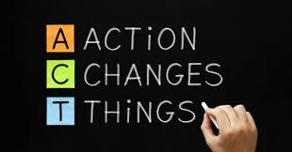
3. action
Resilient people cope effectively with both negative and positive life events, taking action to adapt, cope with, understand, and self-apply discoveries associated with adverse or stressful events.
Examples:
Finding Silver Linings
A Personal Coping Mantra
Costs and Benefits of Unhelpful Thinking
Extracting Strengths from Problems
Strength Spotting from Exceptions
Tapping Into Your Inner Optimist
Hope Map
Inspiration and Dealing With Challenges
From Positive Psychology, 2020

Slide 26
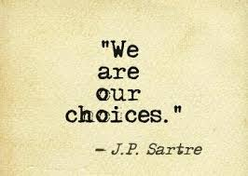
Exercise #3: your choice!

Slide 27
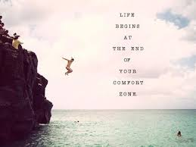
4. motivation
What creates motivation to be resilient, to balance attention and perspectives, cultivate savoring and positive thoughts, and take action?
What inspires motivation to do all of the above?
EXERCISES:
Values Living Through Challenging Times
Doors Closed, Doors Opened
From Positive Psychology, 2020

Slide 28

Exercise related to #4 motivaiton

Slide 29
Bridging to your unique resilience

Slide 30
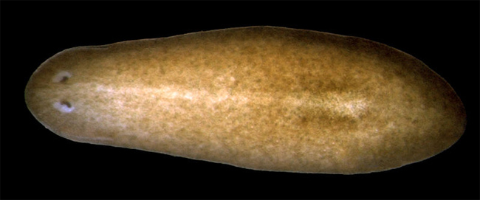
This Week’s Resilience Inspiration: THE
TARDIGRADE. The most resilience animal on earth
Planarian Worm: Live in fresh and salt water AND regenerate body parts! If cut in half, the part without a head will grow a new FULLY FUNCTIONING HEAD WITH A NEW BRAIN and the part without a tail will grow a new one – ALL WITHIN 7 -10 DAYS!
Called the Immortal Worm. Many stem cells mean that a part as small as 1/279 can regenerate a completely new worm!
Can survive -273C (absolute zero), or 150C. Can resist 6X the pressure at the deepest ocean levels, 1,000X more radiation than humans, go without water for 100 years, and survive in space.
The “Water Bear”.

Slide 31
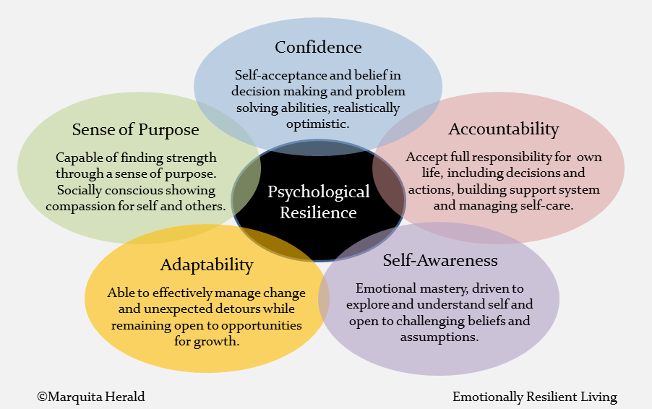

Slide 32
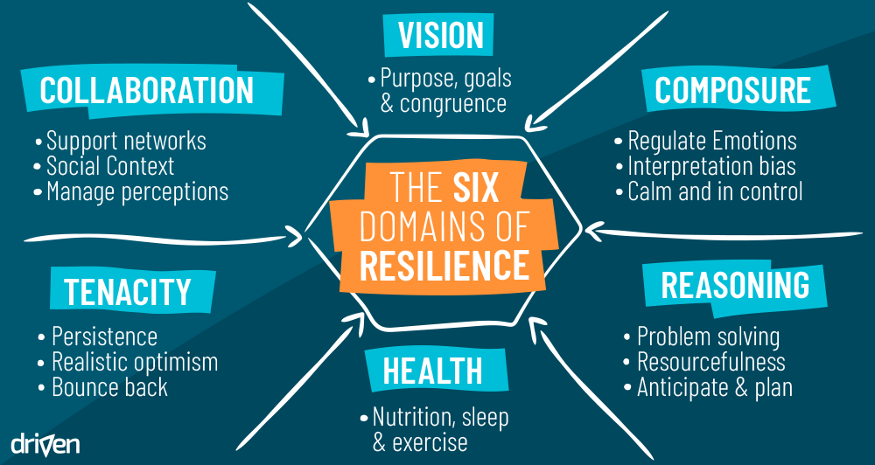

Slide 33
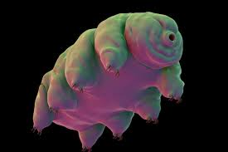
THE
TARDIGRADE. The most resilience animal on earth
Can survive -273C (absolute zero), or 150C. Can resist 6X the pressure at the deepest ocean levels, 1,000X more radiation than humans, go without water for 100 years, and survive in space.
The “Water Bear”.

Slide 34

Bridging to session #4: what stood out?
Options, focus, and looking to January 2021 …

Slide 35

For next week: one self care partner …

