Slide 1

bridging to resilience
Mental wellness for charity Leaders During Covid-19
SESSION #4
Tuesday, December 15th, 2020
10:00 am - Noon
You’re doin’ it!

Slide 2

Session calendar
SESSION #1
Tuesday, November 24th
10:00 a.m. to 12:00 p.m.
SESSION #2
Tuesday, December 1st
10:00 a.m. to 12:00 p.m.
SESSION #3
Tuesday, December 8th
10:00 a.m. to 12:00 p.m.
SESSION #4
Tuesday, December 15th
10:00 a.m. to 12:00 p.m.

Slide 3

Goals of today’s session
Check-in: Self Care – Resilience Place, Resilience Hope (RH Factor), WOT, Dual Awareness
Completing Resilience Building Exercises:
  the Four Foci
Empathy Versus Compassion
Creating a Resilience Workplace
  You as the Model of a Growth Mindset and CRO
  Internal Assessment and Readiness
  Building Perspectives, People, Environments
  Tending the Organizational Place of Resilience

Slide 4

Checking in

Slide 5

Bridging to Resilience
FOUNDATION
Perspective
Dual Awareness
Emotional Regulation
Whole Self Versus Parts
Resourcing
Values
Our Current Group Strategy #1:
Building the Foundation of the Bridge

Slide 6

P
E
R
S
P
E
C
T
I
V
E
P
E
R
S
P
E
C
T
I
V
E

Slide 7

Delving deeper into resilience building – the four foci

Slide 8

where do we focus to build resilience?
Attention
    Thoughts
          Action
              Motivation
From Positive Psychology, 2020

Slide 9

1. attention
How do you direct attention to negative and positive events? (Particularly given we are hard-wired for negative bias?)
People tend to dwell on things that have gone wrong in their lives—a mistake they made at work, saying the wrong thing in a social setting, or an evening that did not go as planned. People may even think about a negative event or experience like this so frequently that their lives seem filled with mishaps and disappointments. Focusing on negative experiences too much, however, can have a detrimental impact on one’s life and wellbeing, and even be associated with depressive thinking (Nolen-Hoeksema, 2000).
From Positive Psychology, 2020

Slide 10

Discussion #1: where does your attention go?

Slide 11

2. Thoughts
Benefit Finding: Rather than thinking about what you did wrong (which may lead to further negative thinking), think about what you could do differently, and perhaps better, next time (which may cascade into positive, hopeful thinking). This change in mindset is known as “finding the silver lining.” Looking on the bright side even when things go wrong is a key component of optimism. In a study that examined the effect of finding silver linings (and another optimism exercise known as goal visualization) on a daily basis for three weeks, participants experienced greater engagement in life and less dysfunctional thinking (e.g., believing that making a mistake is a sign of weakness), (Sergeant & Mongrain, 2014). Participants who were more pessimistic at the outset of the study experienced greater benefits, showing fewer depressive symptoms afterward.
Appraisal Theory: the theory that emotions are extracted from our evaluations (appraisals or estimates) of events that cause specific reactions in different people. Essentially, our appraisal of a situation causes an emotional, or affective, response that is going to be based on that appraisal.
Explanatory Style: While resilience is typically associated with the ability to effectively deal with negative life events, resilience can also result from effective dealing with positive events (Bryant & Smith, 2015). Research shows that a higher capacity to savor the moment predicts lower levels of work-family conflict (Camgoz, 2014), suggesting that savoring may support coping with work and family demands. During stressful events, the positive emotions that emerge from savoring can help offset the experience of negative emotions (Zautra, Affleck, Tennen, Reich, & Davis, 2005). Savoring positive experiences has been suggested to be the most beneficial for people who experience fewer daily positive events (Hurley & Kwon, 2013; Jose, Lim, & Bryant, 2012).
From Positive Psychology, 2020

Slide 12
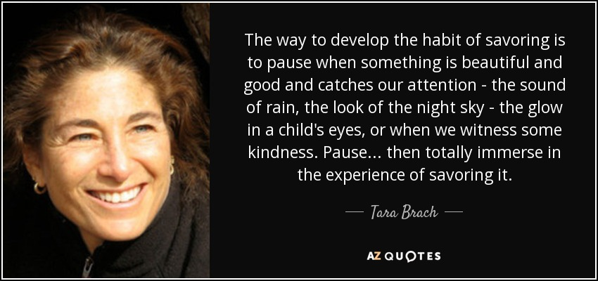
Exercise #1: savoring

Slide 13

3. action
Resilient people cope effectively with both negative and positive life events, taking action to adapt, cope with, understand, and self-apply discoveries associated with adverse or stressful events.
Examples:
Finding Silver Linings
A Personal Coping Mantra
Costs and Benefits of Unhelpful Thinking
Extracting Strengths from Problems
Strength Spotting from Exceptions
Tapping Into Your Inner Optimist
Hope Map
Inspiration and Dealing With Challenges
From Positive Psychology, 2020

Slide 14

Exercise #3: your choice!

Slide 15

4. motivation
What creates motivation to be resilient, to balance attention and perspectives, cultivate savoring and positive thoughts, and take action?
What inspires motivation to do all of the above?
EXERCISES:
Values Living Through Challenging Times
Doors Closed, Doors Opened
From Positive Psychology, 2020

Slide 16

Exercise related to #4 motivaiton

Slide 17
Bridging to your unique resilience

Slide 18
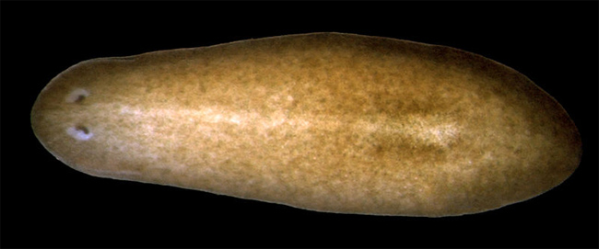
This Week’s Resilience Inspiration: THE
TARDIGRADE. The most resilience animal on earth
Planarian Worm: Live in fresh and salt water AND regenerate body parts! If cut in half, the part without a head will grow a new FULLY FUNCTIONING HEAD WITH A NEW BRAIN and the part without a tail will grow a new one – ALL WITHIN 7 -10 DAYS!
Called the Immortal Worm. Many stem cells mean that a part as small as 1/279 can regenerate a completely new worm!
Can survive -273C (absolute zero), or 150C. Can resist 6X the pressure at the deepest ocean levels, 1,000X more radiation than humans, go without water for 100 years, and survive in space.
The “Water Bear”.

Slide 19
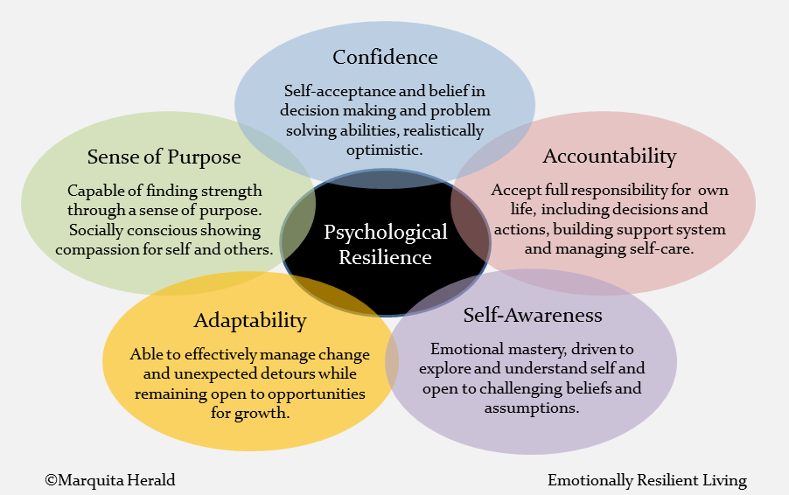

Slide 20
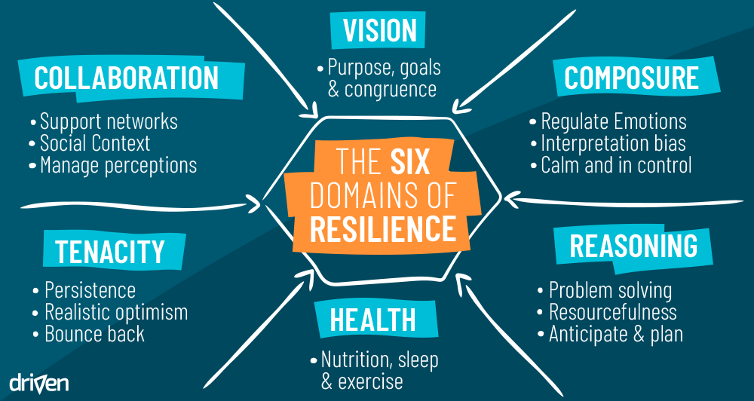

Slide 21
Bridging compassion

Slide 22
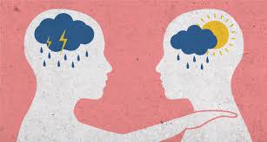
Empathy versus compassion
In contrast to empathy, compassion does not mean sharing the suffering of the other. It is characterized by feelings of warmth, concern and care for the other, and a strong motivation to improve the other’s wellbeing. Compassion is feeling for and not feeling with the other.
Empathic response to suffering can result in two kinds of reactions: empathic distress (personal distress); and compassion (empathic concern or sympathy).
Empathy refers to our general capacity to resonate with others’ emotional states irrespective of their positivity or negativity. Empathic distress is a strong aversive and self-oriented response to the suffering of others, accompanied by the desire to withdraw to protect oneself from excessive negative feelings.
Compassion is a feeling of concern for another person’s suffering accompanied by the motivation to help. By consequence, it is associated with approach and prosocial motivation.
People who feel compassion help more often than people who suffer from empathic distress.
Current Biology, 2014
Notes:
comparing the brain activations that are elicited by the first-hand experience of pain with those purely elicited by the vicarious observation of another person in pain, researchers have repeatedly found evidence for the existence of such shared neuronal networks (Figure 2). For example, meta-analyses on empathy for pain studies have revealed that a portion of the anterior insula and a specific part of the anterior cingulate cortex were consistently activated, both during the experience of pain as well as when vicariously feeling with the suffering of others.
magnitude of these empathy-related activations was modulated by individual differences in the degree to which participants reported having experienced negative feelings while empathizing with the other.

Slide 23
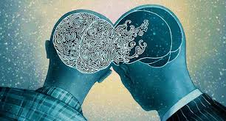
Empathy versus compassion
Exposure to the distress and suffering of others can lead to two emotional reactions:
Empathic distress results in negative feelings and is associated with withdrawal. When experienced chronically, empathic distress can lead to negative health outcomes.
Compassionate responses are based on positive, other-oriented feelings and the activation of prosocial motivation and behavior. The plasticity of adaptive social emotions is encouraging, especially as compassion training promotes prosocial behavior and augments positive affect and resilience, fostering better coping with stressful situations.
Current Biology, 2014

Slide 24
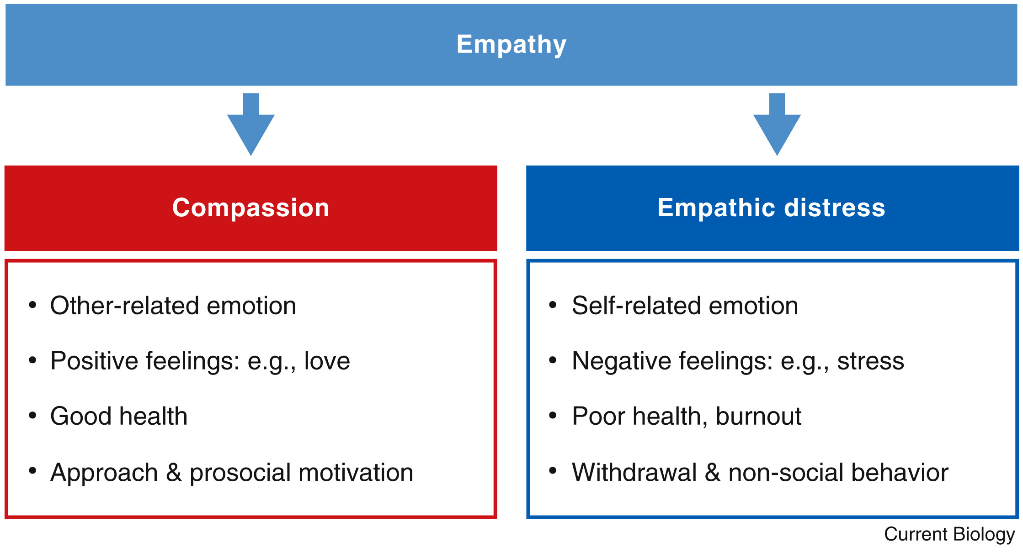

Slide 25

Empathy versus compassion
“
… too much empathy can be debilitating. When we are too distressed about the suffering of others, we don’t have the cognitive and emotional resources to help them. Having compassion, a cognitive understanding of how they’re feeling, is better for our well-being and that of those in need.”
“Buddhism teaches the practice of compassion, called karuna. This is the idea of sharing in suffering, “feeling for and not feeling with the other.”
Studies comparing empathy and compassion:
Empathy training activated the insula (linked to emotion and self-awareness) and the anterior cingulate cortex (linked to emotion and consciousness), as well as pain registering. The compassion group stimulated activity in the medial orbitofrontal cortex (connected to learning and reward in decision-making) and the ventral striatum (also connected to the reward system).
The two types of training led to very different emotions and attitudes toward action. The empathy-trained group actually found empathy uncomfortable and troublesome. The compassion group created positivity, feeling kinder and more eager to help others than those in the empathy group.
.
Current Biology, 2014

Slide 26
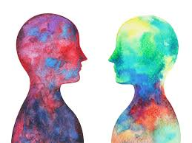
Avoiding empathic distress
Breathe
Seeing something distressing activates the fight-flight response. Breathing becomes fast and shallow, which increases anxiety and gives emotions momentum. Slow, steady deep breathing activates the relaxation response.
Feel Your Body
When witnessing strong emotions in others, stay with yourself rather than getting caught up in their experience. Feel your feet on the ground and wiggle your toes. Bend your knees slightly if you are standing. Feel your butt in the chair supporting you. Be aware of body sensations and imagine yourself holding the sensations and emotions as they move through your body. Keep the option open to physically remove yourself situations that become too distressing.
Differentiate Between Self-Other
People in helping professions are vulnerable to this.
Psychology Today, 2017
Current Biology, 2014

Slide 27
Cultivating compassion
Limit Exposure to Negativity
We have a perceptual bias to pay more attention to negative, potentially threatening information. It’s good to be aware of possible threats and problems. But without some perspective-taking, it can lead us to believe that the negative outweighs the positive. Be discerning about the amount of time and attention you give to distressing information on a regular basis.
Practice Loving-Kindness
Visualize a person one feels very close to, then gradually extend the feeling of kindness towards others, including strangers and, at a later stage, also people one has difficulties with.
Research: participants who undergo loving kindness and compassion training increased their helping rates towards strangers. The amount of time participants practiced compassion predicted how much pure altruistic helping as opposed to reciprocity-based helping occurred. Perceived group membership or fairness of another person matters for how much empathy one will actually experience for the other.
Psychology Today, 2017
Current Biology, 2014

Slide 28
Bridging to aN organizational resilient place

Slide 29

Organizational Resilience
You are the Model of a Growth Mindset and CRO
Tending the Organizational Place of Resilience
Internal Assessment and Readiness
Building Perspectives, People, Environments

Slide 30
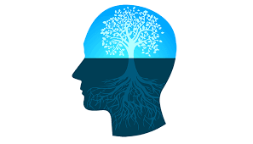
You are the model of resilience and a growth mindset
What’s your:
Resilience level?
Capacity for self-compassion?
Plan for self-care?
Attentional focus?
Practice of perspective taking?
Ability to Reframe?
Ability to Accept What Cannot Be Changed?
Patience for Iterative Steps?
Readiness for Decision-Making?
Hope level?
Connection to Your Deepest Value(s)?

Slide 31

Internal assessment and readiness
  Assessing Adversity
  Assessing Resilience Levels
    Bounceback factor
    Able to self-regulate:
      Ability to recognize own and others’ feelings
      Knows own triggers
      Aware of own inner critic and can soften
      Sense of self-worth
      Aware of own strengths and coping skills and when to employ
      Self-talk
    Relational
    Purpose and values-driven
  Assessing Resilience Building Readiness Levels

Slide 32

Building perspectives, people, and environments
  Identifying Models/Inspirers/Buddies
  Reality Checking
  Obstacle Identification – Link to Feelings
  Cultivating Agreement on Reality:
    Reframing Obstacles
    Socratic Questioning
    Where’s the Attention?
  Group Assessment on Resilience Levels and Readiness for Adversity
  Group Triaging
  Group Agreement on 4 Foci
  Create Opportunities for People to Connect

Slide 33

Tending the organizational place of resilience
  “DEW Line” on Attention
  Sense-making
  Boosters – Performance and High/Low Resilience
  Organizational Shared “Clean Emotional Fuel”
  Sense-making
  Relating to Hope

Slide 34

Bridging to the next month!

Slide 35


