Slide 1
HOW TO BUILD A SAFETY CULTURE
Assessing Risk, and Strategies for Managing Respiratory Infectious Diseases in Congregate Living Settings.
Presented by Jeanette MacLean, Senior Health & Safety Consultant, Pandemic Response Lead for CLTO.

Slide 2
SPPI SECTOR PANDEMIC PLANNING INITIATIVE
ESTABLISHED IN MARCH OF THIS YEAR BY THE TORONTO DEVELOPMENTAL SERVICE ALLIANCE AND SERVICE PROVIDERS COMMITTEE, TO ENABLE COLLABORATION ACROSS TORONTO AGENCIES IN RESPONDING TO THE PANDEMIC.
CHAIRED BY URSULA REHDNER, PRESIDENT & CEO OF APTUS TREATMENT CENTRE FOR COMPLEX DISABILITIES; AND DON WALKER, EXECUTIVE DIRECTOR OF MARY CENTRE OF THE ARCHDIOCESE OF TORONTO.
THE SPPI IS COMPRISED OF 40 VOLUNTEERS ACROSS 19 AGENCIES WHO HAVE BEEN WORKING VERY HARD TO PRODUCE AND DISTRIBUTE GUIDANCE DOCUMENTS ON A RANGE OF TOPICS RELATED TO THE PANDEMIC.
Notes:
INCREASINGLY THESE PAPERS HAVE BEEN DISTRIBUTED ACROSS THE PROVINCIAL NETWORK AND MADE AVAILBLE ON THE REAL EXCHANGE VIRTUAL SITE HOSTED BY COMMUNITY LIVING ESSEX.
THE REAL XCHANGE IS A LIBRARY OF RESOURCES HAS BEEN COMPILED FROM DS SECTOR AGENCIES BY THE PROVINCIAL NETWORK ON DEVELOPMENTAL SERVICES TO ASSIST YOU IN RESPONDING TO THE COVID-19 PANDEMIC THROUGH INFORMATION SHARING AND KNOWLEDGE TRANSFER.
THIS WEBINAR SERIES IS A TESTAMENT TO THAT WORK ETHIC AND COLLABORATIVE SPIRIT.
IN PRODUCING THIS SERIES, I WOULD LIKE TO THANK GEORGIE VINCENT, MIA TREMBLAY AND YOU JAMES OF COMMUNITY LIVING TORONTO AND ALSO OF THE SPPI PROJECT MANAGEMENT OFFICE; AND JEANETTE MACLEAN SENIOR CONSULTANT, OCCUPATIONAL HEALTH AND SAFETY, HEATHER DAWSON SENIOR MANAGER, QUALITY ASSURANCE FOR THIS IPAC ASSESSING PRACTICES THEY ARE GOING TO SHARE WITH ALL OF US TODAY.

Slide 3
INCREASINGLY THESE PAPERS HAVE BEEN DISTRIBUTED ACROSS THE PROVINCIAL NETWORK.
THIS WEBINAR SERIES IS TESTAMENT TO THAT WORK ETHIC AND COLLABORATIVE SPIRIT.
IN PRODUCING THIS SERIES, I WOULD LIKE TO THANK GEORGIE VINCENT, MIA TREMBLAY AND YOU JAMES OF COMMUNITY LIVING TORONTO AND ALSO OF THE SPPI PROJECT MANAGEMENT OFFICE; THIS WEBINAR TODAY WILL FOCUS ON HOW TO BUILD A SAFETY CULTURE, ASSESSING RISK USING THE PSHSA INFECTIOUS DISEASES RISK ASSESSMENT TOOL AND STRATEGIES FOR MANAGING RESPIRATORY INFECTIOUS DISEASES IN CONGREGATE LIVING SETTINGS BASED ON PUBLIC HEALTH ONTARIO GUIDANCE WITH JEANETTE MACLEAN, SENIOR HEALTH & SAFETY CONSULTANT, PANDEMIC RESPONSE LEAD AT CLTO PRESENTING.

Slide 4
Building a Safety Culture
Notes:
Sandy

Slide 5
Building a Safety Culture
Zero Harm
Vision
Trust, Respect and Inclusion
Board Engagement
Leadership Development
Behavior Expectations
Just Culture
Establish a Compelling Vision for Safety
Value Trust, Respect, and Inclusion
Select, Develop, and Engage Your Board
Prioritize Safety in Selection and Development of Leaders
Lead and Reward a Just Culture
Establish Organizational Behavior Expectations
American College of Healthcare Executives (2017). Leading a Culture of Safety: A Blueprint for Success
Notes:
An organization’s vision reflects priorities that, when aligned with its mission, establish a strong foundation for the work of the organization
Establishing trust, showing respect, and promoting inclusion — and demonstrating these principles throughout the organization and with individuals and families — is essential to a leader’s ability to create and sustain a culture of safety.
Governing Boards play a vital role in creating and maintaining safety cultures. Boards must ensure that metrics that meaningfully assess organizational safety and a culture of safety are in place and systematically reviewed, analyzed, and the results acted upon.
Expectations for the design and delivery of relevant safety training for all executive and frontline leaders should be set by the CEO and subsequently spread throughout the organization. Accountability for safety should be included as part of the leadership development strategy for the organization.
Leaders must possess a thorough understanding of the principles and behaviors of a just culture and be committed to teaching and modeling them. Human error is and always will be a reality. In a just culture framework, the focus is on addressing systems issues that contribute to errors and harm.
Senior leaders are responsible for establishing safety-mindfulness for everyone and, perhaps even more importantly, modeling these behaviors and actions. These behaviors include, but are not limited to, transparency, effective teamwork, active communication, civility, and direct and timely feedback. These cultural commitments must be universally understood and apply equally to the entire workforce, regardless of rank, role, or department.
The journey towards building a culture of safety demands the involvement and commitment of the entire organization. However, an organization cannot be what its leader is not. It is both the obligation and the privilege of every CEO to create and represent a compelling vision for a culture of safety: a culture in which mistakes are acknowledged and lead to sustainable, positive change; respectful and inclusive behaviors are instinctive and serve as the behavioral norms for the organization; and the physical and psychological safety of clients/residents and the workforce is both highly valued and ardently protected.

Slide 6
Vision
Safety & Operational Excellence –
Zero Preventable Harm to Individuals supported and our Workers
Mission
Defines who we are and our purpose
Building a safety culture – protect and promote the health, safety & wellness of all our people
Notes:
To shift a culture within an organization won’t happen overnight. It begins with a vision and a well-defined mission statement identifying who you are and your purpose. Does your organizations’ vision and mission drive a culture of safety?
Paul O’Neil former CEO of Alcoa – and U.S. Secretary of the Treasury –
Posed three questions - If you want to know whether you are part of an organization that has the potential for greatness consider asking your workforce these three questions
1. Am I treated every day with dignity and respect by everyone I encounter? O'Neill further clarified the question: "Not 'some people' or 'not by the people who work for me' but by everyone I encounter." 2. Am I given the knowledge, tools, and support that I need in order to make a contribution to my organization—"and this is the important part," he said—that gives meaning to my life? 3. Did somebody notice I did it?
not a guarantee of greatness – organizations with potential – their people can say every day – without reservation – yes to each questions
in every organization—public, private, non-profits—their written statements all say the same thing: 'Our most important asset is our people.' ...
However, there is little evidence that this is true - in most organizations. What are the ways that your organization measures efforts which validate this statement?
A vision and mission is only the beginning – great organizations are based on values without reservations or excuses.
prove to people - important - you need to connect - to a goal that is not open to debate.
In Alcoa’s case, the goal was zero preventable harm – not simply a reduction a harm.
O’Neil’s approach and leadership style not only improved Alcoa’s safety record and other metrics - the company’s market value - $3 billion in 1986 to $27.53 billion in 2000,
net income increased from $200 million to $1.484 billion.
Alcoa was already known for its stellar safety performance when O’Neil took office - when he retired in 2001 the company injury rate had decreased from
1.86 in 1986 to 0.14 in 2001 - This represents less than 1 worker injured per 100 per year.
Even now 20 years later, Alcoa continues to be recognized as one of the safest organizations in the world.
Mr. O'Neil shares his experiences at Alcoa nationally in addressing issues of safety and quality in healthcare.

Slide 7
What is a Just Culture?
Safety Culture
Just Culture
Reporting Culture
Learning Culture
Cultivating an atmosphere where people have confidence to report safety concerns without fear of blame.
People are not punished for system issues that result in error - but which result in a reportable event; negligence, wilful violations and destructive acts are not tolerated.
An organization can learn from its mistakes and make changes. It will also ensure that people understand the HSMS processes and protocols.
Notes:
In these current times of change and uncertainty – many new concepts, practices, processes have been introduced and thrust upon everyone. Adherence to protocols and procedures are critical if we hope to prevent COVID19 from impacting those who are most vulnerable. How do we support workers and help them adjust to the changing landscape and why is a just culture important?
First, we need to explore what its mean when we talk about just culture? – again this is a question I would like you to think about as you leave this webinar - how can you drive a just a culture in your organization?
While training of leaders and the workforce on just culture is vital, everyone at all levels of the organization must consistently integrate just culture principles as an organizational norm. The CEO’s role in ensuring that just culture principles are understood and implemented across the organization is fundamental to success. If one individual within the organization is punished for a system flaw, just culture efforts can be severely undermined. Leaders must be transparent with the Board, the workforce, and the public about the organization’s approach, so that when something does go wrong, the response is expected, practiced, and applied uniformly throughout the organization.
A just culture is not a blame-free environment; leaders and the workforce are still held accountable for following protocols and procedures. Most errors are not a result of individual failures but are the result of systems that are inherently flawed and create environments of risk. A just culture acknowledges that punishing people for mistakes discourages reporting, fails to correct problems in the system, and sets up the likelihood of recurrence. Just culture also emphasizes the importance of the affected workforce after events occur and focuses on support and peer-to-peer counseling for affected individuals
When clearly defined, articulated, and implemented by leadership, a just culture approach encourages the reporting of errors, lapses, near-misses, and adverse events. It is through reporting and event analysis that the organization learns what went wrong, or could have gone wrong, and how to prevent it from happening again.

Slide 8
Public Health Ontario
COVID-19 Resources
Several resources have been developed for congregate living settings regarding COVID-19:
Congregate living setting landing page
Specific resources include:
COVID-19: Infection Prevention and Control Checklist for Long-Term Care and Retirement Homes
COVID-19 Preparedness and Prevention in Congregate Living Settings
Planning for Respiratory Outbreaks in Congregate Living Settings
Managing COVID-19 Outbreaks in Congregate Living Settings
Notes:
Resources relevant to Congregate Living Settings available on the PHO Congregate living setting landing page. Specific resources relevant to managing infectious diseases and outbreaks are listed here.

Slide 9
Respiratory Infectious Diseases
https://www.publichealthontario.ca/-/media/documents/ncov/ipac/2020/09/key-features-influenza-covid-19-respiratory-viruses.pdf?la=en
Notes:
Sharing with you the overview prepared by Public Health Ontario on the common Respiratory Infectious Diseases that exist in our communities. I would encourage you to become familiar with the similarities and differences between each of these infectious diseases. In planning and managing through outbreaks of respiratory infectious diseases it will be important in understanding the epidemiology of each.

Slide 13
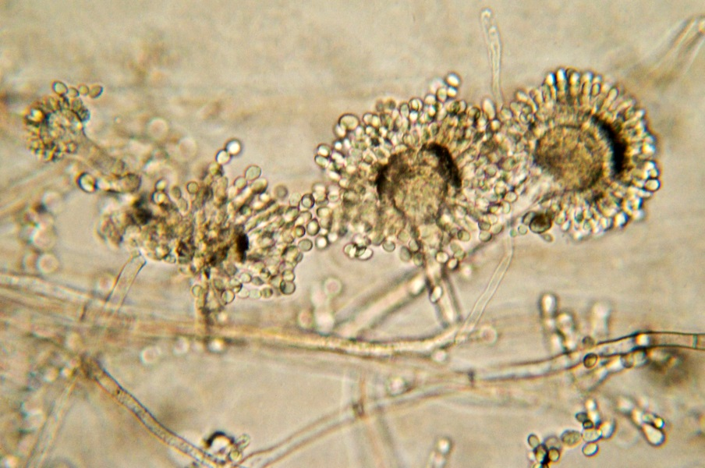
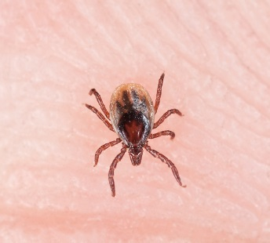
General Infectious Disease Risk Assessment and Management Tool
December 11, 2020
Notes:
Welcome. Presenter introduction here.
This presentation focuses on the broader public sectors but it can apply to any sector. Biological hazards can cause disease in any workplace, the impact on workers and others can be devastating so it is important that organizations proactively conduct an infectious disease risk assessment or IDRA.

Slide 14
Agenda
Understanding Biological Hazards and Infectious Agent Threats
PSHSA General Infectious Disease Risk Assessment (IDRA) Tool
Steps to Completing the Tool
PSHSA Resources
References
Notes:
Understanding Biological Hazards and Infectious Agent Threats
PSHSA General Infectious Disease Risk Assessment (IDRA) Tool
Steps to Completing the Tool
PSHSA Resources
References

Slide 15
Biological Hazards
Biological agents are living organisms or substances produced by living organisms that have the potential to cause health effects in humans
Bacteria
Live Independently
Viruses
Cannot Live Independently e.g. coronavirus
Fungi
Simple Multi-cell Organisms e.g. mold
Parasites
Complex Multi-cell Organisms e.g. scabies
Plants/Pollen
e.g. poison ivy
Notes:
Biological agents are living organisms or substances produced by living organisms that have the potential to cause health effects in humans
Hence, infectious diseases can be caused by these organisms such as bacteria, viruses, fungi and parasites etc.

Slide 16
Infectious Disease Risk Threats
Some pathogens can cause infectious disease threats in the workplace
Infection control knowledge and demonstration of readiness and response capabilities is critical
Important for organizations to identify and assess infectious disease risks and prevent disease exposure
Notes:
Some harmful organisms can cause disease in workers and others in the workplace, in fact any workplace may be faced with infectious disease threats regardless of the sector
It is becoming increasing important for organizations to have infection control knowledge and demonstrate readiness and response capabilities to these types of threats. Without the focus and commitment of employers, many workers and others may be at an increased risk of exposure to infectious diseases.
It is essential that organizations build capacity to identify, assess and manage infectious disease threats. An infectious disease risk assessment (IDRA), is an important component of every organization’s workplace health and safety prevention program. Identifying and assessing an organization’s infectious disease risks is the first step in preventing infectious disease exposure.
PSHSA has developed a easy to use tool for broader public organizations to help them identify and assess infectious disease risks, develop controls and an action plan to protect workers or others in the workplace.
But first we will review a few infectious disease concept so you will have a better understanding of the IDRA and Management Tool components.

Slide 17
PSHSA IDRA and Management Tool
Developed for the broader public sector organizations beyond healthcare
Assists in management of infectious disease hazard risks e.g. controls such as engineering, administrative, personal protective equipment
Manage the risk with proposed controls
Designed
to identify Infectious
Disease
Analyze existing controls and assess level of Risk
Develop an Action Plan, Assign Responsibility and Dates
Notes:
It is essential that organizations build capacity to identify, assess and manage infectious disease threats.
Identifying and assessing an organization’s infectious disease risks is the first step in preventing infectious disease exposure.
The following tool has been developed for broader public organizations
Designed to:
Help organizations identify infectious diseases in the workplace
Analyze existing controls and assess infectious diseases risks
Proposed infection controls or additional controls to prevent exposure
Develop an action plan to implement proposed controls, assign responsibility and identify target and completion dates
And also Document the process
Technically it is a hazard management tool because it is more that identifying and assessing ID risk
For those working in acute healthcare please see the Infectious Disease Threat Risk Assessment for Acute Care resource.

Slide 18
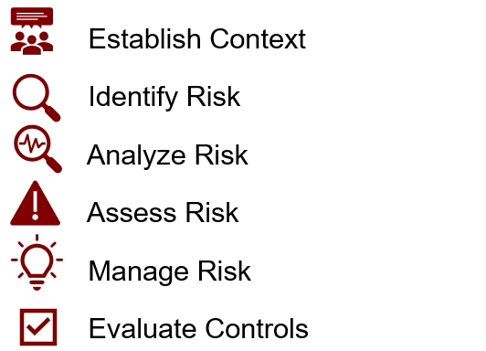
Steps to Completing IDRA
- Proposed Controls
Notes:
Step 1 Establish Context - Conduct a review to obtain an understanding of the workplace. Factors to consider:
Organization mission, vision and values
Safety Culture
Type of workplace/institution e.g. education, municipality
Location of workplace
Type of facilities and work provided
Locations and nature of work and tasks done
History of existing/potential infectious diseases or exposures
Step 2 Identify Risk
Employer establish a governance process. Appoint a leader who ihas oversight and is responsible to coordinate, report and follow up on team activities
Suggest the employer develop a multidisciplinary team of management, workers and Joint Health and Safety Committee (JHSC) and/or Health and Safety Representatives (HSR) to collaborate and identify infectious disease hazards. May require additional expertise
The Team Identify locations, jobs and tasks to be evaluated
Using the PSHSA IDRA and Management Tool categorize the task into the appropriate infectious disease domain
Review job task and identify existing or potential exposures
Document the findings
Step 3 Analyze Existing Controls, Contributing Factors and Applicable Legislation and Infection Prevention and Control Standards
Identify and analyze existing controls for example
Engineering controls such as ventilation, sharps containers
Administrative controls such as policies, procedures, barriers, signage, training programs e.g. policy, procedures, PPE (use, fit, care and limitations), fit testing
Personal protective equipment e.g. gloves, gowns, eye/face protection, surgical masks, respirators
Consider contributing factors
Exposure – frequency, type (protected vs unprotected, routine vs non-routine, via people, equipment, material, environment, process), duration
Task
Workplace
Environment
Workers – type, competencies
Infectious Disease Characteristics – including transmission
Effectiveness of Current Controls
Consider Applicable Infectious Disease Standards e.g. OHSA, Health Care Residential and Facilities Regulation, Health Canada, Public Health Ontario, PIDAC, Ministry of Health, Ontario Government Directives etc.
Step 4 Assess the Risk
Assess the current level of risk of exposure (high, medium, low) using the risk assessment matrix
Prioritize risks to be managed
Step 5 Manage Risk
Propose controls to mitigate the existing gaps for each risk
Apply the hierarchy of controls
At the source - Elimination, Substitution, Engineering
Along the path - Policies, Procedures, Training etc.
At the worker - Personal Protective Equipment
Develop an action plan, assign responsibilities and target/completion dates
Step 6 Evaluate the proposed controls
Use the risk assessment chart to complete another hazard risk assessment to determine whether the risk has been lowered or reduced
Evaluate that the new controls against the legal and established standards
Review infectious disease statistics to identify any changes and trends and talk to workers
Communicate successes to workplace parties affected
Document findings

Slide 21
PSHSA Resources
PSHSA General Infectious Disease Risk Assessment Tool Public Services Health and Safety Association | General Infectious Disease Risk Assessment Tool (pshsa.ca)
PSHSA Covid-19 Resources Public Services Health and Safety Association | Search Results (pshsa.ca)
Find Your PSHSA Consultant Public Services Health and Safety Association | Find Your Consultant (pshsa.ca)
Fit Testing Training (Distance Learning) Public Services Health and Safety Association | Training the Fit Tester for Respiratory Protection Distance Learning Training Program (pshsa.ca)

Slide 22
References
Public Health Ontario. (2020). Infectious Diseases. Retrieved from https://www.publichealthontario.ca/en/diseases-and-conditions/infectious-diseases
Public Services Health and Safety Association. (2019). Infectious disease threats risk assessment tool for acute care. Retrieved from https://www.pshsa.ca/resources/infectious-disease-threats-risk-assessment-tool-for-acute-care
Rim, K., & Lim C. (2014). Biologically hazardous agents at work and effort to protect workers’ health: A review of recent reports. Safety and Health and Work, 5, 43-52.

Slide 23
Thank You! Contact your PSHSA Health and Safety Consultant

