Slide 1
Provincial Network COVID-19 Vaccine Work Group
Hosted by the Sector Pandemic Planning Initiative (SPPI)
Notes:
12:01 start

Slide 2
Agenda
Welcome – James Janeiro
Introduction to PN Vaccine work group – Bryan Keshen
Priority and Advocacy – Eugene Versteeg
Education, Consent & Promotion – Laurie Thomas
Distribution – Susan Bisaillion & Sandy Stemp
Qs & As – Lorrie Heffernan
Notes:
12:05 W

Slide 3
SPPI: Sector Pandemic Planning Initiative
Established in March 2020, by the Toronto Developmental Service Alliance and Service Providers Committee, to enable collaborations across Toronto agencies in responding to the Pandemic.
Chaired by Ursula Rehdner, President & CEO of Aptus Treatment Centre for Complex Disabilities; Don Walker, Executive Director of Mary Centre of the Archdiocese of Toronto. Supported by Malcom Bernstein, Mia Tremblay and Georgie Vincent at Community Living Toronto.
SPPI is comprised of 40 volunteers across 19 agencies who have been working very hard to produce and distribute guidance documents on a range of topics related to the Pandemic.
Ongoing webinar series focused on resilience, reopening, and ongoing adaption to the Pandemic – NEXT SESSION: March 4th @ NOON
Notes:
INCREASINGLY THESE PAPERS HAVE BEEN DISTRIBUTED ACROSS THE PROVINCIAL NETWORK AND MADE AVAILBLE ON THE REAL EXCHANGE VIRTUAL SITE HOSTED BY COMMUNITY LIVING ESSEX.
THE REAL XCHANGE IS A LIBRARY OF RESOURCES HAS BEEN COMPILED FROM DS SECTOR AGENCIES BY THE PROVINCIAL NETWORK ON DEVELOPMENTAL SERVICES TO ASSIST YOU IN RESPONDING TO THE COVID-19 PANDEMIC THROUGH INFORMATION SHARING AND KNOWLEDGE TRANSFER.
THIS WEBINAR SERIES IS A TESTAMENT TO THAT WORK ETHIC AND COLLABORATIVE SPIRIT.
IN PRODUCING THIS SERIES, I WOULD LIKE TO THANK GEORGIE VINCENT, MIA TREMBLAY AND YOU JAMES OF COMMUNITY LIVING TORONTO AND ALSO OF THE SPPI PROJECT MANAGEMENT OFFICE; AND JEANETTE MACLEAN SENIOR CONSULTANT, OCCUPATIONAL HEALTH AND SAFETY, HEATHER DAWSON SENIOR MANAGER, QUALITY ASSURANCE FOR THIS IPAC ASSESSING PRACTICES THEY ARE GOING TO SHARE WITH ALL OF US TODAY.

Slide 4
Provincial Network Vaccine Work Group
Provincial Network
Not a mandated provincial organization
Volunteer group to inform and engage
Does not replace decision-making authority
Ensure consistent flow of information
Open dialogue with the Ministry
Notes:
12:04 Bryan

Slide 5
Priority & Advocacy
Members: Lorrie Heffernan, Chris Beasley, Eugene Versteeg (M), Yona Lunsky, Marwah Younis Damani, Gina St. Amour
Update:
Government Engagement
Sent letter to Minister of Health (Christine Elliott) and copied Minister of MCCSS (Todd Smith)
Sent letter to Min MCCSS
Engaging MPPs:
Drafting speaking notes of key messages to org leaders for discussions with MPPs and local Public Health
(available end of week)
Next Steps:
Agency Prioritization Survey (from Ottawa)

Slide 6
Education, Consent & Promotion
Members: Laurie Thomas (M), Dean Johnson, Gregory Crunican, Amanda Price, Marwah Younis Damani, Brian Swainson, Barbara Wallace

Slide 11
Vaccine Distribution
Members:
Susan Bisaillon, Alastair Lamb and Sandy Stemp
Focus: Covid-19 Distribution
Vaccine Distribution is coming shortly
Regional Public Health and LHIN in DS sector vaccine launch
Covax excel file – needs to be completed for each site – one for staff and one for clients
Connect with local Public Health as they may have different approaches regionally however core data is needed:
First Name, Last Name, Date of Birth, Health Card Number without version code and gender.
Notes:
12:30

Slide 12
Vaccine Distribution
Have “Pre-Vaccine Discussions” with staff & residents
Consents for Clients and Staff – complete as soon as possible
Can use Verbal consent for planning but require Completed & Signed for Clinic
Obtaining consent takes time
Health screening plan for risk factors for clients who need support with this
Notes:
12:30

Slide 13
Vaccine Distribution
Vaccine Distribution for Developmental Sector Provincially
Received Regional Lead information from 24 of the 34 Public Health Units
Regional Tables need to collect and ensure the data is complete with information related to all agencies including OPRs and SILs
Notes:
12:30

Slide 14
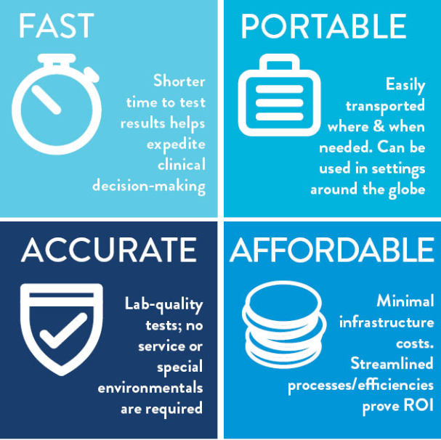
Rapid Testing
Notes:
12:30

Slide 15
Rapid Testing
Notes:
12:30

Slide 17
Closing Remarks with …

Slide 18
Resources
RealXchange
https://realxchange.communitylivingessex.org/
ConnectABILITY
https://connectability.ca/

Slide 19
Connect to Working Group
Mario Longo, Health Services Lead @ Reena
Mlongo@reena.org

