Slide 1
CORONAVIRUS (COVID-19)
What I need to know about COVID-19 and the COVID-19 vaccine

Slide 2
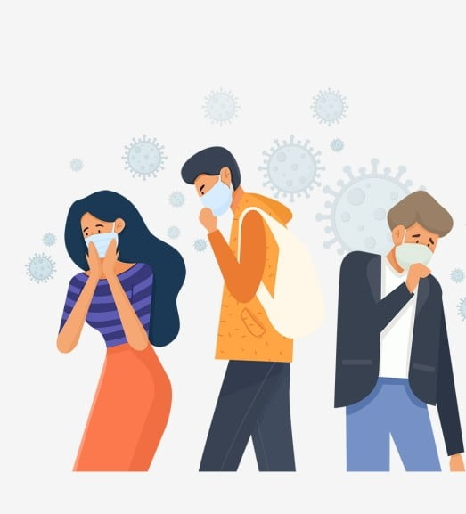
Covid-19 is an infection caused by the coronavirus.
COVID-19 is like a flu or cold virus and spreads when someone who has it coughs, sneezes or talks to another person. The virus spreads easily and quickly!

Slide 3
Scientists have been working hard to make a vaccine that will help protect us from COVID-19.
They have made a COVID-19 vaccine that is available now and everyone around the world is getting it.

Slide 4
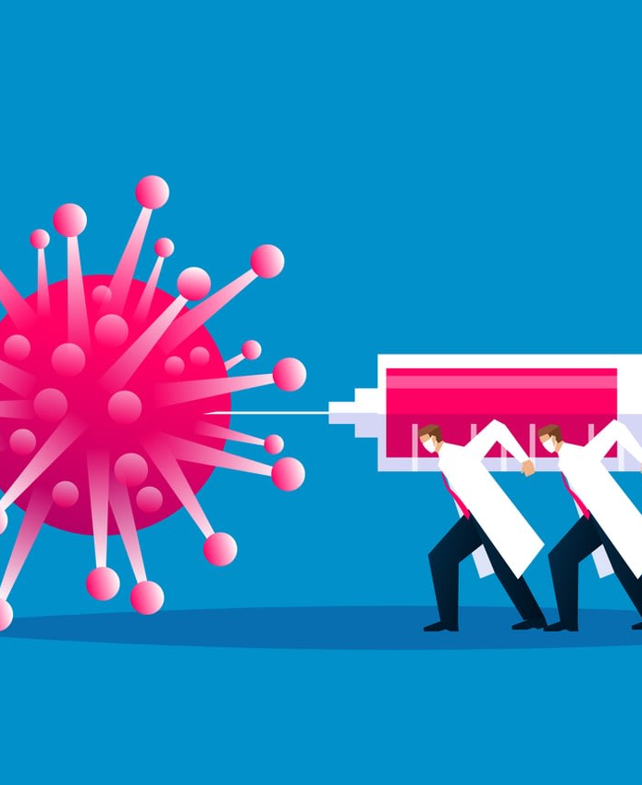
This means that I could be getting the COVID-19 vaccine very soon.
It is important that I get the COVID-19 vaccine to protect myself and other people from getting sick.
Doctors and scientists think less people will get sick from Covid-19 if more people have the vaccine.

Slide 5
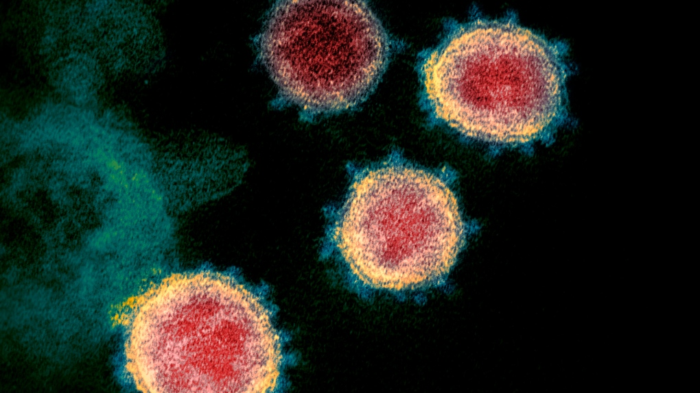
The COVID19 vaccine is like other vaccines I may have gotten before, like the flu shot or a tetanus shot.
It will make my body stronger to fight COVID-19.

Slide 6
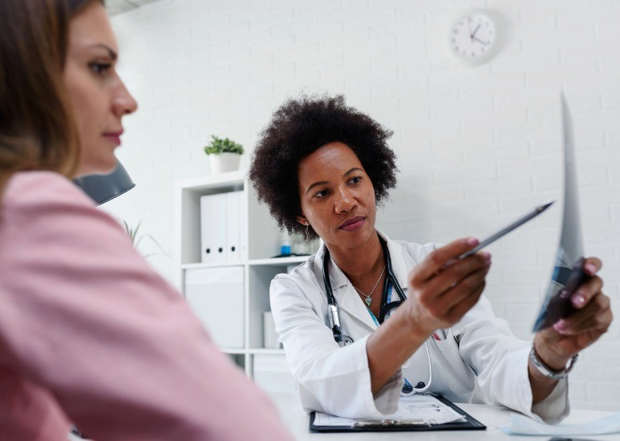
The vaccine is for anyone who could get the virus. This includes people who had the virus before and for people who have not had the virus.
Most people will be able to able to get the vaccine, but there are some people who should not get the vaccine, like
people under the age of 16
those who had an allergic reaction to another vaccine
people who have current Covid-19 symptoms.
If I am unsure if I should get the vaccine, I can talk to my doctor. A caregiver or staff member can help me to do this.

Slide 7
COVID-19 VACCINE
WHAT I NEED TO KNOW BEFORE I GET THE VACCINE
Safety
Side Effects
Allergies
Medication
Who is paying for it
Who will get it first

Slide 8
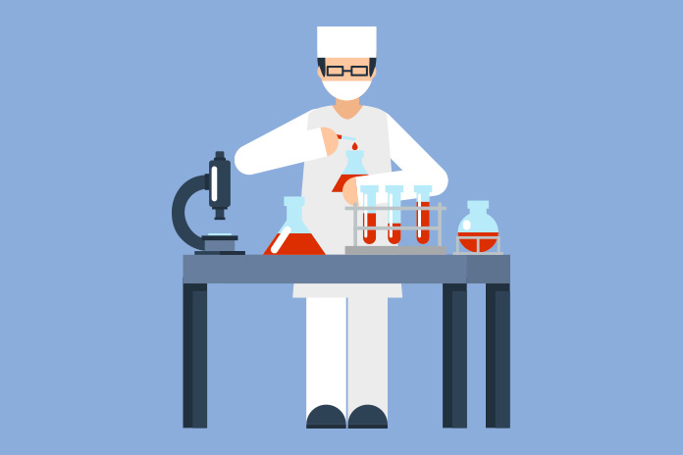
SAFETY
Doctors and scientists have done lots of work to make sure it is safe to use. Before I get the vaccine, I will be asked questions to make sure that it is safe for me.
Few people have serious side effects or allergic reactions.

Slide 9
SIDE EFFECTS
Side effects are not likely, but some of these things can happen.
Hives
Face or mouth gets swollen or puffy
Skin looks pale
Feel like fainting
Fever
Seizure
If you feel any of these side effects in the 3 days after the vaccine, call 911 or tell your caregiver or staff and they will help you.

Slide 10
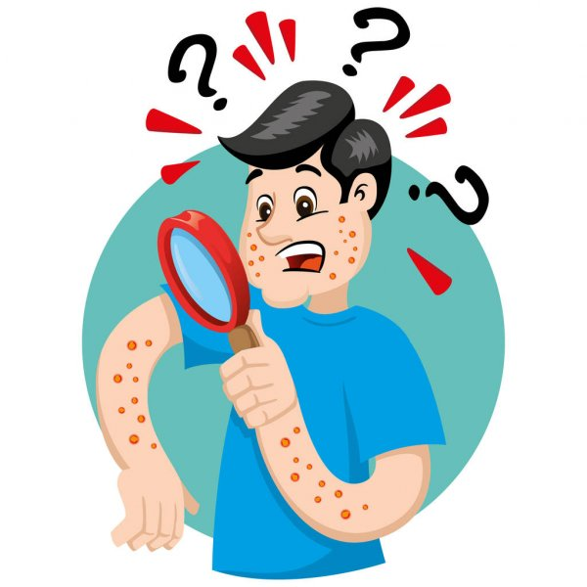
ALLERGIES
Very few people are allergic to vaccines.
The doctors and nurses will watch me closely after giving me the vaccine. They are there to keep me safe.
If I have concerns about an allergic reaction to the vaccine, I can talk to my doctor. My caregiver or staff will help look for signs of side effects and allergies.

Slide 11
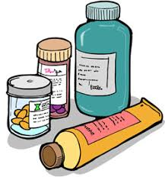
MEDICATION
Most people who take different medications will not have to worry about how their medications mix with the vaccine.
If I have any concerns about my medication and the vaccine, I can talk to my doctor.

Slide 12
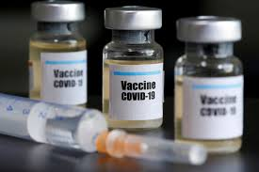
WHO IS PAYING FOR THE VACCINE
The Government of Canada is paying for everyone’s vaccine.
This means that the vaccine is free for me.

Slide 13
WHO WILL GET THE VACCINE FIRST
Some people will get the vaccine before others.
People who are at greater risk from becoming very sick from Covid19 will get it first.
I know my turn will come to get the vaccine very soon.

Slide 14
COVID-19 VACCINE
WHAT I NEED TO KNOW WHEN I GET THE VACCINE
Safety at the appointment
How to prepare
What will happen
What to expect after my vaccine
How many times do I need to get the vaccine

Slide 15
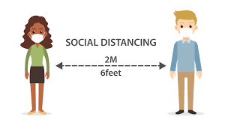
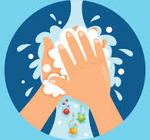
SAFETY AT THE APPOINTMENT
Everyone is being very careful to make sure no one gets COVID-19 when they get their vaccine. Strict safety rules will be in place.
This means when i go for my vaccine, I will need to wear a mask, wash my hands and stay 6 feet away from people in the clinic.

Slide 16
HOW TO PREPARE FOR MY APPOINTMENT
Eat a small snack
Have on a short sleeve t-shirt or sleeves that are easy to roll up
Pack my health card and immunization card and if I need it, an item that makes me feel happy or calm (e.g., iPad to play videos or a stress ball to squeeze)
Wash my hands
Put on my winter clothes and mask

Slide 17
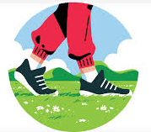
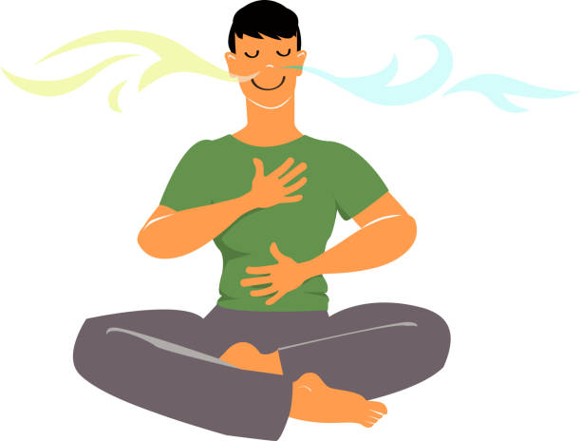
HOW TO PREPARE FOR MY APPOINTMENT
If I am stressed or nervous about my appointment, I can do activities that keep me calm, like:
Deep breathing Listening to music Going for a walk,

Slide 18
WHAT WILL HAPPEN WHEN I GET THE VACCINE?
The doctor/nurse/pharmacist will apply an alcohol swab on my upper arm to clean the area
I will sit still. The needle is put in my upper arm, this will pinch
Once I get the needle, I will wait for 15 minutes in the waiting area. After 15 minutes, I can go home
I did a good job! I am proud of myself. My caregiver/staff will let me know how proud they are of me

Slide 19
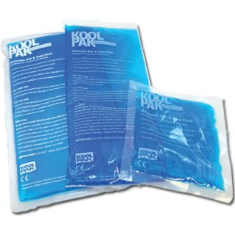
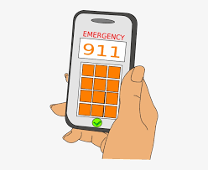
WHAT TO EXPECT AFTER MY VACCINE
When I go home, I can carry on doing my regular routine.
I might have sore muscles, a red spot where the needle went in, or a low fever after I get the vaccine. This is okay and normal! I can use an ice pack to make it feel better.
If I don’t feel well or am worried, I can call the doctor or nurse. They are here to help.
If i am very unwell, I should call 911.

Slide 20
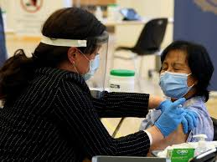
HOW MANY TIMES DO I NEED TO GET THE VACCINE
I will need to get the vaccine 2 times. This means after I get my first vaccine, I will need to get my second vaccine shortly after.

Slide 21
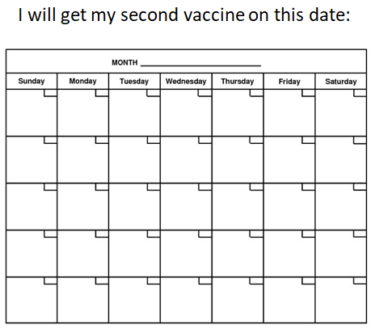
HOW MANY TIMES DO I NEED TO GET THE VACCINE
It is very important that I get my second vaccine to make sure it works.

Slide 22
COVID-19 VACCINE
LIFE AFTER I GET THE VACCINE

Slide 23
Even though the COVID-19 vaccine is here and many people will be getting vaccinated, life will not go back to normal right away.
It is going to take a long time for everyone to get fully vaccinated. This means COVID-19 rules will be around for a while.
After I am vaccinated, I will need to follow all the Covid-19 rules to keep myself and the people around me safe.

Slide 24
To keep safe, I can continue to do things that I have been doing so well, such as social distancing.
This means keeping 2 meters/6 feet distance from others OR the length of 1 pool noodle apart.

Slide 25
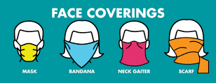
Wearing a mask or face covering that covers my nose and mouth.
This is especially important when it is difficult to physical distance from others, such as going to a medical appointment or in my home.

Slide 26
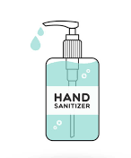
Cleaning my hands often using soap and water or hand-sanitizer (if soap and water is not available).

Slide 27
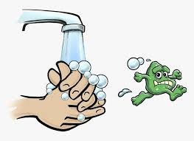
I should wash my hands when:
I come in from outside.
After I have touched a surface or item from outside.
Before i touch my face.
Before i eat.

Slide 28
Staying at home as much as possible
The only times I should be leaving home is for medical appointments, essential goods (like food and medication), or to work.
This means I can connect with my family and friends through phone, video or email.

Slide 29
Learning about the COVID-19 vaccine, might make me feel different emotions.
It is okay to feel this way.

Slide 30
I have people in my life who are here to support me.
If i have questions or need support i can talk to them.

