Slide 1
Education working Group
Laurie Thomas
Dean Johnson
Brian Swainson
Gregory Crunican
Amanda Price

Slide 2
Educational focus Post-survey
Vaccine development and vaccine safety
Focus on those populations who indicated on survey that they are unlikely and very unlikely to receive the vaccine.
Post-vaccination educational material
Building trust
Sources of information
Conversation with trusted resources, more important than the information published.
www.19tozero.ca Are working on communication resources.

Slide 3
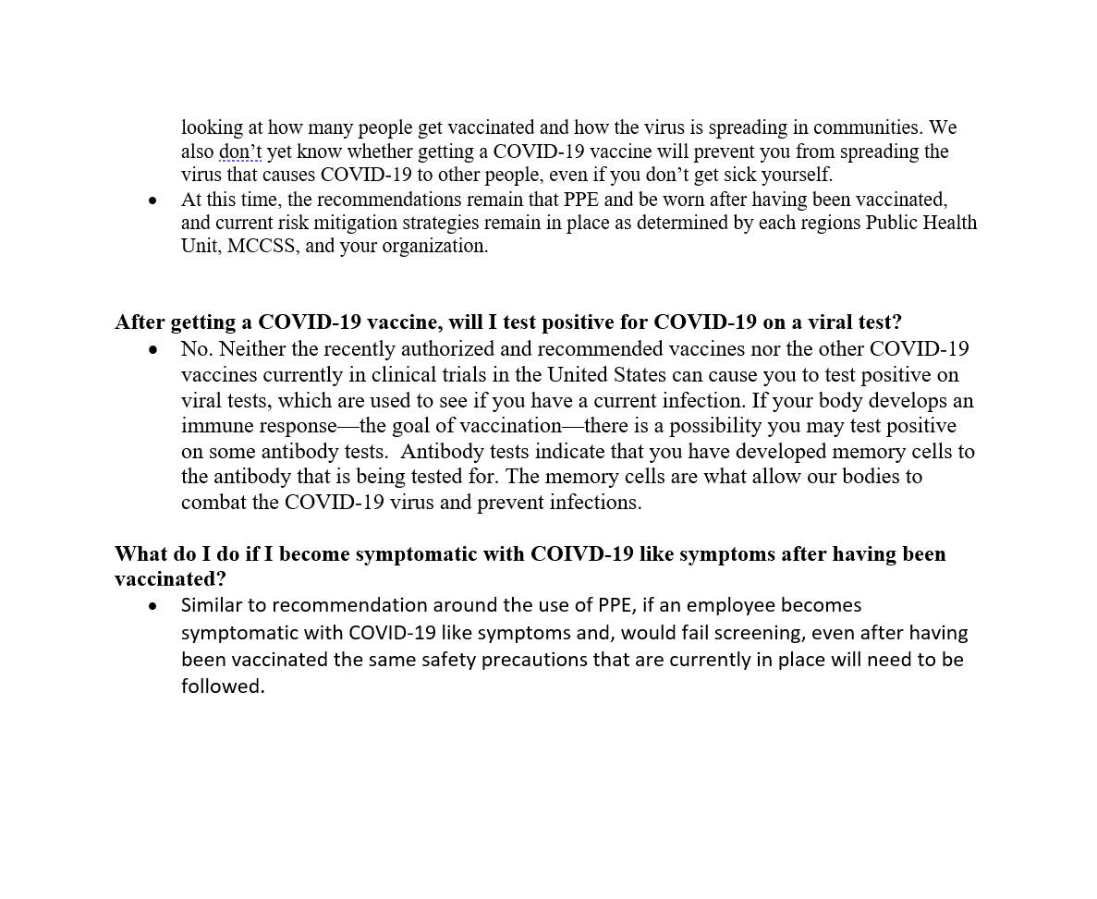
Educational focus Post-survey
I have had the Vaccine.. Now what?

Slide 4
Educational focus Post-survey
Unpack drivers associated with those who do not intend to receive the vaccination.
Increase the understanding and inform through educational resources.
Determine if it makes a difference as to who the messaging comes from (Physician, nurse, employer, trusted colleague, family).
Is having a conversation with a trusted resource equally as valuable as the information published?
Employees have indicate that they still wish to receive information from employer, news and unions to reinforce the messaging. (Who are influencers)?
If one does not receive the vaccine.. What is the risk? (travel, social, and impacts).

Slide 5
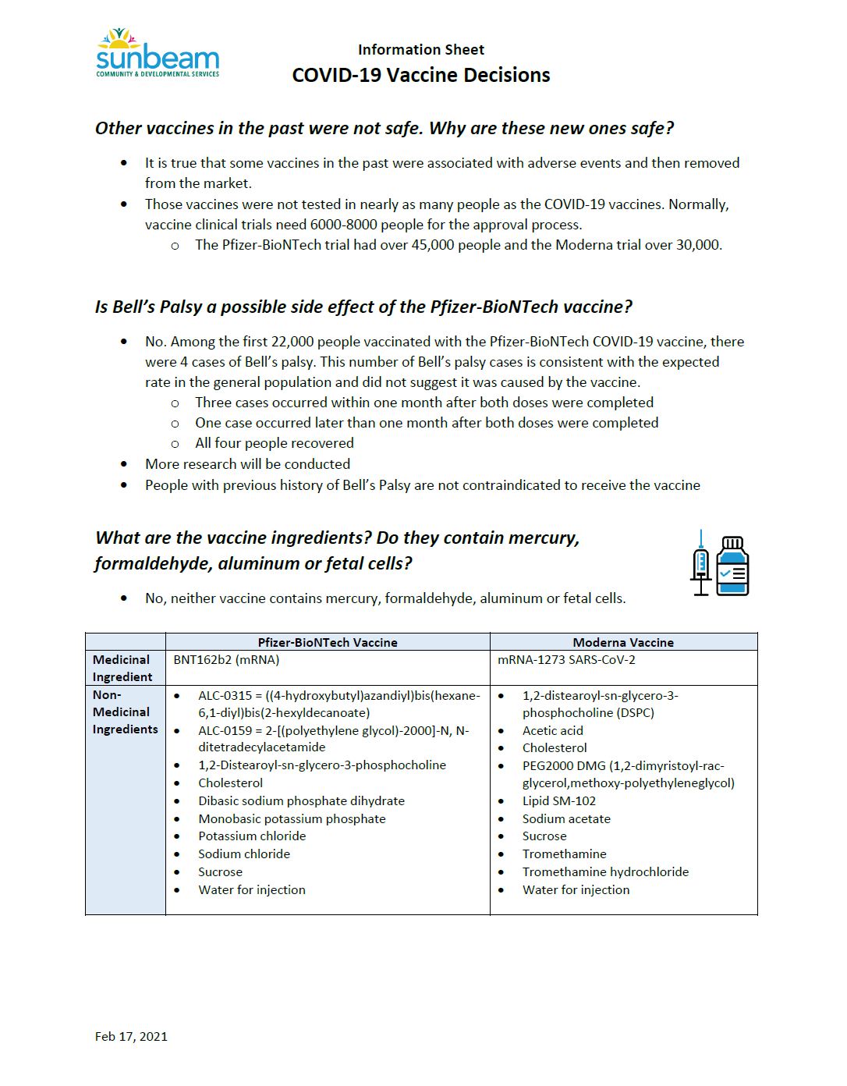

Slide 6
Educational focus Post-survey
Trusted Institutions
Healthcare sector
Employer
Unions
Link: Toronto Star Feedback Post-Vaccine
https://www.thestar.com/news/canada/2021/03/16/they-got-their-covid-19-vaccines-now-in-their-own-languages-they-want-to-tell-you-how-it-felt-and-why-it-matters.html This article includes a wide variety of brief video clips, in many languages, wherein individuals share what motivated them to be vaccinated. Includes some nurses, care workers and others in their own language(s). Perhaps a helpful link to share related to vaccine hesitancy.

Slide 7
Educational focus Post-survey
Vaccine Development Resource

