Slide 1
Core Competencies
Engagement and Buy-In
Mark Benner, from a college perspective
Brenda Van Houtven, from an agency perspective

Slide 2
FACILITATING COMMITMENT TO CORE COMPETENCIES
OUR DSP’S MAY NEED A REMINDER
Core Competencies are all about THEM!
Core Competencies describe the VALUED characteristics of a DSP
Core Competencies specify the UNIQUE characteristics of the role of the DSP
The commonality of Core Competencies will promote CONSISTENCY for them across the sector
Core Competencies enable & facilitate PROFESSIONAL GROWTH & DEVELOPMENT opportunities
Core Competencies promote PROFESSIONALISM of the DSP role
Core Competencies UNITE them in the COMMONALITY of language and values
Core Competencies establish QUALITY CARE & SUPPORT OF PERSONS WITH DISABILITIES

Slide 3
Ideas to build Engagment
To get the ball rolling
Involve all levels of employees
Create champions and/or engage mentors
Share information about how this benefits employees, the people we support and the organization.
Provide comprehensive training
Communicate with posters, flyers, newsletters etc.
Notes:
To get the buy in all levels need to be part of the training and development. Involve people in the process
Either use established mentors or create champions who are keen and want to learn, share and live the competencies. They can be the ring leaders for teams, can help to create promotional materials, games, activities etc. Can become the superusers for the website – help others to engage with the site and complete assessments, can be the mentors for them if appropriate.
We have also linked it with our wellness plans and so for example this January wellness is focussing on setting healthy goals, being mindful and as such we are using the core comps on championing change and innovation and resilience.
Also, use the whats in it for me mentality – why does it benefit the employees, the people we support, the culture of the organization.

Slide 4

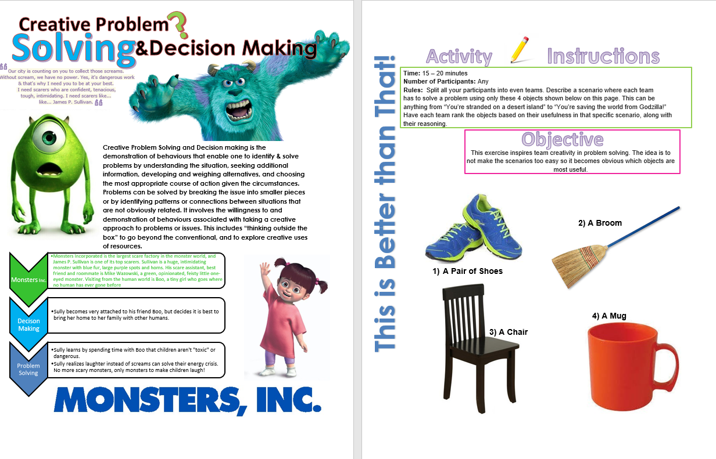
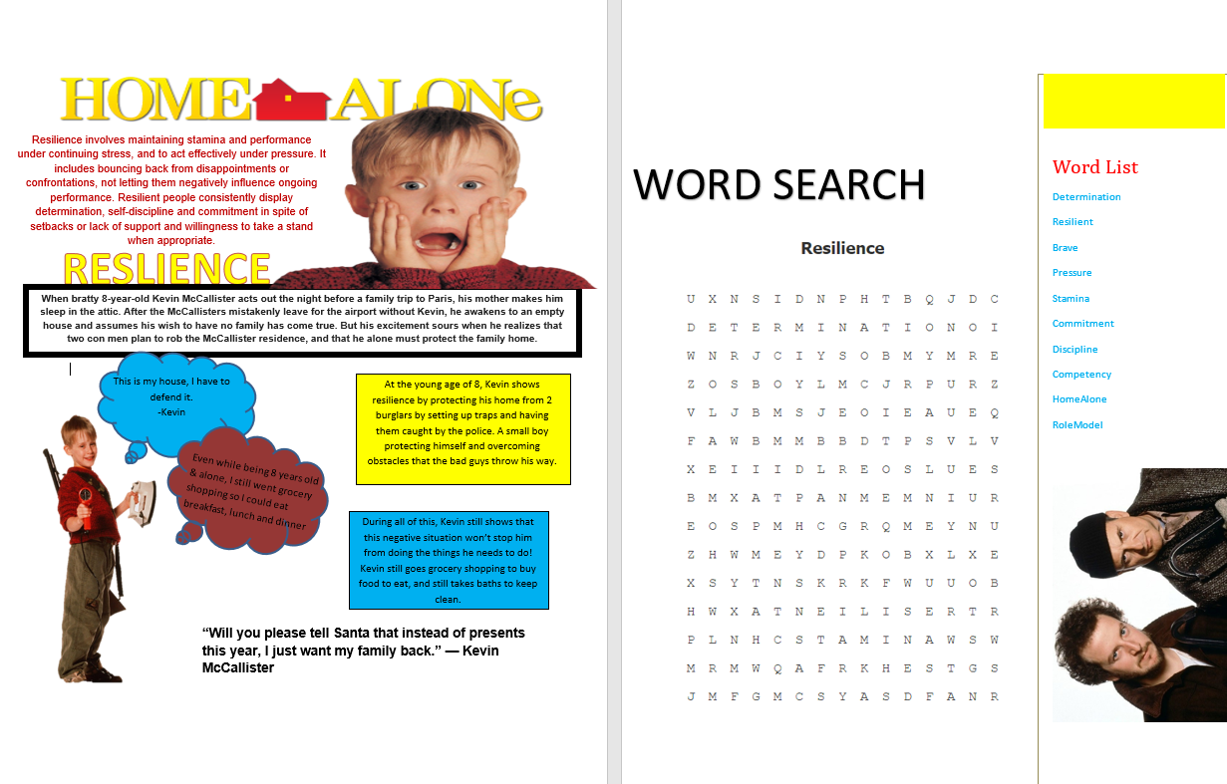
Newsletters and Activities
Make it
Notes:
These are examples from the old competencies – 2014-2017 but just getting a general idea. sometimes the activity is for people to do together and sometimes personal reflection activity.
We are building our modern newsletters right now for a 2024 reveal.

Slide 5
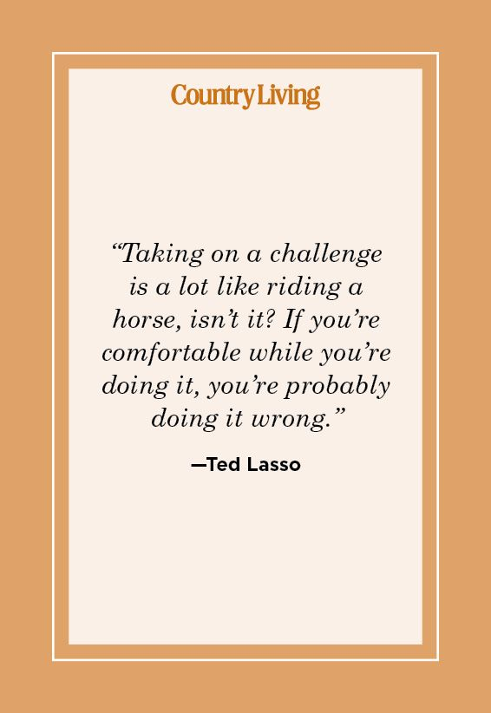
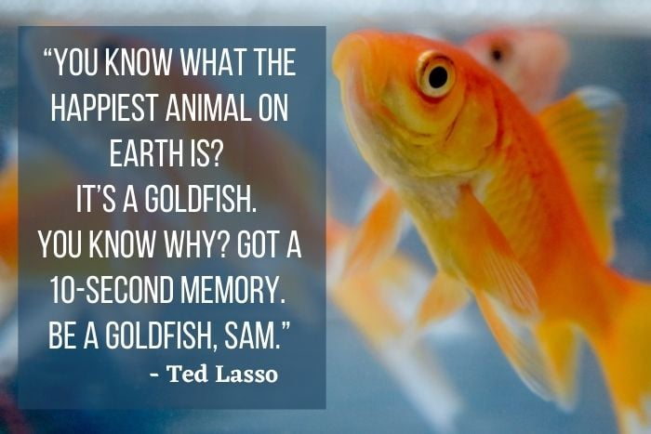
Use pop culture
Resilience, Facilitating Growth and Development
Notes:
These are just a couple of idea but there are thousands of movies and shows and ted talks etc. that showcase these competencies, can use these in your training sessions.
For our training we like to share a video clip or something like that which showcases the competency, then talk about how that makes sense in their role, and then I also like to have some activity that represents it as well for staff to learn, put things in practice and in real situations.

Slide 6
Some fun and engaging examples of contests and challenges
Game of Homes
Cartoon Comic Challenge
What did your job do for you today? Challlenge
Mission Possible
PCL Hunger Games
Notes:
Pull together notes from each one, short story of how it worked.
Game of Homes was each home had to complete a challenge together based on one of the competencies, take it to another home for a stamp and get the next challenge etc. First team to complete all the challenges won a pizza prize. E.g. they created a shield of resilience, to showcase all their support mechanisms to thrive., or they created a video showing how they fostered independence with someone
Cartoon was people provided stories about a co-worker exhibiting a competence and we created a cartoon comic out of them that we shared around to the teams,
We had them think about what their job did for them today as well and collected stories for prizes
Mission possible was another team challenge – each team was given a competency and together with the people they supported had to create something, a poster, a song whatever they decided that represented what that competency meant to the team, and then we awarded prizes to every team that submitted and a larger prize for the most meaningful
Hunger games was each team had to submit a tribute to the capital – this was a mentor and sponsor challenge, with team support and they completed a behaviour based interview together after completing a scavenger hunt activity with the team.

Slide 7
Growth and development
Coaching
Committees
Culture
Mentor Program
Promotion
Wellness Ambassadors
Notes:
Whats in it for me, as mark talked about and relating back to my first slide, this is all about the DSPs, to promote professionalism and create opportunities for growth.
Also to create a culture of inclusion, respect and resilience, that people want to work in a place that shows they are appreciated.
These are just some areas for growth for people things they can engage in for their own continuing development.

