Slide 1
PCL
Introduction to Core Competencies https://www.dscorecomp.com/
Brenda Van Houtven, Amber Alexander & Jikulunu Jorgbo
Notes:
ICE Breaker 5 minutes Would you rather – put up your hands
Have whole year of summer or whole year of winter
Live in a tree house or a cave
Explore space or the ocean
Have a runny nose for rest of life or sneeze three times every hour for rest of life
Be 10 always minutes late or always 20 minute early
Be too hot or too cold
Go fishing or camping or shopping
Drink pepsi or coke
Be batman or spiderman
Go to a beach or go to the mountains
Brenda , welcome

Slide 2

What will we talk about?
What and Why Core Comps
History and Fit with Journey to Belonging
A review of the Core Comps
Examples from the website and real life of how core comps look in your role at each growth level
Website and Resources
Notes:
.
Brenda
So what are core competencies?

Slide 3

What are the Core Competencies
Core Competencies reflect the needs of our workforce by recognizing the professional nature of Developmental Services, recruiting the right people, building leadership capacity and ultimately enhancing the lives of the people we support.
They are the behavioural qualities that you exhibit when you do your job. It is the how, the behaviour
Notes:
Brenda
Build the culture of our workplace and develop our employees
Talent wins games, but teamwork and intelligence win championships – Michael Jordan
Ted Lasso – Nobody is bigger than the team. Every group of people has a unique set of personalities. Always put the team first. There are no superstars, we are all working together , every day to make each other better.
Brenda
A competency is any skill, knowledge,
behaviour or other personal characteristic that
drives superior performance in a job role.
Competencies are what outstanding performers do
more often, in more situations, and with better results
than typical performers

Slide 4
Competencies can be thought of in terms of an iceberg
Necessary for
top performance
but not sufficient; easiest to develop,
but least
differentiating
Knowledge,
Skills and
Abilities
Technical
Competencies
(e.g., Computer skills,
knowledge of first aid)
Personal
Characteristics
Values
Self-image
Traits
Motives
Differentiating behaviours stem from factors below the water line;
tend to drive people’s long-term behaviour and lead to longer-term success
Behavioural
Competencies
(e.g., Caring, creativity, initiative)
Our Focus
Notes:
Brenda
Notes: Performance is driven by a number of factors in people. One of the easiest ways to describe these factors is by using the analogy of an iceberg.
What we see above the waterline are skills and knowledge – the technical competencies. Skills are the things a person knows how to do well e.g. Med administration
Knowledge is what a person knows about a particular are e.g. basic principles of CPI, or specialist in Autism
Skills and knowledge are easy to identify/see, easier to develop, and essential to perform the job. But they rarely predict or drive outstanding performance. They are often what one can see and read on a resume.
Below the waterline are the other factors related to performance – the key drivers of behaviour/performance.
They are not readily apparent and harder to see in someone; however they are critically important as they tend to drive people’s long term behaviour and, thus their long term performance.
They help determine whether someone is well matched with his or her job role, the better the match the more effective and satisfied a person will be in carrying out what the job or role requires.
In addition, competencies can be developed.

Slide 5
History and connection to J2B
The Developmental Services Workforce Initiative was formed with the focus to address one aspect of Journey to Belonging: Choice and Inclusion, namely, Planning for a Skilled Workforce. This part of the plan is about supporting a skilled, diverse and professional workforce that will help people participate meaningfully in their communities and live good lives.
Notes:
Brenda
In 2008 the Developmental Services Human Resource Strategy (DSHRS) was launched, as a partnership between the Ministry of Community and Social Services (MCSS) and the Provincial Network on Developmental Services (PNDS). It was initiated with a vision to professionalize the sector and ensure the best quality supports for people with developmental disabilities in Ontario.
The provincial implementation of these Core Competencies was an important and critical key driver for all aspects of DSHRS and laid the foundation for strengthening human resource development, recruitment and retention practices for the sector.
The Competency model focused on Behavioural (Core) Competencies and not technical competencies, concentrating on the behaviours that drive superior job performance – the core competencies – of highly effective people in these job roles.
Since the launch of the Core Competencies the competencies continue to be used within agencies and taught as part of the DSW program in Colleges.
In 2021 the Ministry of Children and Community Social Services released Journey to Belonging: Choice and Inclusion, a long-term vision for Ontario’s Developmental Services. A key pillar of this vision is to focus on launching a strategy that will support a skilled, diverse and professional workforce to help people participate meaningfully in their communities and live good lives. Integral to this is ensuring that the strategy recognizes that an employer is not just an agency, but can also be a family, individual or other support group, aligning with the person-directed focus of Journey to Belonging. To do this, the MCCSS partnered with the Provincial Network on Developmental Services to launch the Developmental Services Workforce Initiative Committee (DSWIC), and develop a long-term workforce strategy so that people and their families have access to high-quality support staff.
Building on the work of the DS HR Strategy, DSWIC’s focus is on the following areas:
Modernize the Developmental Services Core Competencies that reflect next generation expectations (e.g., individualized supports; skilled practitioners in other key sector(s))

Slide 6
Building Relationships
Knowing people matters. Establishing relationships builds trust and trust is the foundation for all good relationships.
Intentionally collaborating to develop meaningful relationships with people supported, co-workers, families, community partners and others. It is about seeking opportunities to create collaborative partnerships to meet mutual goals.
Emerging – Establishes positive relationships
Evolving – growing collaborative relationships
Leading – builds networks
Influencing – creates social capital for greater good.
Notes:
Brenda
Emerging
Shares information, expertise and insight with team members about actions or proposed changes that will affect them. Uses ethical judgement about sharing information with others
Assumes personal responsibility to do their share of the work and follows through in a timely manner on inquiries, requests and concerns from individuals, their families, community partners and others
Identifies the strength of key individual relationships and improves them in their immediate environment
Maintains clear and timely communication with individuals and families, seeks continual feedback about service experience and shares helpful information and person directed goals
Shares information, expertise and insight with team members about actions or proposed changes that will affect them. Uses ethical judgement about sharing information with others
Treats other team members with respect, and listens with an open mind to others’ points of view
Evolving
Engages others in dialogue about the importance of relationship building to foster reflection and growth in self and others
Able to maintain current and established relationships that benefits the person receiving services, their family, the organization and the community
Demonstrates commitment to initiatives by actively contributing to the efforts of a team and by recognizing the contributions of others
Engages others in dialogue about the importance of relationship building to foster reflection and growth in self and others
Appreciates the value that diversity and people’s lived experiences, contributes to a relationship
Identifies the strength of key individual relationships and improves them in their immediate environment
Encourages people to continue their efforts through support and feedback when they become discouraged
Actively finds ways to build positive, friendly, inclusive, diverse and cooperative relationships that will lead to new community involvement opportunities
Leading
Seeks to creatively build on and develop new relationships beyond their current sphere that would benefit people receiving supports, families, other staff, and the workplace to address immediate and future needs as an agent of change
Recognizes where strengths lie within and across resources and taps into their expertise; makes best use of people’s talents to achieve superior services/results
Influencing
Uses strategic planning processes to create new opportunities and build on existing relationships as a driver of positive change and transformation

Slide 7
Building Relationships
Choose one question to answer when the bean bag comes to you
1.What is your favourite TV show, book or movie
2.Where was the last place you went on Vacation
3.What do you like to do for fun
4.Where is your favourite place to eat
5.What is your favourite sport to play or watch
Notes:
Brenda
Question ball activity
10 minutes throw the ball around.
The question ball
Another simple team activity that allows employees to let their guard down and have some fun. You only need a medium-sized beach ball, a marker, and some motivated team members to play this game.
Take the marker and write ten questions on the beach ball. Gather your team into a circle and kick things off by passing the ball to an employee. Whoever catches the ball must answer the question closest to their right thumb.
Sample questions that will help employees get to know each other on a more personal level include:
What is your favorite TV show/movie/book/author?
Where was the last place you went on vacation?
What do you like to do for fun?
Where is your favorite place to eat?
https://teambuilding.com/blog/relationship-building

Slide 8
Value ALL Opinions (even if they’re wrong)
Listening and Respect
Maintain Eye Contact
Be relaxed
Don’t Jump to Conclusions
Focus on the words being said
Do not interrupt
Default to the golden rule
Notes:
Brenda
While it’s not advisable to flat out tell people their opinions are wrong (even if or especially if you’re the boss), it is solid advice to value every person’s opinion at work. Why? It boils down to respect.
Respect and Opinions at Work
According to Harvard Business Review, workers value feeling respected at work. In fact a whopping 20,000 survey respondents report respect as the most important value at work.
When you value all opinions (even those you don’t agree with), you are extending respect to your colleagues. It’s really that simple
So, how exactly do you value someone’s opinion whether or not you agree with them? You can check out career-related TED Talks for ways to listen better or simply follow these simple tips to effective listening provided by Forbes:
How to Value Work Opinions through Listening
Maintain eye contact – This is the basic ingredient to show someone you value what they’re saying. Always turn to face the person speaking and put down your phone, papers, or anything else that is a distraction.
Be relaxed – Eye contact is great, but you don’t have to stare the person down. A too intense stare can be intimidating. Similarly, tense posture like furrowing your brow or folding your arms can also tell the speaker you’re disinterested in what they’re saying.
Don’t jump to conclusions – When someone speaks to you they are verbally expressing thoughts and opinions that matter to them. Them. Not you. Allow them to get out these opinions fully before you interject or attempt to finish their sentence.
Focus on the words being said – Active listening is important. But too often we are focused on topics outside of what the person is actually saying or simply staying quiet until it’s “our turn” to speak. If you have a hard time fully zoning in to what’s being said try to focus on key phrases. You can even visualize the conversation using mental pictures. This will keep you from rehearsing your response in your head. Remember, you can’t listen and rehearse at the same time.
Do not interrupt – This is a big one. No matter how much you disagree or limited your attention span may be, do not interrupt the person speaking. Period. When you do it always sends the wrong message like:
I’m more important.
Your opinion doesn’t matter.
This is a contest, and I’m going to win.
I don’t care what you think.
There’s never a justifiable excuse for interrupting someone (unless there’s a fire or a giant spider is dropping from the ceiling about to land on their head).
Default to the Golden Rule
If all else fails, remember the golden rule: Treat others how you want to be treated. Think about how you expect to be received when addressing someone. You want your opinion to be valued (even if it’s wrong!).

Slide 9

Advocacy
The desire and determination to champion a cause or issue and try to get others to support it. It recognizes the importance of amplifying the voices of the person/family and creating space for them to advocate on their own behalf
Emerging – Recognizing when advocacy needs to happen
Evolving – takes action to advocate
Leading – Strategizes and Adapts to Audience
Influencing – uses complex influence strategies for collective advocacy
Notes:
Jikulunu
Emerging
Recognizes that one is not speaking for a person but amplifying their thoughts, preferences and choices
Identifies factors that may impact the person
Understands the barriers/opportunities for the person or group
Recognizes the significance of personal experiences, values, cultural diversity, and inclusion
Shows sensitivity to time, issue, place and role
Takes appropriate steps and opportunities to advocate
Communicates through facts, data and examples to convince
Recognizes that one is not speaking for a person but amplifying their thoughts, preferences and choices
Evolving
Uses a person directed approach to develop a plan of action, including potential outcomes with individual/family/team
Understands the decision-making process and identifies the key decision makers
Communicates facts in response to understanding different views
Uses a person directed approach to develop a plan of action, including potential outcomes with individual/family/team
Reflects/evaluates the effectiveness of advocacy and adjusts approach
Considers impact of actions or words, anticipating and preparing for response
Supports individuals and families to advocate for themselves and others
Effectively questions existing practices and offers opportunities for new ideas
Leading
Adapts a communication strategy based on the audience and when applicable, uses trauma informed practices
Anticipates and prepares for others’ reactions
Influencing
Builds partnerships and alliances to promote advocacy efforts within various internal and external systems and broader society

Slide 10

Example of Advocacy
A supported person has a physician’s appointment. Before the appointment, you sit and create flash cards or MagnusCard for the person to communicate with their physician. At the appointment, you direct the physician to ask questions directly to the person supported. You encourage the person to use their resources to communicate back. You support and reiterate their statements when needed.
Notes:
Jikulunu
Meaning you can help clarify what they are saying, you are teaching this person to speak up for themselves and also teaching the doctor to respect and value the person with a disability.

Slide 11

Inclusive Leadership
About organizing people and processes towards accomplishing a goal through coaching, mentoring, and motivating others. Effective leaders foster an inclusive and positive environment.
Emerging – Authentic Leader
Evolving – Participatory Leader
Leading – Inspirational Leader
Influencing – Transformational Leader
Notes:
Jikulunu
Emerging
Takes every opportunity to integrate an organization’s core values into all communication and action
Is self aware of own leadership style and values
Shows awareness of, and commitment to fundamental values and goals for the profession
Provides clear direction
Encourages ideas and contributions from others
Is aware when mistakes are made and takes personal responsibility to correct them
Ensures consistency between words and actions
Genuinely cares about people, which is made abundantly clear in their leadership style
Uses a person-centered approach in the provision of services, and respects and facilitates self-determination, supports informed decision making
Demonstrates evidence of character traits such as honesty, transparency, fairness, and respect
Shows tact, sensitivity to personal/professional boundaries and to personal differences
Evolving
Acts in support of an open and safe workplace atmosphere in which everyone feels encouraged to safely raise, discuss, and address ethical issues
Seeks full understanding of facts and interests of all concerned when confronted with ethical issues and dilemmas and reflects upon all options in search of optimum solutions (ethical judgement)
Seeks input of others and values differing views
Actively facilitates the resolution of conflict
Establishes group norms
Fosters belonging and promotes diversity in team makeup
Celebrates accomplishments
Is an effective coach by providing specific feedback
Leading
Effectively resources the team by identifying and accessing opportunities
Questions and challenges the discrepancies and practices that do not align with the professional ethics of the workplace
Influencing
Champions a vision and leads others to buy into their mission, goals, strategy, and priorities, creating the optimum climate for achievement

Slide 12
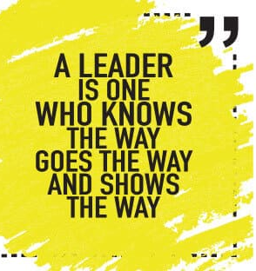
Example of Inclusive leadership.
https://youtu.be/HVjA4YgiOGU?si=LiCY7YILgr-DewpV
Include a brainstorming session in a staff meeting to allow each team member to give their input on how best to support an individual with challenging behavior. Use the “Yes and” model to expand on and include all ideas.
Notes:
Jikulunu
Video 56 seconds

Slide 13
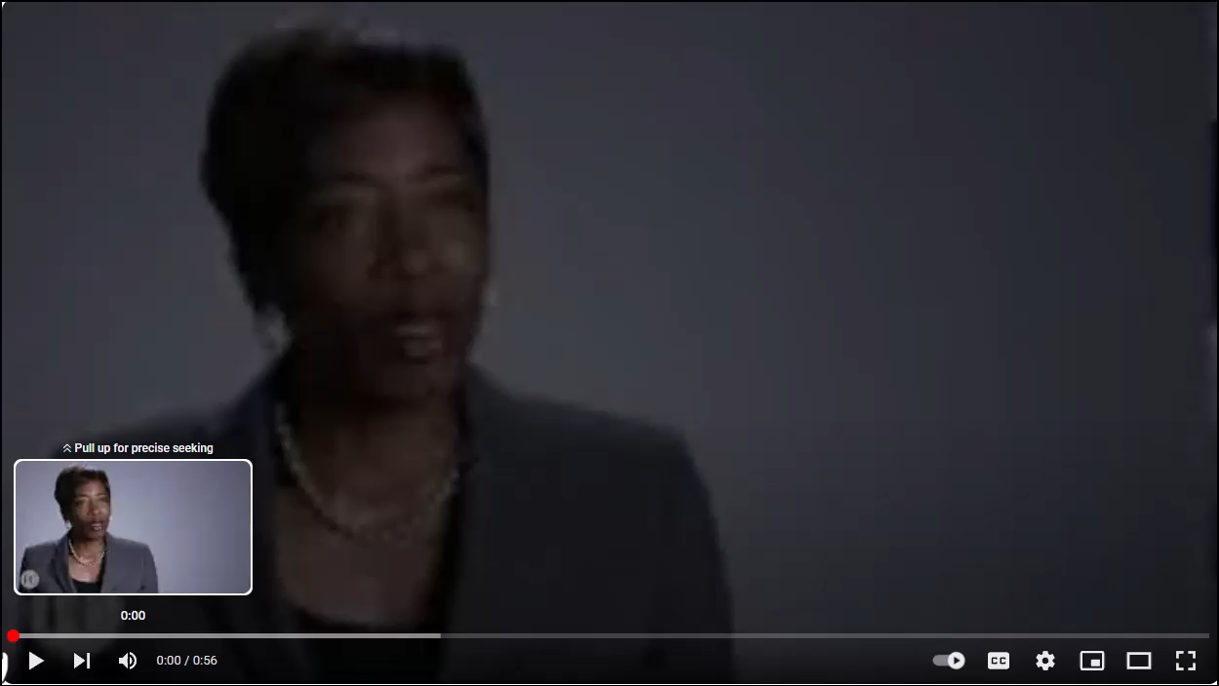
Example of Inclusive leadership.
Notes:
Jikulunu
Video 56 seconds

Slide 14

Nobody is bigger than the team. Every group of people has a unique set of personalities. Always put the team first. There are no superstars, we are all working together, every day to make each other better.
Ted Lasso

Slide 15

Valuing Equity, Diversity and Inclusion
Uses social competence to understand and respect the practices, customs and values or all people and cultures. It is the ability to work effectively with a diverse community and be aware of current societal issues. It involves evaluating social situations and determining what is expected or required to recognize the feeling, intention and lived experiences of others.
Emerging – Values and respects all people
Evolving – Contributes to create a safe space for everyone
Leading – Creates a sense of belonging for everyone
Influencing – Change agent for equity, diversity and inclusion
Notes:
Jikulunu
Emerging
Understands and respects differences in culture, working style and priorities, and tailors approach to deal with an issue/situation accordingly
Shows awareness of their own body language, tone of voice and facial expressions
Articulates one’s own ideas and needs for others
Responds to concerns by altering one’s own behaviour in a helpful, “responsive” manner
Is aware of their own culture and value differences
Examines one’s own unconscious bias and assumptions in language and stereotypical responses
Practices behaviors that reflect an understanding and appreciation of diversity
Shows understanding of people’s experience of personal trauma and develops coping strategies for self
Values diversity and seeks out opportunities to gain new knowledge through relationships with people who are different from oneself
Evolving
Creates an atmosphere of valuing and accepting others. Actively and intentionally engages with diverse groups, where each person is valued and provided with the opportunity to participate fully in creating a successful and thriving community
Takes responsibility for actions and seeks to understand diverse points of view
Produces good results when working with others by displaying tact, cooperation, sensitivity and respect for the opinions and situations of others and their culture
Recognizes potential experiences of trauma in others and adopts trauma informed practices
Practices allyship with individuals who are different from themselves and adapts behaviour to support others
Values the involvement of those who have a broad base of experience and backgrounds
Creates an atmosphere of valuing and accepting others. Actively and intentionally engages with diverse groups, where each person is valued and provided with the opportunity to participate fully in creating a successful and thriving community
Demonstrates an open mindset and deep curiosity about others, listens without judgment, and with empathy, seeks to understand those around them
Leading
Takes a careful read of the atmosphere to accurately anticipate how individuals and groups will react, and tailors approach accordingly, pushing forward or holding back, as necessary
Builds cohesion among the team to feel a sense of belonging by sincerely caring for what people are experiencing and acts accordingly
Influencing
Influences decision makers in support of policies and practices that enhance diversity, equity and inclusion

Slide 16
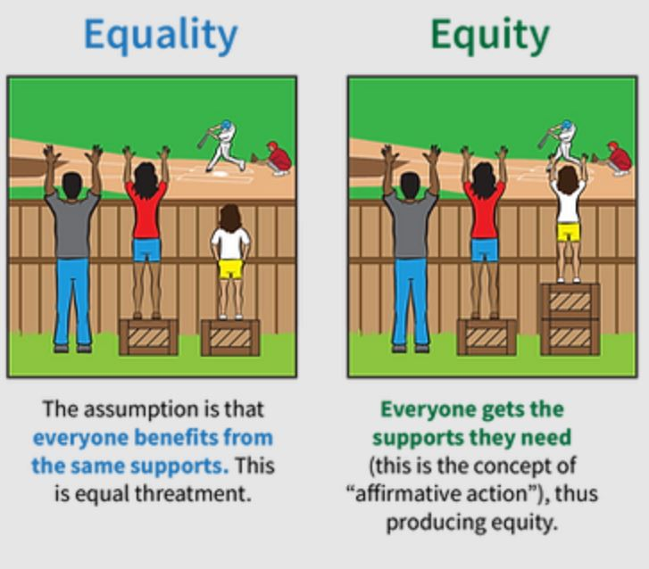
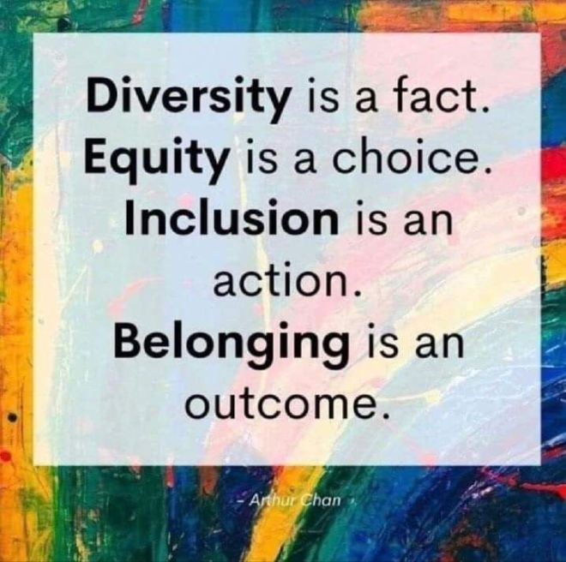
Examples of VEDI
Notes:
Jikulunu

Slide 17
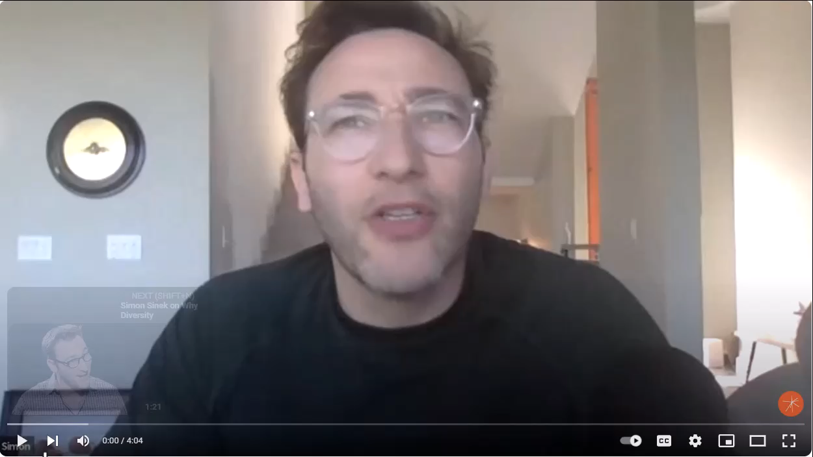
Examples of VEDI
https://www.youtube.com/watch?v=R55OXlC2f2w
Notes:
Jikulunu

Slide 18

Examples of VEDI
Notes:
Jikulunu

Slide 19
Championing Change and Innovation
Being flexible and adaptable to changing environments to work effectively with various people and groups. It involves and open mindset to understand, appreciate and empathize with different and opposing perspectives. Is about having a clear vision for change and communicating this in a way that all people are included and understand what the change means to them.
Emerging – Accepts the need to be flexible
Evolving – Adapts and adjusts the approach
Leading – Gets buy in for change
Influencing – Changes the direction
Notes:
Amber
Emerging
Uses a person directed approach that is responsive to the needs and preferences of the person
Uses a person directed approach that is responsive to the needs and preferences of the person
Sees change as an opportunity and demonstrates a willingness to modify ideas or perceptions based on new information or contrary evidence
Adjusts behaviour to meet changing demands by choosing to not let things affect them when they do not go as planned
Prioritizes responsibilities and responds to immediate needs while reorganizing timelines for less urgent situations
Temporarily alters normal procedures or guidelines to fit a specific situation to get a task done and/or meet goals (within acceptable boundaries)
Supports change initiatives by following new directions in a positive manner and providing appropriate information
Asks for feedback and ideas, and tries new approaches
Evolving
Acts as a role model in promoting positive attitudes and is able to coach and lead others in being adaptable
Revises plans as necessary and considers other people’s concerns during change
Collaborates with others for creative options when change is needed, encouraging them to be adaptable as well
Recognizes how change affects people uniquely, and tailors the message appropriately
Acts as a role model in promoting positive attitudes and is able to coach and lead others in being adaptable
Explains how change will impact current processes or structures, and reinforces the link to overall values and goals in order to build momentum toward change
Leading
Uses the opportunity as a driver of positive change and translates the vision into specific and practical goals
Influencing
Creates an environment that embraces change, reinforcing the reason for the change by linking it to the overall vision, inspiring others to become champions for the needed change

Slide 20
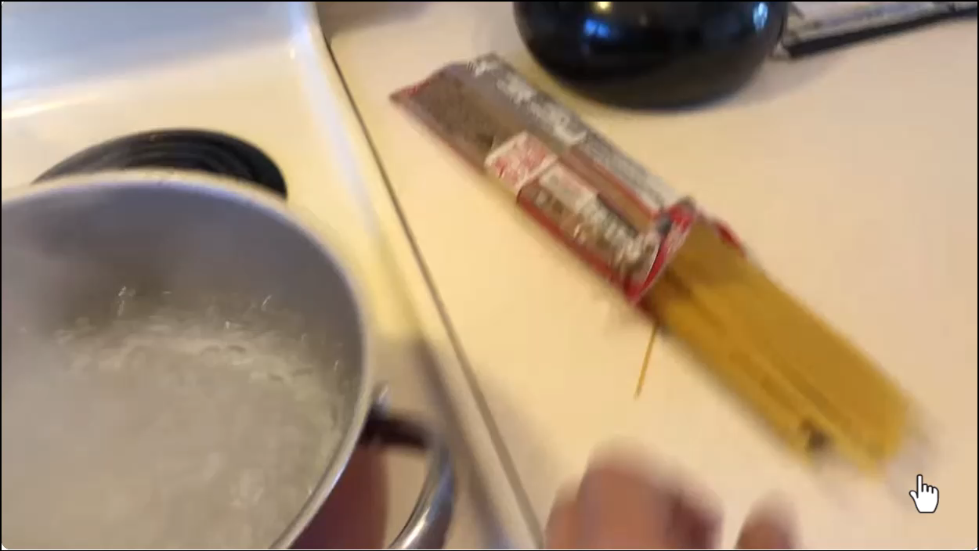
Championing Change and Innovation
Notes:
Amber
Superpower video is 1 min 30 secs
Do the handwriting exercise to show people how changes impacts

Slide 21
Get out of your comfort zone
8. Index cards
How to play:
Divide into teams of three to five people, and give each team 25 index cards and a roll of tape. Set a five-minute timer and ask the groups to construct the tallest tower they can with their materials. Measure which team had the highest tower, then ask them to destroy their towers.
Give each team 25 more index cards and ask them to build another tower in five minutes — this time with no tape. Measure the new towers again.
Why it's useful: Participants learn that challenges stemming from change can be mitigated through creative teamwork and support.
Notes:
Amber
It’s pretty easy to fall into a work rut. You show up. Complete tasks. Clock out. Do it again. You rinse and repeat this for weeks, months, and even years. This complacency can seem safe but it’s also an invite for disaster.
Complacency leads you to feel a little too secure at work which can lead to laziness. Often, you don’t even realize you’re cutting corners or not putting in as much effort as you once did. But everyone else around you does.
Still, we often try to avoid challenges because we don’t want to feel vulnerable but that’s exactly how you’re supposed to feel.
As Ted Lasso says, “Takin’ on a challenge is a lot like ridin’ a horse. If you’re comfortable while you’re doin’ it, you’re probably doin’ it wrong.”
Challenges are supposed to be, well, challenging. If you take on assignments at work and everything feels like a breeze, it’s time to check in with yourself.
Signs You May Be in Need of a New Work Challenge
Forbes suggests looking out for these warning signs of complacency at work:
Being disengaged
Lack of initiative
Not investing in yourself
Taking shortcuts
No more passion
Disgruntled with career trajectory
No hope for a brighter future
We all lose a little pep in our step every so often. It’s part of being human. But if you repeatedly find yourself going through the motions at work, it might be time for a change. And this doesn’t necessarily mean a brand new job (although sometimes a career change is a definite must). You can reignite your spark at work with a new and exciting challenge. Run a meeting. Take on a project. Enroll in an employer-sponsored course. Assist coworkers in different departments. Go after a promotion.
SMART Goals for Challenge and Growth
Complacency is convenient. Change is hard. It’s easiest to opt for the bare minimum to get by but you won’t do yourself any favors in the long run. Ultimately, your career will stall as your engagement declines along with your happiness. So, commit to change regularly. This doesn’t have to be a giant change.
Think about small steps you can take to make a big change in the long run. Start with a SMART goal and then break it down into smaller action steps. Goals are supposed to be challenging and a bit of a stretch. But they’re also a lesson in resilience. You will certainly hit obstacles. That’s okay. It’s how you respond to and overcome those obstacles that counts.
Remember, you know your goal is a challenge if you’re slightly uncomfortable (just like riding a horse for the first time).
Positive Work Quotes by Ted Lasso
A little positivity can go a long way in well being at work. Take it from Ted Lasso who lives by the simple mantra “believe.” When things are bad, Ted “believes” they will eventually get better. If players (coworkers) don’t get along, Ted “believes” there’s always a way to work it out. And when you’re the new guy in town with everyone rooting against you, Ted still believes he can work hard to win everyone over — on and off the field (or pitch as it’s called over there).
Often, workplace dissatisfaction can be traced back to you. Sure, some companies have crappy cultures (and in these cases I recommend you run away as fast as you can to find a new job) but more often than not it’s our own take on things that hampers our professional progress.

Slide 22
Facilitating Growth and Development
Facilitating self-directed growth and development. If fosters self-determination and independence. It intentionally support the long term learning or development of others through coaching, recognition , encouragement and feedback.
Emerging – Provides encouragement and shares knowledge with others
Evolving – Creates learning opportunities for others
Leading – Coaches others and provides advice relative to development
Influencing – Champions a supportive learning environment
Notes:
Amber
Emerging
Provides direction or advice on how to continuously learn and improve in a way that is responsive to different learning styles
Expresses positive expectations of others in terms of their potential (e.g., individuals, team members, families)
Shows respect for others’ capabilities and their lived experience
Identifies or suggests activities that could help others develop new skills
Credits others who have performed well to motivate continued growth
Supports the person to be self-sufficient to make decisions or complete tasks in their own way, including the opportunity to make and learn from mistakes
Shares expertise and knowledge with others
Able to identify areas that require support
Supports others by demonstrating with an intention to teach
Evolving
Advocates for opportunities for skill development in various contexts that promote social inclusion
Collaborates to encourage independence of skill-building and/or decision-making
Asks questions to assess level of understanding
Recognizes the potential “want and need” development opportunities and seeks resources when needed
Gives directions or demonstrations using reasons or rationale as a training strategy
Encourages and supports independent thinking and ownership in self development
Recognizes the strengths of others and actively promotes and supports professional growth and development
Leading
Creates a positive and safe learning environment where people are learning from their experiences
Influencing
Identifies the need for, and Implements structures, succession-planning mechanisms, and processes that promote development in line with the organization’s goals

Slide 23

Facilitating Growth and Development
Notes:
Amber
Video: 2 mins 9 secs
As a leader it is your responsibility to decipher what type of mindset your employees are exhibiting. This way you can be better prepared for how you will want to proceed in helping them grow and develop. Carol Dweck the Stanford psychologist has many ted talks and resources to further assist you in this area.

Slide 24


Notes:
Break – 10 minutes

Slide 25
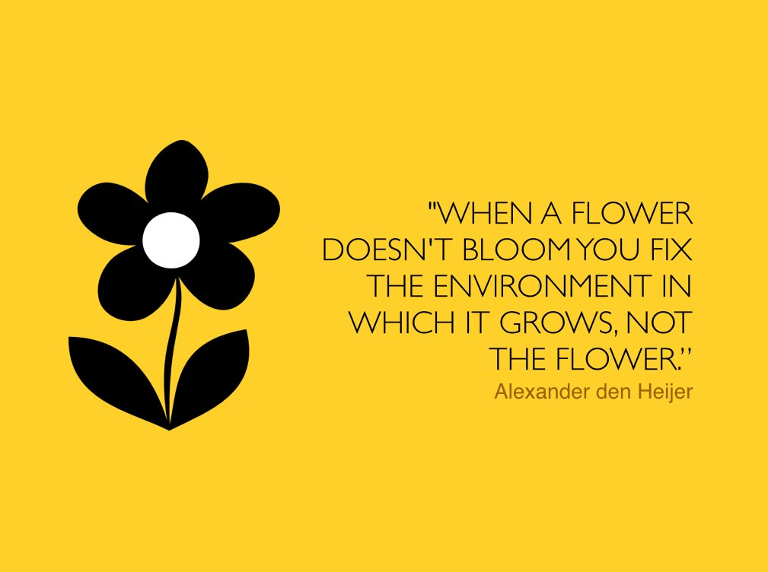
Problem Solving and Decision Making
The demonstration of behaviours that enable one to identify and solve problems by understanding the situation, seeking additional information, developing and weighing alternatives, and choosing the most appropriate course of action.
Emerging – Uses an experience-based approach to problem solving and decision making
Evolving – Is open to new ideas/solutions
Leading – Solves complex challenges
Influencing – Drives solutions for multi-layered challenges
Notes:
Amber
Emerging
Evaluates potential solutions and decide on a solution
Uses a person directed approach to problem solving and decision making
Uses knowledge and/or experience to understand, evaluate and solve problems/issues
Identifies and defines problems
Considers both common and possible solutions (e.g., “if this, then that” thinking)
Breaks problems down into simple lists, activities, or tasks, without assigning values or priorities
Evaluates potential solutions
Decides on a solution
Acts on the solution and evaluates the outcome
Evolving
Identifies options to solve a problem and considers the impact of decisions
Is open minded when presented with new perspectives from families, person supported and others
Applies new information to work through problems and situations
Recognizes when a situation calls for, or can be improved by an approach different from the usual
Identifies discrepancies, trends, and patterns
Applies past successful approaches to new situations
Uses expertise of team members and generates multiple alternative solutions
Leading
Gathers information and uses evidence based and/or best practices to assess possible solutions and outcomes
Evaluates the benefits and risks to make informed decisions
Influencing
Proactively identifies multi layered challenges and drives towards positive change across multiple systems

Slide 26

Problem Solving and Decision Making
Notes:
Amber

Slide 27
Strategic Thinking
Requires initiative, which is the ability to independently decide what to do and when to do it without relying on someone else’s direction. Proactively anticipate future opportunities and challenges while ensuring a person directed approach.
Emerging – Takes initiative to respond to problems and opportunities
Evolving – Thinks ahead and plans
Leading – Promotes strategic direction
Influencing – Develops a vision
Notes:
Amber
Emerging
Uses knowledge and/or experience to identify, define, understand, evaluate and solve problems/issues
Recognizes and acts independently while considering the impact on others
Goes beyond normal expectations
Takes responsibility for their own actions and inactions and seeks to improve
Considers the appropriate timeframe of action
Seeks opportunities to support/implement person directed plans
Voluntarily takes the first steps to address immediate obstacles/challenges and take advantage of opportunities
Understands when to independently initiate a solution, or when to involve others
Evolving
Recognizes when a situation calls for, or can be improved by an approach different from the usual or applies past successful approaches to new situations
Uses professional judgement to decide/act when the situation demands a quick response, while using a person directed approach
Communicates and interprets the vision and goals to others within the scope of responsibility
Identifies who can provide support and asks for input/help as appropriate
Demonstrates time management with effective prioritization and follows up on progress to ensure task completion
Identifies potential future directions for the work area
Monitors their work and that of the team to ensure alignment with vision and values, and current/future trends in services and supports
Leading
Gathers information and uses evidence based and/or best practices to assess possible solutions and outcomes
Influencing
Proactively identifies multi layered challenges and drives towards positive change across multiple systems

Slide 28
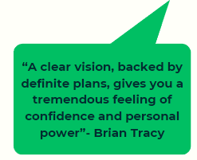
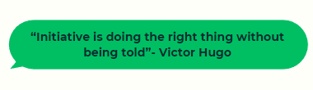
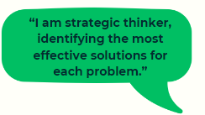
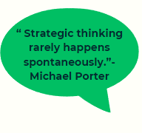
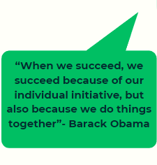
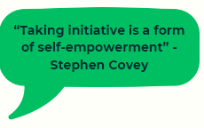

Strategic Thinking
Notes:
Amber

Slide 29
Resilience
Maintaining stamina and performance under continued stress and to act effectively under pressure. It includes bouncing back from disappointments or confrontations, and not letting them negatively influence ongoing performance. It involves keeping ones emotions under control.
Emerging – Shows self control
Evolving – Demonstrates persistence
Leading – Model of resilience
Influencing – Manages self in highly adverse situations
Notes:
Brenda
Emerging
Able to monitor own emotional state and has an awareness of strong emotions (such as anger, frustration) and deals with them appropriately
Able to monitor own emotional state and has an awareness of strong emotions (such as anger, frustration) and deals with them appropriately
Maintains composure in situations when being challenged by others
Knows when to take a time out and step away from a situation to consider possible solutions
Is aware of own trauma experiences and adopts coping strategies
Does not contribute to a heightened situation
Knows own strengths and weaknesses and demonstrates self-confidence
Ensures the quality level of support and meets the needs of people even though the work is sometimes mundane
Ensures a high level of quality no matter what level of stress/pressure may be present
Evolving
Focuses on how to successfully meet a challenge rather than on the obstacles or constraints
Maintains composure when challenged by others and finds effective/acceptable solutions
Understands others’ perspectives, works towards building consensus and finding effective solutions in difficult situations
Recognizes when emotions are building up and proactively manages response and expectations
Plans ahead and uses trained approaches to help others manage their emotions or stress
Is strong and successful in providing quality care, even when faced with extreme obstacles
Acknowledges and shows sensitivity to experiences of others using a trauma informed lens
Tries to understand the meaning behind a comment without it impacting the relationship
Leading
Creates an atmosphere that puts others at ease during difficult times
Constantly takes the opportunity to learn and grow within their role and has self drive to continuously seek further knowledge (education, training, courses, trending support needs)
Influencing
Demonstrates endurance and ensures a continued high level of service and commitment to individuals, families, agencies, community partners, etc.

Slide 30
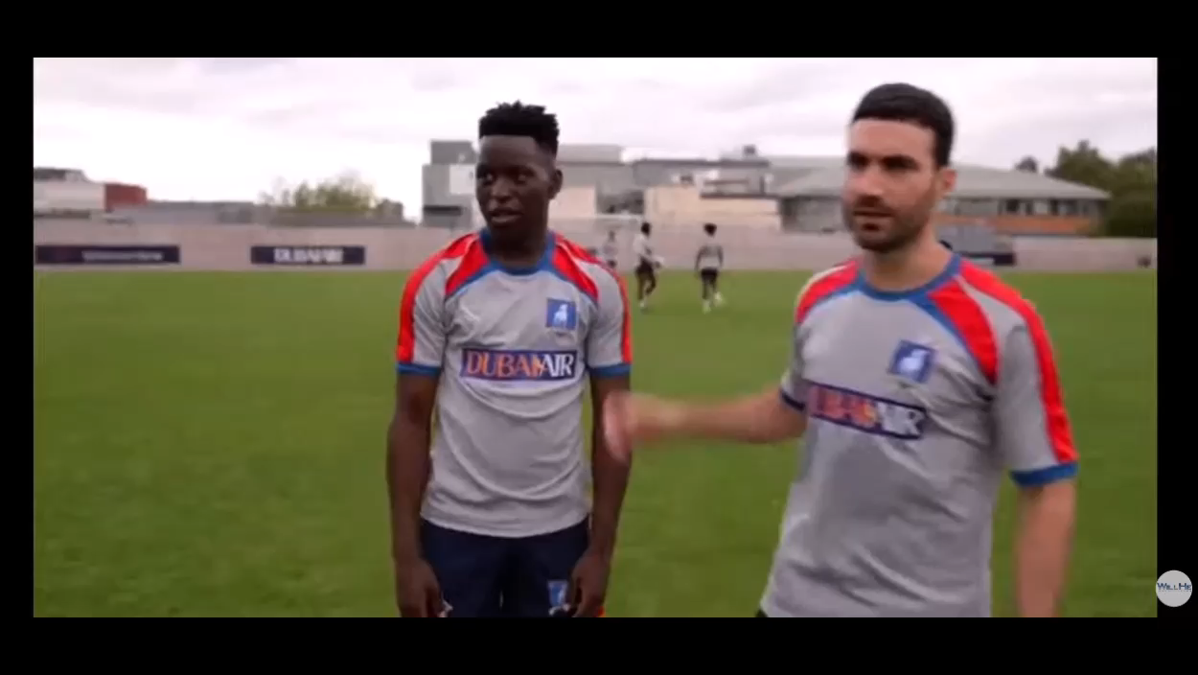
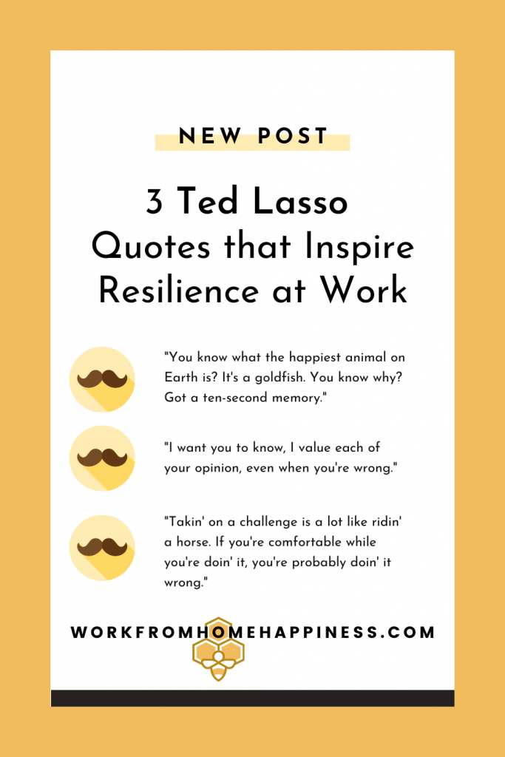
Be a goldfish
Notes:
Video 21 seconds
Brenda
What’s the happiest animal in the world? If you ask me, I’d say it’s my golden retriever, Norman, who perpetually has a smile and a tail wag even when he’s in trouble. But according to Ted Lasso, the answer is: a goldfish.
Yep, a goldfish. While any goldfish I’ve ever owned doesn’t seem overly joyful, apparently it’s their 10-second memory that allows them to be forever happy.
Ted tells one of his players, Sam, to “be a goldfish” after Sam was having a hard time letting go of criticism leveled at him by another player, Jamie Tartt. Sam didn’t quite get the reference at the time, but they’re wise words nonetheless.
We all face criticism at work. Sometimes it’s justified. Other times it’s not. The point is to accept the criticism and move on. Don’t let it define you. Try not to take it personally. Instead of dwelling on the criticism or getting defensive, stay calm. Feedback is valuable, whether it’s positive or critical. Even if it’s from a coworker you dislike, feedback allows for growth from all sources (flawed or not).
How to Accept Criticism at Work
Forbes offers these healthy ways to deal with criticism at work:
Be open – Absorb the words and don’t dismiss criticism as an attack.
Body language – Slow down your breathing and take a relaxed posture. It’s difficult to take criticism with grace. Having a relaxed and open body helps.
Ask questions – No, one of the questions after receiving feedback shouldn’t be, “What the f@$k?!?! Focus on clarifying questions so you’re both on the same page.
Share the feedback – When in doubt share the feedback with someone you trust. It helps to get a different perspective. Just be sure you ask someone who will be honest with you. Criticism is an opportunity for growth and not a means to convince yourself you’re “right.”
I know goldfish forget everything after ten seconds but you shouldn’t simply dismiss criticism. Instead, use the goldfish method to accept the words and move on quickly. It’s especially effective when you are told something about yourself you don’t like or agree with.
Take those precious initial 10 seconds to absorb what is being said then move on. Graciously accept the criticism to prevent a knee jerk response that sounds angry or defensive. This type of reaction will eat away at you more than the criticism itself.
3 Fundamental Lessons Ted Lasso Can Teach You About Resilience at Work
posted on AUGUST 25, 2021
Not gonna lie, Ted Lasso is my new favorite show. It came to me just at the right time; in the middle of a pandemic when everything seemed to be going to shit or shite, if you’re Roy Kent. This feel-good gem of a show with its unflappable main character (complete with epic mustache) provides equal parts warm-fuzzies and inspiration.
It’s not too heavy (although some episodes do feel like a punch in the gut) yet still delivers some fundamental life lessons we all can apply to work whether you work from home, in an office, or for a world-famous soccer league.
Hold Up. What is Ted Lasso?
I’m going to do my best to not include spoilers in this general synopsis. If you haven’t already, you can binge watch the entire first season of Ted Lasso on Apple TV+. New episodes are released (painfully slowly) one episode at a time every Friday.
We meet Ted Lasso, played by Jason Sudeikis, as a Kansas resident and college football coach. He’s hired to coach a professional soccer (or futbol if you’re Dani Rojas) team across the pond in England.
Ted has zero experience coaching soccer and locals and players alike are not happy with his arrival. But ever-positive Ted doesn’t seem bothered by the criticism, disregard, and general ridicule (locals call him wanker) he faces daily. He always tries his best (even when his personal life is falling apart) and encourages his players to do the same. Aside from being optimistic, Lasso is pretty darn resilient.
We get some powerful midwestern advice episode after episode (thanks to the mustachioed Lasso) that can teach us all a thing or two (or three) about resilience at work.

Slide 31
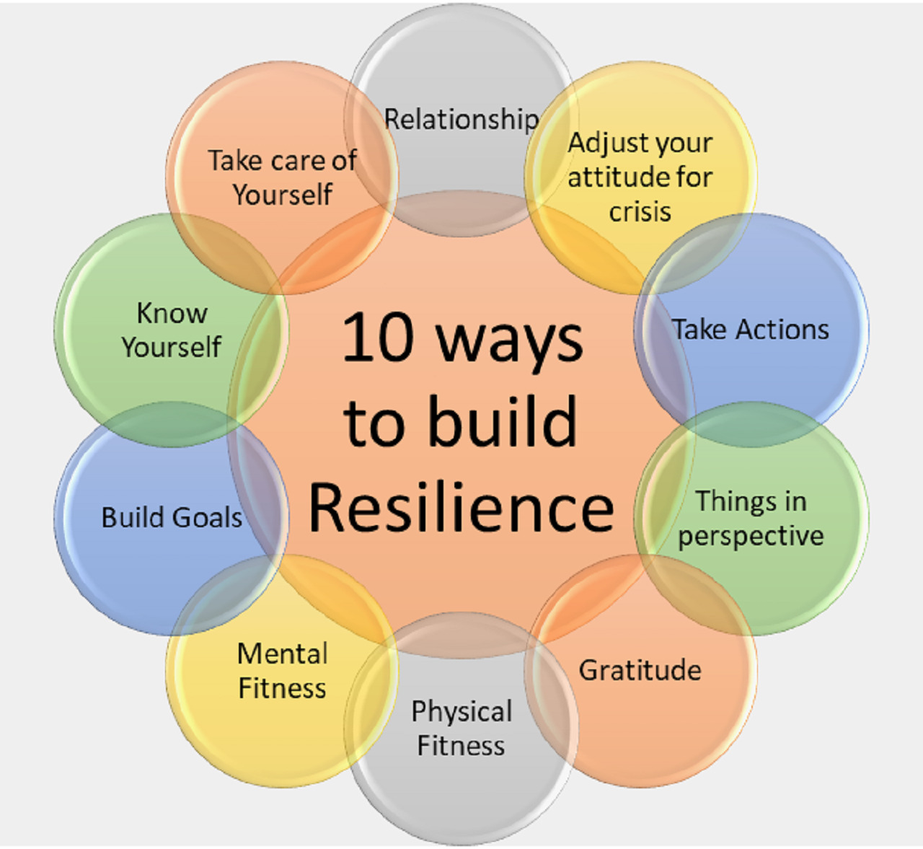
3 Good Things Activity
Positive emotions can help develop your brief thoughts, actions, and attention to your surroundings. One example of this is to foster positive thoughts and emotions.
Consider ending your day by reflecting on and writing down 3 good things that happened today. Be intentional about reflecting on the experiences, noting how you felt, and what was the best thing about the experience.
Becoming more positively aware of your experiences will allow you to take more control of your surroundings. Team resilience is strongly based on how you control yourself and your emotions during a setback.
Notes:
Brenda
Blank piece of paper
Write down three good things that happened yesterday, and reflect on why they were good.
Ask people to share if willing. Sharing stories builds resilience.

Slide 32
Resource Management
Capacity to plan, effectively leverage and optimize resources. It means that these resources are allocated efficiently to provide heigh quality support.
Emerging – Understands and utilizes resources
Evolving – Leverages Resources
Leading – Allocates Resources
Influencing – Strategically administers resources
Notes:
Brenda
.
Emerging
Ensures the individual/family/those surrounding them Is aware of available resources within the immediate environment and organization/family
Uses a person directed approach to understand the strengths and needs of the individuals they serve to be able to identify the resources required (day to day, life skill support, community, family, etc.) to help the individual have a well-rounded life
Ensures the individual/family/those surrounding them Is aware of available resources within the immediate environment and organization/family
Understands the personal support network for each individual and encourages participation by the personal support network (teach, guide, share knowledge)
Able to identify where resources are needed for quality support and optimal functioning
Evolving
Makes recommendations and pursues new initiatives and opportunities to continuously ensure high levels of support
Understands how to best leverage existing resources
Makes recommendations and pursues new initiatives and opportunities to continuously ensure high levels of support
Ongoing focus is on building own resource management skills and capabilities while encouraging others to do the same
Maintains good working order of all physical resources and equipment where possible, and immediately follows up with service providers for maintenance outside of their role
Takes responsibility for financial decisions made
Identifies gaps and areas for improvement and makes recommendations to decision makers
Leading
Collects ongoing information and feedback about resource utilization to make timely, effective decisions
Able to effectively manage human assets and financial resources and make decisions with sound rationale
Holds high standards when it comes to resource management – there is a focus on people
Influencing
Operates at a strategic level and is able to identify risks and contingencies

Slide 33

Talent wins games but teamwork wins championships
Michael Jordon

Slide 34
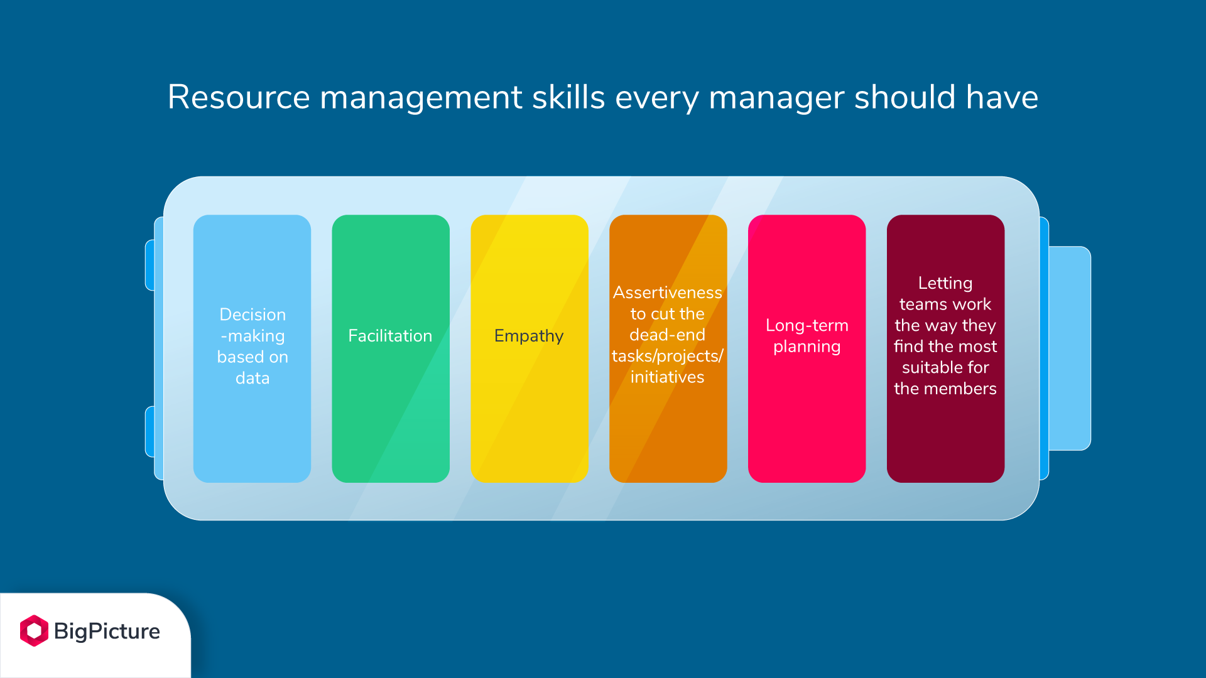
Resource Management
Having the right people on the right bus, in the right seats, going in the right direction
Notes:
Brenda
Learning activity as a group – give scenario see how they divide up the tasks. Planning an event.
Picture this: your boss approaches you with a new idea. Naturally, the question arises: do we have available resources to start working on it? Or what if it really is the next big thing and you need to start now? How will this decision impact the existing work? To answer these questions you will need to gather and analyze tons of information and different scenarios. That’s why it is one of the key components to be successful in business. The ability to assign them, divide them into the key areas and then increase, decrease their amount and allocate them can make or break a company. Check and learn the most important elements of proper resource management.
​​Plan.
Estimate Activity Resources.
Acquire Resources.
Develop Team.
Manage Team.
Control Resources
For example, if you're planning an event, a few resources include scheduling staff for the event, planning what vendors to use for promotional materials, investing in software that allows attendees to register, and budgeting for everything from giveaways to catering.
Get into teams at a table – plan an event and ensure you have the resources 10 minutes

Slide 35
Notes:
Break – 10 minutes

Slide 36
Review of the Website
Home page and logging and the Core Comps
01
Self Assessment
02
Coaching
03
Behaviour Based Interviewing
04
Notes:
Brenda
Share the website screen and walk them through the page.

Slide 37
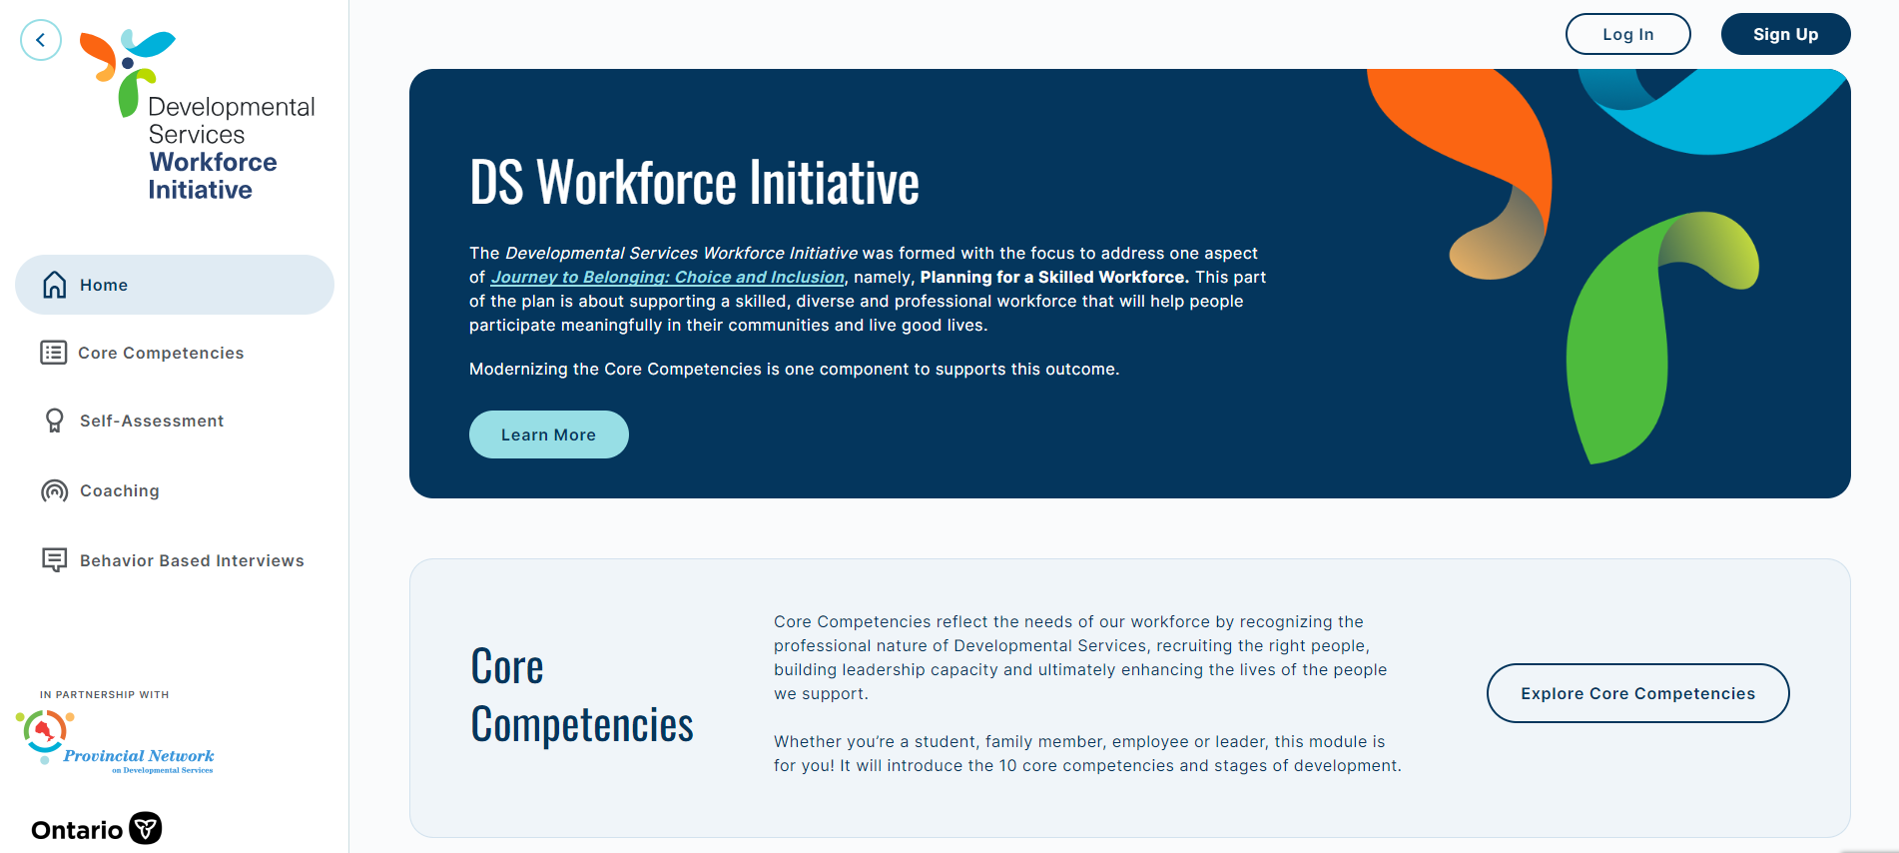
New Website
Notes:
Now that we have some of history out of the way, and what the modernized core comps look like, lets get into the new interactive website and how you can utilize it for continuous development and a way to seek our resources.
The new website has all the resources you will need to learn more about core comps, complete self assessments, and access resources that will help you with your career development and personal growth.
Lets take a look closer at the website!
First you will want to log in or sign up for the comps, this allows you to track your progress through the learning stages

Slide 38
Main access page
Info on Journey to Belonging
Links to move you throughout the website
Or you can continue to click on the left hand side sections
Notes:
The sections of the website are:
Core Competencies
Self Assessment
Coaching
Behaviour Based Interviews
I will break down the sections for you and what is in them

Slide 39
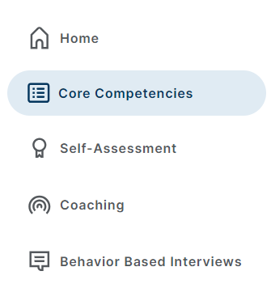
Video intro to Core Comps (17 minutes)
How the Growth Stages work
Breaks down each Core Comp and their Growth Stages
You can also download the Competency Dictionary
Notes:
https://www.dscorecomp.com/core-competencies/
Show web page

Slide 40
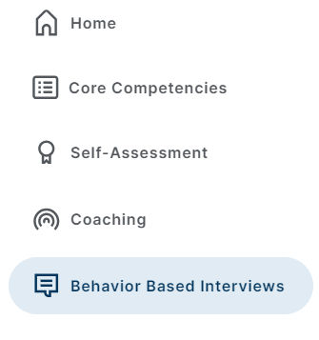
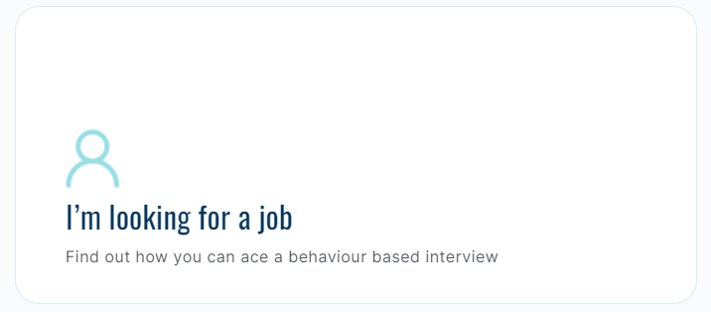
Need help with interviews?
Watch the video How to use the STAR method to prepare for a Behavioural Based Interview
Notes:
This is the page you can use to help you with the interview process.
When you hear the term Behaviour Based Interviewing, what does that mean to you? – wait for answers
Using Behaviour Based Interviewing leads to the selection of the right candidate for the right job. It focuses on past performance to predict future behaviour. By using the Core Competencies in Interviews it allows the candidate to explain why they are the right person for the job.
This is where you will have questions like, “Tell me about a time when …”
It also highlights the importance of using the STAR Method when answering behaviour based questions
Meaning when you are answering a question you will use the following sequence:
1.Situation – What was the situation you were in?
2.Task – What was the task that had to be done?
3.Action – What action or steps did you take?
4.Result – What was the result of the situation and your actions?
Lets watch the video (7 minutes)

Slide 41
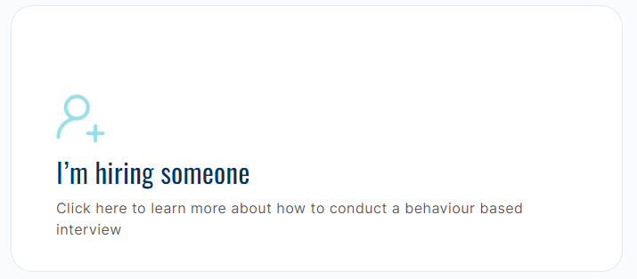
For Leaders
  Behaviour Based Interviewing (3-part video)
  Full Behaviour Based Interview example video
  Redirecting to “I” Statement video
  Prompting vs Probing video
  Probing for Intention video
  Behaviour Based Interview Guide
  Codable Data Exercise
  Sample Questions
Notes:
In this section for leaders – you want to click on “i;’m hiring someone”
Sample questions ascend in order aligning with the growth stages – these are just samples, but does not mean that these are the only questions that will be used

Slide 42


Notes:
Activity with questions
Split into 2 teams, give you some interview questions to practice with
Remember the STAR method
1.Situation – What was the situation you were in?
2.Task – What was the task that had to be done?
3.Action – What action or steps did you take?
4.Result – What was the result of the situation and your actions?
Questions to ask:
- Tell me about a time when you advocated for an idea, position or approach (Advocacy)
- Can you tell me about a time when you were involved in a challenging or difficult team situation? (Building Relationships)
- Describe a time when you altered your own behaviour to fit the situation? (Championing Change & Innovation)
- Can you tell me about a time when you tried to fully empower another person to do something? (Facilitate Growth & Development)
- Tell me about a difficult situation in which you behaved in a way that was consistent with your values. (Inclusive Leadership)
- Tell me about a time when you had to solve a problem or make a decision. (Problem Solving & Decision Making)
- Describe a time when you were in a high-pressure situation. What was the situation and what did you do? (Resilience)
- Tell me about a time when you took it upon yourself to do something outside of your normal responsibilities. (Strategic Thinking)
- Describe a challenging interpersonal situation you have had to handle. What did you do? (Valuing EDI)

Slide 43
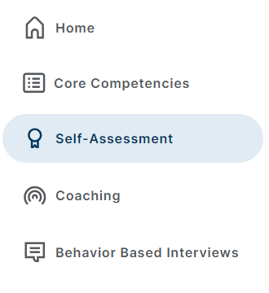
Self-assess to determine what growth stage you are at
Work with a mentor to discuss results and help create a development plan
Try and focus on 1 or 2 competencies at a time
Notes:
The self-assessment part of the new core comps is for you to determine what stage growth of a competency you are in, by looking at examples from your professional experiences. This is driven by you, not your manager.
When you go into each core comp it breaks down what the core comp is, and then has behavioural indicators for each growth stage.
You would review the behavioural indicators and then start the self-assessment
It then gives you instructions on how to complete the self assessment
If you choose to do this, connect with your manager as they play a role in the development of your core comps

Slide 44
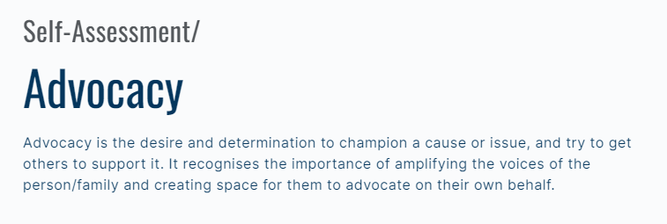
Notes:
When you go into each core comp it breaks down what the core comp is, and then has behavioural indicators for each growth stage.

Slide 45
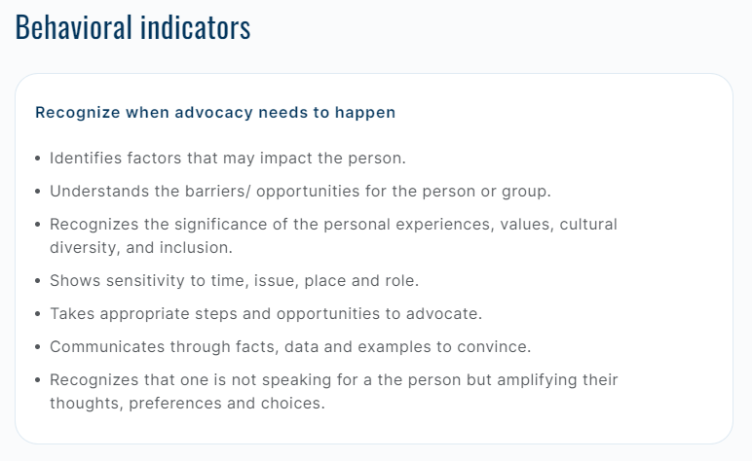

Notes:
it will automatically start you at the emerging stage
You would review the behavioural indicators and then start the self-assessment

Slide 46
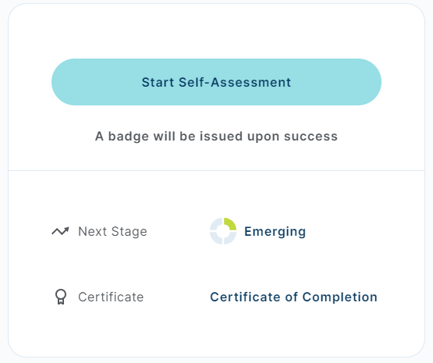
Notes:
Once you have reviewed the description, and gone over the behavioural indicators, you can now start the self assessment

Slide 47
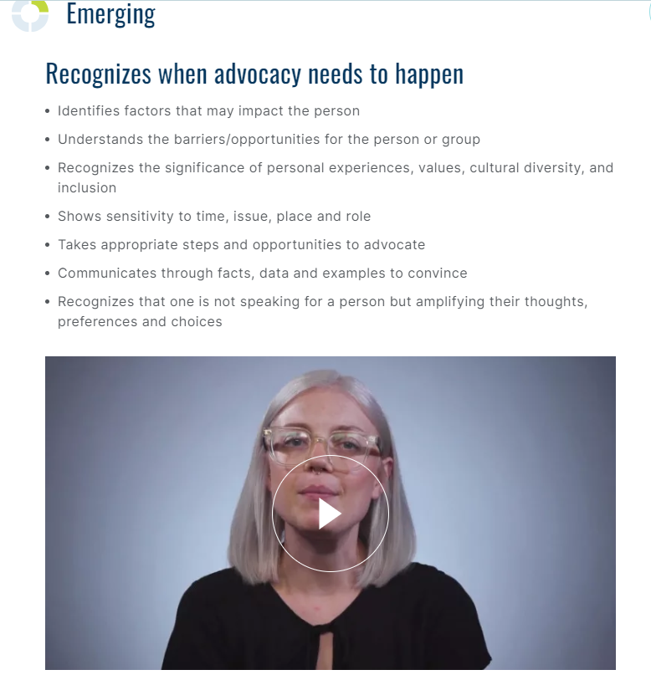
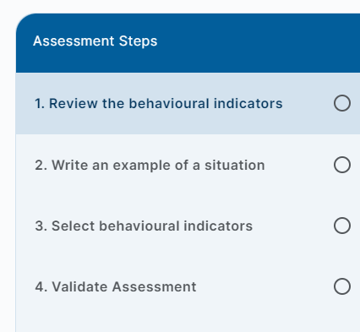
Notes:
It then gives you instructions on how to complete the self assessment (say each step)
Review the Behavioural Indicators for all the stages, there are drop down sections at each growth level and come videos to watch

Slide 48
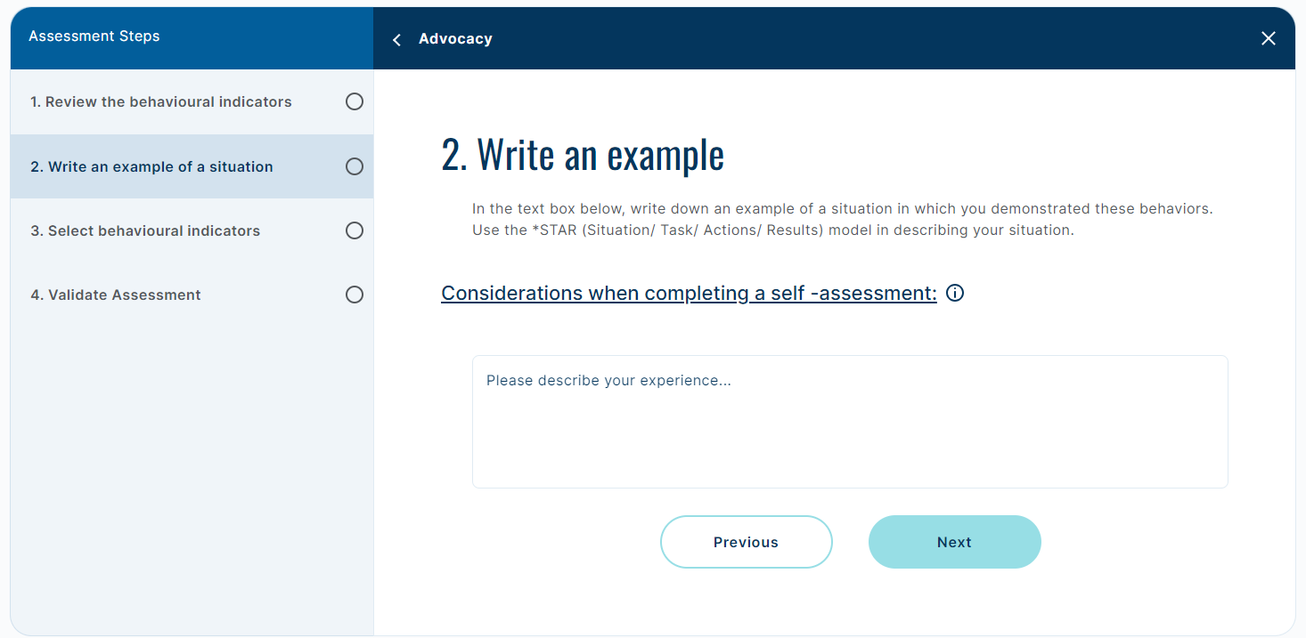
Notes:
2. Write your example of a situation that you demonstrated these behaviours (Use the STAR method (Situation, Task, Actions, Result)
Considerations when completing a self assessment **

Slide 49
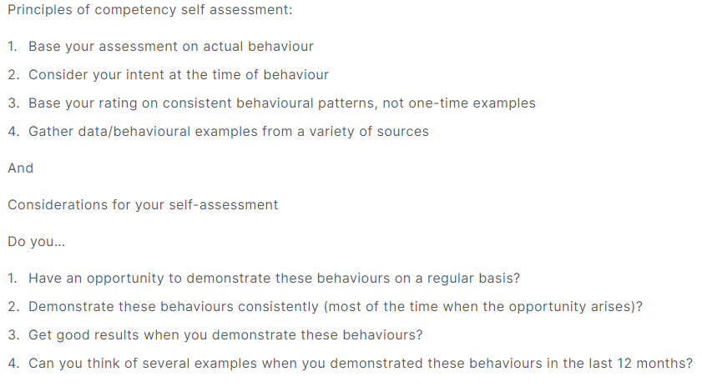
Notes:
Write your example of a situation that you demonstrated these behaviours (Use the STAR method Situation, Task, Actions, Result)
Considerations when completing a self assessment ** (read from slide)

Slide 50
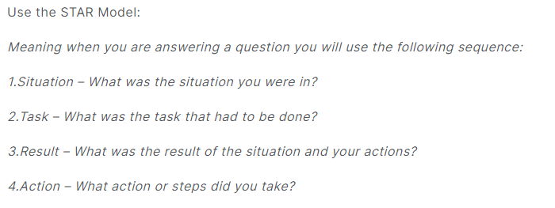
Notes:
Write your example of a situation that you demonstrated these behaviours (Use the STAR method (Situation, Task, Actions, Result)
Considerations when completing a self assessment **

Slide 51
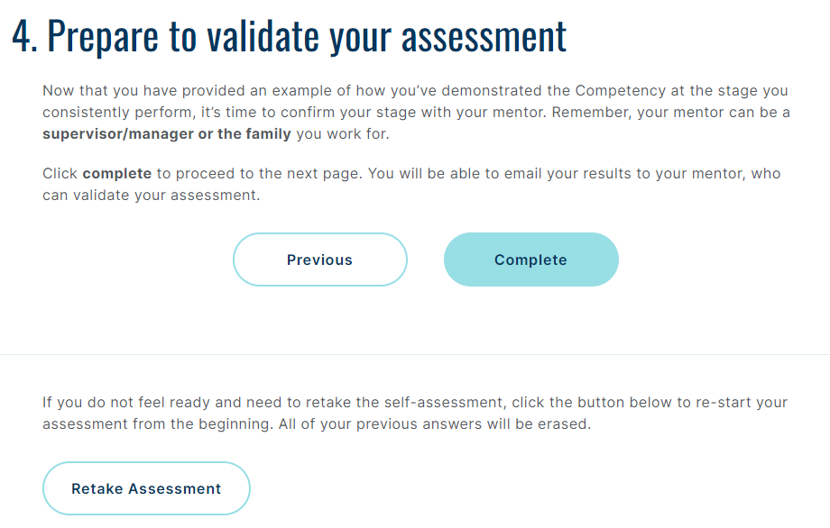
Notes:
4. Validate your assessment
Good opportunity to have those discussion with your mentor and vice versa, allows for good coaching discussions to happen
Once you click complete you now have the option to email it to yourself and forward it to your mentor
** who is your mentor

Slide 52
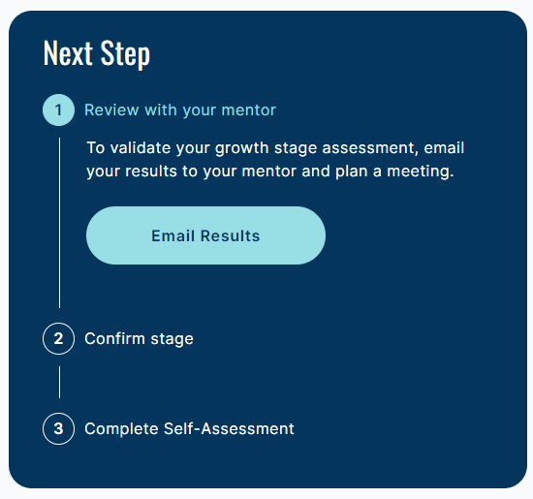
Notes:
5. Validate your assessment
Good opportunity to have those discussion with your mentor (your direct reporting manager) and vice versa, allows for good coaching discussions to happen
Once you click submit you now have the option to email it to yourself and forward it to your mentor

Slide 53

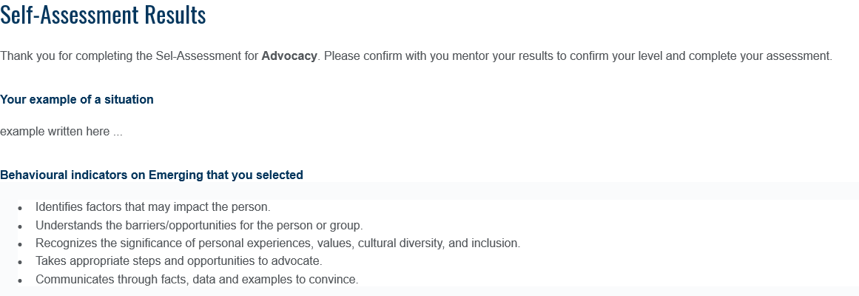
Notes:
Go back to powerpoint
This is what the email will look like
Once you email it to your mentor, connect with them to let them you are starting this process and would like to set up a meeting to discuss your self assessment. The whole core comp development process is individual run, meaning it is your responsibility to start the process, do thr self assessments and set up meetings with your mentors.
This then leads us into the Coaching Part of the website, we will come back to the self assessment piece.

Slide 54
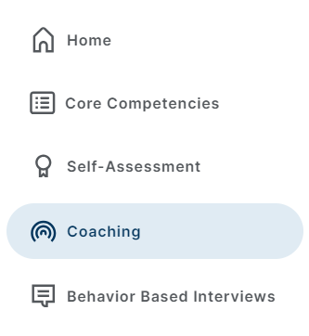
This tab has tips and a video leaders can watch to help them with a coaching session with their employee
Discussion Planner Guide
Developmental Resource Guide
Notes:
Leaders play a key role in facilitating the development of your direct reports. This may involve helping them accurately assess their Core Competencies and create a development plan, along with providing continuous feedback and coaching.
Recommend watching the video in the module!
Discussion Planner:
Breaks down steps once employee completes a self-assessment
Can use the form template as a guide to document what was discussed
Development Resource Guide
- tips, tricks or activity examples that can help give ideas on ways the employee can build on that core comp they are working on
Once the coaching session has been completed and you have been confirmed you are at that growth stage, you will go back to your self-assessment page and click on “confirm my stage”

Slide 55
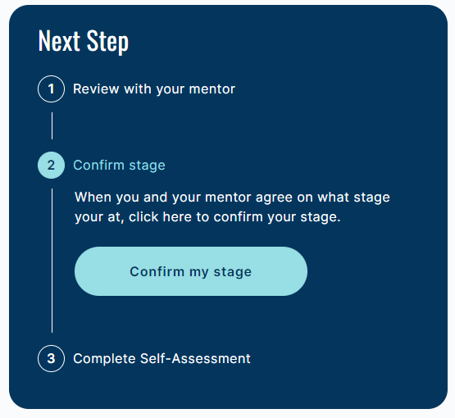

Slide 56
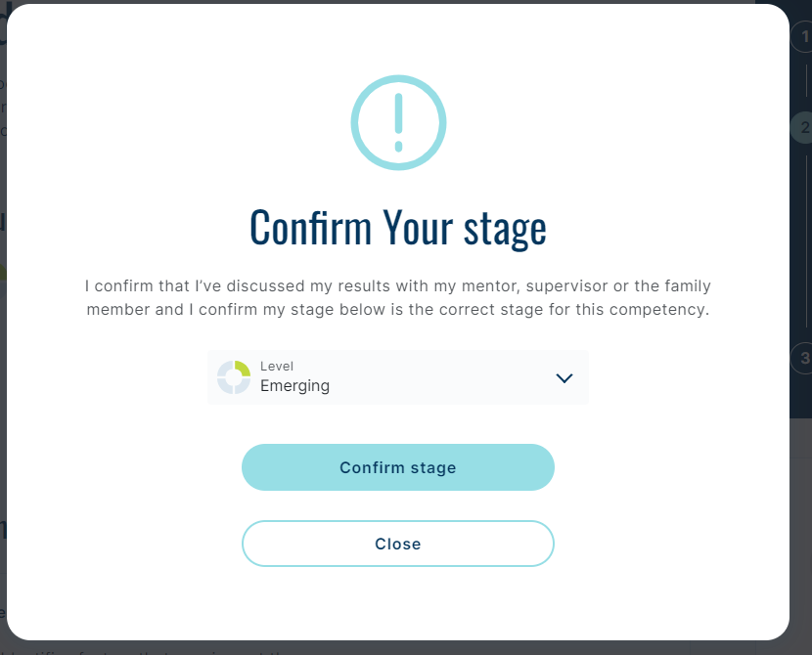
Notes:
It will confirm again, yes you are conforming you are at this stage

Slide 57
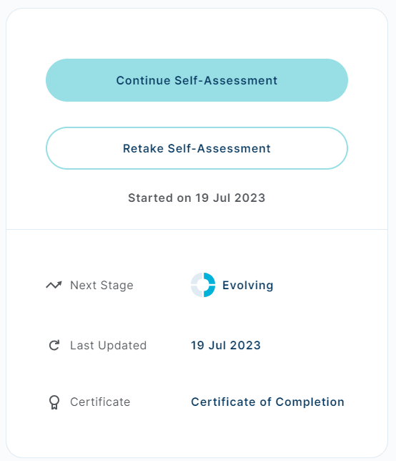
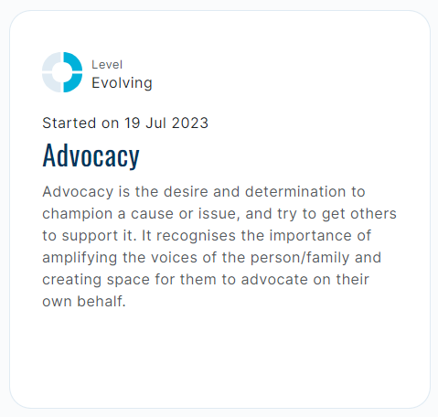
Notes:
It is important to note that as you work on the development of the core comps, it is not over night. It takes time, and that’s ok.
As you work through the growth stages, you can see here that now advocacy is at Evolving. I can continue my journey and continue will my self assessment

Slide 58
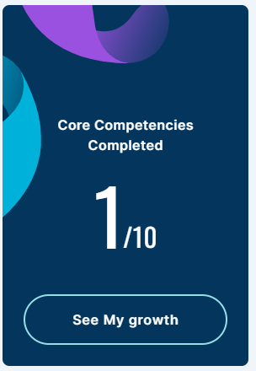
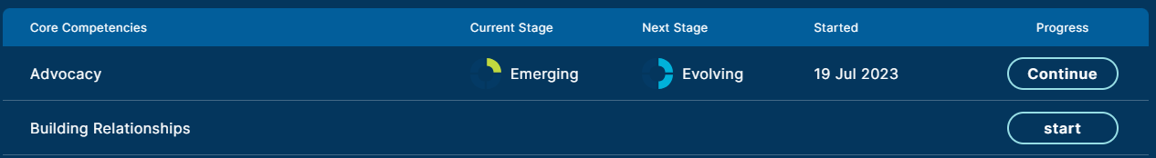
Notes:
At anytime you can go on and click see my growth – and it gives a break down of where you are at in your growth stages
Lets go over the website on self assessment and walk through one together.

Slide 59
Resources:
Core Competencies website – www.dscorecomp.com
Core Competency Café Webinars – Real Xchange - https://realxchange.communitylivingessex.org/core-competencies/
Behaviour Based Interview Guide
Discussion Planner
Development Resource Guide
Competency Dictionary

Slide 60
So What Now?
Questions?
Follow the PCL Newsletters and participate in the Activities
Incorporate into your professional goals
Complete the Self Assessment and Share with Mentor or Supervisor, prepare to coach your DSPs.
Notes:
Reminding them as leader they need to go through this process so they can coach and lead others.
Good resource for performance development plans.
Staff will be trained in February.

