Slide 1
Navigating the Current Labour Climate
Charles Hofley

Slide 2
Navigating in the Current Labour Climate
Charles Hofley
613.369.2101 (8401)
Charles-hofley@hicksmorley.com

Slide 3
Agenda
01
Privacy in the Unionized Setting
02
AI in the Workplace
03
Surreptitious Surveillance: When Employees Record

Slide 4
Agenda
04
Bargaining Trends and Strategic Considerations
Attendance Management
05

Slide 5
Privacy in the Unionized Setting

Slide 6
Privacy in the Unionized Setting
Implied Right to Privacy
Many arbitrators have found that an implied right to privacy must be taken into account when considering employer policies and actions which are privacy invasive.
Engages a balancing test between right of privacy and institutional needs.

Slide 7
Electronic Monitoring
Employment Standards Act, 2000, Section 41.1.1
Requires employers with over 25 employees to create policy addressing monitoring
Policy must state purpose for which they are monitoring employees

Slide 8
Employee Surveillance
May be used to address:
Productivity Issues
Damage & Theft
Safety

Slide 9
Searching Devices
Considerations:
Is there a reasonable ground to conduct the search?
Do you have a policy in place?
Is there a reasonable expectation to privacy?

Slide 10
AI in the Workplace

Slide 11
Usage
General Usage
General conversations
Internet research
Generative text (no links)
Data analysis
Create lists
Explain complex topics
Starting point (through midpoint and endpoint?!) for any written product
Workplace Usage
On-line research
Writing, speeches, correspondence, company communications, policies
Employee evaluations
Preliminary advice/assessment (medical/legal)
Simple computer code
Automated customer support

Slide 12
Privacy Concerns
Use/Disclosure: Use/disclosure of personal information without consent. Anonymization not enough.
Breach Notification: Mandatory notice obligations, unclear which organization has primary responsibility.
Data Breach Obligations: Improper disclosure, employers may not be aware of breach.
Risk surrounding generation of evidence through AI.

Slide 13
Bill 149 Amendments
01
Bill 149 amends the Employment Standards Act, 2000 and other workplace-related statutes
Notably, makes significant ESA amendments to job application process:
Advising applicants of use of AI in screening and selection process
Publication of range of compensation in publicly advertised job postings
Banning requirement for Canadian work experience
02

Slide 14
Bill 149 Amendments
These amendments all take effect on proclamation, but you will want to start now to ensure you are prepared
03

Slide 15
Surreptitious Surveillance: When Employees Record

Slide 16
When Employees Record
01
Increase in employees recording themselves and others in workplace
02
Employees might record disciplinary or investigation meetings, or even interactions with co-workers
03
Termination meeting recordings increasingly popular due to TikTok trend
04
Potential violation of individuals’ privacy interests and reputational harm

Slide 17
The TikTok Trend – Recording Termination Meetings
01
January 2024 viral TikTok video showed San Francisco technology worker getting fired from her cybersecurity company
02
Video started a trend of employees (primarily Gen Z) recording their termination meetings and posting the videos on TikTok

Slide 18
When Employees Record
Employees may decide to record any kind of meeting in an attempt to aid in a future case against the employer (i.e. investigation meetings, disciplinary meetings, interactions with coworkers, etc.)
Difficult to know when being recorded or how it will be used
What happens if an employee does record a meeting and then uses it in their civil claim?

Slide 19
When Employees Record – Example
Shalagin v Mercer Celgar Limited Partnership, 2023 BCCA 373
Employee was terminated and he sued in the civil court, the BCHRT, and under the BC ESA
Proceeding before BCHRT revealed employee surreptitiously recorded many conversations with supervisors and others during his ten years of employment
In response, employer amended its civil pleadings to plead just cause for termination
Trial judge found employer had established just cause
Upheld by the BCCA: trial judge correctly considered the surreptitious recordings in the context of the case and did not err in application of the law of just cause or by failing to consider relevant factors

Slide 20
When Employees Record – Example
Shalagin v Mercer Celgar Limited Partnership, 2023 BCCA 373
[42] I do not necessarily equate Mr. Shalagin’s surreptitious recording of his colleagues and supervisors with expressly misleading one’s employer or telling lies to someone in the course of one’s duties. However, the recording activity was underhanded and would be regarded by most employers as misconduct undermining the trust relationship between employer and employee. It also violated the privacy interests of persons who were recorded, as well as those who were discussed in the recordings. In any event, it is my view that McKinley applies to this case, requiring a “contextual approach” and a determination of whether the nature and degree of the dishonesty warranted dismissal — a factual question. (McKinley at para. 49.) As part of this contextual approach, the court should bear in mind the “sense of identity and self‑worth individuals frequently derive from their employment”. It should strike an effective balance between terminating that sense of identity and self‑worth with the severity of the employee’s misconduct. (At para. 53.)

Slide 21
Best Practices for Employers
01
Generally impossible to know whether employee is recording at work
02
Policies on recording can make expectations clear but cannot guarantee employees will not record
Practically, may need to assume certain workplace meetings may be surreptitiously recorded (investigations, terminations)
03

Slide 22
Best Practices for Employers
To manage this risk during meetings:
Reiterate at the outset of a meeting the expectation is that the meeting is not to be recorded and explain why (confidentiality, etc.)
Have employee verbally confirm they are not recording
Ensure diligent notetaking and consider an employer witness or designated notetaker
Employer representative should behave professionally and on the assumption their words and actions are, in fact, being recorded

Slide 23
Bargaining Trends and Strategic Considerations

Slide 24
Wage Trends – Broader Public Sector

Slide 25
Wage Trends by Industry

Slide 26
Increased Wages
01
Wage increases – responding to inflation
02
Education, Health, and Social Services industry average was 2.6% in 2022 and 3.6% in 2023
03
3.0% in 2024

Slide 27
Inflation
Inflation
Unions are arguing that wage increases should reflect inflation adjustments

Slide 28
Inflation – The Long View

Slide 29
Wage Increases vs CPI

Slide 30
Inflation – Recent Trends

Slide 31
Trends of Work Disruptions

Slide 32
Trends of Work Disruptions

Slide 33
Trends of Work Disruptions
Number of Labour Disruption

Slide 34
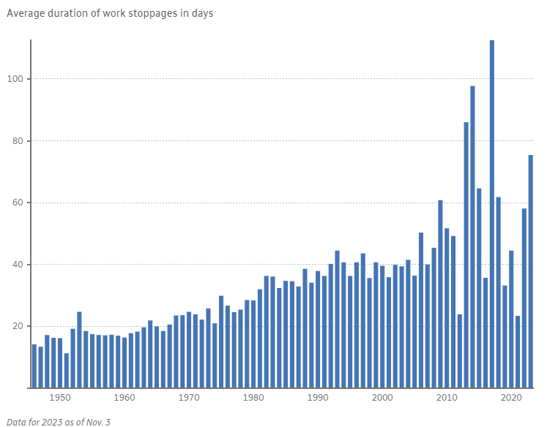
Length of Strikes
The average length of strikes in Canada has increased in the past decade

Slide 35
Labour Disruptions Trends
Longer negotiations
Tentative agreements are not being ratified

Slide 36
Failed Ratifications
Failed Ratification
Public disputes
Inflation
Social media usage
Tight labour market
Union’s failure to manage expectations

Slide 37
Conciliation

Slide 38
What is Conciliation?
Conciliation is a process by which a conciliation officer is appointed by the Minister of Labour, Immigration, Training and Skills Development (MLITSD) to meet with the union and employer to attempt to conclude a collective agreement

Slide 39
Conciliation and the Ability to Strike
Mandatory to acquire the right to strike/lockout
Minister informs parties whether conciliation support will be offered
Majority of cases, no additional conciliation assistance is provided

Slide 40
Early Reliance on Conciliation - Effects
Neutral third party
May be proactive
Ability to strike out or lockout
May be inefficient

Slide 41
Attendance Management: General Principles

Slide 42
Overview
Why and how do we manage attendance?
Statutory considerations
Fundamentals of Attendance Management Programs

Slide 43
Absenteeism Rates
Source: Statistics Canada, Table 14-10-0196-01

Slide 44
Why Do We care?

Slide 45
Attendance Management – Purpose and Rationale
Employer is entitled to expect employees to regularly attend at work
Employer is entitled to manage workplace absences
Not to punish, but to assist and encourage employees to attend and stay at work

Slide 46
Types of Absenteeism
Non-Culpable or
Innocent
Beyond employee’s control
Illness, family emergency, excused absences, etc.
Response: Support, assistance, intervention
Culpable
Within employee’s control
Failing to notify manager of absence, chronic lateness, presenting a false reason for an absence, absent without authorization or valid reason (unexcused absences)
Response: Immediate discipline

Slide 47
Addressing Absenteeism
Distinguish between non-culpable and culpable absenteeism
Non-culpable – response should be remedial in nature rather than disciplinary
Approach must be “reasonable” in substance and application
Ensure approach is consistent with applicable legislation
Ensure there is no conflict with the terms of the collective agreement

Slide 48
Human Rights Considerations
Disability
Family Status
Religion…
Are the absences related to a protected ground?
If so, discipline or application of a policy or an Attendance Management Program may be “discriminatory”
Duty to accommodate up to point of undue hardship
→ Both substantive and procedural components

Slide 49
Human Rights Considerations (Continued)
It is important to be flexible when managing attendance and considering, on a case-by-case basis, the ability to accommodate
Blind application of policy or AMP may be a breach of procedural duty
Where an absence is due to a disability, an employer must consider
Duty to Accommodate
Undue Hardship

Slide 50
Best Practices for Attendance Management
Distinguish between culpable and non-culpable absences
Create reasonable and rational thresholds
Provide counselling and offer assistance; warn when necessary
Apply consistently
Build in flexibility and discretion

Slide 51
Attendance Policies and AMPs
Enforce attendance policy consistently
Address absences and tardiness immediately
Attendance Management Program (AMP)

Slide 52
Fundamentals of an AMP
Benefits
Medical documentation practices
Reporting procedures
Accommodation procedures
Improving attendance
Challenges
Breach of collective agreement
ESA/WSIA leaves
Discriminatory effect
Disciplinary effect

Slide 53
The Fundamentals of an AMP
Individualized approach
Consultation
Establish clear roles

Slide 54
The Fundamentals of an AMP
Setting the appropriate attendance standard
Reasonable steps of progression
Effective communication with employees
Apply discretion as needed

Slide 55
Discipline for Absenteeism

Slide 56
Purpose of Discipline
Identify causes of unacceptable behaviour
Rehabilitate and correct unacceptable behaviour
Deterrence of others

Slide 57
Progressive Discipline
Flexible response to unacceptable culpable conduct
Increasing sanction with repeated misconduct

Slide 58
Supervisory Communications
Tell the employee what you expect
Be direct
Be clear
Do not waiver
You want to avoid uncertainty

Slide 59
Discipline Process – Steps
Conduct thorough investigation
Review employee’s disciplinary record
Conduct discipline interview
Assess any further information provided by the employee
Determine appropriate degree of discipline
Issue discipline
Follow up

Slide 60
What Does the Case Law Say?
Central East Lhin and ONA (N.S.), Re, 2019
Algoma Tubes Inc. and USW, Local 9548 (Vaz), Re, 2019
Canada Post Corp. v. C.U.P.W, 1990

Slide 61
The Decision to Discipline
The penalty should “fit the crime”
Verbal warning
Written warning
Informal coaching
Final warning
Discharge

Slide 62
The Decision to Discipline
Mitigating factors
Length of service
Clean record
Apology/remorse
Momentary aberration
Personal problems

Slide 63
Determine Degree of Discipline
Factors
Past practice of employer (previous record)
Seriousness of offence
Whether standards were properly communicated
Premeditation
Reasonableness of applicable rules and/or standards

Slide 64
It’s Not What You Know…
It’s What
You Can Prove!

Slide 65
Questions and Answers

