Slide 1


Implementation of Core Competencies
A Blueprint for Organizational Success
Notes:
Elizabeth and Brenda Welcome

Slide 2
Agenda
Welcome
Why would I want to implement the DS Core Competencies
Things to think about when preparing to implement
Stories from a Panel of Experts
Core Competency Mentor Program
Core Competencies and the DSW Curriculum
Final Tips – Resources
Notes:
Elizabeth
Over the next hour we will cover Selling the Why, who to involve , things to consider, our panel, the mentor program and café reminder and final tips/resouces.

Slide 3
Here is Why you should Implement?
A professional development tool to ensure a
strong and sustainable workforce
Focus on people - a person-centred service
Align us with Journey to Belonging
Focus on innovation, positive change & growth
A modernized language for defining human service
Notes:
Elizzabeth
Everyone needs to understand the why we are so excited about core competencies and what is in it for them. If we want people to be engaged to support and champion this work they need to understand the importance.
Core competencies are the foundation for us to develop a professional and sustainable workforce that have the right competencies to align us with Journey to Belonging.
We need to hire the right people. The ones that are focused on the person. They can amplifying the voices of the person/family and create a space for them to advocate on their own behalf. They can intentionally collaborate and build meaning full and sustainable relationship with people supported , co-workers, families and community partners. They demonstrate self-directed growth and development in themselves and others. They use a person centered approach when providing services, they support informed decision makings and problem solving. They are resilient and ensure a high level of quality of service no mater what level of stress or pressure is present. These are the behaviour we are looking for in our new hires and our present employees. Core Competencies will help you identify these behaviours. They are also the elements that will help us focus on innovation, positive change and growth.
Valuing Equity, Diversity and Inclusion has not only been interwoven into the language of all the competencies but is a stand alone competency. The lens of Trauma informed care has also been used to modernize the language.
If you consider the growth model this is setting us up to create a workforce of leaders encouraging development in all the competencies no matter what position they hold. The lateral and lattice growth that will help to sustain our workforce.
The Core competency growth model is a tool to mentor and coach our employees from within. This will prepare our employees when there are leadership positions available. This will encourage our employees to see a career in the developmental sector.
This is why it is important to implement Core Competencies.

Slide 4
Who you should be involving
All levels of Leadership
All employees
Your union/employee relations group
Your Board
People supported
Other Stake holders - families
Notes:
Elizabeth
You can not implement CC in isolation you need to be inclusive of everyone
You need to communicate/share core competencies with all levels of your leadership so that you can work together to implement the core competencies and build a strong work force. This means from your top to bottom, side to side. Your Executive Director, Directors, leadership. front time, administrative support, your union or employee relations committee, your Board, people supported, stake holders need to have an understanding of the benefits of core competencies.
I will now pass things over to Brenda

Slide 5
Prepare for Implementation
Engage your employee engagement committee or labour relations committee, recruit champions to lead the implementation
Create a co-designed implementation plan with dates.
Decide who will do what
Begin the behind-the-scenes work
Notes:
Brenda –
Each organization has to decide what to implement, when to do it and how they want to incorporate the Core Competencies into your organization. You know your culture, your internal structure, policies and procedures the best. We are going to share a few examples and ideas of things to consider around your implementation.
And when we hear from our panelists today , you will notice that each agency has developed the plan in a manner that works best for them.
Some ideas that can help:
First you may want to make sure you have some help, so create a team of champions who can assist in the promotion, lead some of the training etc.
Make sure it is co-designed in particular with your union or employee relations committee as this will assist in getting the engagment from all areas of the organization , should include HR as well, in terms of policies, job descriptions and interview process
With your committee of champions decide who will take on each piece and get your HR team or designate started on the behind the scenes work which I will review more thoroughly in an upcoming slide.

Slide 6
Remember to include in the Plan
Formalize a communication strategy to keep everyone in the loop
Develop a feedback mechanism
Consider what success looks like - monitor and evaluate
Consider using Core Competencies throughout your recruitment process
Consider how growth strategies could be implemented into employee development, succession planning
Embed in your Learning Management System – if applicable
Consider employee engagement activities and how to celebrate success
Consider impact on policies and procedures
Notes:
Brenda
Formalize a communication strategy to keep everyone up to date about Core Competency Implementation.
Develop a feedback mechanism and consider how success should be monitored and evaluated in your organization.
CC incorporated throughout the recruitment process - from job postings to the interview

Slide 7




Panel of Experts
Interactive Question and Answer Session
Notes:
Isabel – Participation House Durham
Sherry S. CL Kingston
Natasha Woodstock ds
Linda - Valoris
Manager of Lambton County DS – video for performance development
Add logos.

Slide 8
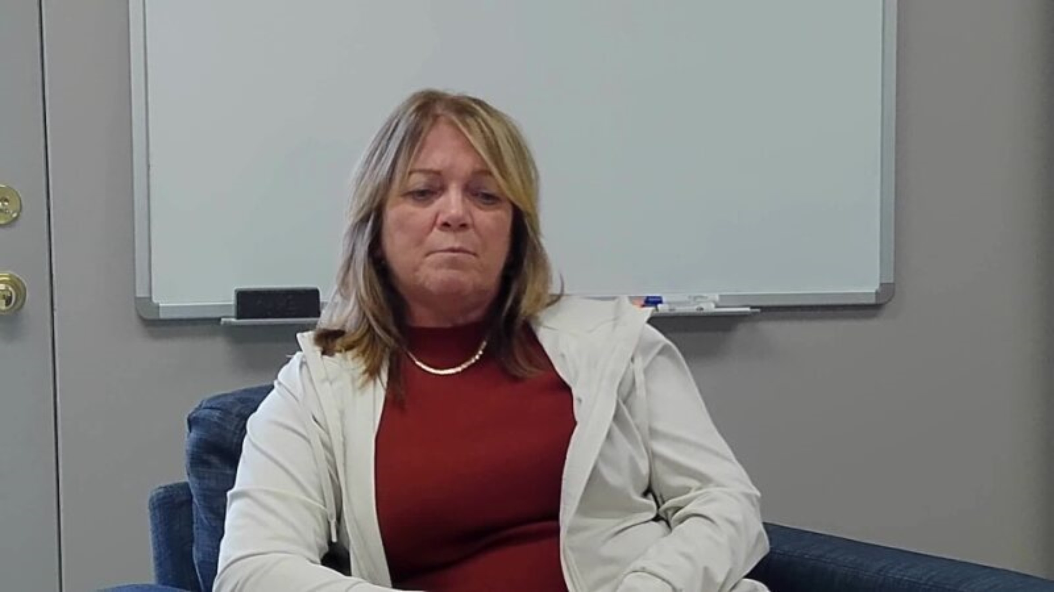
Implementation of Core Competencies

Slide 9
Core Competency Mentor Program
A collaboration with Real XChange
Sign up with the Real Xchange mentorship program
Ask for a mentor around implementation of core competencies
We have mentors that you can be matched to help you with your Core competency Journey
Notes:
Elizabeth

Slide 10
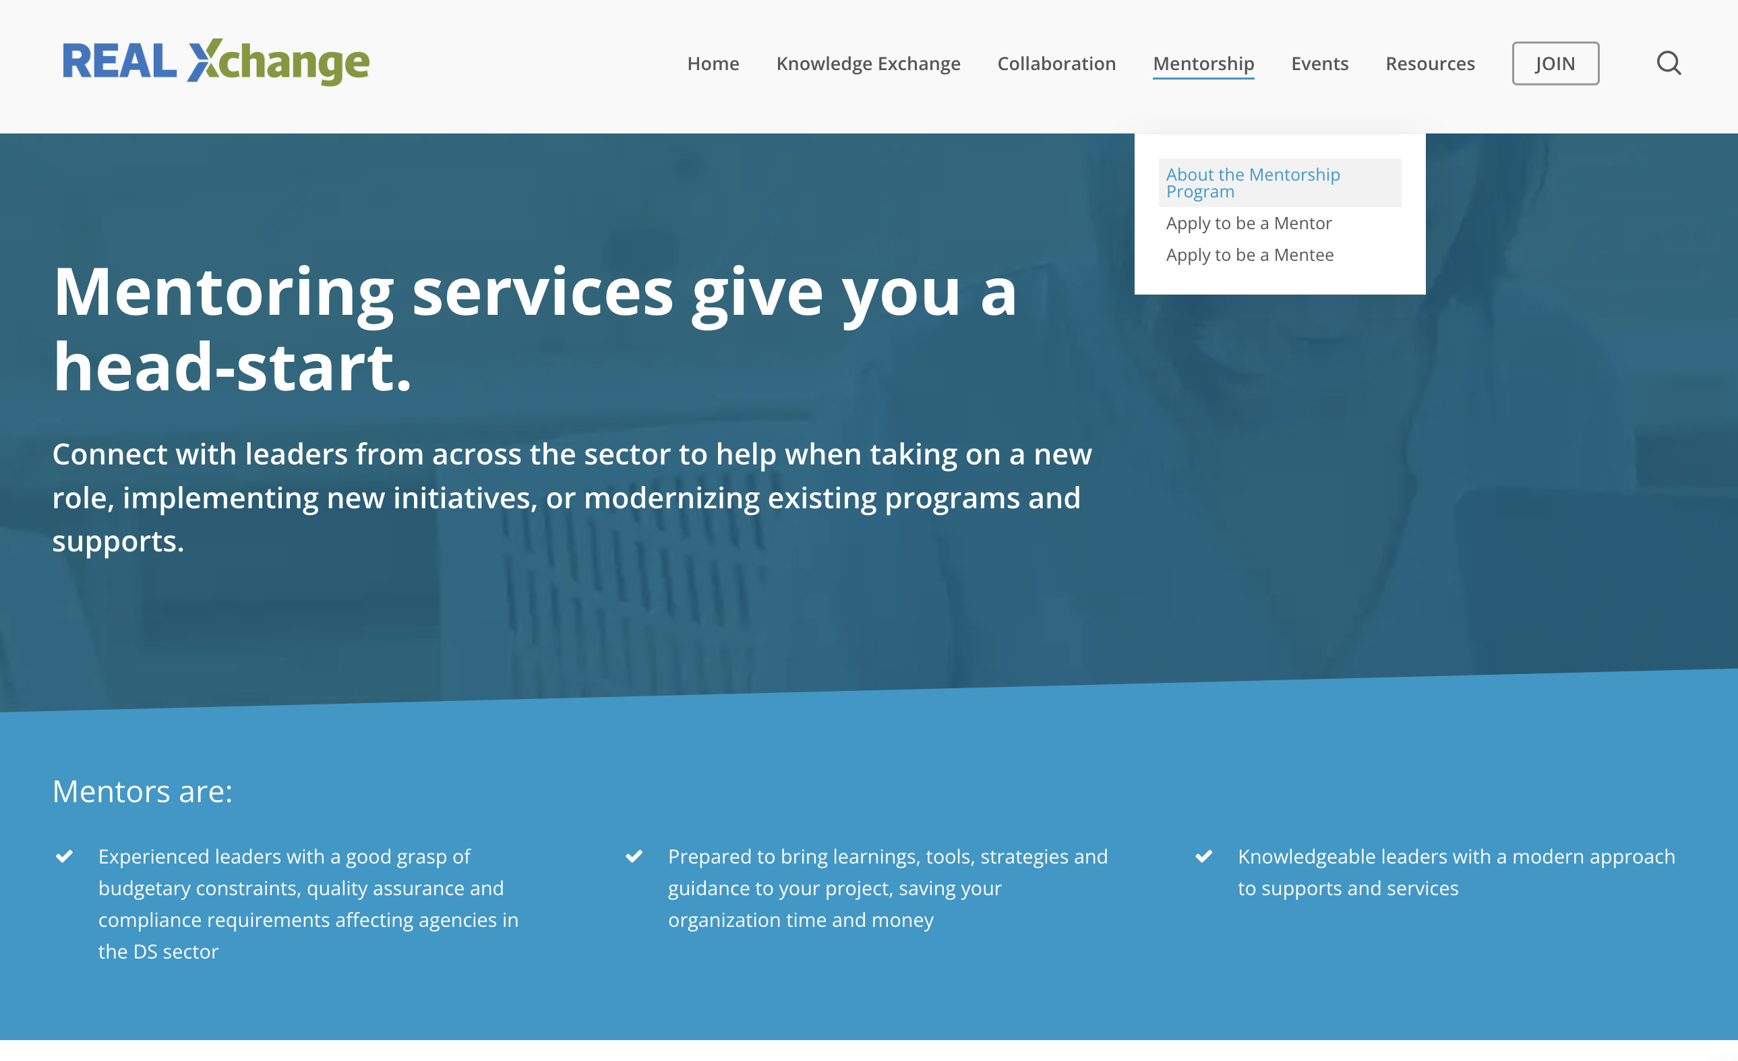

Where to find resources on RealXchange

Slide 11
Core Competencies and the DSW Curriculum
DSW students graduate with knowledge and experience in the core competencies through:
Learning the background, context and the factors that drive the DSW Core Competencies
Learning the differences between technical and behavioural competencies
Recognizing the relevance of Core Competencies for future employment and professional growth in this field.
Understanding the growth model
Understanding the purpose of Behavioural Interviews and practicing for future employment.
Completing their own self-assessments of current behavioural competencies, knowledge and technical skills to create a professional development plan.
Receiving placement performance feedback based on the Core Competencies
Notes:
Elizabeth

Slide 12


Where to find resources on RealXchange
https://realxchange.communitylivingessex.org/core-competencies/
Notes:
Brenda

Slide 13
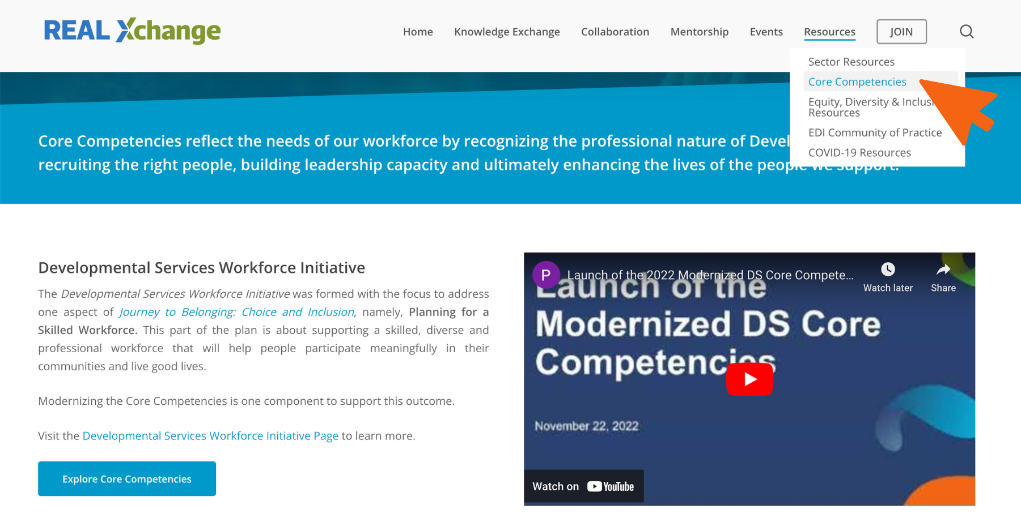
Where to find resources on RealXchange
Notes:
Brenda

Slide 14
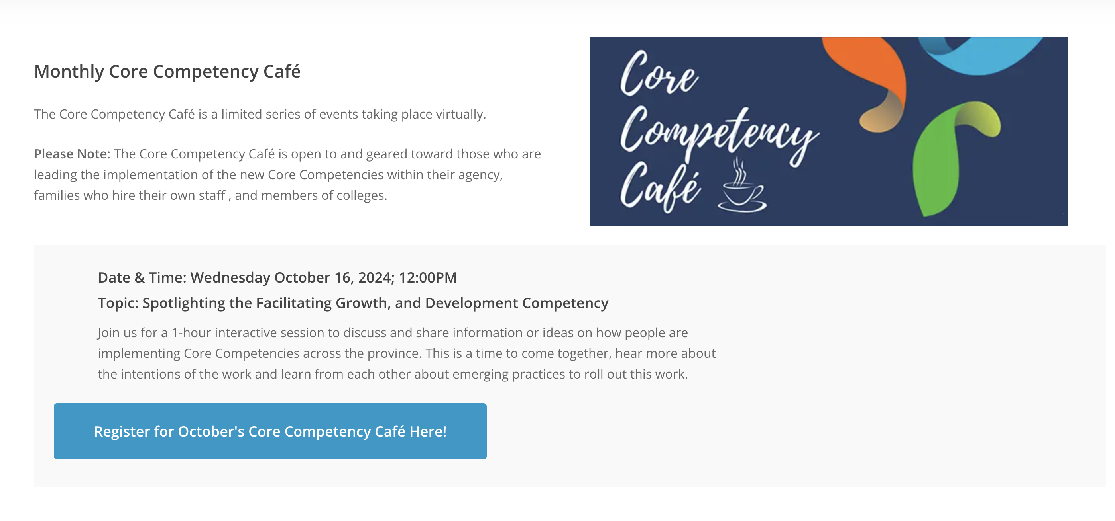
Where to find resources on RealXchange
Notes:
Brenda

Slide 15
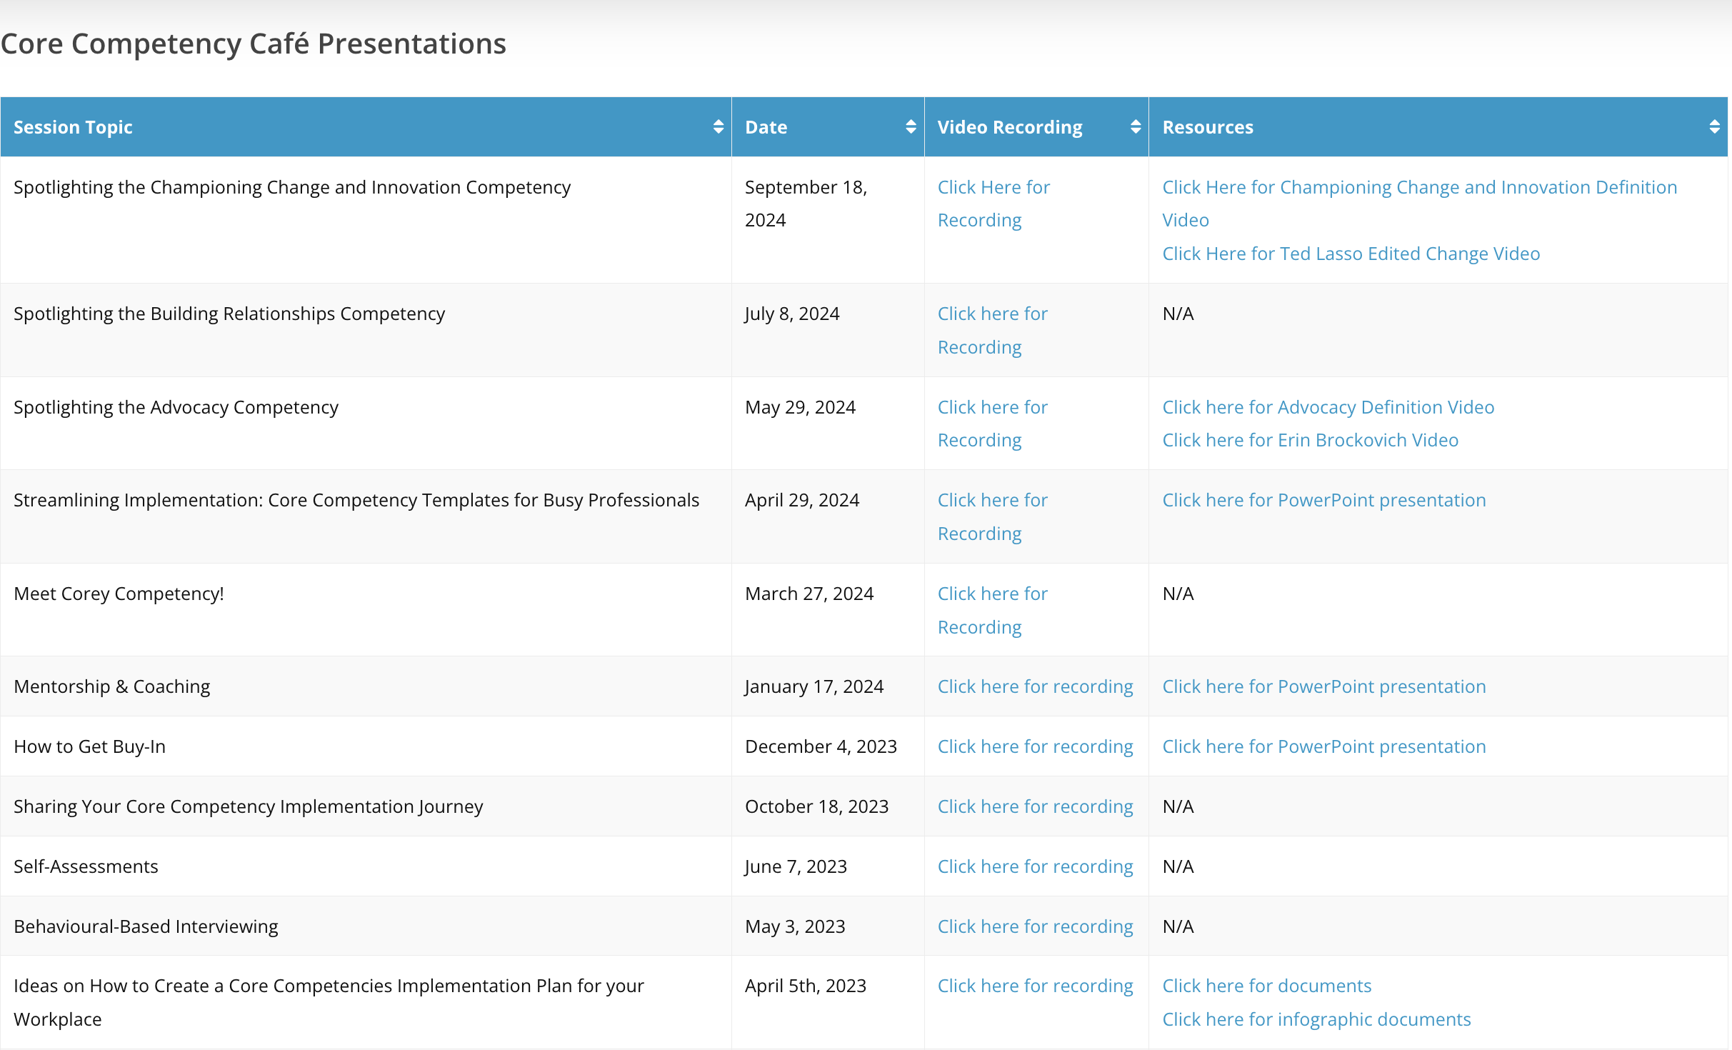
Where to find resources on RealXchange
Notes:
Brenda

Slide 16
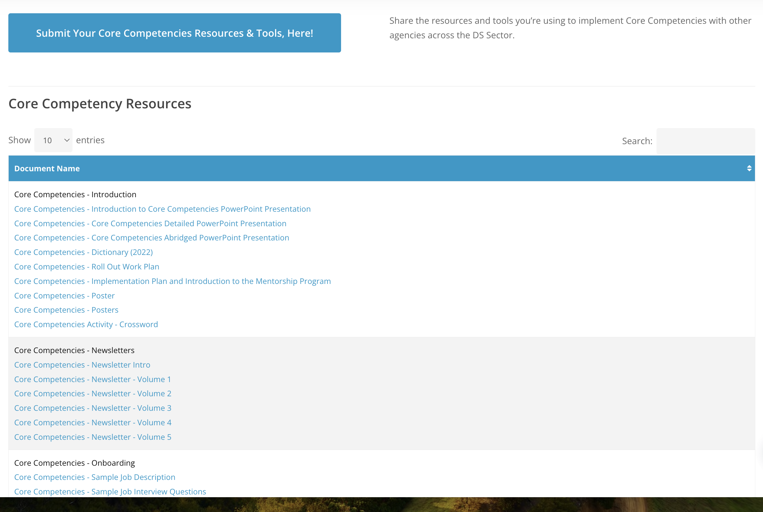
Where to find resources on RealXchange
Resources:
Introduction to Core Competencies
Newsletters
Onboarding
Core Competency definitions, poster and activities
Notes:
Brenda

Slide 17
Remember the Resources
https://www.dscorecomp.com/
Intro to Core Competencies video
https://www.dscorecomp.com/core-competencies/
Competencies Quiz
Self assessment
https://www.dscorecomp.com/self-assessment/
Development Resource Guide
https://www.dscorecomp.com/wp-content/uploads/2022/09/6.1-Development-Resource-Guide-PDF.pdf
Notes:
Brenda

Slide 18
More Resources
Tips for coaching
https://www.dscorecomp.com/wp-content/uploads/2022/09/7.-Preparing-for-a-coaching-session-Supervisor-Final.pdf
Core Competencies Discussion Planner
https://www.dscorecomp.com/coaching/
www.provincialnetwork.ca
Recruitment Based Marketing tools
https://provincialnetwork.ca/recruitment-based-marketing-resources/
The Real Xchange
https://realxchange.communitylivingessex.org/core-competencies/
Notes:
Brenda

Slide 19

Questions ??
Next Café November 13/24
Inclusive Leadership
Notes:
Next Café
Anyone can answer questions

Slide 20
Thank you!
Contact for the DS Workforce Initiative:
Ann-Marie Binetti
abinetti@cltoronto.ca

