Slide 1
Navigating Opportunities and Challenges: Hiring International Student Graduates in Ontario

Slide 2
Introductions
Karen Klee Emily Low Jamie Russell

Slide 3
Agenda and Learning goals.
Identify major recruitment barriers in Ontario with a sneak peak at the HR Survey and Vacancy data
Contrast vacancy with the trend of increased international student enrollments across the province that could serve to fill the vacancy gap
Using case studies review the common pathways to Permanent Residency in Canada (PR)
Understand NOC and TEER in the PR process
Understand the Employer Requirements
Considering the need for international workers in the sector and the recent changes to immigration #s, we will brainstorm action items to promote the hiring and retaining of skilled international graduates in Ontario

Slide 4
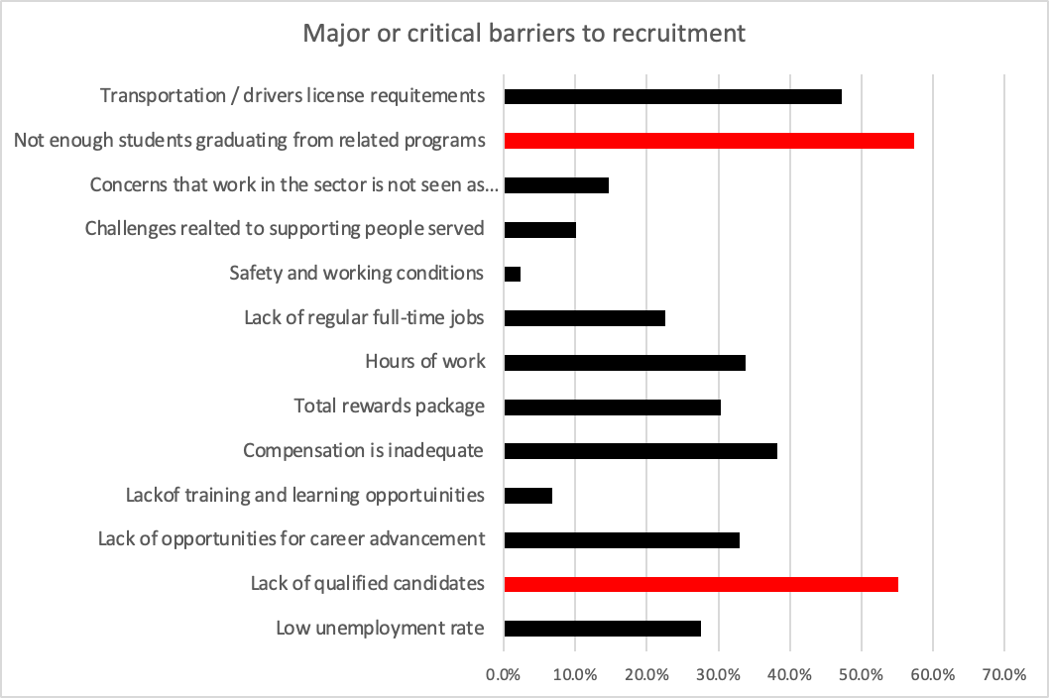
Human Resources Survey
(DSWI, HR Manager Survey 2024)
Notes:
Fresh off the press

Slide 5
Severe Vacancies across the Province
(DSWI, HR Manager Survey 2024)

Slide 6
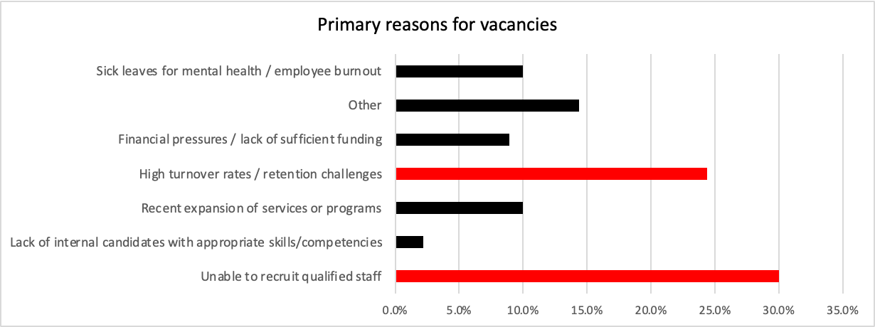
Reasons for Vacancies
(DSWI, HR Manager Survey 2024)

Slide 7
DSW Enrollment Trends at Colleges

Slide 8
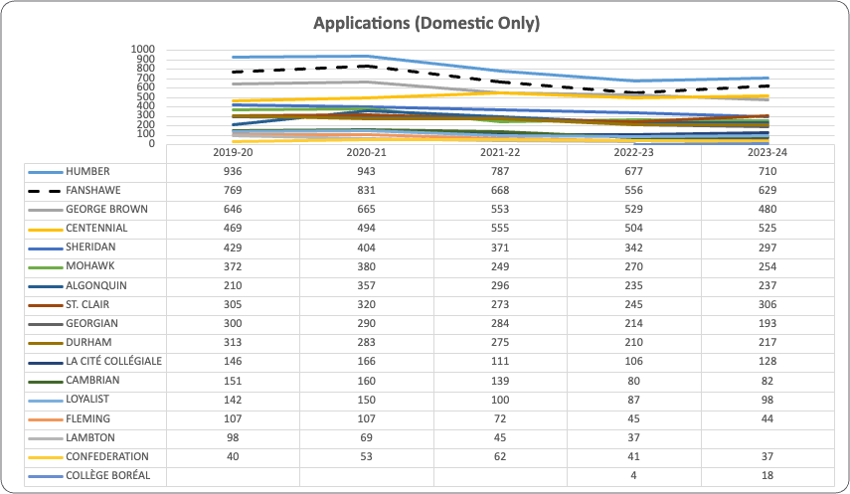
Domestic applications across the Province in DSW
Notes:
Fanshawe’s business library

Slide 9
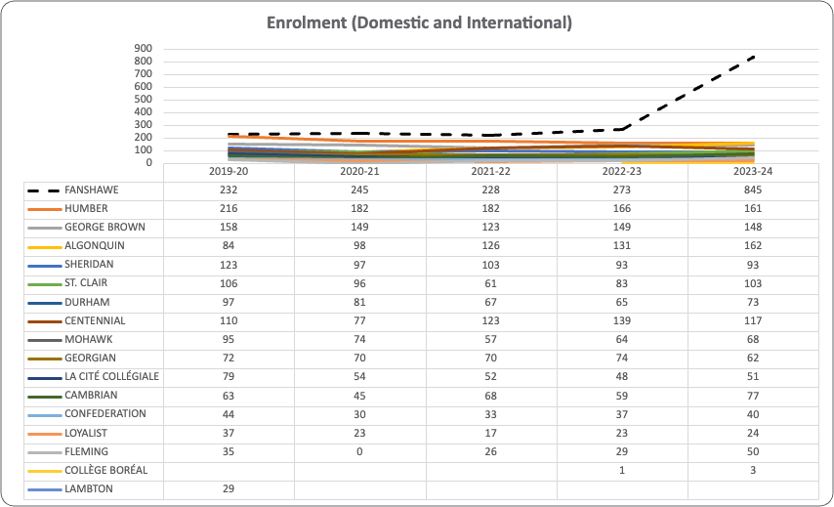
DSW Enrollment across the Province
Notes:
Increasing number of international graduates across all schools

Slide 10
Stats of international workers
Out of 607 total staff
Work Permit
89 staff
7 FT
82 PT
Study Permit
39, all PT
21% of staff

Slide 11
Understanding the PR process

Slide 12
Overview
The Ontario Immigrant Nominee Program (OINP) is the province’s economic immigration program. It works in partnership with the Government of Canada through Immigration, Refugees and Citizenship Canada (IRCC)
Foreign workers, international students and others with the right skills, experience and education apply to the OINP for a nomination.
The OINP recognizes and nominates people for permanent residence who have the skills and experience the Ontario economy needs, and the Government of Canada makes the final decision to approve applications for permanent residence

Slide 13
Exploring the NOC
In a nutshell, the NOC is a tool that is used to classify occupations according to their Training, Education, Experience and Responsibilities (TEER) category and broad occupational category. A five-digit code, also referred to as a unit group, identifies the occupation. There are 516 unit groups in the NOC 2021.
Let's use 42201 - social and community service workers
Notes:
NOC is a tool that ranks occupations according to their Training, Education, Experiences and Responsibilities into a 5 digit code
it breaks it down into
Broad Category
Major Group
Sub Major Group
Minor Group
Unit Group

Slide 14
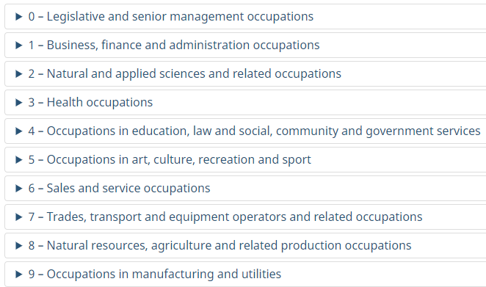
10 Occupational Categories
NOC 42201
Notes:
there are 10 broad occupational categories as represented by the first digit of the NOC code

Slide 15
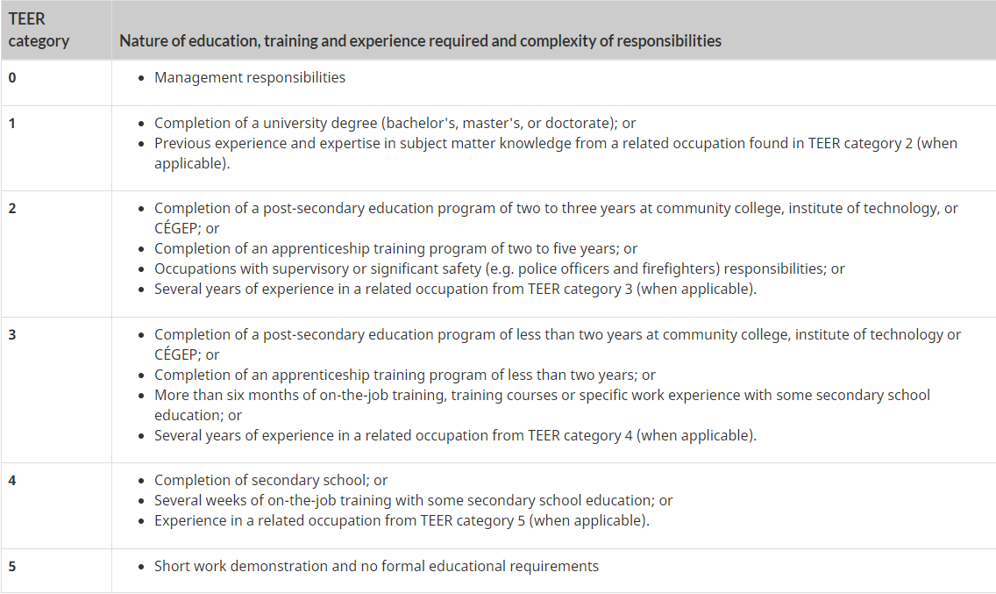
6 TEER Categories
NOC 42201
Notes:
TEER category corresponds to the type and/or amount of training, education, experience and responsibility typically required to work in an occupation. The NOC consists of six TEER categories, identified 0 through 5, which represent the second digit of the NOC code.
For the 42201 - social and community service workers, we see the second number is a 2 letting us know its TEER 2

Slide 16
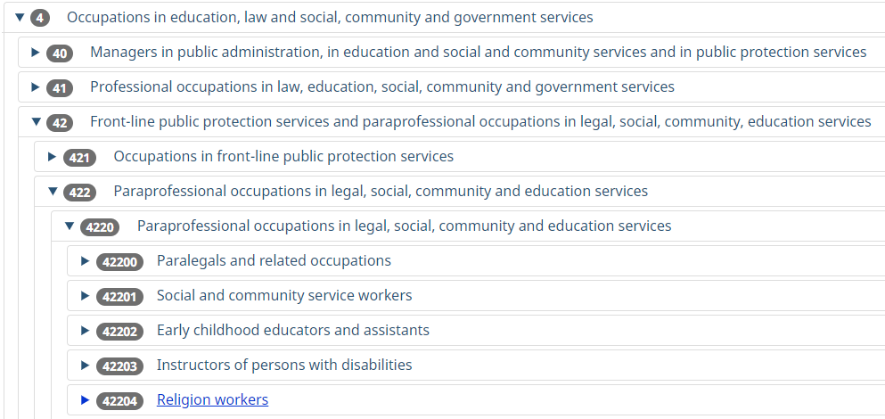
NOC 42201
Notes:
Here you can see how the NOC code 42201 is broken down
4 = Broad Category
42 = Major Group
422 = Sub Major Group
4220 - Minor Group
42201 - Unit Group
when you have staff reaching out asking for a specific NOC code, make sure you are giving them the one that relates to the position they are in. this will be explained more through the next few slides

Slide 17
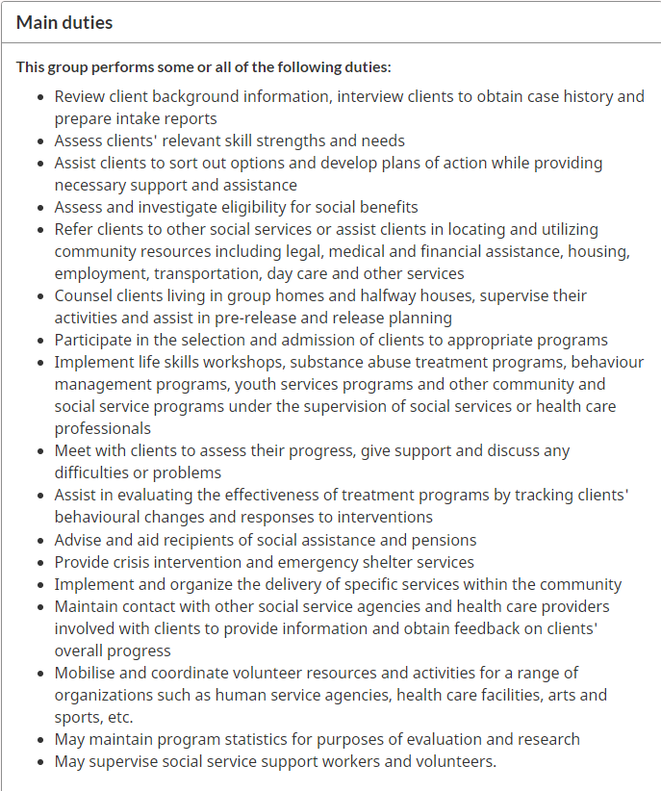
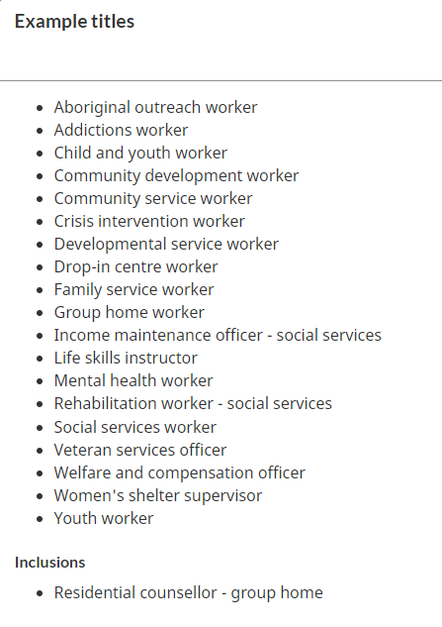
NOC 42201
Notes:
Each NOC code breaks down titles, main duties, employment requirements and any additional information
For 42201 is describes it as: Social and community service workers administer and implement a variety of social assistance programs and community services, and assist clients to deal with personal and social problems. They are employed by social service and government agencies, mental health agencies, group homes, shelters, substance abuse centres, school boards, correctional facilities and other establishments.
This shows the breakdown on the website, you will need to know these things to make sure that, if you are giving support for someone's nomination under OINP are giving the right NOC code

Slide 18
Pathways to PR
OINP - How to pick the right Stream
Encourage workers to complete the OINP - Stream Selector Tool
Determines the most suitable based on the following:
education;
language ability;
residency;
work experience;
Ontario job offer.

Slide 19
Meet Manmeet
International highschool student and DSW graduate from Ontario in search of Permanent Residence in Canada working in dual diagnosis at a hospital
Notes:
So for pr one important thing you need is a full-time permanent job which I was luckily able to get at the hospital but otherwise it's very difficult cause most of the available jobs are at group homes where it's too hard to get full time jobs cause it goes by seniority.
After I started working there I found out that hospital won't provide necessary documents and I met one girl who told that she got the invitation for pr but lost the opportunity because HR at the hospital refused to give the necessary documents so I was already looking at alternatives one of them being moving to another province but so we're the other 10 or so people working all of them international students so all of us talked with each other and then we talked to coordinator that if we don't get the documents we will have no choice but to leave and obviously they can't lose 10 people at the same time so the coordinator agreed and talked to her and got us the documents and then we had another problem the noc code that they gave us wasn't very and doesn't gets down out very frequently but cause our job description matches another noc code very well and because aging they didn't wanna lose 10 people they agreed to it. Some of the people thet applied got pr but some of us including me still haven't got it cause they draw limited number of every two weeks from random job categories. Using NOC nurses aide

Slide 20
Pathways to PR
Ontario Immigration Nominee Program (OINP)
Submit an Expression of Interest for Employer Job Offer: International Student stream
Graduate - Full time job offer in DSW - TEER 2 -
Graduate degree, graduate certificate or diploma that takes at least one year if pursued on a full-time basis from an eligible Canadian institution (within the last two years)
- Intent to live in Ontario once PR is obtained

Slide 21
Meet Anna
Internationally trained nurse and DSW graduate from Ontario in search of Permanent Residence in Canada – relocated to Western Canada
Notes:
Several programs in Saskatchewan can help people get their PR, there is a special program for workers that are in the high domain - certain careers, and another option applies as a student (does not matter where they graduated in SK or somewhere else in Canada). People can apply through SINP (Saskatchewan Immigrant Nominee Program), one of the requirements is to work a certain amount of hours as full-time staff ( in my case DSW). Another option is to apply for Express Entry, after receiving SINP, which is only about 6 months of waiting for PR, but it is a similar lottery, whoever gains more points - age, education, work experience and so on, wins and there is IELTS general test - could be challenging to pass for international students.
Workers that want to gain their PR in SK, first of all, have to find an organization that collaborates with the government (IRCC), which means not all companies may provide the documents to get PR ( same with ON). My gurney is still in process as it takes a long time to complete all the requirements and also the IRCC processing time is extremely long. After moving to SK, I was very lucky and I found a full-time job almost right away with the company (light of the prairies/LOTP) that in the government list. After a probation period of 3 months, I was able to apply through LOTP for a job offer letter, this letter is the pass to apply for SINP as the letter is proof of my work experience in SK: that I worked a certain amount of hours and my responsibilities match with the requirements of DSW, which takes about 3 months of the waiting process and the letter is expired within 6 months. Currently, I am waiting to hear back from the SINP student program (processing time for the SINP is approximately 2-4 months), and after the approval for SINP, a person can apply for PR (the waiting time for PR is approximately 10-20 months). One of the benefits is that RP applicants could change employers in SK, but they have to let the IRCC know of the changes and they have to find another job with exactly the same responsibilities, which helps a lot of people, in case of emergency, to leave the job that they currently occupy, not to lose their applications.
I decided to move to SK as I experienced a challenge in ON to get a full-time position as there is always senior staff that become ahead of the new graduate, or if it is a full-time position organization may not support with the documents, which happened with me in both ways. Also, one of my friends, a couple of years ago, had a bad experience in Ontario to get their PR. They were working hard and after a year of waiting the program was closed and they lost a yeah, so they had to move to another province. My friend at that time was working with the immigration assistant, so they were advised to choose the SK province. In my experience, since I moved to SK, I know 2 people who moved to SKfrom ON, because they were not able to get the paperwork. My experience or example is not the best, as it took a lot of time and energy ( very emotional), but so far it is slowly going and giving me more chances to become PR in Canada.

Slide 22
Pathways to PR
Ontario Immigration Nominee Program (OINP)
Submit an Expression of Interest for Employer Job Offer: In-Demand Skill Stream
Full time job offer that fits under NOC 44101 Home support workers, caregivers and related occupations. Must meet Median Wage level
Canadian secondary school diploma or credential, or its equivalent in another country.
Intent to reside in Ontario.
At least 9 months accumulative paid FT work experience in this NOC (1,200hrs)
Language Requirements - (CLB4+)
Notes:
The Ontario Immigrant Nominee Program (OINP) is the province’s economic immigration program. It works in partnership with the Government of Canada through Immigration, Refugees and Citizenship Canada (IRCC)
Foreign workers, international students and others with the right skills, experience and education apply to the OINP for a nomination.
The OINP recognizes and nominates people for permanent residence who have the skills and experience the Ontario economy needs, and the Government of Canada makes the final decision to approve applications for permanent residence

Slide 23
Meet Bianca
Internationally trained nurse, in search of Permanent Residence in Canada within Community Living and no education in Canada
Notes:
Applied OINP through: Expression of Interest, if you have a job offer: Foreign Worker Stream

Slide 24
Pathways to PR
Ontario Immigration Nominee Program (OINP)
Submit an Expression of Interest for Employer Job Offer: Foreign Worker Stream
Full time permanent job offer that fits under a skilled occupation at TEER category 0, 1, 2 or 3 (DSW is Teer 2) and must meet Median Wage level
Canadian secondary school diploma or credential, or its equivalent in another country.
Intent to reside in Ontario.
At least 9 months accumulative paid FT work experience in this NOC (1,200hrs)
Language Requirements - (CLB4+)
Notes:
The Ontario Immigrant Nominee Program (OINP) is the province’s economic immigration program. It works in partnership with the Government of Canada through Immigration, Refugees and Citizenship Canada (IRCC)
Foreign workers, international students and others with the right skills, experience and education apply to the OINP for a nomination.
The OINP recognizes and nominates people for permanent residence who have the skills and experience the Ontario economy needs, and the Government of Canada makes the final decision to approve applications for permanent residence

Slide 25
Pathways to PR
Canadian Experience Class - Express Entry (not Province specific)
At least 12 months (equal to 1,560hrs/30hrs a week) of skilled work experience in TEER 0,1,2,3 (DSW TEER 2) in the last 3yrs.
Show that they performed:
the actions in the lead statement of the occupational description (National Occupational Classification (NOC)) and most of the main duties listed
Meet language requirement (CLB 5 for TEER 2/3)
There is no education requirement
Eligibility for Express Entry programs: Who can apply for the Canadian Experience Class - Canada.ca

Slide 26
A New Wrinkle
Despite meeting the descriptive criteria for Health and education for people with disabilities, DSW’s program code was excluded from options for International students to use to apply for a study permit
Is this an oversight?
Fanshawe’s DSW to shrink to less than half of what it’s previous graduate numbers were. Similar across other colleges
SSW is still viable but does not have the expertise in health care and DS as the DSW
The impacts could be significant depending on where your agency is.
Notes:
am writing this email to inform you of changes to student immigration services in Canada that will have a significant impact on the Developmental services sector in Ontario.
On September 18, the federal government announced additional cuts to student study permits. In the announcement, there is recognition that certain sectors are so underserviced by domestic workers that international graduates will still be required. These include programs that support
Health Care
Agriculture
Trades
STEM programs and
Transport
As of Nov 1, 2024, any international student hoping to apply for a Post-graduate work permit will need to meet the criteria linked here, which includes certain designated fields of study which are coded using the Classification of Instruction Program system (CIP).
The Developmental services worker program (CIP code 19.0710) is no longer listed as an eligible program. This, even though there is a description in the criteria that indicates the health and education of people with disabilities is among the required skill set for international workers. Yet, in Ontario the program that meets that skill set is the DSW program, and it has been excluded. The implications for DSW students and of course the Agencies that hire them will be profoundly affected by these changes. Many DSW programs across the province rely on international student enrollments to meet market labour demands. DSW graduates work in Residential, Day program and Employment supports, as well as family homes and as Educational Assistants within our local school boards, many of which are already experiencing critical staffing shortages. Colleges and Institutes Canada provided a similar open message to all Canadians.
By sending out this communication, we are hoping to inform our community partners and the DS sector and discuss opportunities to dialogue with our MPs, MPPs and government officials to highlight the need within our services to have access to both domestic and international graduates to meet the employment demands.

Slide 27
A New Wrinkle
On September 18th, the Federal Government made an announcement to reduce student permit’s and despite our sector being reliant on international graduates, DSW programs were excluded
In the announcement, there is recognition that certain sectors are so underserviced by domestic workers that international graduates will still be required. These include programs that support
Health Care
Agriculture
Trades
STEM programs and
Transport
Notes:
Bianca option is still available.

Slide 28
Brainstorm
Notes:
Contact Mp and MPPs if you want to advocate for international workers and student graduates
Brainstorming
To help international employees fill vacancy gaps in developmental services in Ontario, a multi-faceted approach can be taken, focusing on recruitment, integration, and support. Here are several strategies:
1. Streamline Immigration and Recruitment Processes
Leverage Immigration Pathways: Utilize immigration programs like the Ontario Immigrant Nominee Program (OINP), Express Entry, and Temporary Foreign Worker Program (TFWP) to attract skilled international workers.
Fast-track Work Permits: Advocate for expedited processing of work permits and visas for professionals in developmental services.
International Recruitment Campaigns: Partner with global recruitment agencies, attend international job fairs, and advertise positions in countries with strong healthcare and social service training programs.
2. Recognize and Accredit Foreign Credentials
Simplify Credential Recognition: Develop pathways to recognize foreign qualifications and experience in social services, education, and healthcare, ensuring employees meet Ontario's professional standards without lengthy delays.
Bridge Training Programs: Offer programs that help international employees meet Ontario’s regulatory and certification requirements, such as providing short courses or mentorship opportunities that bridge any gaps.
3. Offer Support with Professional Development and Training
Onboarding and Orientation: Provide comprehensive orientation programs that introduce international employees to the specific practices and regulations in Ontario’s developmental services sector.
Language and Communication Support: Offer language training and communication workshops, especially in specialized terminology used in developmental services.
Ongoing Training: Provide access to continuous professional development, ensuring international workers are up-to-date on industry best practices and Ontario regulations.
4. Cultural Integration and Support
Create Welcoming Work Environments: Foster an inclusive workplace culture by offering diversity and inclusion training to existing staff. This can help ease international workers into the team and reduce potential barriers.
Mentorship Programs: Pair international employees with local mentors to provide guidance and support, both professionally and socially.
Support Networks: Establish support networks or affinity groups where international workers can share experiences and access resources.
5. Retention Strategies
Offer Competitive Compensation: Ensure that wages are competitive, with opportunities for career growth and development, to retain talent.
Support Permanent Residency: Encourage pathways to permanent residency through job stability and additional support in navigating the immigration system.
Work-Life Balance: Promote a healthy work-life balance and provide assistance with housing, relocation, and family integration for international employees and their families.
6. Collaborate with Educational Institutions
International Student Pathways: Work with colleges and universities that offer social services and developmental programs to attract international students. Offer internships and co-op placements to create a pipeline of qualified workers.
Specialized Training Programs: Collaborate with training institutions to design programs tailored to developmental services that target international professionals with related backgrounds (e.g., nursing, psychology, special education).
7. Government and Sector Partnerships
Advocate for Policy Changes: Work with government bodies to create policies that support the hiring and retention of international employees in developmental services.
Sector Partnerships: Collaborate with agencies and organizations within the developmental services sector to develop standardized approaches to international recruitment, credential recognition, and integration.
These strategies can help alleviate staffing shortages in Ontario’s developmental services sector by tapping into the global talent pool and providing the necessary support for international employees to thrive.

Slide 29
Requirements
have been in active business for at least three years
have business premises in Ontario where you will work
have no outstanding orders made against them under the Ontario Employment Standards Act, 2000 or the Occupational Health and Safety Act
a minimum of $1,000,000 in total gross annual revenue if you will work or report to work at a location in the Greater Toronto Area (City of Toronto, Durham, Halton, York and Peel regions) or
a minimum of $500,000 in total gross annual revenue if you will work or report to work at a location outside the Greater Toronto Area

Slide 30
Requirements
have been in active business for at least three years
have business premises in Ontario where you will work
have no outstanding orders made against them under the Ontario Employment Standards Act, 2000 or the Occupational Health and Safety Act
a minimum of $1,000,000 in total gross annual revenue if you will work or report to work at a location in the Greater Toronto Area (City of Toronto, Durham, Halton, York and Peel regions) or
a minimum of $500,000 in total gross annual revenue if you will work or report to work at a location outside the Greater Toronto Area

Slide 31
Requirements
Your employer’s business must have at the time of application submission one of the following:
in the Greater Toronto Area (City of Toronto, Durham, Halton, York and Peel regions) at least five full-time employees who are Canadian citizens or permanent residents who work at the location where you will work, or will report to work.
outside the Greater Toronto Area at least three full-time employees who are Canadian citizens or permanent residents who work at the location where you will work, or will report to work.

Slide 32
Requirements
the employee you support nomination in must stay employed during the nomination period (ie. when they get PR)
Employer has to fill out the Employer Form
and more ...

Slide 33
Pathways to PR
Opportunities
Changes to Post Graduate Work Permit this Fall 2024/Winter 2025 (Federal Gov’t)
Realigning with immigration goals and labour market needs
= Only specific College and University programs will remain eligible…
Local and Provincial representatives to help identify these Occupations as “In-Demand”
MPs/MPPs/Chambers of Commerce/Municipalities
Connect with a Municipal Newcomer Strategy near you!
London's Newcomer Strategy | City of London
Toronto Newcomer Strategy – City of Toronto

Slide 34
What can the sector do?
Let’s take a minute to brainstorm action items recognizing that international employee’s can help fill the vacancy gaps

Slide 35
Resources
Ontario Immigrant Nominee Program (OINP)
The National Occupational Classification (NOC)
Learn About the NOC - Tutorial
Employer Guidelines: Job Offer Streams
Employer Forms

