Slide 1
RESILIENCE
the ability to successfully adapt to stressors, maintaining psychological well-being in the face of adversity

Slide 2
7 key components that make up resilience
Confidence
Competence
Connection
Character
Contribution
Coping
Control
Notes:
Dr Ginsburg, child paediatrician and human development expert, proposes that there are 7 integral and interrelated components that make up being resilient – competence, confidence, connection, character, contribution, coping and control.Dec 14, 2013
Competence – is the ability to know how to handle stressful situations effectively. It requires having the skills to face challenges, and having had the opportunity to practice using these skills so that one feels competent in dealing with situations..
2. Confidence – is the belief in one’s own abilities and is rooted in competence. people gain confidence by being able to demonstrate their competence in real situations.
3. Connection – people with close ties to friends, family, and community groups are likely to have a stronger sense of security and sense of belonging. These people are more likely to have strong values and are less likely to seek out alternative destructive behaviours..
4. Character –people with “character” enjoy a strong sense of self-worth and confidence. They are in touch with their values and are comfortable sticking to them. They can demonstrate a caring attitude towards others. They have a strong sense of right and wrong and are prepared to make wise choices and contribute to the world
.
5. Contribution – if people can experience personally contributing to the world, they can learn the powerful lesson that the world is a better place because they are in it. Hearing the thank you’s and appreciation when you contributes, will increase their willingness to take actions and make choices that improve the world, thereby enhancing their own competence, character, and sense of connection.
6. Coping – people who have a wide repertoire of coping skills (social skills, stress reduction skills) are able to cope more effectively and are better prepared to overcome life’s challenges
7. Control – when people realize that they have control over their decisions and actions, they are more likely to know how to make choices in a way that they can bounce back from life’s challenges.

Slide 3
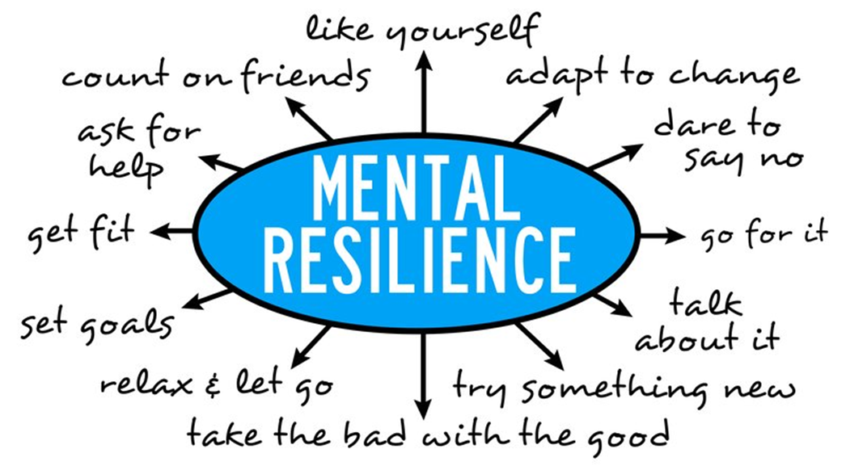

Slide 4
Self Development Ideas from the DRG
Maintain a healthy lifestyle – eat well, exercise, walk in nature
Make connections to lean on during difficult times – list 6 people you can call on when needed.
Nurture a positive view of yourself. – list 6-10 positive things you can say to your self
Practice gratitude – start a gratitude journal
Identify a tough situation you faced and make a list of 5 things you would do differently next time.
Notes:
Evolving - Identify a situation where you tried to calm others and note what did or did not work. ● Identify two situations where you demonstrated self control and two situations where you did not. Note what you did different in the situations and what the outcomes were, Make a list of how you physically feel during a crisis or challenging situation. Explore 3 grounding techniques you can employ during challenging times. ● Journal every evening for 3 weeks.
Leading - Identify a challenge that you or your team overcame. Make a list of things that supported you to be successful. How did the challenge help you grow personally/ professionally. ● Make a list of 5 activities that you enjoy and find relaxing. Schedule in your calendar a time to engage in the activities. Reflect on the benefits of these activities. ● Identify a time when you handled a crisis well. Note the strategies you used and their effectiveness. Ask a colleague for their feedback.
Resilience Activity: Life experiences that strengthened me: My support network of people who encourage me: Attitudes and Beliefs that Protect me: Physical self-care habits that prepare me or help me release tension: Action skills I can use to change the situation

Slide 5
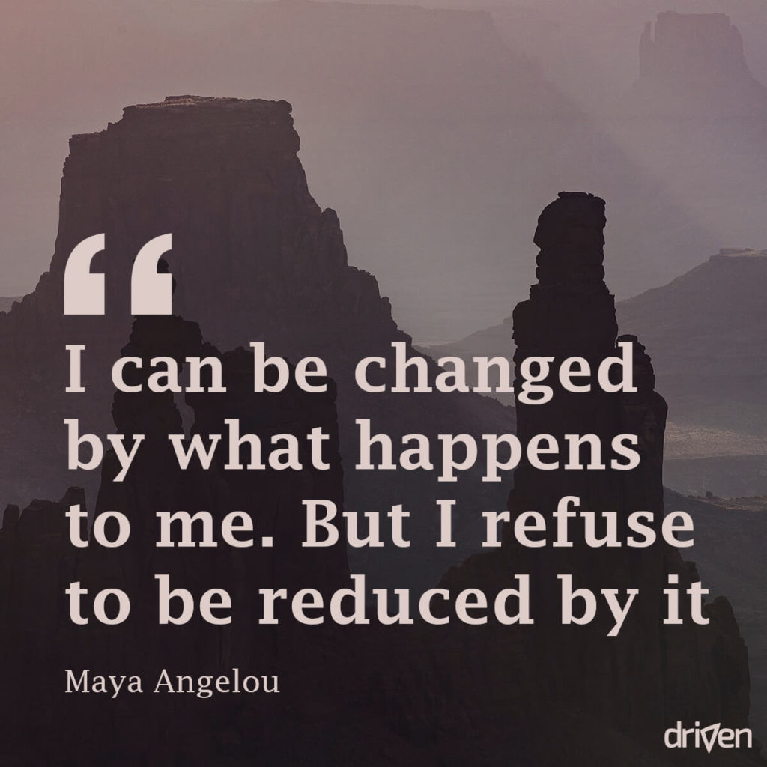
Bouncing back
Everything we experience impacts us, but it is our way of dealing with these situations that builds resilience.
The ability to move through and grow from difficult times.
It’s a skill you develop over time from the lessons and experiences you absorb

