Slide 1

Exploring the Intersectionality of Disability and Race:
Advancing Equity and Inclusion
March 6, 2025

Slide 2

AGENDA
Race & Disability Canada
        Brave Spaces
Social Location & Intersectionality
Unpacking Culture, Race and Colorblindness
The Intersection of race and disability
Courageous Conversations
ODEN
Impact on Employment Service Delivery

Slide 3

Land Acknowledgement
Staff at Race and Disability Canada live and work on the traditional territories of many Indigenous nations including Mississaugas of the Credit First Nation.
We acknowledge the legacy of colonization and oppression of indigenous peoples in Canada and across the world. We are hopeful that all indigenous nations have their rights protected and upheld.
As a Canada-wide organization committed to tackling the interconnectedness of race and disability, our work is bound with Indigenous solidarity, and we are on a constant journey to uphold this commitment.
Notes:
Disability justice and a commitment to reconciliation with indigenous peoples all over the world
At Race and Disability Canada, we see Indigenous solidarity as an active, ongoing commitment. I encourage you to consider: What does solidarity look like in practice for you and your organization? How can we work together to ensure that our commitments go beyond statements and into real, transformative change?"

Slide 4
Introductions:
About Race and Disability Canada

Slide 5


About Race and Disability Canada
We conduct research and provide education and training to understand and amplify the lived realities of Indigenous, Black and Racialized people with Disabilities (IBRpD) in Canada. Our work addresses the root causes of systemic marginalization of IBRpD with the aim of driving transformative change in service provision and policy directives across the country.

Slide 6



Our Projects
This project is funded by the Government of Canada's Social Development Partnerships Program-Disability Component (SDPP-D).
This project is funded by the Government of Canada’s Social Development Partnerships Program – Disability Component –Intersectional Capacity Development Stream 2.

Slide 7
Brave Spaces:
Creating the space for discussion

Slide 8
Brave Spaces over Safe Spaces
Respect - Responsibility
Oops - Openness - Opportunity - Optional
Presence - Privacy
Energy - Empathy - Engaged
Speak from the I - Seek Clarity - Share
Notes:
Go through the acronym in the next slide and discuss what each letter means.
We differentiate from safe spaces because what is safe for one person, will not be safe for others
We have the acronym ROPES for guidelines on how to engage with one another
Respect – give benefit of doubt – engage with disagreement with kindness and care
Responsibility – take ownership of your own experiences, actions and words
Oops – it is OK to make mistakes in this space, this is how we will learn
Openness – be receptive to hearing things that are uncomfortable or different – accept differences – recognize that we make mistakes, and we will learn
Opportunity – use this CoP to learn, engage and give back to colleagues and facilitator/org
Optional – do not have to speak all the time– can use the chat, can take in and reflect
Presence – show up and join the program – recognize feelings of discomfort/frustration etc – keep camera’s on
Privacy – share only what you are comfortable with – we cannot guarantee confidentiality – respect privacy of colleagues in the group – share examples but no names or seek permission
Energy – Attend with intent and capacity to engage
Empathy – we are all at different levels of our learning as individuals and orgs – reserve judgment, seek to understand and support
Engaged – similar to presence – stay with us even when you are not sure of relevance
Speak from the I – speak on behalf of yourself, not others
Seek Clarity – ask questions to understand
Share – share the air time – read the room – who is speaking and who is not.

Slide 9
Social Location & Intersectionality:
How we show up to do the work

Slide 10

Social Location
What is it?
The social position or power/influence an individual holds in society based on social characteristics considered important by society. This can be conceptualized as relational status, position in society, privilege, and/or oppression/marginalization, depending on which element of your identity is at play.
Why is it important?
When we advocate for a group, we come to the work with perspectives/analysis, experiences, power and/or influence. This impacts and informs the way we approach the work.
Important to acknowledge social location as it informs our interest in the work, how we show up/how we are perceived and how we engage and do the work.
It keeps us accountable to our communities.

Slide 11
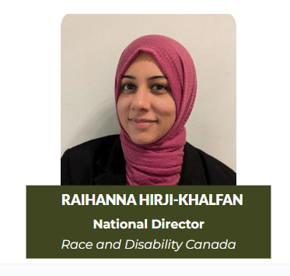
Social Location – Raihanna Hirji-Khalfan
Notes:
I want to share with you my social location, how I fit into the context of the work Race and Disability Canada.
My name is RHK
I am racialized
I am visible Muslim – wear hijab – a scarf that covers my hair and neck.
My family are from Tanzania, East Africa, but I am brown because of my ancestry is Indian
British and also Canadian
Immigrant to Canada, and a settler on stolen indigenous land
Woman
Able-bodied
I grew up in a household with a mom who had significant mental health issues
I am an aunt to a now adult nephew with autism – I watched and observed my sister navigate systems and develop supports for her son.
I married a wonderful man who has lupus and have witnessed and lived through all the joys and challenges of episodic disabilities.
I am a mom of 3 daughters.
I have 3 master degrees – Business, Critical Disability Studies and Canadian Common Law and I am currently training to be a lawyer in Ontario.
My work in the disability sector began in 2005 where I worked as the diversity worker at Deafblind UK looking at the needs of racialized people who had a dual sensory impairment – people who were bot deaf and blind. As part of an expanded portfolio, I conducted community-based research on the social, religious, and cultural needs of racialized people with disabilities in England. When I moved to Canada, I connected with Rabia who in turn connected me to grassroots race and disability organizations where I worked with them on governance issues and supporting their work through education and training. I also worked with Deaf communities in North America and helped to est the first international conference of Deaf Muslims in Qatar in 2013.
After a Masters in Critical Disability Studies in 2010, I worked at McMaster University as the Accessibility Officer when I managed the institutions compliance obligations with the Ontario Accessibility legislation the AODA, I also designed and delivered training and education programs on human rights, diversity, equity and inclusion.
These experiences all have a direct impact and connection to my work at Race and Disability. This acknowledgement of my social location is always top of my mind and informs the way think about race and most importantly underscores my relationship to disability.
My experiences with disability has been as an observer and supporter pwd. I recognize my role is very clearly as an ally to the disability rights movement and to Deaf communities as well.
I share this with you all today, as a humble acknowledgement that my work in the disability sector spanned across almost 2 years, it has crossed international borders and as an ally, I am on a constant journey to renew my commitment to fulfil my work at RDC, with integrity and in full recognition of my social location.

Slide 12
Social Location in Practice:
How to use social location in your work
Notes:
Why did I share all this? Any work we do on equity, inclusion and intersectionality requires us to be conscious of our social location – not just our identity markers but how these impact our work and how we engage in this sctor – being an ally is important for me to be aware of given my position – so the Q for you all is the same -

Slide 13
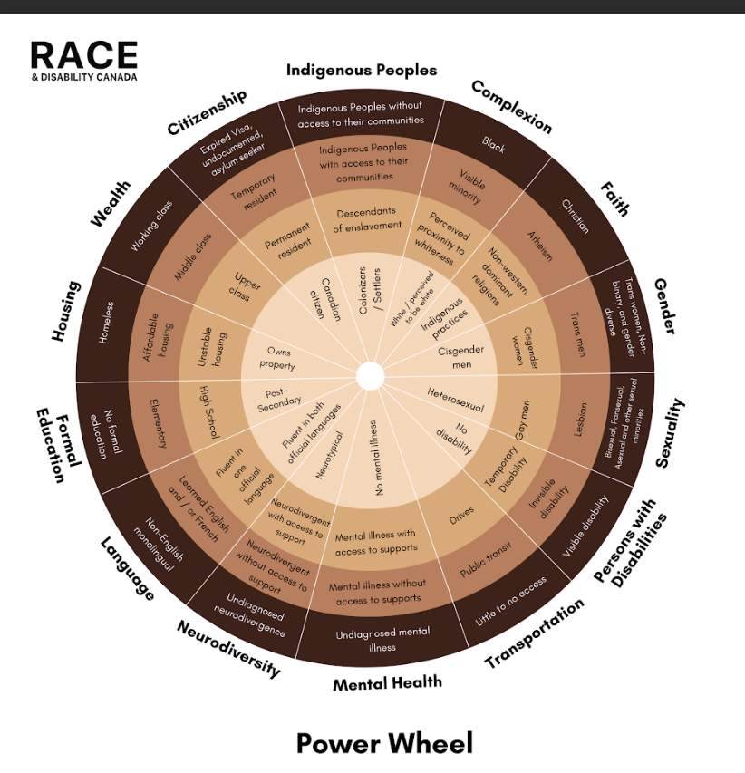
Reflection
Who am I and how does this affect the way I approach my work?
Whose voices are invited/included in your work?
Notes:
The wheel is an example of identies to consider and how they impact you – note that these are relational – power in one context does not equal power in another context. E.g.: my educational background gives me an edge in some cases but when people see me first the first time – my competence and professionalism is not assumed so my privilege is diminished and is context dependant

Slide 14
Defining commonly (mis)used terms
Notes:
Ask participants – what is culture?

Slide 15


What does Culture mean to you?
ⓘ Start presenting to display the poll results on this slide.

Slide 16
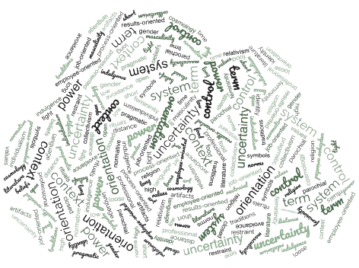
What is culture?
Ideas, customs, traditions, beliefs, and practices shared by a group of people
We all have a culture that is:
  Shared with others
  Based on symbols – language, art, stories, rituals etc.
  Learned
  Integrated and reinforced across institutions
  Dynamic
  We all have a culture
  Culture has many dimensions to it.
Notes:
Important to note culture – often gets a bad rep but most often is referred to in the context of ‘diversity’ and minority communities rather than being a catch all concept to describe how we all do things.

Slide 17

What is Race?
ⓘ Start presenting to display the poll results on this slide.

Slide 18
Defining race
Race is used to categorize groups of people based on physical characteristics or skin color/hair texture.
While racial categories are biological and describe physical traits inherited from parents, the categorization into groups have been developed in a hierarchical and arbitrary manner.
Race is basically socially constructed to divide us into racial categories based on social, political, cultural and economic dynamics that have place the racial category of White at the top of the hierarchy.
Notes:
There is no such thing as race – instead, it is a “social construct.” This means that society forms ideas of race based on geographic, historical, political, economic, social and cultural factors, as well as physical traits, even though none of these can legitimately be used to classify groups of people (Ontario Human Rights Commission).

Slide 19
Defining racialization
The term "racialized persons" broadly encompasses individuals and groups identified outside the dominant White or Caucasian racial categorizations.
This classification recognizes a diverse array of ethnicities and races, including South Asian, Chinese, Black, Filipino, Latin American, Arab, Southeast Asian, West Asian, Korean, mixed-race individuals, and others who are non-White.
Whiteness is a social construct that considers the White race as the default or "normal" standard in society, giving privilege and advantage to white people while pushing other racial identities to the margins.
This process, known as racialization, determines how different groups are categorized and valued, often reinforcing discrimination and exclusion.

Slide 20
Disability & Racialization
Canada’s first immigration statute, An Act Respecting Immigration and Immigrants (1869 Act) sought out to recruit “White, Angle-Saxon “healthy” individuals willing to work and build a new home and a new country for themselves and their families,” (Chadha, 2008; Hanes, 2009; Niles, 2021).
The 1869 Act also had an explicit preference for British and French subjects (Niles, 2021).
The 1976 Immigration Act amendments continued its preference for younger, able-bodied individuals effectively excludes and reifies notions of people with disabilities as unproductive members of society who do not adequately contribute to the Canadian economy, instead excessively putting demand on the health and social services of this country (Niles, 2021).
Notes:
clear and explicit example of how the history of Canada is rooted in racist ableism – more info on this re: colonization and enslavement and disability @ RDC – join programs!

Slide 21
Disability and Race
When policymakers, service providers, and funders design disability programs, which racial group do they typically have in mind?
Notes:
In many societies, Whiteness is seen as the "default" or "normal" standard, which gives White people more social advantages.
At the same time, people from other racial backgrounds are often pushed to the margins, facing discrimination and fewer opportunities because of this power imbalance.
Disability = whiteness.

Slide 22
What does colour blindness mean to you in the context of Race?
ⓘ Start presenting to display the poll results on this slide.

Slide 23
Colorblindness
Colorblindness is the idea that ignoring race makes society fairer.
People who believe in colorblindness often say things like "I don’t see color" or "Race doesn’t matter to me”.
While this may sound positive, colorblindness actually hides racism instead of fixing it.

Slide 24
Why “not seeing race” is a problem
It ignores systemic racism- Pretending race doesn’t matter overlooks the real ways racism affects jobs, education, healthcare, and policing.
It erases lived experiences – Racialized people face discrimination daily. Saying "I don’t see color" dismisses this reality.
It keeps privilege invisible – If race isn’t acknowledged, neither is the privilege that comes with being white in society.
It prevents meaningful change – Solving racial injustice requires recognizing race and addressing inequalities, not ignoring them.

Slide 25
The myth of neutrality
The idea that acknowledging differences creates division, or that we can be completely free of bias, assumes that neutrality is possible.
Bias is not about being "good" or "bad"—it’s something we all have.
The key is to recognize and challenge our biases and the reality that we can never be truly neutral.
Instead of colorblindness, we need race consciousness—acknowledging how race shapes experiences and working toward equity.
Notes:
Examples:
"I don’t see color."
Ignoring race means ignoring the impact of racism and systemic discrimination.
Media Objectivity
Stories told/ignored are shaped by biases, e.g., depiction of disability in media
Which missing kids have the amber alert?
How are pwd depicted in cartoons and movies?
Academic research – reflective of researcher biases
Hiring – white sounding names get more callbacks

Slide 26
The intersections of race and disability
Notes:
Ask participants – what is culture?

Slide 27
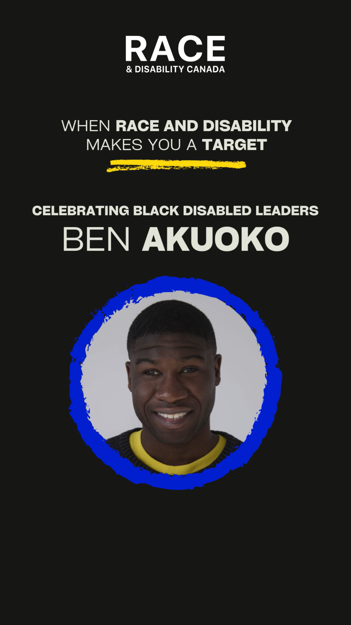
Racism, Ableism & Police Brutality
Notes:
https://www.instagram.com/reel/C_1BCy-Pt3w/?utm_source=ig_web_copy_link&igsh=MzRlODBiNWFlZA==
A young black man with vision loss feels more comfortable without his cane
However, when he is in public he is often stopped by the police for ‘strange behaviour’ when he walks without one
In order to protect himself from police harassment, and to appear ‘non-threatening’ he carries his cane

Slide 28
Racism, Ableism & Terrorism
South Asian man with autism at Tim Horton’s flipping through a magazine on airplanes.
Onlooker called the police because of ‘suspicious’ behaviour.
The combination of being a south Asian man demonstrating typical behaviours of someone with autism = terrorism.
Notes:
Key point – individual racism, systemic racism has a profound impact of the lives of IBRpD. Examples are jarring but provided to showcase the real life impact.
Less jarring example – customer at a bank requested info translated into Urdu in accessible format – the accessibility department and the EDI dept operate separately – this request fell through the gaps.

Slide 29
Racism, Ableism & Service Gaps
Customer at a bank request banking information translated into Urdu and in an accessible format.
The bank has a DEI department and an accessibility department that do not work together.
Results in a service gap highlighting the siloed approach and failure to included racialized people in the category of customers with disabilities.
Notes:
Key point – individual racism, systemic racism has a profound impact of the lives of IBRpD. Examples are jarring but provided to showcase the real life impact.
Less jarring example – customer at a bank requested info translated into Urdu in accessible format – the accessibility department and the EDI dept operate separately – this request fell through the gaps.

Slide 30
Courageous Conversations
Notes:
Ask participants – what is culture?

Slide 31
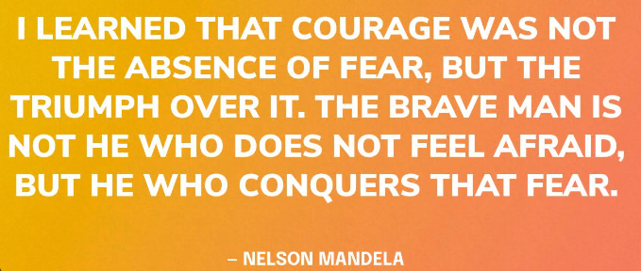
Notes:
Important to note this as courageous conversations because talking about race often induces a lot of worry, fear, anxiety and nervousness. We know and this has been shown in our research that non-racialized people (in general) do not know how to talk about race.
Language
Unsure of history
Don’t want to say something wrong
Do not want to be called out and def not want to be called a racist.

Slide 32

Why is this a Courageous Conversation?
Non-racialized people are (generally) uncomfortable talking about race:
  Fear
  Uncertainty
  Nervousness
Concerns include:
  How to apply the language of race – terms, context and insider/outsider status
  Unsure/unaware of history – not sure how concepts affect the context today
  Do not want to be called out for saying the wrong thing/be called a racist.
Notes:
Why is this presentation called Courageous conversations?
Important for you to know this – 1st – even if racialized – we all at risk when we talk about race – connect to social location and 2nd – understand the difficulty of talking about race when this is the underlying fear/worry 3 – meet people where they are at – esp now – so much fear, worry and concern about IDEA work – must use this as an opportunity to build communities – open dialogue and create last, intentional change

Slide 33
Key Takeaways

Slide 34
Reminders
Our social location impacts the way we do the work
We all have culture
Disability is not = whiteness
None of us are truly “neutral”
We need race consciousness in disability advocacy
Courageous Conversations are critical to our work
Race & Disability Canada is here to support your ongoing learning

Slide 35
Race and Disability Canada Resources:
Toolkits and networks to support your IDEA work

Slide 36

IDEA Toolkits
The IDEA toolkits are designed to support organizational leaders to facilitate meaningful dialogue on the intersection of race and disability. These toolkits support leaders to move through a six-stage journey towards building an inclusive workplace. Use these tools to build your leadership and confidence on Inclusion, Diversity, Equity & Accessibility (IDEA) in your organization.
Free downloadable resources
Available at: racedisability.ca/idea-toolkits

Slide 37

IDEA Practitioners and Professionals Network
The Inclusion, Diversity, Equity and Accessibility (IDEA) Practitioners and Professionals Network is an opportunity for staff who hold the diversity portfolio within disability organizations to come together and share information, network, and engage in dialogue on how to address the intersections of race and disability within your respective organizations.
Register at: racedisability.ca/ideappnetwork

Slide 38


Intersectionality and Disability Impact on Employment Service Delivery

Slide 39


The Canadian Youth Success Strategy (C-YSS)
Research findings:
Expectations of parents, caregivers, and educators matter when it comes to employment outcomes.
Lack of employment preparation experiences tailored specifically to address the intersectional barriers that youth who have developmental disabilities face before entering the workforce.
When finishing high school, compared to their peers without a disability, youth who have a developmental disability do not have the same foundational skills to connect to employment.
Notes:
The Canadian Youth Success Strategy was established by the Ontario Disability Employment Network in 2021 and through this research, ODEN uncovered several key findings, including:
Expectations of parents, caregivers, and educators matter when it comes to employment outcomes; if youth are encouraged and supported towards a future that includes paid work, it is more likely that they will achieve it.
There is a lack of employment preparation experiences like co-op and volunteer opportunities, programs, supports, and resources that are tailored specifically to address the intersectional barriers that youth who have developmental disabilities face before entering the workforce.
When finishing high school, compared to their peers without a disability, youth who have a developmental disability do not have the same foundational skills (technical, soft, and literacy) that employers look for in job candidates.
To address these findings, ODEN created a number of resources including webinars, learning modules and curriculum to support the development of employability skills for youth who have a developmental disability.
In addition, by doing the work, ODEN has come to understand that, in preparing resources to advance the employment paths for youth who have developmental disabilities, we need to be aware and take into account that disability is just one aspect of an individual’s identity, and that this aspect does not exist in isolation; an individual's path is also impacted by other aspects and social determinants, such as their gender, sexuality, race, or socio-economic status. We must recognize that a person's individual experiences, the barriers that they face, and the opportunities that they receive, are largely shaped and influenced by these different factors or aspects of their identity.
This resource is then a respond to this new understanding and will unpack what intersectionality is, will explore the importance of intersectionality in working with youth who have a disability, and will provide guidance on how to facilitate a workshop that is safe and equitable for all.

Slide 40
Acknowledgement – Intersectionality & Disability
ODEN has come to understand that, in preparing resources to advance the employment paths for youth who have developmental disabilities, we need to be aware and take into account that disability is just one aspect of an individual’s identity, and that this aspect does not exist in isolation; an individual's path is also impacted by other aspects and social determinants, such as their gender, sexuality, race, or socio-economic status.
We must recognize that a person's individual experiences, the barriers that they face, and the opportunities that they receive, are largely shaped and influenced by these different factors or aspects of their identity.
Notes:
The Canadian Youth Success Strategy was established by the Ontario Disability Employment Network in 2021 and through this research, ODEN uncovered several key findings, including:
In addition, by doing the work, ODEN has come to understand that, in preparing resources to advance the employment paths for youth who have developmental disabilities, we need to be aware and take into account that disability is just one aspect of an individual’s identity, and that this aspect does not exist in isolation; an individual's path is also impacted by other aspects and social determinants, such as their gender, sexuality, race, or socio-economic status. We must recognize that a person's individual experiences, the barriers that they face, and the opportunities that they receive, are largely shaped and influenced by these different factors or aspects of their identity.
This resource is then a respond to this new understanding and will unpack what intersectionality is, will explore the importance of intersectionality in working with youth who have a disability, and will provide guidance on how to facilitate a workshop that is safe and equitable for all.

Slide 41
ODEN Overview
ODEN is a provincial network of Employment Service Providers united to increase the employment opportunities for people who have a disability.
Members are from every corner of the province and support people of all disability types.
130+ Members
Notes:
Ingrid
The Ontario Disability Employment Network – known as ODEN is a provincial network of Employment Service Providers united to increase the employment opportunities for people who have a disability. Members are Ontario wide and support people of all disabilities. Our membership has also expanded to include corporate membership.
We have 130+ members in our network.

Slide 42
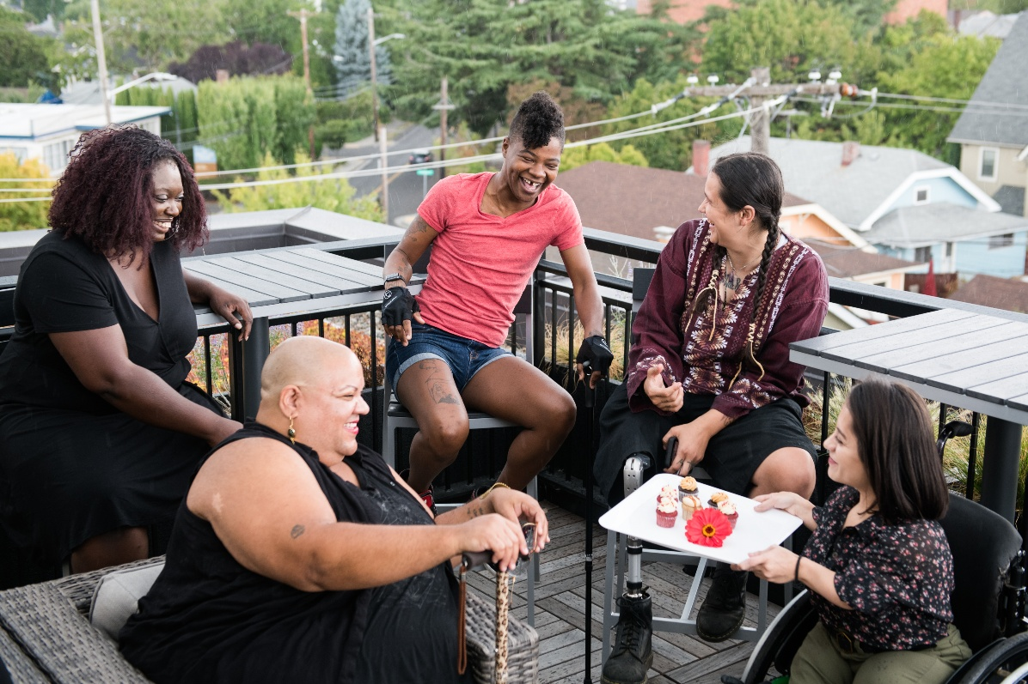
Why is Intersectionality Important when Working with Jobseekers Who Have a Disability?
A person’s disability is only one part of their story, one part of their identity.
Their life (experience) is also impacted by where they live, what their family’s socio-economic status is, what color their skin is, what gender they identify with, what culture they identify with and more.
The interaction of these identities can bring both privilege and oppression (or unique challenges) – at the same time.
Photo credit: Disabled and Here
https://affecttheverb.com/disabledandhere/
Notes:
Why is Intersectionality Important when Working with Youth who Have a Disability?
A young person’s disability is only one part of their story, one part of their identity. It cannot be considered in isolation.
Their life (experience) is also impacted by where they live, what their family’s socio-economic status is, what color their skin is, what gender they identify with, what culture they identify with and more.
The interaction of these identities can bring both privilege and oppression (or unique challenges) – at the same time.
These unique experiences and/or challenges must be recognized in order to effectively and equitably provide services to youth who have a disability.

Slide 43
Systemic Barriers & Discrimination
Structural Barriers in Employment Services
  Lack of accessible hiring processes
  Policies that do not account for intersectional needs
Workplace Discrimination & Bias
  Ableism: Employers assumptions
  Racism & Sexism: Example - Women and racialized people, who also have a disability
  Class Disadvantages: Low-income job seekers, who also have a disability, having limited access to job training, technology, or transportation.
Notes:
1. Structural Barriers in Employment Services
Lack of accessible hiring processes (e.g., inaccessible application portals, interviews that don’t accommodate disabilities).
Policies that do not account for intersectional needs (e.g., rigid eligibility criteria that disadvantage racialized or LGBTQ+ people who have a disability).
2. Workplace Discrimination & Bias
Ableism: Employers assuming people who have disabilities cannot perform certain jobs.
Racism & Sexism: Women and racialized individuals with disabilities facing compounded bias.
Class Disadvantages: Low-income individuals with disabilities having limited access to job training, technology, or transportation.

Slide 44
Systemic Barriers & Discrimination
(continued)
Service Delivery Gaps
  Disability service providers not trained in intersectionality (e.g., failing to recognize how race or gender identity affects a client’s experience).
  Culturally unresponsive employment support programs that do not address the unique experiences of diverse groups.
Policy & Funding Challenges
  Funding models that prioritize "job placements" over sustainable, meaningful employment.
  Lack of intersectional data collection, making it harder to advocate for policy change
Notes:
3. Service Delivery Gaps
Disability service providers not trained in intersectionality (e.g., failing to recognize how race or gender identity affects a client’s experience).
Culturally unresponsive employment support programs that do not address the unique experiences of diverse groups.
4. Policy & Funding Challenges
Funding models that prioritize "job placements" over sustainable, meaningful employment.
Lack of intersectional data collection, making it harder to advocate for policy change

Slide 45
Best Practices for Employment Services
Considering Intersectionality
Person-Centered Service Delivery
  Customizing employment plans to reflect the individual’s full identity and lived experience.
  Recognizing that a one-size-fits-all approach does not work.
Culturally Competent & Disability-Informed Approaches
  Training staff on how race, gender, and class intersect with disability.
  Hiring diverse staff and consultants with lived experience.
Notes:
1. Person-Centered Service Delivery
Customizing employment plans to reflect the individual’s full identity and lived experience.
Recognizing that a one-size-fits-all approach does not work.
2. Culturally Competent & Disability-Informed Approaches
Training staff on how race, gender, and class intersect with disability.
Hiring diverse staff and consultants with lived experience.

Slide 46
Best Practices for Employment Services
Considering Intersectionality
(Continued)
Accessible & Flexible Hiring Practices
  Ensuring job postings and applications are in multiple formats (e.g., screen-reader friendly, plain language).
  Providing flexible interview options (e.g., remote, alternative assessments).
Advocacy & Policy Change
  Partnering with community organizations that work with marginalized groups.
  Pushing for policy changes that integrate intersectionality into funding and program design.
Notes:
3. Accessible & Flexible Hiring Practices
Ensuring job postings and applications are in multiple formats (e.g., screen-reader friendly, plain language).
Providing flexible interview options (e.g., remote, alternative assessments).
4. Advocacy & Policy Change
Partnering with community organizations that work with marginalized groups.
Pushing for policy changes that integrate intersectionality into funding and program design.

Slide 47
Strategies for Change & Advocacy
1. Systemic Advocacy and Policy
  Systemic advocacy -broader social change addressing the root causes of systemic issues. Advocate for policy and legislative changes, as well as challenging societal norms and attitudes that perpetuate inequality and discrimination.
  In the context of disability, promote the rights and inclusion of job seekers who have a disability in all aspects of society.
  Intersectional Policy Changes, advocate for funding models that consider diverse needs of job seekers – supporting racialized people who have a disability
  Advocate for disaggregated data collection within your organization – race, gender, disability, employment outcomes
Notes:
Policy & Systemic Advocacy
Systemic advocacy is a strategy used to bring about broader social change by addressing the root causes of systemic issues. It involves advocating for policy and legislative changes, as well as challenging societal norms and attitudes that perpetuate inequality and discrimination.
In the context of disability, systemic advocacy aims to promote the rights and inclusion of people with disabilities in all aspects of society. It recognizes that disability is not solely an individual issue, but rather a result of societal barriers and prejudices.
Intersectional Policy Changes – advocate for funding models that consider diverse needs of job seekers – supporting racialized people who have a disability
Advocate for disaggregated data collection within your organization – race, gender, disability, employment outcomes

Slide 48
Strategies for Change & Advocacy
2. Employment Service Provider Strategies
Adopt a trauma-informed, culturally responsive approach
  Train staff to recognize how historical and systemic oppression affects job seekers.
  Implement support systems for clients facing multiple barriers (e.g., racialized women with disabilities experiencing workplace discrimination).
Offer wraparound supports
  Provide additional services such as mental health support, financial assistance, and transportation aid.
  Work with community organizations that specialize in serving marginalized groups.
Develop tailored employment pathways
  Avoid “one-size-fits-all” approaches by co-designing employment plans with clients.
  Recognize that job seekers may need longer-term supports to achieve meaningful employment.
Notes:
Employment Service Provider Strategies
Adopt a trauma-informed, culturally responsive approach
Train staff to recognize how historical and systemic oppression affects job seekers.
Implement support systems for clients facing multiple barriers (e.g., racialized women with disabilities experiencing workplace discrimination).
Offer wraparound supports
Provide additional services such as mental health support, financial assistance, and transportation aid.
Work with community organizations that specialize in serving marginalized groups.
Develop tailored employment pathways
Avoid “one-size-fits-all” approaches by co-designing employment plans with clients.
Recognize that job seekers may need longer-term supports to achieve meaningful employment.

Slide 49
Strategies for Change & Advocacy
3. Influence Employer and Workplace Strategies
Support the creation of truly inclusive workplaces
  Help employer implement robust and long-lasting accessible, diversity, equity, and inclusion efforts that explicitly include disability and intersectionality.
  Promote education and training - hiring managers can trained to recognize and address unconscious bias.
Support the implementation and enhancement of workplace accommodations
  Help employers go beyond minimal compliance with accessibility laws – ODEN offers a learning module on this!
  Help employers understand how mentorship and peer support programs for employees who have a disability are a good strategy

Slide 50
Strategies for Change & Advocacy
4. Community Engagement and Coalition Building
Build partnerships across sectors
  Collaborate with disability organizations, racial justice groups, and other employment organizations to share resources and best practices.
Empower job seekers through self-advocacy
  Support job seekers with tools and training to advocate for their rights in the workplace.
  Foster peer-led networks for job seekers who have a disability to share their experiences and strategies.
Notes:
4. Community Engagement and Coalition Building
Build partnerships across sectors
Collaborate with disability organizations, racial justice groups, and other employment organizations to share resources and best practices.
Empower job seekers through self-advocacy
Support job seekers with tools and training to advocate for their rights in the workplace.
Foster peer-led networks for job seekers who have a disability to share their experiences and strategies.

Slide 51
Case Study – Reflexivity
You are working as an employment coach with a youth who has a developmental disability. You knew this youth as Davina and as a girl. Davina has told you of their plan to transition to identifying as a male and would like you to you call them Devon from now on.
You have always held the personal belief that the gender you are born with is the one you stay with for life. Furthermore, you recognize that they may now face greater challenges as both a transgender person and a person who has a developmental disability. You are worried about how your personal feelings will get in the way of you being able to support them.
Notes:
You are working as an employment coach with a youth who has a developmental disability. You knew this youth as Davina and as a girl. Davina has told you of their plan to transition to identifying as a male and would like you to you call them Devon from now on. You have always held the personal belief that the gender you are born with is the one you stay with for life. Furthermore, you are a religious person and in religion, transgender people are not recognized. You recognize that they will now face greater challenges as both a transgender person and a person who has a developmental disability, but you are more worried about how your personal feelings will get in the way of you being able to support them.

Slide 52
Case Study Reflection– Reflexivity
Consider the who I am exercise and discuss how that might impact your work with Devon.
Consider why it is important to consider your preconceptions, what is informing them and how they might impact you in a professional setting. How can this be professionally mediated?
Notes:
Reflect on this scenario and consider the following:
Consider the who I am exercise and think about (or discuss) how that might impact your work with Devon.
Consider why it is important to consider your preconceptions, what is informing them, and how they might impact you in a professional setting. How can this be professionally mediated?
Please pause the recording for as long as you need to complete this activity.

Slide 53
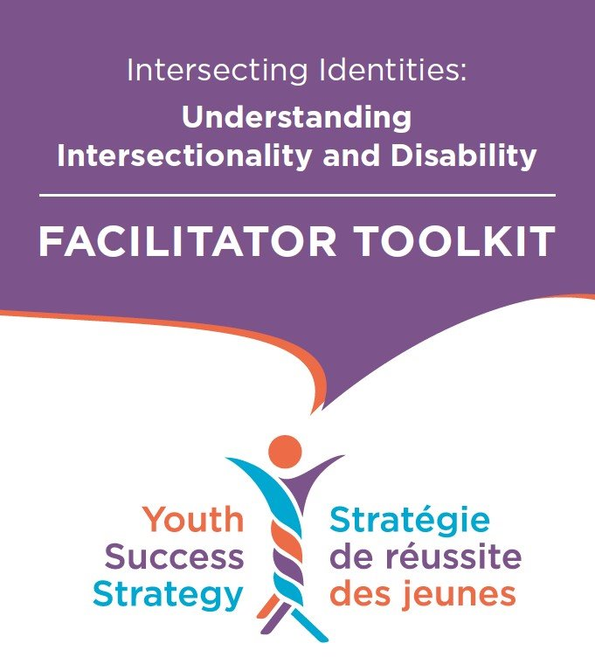
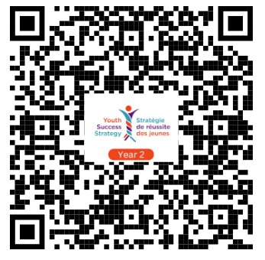

Resources on Intersectionality & Disability
Visit ODEN’s Learning Centre at
https://learn.odenetwork.com/youth-success-strategy-year-2-resources/
OR VIA QR CODE BELOW
Notes:
To access more resources like the Understanding Intersectionality and Disability Facilitator Toolkit, visit the link shown or use the QR Code. For more information, please contact ODEN at info@odenetwork.com

Slide 54
Key Takeaways and Questions

Slide 55

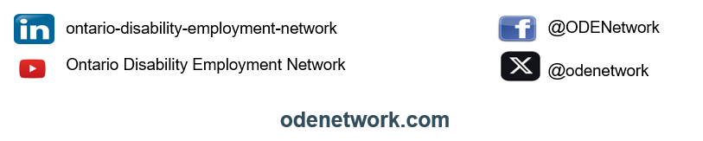
National Director
Raihanna Hirji-Khalfan
raihanna.khalfan@racedisability.ca
Director of Special Projects & Innovation
  Ingrid Muschta
  ingridm@odenetwork.com
Website: racedisability.ca
Instagram: @racedisabilityca
Facebook: @RaceandDisability
LinkedIn: Race and Disability Canada

