Slide 1


Ambassadors For Inclusion
Community Living Ontario Conference - 2025

Slide 2
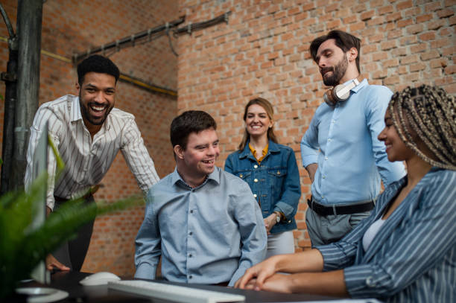
How Are You Connected?
Clubs
Groups
Events
Committees
Volunteer
Sports
Ambassadors for Inclusion

Slide 3

Evolution of AFI
How has Ambassadors for Inclusion evolved.
Where are we today?
Self Advocate – My Story
Ambassadors for Inclusion

Slide 4
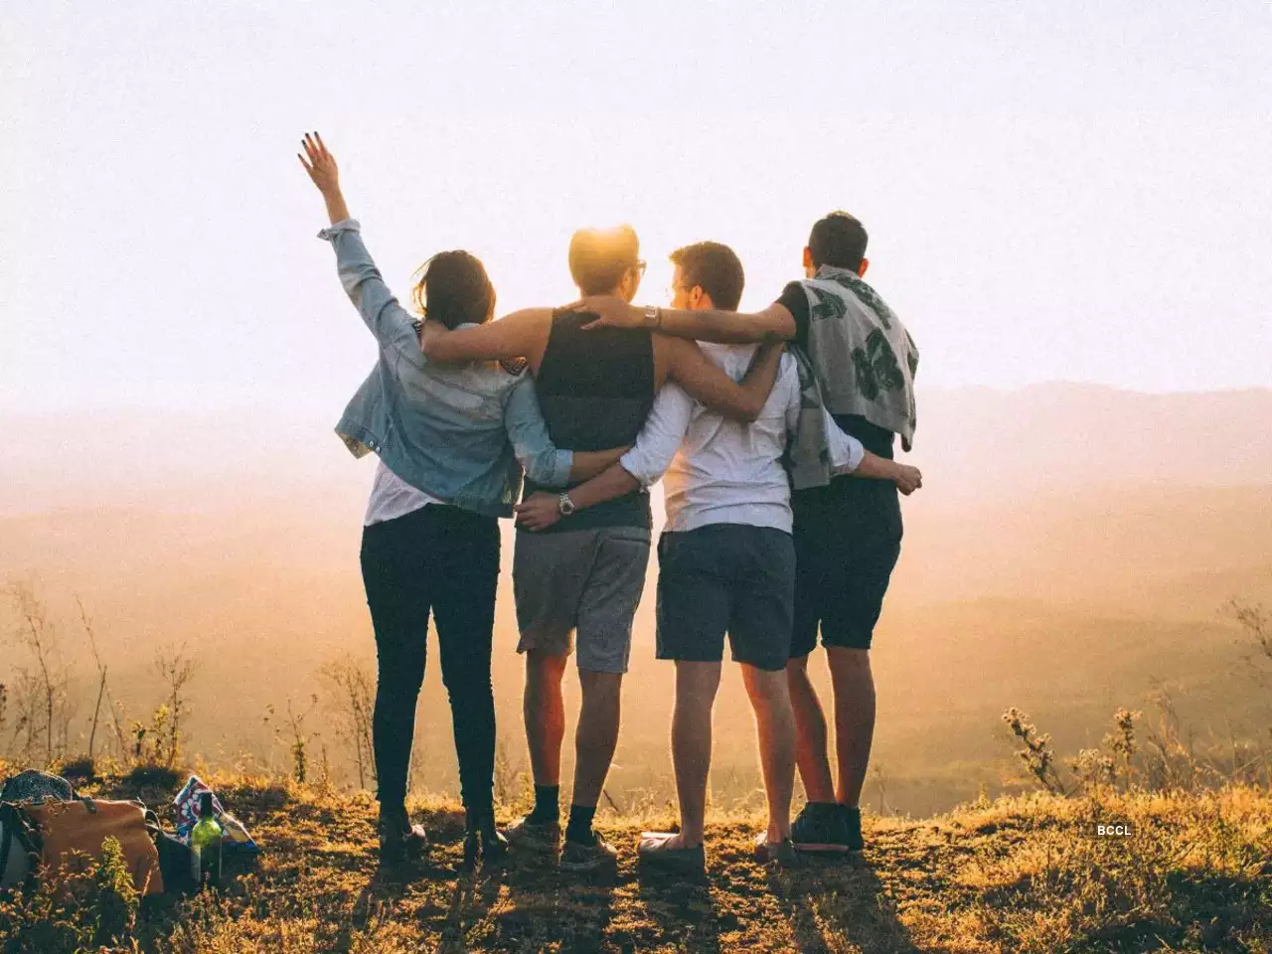
Inclusion Through a Wider Lens
More then meets the eye
Intentional Actions
Be a
“Mr. Jensen”
Ambassadors for Inclusion

Slide 5

Notes:
https://youtu.be/4p5286T_kn0?si=YFSdtHV03Ce8CW9A

Slide 6
Purposeful Actions to Foster Inclusion
Words are powerful
Authentic Listening
Perspectives
Ambassadors for Inclusion

Slide 7


Slide 8

Empowered to Lead and Inspire Change
Challenge Your Baises
Building Confidence to take meaningful steps toward fostering inclusion
Approaching Inclusion Mindfully
Ambassadors for Inclusion

Slide 9
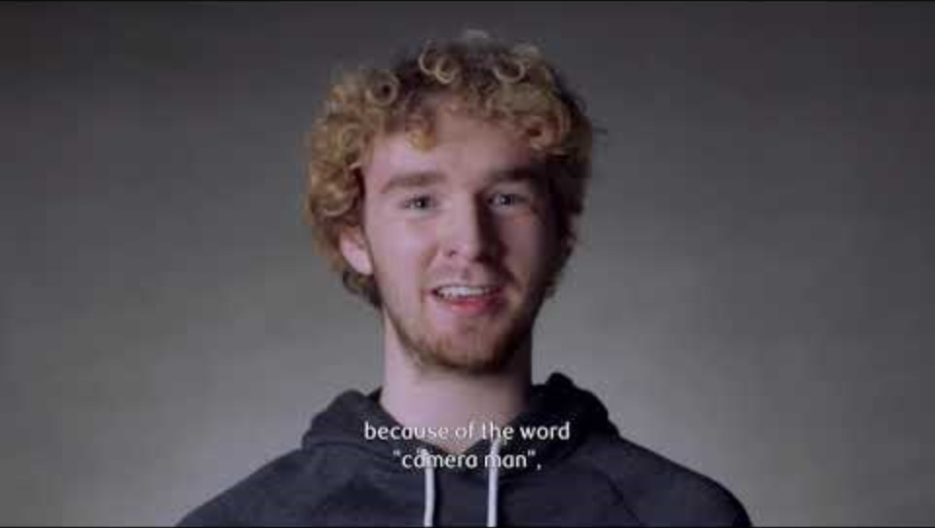
Notes:
When more people speak up, more people listen
https://youtu.be/b1nJqpqgzR0

Slide 10
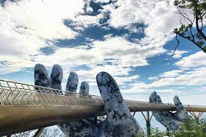
Building Bridges
Inclusion doesn’t always mean tearing down every barrier—it starts with small changes that open big doors.
Ambassadors for Inclusion

Slide 11
Your coloured paper means..
🟡Yellow = Religious/Cultural Gathering
🟢 Green = Sporting Event
🔵 Blue = Library/Community Center
Ambassadors for Inclusion

Slide 12
Practical tools - Heightened Awareness
Belonging
Exercises
Activities
Actions
Ambassadors for Inclusion

Slide 13
Thank You For Joining Us!
Community Living Prince Edward
67 King Street, Picton, Ontario
K0K 2T0
613-476-6038
www.clpe.on.ca

