Slide 1


Being Value-able why conscious connection to values matters
Helen Sanderson Associates Canada www.hsacanada.ca

Slide 2
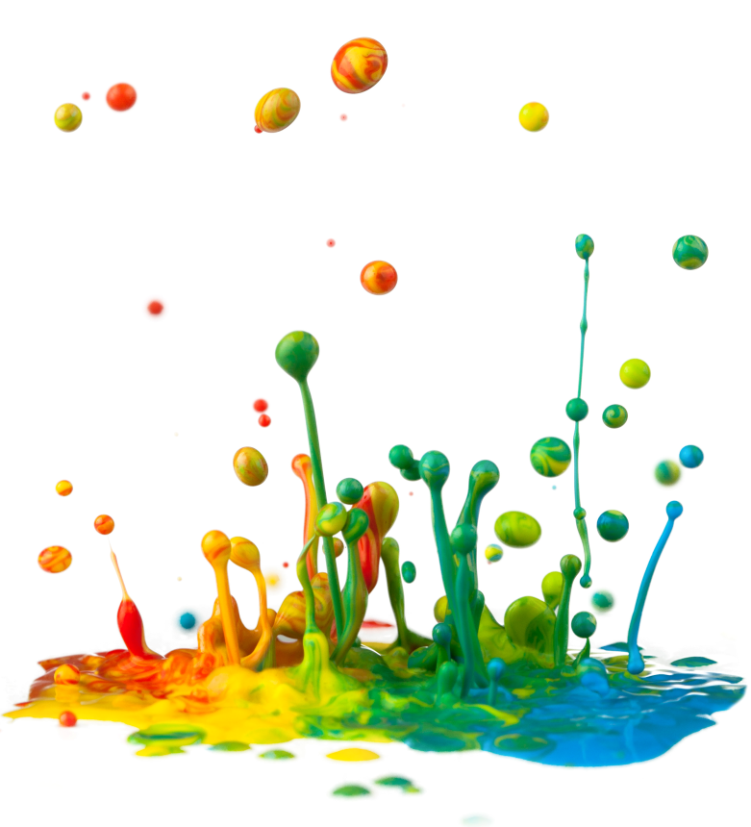
What are values?

Slide 3
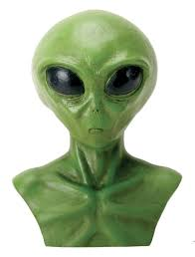
3 words to describe chocolate

Slide 4
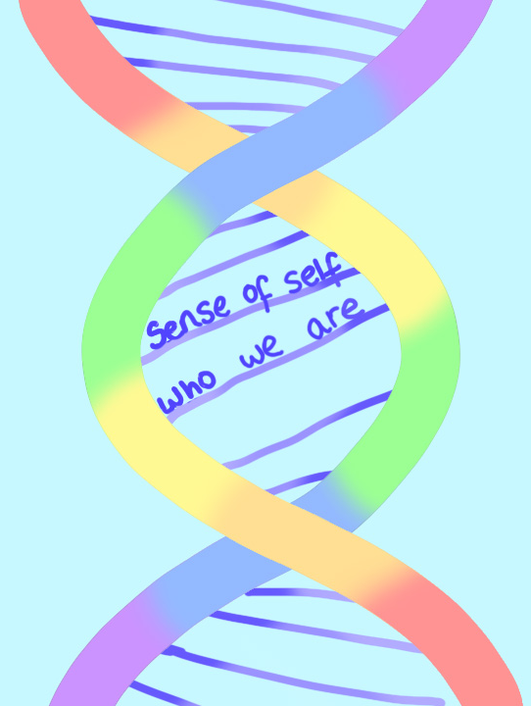
Values are emotionally rich, energy laden ideas that drive us to do what we do, be who we are

Slide 5

”Values are the ideals that give meaning to our lives that are reflected through the practices we choose and that we act on consistently and repeatedly”
Prof Brian Hall

Slide 6
“values are powerful ideas about what matters”
“some values are powerful enough to determine what it means to live true to self”
~ Dr Jackie Lefèvre

Slide 7


Tell me a story

Slide 8
Source: Dr. Jackie LeFèvre www.magmaeffect.com

Slide 9
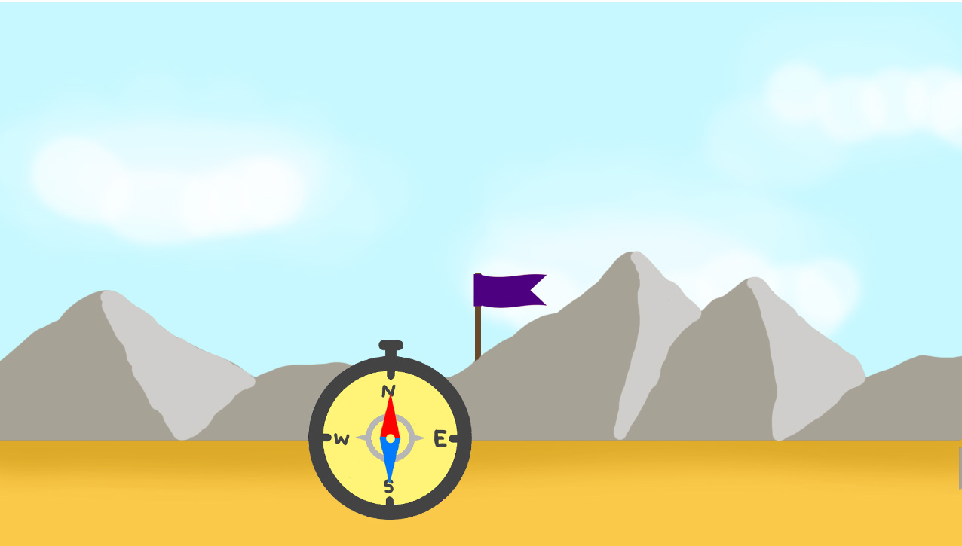

Slide 10
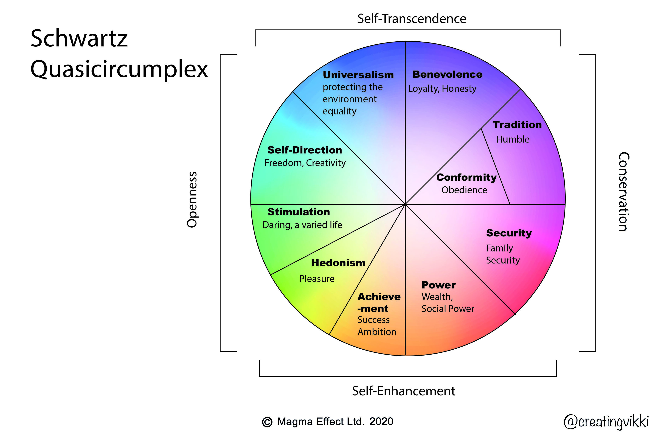

Slide 11
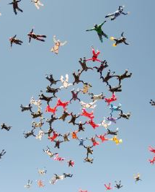
“Personal values drive commitment. Personal values are the route to loyalty and commitment, not organisational values.”
Kouzes and Posner
(The Leadership Challenge 2010, p56)

Slide 12
Research shows
Experiencing personal values in life is ‘crucial’ to wellbeing
Value fulfilment may prevent burnout and recovery from moral injury

Slide 13
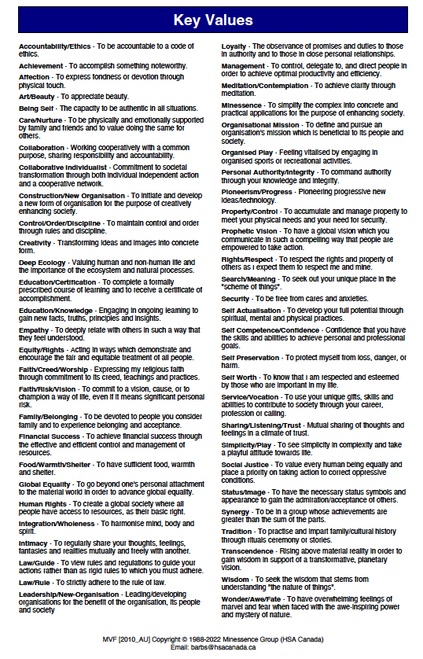
Exploring Values
Helen Sanderson Associates Canada www.hsacanada.ca

Slide 14
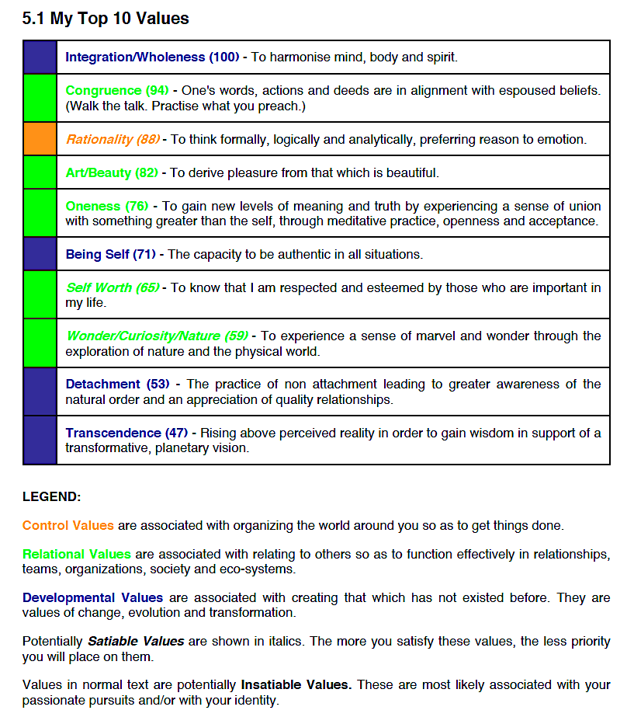

Slide 15
My Value Important to me My approach to
now because: living this value:
- actions I take
- activities I get involved with

Slide 16
Questions?
barbs@hsacanada.ca
705-773-9736
Other resources
www.magmaeffect.com
www.minessence.net
Helen Sanderson Associates Canada www.hsacanada.ca

