Slide 1

RAISE THE ROOF RAISE THE RENT IN YOUR LIFE
Hi I am Crystal Silverthorne
I am 38 years old
I live in a Small town Dunnville Ontario
My presentation is about reaching for higher in your life .
Working towards what you want for your life.
Then going after what ever that maybe for you.

Slide 2
Welcome to my Life
I live in my own apartment .
I am on the board of my local agency.
I am self employed with two business.
I like to spend time with family and friends and fur friend.
I love making jewelry , rock painting and more.
I enjoy traveling .I have been Hawaii , Flordia 2 and Las Vegas 2,Branston Cuba, Nashville, PEI.
I enjoy taking pictures.
I enjoy shopping .
I enjoy doing day trips.
I enjoy magnet fishing.
I enjoy baking.
I love Yoga
I love bowling. I am on a bowling league. I really good bowler.
Advocacy is important part of my life. I am voice for myself and many others.
Fund raising .
I enjoy the beach.
I like to swim.

Slide 3
Crystal`s Creations
I run my own business that is hand made jewelry and more .
I have been business for about 10 years.
I make bracelets , necklaces , earrings and keychains and sell croc charms.
I do many shows and sell at stores and online.
All items are made by hand from the heart.
This has allowed me to make some extra money.
I have been able give back to my community as well.
It amazing to create a product know many people are wearing my work.
I doing what I love to do create.
I am able to be seen for my ability , my gifts, my talents.

Slide 4
What I wanted for my life career wise
I wanted the same job as someone without a disability has.
I wanted to paid more then minimum wage.
Benefits would be great.
To be finally stable and not have to be worried as much about money.
I could retire one day and not worry.
I wanted a bright future for myself.

Slide 5
What inclusion isn`t on the job.
Creating a job that is only for a person with a disability.
Paying them less then their co-workers .
Being left out the team at work.
Co-workers having keys and me fighting 6 moth in for keys and only getting one key other things use for job very little.
Not aloud to be trained in other skills like your co-workers are.
Feeling lonely.
Not being aloud to use tools that your co-workers can.
No seniority
No over time.
Left to do everyone else work that both yours and theirs.
Burnout.
Bad mental health.
Bullying
Jobs being taking away from me but not my co-workers.
Workplace having training on two disabilities one which I don`t have and other have but doesn`t effect me on job .
So, co-workers thinking that is me when not me.
The r-word being use the workplace .
Being told I may never drive company truck mean while have more experience and safter driver then many .I feel my disability makes better driver I go by the rules and more aware of things around me.
I fought for change for 4 years some changing were made but not enough.
These were actual things that experienced with a job and ending up leaving due to my mental health. I ended really finding myself through speaking and this is a great passion of mine.

Slide 6
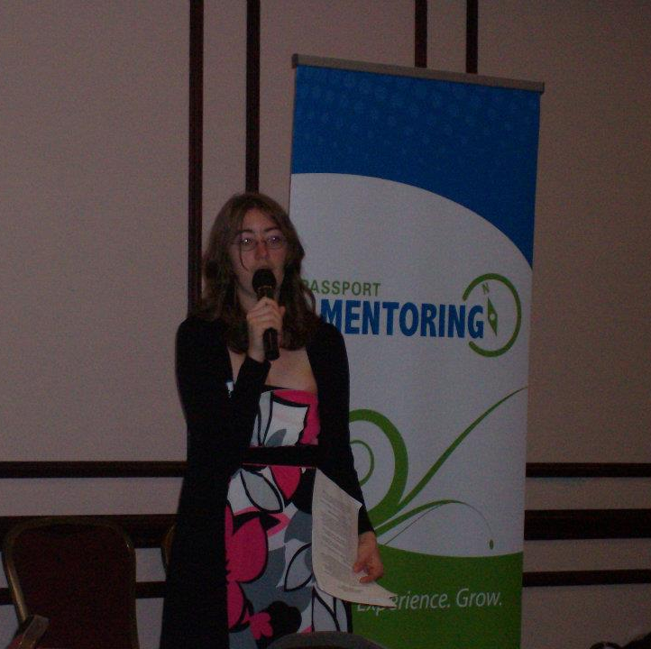
Motivational Speaker Crystal Silverthorne
My new adventure
Quit my day job .
To go on my own career path as a motivational speaker.
Speaking has been my passion for long time.
I was burnt out at work and my mental health was not good so made the decision that was best for me .It isn`t for everyone.

Slide 7
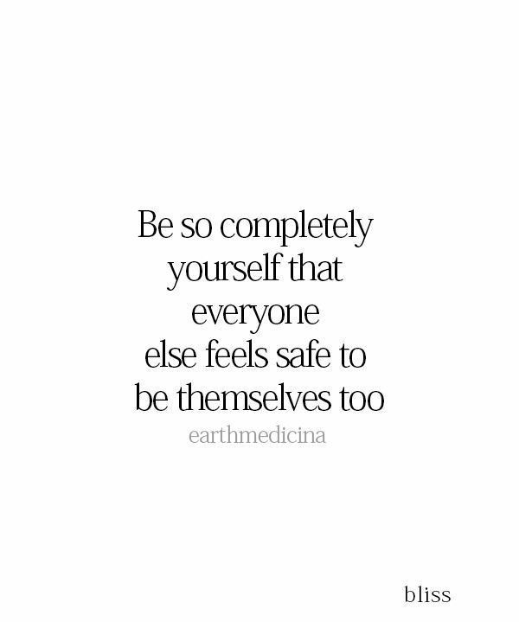
Therapy
Seeking help is huge .
But it can be best decision you make.
Working with right therapist for you is important.
I have learned so many amazing skills for life .
I learn so much more about myself.
I have accountability person.
I can work through anything that is going on in life with someone that supports me and wants the best for me and cheering for me on ever step of the way.
It could truly change your life to.
Therapy has been a game changer for my life.
Don`t be afraid of therapy
It has helped me grow as a person.
Needing help is not a bad thing it is a good thing.
Don`t let the stigma behind word therapy, get in the way of getting the help and guidance you need .

Slide 8
Routine
Realizing regular routines are not for everyone.
Some of us need a different style of routine to work for us.
My therapist has created many different style ones for to see which style was best for me.
Checklist work best for me .
When life changes so do routines.
I feel good checking them off.

Slide 9
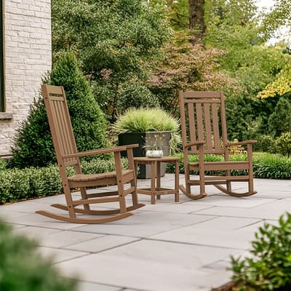
What is Stimming Self Stim Tory Behavior
Stimming is a way for us to express our self.
It is our way of communicating with the world around us.
We don`t choose when we stim.
Stimming is not a choice.
My stims are .
Rocking back and forth.
Clapping three times.
Moving my head a certain way.
Rubbing my hands together with fidget or without.
Moving my hands couple different ways.
Shaking my one foot.
Also, one vocal stim.
And maybe more
Sometimes we know we are stimming and sometimes not cause a body decides when it happens.
I stim a lot when happy to.
This is called happy stim.
Stimming is the way we know how are feeling.
It can help people understand when we are or excited or fustered. or if were not stimming could stress day or were masking.
Also is a way get are self to calm if we need to .
It can be hard for us to build comfort to stim around people because we fear judgement .
I put up walls to protect my self.
I have been judged in the past because of my ADHD.

Slide 10
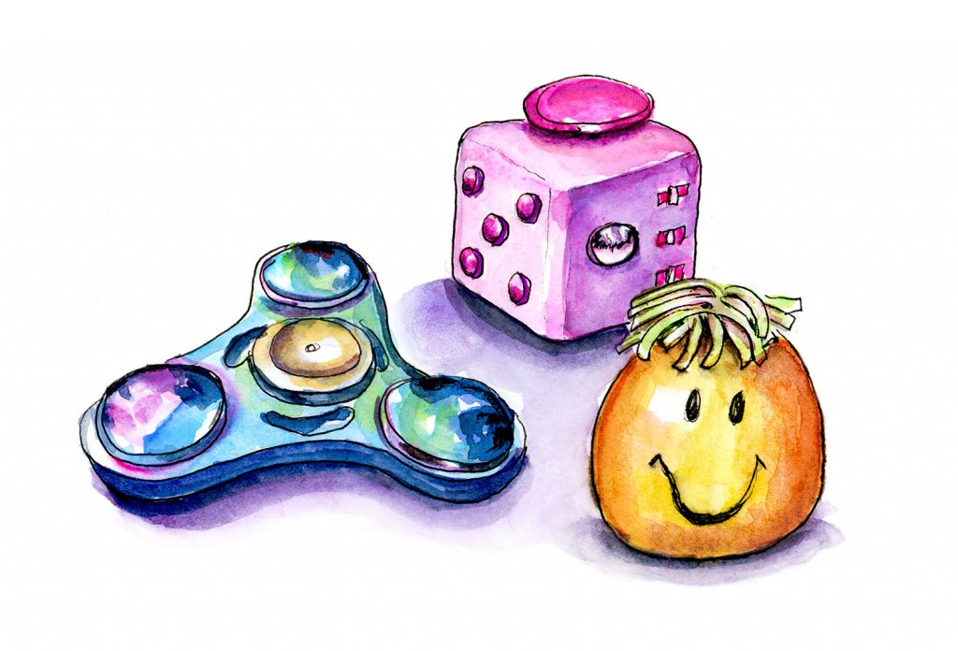
Fidgeting
I need to fidget a lot in a day.
I need to keep my hands busy.
I use things called fidget tools of different types just depends which need at moment.
They help me sit longer as sitting still is hard and sitting to long can be boring if not doing something.
Sitting still can make me feel anxious if don`t have fidget.
Fidgeting makes me feel calm.
Fidgeting helps me meet my needs in a day.
They help me stay focus.

Slide 11
Socially Awkward ADHD Life
Social setting can be hard to finger out.
We have hard to read social ques.
We are not sure where to sit or who sit with at times.
Were not sure who talk to or what to say when there is a lot of people.
We often talk about same things cause that what know we can talk about.
We don`t stand around talking as not easy just connect that way.
Some social events we feel comfort some we feel awkward like the odd one out.
We aren`t but that we are just how ADHD makes us feel and social anxiety .
We have a blank stare sometimes social setting because are ADHD so often people think were not ok when we are just find so if I look like I staring I am all good.
Social setting can put us in sensory overload.
Most social setting headphones are a need.

Slide 12
Need chew stim
Some of us wear chewelry to help us have something to chew on.
This is not a choice it is a need .
We don`t choose when we do, we just listen body what it needs.
We fear judgement from others because are need.
It helps me sensory need plus ADHD stim helps anxiety and stress .

Slide 13
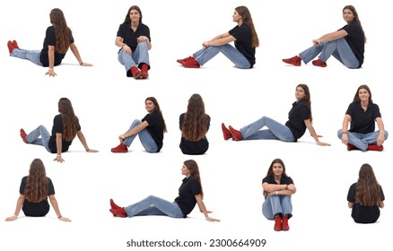
Floor time
Sitting in a chair but your brain telling you need the floor.
So, you listen to it and sit on the floor as that is what your body needs now.
You may worry that people will think it is unprofessional but do it anyway if can.
Too often we go against our body because we have masked, to long or fear of judgement, but it is time to listen to our bodies ,and what our bodies needs are .Then do them so we can meet our needs in a day.

Slide 14
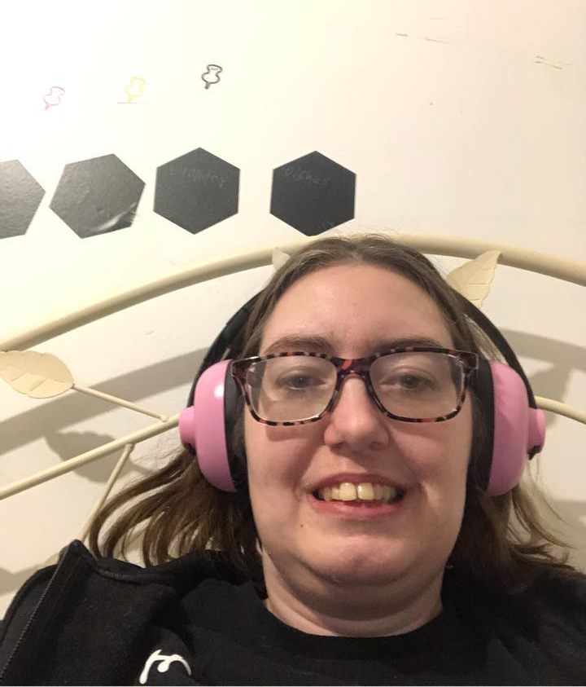
Sensory Needs For me I wear headphone to help me. I am sound sensitive. Sounds for me are louder than they would be for others which bother me I have put hands over my ears if I can. So, headphones help not have to. They muffle the sound so sounds aren`t as load. They also help me focus and constraint better and help emotional regulate better. They also help when I get home from being out and in sensory overload then I can put them on and lay in the dark to calm mind and body .Sensory overload is tiring. When we mask and don`t do what we need for body it is tiring. We have to spend more time doing what we needed to when we get home as that is our safe space. I contacted a OT find out my sensory profile . So, I know what I need in my day to have my sensory needs met.
ADHD Life

Slide 15
Unmasking
Decide to be your true self and letting world see the real you.
I decide I was tired hiding who am to fit into a world that not made for people like me in mind.
I do thing that others don`t stim , fidget.
Fear of judgement from other that don`t think it the normal for my world it is.
People not understand that need to wear headphone as world is load for me.
Will they stare or judge I want to not care but time hard not care what others think . Being judge cause your energy so high you learnt to hide cause people told calm. When you're not meant to be calm.

Slide 16
Changing attuides of Disability
That we just want same things life as anybody wants.
We have the same skills and abilities as people without disabilities.
There is need change for wage it should equal to other co-workers without a disability.
We are more alike then different.

Slide 17
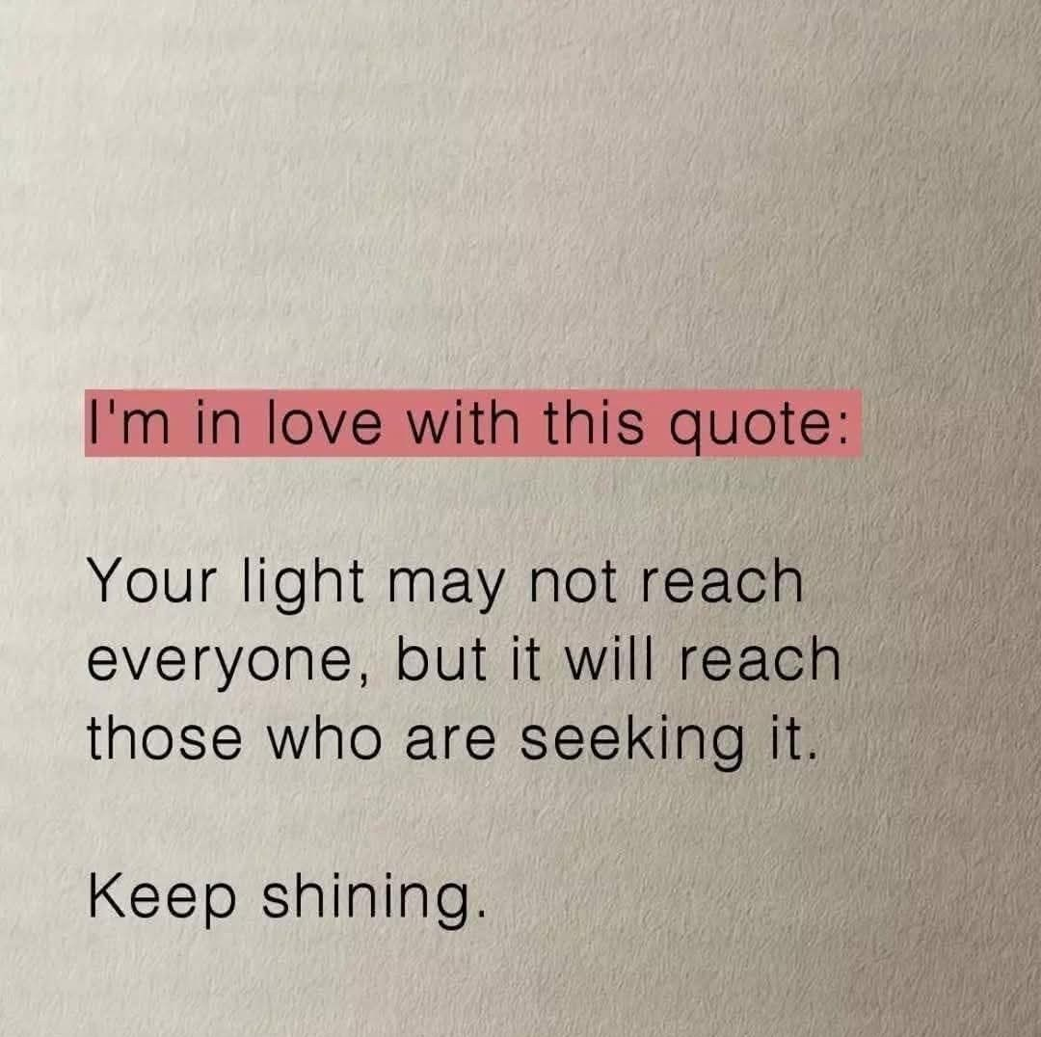
Self Care For Mental Health
Going to the salt cave and just chilling .
Taking time for you doing things you love to do.
Giving back to your community.
Spending time family and friends.
Nice walk out fresh air.
Fun outing with others.

Slide 18

Having goals for life.
I wanted to get my driver licence.
I wanted own my own business .
I want to go on a vacation next year.
I wanted to change career.

Slide 19
My Community Connections And What They Have Brought To My Life.
Friendships
Belonging
Partnership
Inclusion
Value member
Teammate
Support
Customers

Slide 20

Natural Friendships Are people in your life that are not paid to be in your life. They are your natural friendships .The ones that you go to each others house or out for coffee with or go for lunch or just do something fun with.

Slide 21
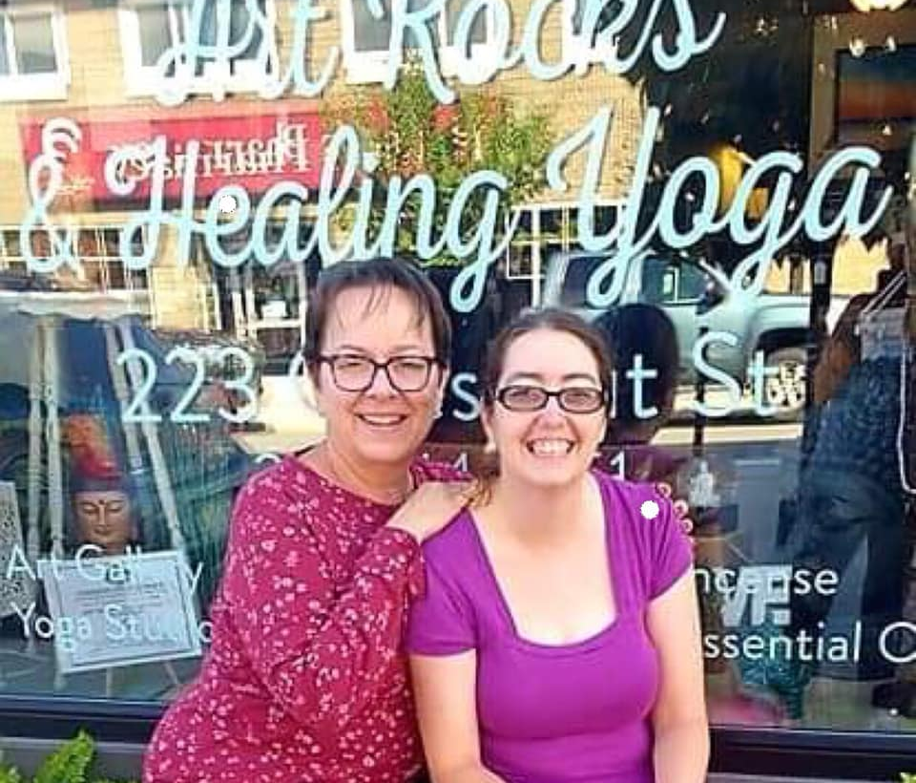
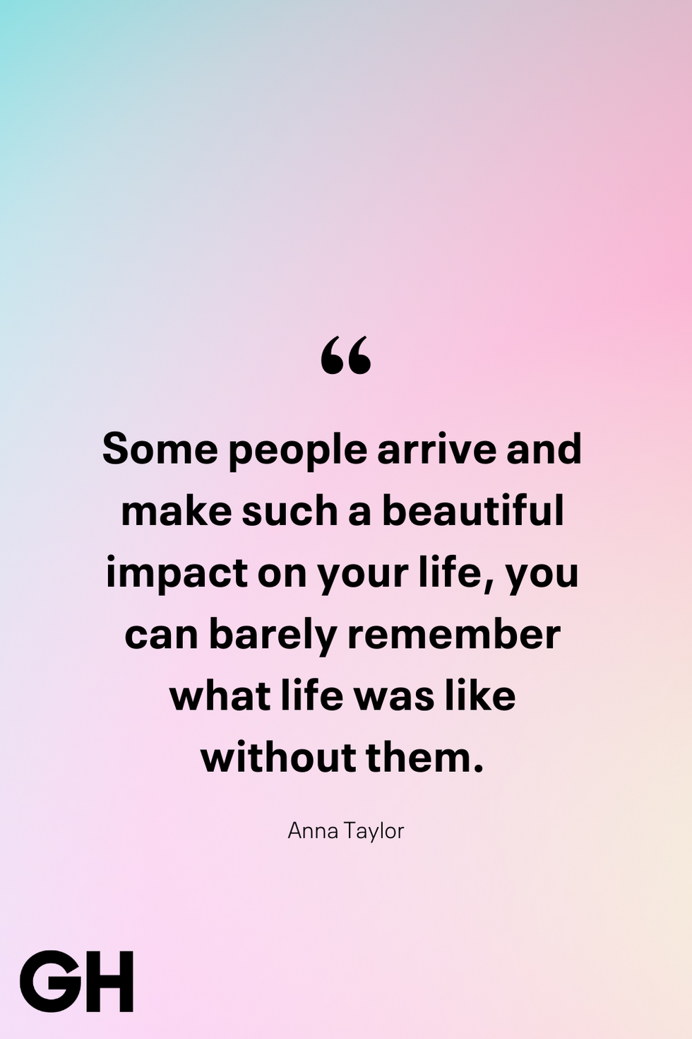
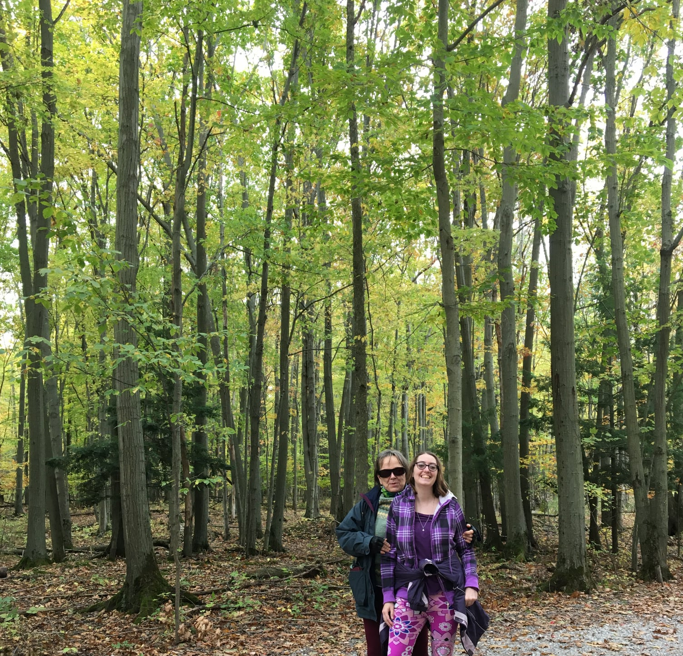
My Friend Roxann

Slide 22
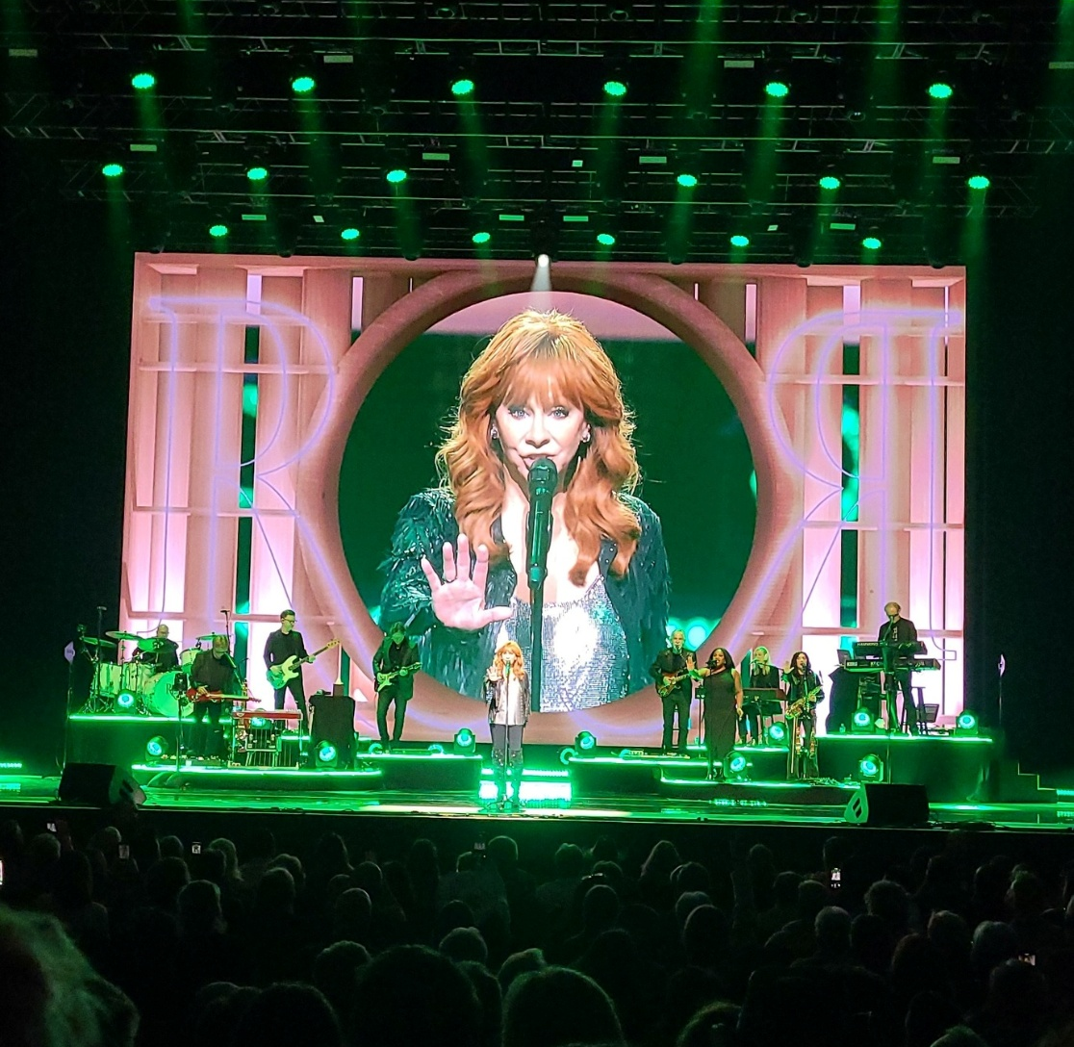
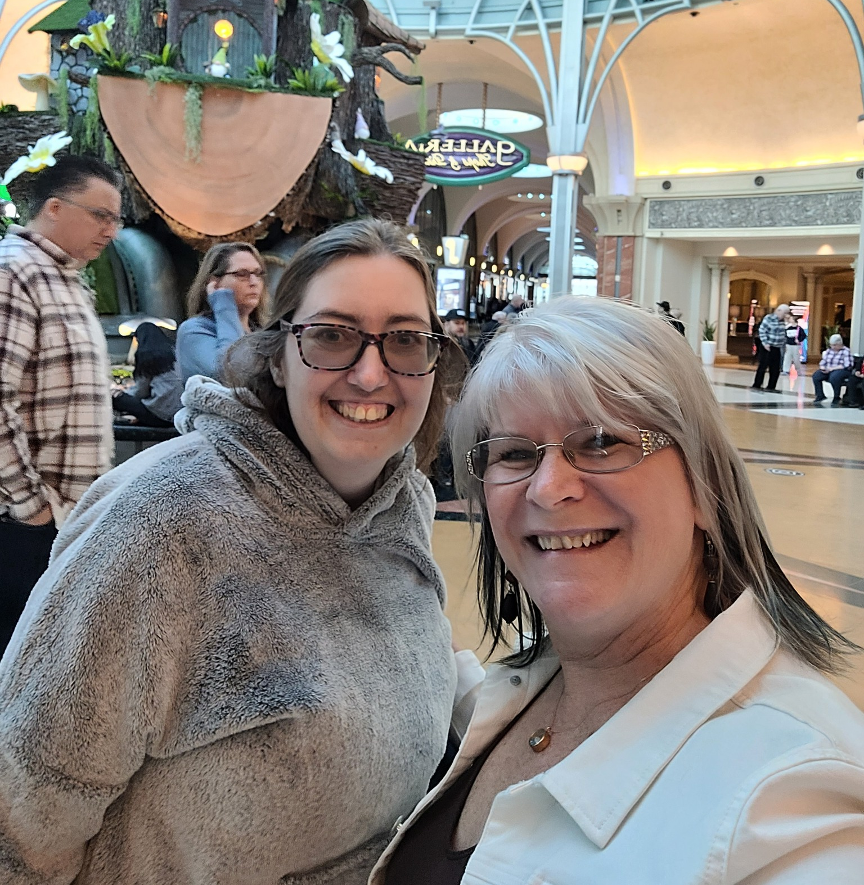
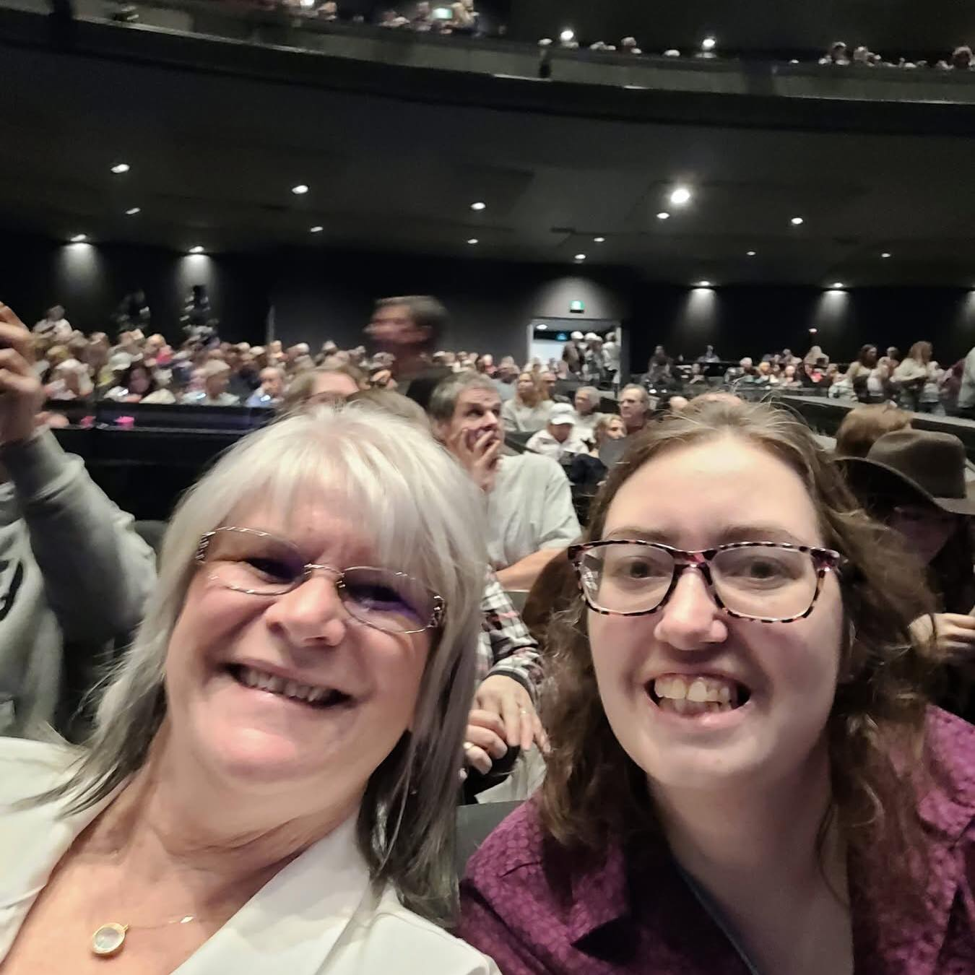

My Friend Valerie

Slide 23


Advocacy
Being the voice for yourself and for others.
Standing up for what believe is an injustice.
Standing up for your rights.
Advocacy speaking up for things to be accessible in your community.
Being the change, you want to see in the world.

Slide 24
Tech
Tech can help us meet are ever day needs.
For those of us that are time blind we don`t how much time has pass or how long something takes to do it.
So having a reminder helps us not miss appointment meetings or appointments or other important things in life.
It can also help time, so we know when they are going be done.
Plus, of communication to of course.
Also, tech can help with spelling .

Slide 25
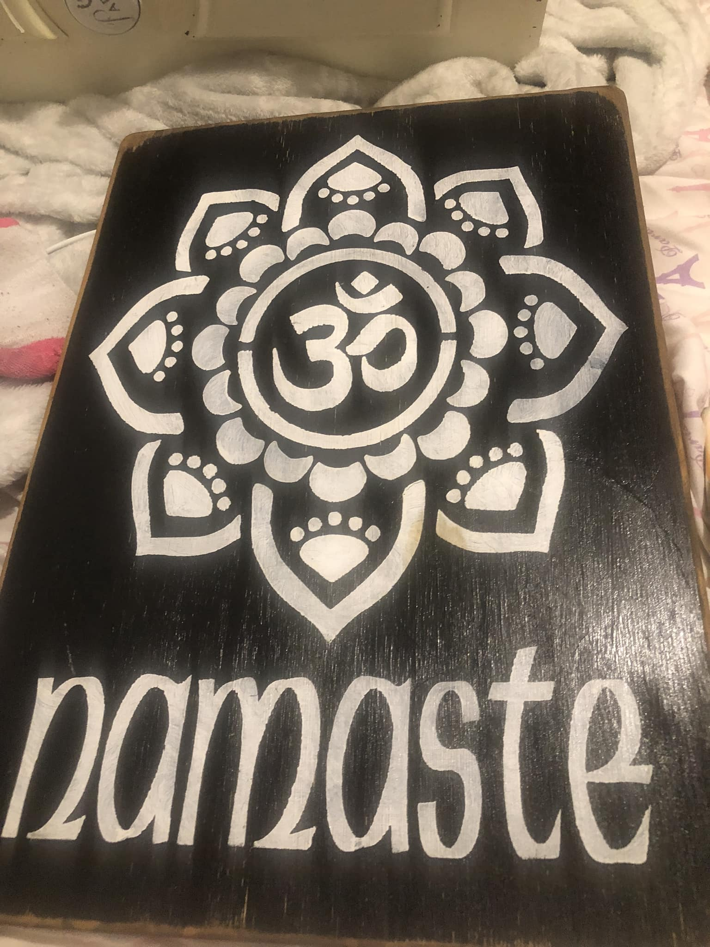
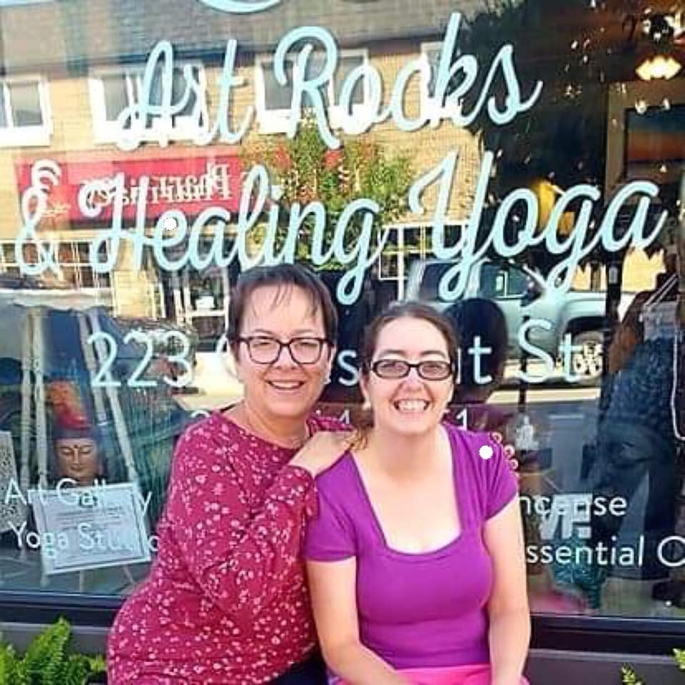
Yoga Life Journey
Meditation Life Journey

Slide 26
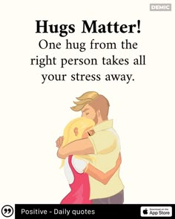
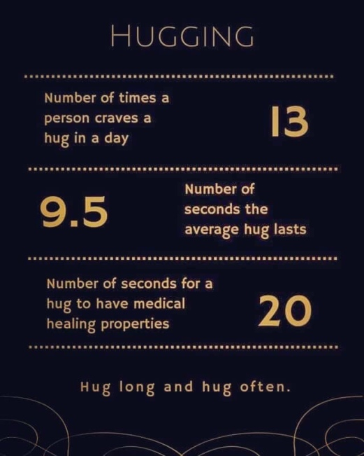
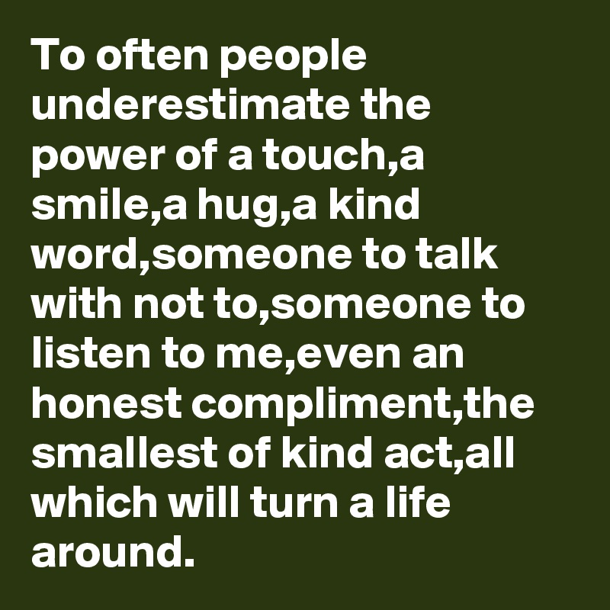

The Power of Hug

Slide 27

I don`t let my challenges stop me from living the life I want to live. I may have to do things in life different at times and take longer to get where I want get with things but that will never hold me back. . The sky is the limit, and I am reaching for higher
Living Life Without Limit

