Slide 1


Creating Welcoming Communities One Building at a Time!
Inclusive Lifestyles in Vertical Communities
September 17-18, 2025

Slide 2
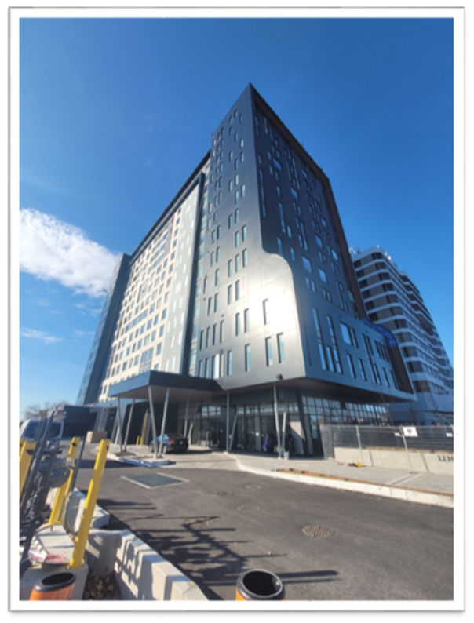
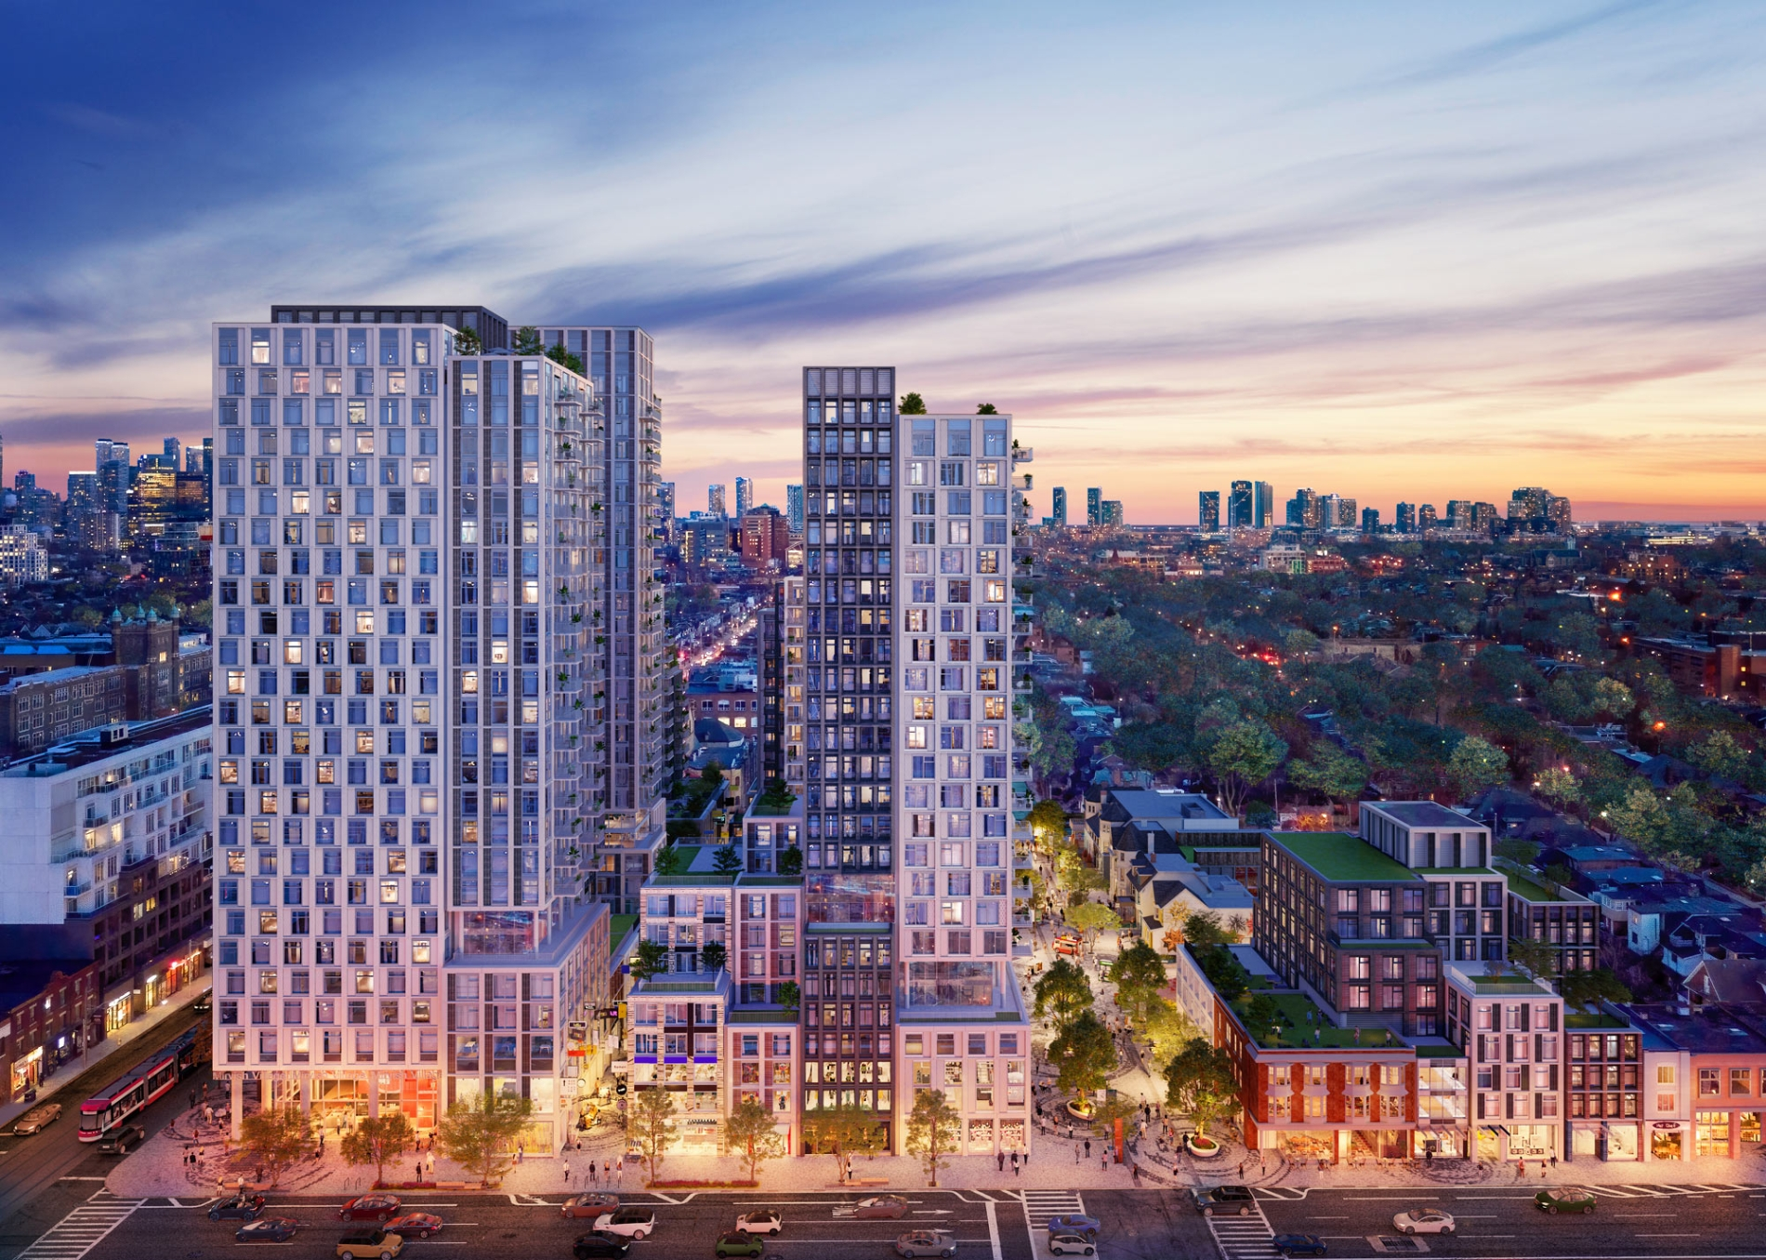

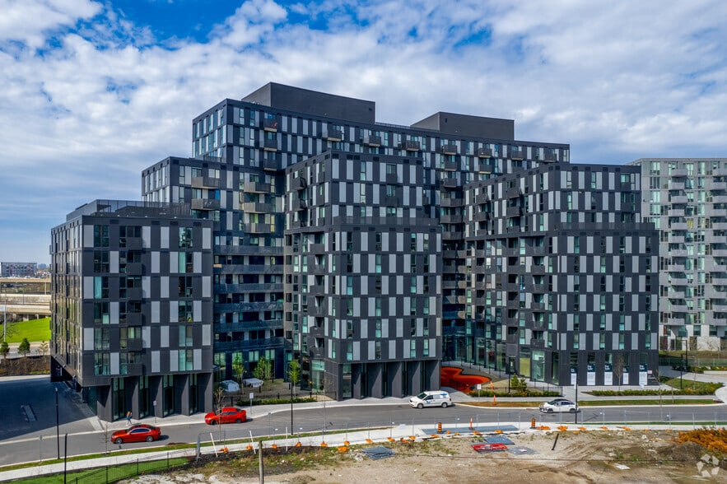
Session Outline
Inclusive Vertical Community Living – what is it, why do it and how? (20 minutes)
Individuals, family member and staff lived experiences – video and panel discussion (40 minutes)
Audience Q and A (15 minutes)

Slide 3
Introduction to Inclusive Vertical Communities
Referral Agreements with developers to access suites in new buildings
Support individuals in 5-20% of suites in new buildings
Occupy less than 50% of suites on any floor/level in buildings
Suites range in size from Studio to 3-bedrooms to optimize choice of whom people live with or increased autonomy
Agency supports provide access to rent subsidies
Lease agreements directly between property management and individuals as Tenants

Slide 4
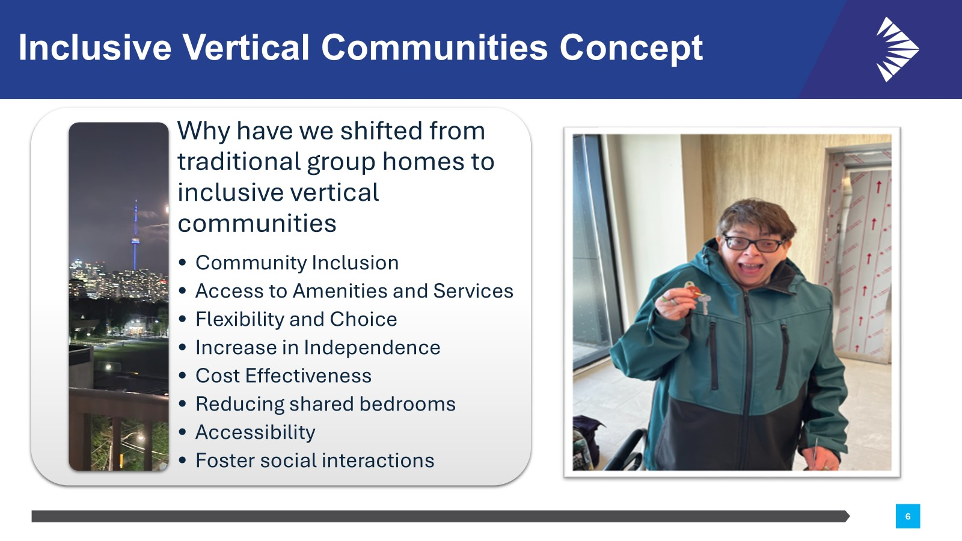
Introduction to Inclusive Vertical Communities
What is it?

Slide 5
Inclusive Vertical Communities In Action
Everyone moves into their new homes as Tenants of a developing community
Supports in a building can range from check-ins up to 24/7 so assistance is available as needed while also leaving space for increasing independence and relationship-building with neighbours
Building events create opportunities for socializing and forming community connections
Citywide opportunities for people to live closer to family, friends and work

Slide 6
People’s Lived Experiences
Individuals, family member and staff perspectives – video and panel discussion
Video 1 – Birchmount Green, one of the inclusive vertical communities
Panelists:
Esther Tuohy (Moderator) – CLTO Senior Manager Supported Living
Colleen Broadhurst – Parent
Jenna Martinuzzi – CLTO Influencer
Dave Esch – CLTO Resident at BG
Joan Williams – CLTO Program Supervisor
Mark Miller – CLTO Resident at DLW
Venus Ocampo – CLTO Support Worker
Kit Leung – CLTO Manager, Real Estate & Insurance
(Slidedeck will also include pictures relating to individuals’ lived experiences once we finalize people and pictures they want to include)

Slide 7

Questions

