Slide 1






PechaKucha: Snapshots of Change, Stories of Impact
CLO Conference – Inspiring Possibilities
September 18, 2025

Slide 2
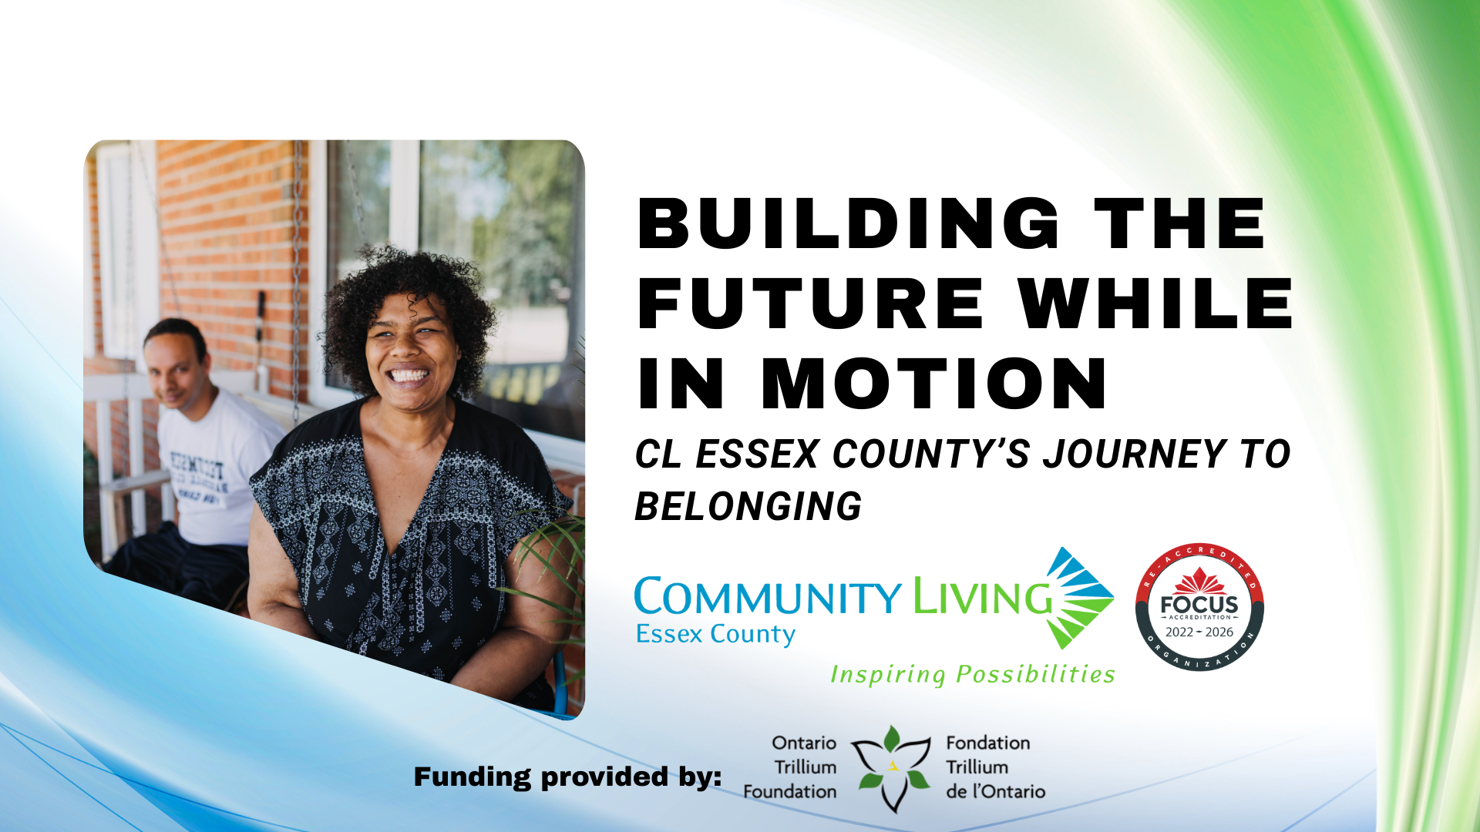

Slide 3
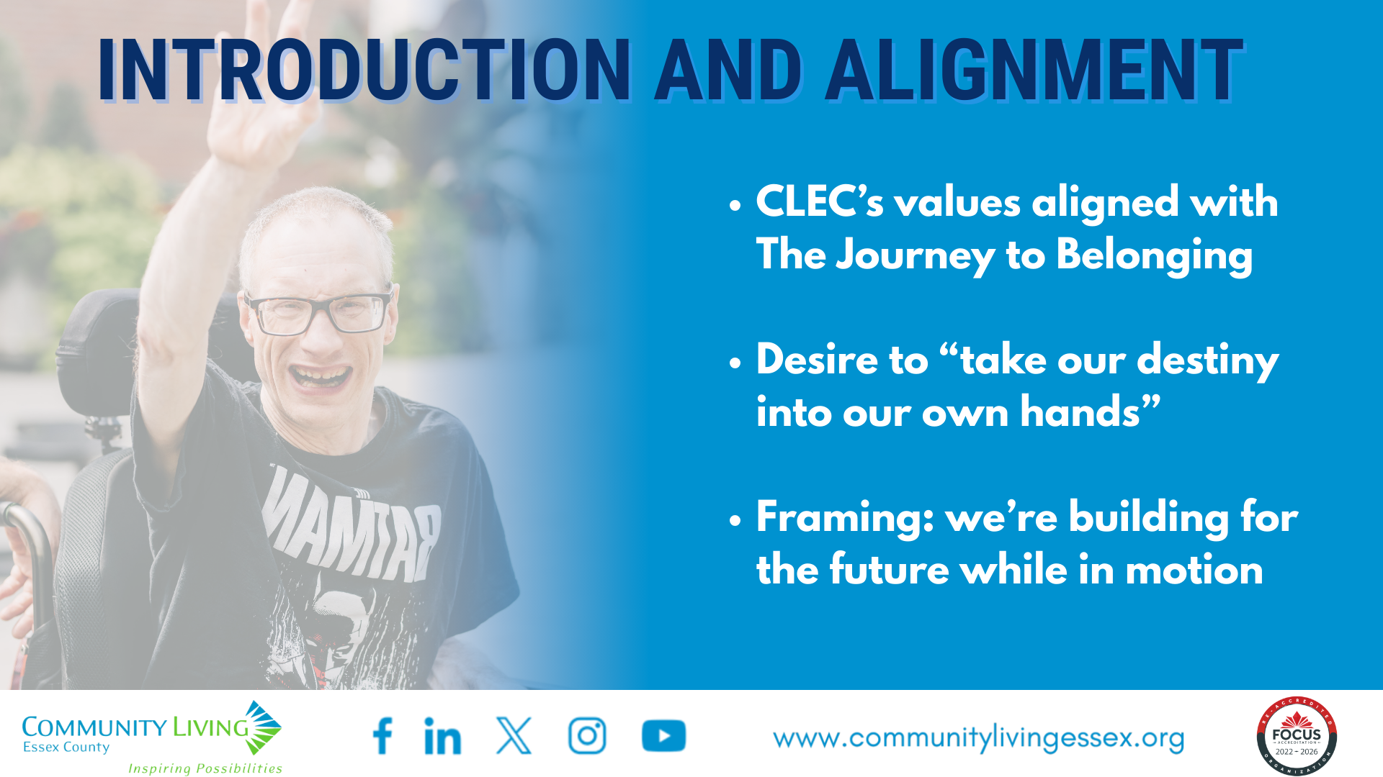

Slide 4
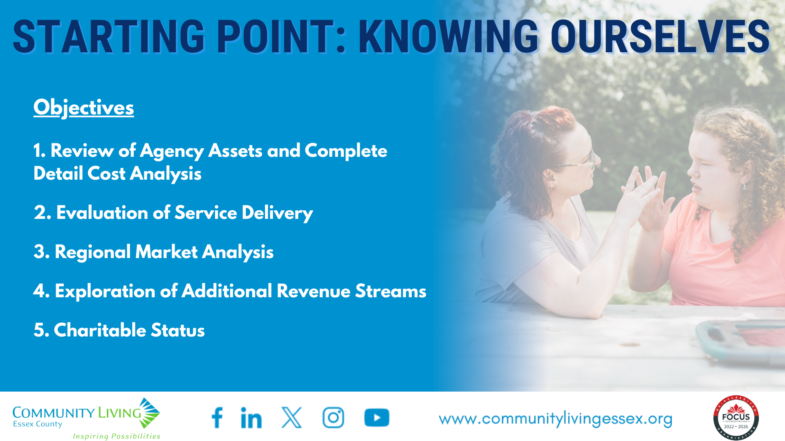

Slide 5
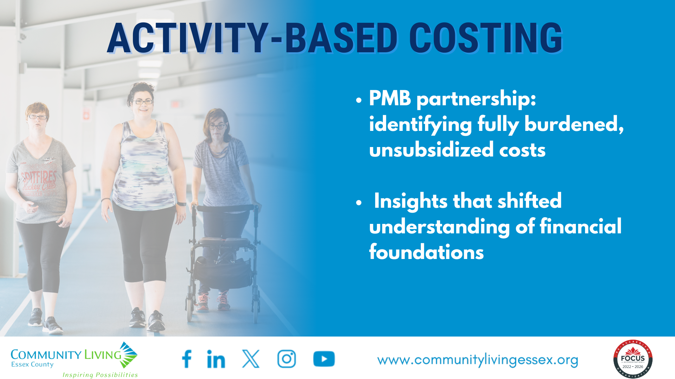

Slide 6
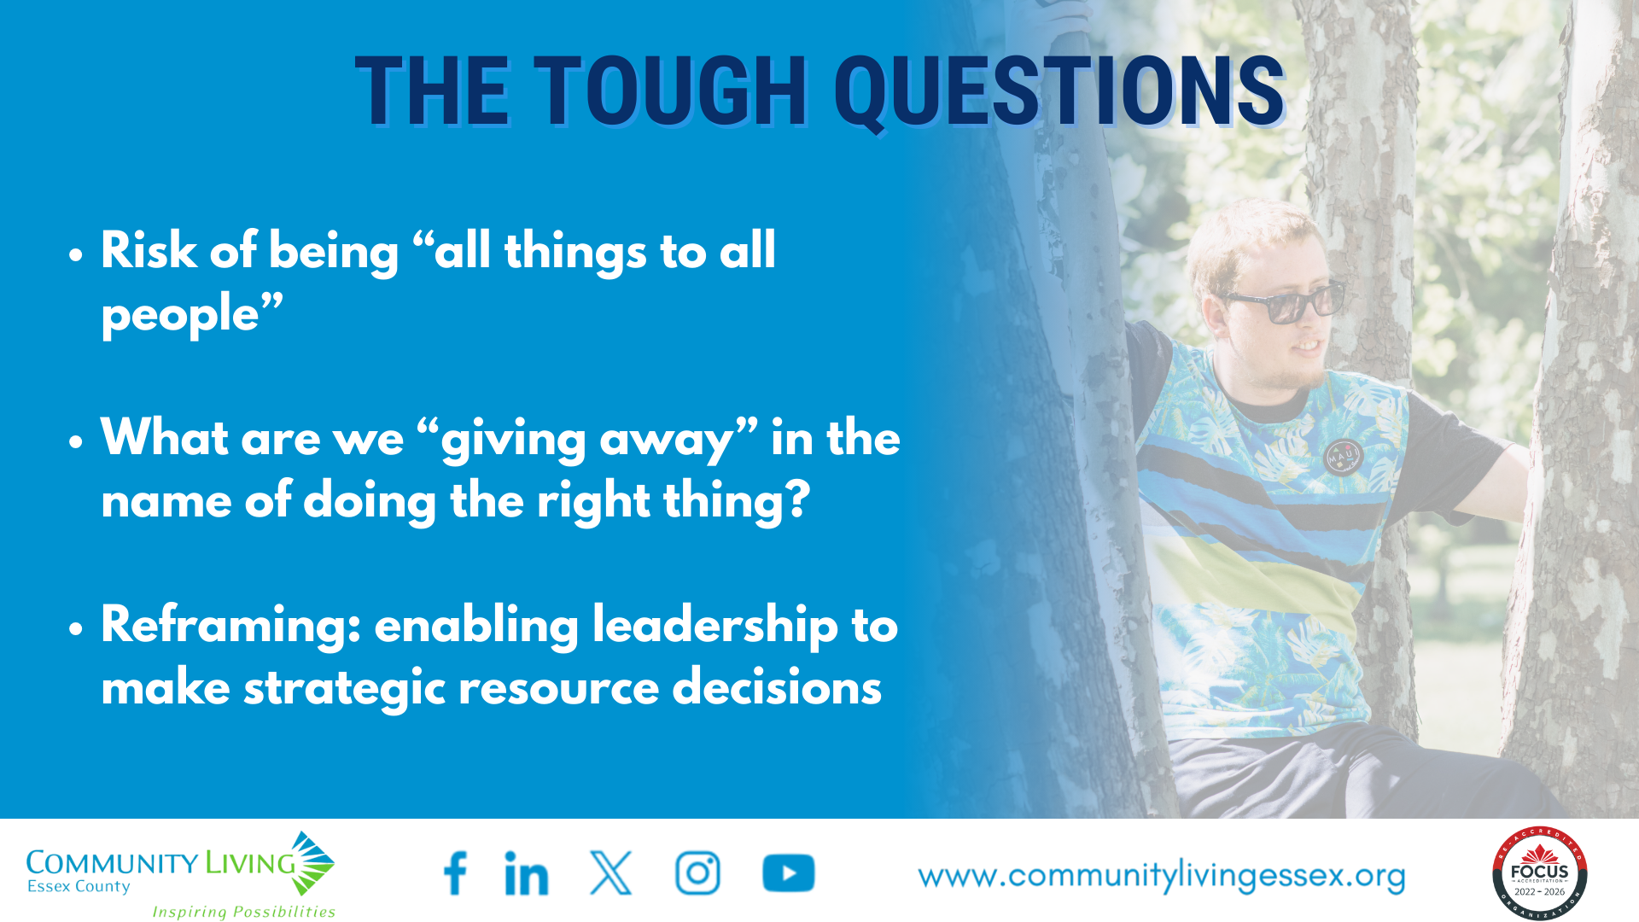

Slide 7
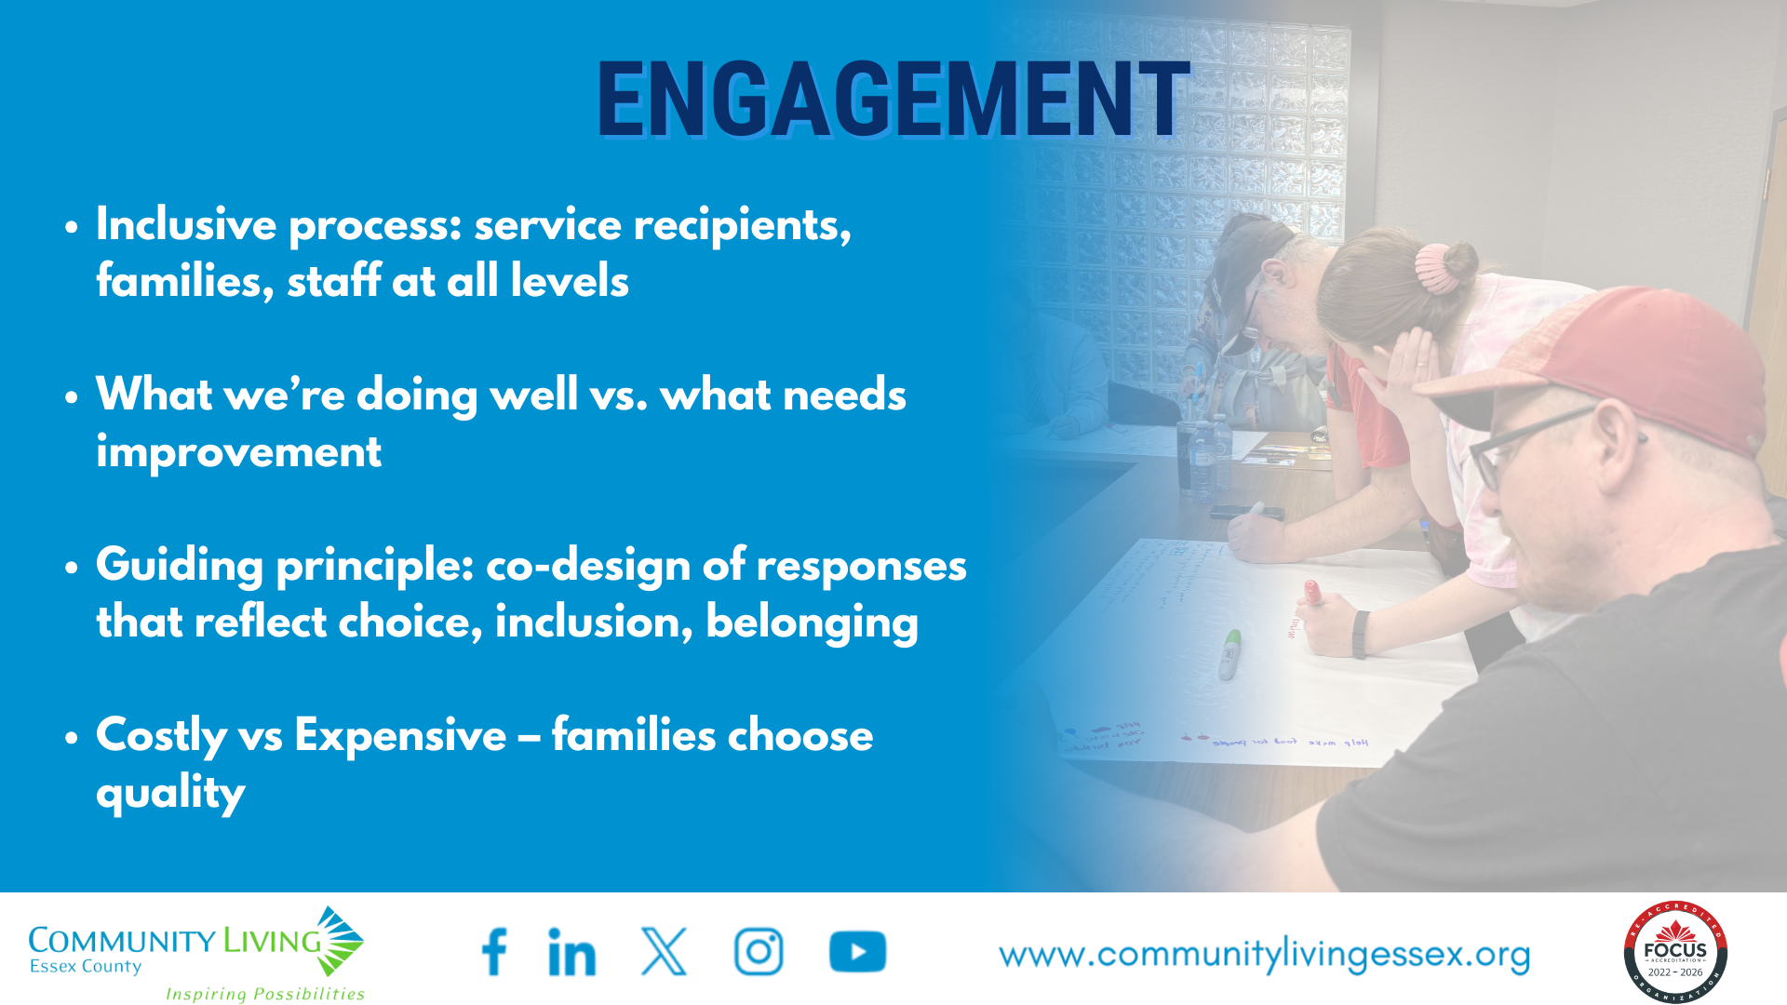

Slide 8
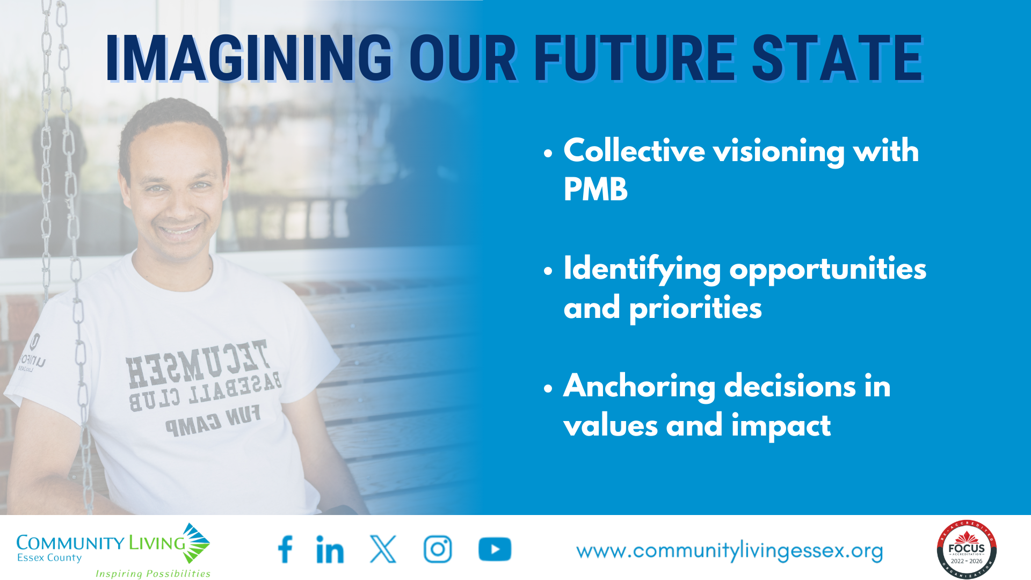

Slide 9
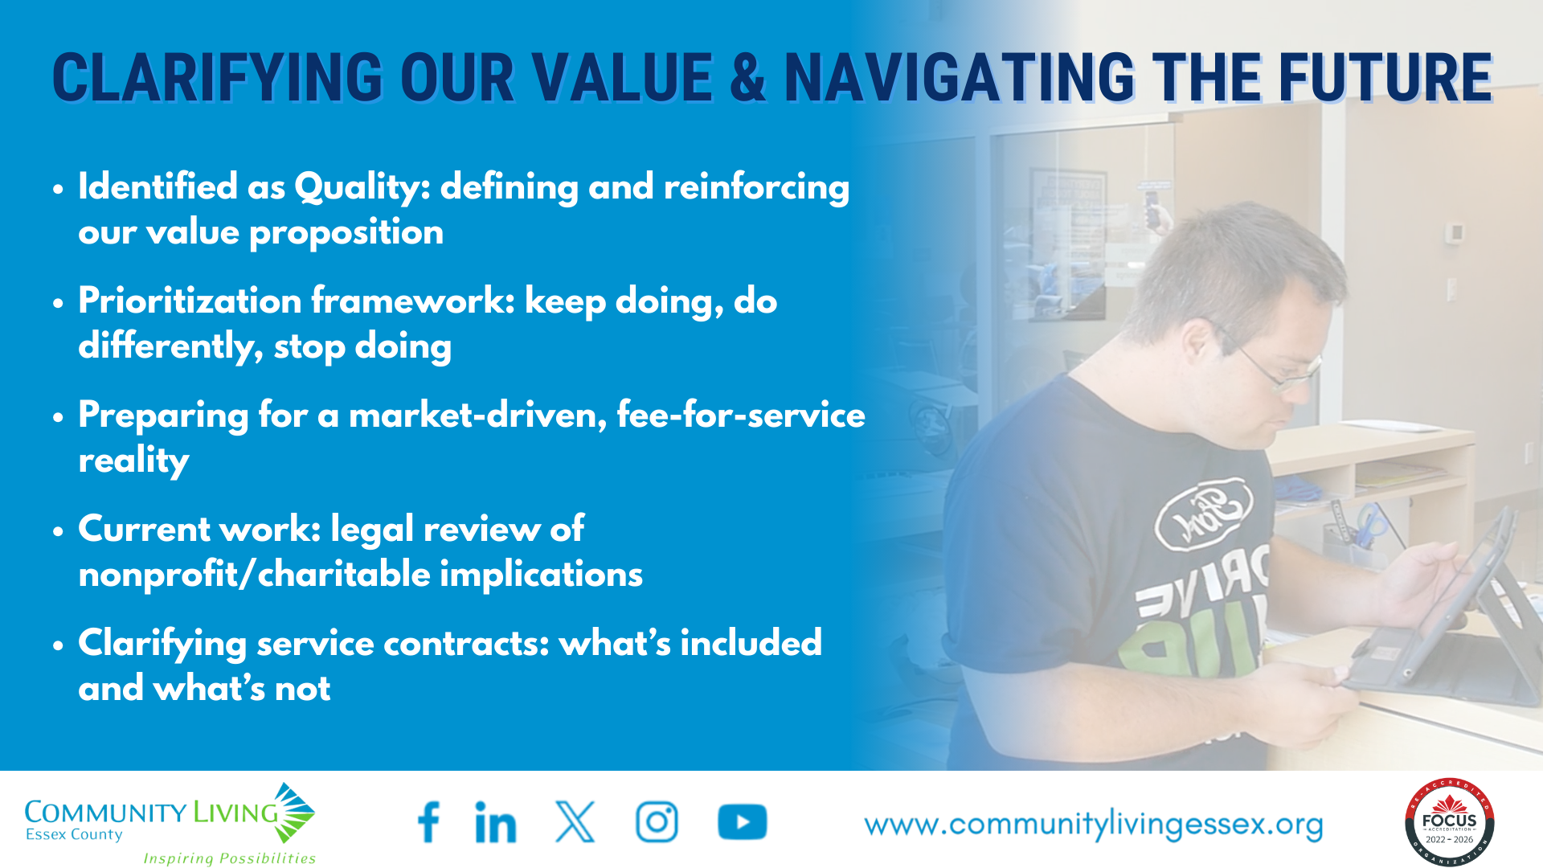

Slide 10
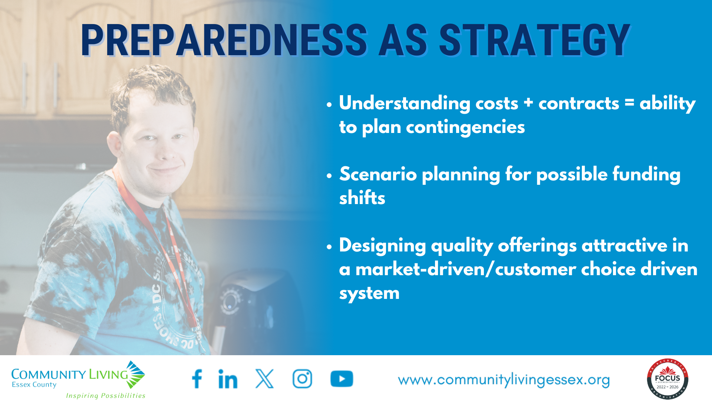

Slide 11
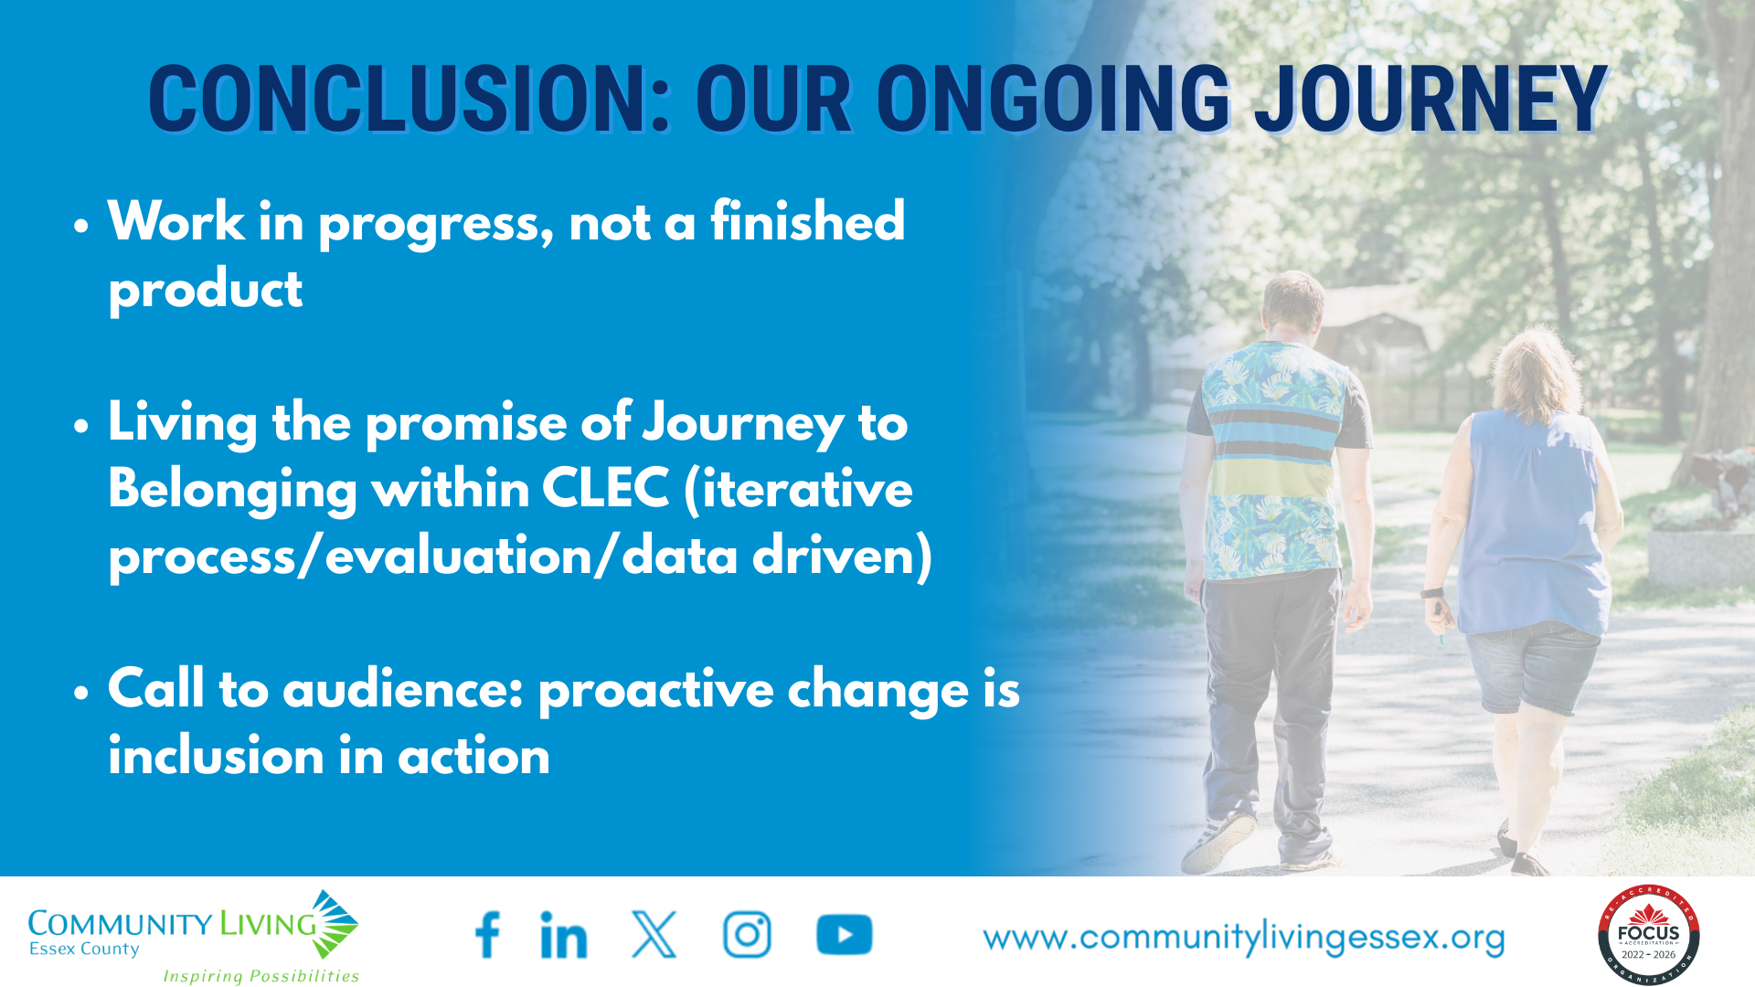

Slide 12

PechaKucha: Snapshots of Change, Stories of Impact

Slide 13


Slide 14
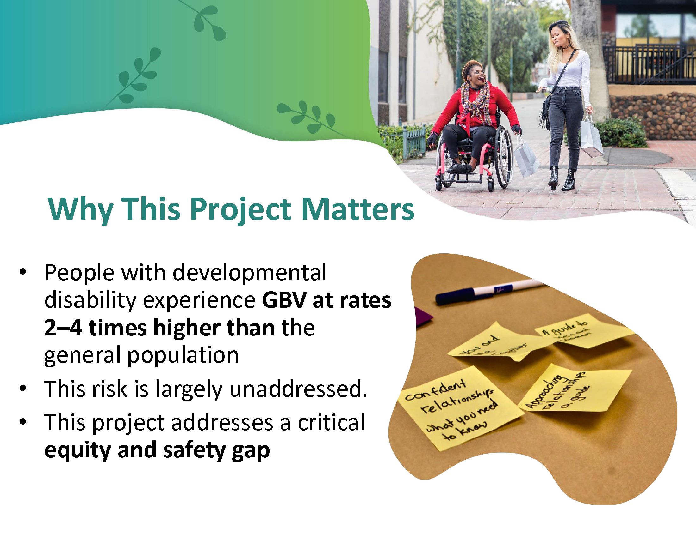

Slide 15
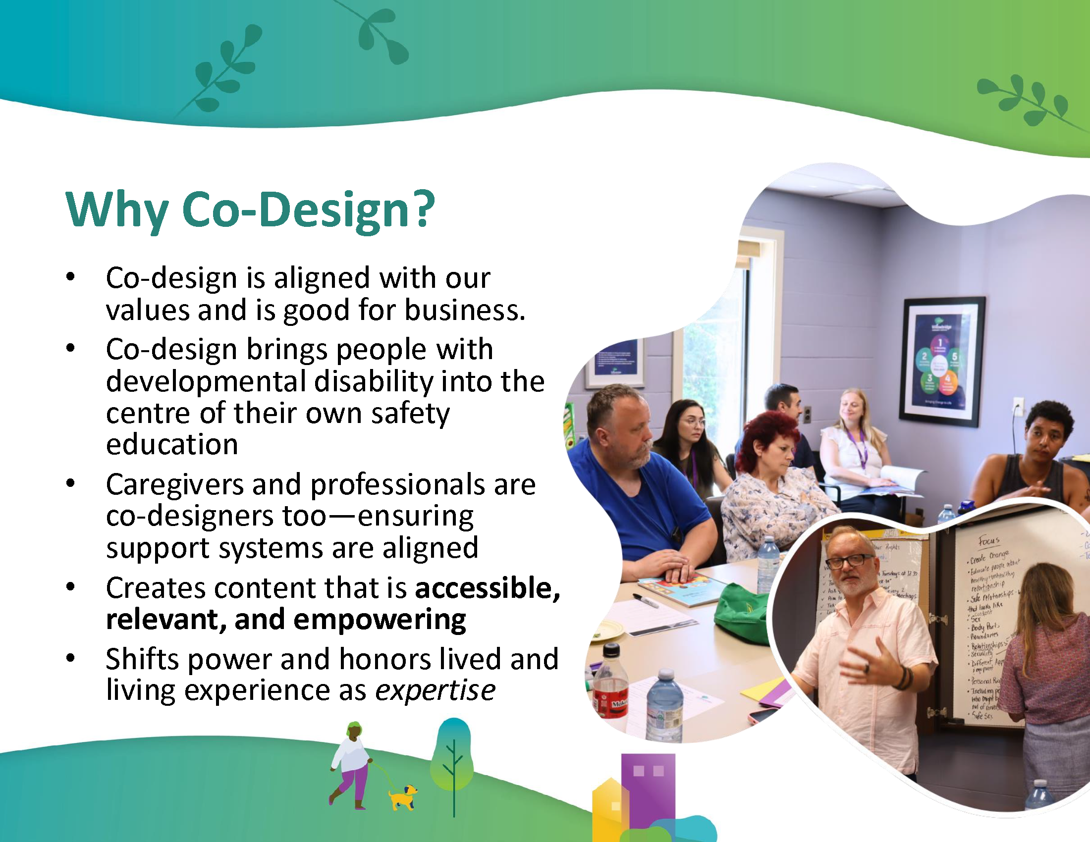

Slide 16


Slide 17
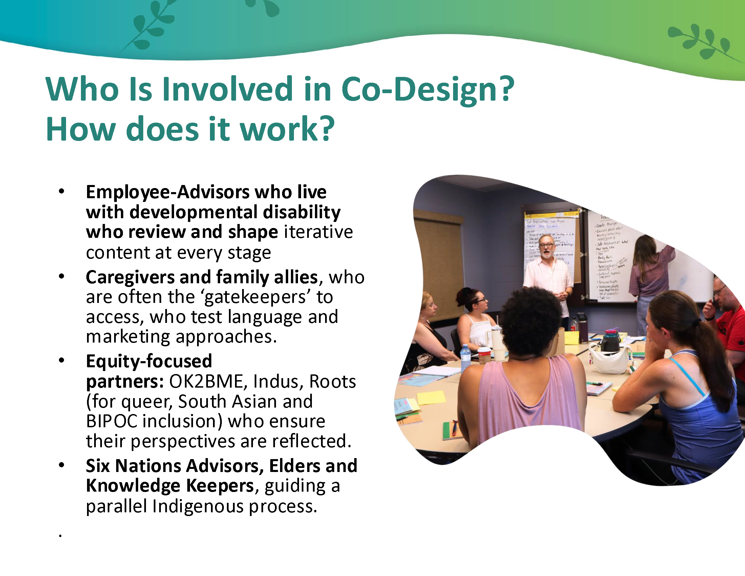

Slide 18
Community Living Six Nations
Ronatahskats

Slide 19
Why is our book different?
Reviewed by our Advisory Committee which consists of community members
Incorporating cultural teachings
Integrating our Mohawk and Cayuga language
Including the impact of generational trauma, such as Residential Schools

Slide 20
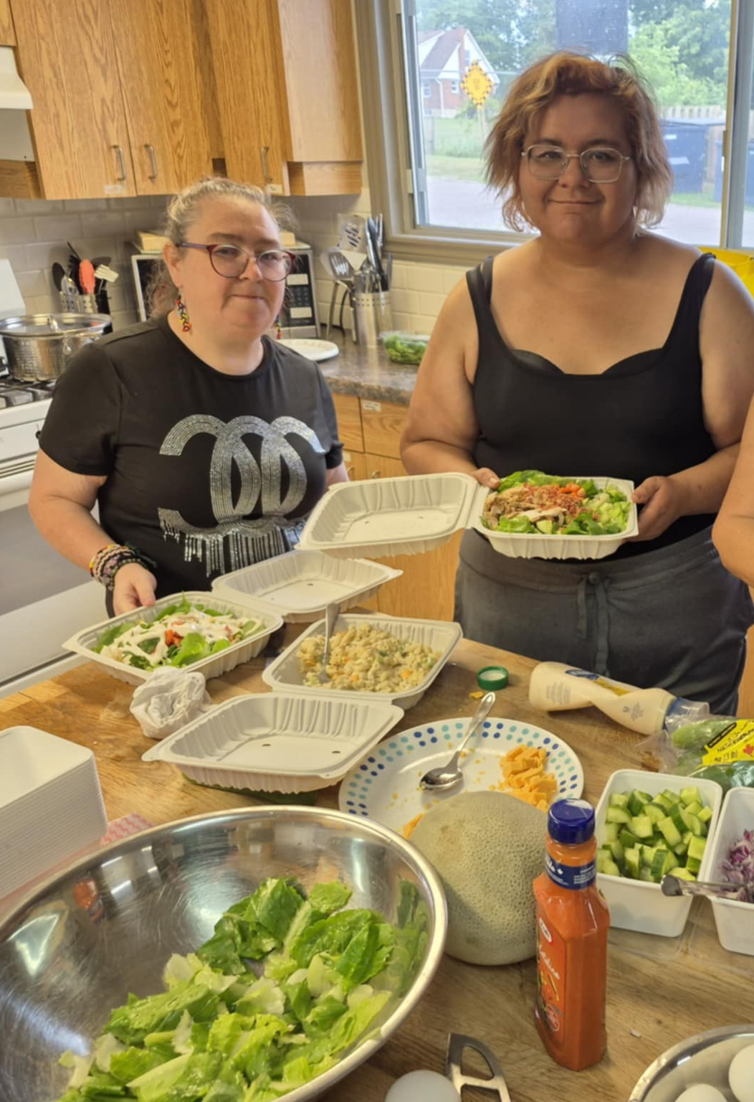
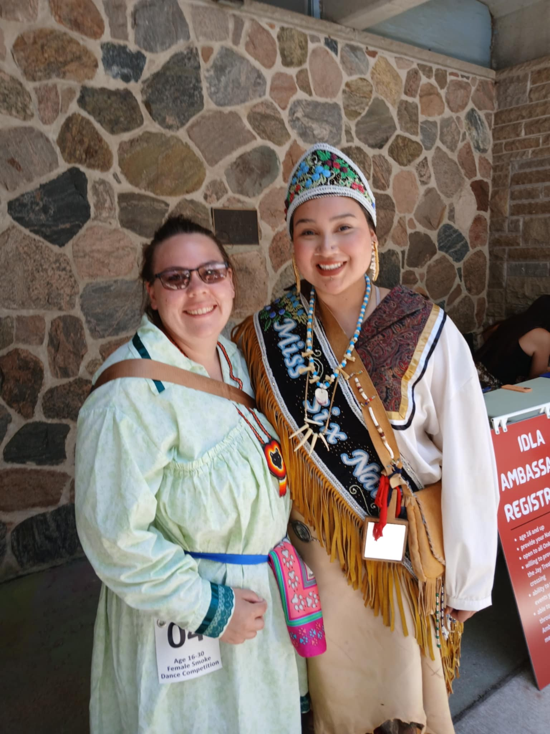

Slide 21
What is next for our Book?
The individuals in Six Nations are well taken cared of.
My worry is for other First Nations people across the Province who are not represented or supported amongst the various agencies.
Share the finished product with other First Nations communities across the Province.

Slide 22
Nya:weh

Slide 23
PechaKucha: Snapshots of Change, Stories of Impact

Slide 24
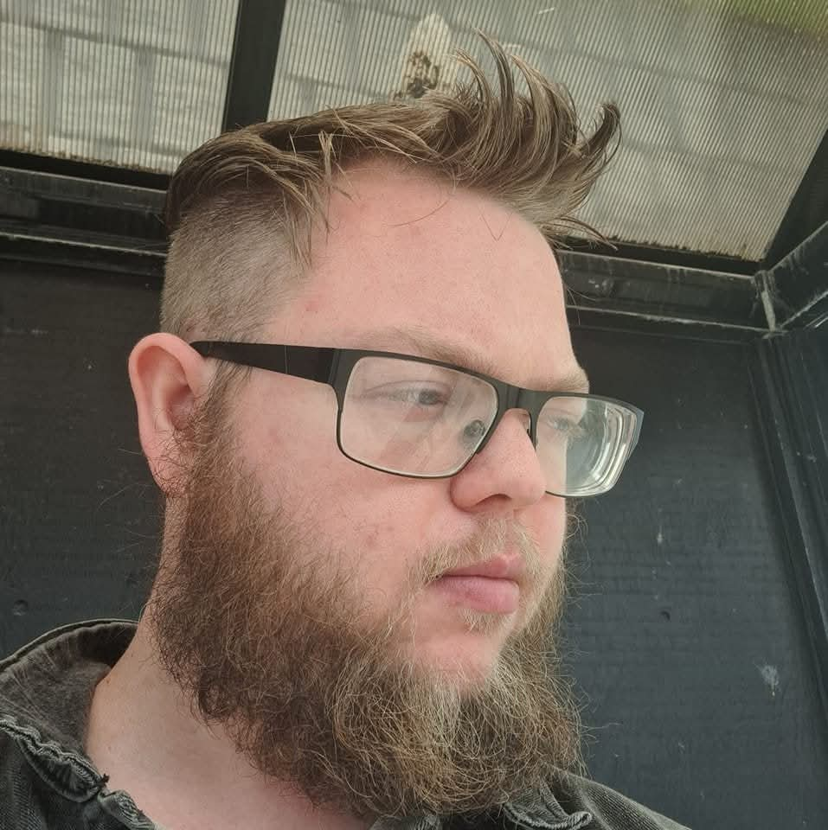




DREAM MAKER:
PERSON-DIRECTED SERVICES WITH A
CO-DESIGN APPROACH
Liam Russell

Slide 25
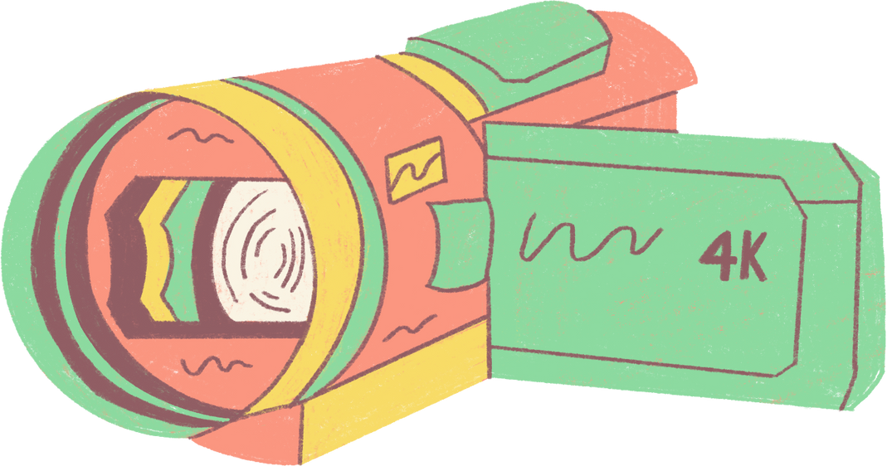
What was it like to be part of a team where your ideas helped shape how services will look in the future?

Slide 26
Can you tell me about a moment in the project when you felt proud of what you shared or did?

Slide 27
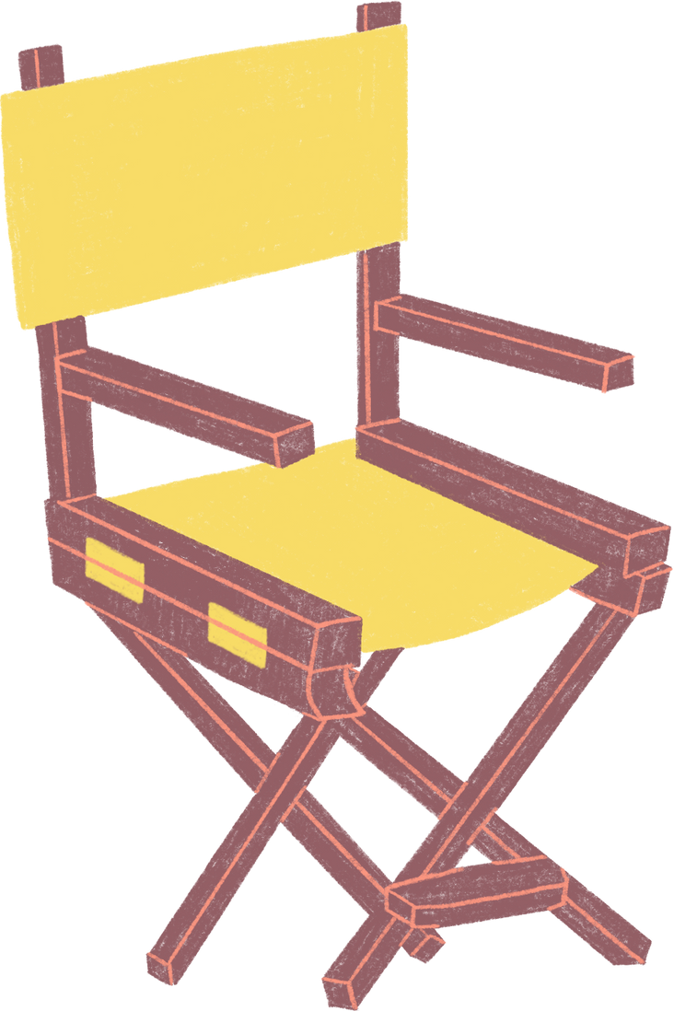

Introducing e3’s New Co-Production Model!
Person Directed Process
Shifting from traditional service model to person-directed supports
The role of the Director’s Chair analogy: Empowering individuals to direct their own life’s story
Empowering people with knowledge and decision-making, like Financial Literacy and making Choices!

Slide 28
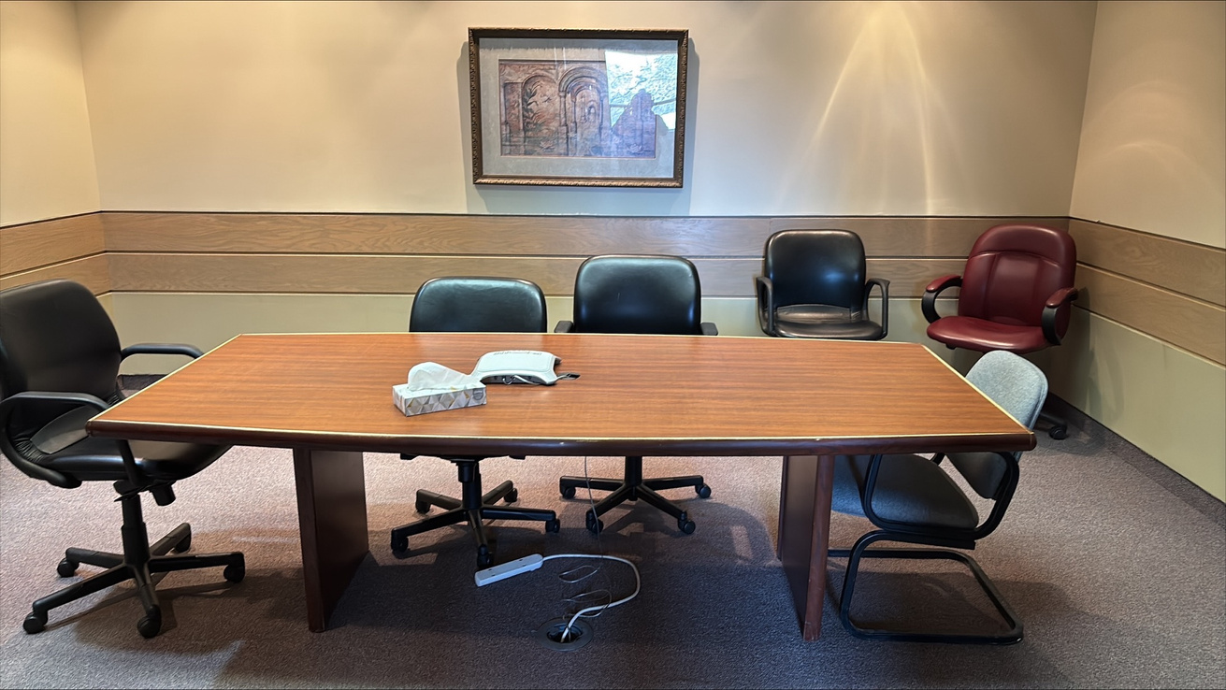
Our New Warm Welcome!

Slide 29
Did anything surprise you about how the team worked together or how decisions were made?

Slide 30
The Power of Co-Design in ACTION
Feedback for our new model:
“Beautiful layout and design, eye catching, quality, easy to read and understand!”
“Lots to choose from. A learning curve; getting used to the new process”
“You are doing a great job!! Improving from feedback”
“We understand this is a work in progress ☺”

Slide 31
How do you hope the new services or ideas will make life better for people who receive support from e3?

Slide 32
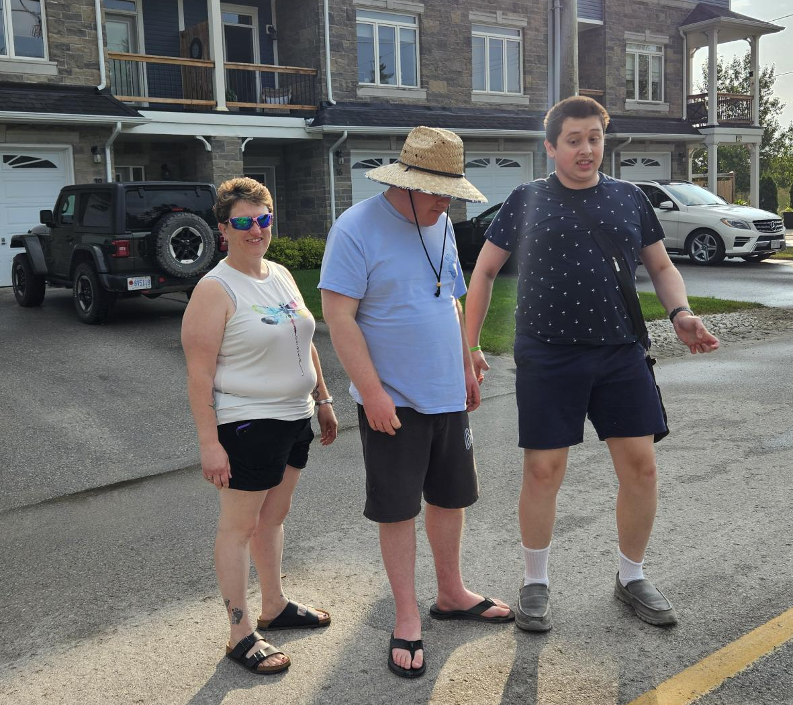
The Power of Co-Production in ACTION
Person-Directed Process
Services shaped by people, not policies, offered publicly using My Community Hub
Warm Welcome environment and tools as a foundation for getting started and life planning
Ongoing collaboration at every stage, including personalized budgets

Slide 33
What would you say to someone who’s never been asked to help design services before—what should they know?

Slide 34
PechaKucha: Snapshots of Change, Stories of Impact

Slide 35


COMMUNITY LIVING ASSOCIATION FOR SOUTH SIMCOE
Community Living Ontario
September 18, 2025

Slide 36
Our focus
Strategic Plan 2025 – 2028 (30)
FOCUS Accreditation
3 – years of labour unrest

Slide 37
Post Pandemic Blues
How do we get back our Timbre and Groove
Timbre: noun; the character or quality of a musical sound or voice as distinct from its pitch and intensity
Groove: verb; informal; “in the groove” – performing confidently or consistently well. “the team is not really in the groove tonight”

Slide 38
Co-Creating Positive Change (May 8, 2025)
Learn about WITHology – our Co-Design process
Practice Co-Design Activities
Gain an understanding of what it will take the CLASS Leadership Team to embrace and engage in positive change and collaboration.
Give the Team an opportunity to share current experience and discuss what/how we might want to change going forward.
Co-creating CLASS Leadership Team's future together.

Slide 39
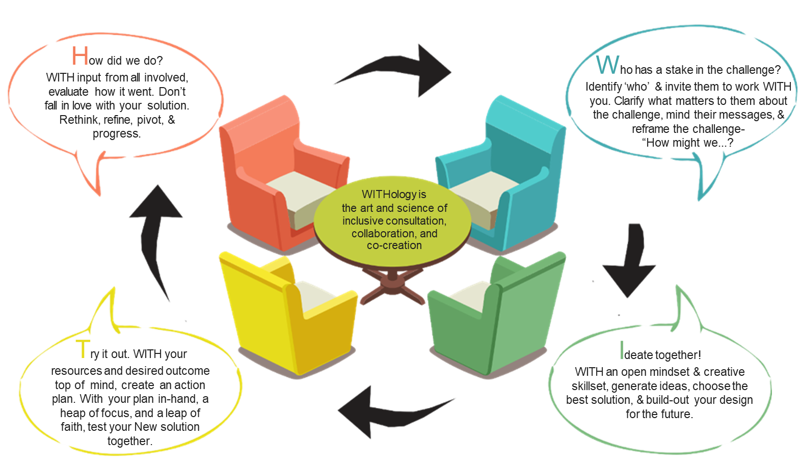
WITHology

Slide 40

HOW MIGHT WE?

Slide 41
Typical Co-design Project Plan
Launch Session
Participatory Research
Determine Co-design Team
Customer Experience - Workshop
Design Labs x approximately 5 – 6
Try it Pilot Implementation Plan and Launch
Pilot Formative Feedback and Implement Changes

Slide 42
Why do we need change management?
Change is good as long as I don’t have to do anything different.

Slide 43
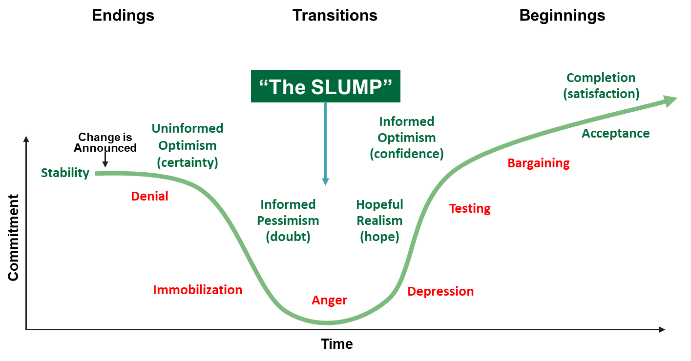
Everyone experiences “The SLUMP”

Slide 44
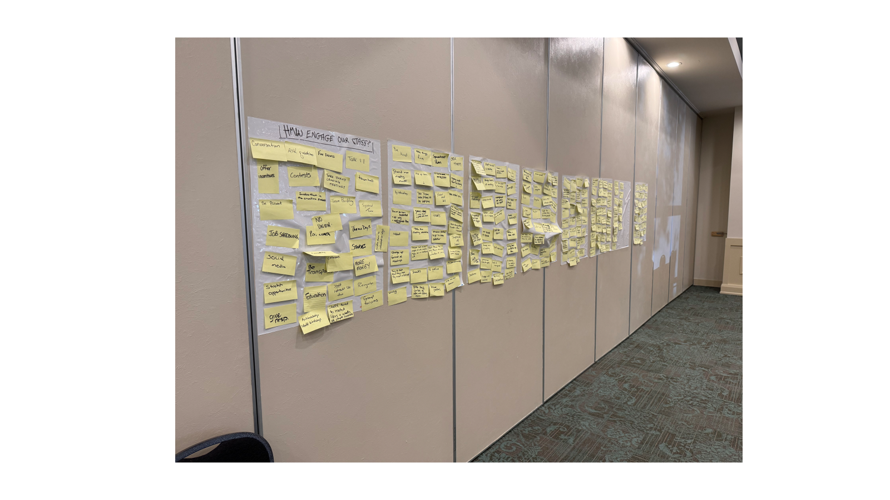

Slide 45
PechaKucha: Snapshots of Change, Stories of Impact

Slide 46



Do not edit
How to change the design
What is one word you would use to describe how you are feeling at the end of this session?
The Slido app must be installed on every computer you’re presenting from

Slide 47

Do not edit
How to change the design
What is your key take away from the 4 Pechakucha stories?
The Slido app must be installed on every computer you’re presenting from

Slide 48

Do not edit
How to change the design
Did you benefit from the format of this plenary session?
The Slido app must be installed on every computer you’re presenting from

Slide 49

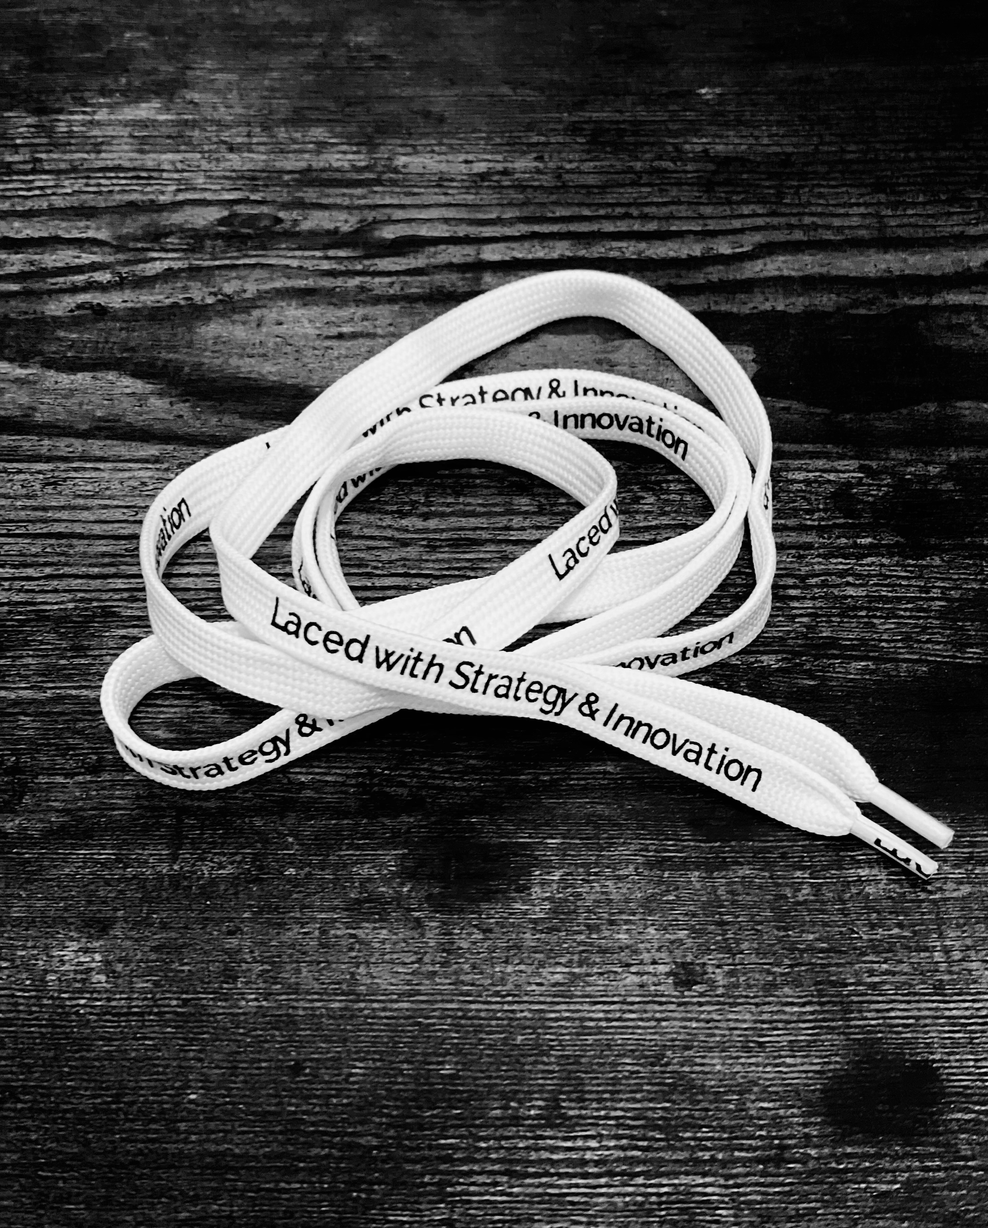
As CLO’s Strategy & Innovation Partner, PMB has a question:
Who at your table has their birthday coming up next?
Happy Birthday to you! This person is gifted with the “Laced with Strategy & Innovation” shoelaces on the center of the table!

Slide 50


Miigwech
Nya:Wen
Ekosani
peoplemindedbusiness.com

