Slide 1

CONTROL AND CONTAINMENT
COMMUNICATING IN A CRISIS

Slide 2
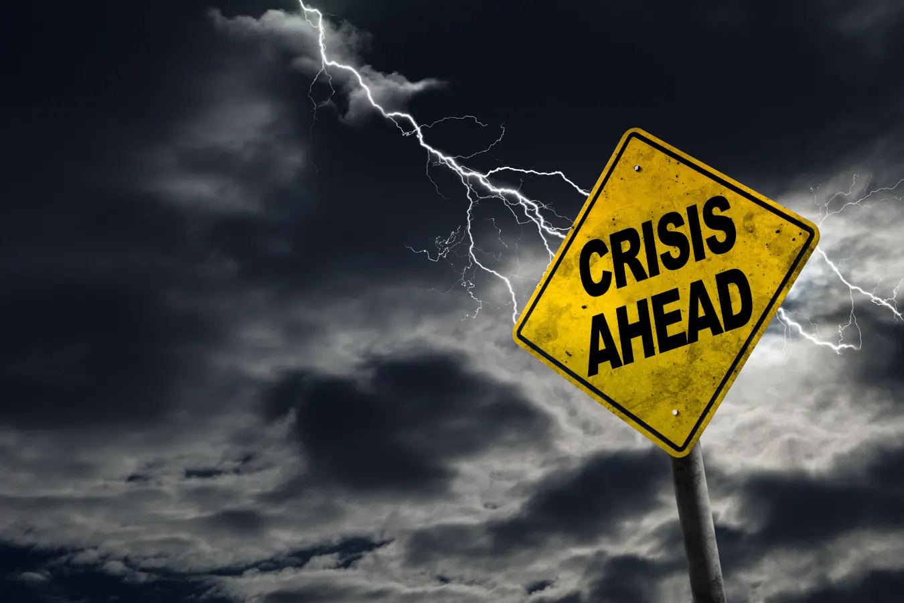
CRISIS.
IT DOESN’T JUST KNOCK.
IT BLOWS IN
LIKE A SUDDEN STORM.

Slide 3
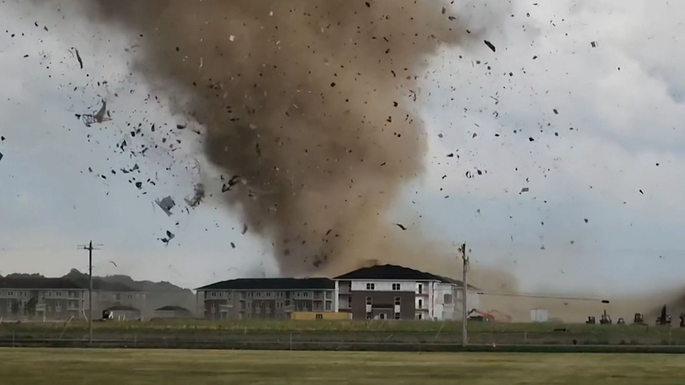
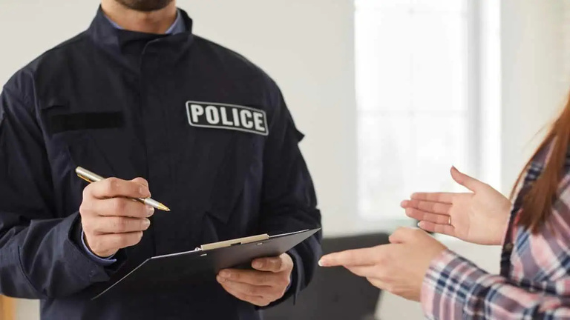

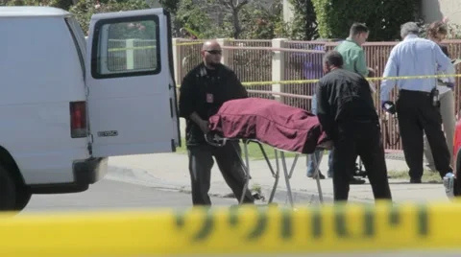
LEADERSHIP THROUGH CRISIS
Catastrophe
Police investigations
Pandemics
Sudden Loss

Slide 4
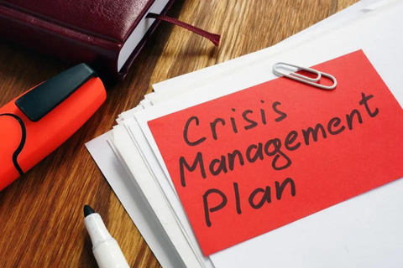
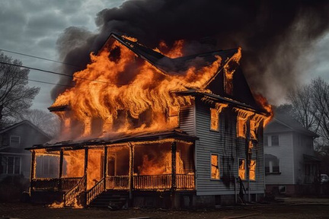
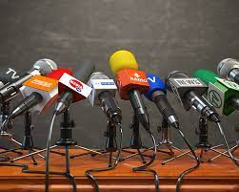

Pre-Crisis Stage
Identify potential issues
Establish preventative measures
Prepare Crisis Management Plan
FOUR STAGES OF
CRISIS MANAGEMENT
Crisis Stage - Control
Activate Crisis Management Team
Contact Families, Board, Lawyer, Stakeholders
Implement Damage Control Measures
Response Stage - Containment
Finalize Public Statement + Key Messaging
Continue contact with people supported
Media - only if necessary
Resolution and Recovery Stage
Conduct post-crisis analysis
Review and improve crisis plan
Restore trust

Slide 5

CONTROL
CONTAIN
COMMUNICATE

Slide 6
CONTROL

Slide 7
CONTAIN

Slide 8
COMMUNICATE

Slide 9

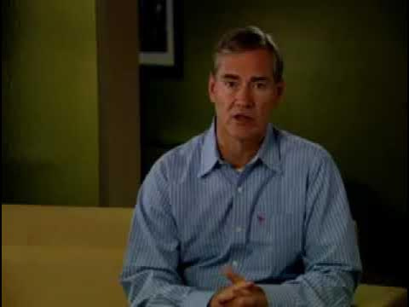
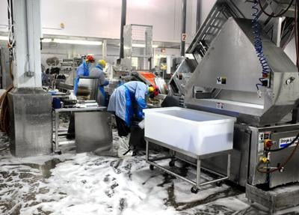
MAPLE LEAF FOODS
2008
Listeriosis Outbreak
23 Deaths
57 Confirmed Cases

Slide 10
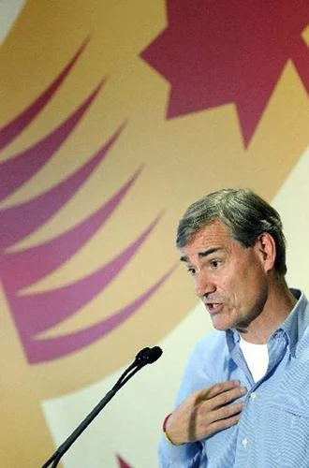

"THE CORE PRINCIPLE HERE WAS TO FIRST
DO WHAT'S IN THE INTEREST OF PUBLIC HEALTH,
AND SECOND TO BE OPEN AND TRANSPARENT IN
TAKING ACCOUNTABILITY"
Michael McCain
“HE EMERGED AS THE
HUMAN FACE OF A COMPANY
THAT CARED ABOUT ITS CUSTOMERS”
“THE BUCK STOPS HERE.”
The Globe and Mail
Michael McCain

Slide 11
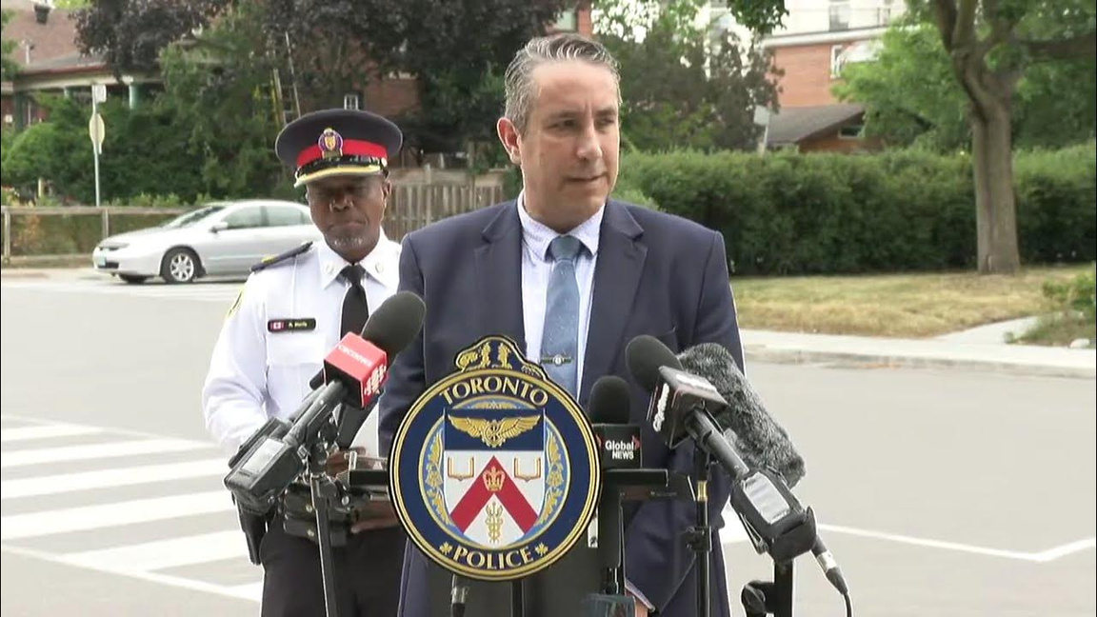
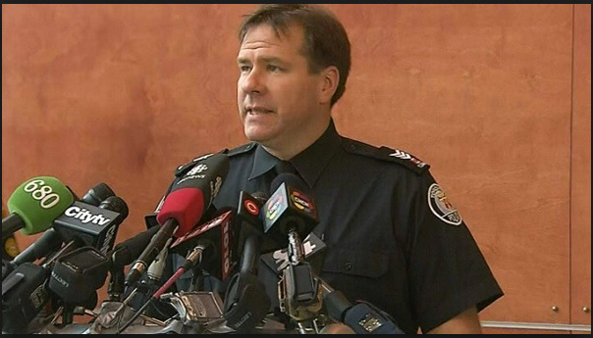
Police and Emergency Responders

Slide 12

KEY MESSAGING
Goal: Control the narrative and maintain credibility
Fast
Factual
Empathetic
Authentic
Transparent
What do we want them to know, feel and do?

Slide 13

TEST CASE
Physical force against a person supported
A video appears on social media appearing to show
a staff member using physical force against a person supported.
The staff member has been removed from their duties pending an investigation.
The police have been contacted.
Source:
Community Living Ontario

Slide 14
TEST CASE
Physical force against a person supported
The alleged incident is out in the public and people are commenting.
The Media is calling.
What do you do ?

Slide 15
TEST CASE
Physical force against a person supported
Call your Lawyer.
Pull your key messaging from your Crisis Plan and
tailor the statements to the situation.
Issue Internal statements and contact Families and People Supported.
Craft and refine your Official Holding Statement.
Finalize the Media Release. (only if needed)

Slide 16

Crisis Communications Plan
Crisis Communications Team & Protocols
Notification and Contact List
Internal & Stakeholder Lists and Communications Plan
Media Relations Plan
Holding Statements and Templates
Social Media Management Protocol
Media Contacts
Post Crisis Review Protocol

Slide 17

ALLEGED Incident
Acted quickly contacted authorities
Immediately contacted people supported and families
Currently under investigation
Will be providing updates as they become available

Slide 18

Demystifying the Media

Slide 19
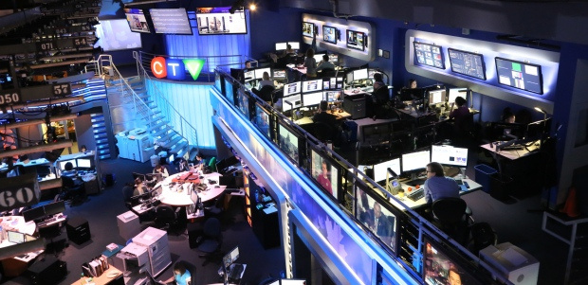
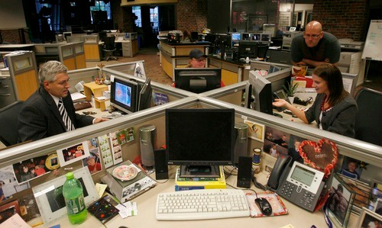
TELEVISION
•EXECUTIVE PRODUCER
•PRODUCER(S)
•ASSIGNMENT EDITOR
•ANCHOR/REPORTER
•WRITERS

Slide 20
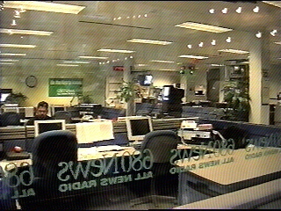
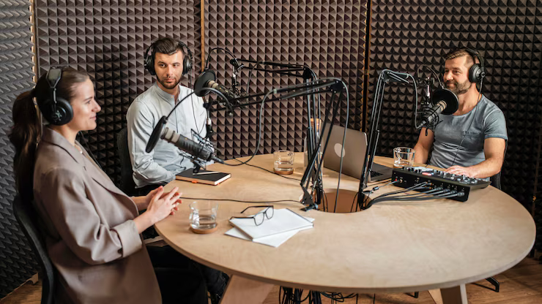
•NEWS DIRECTOR
•EDITOR/LINEUP EDITOR
•NEWS READER
•REPORTER
•WRITERS
RADIO

Slide 21
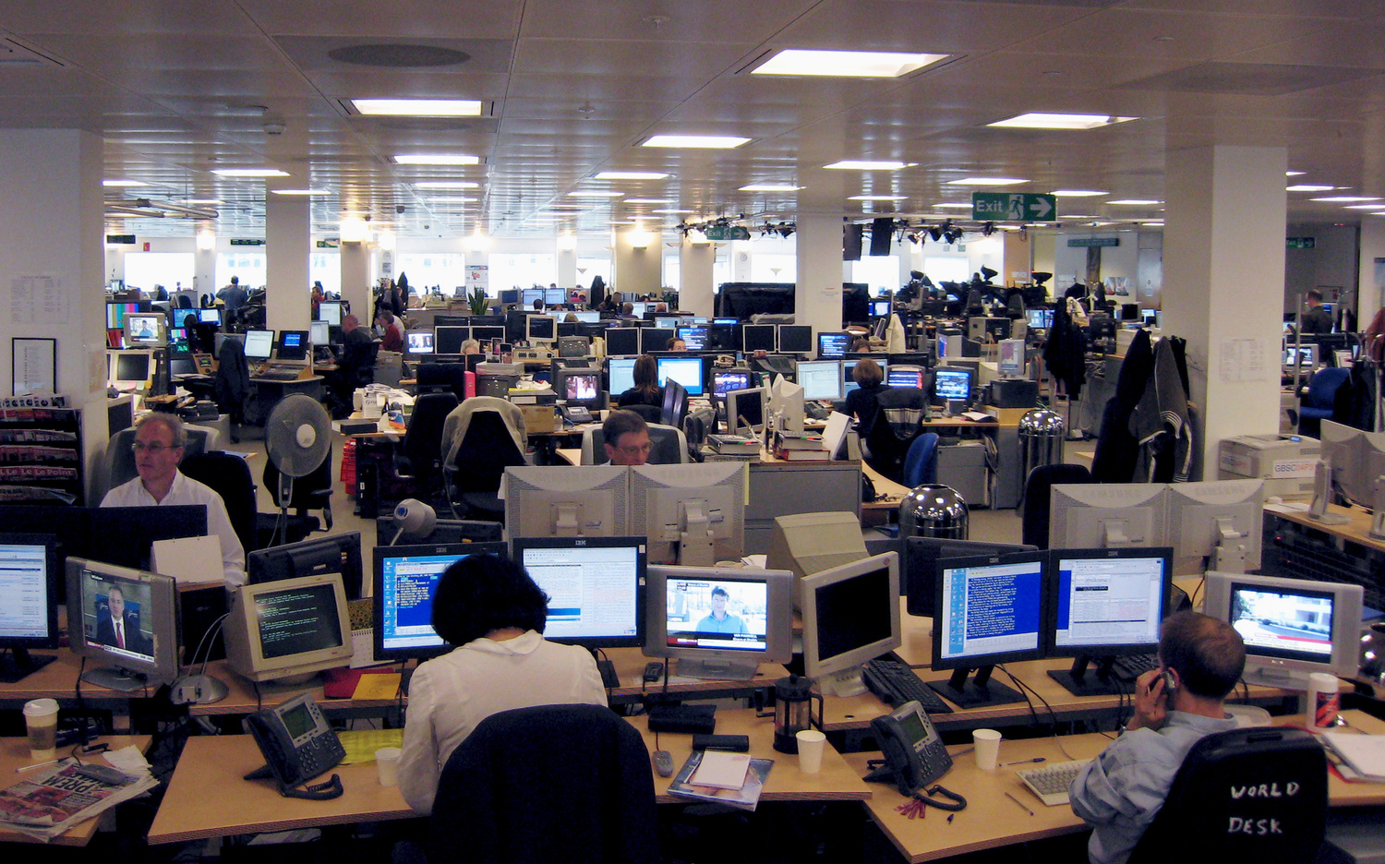
PRINT/DIGITAL
•NEWS EDITOR
•PHOTO EDITOR
•REPORTERS
•WRITERS

Slide 22
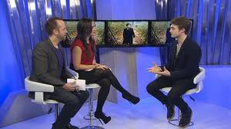

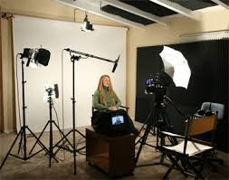
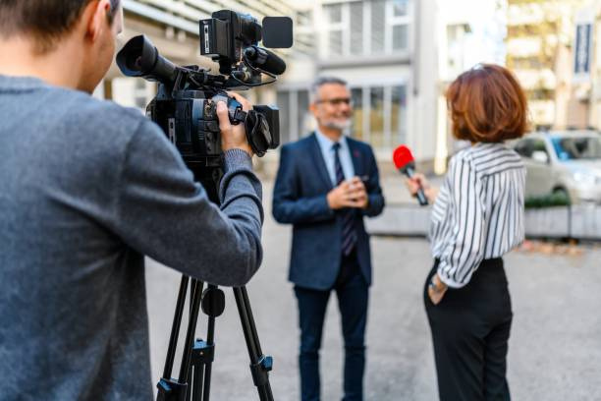
TYPES OF TV INTERVIEWS
TV Studio
Double Ender
News Conference
Reporter Interview

Slide 23
TYPES OF TV INTERVIEWS
TV Studio
Double Ender
Reporter Interview

Slide 24
HOW TO HANDLE REPORTERS
Repeat Questions
Fishing and Digging

Slide 25
LET’S GET TO WORK

Slide 26
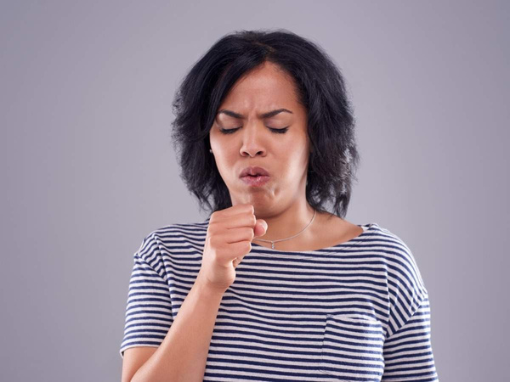
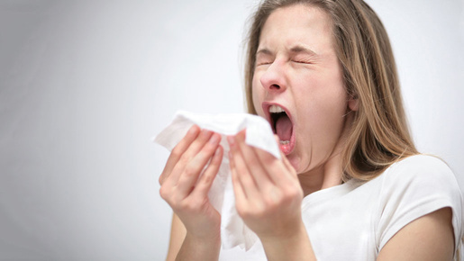

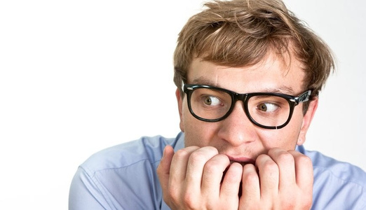
Calming a Cough
TIPS FROM A
TV INSIDER
Conquering a Sneeze
Calming Anxiety

Slide 27
CONTROL AND CONTAINMENT
COMMUNICATING IN A CRISIS

