Slide 1

Choices at End of Life: Essential Partnerships and Knowledge for a Quality Life
E3 Community Services and
Hospice Georgian Triangle
Presented by:
Christine Vallis-Page, RN, BCom, MHA, CHE
Lisa Wright, RN, BScN, CHPCN©

Slide 2

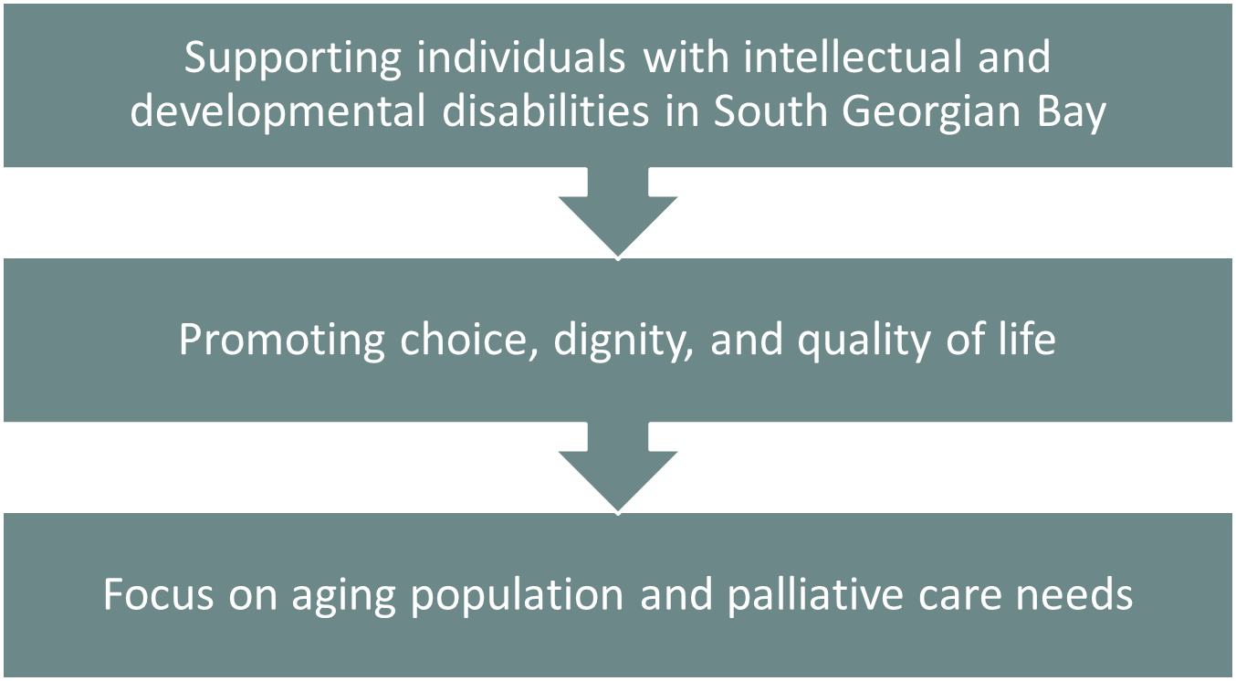
Enhancing Support at E3 Community Services

Slide 3
Who We Are… E3 Community Services Our Mission and Services
E3 Community Services is dedicated to empowering people with developmental disabilities through high-quality support, inclusive programs, and strong advocacy. Our team is committed to fostering a community where everyone can thrive.
We believe that each person deserves individualized support tailored to their strengths, choices, and goals. Over the years, E3 has transitioned from structured programs to flexible, person-centered supports that empower independence and enhance quality of life. Our comprehensive offerings range from integrated child care services and supported living to social engagement opportunities, all designed to enable individuals and families.

Slide 4
Why a Palliative Approach Matters…
Aging population with complex health and communication needs
Historical trauma and institutionalization impacts
Barriers to accessing quality health care
Goal: Empower people to age and die in place, with comfort and respect

Slide 5
Partnering for Impact…
The Palliative Care Clinical Coach Program
Launched in 2024 by Ontario Health & HPCO
50+ coaches across Ontario supporting community-based care
Central Region using Ontario Health Team (OHT) mode
Lisa Wright: Coach for South Georgian Bay OHT

Slide 6

Project Overview

Slide 7
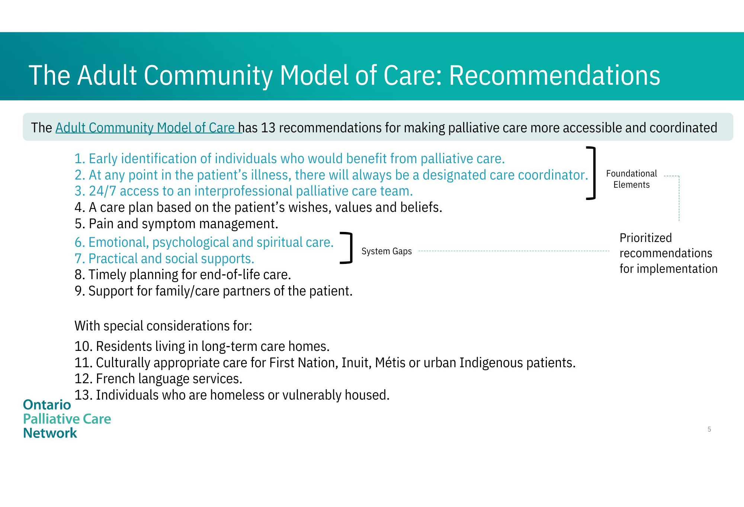
Model of Care & Implementation

Slide 8
Building a Home Hospice Program
Vision: Individuals die in their preferred location, with dignity
A dedicated Palliative Care Support Team
Staff growth and development in end-of-life care
Laying the foundation for a compassionate, person-centred model

Slide 9
Creating Collaborative Partnerships
Network
Local Hospice
Education
Virtual Resource Binder
Palliative Pain and Symptom Management Consultation
Volunteers
Grief and bereavement
Debriefing- train the trainer
Residential hospice- a choice

Slide 10
Creating Collaborative Partnerships
Ontario Health@Home
Service Provider Agencies
Services
Equipment
Therapies
Medication delivery
Case management
Delegated act training
Nursing visit 24/7 support
Palliative nurse practitioner
Coaching

Slide 11
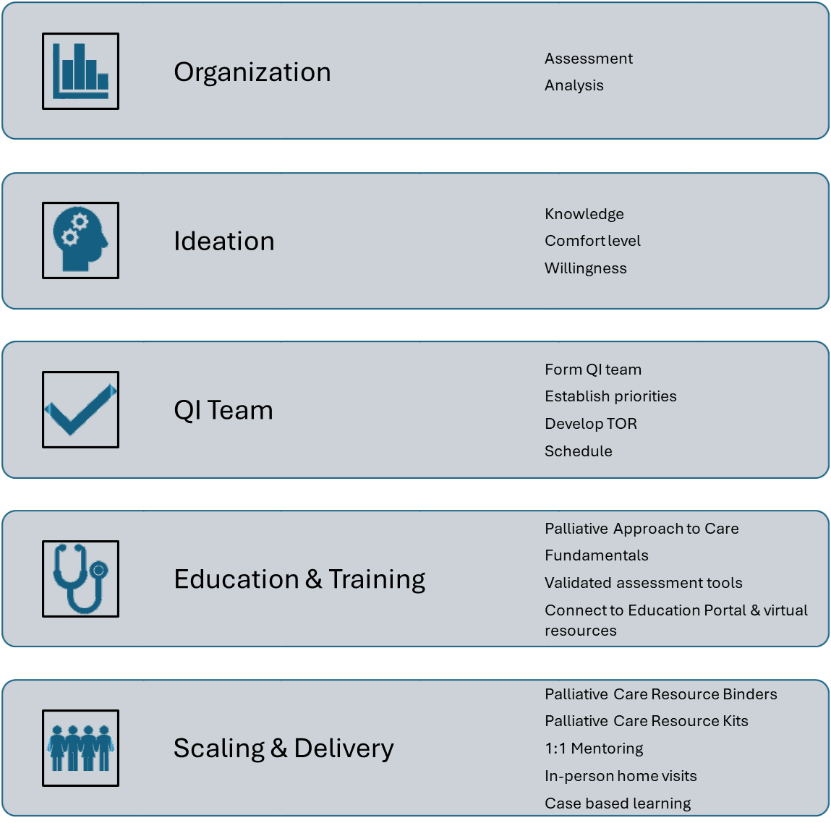
Process

Slide 12
Key QI Priorities
Early Identification
Frailty(CFS) Assessment Integration
Use of Validated Tools (PPS, ESAS, Braden)
Policy & Binder Development
Standardized Documentation
Emotional, Psychological, and Spiritual Care
Palliative Resource Sharing
Communication Protocol
**Challenge: Standard validated tools do not translate well

Slide 13
Implementation Strategy & Approach
Action Plan
Education and Training
ShareVision Integration
Palliative Care binders and baskets
SharePoint virtual resource hubs
Resource Binders
Policy Development
Ongoing assessments and training with a clinical coach

Slide 14
SMART Goals & Accountability
Each partner signs a Commitment Statement with SMART goals for:
Increasing palliative competencies
Improving access to education
Embedding assessment tools
Creating supportive documentation and policies

Slide 15

Integration and Quality Improvement Strategy

Slide 16
Integrating Validated Assessment Tools Early ID
*Awaiting the release of the IDD-specific tools & Resources…
Clinical Frailty Scale (CFS)
Adapted use for the IDD Population
Timing:
Admission Assessment
Routine Assessments
Decision tree for care planning
Training & Education:
Frailty Matters Training
Baseline frailty assessments completed with the clinical coach for all existing residents
Frailty Module

Slide 17
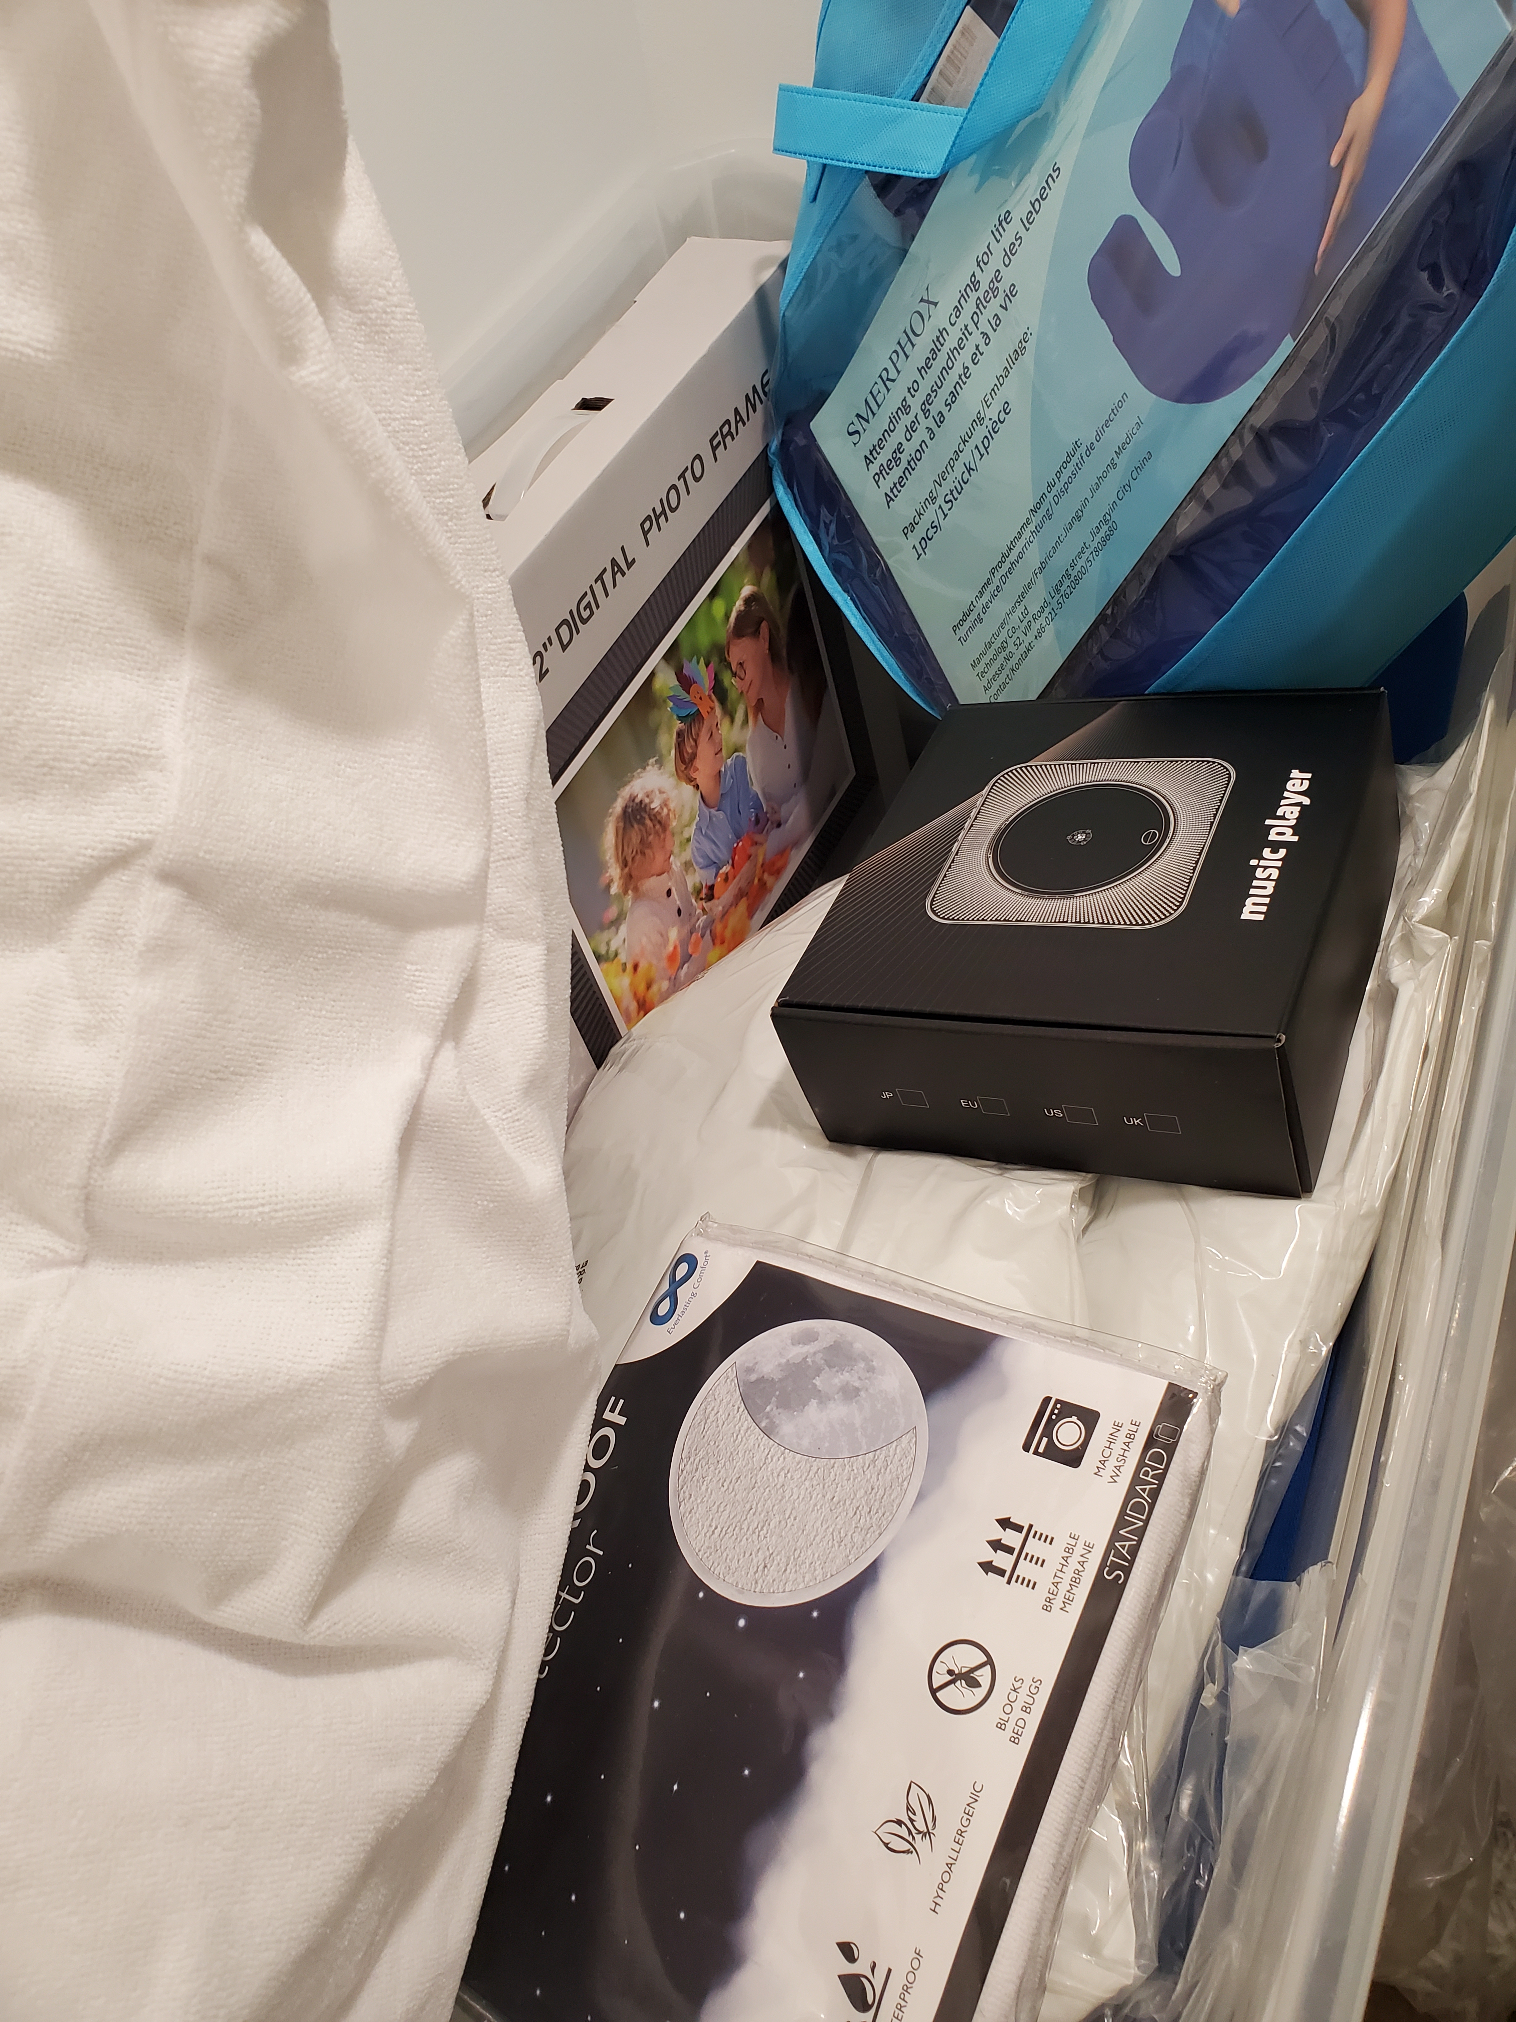
Tools
Home binder ( not digital)
Care team
Interdisciplinary notes
All about me
DRN/Full code
EDITH
Repositioning
Mouth care
Urine output
Bowel Routine
Wound Care
Pain Management
SRK meds
Reference tools:PPS
ESAS
Braden
Stop and Watch
Palliative Care Kit
Designated champions

Slide 18
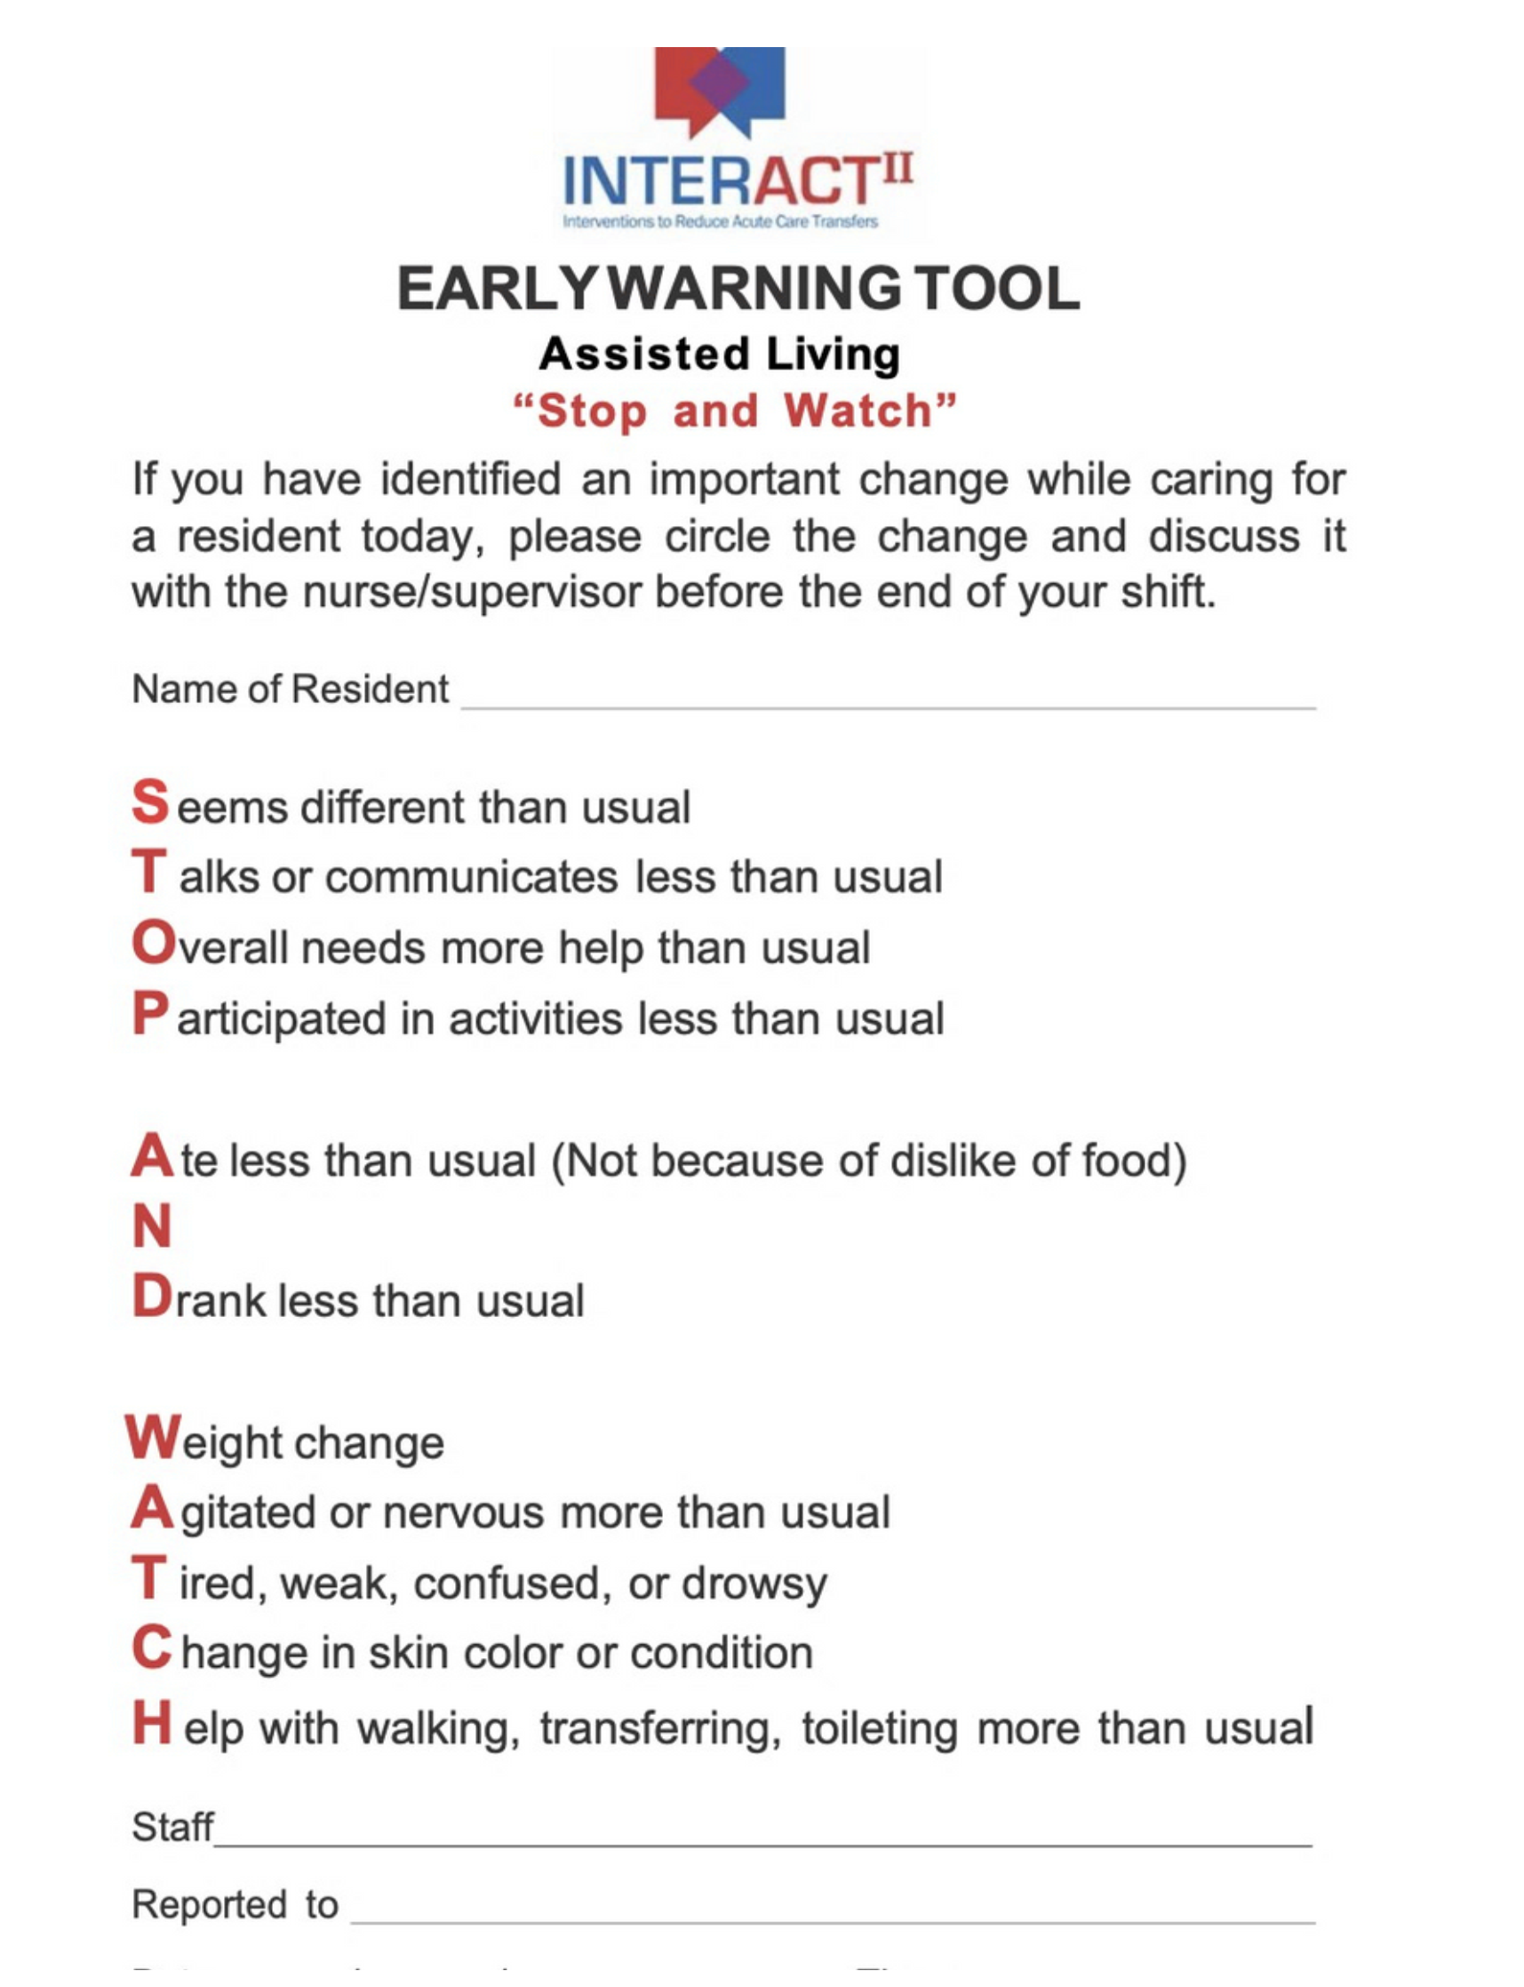

Slide 19
Integrating Validated Assessment Tools 24/7 Pain and Symptom Management
PPS, ESAS &Pain Assessment
Palliative Performance Scale (PPS):
Used to Assess Functional Status of Palliative Residents
Routine Assessments
Guides Care Planning and Resource Needs
Edmonton Symptom Assessment Scale (ESAS):
Frailty Matters Training
Baseline frailty assessments completed with the clinical coach for all existing residents
Pain Scale:
Non-verbal pain scale for assessment of pain in developmentally delayed and non-verbal residents
NSMHPCN Virtual Resource Binder

Slide 20
Integrating Grief & Bereavement Support Care Coordination from ID through Grief and Bereavement
Grief & Bereavement
Team Debriefing:
Team debriefing after all cases and loss
Grief & Bereavement Support
For Staff
For People
For Family Members and Housemates
Training & Education:
Hospice Georgian Triangle G&B
Navigating Loss and Grief with People with Intellectual Disabilities
Dr. Wolfett

Slide 21
E3 Palliative Support Program
Palliative Care
Communication
Clear protocols for who to call when
Roles & responsibilities
Physician locating list
Documentation
Integration of standard assessment tools within ShareVision
Palliative care binders
Referrals
NSMHPCN Case Based Support
Hospice Georgian Triangle

Slide 22
Key Education and Resources
NSMHPCN Education Portal & Virtual Resource Binder
ACP Canada
Clinical Coach
Community Resource List
Fundamentals of Palliative Care
Grief and Bereavement
Frailty Matters
Accessing Your Care Team Communication Tool
PPS & ESAS
Non-Verbal Pain Scale
***Future partnership with IDDPCN

Slide 23
Quality Assurance
Physician Input
Orientation of New Staff
Ongoing Commitment to Education and Training
Staff Survey & Feedback
Palliative Support Team
Performance Review Process
Quality of Program Delivery
Spread and Scale with IDD PCN Support

Slide 24

Reflective Study
John

Slide 25

Questions?

Slide 26


Thank You!
Choices at End of Life: Essential Partnerships and Knowledge for a Quality Life

