Slide 1
Keeping EDI Active in Today’s climate

Slide 2
Agenda
Introductions
Panel discussion
Audience engagement
Q&A
Final takeaways

Slide 3

Truth & reconciliation

Slide 4

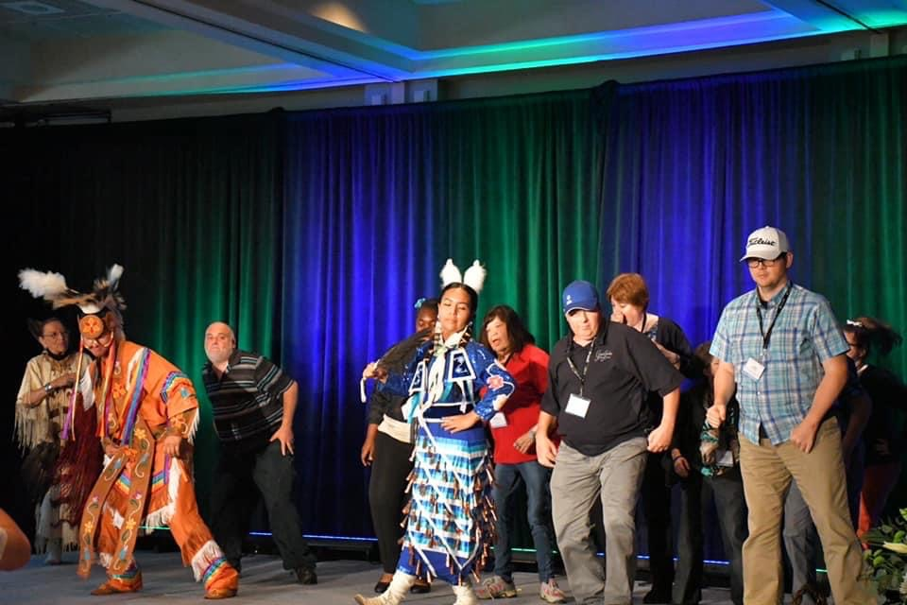
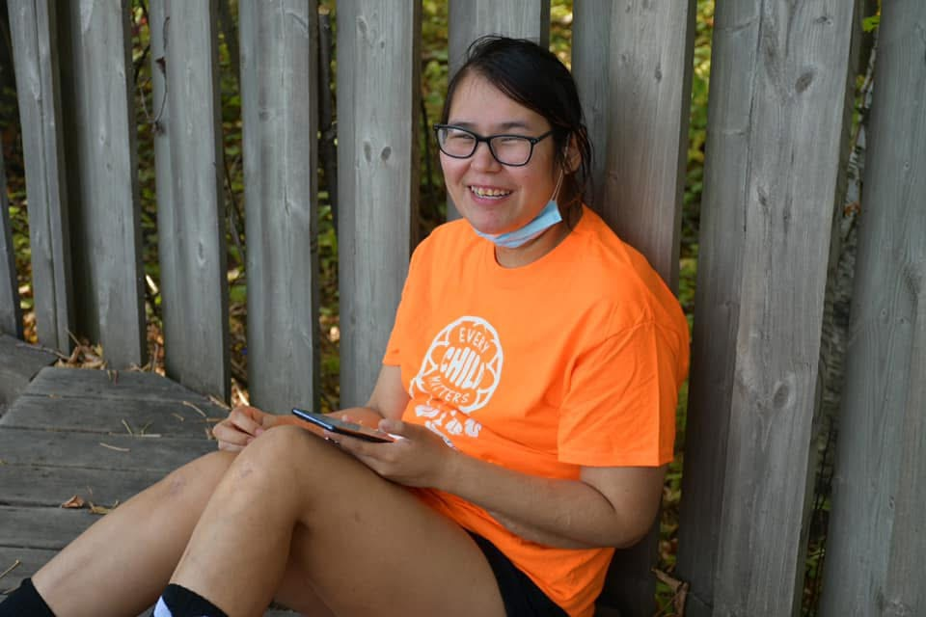
What does it look like for an agency or
organization to meaningfully build relationships
with Indigenous peoples, organizations, and
communities, to advance reconciliation?

Slide 5
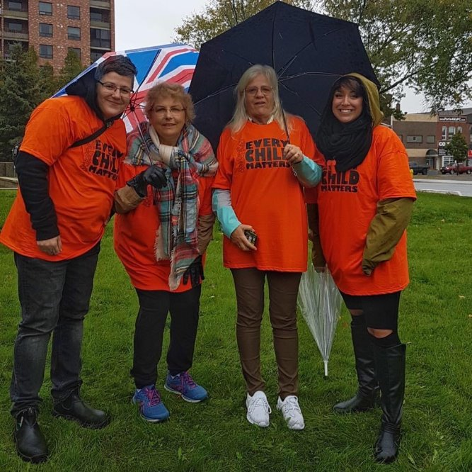
First steps
Review the Truth and
Reconciliation Commission's 94
Calls to action
Research and discuss the history of
colonization and racism in your treaty
area and local community
Individualize Land Acknowledgement to
include leadership and commitment to
acts of reconciliation in your community
Build partnerships with Indigenous
service providers

Slide 6
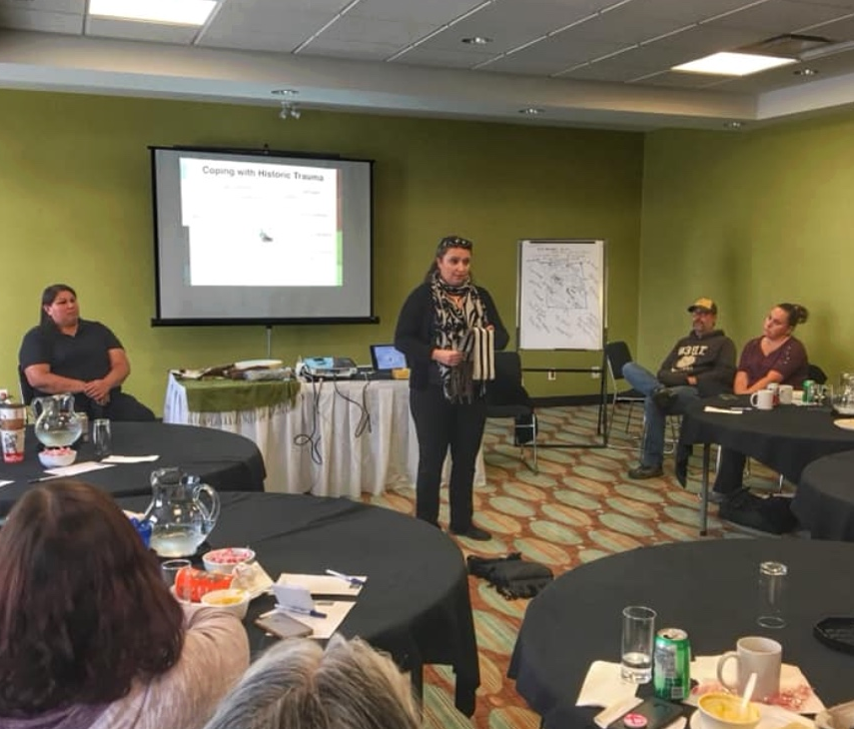
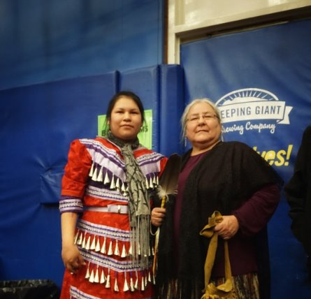
Ongoing…
Seek ongoing guidance and
leadership from Indigenous
Teachers and Elders
Cultural Teaching
Trauma informed strategies
Notes:
Lee will answer too after Lisa talks through this slide

Slide 7

Mental health & psychological safety

Slide 8
Mental health & psychological safety
What is the role and/or
responsibility of an agency or
organization when it comes to
the mental health and
wellbeing of its staff?

Slide 9
Mental health & psychological safety – Research
Research has looked at the
connection between culture and
mental health, and one of the
clearest findings is this: when
organizations and institutional
processes don’t consider the
demographics and lived realities of
their staff, they unintentionally put
them at a disadvantage.

Slide 10
Mental health & psychological safety
What is the role and/or
responsibility of an agency or
organization when it comes to
the mental health and
wellbeing of its staff?

Slide 12



Do not edit
How to change the design
How do you approach supporting and/or protecting
the mental health and
wellbeing of staff in your organization / agency?
The Slido app must be installed on every computer you’re presenting from

Slide 13

Leadership & EDI

Slide 14
Leadership & EDI
What impact does intentional
leadership support have on the
success of embedding of EDI in
an organization?
Notes:
CLAUDINE

Slide 15
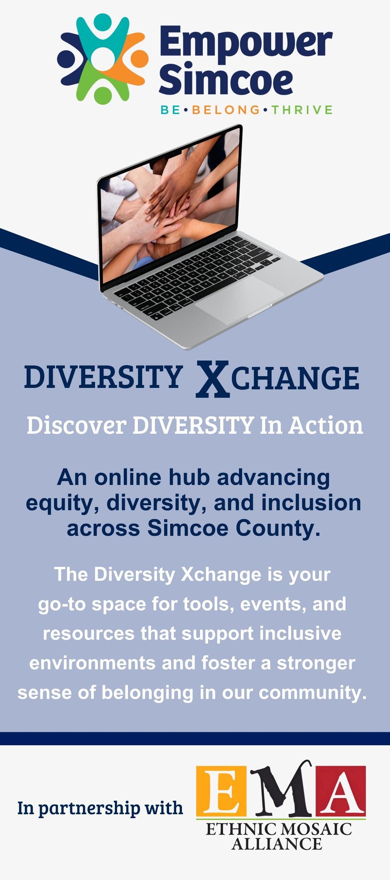
Activities/Initiatives
Empower Simcoe Partnered with the Ethnic Mosaic Alliance to launch Diversity Xchange
The Xchange allows people to
LEARN: Explore articles, videos, and interactive tools that deepen understanding of diverse cultures, perspectives, and abilities.
APPLY: Discover strategies and best practices that help bring diversity and inclusion into everyday environments.
CONNECT: Celebrate community events, stories, and cultural highlights that reflect the richness of Simcoe County.

Slide 16
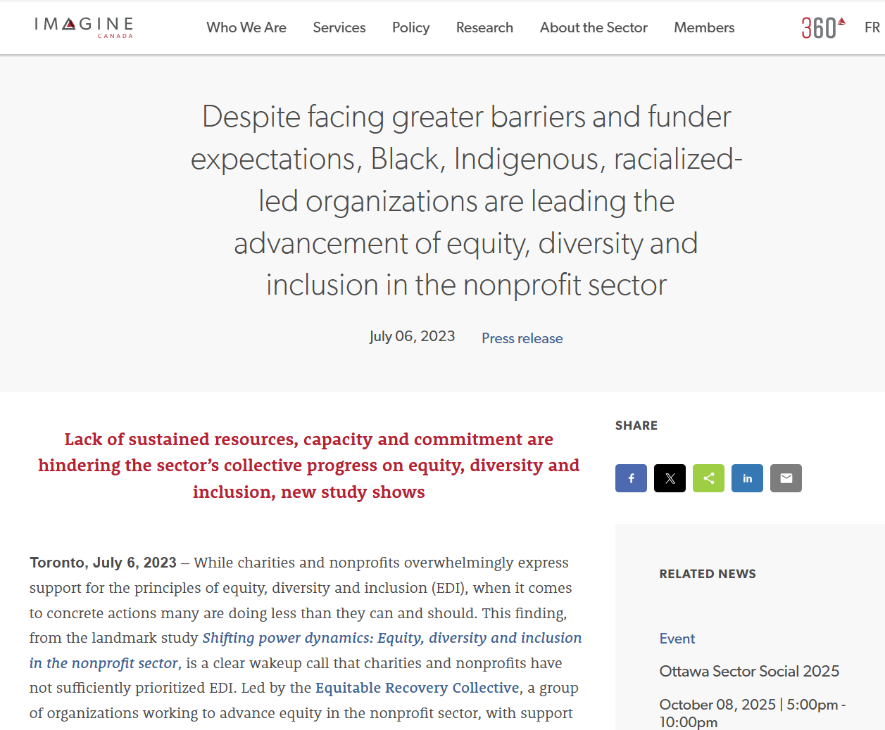
Notes:
The study was conducted by the Equitable Recovery Collective, a group of nonprofit organizations which includes the following members: ASE Community Foundation for Black Canadians with Disability, Canadian Red Cross, Canadian Women's Foundation, Community Foundations of Canada, Disability Without Poverty, Egale Canada, Foundation for Black Communities, Imagine Canada, Muslim Association of Canada, National Association of Friendship Centres, Network for the Advancement of Black Communities, Ontario Nonprofit Network, Philanthropic Foundations Canada, Pillar Nonprofit Network, PolicyWise for Children & Families, and The Circle on Philanthropy and Aboriginal Peoples in Canada.
ACKNOWLEDGEMENT
This project was proposed and advocated by the Network for the Advancement of Black Communities (NABC). It was made possible thanks to support from our Lead Partner, Scotiabank. We'd also like to thank our Sector Partner, The Canadian Red Cross Society, and our Knowledge Partners, Community Foundations of Canada and KCI.

Slide 17
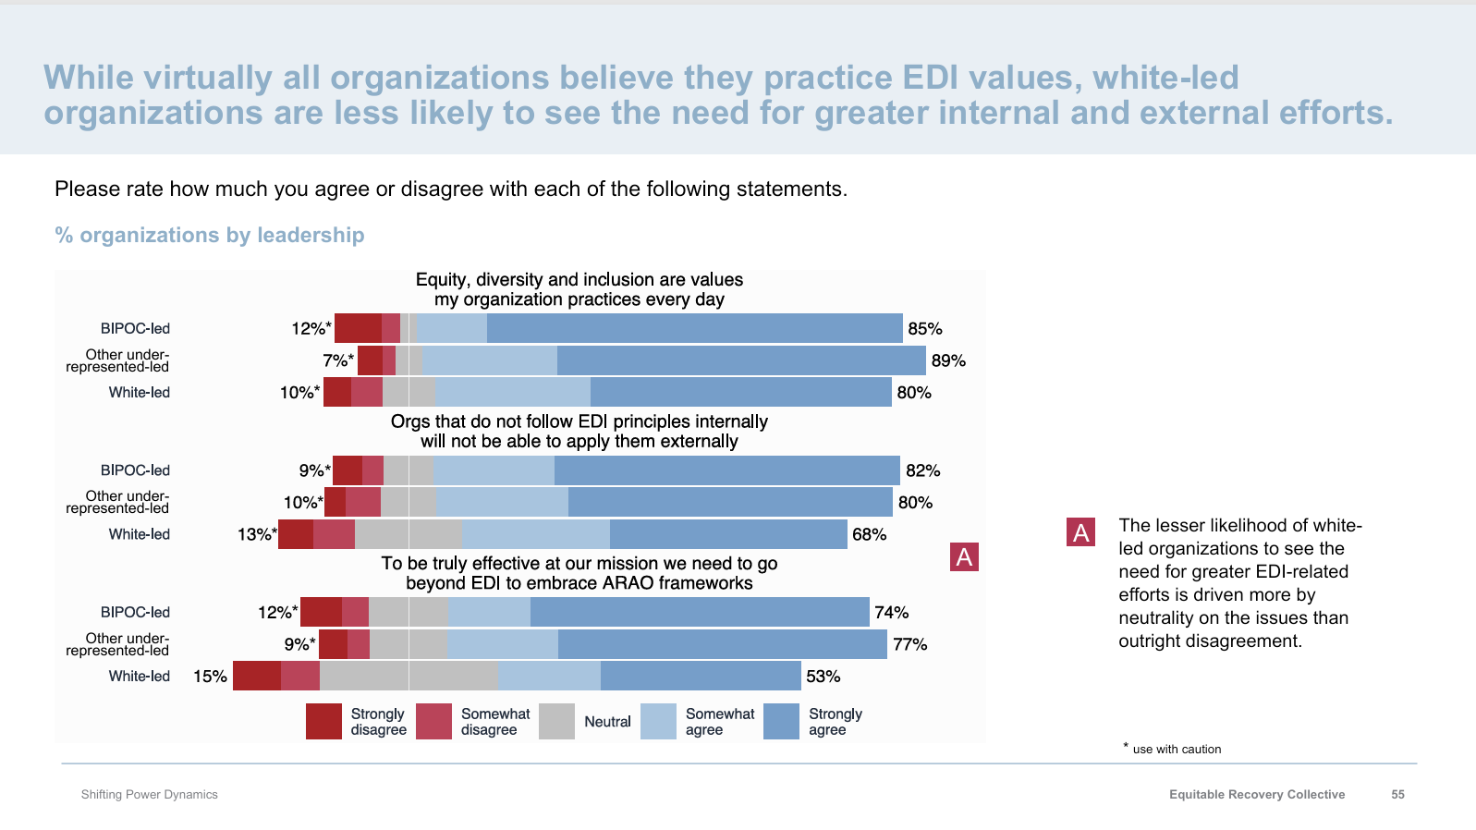
Notes:
The first study of its kind, Shifting Power Dynamics: Equity, diversity and inclusion in the nonprofit sector, explores what Canadian charities and nonprofits are doing to advance equity, diversity, and inclusion (EDI) within their organizations.
The study was conducted by the Equitable Recovery Collective, a group of nonprofit organizations which includes the following members: ASE Community Foundation for Black Canadians with Disability, Canadian Red Cross, Canadian Women's Foundation, Community Foundations of Canada, Disability Without Poverty, Egale Canada, Foundation for Black Communities, Imagine Canada, Muslim Association of Canada, National Association of Friendship Centres, Network for the Advancement of Black Communities, Ontario Nonprofit Network, Philanthropic Foundations Canada, Pillar Nonprofit Network, PolicyWise for Children & Families, and The Circle on Philanthropy and Aboriginal Peoples in Canada.
ACKNOWLEDGEMENT
This project was proposed and advocated by the Network for the Advancement of Black Communities (NABC). It was made possible thanks to support from our Lead Partner, Scotiabank. We'd also like to thank our Sector Partner, The Canadian Red Cross Society, and our Knowledge Partners, Community Foundations of Canada and KCI.

Slide 18
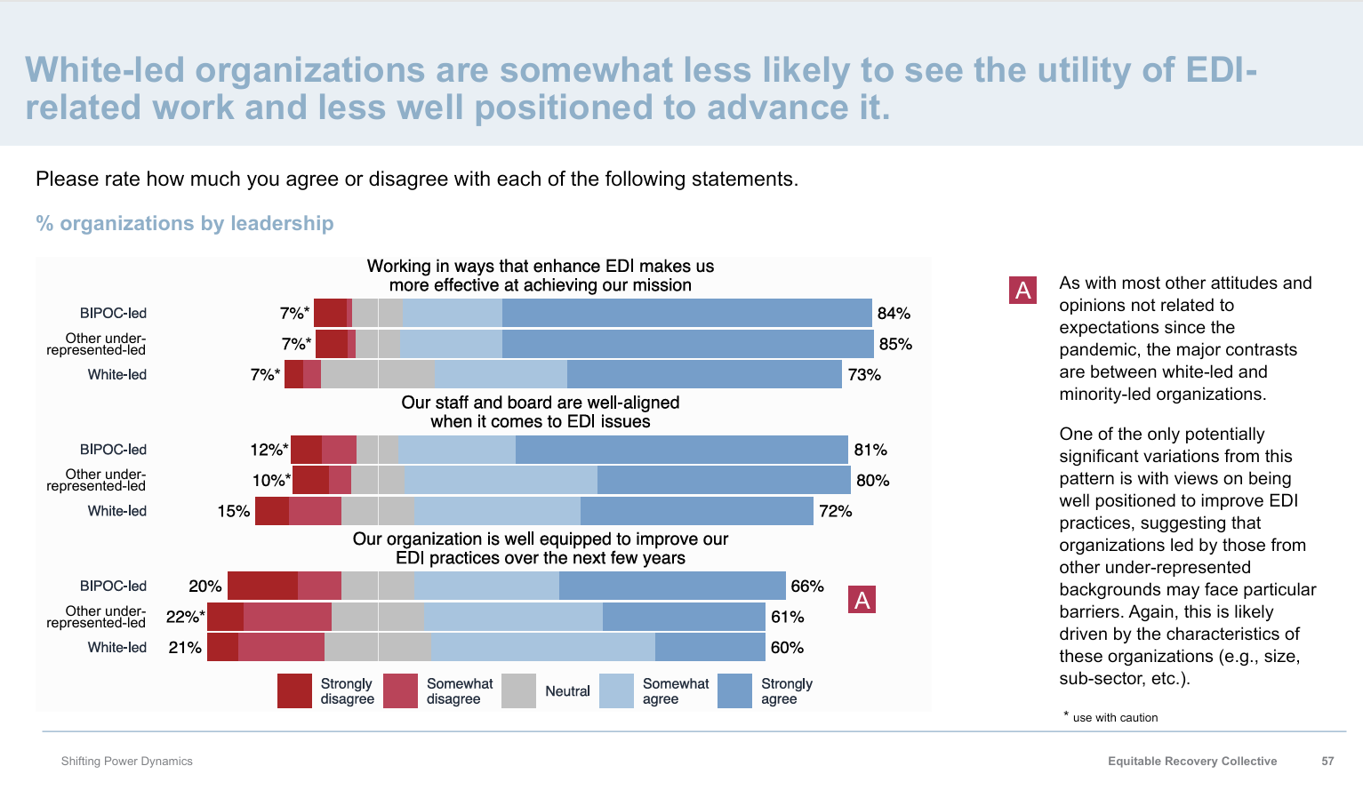
Notes:
The first study of its kind, Shifting Power Dynamics: Equity, diversity and inclusion in the nonprofit sector, explores what Canadian charities and nonprofits are doing to advance equity, diversity, and inclusion (EDI) within their organizations.
The study was conducted by the Equitable Recovery Collective, a group of nonprofit organizations which includes the following members: ASE Community Foundation for Black Canadians with Disability, Canadian Red Cross, Canadian Women's Foundation, Community Foundations of Canada, Disability Without Poverty, Egale Canada, Foundation for Black Communities, Imagine Canada, Muslim Association of Canada, National Association of Friendship Centres, Network for the Advancement of Black Communities, Ontario Nonprofit Network, Philanthropic Foundations Canada, Pillar Nonprofit Network, PolicyWise for Children & Families, and The Circle on Philanthropy and Aboriginal Peoples in Canada.
ACKNOWLEDGEMENT
This project was proposed and advocated by the Network for the Advancement of Black Communities (NABC). It was made possible thanks to support from our Lead Partner, Scotiabank. We'd also like to thank our Sector Partner, The Canadian Red Cross Society, and our Knowledge Partners, Community Foundations of Canada and KCI.

Slide 19
Leadership & EDI
What impact does intentional
leadership support have on the
success of embedding of EDI in
an organization?
Notes:
CLAUDINE

Slide 20

Money talks
How can we continue to invest in EDI initiatives in the current climate of funding cuts, inflation, tariffs, etc.?
Notes:
Everyone

Slide 21
Sustaining EDI learning

Slide 22

Sustaining EDI learning
How can organizations in the developmental sector move beyond foundational EDI training to create leadership programs that empower leaders to embed these principles into decision-making, culture, and strategy?
Notes:
Lee

Slide 23
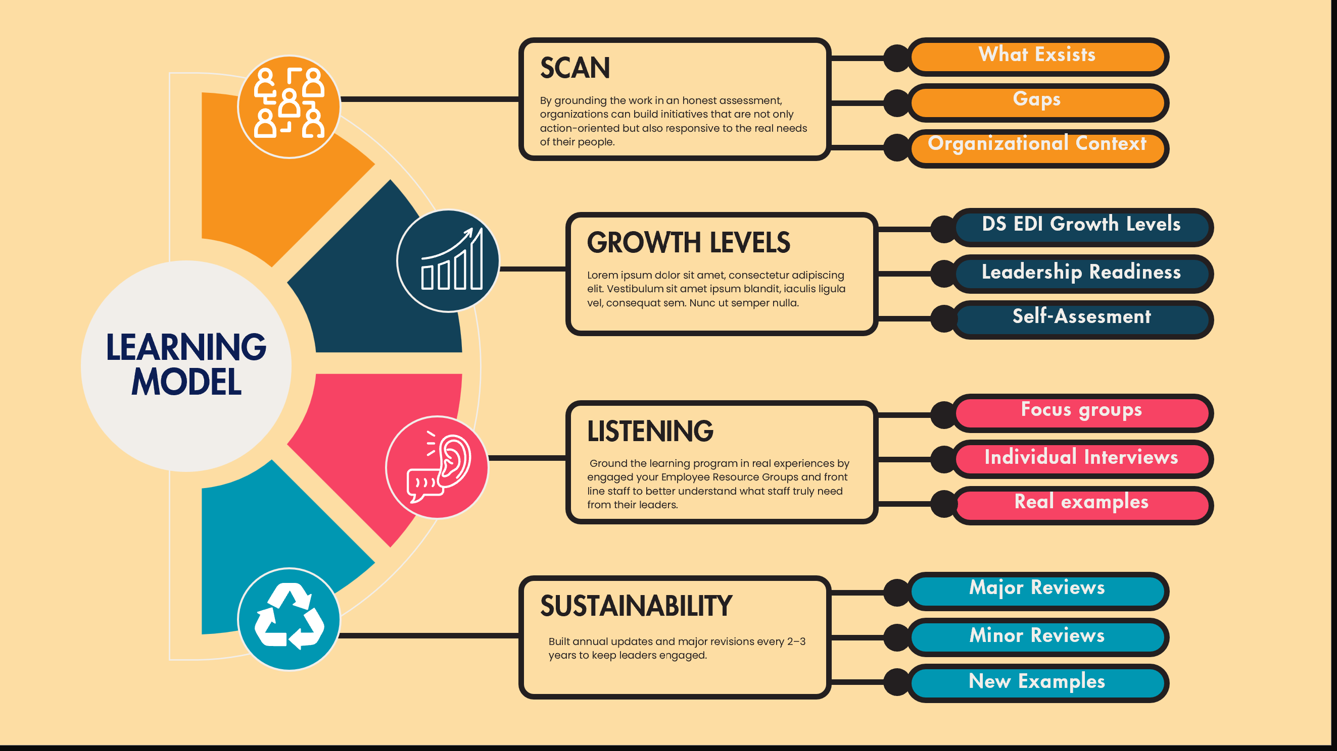
Notes:
Lee

Slide 24
Do not edit
How to change the design
How are you sustaining EDI learning in your organization / agency?
The Slido app must be installed on every computer you’re presenting from

Slide 25

Q&A

Slide 26

Do not edit
How to change the design
Audience Q&A
The Slido app must be installed on every computer you’re presenting from

Slide 27
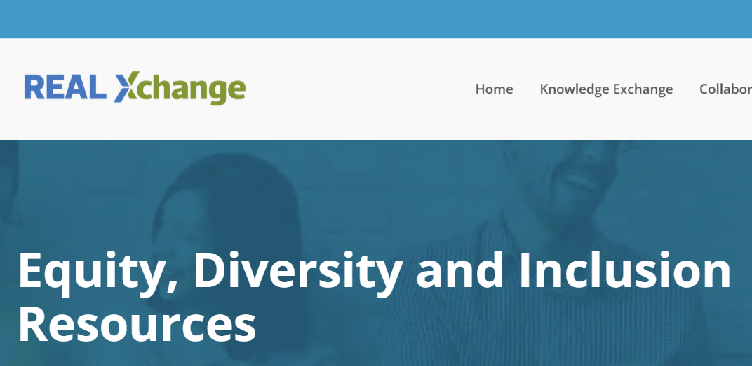
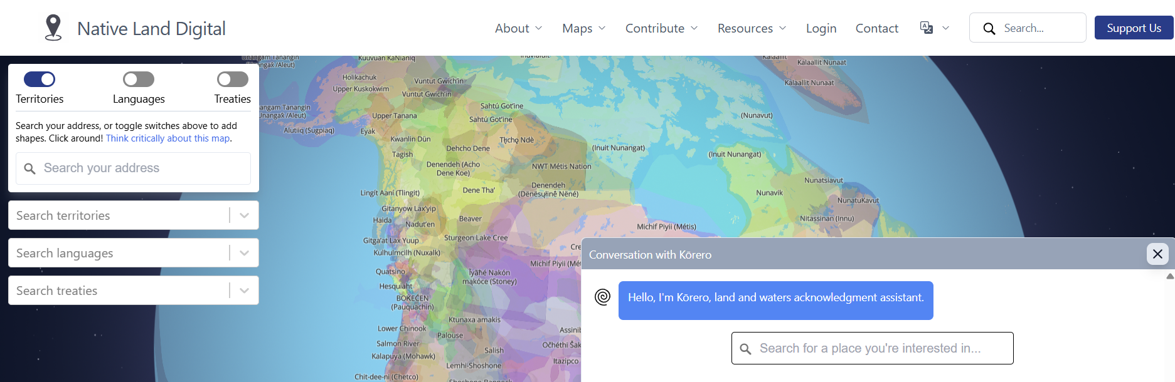
Resources
Personalized Land Acknowledgement

Slide 28
Thank you

