Slide 1






An Introduction To Inclusive Meetings
Presented by: Council of Community Living Ontario (CLO) and The Community Living Toronto (CLTO) Influencers
Notes:
Mary, josh, erica, zoe
1

Slide 2

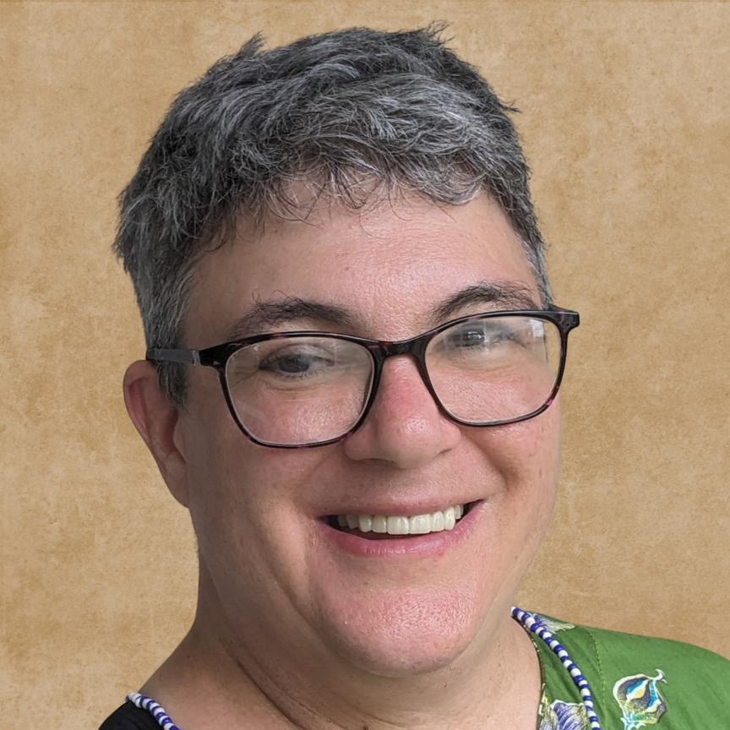
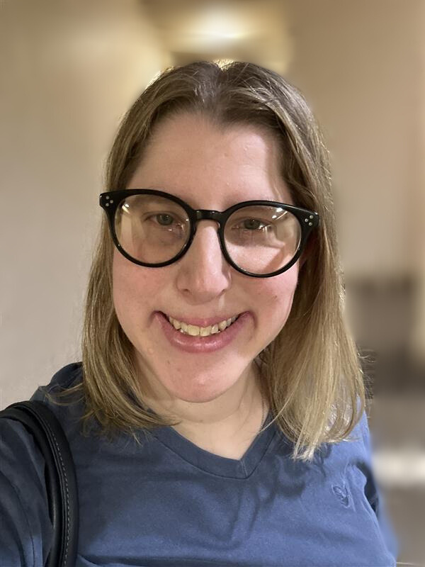
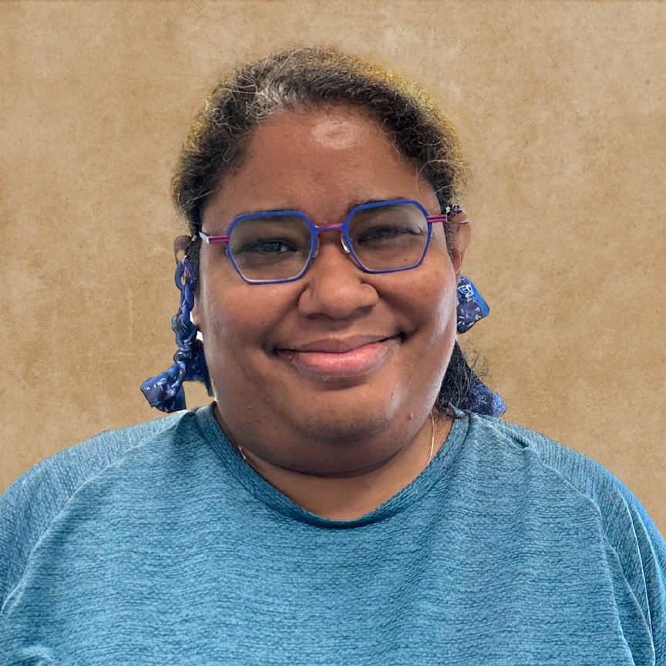
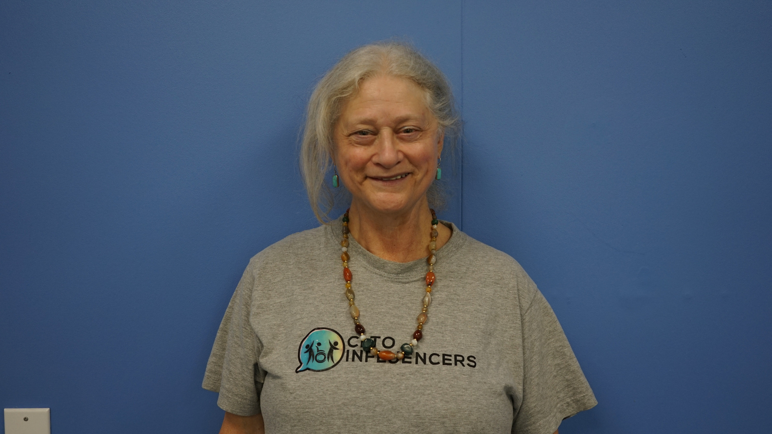

Meet the Presenters
Judy Noonan
CLO Council
Erica Machtinger
CLTO Influencers
Dzidra Halar
CLO Council
Lorraine Bradley
CLTO Influencers
Notes:
1.7.2013
Mary
2
‹#›

Slide 3

Icebreaker
We’ll be playing “This or That.” You’ll be given two options to choose from, for example: “Do you prefer chocolate or vanilla?” ​
​
Discuss your choice briefly with the people around you. ​
​
We’ll then ask: ​
​
Who prefers Option 1?” — please raise your hand.
*Pause* ​
​
Who prefers Option 2?” — please raise your hand.
Notes:
1.7.2013
Mary
2
‹#›

Slide 4

Today's Agenda
Overview of the Train the Trainer Program
What are The Listen Include Respect Guidelines
What we’ve learned
An Introduction about Inclusive Meetings
Group activity
Notes:
1.7.2013
Mary
2
‹#›

Slide 5
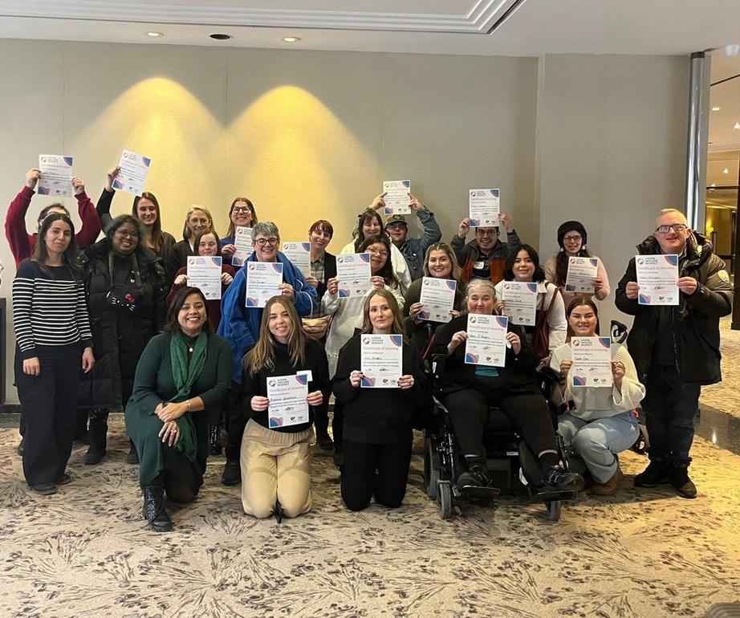
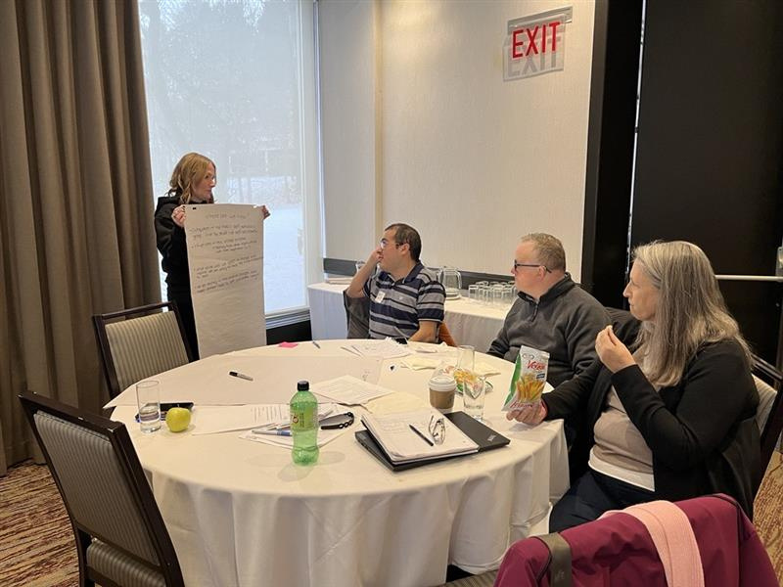
Overview of Train the Trainer Program
Train the Trainer was held on January 28-30th, 2025, to prepare self-advocates and organizations to train others
Self-Advocates and staff from CLO, CLTO, Corbrook, Participation house, KW Habilitation and Down Syndrome International Attended the training
Notes:
1.7.2013
Mary
2
‹#›

Slide 6
What is Listen, Include, Respect (LIR)?
A set of guidelines to help organizations understand what they need to do to make sure people with Intellectual disabilities are included in their organization
Notes:
1.7.2013
Mary
2
‹#›

Slide 7
What is Listen, Include, Respect (LIR)?
The steps (principles) of listen include respect are:
Believing in Inclusion
Creating Opportunities for Self-Advocate Leadership
Building Awareness and Understanding
Communicating in an Accessible Way
Providing Reasonable Accommodations
Valuing the Process
Using the Convention on the Rights of Persons with Disabilities(CRPD)
Understanding that Inclusion is a Journey
Notes:
1.7.2013
Mary
2
‹#›

Slide 8
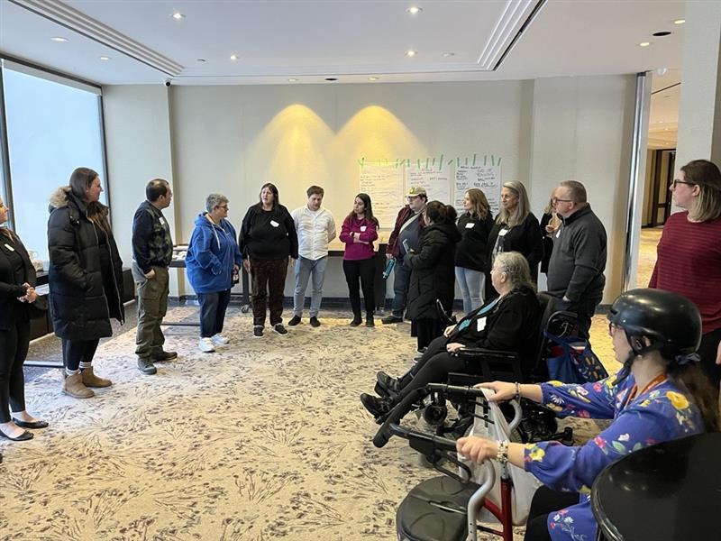
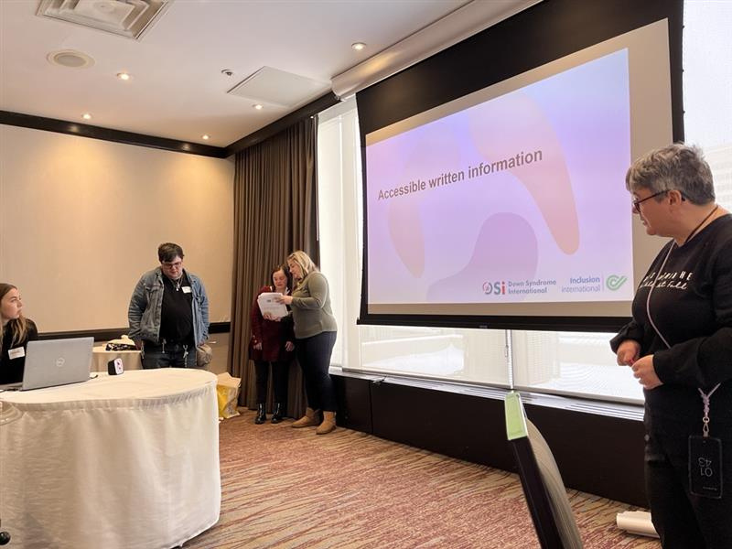
What we learned
Practiced training sessions
Participated in fun activites, such as role play, to learn about the guidelines
We have taken what we learned and brought it back to our organizations
Notes:
1.7.2013
Mary
2
‹#›

Slide 9

Introduction to Inclusive Meetings
Notes:
1.7.2013
Mary
2
‹#›

Slide 10
What Does An Inclusive Meeting
Mean To You?
Notes:
1.7.2013
Mary
2
‹#›

Slide 11
Inclusive Meetings
An Inclusive Meeting is:
A meeting where everyone can participate, feels valued and understands
It means making sure no one feels left out, whether because of how information is shared, who gets to speak, or the way decisions are made.
Notes:
1.7.2013
Mary
2
‹#›

Slide 12
How Can We Make Meetings More Inclusive?
Clear Communication
Meaningful Participation
Accessibility
Notes:
1.7.2013
Mary
2
‹#›

Slide 13



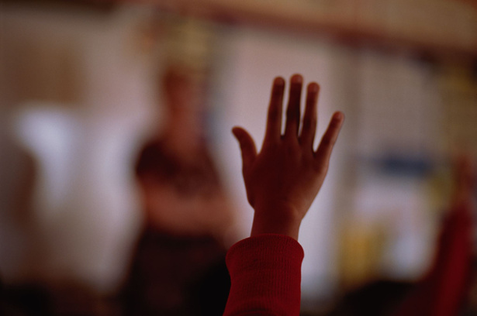
Clear Communication
Use Simple
Words
Check if
People
Understand
Share materials
Ahead
of time
Use
Pictures
Notes:
1.7.2013
Mary
2
‹#›

Slide 14

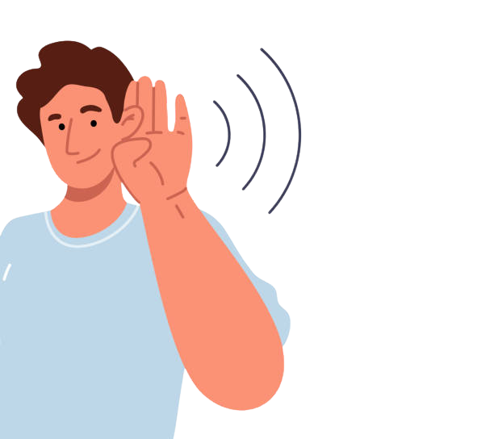
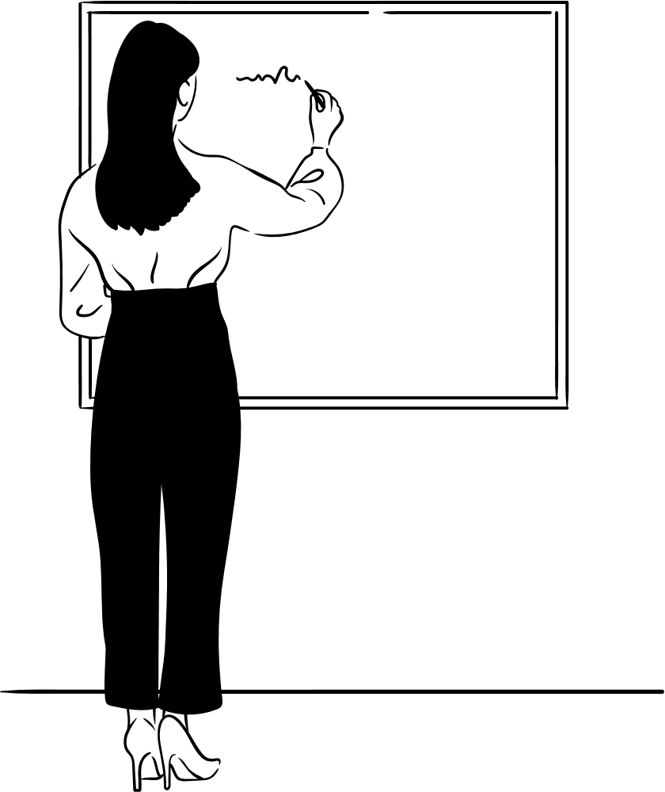

Meaningful Participation
Everyone has
a role
People are asked
for their ideas
People are listened to
Everyone gives feedback
Notes:
1.7.2013
Mary
2
‹#›

Slide 15
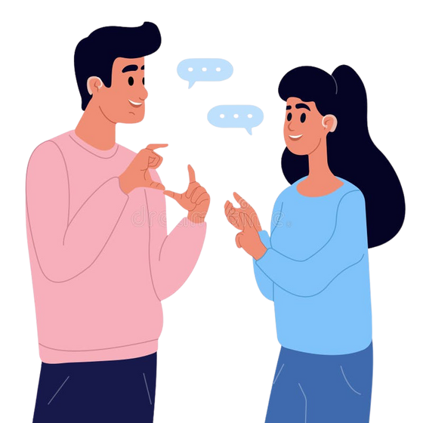
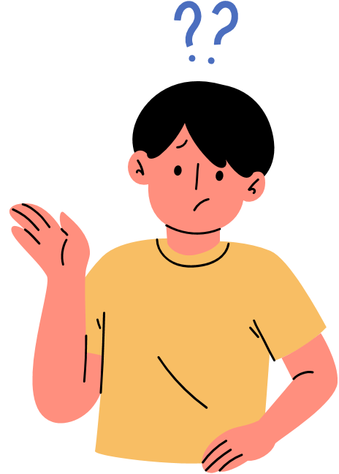


Accessibility & Flexibility
Ask people what they need
Send information before
Take short breaks
Give time for questions
Notes:
1.7.2013
Mary
2
‹#›

Slide 16
Have you ever been in a meeting where you felt ignored, confused, or left out?
Take a moment to think about it.
Notes:
1.7.2013
Mary
2
‹#›

Slide 17




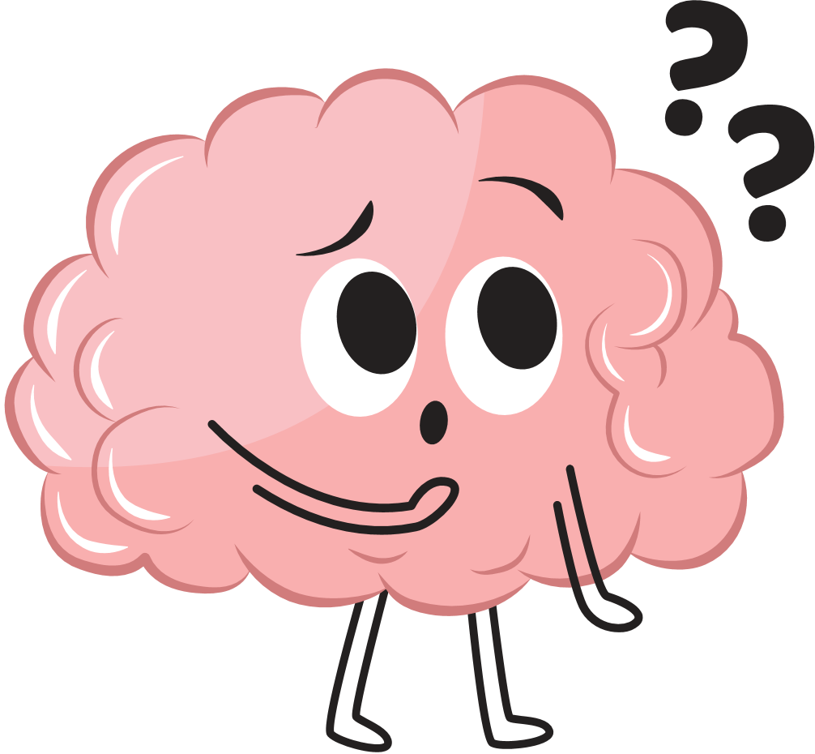
Our Experiences With Meetings
Judy
I like having time to think
I have felt rushed and confused
Zoom can be hard
I Like Small Groups
Notes:
1.7.2013
Mary
2
‹#›

Slide 18




Our Experiences With Meetings
Erica
I like to get notes ahead of time
Plain Language
People are not talking over eachother
Everyone is in a quiet area
Notes:
1.7.2013
Mary
2
‹#›

Slide 19



Our Experiences With Meetings
Dzidra
I Like When Notes are Taken
Everyone is apart of the team
People stay Muted or talk one at a time
Notes:
1.7.2013
Mary
2
‹#›

Slide 20





Our Experiences With Meetings
Lorraine
Online Meetings can be hard
My husband supports me
Everyone listens
People are supportive
Notes:
1.7.2013
Mary
2
‹#›

Slide 21
Instructions:
We’re going to read a short story out loud.
After the story, you’ll turn and talk with a partner
or small groups.
You’ll answer 3 questions together based on what happened in the story.
You will share your answers with the group
Group Activity: What Went Wrong in That Meeting?
Notes:
1.7.2013
Mary
2
‹#›

Slide 22
Group Activity: What Went Wrong in That Meeting?
Story:
The team has a meeting on Monday morning. Alex is the boss. He talks very fast and uses a lot of big words. He doesn’t stop to check if people understand. He did not send any notes or agenda before the meeting.
Maria tries to share an idea. Alex says, “We don’t have time for that,” and keeps talking.
Jamal asked to join the meeting on Zoom because they can’t come in person. But Alex didn’t reply, and the meeting is only in person. At the end, Alex says, “If you have any questions, ask me later,” and ends the meeting.
.
Notes:
1.7.2013
Mary
2
‹#›

Slide 23
Questions:
1. What went wrong in that meeting?
​
2. What could be better to make the meeting more inclusive?​
3. What should Alex do next time there is a meeting? ​
Notes:
1.7.2013
Mary
2
‹#›

Slide 24

Any questions?

