Slide 1

Relationships That Support
Self-Determination
or Amet

Slide 2


What We’re Going To Talk About
What is Self-Determination?
Mindset and Confidence
Supported Decision-Making
Communication is Key
Tips

Slide 3


What Does Self-Determination Mean to You?

Slide 4
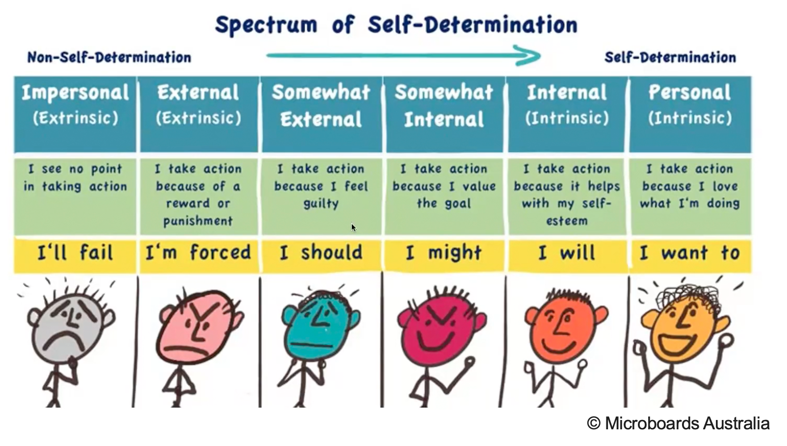
What Is Self-Determination?
Self-determination is the ability to make choices and have control over your own life, driven by internal motivation rather than external pressure (Ryan & Deci, 2010).

Slide 5
Self-Determination and Microboards
Self-determination is one of the foundational values and principles of a Microboard.
Built around one individual;
Highly individualized, customized supports;
Control over how resources are spent;
Draw on the strength of natural support networks – those who know and love them best;
Advocacy and navigation.
Notes:
Built around one individual – one person, one Microboard
highly individualized, customized supports – a person’s life and goals are the centrepoint of decision-making and planning. Whole life and long-term planning not just short-term
Control over how resources are spent – being involved in deciding how monies are spent are a powerful aspect of self-determination.
Draw on the strength of natural support networks – those who know and love them best;
Advocacy and navigation - Microboards help the person navigate complex systems (like healthcare, housing, and employment), advocating for their rights and preferences. This support enables greater independence and informed choice

Slide 6

Self-Determination Theory
Three psychological needs must be met for a person to feel
self-determined:
Autonomy – feeling in control of your own actions and decisions.
Competence – feeling capable and effective in what you do.
Relatedness – feeling connected to others and a sense of belonging.
When these needs are supported, people are more likely
to be intrinsically motivated.

Slide 7
Internal vs. External Motivation
They do things because they find them meaningful or enjoyable, not just for rewards or approval. | Driven by someone else’s expectations.
Feeling fulfilled by making their own decisions. | Motivated by avoiding disapproval or conflict.
You want your voice heard and your goals respected. | The behavior is motivated by the reward, not the task itself.
Motivated by personal growth and self-confidence. | To fit in or avoid tension, not because it reflects views or personal needs.

Slide 8

Mindset and Approach
Mindset first – Self-determination starts in how we think.
Know them deeply – Tune in to what’s too much or just right.
Manage our worries – Support without letting fear lead.
Notes:
Start with mindset: Believing in your loved one's autonomy is the foundation of self-determination. When we shift from “How can I protect them?” to “How can I support their journey safely?”, we begin to make space for more independence and personal direction - on their terms.
Attune deeply: The more we understand and connect with our loved one, the better we can notice subtle cues like when they’re asking for help, and when they’re ready to try something on their own. This kind of deep listening builds trust, confidence, and mutual respect.
Manage fears: It’s natural to worry - you care deeply! But part of supporting autonomy is recognizing when fear is guiding your response, and gently stepping back so your loved one can explore, decide, and grow with your encouragement behind them.

Slide 9
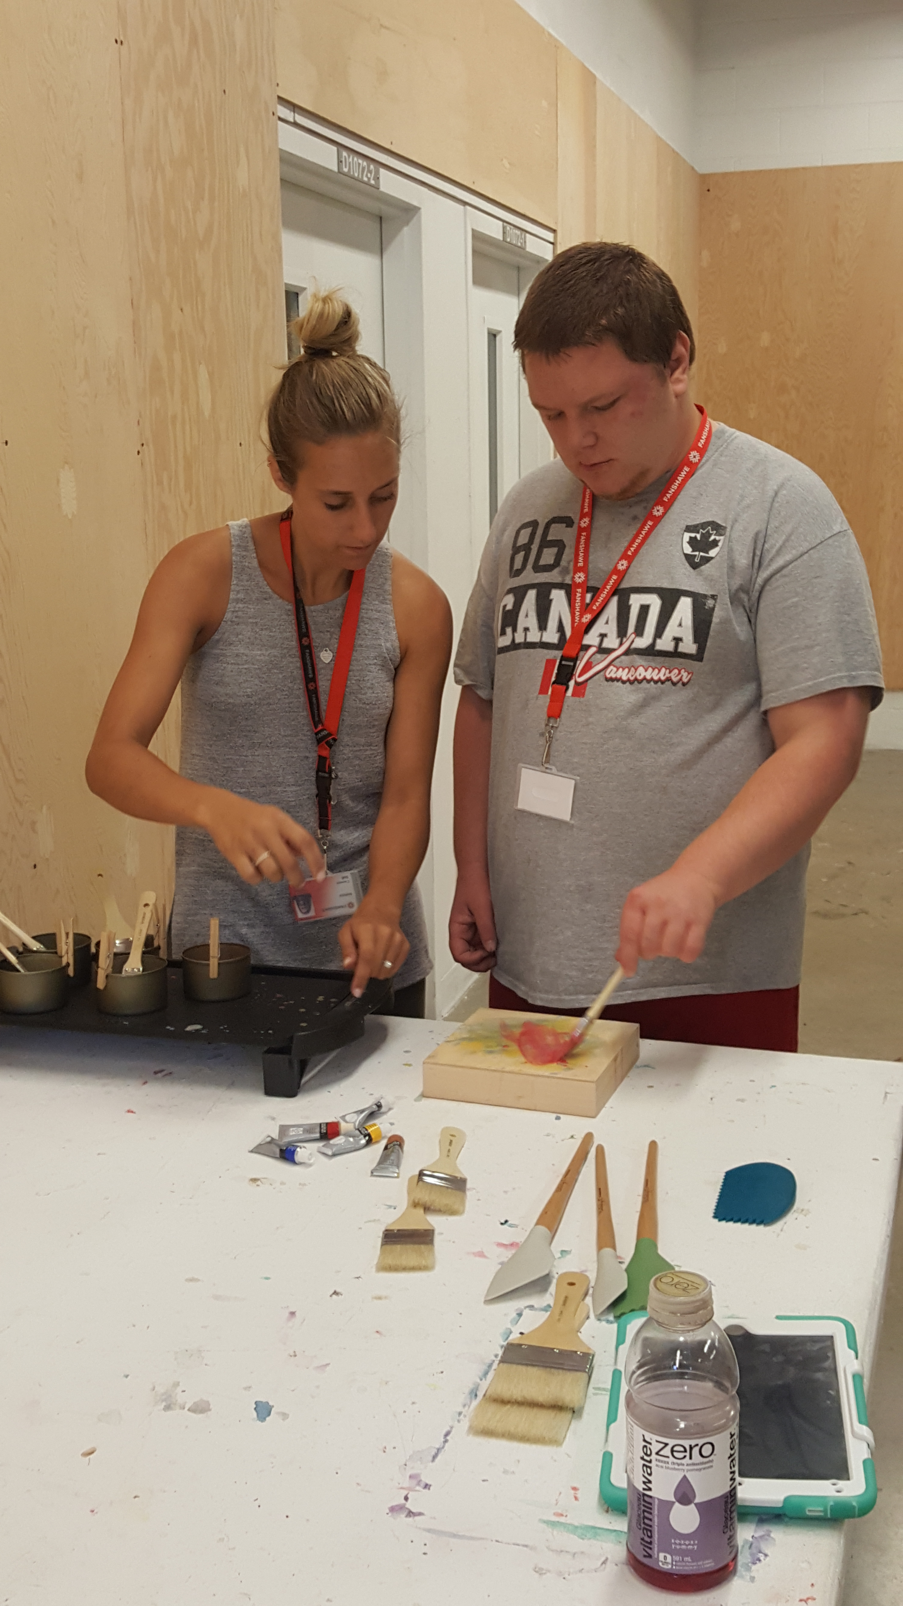
Real Choices
Expand the range of choices being offered.
Ask: Are these real choices or pre-decided options?
Respect and follow through on decisions.
Support learning through mistakes and risks.
Notes:
Expand the range of options. Ask, "What would you like to do?" or "Is there something else you're interested in?" at times, instead of "Do you want this or that?"
Ask yourself: Are these real choices, or are they limited by my assumptions or what I think is best?
Respect and follow through when someone makes a decision, even if it’s not what you would have chosen.
Support learning through risks and mistakes. This is how everyone grows.
Present options in a way that’s clear, accessible, and meaningful. You can use visuals, gestures, routines, or whatever works best for your loved one.
Offer age-appropriate experiences alongside same-age peers. Real choice includes the chance to be part of the same world as others their age.
Be intentional with your support. Ask yourself, "Am I guiding, or am I controlling?"
Notice your own reactions and limits. Supporting real choice sometimes means stepping back, checking your instincts, and trusting the process. Recognize that it takes time, energy, lots of thoughtful support, and being mindful in how you respond.

Slide 10

Real Choices
Present choices clearly and meaningfully.
Provide age-appropriate experiences with typical peers.
Be intentional: support, try not to control.
Recognize your own limits and instincts.
Notes:
Expand the range of options. Ask, "What would you like to do?" or "Is there something else you're interested in?" at times, instead of "Do you want this or that?"
Ask yourself: Are these real choices, or are they limited by my assumptions or what I think is best?
Respect and follow through when someone makes a decision, even if it’s not what you would have chosen.
Support learning through risks and mistakes. This is how everyone grows.
Present options in a way that’s clear, accessible, and meaningful. You can use visuals, gestures, routines, or whatever works best for your loved one.
Offer age-appropriate experiences alongside same-age peers. Real choice includes the chance to be part of the same world as others their age.
Be intentional with your support. Ask yourself, "Am I guiding, or am I controlling?"
Notice your own reactions and limits. Supporting real choice sometimes means stepping back, checking your instincts, and trusting the process. Recognize that it takes time, energy, lots of thoughtful support, and being mindful in how you respond.

Slide 11



In what parts of a person’s life do they get to make decisions?
How can you create more opportunities for them to express what they want, or take the lead, even in small ways?
Notes:
Expand the range of options. Ask, "What would you like to do?" or "Is there something else you're interested in?" at times, instead of "Do you want this or that?"
Ask yourself: Are these real choices, or are they limited by my assumptions or what I think is best?
Respect and follow through when someone makes a decision, even if it’s not what you would have chosen.
Support learning through risks and mistakes. This is how everyone grows.
Present options in a way that’s clear, accessible, and meaningful. You can use visuals, gestures, routines, or whatever works best for your loved one.
Offer age-appropriate experiences alongside same-age peers. Real choice includes the chance to be part of the same world as others their age.
Be intentional with your support. Ask yourself, "Am I guiding, or am I controlling?"
Notice your own reactions and limits. Supporting real choice sometimes means stepping back, checking your instincts, and trusting the process. Recognize that it takes time, energy, lots of thoughtful support, and being mindful in how you respond.

Slide 12
Supported Decision-Making & Autonomy
Supported decision-making means helping a person make decisions without getting in the way of a person’s right to decide. People supporting a decision are chosen, as is how they help, and what help is needed.
Support the person, not the decision – Sometimes support is needed for understanding or communication, not making the decision itself.
Notes:
Everyone has the right to make decisions. Regardless of ability, all people have the right to make choices about their own lives.
Support can look different for everyone. It might mean using pictures, plain language, trusted people, or extra time to understand.
The person is always the decision-maker. Supporters help explain options or communicate decisions but they don’t make the decision for the person.
Build decision-making skills over time. SDM is a skill-building process. The more practice someone gets making choices, the more confident and capable they become.

Slide 13
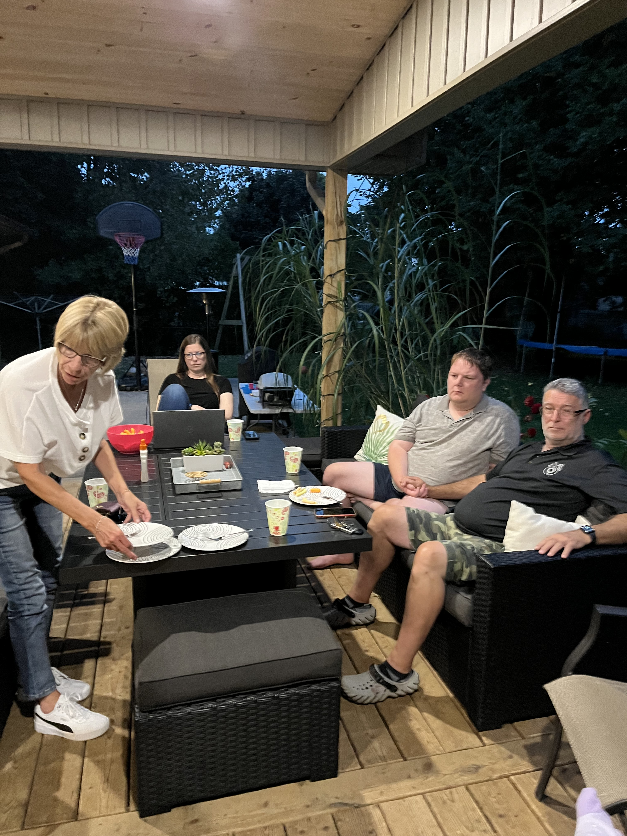
Supported Decision-Making & Autonomy
Support looks different for everyone – One size doesn’t fit all!
Notes:
Expand the range of options. Ask, "What would you like to do?" or "Is there something else you're interested in?" at times, instead of "Do you want this or that?"
Ask yourself: Are these real choices, or are they limited by my assumptions or what I think is best?
Respect and follow through when someone makes a decision, even if it’s not what you would have chosen.
Support learning through risks and mistakes. This is how everyone grows.
Present options in a way that’s clear, accessible, and meaningful. You can use visuals, gestures, routines, or whatever works best for your loved one.
Offer age-appropriate experiences alongside same-age peers. Real choice includes the chance to be part of the same world as others their age.
Be intentional with your support. Ask yourself, "Am I guiding, or am I controlling?"
Notice your own reactions and limits. Supporting real choice sometimes means stepping back, checking your instincts, and trusting the process. Recognize that it takes time, energy, lots of thoughtful support, and being mindful in how you respond.

Slide 14
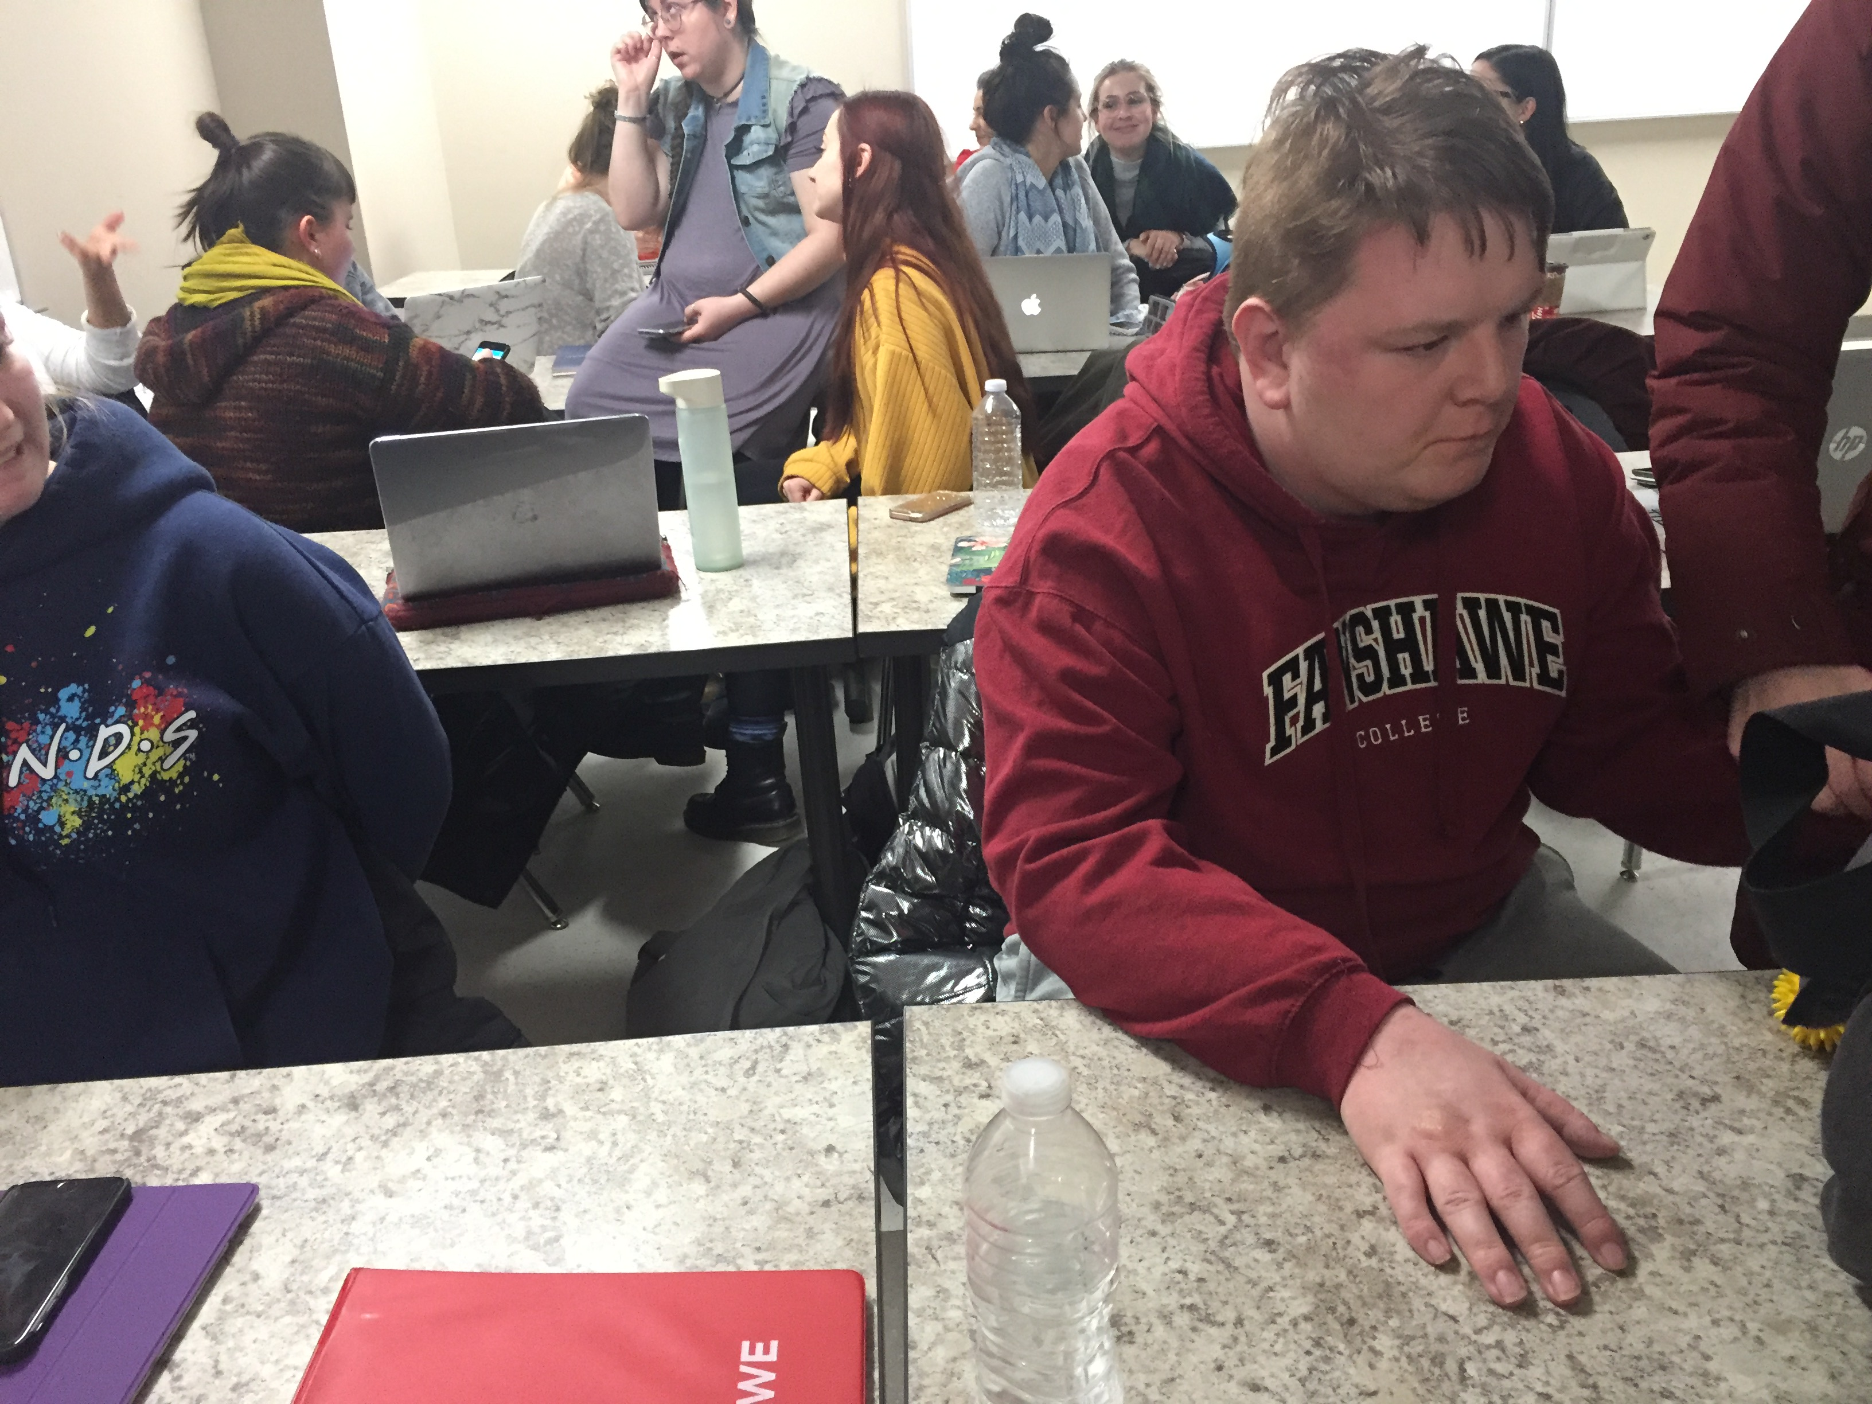
Dignity of Risk
Everyone has the right to take risks
and make mistakes.
Growth comes from experience and trust.
Support means preparing for risk, not preventing it or being too overprotective.
Inclusion means being free to try, fail, and try again.
Notes:
Respect for dignity and risk. People learn by trying, including making mistakes. SDM includes helping people understand risks, not avoiding them completely.

Slide 15
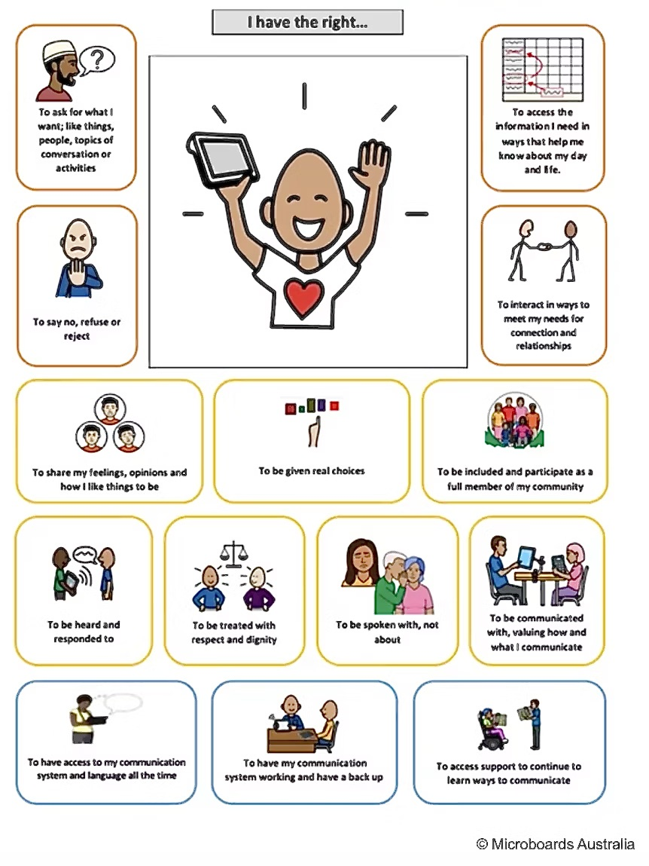
The Communication Bill of Rights
To ask for what I want.
To access the information I need.
To say no.
To interact in ways that suit me.
To share my feelings and opinions.
To be given real choices.
To be spoken with, not about.

Slide 16

A Few Tips!
Look for opportunities that stretch decision-making.
Make sure the people in a person’s life (network, Microboard, paid support workers) know that supporting a person to make their own choices is really important.
Have facilitated conversations.
When you start on the path, the path appears.

Slide 17
We’re Here For You!
Join us October 4th in Kingston for our 3rd Annual Family Networking Forum
Learn more about our project supporting families with incorporating Microboards. Have a child under 18? We want to connect with you!
Watch for our Fall series of workshops – Family Connection Night, Succession Planning and more!
Join our mailing list.
All the news: www.microboardsontario.com

Slide 18

Thank You for Joining Us!

