Slide 1


EXPANDING THE CAPACITY OF PLANNING AND FACILITATION SUPPORTS IN CANADA
Community Living Ontario, Inspiring Possibilities Conference, 2025

Slide 2
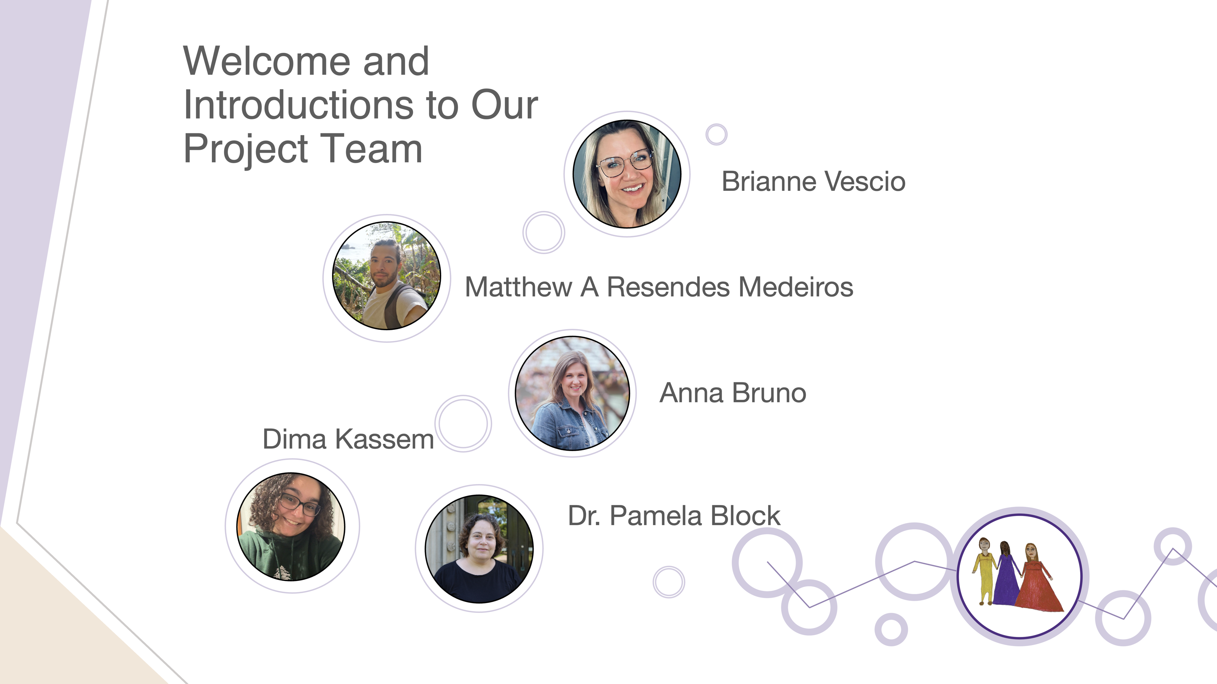

Welcome and Introductions
S

Slide 3
Our Why…
A Belief…that quality, value-based planning and facilitation supports can assist people with disabilities to live meaningful, inclusive lives rooted in their community.
Our experience…shows that supports varied in quality and availability, made even more complicated by issues geography, economic status and intersectionality of identity .
We know…there is great expertise in planning and facilitation supports that already exists.
We can…make a contribution to growing these supports across Canada and beyond by bringing people together.
Notes:
How are we solving this problem.

Slide 4
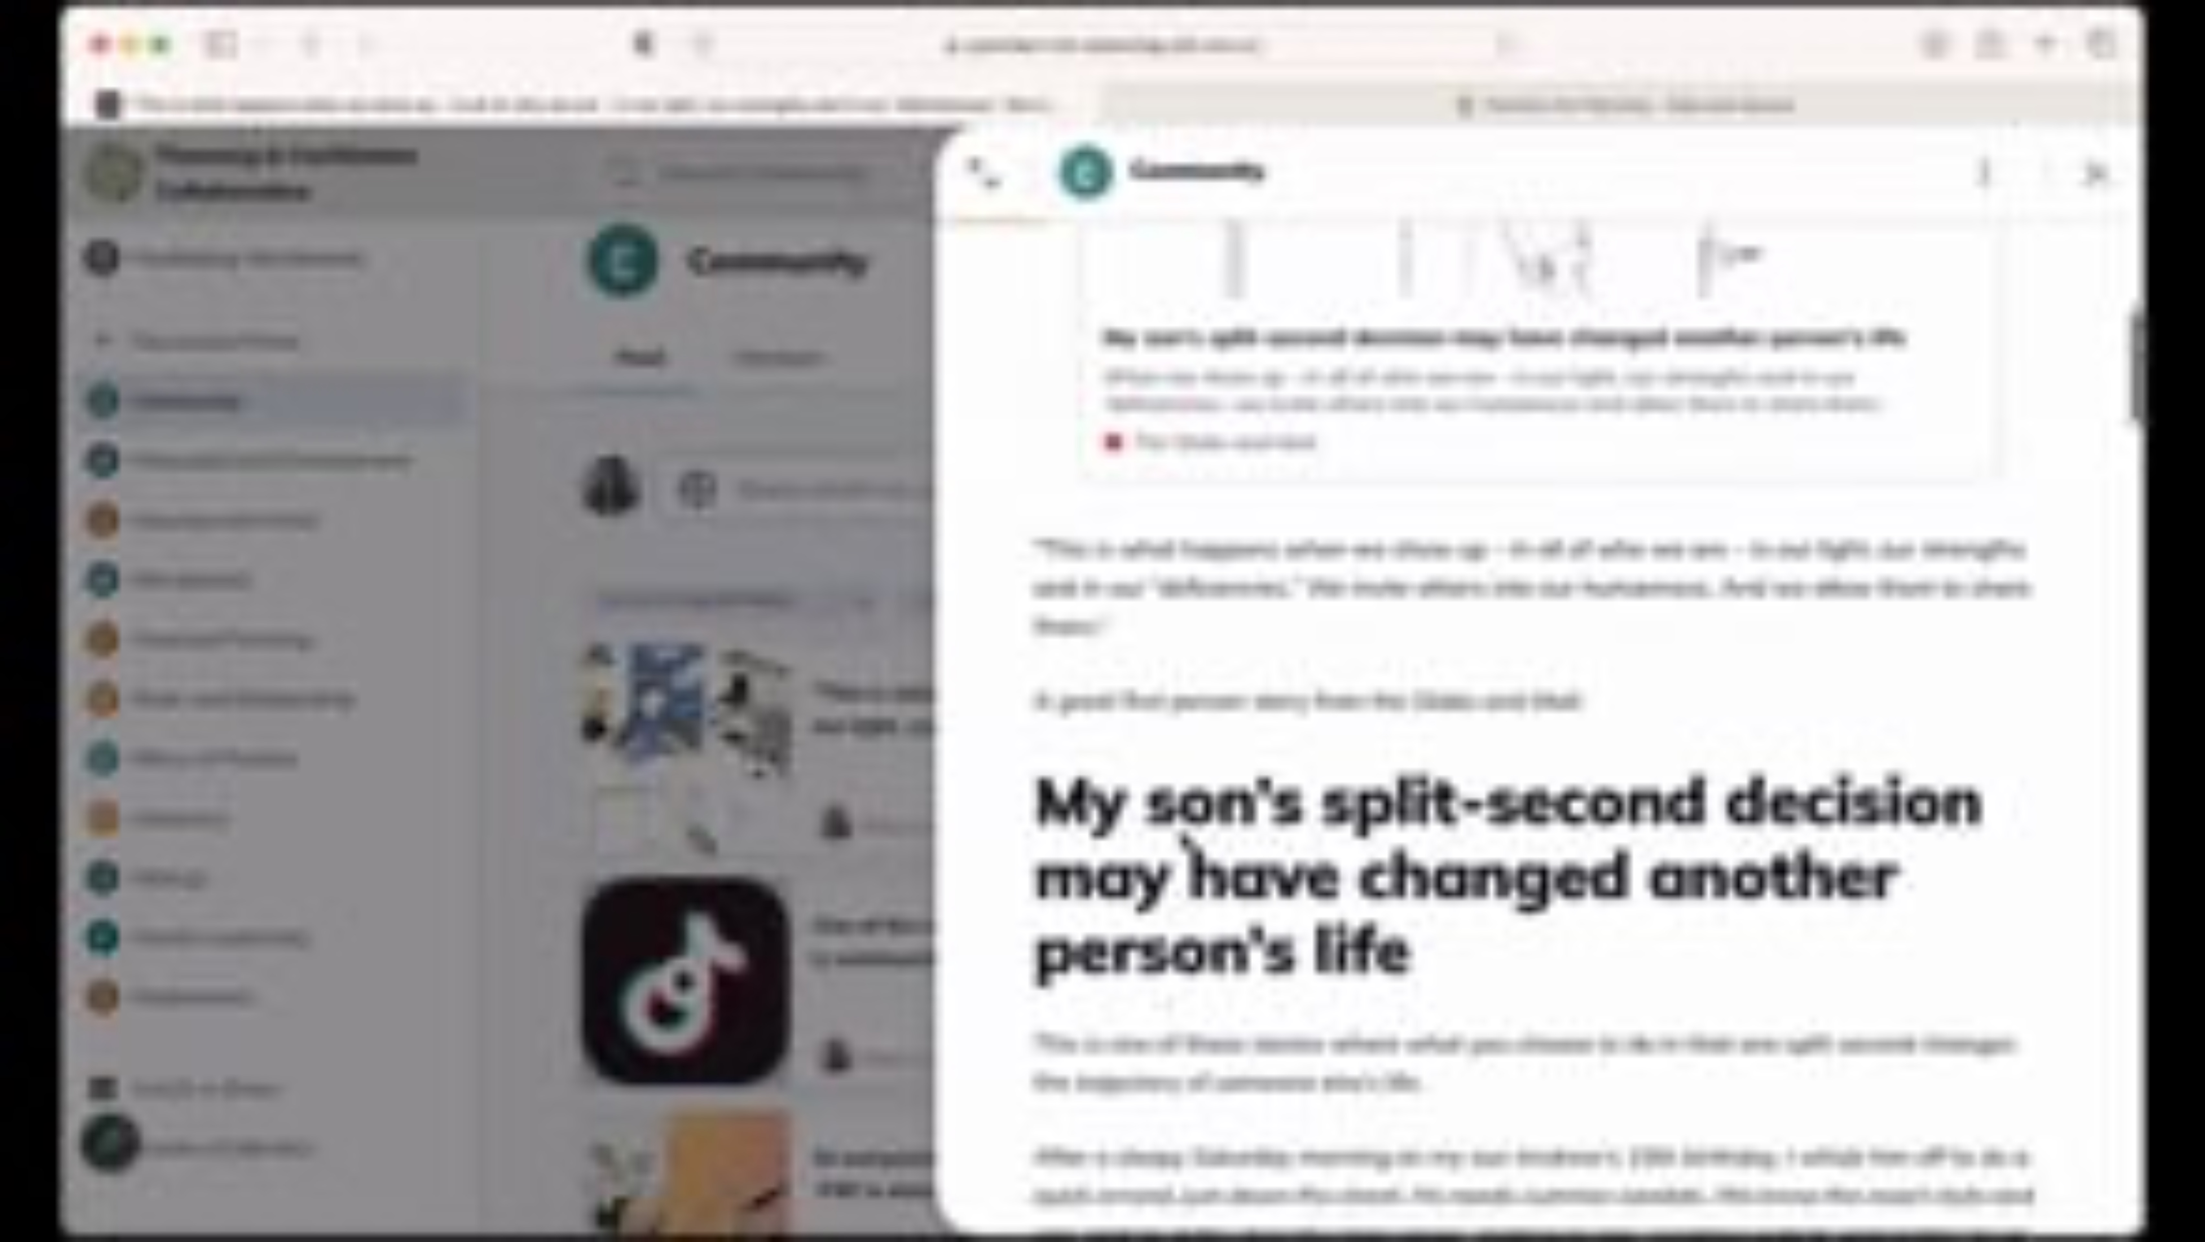
Project Background
-Funded by Employment and Social Development Canada
-3 year project to expand the capacity of planning and facilitation supports across Canada
-Developed the Planning & Facilitation Collaborative, an online community to share resources, learn together and grow in our practice

Slide 5
Introducing the Expanding Capacity of Planning & Facilitation In Canada Research Study
As part of the grant, we were able to include a research project to better understand the experience of planning and facilitation in Canada and this led to partnership with Western University.
With a qualitative research design, this study aims to explore the impact of planning and facilitation on disabled individuals and their families engaged in the process.
Notes:
Anna- Criteria for inclusion. Understood quickly that we also wanted to hear from people who experienced barriers to even accessing planning supports. Also understood quickly that how, where and who is involved with planning is quite diverse.

Slide 6
Initial Research Themes

Slide 7
How are participants talking about facilitators?
“What she has done for us... we have freedom... so that part has been amazing... it’s given us a chance to live how.. You know..”
"Us parents are basically the facilitators, unless you want to pay a lot of money to somebody to go do this for you, which none of us have the funding for that”
Notes:
Pam

Slide 8
How are participants talking about facilitators and the practice of facilitation continued…
Artform – creativity
Being curious, asking questions
Walking with and power with (not over)
Person centered vs. person directed
Respect and love flowing in both directions
A distinct profession
Something family are doing on top of everything else
Something so built into disability services that there is no name for it.
Everyone (disabled or not) can benefit from participating in this process

Slide 9
What are facilitators doing:
Building relationships
Breaking goals down into small attainable steps
Mentoring self-advocates to be facilitators or have their own voice
Sustaining Microboards (or networks of support)
Allowing parents to live their own lives (not fighting alone) and helping provide a sense of ease that once they die the relationships will live on.
Notes:
Anna

Slide 10
Where are people getting facilitation (or not):
Agencies and directly from facilitators (independent ones and one's part of a facilitation organization)
Through government funding, if families receive it because it is a ”long waiting game”
From self-advocates
Parents becoming the facilitators
Notes:
Matthew
Those who are getting facilitation, are receiving it through agencies, facilitators, or independent facilitators in their region/ city. Agencies, such as Facile, have contracts with the Catholic school board and that is how parents find out about facilitation and find facilitators
- Melanie– learned of facilitation through Catholic schoolboard – otherwise wouldn’t have known about it – seems like this is a typical pattern. People finding facilitation by chance.
- Judy- expressed how her quality of life improved due to facilitation because it gives her direction. She used facilitation services years ago and did it through Community Living Ontario. She doesn’t have a facilitator now, “I don’t know how to go about getting it now, it probably costs a lot”. With her past facilitating planning, she used to go for walks with her facilitator. “I felt like someone was interested in me, and genuinely cared, and really wanted me to have a good life and gave me resources”. She expressed that facilitation, “helps me know what I want in life, which resources are out there when my friends aren’t around”. Also, she wishes that facilitation would be universal because she believes everyone can benefit from it. As well, Judy asked out loud, “How do I go about doing facilitation planning?”, speaks about trying to find the book she had from facilitator in the past and wanting to do so again.
Families pay or use government funding, such as passport funding to pay for facilitators, however, some families do not receive enough funding or no funding at all due to long wait times
- When Melanie’s song turned 16, she expressed by it was the “golden ticket” for DSO funding (passport funding) to start the process of it. But they have to wait until he is 17 and a half to start other types of funds. However, waiting for the DSO to inform about passport funding, Melanie can’t hire respite workers, or get support until they know what money they have. It is all a ”long waiting game”.
- Patti’s son Matthew receives ODSP and passport funding. They lost of chuck of passport funding when he moved out of the house because it’s considered “respite money”. Government thinks because Matthew isn’t living with Patti anymore, that respite was for her and her husband, which doesn’t make sense cause Matthew still needs that chuck of funding for programs and Debbie needs that respite. Patti discovered the funding was less when she was told she ran out of money. She asked for an explanation and that is when she was told [by someone she knew – that this was the likely reason, but never received an official response on this] since her son moved out of the house, you lose the respite portion of passport funding. “I think the people dealing with these situations don’t live it... walk a mile in my shoes” .
From self-advocates: Jennifer- she advocates for herself and others. She completed many training courses and received lots of mentorships. She has been a recipient of planning and facilitation support and now has started a business with a partner where she hopes to provide planning and facilitation to other people with disabilities. Advocacy organization is “New Vision Advocates”
Parents also being facilitators: All the parents we have interviewed have become facilitators even when they had a facilitator. There are some things that the parents did better due to them knowing what their child needed.
- BC Example: Joey, Rob and Pamela- Rob and Pamela are the parents of Joey. Joey’s facilitation fell off when he was in adulthood (there was more when he was younger), so Pamela and Rob took over. They found Joey a job that works well for him (Rob took over finding Joey a job when the facilitation wasn’t taken into account Joey’s abilities), they rebuilt the whole bottom floor of their home to make Joey his own space with a roommate, so Joey can have independence. Pamela and Rob were respite workers as well, so they know how things work. They also expressed the lack of advocates in BC, so they are helping spread information and education to other parents. “You have to understand your client, know what their strengths and weaknesses are, find them a job rather than just a job.”- Rob
- ON Example: Patti, a mom of a person living with a disability- “I feel like I'm the facilitator, I wouldn’t even know how to find someone to pay”, "Us parents are bascially the facilitators, unless you want to pay a lot of money to somebody to go do this for you, which none of us have the funding for that”

Slide 11
Facilitation as Activism
Anti-ableism and Disability Justice
Critiques of bureaucracies
Focus on person-directed instead of person-centered
Dignity of risk supported rather than automatically seen as dangerous
Promoting Deinstitutionalization
Supporting Self-advocacy
In absence of an outside facilitator there is more traditional parent/family advocacy
Notes:
Eg: Parents discussing how facilitator advocates for a more accessible high school experience for her son; opened her eyes to what son could be a part of; didn’t realize inclusion could be more
Facilitator gets parents to think about things more from a disability activist perspective (keeping parents from being overprotective or intrusive/controlling – dignity of risk)

Slide 12
Distrust of Bureaucracy
Poor Communication & Lack of Transparency
Ex. Patti - Sudden & (continuously) unexplained cut to Passport funding
“By this age you get exhausted of trying to fight city hall”
“I think the people dealing with these situations don’t live it... walk a mile in my shoes”
Ex. Allison (A Facilitator Perspective) - "The passport thing seems to be a mystery to everyone” - "There doesn’t seem to be rhyme or reason to it sometimes” - “There are people that almost don’t know what to do with the funding sometimes, and others in desperate need of it”
Facilitators (when had) may feel like a "partial antidote"
Ex. Mellanie - Navigating VON & DSO services – Help prepare for interview which makes up important component of bureaucratic process.
"Some people aren't in an emergency because some people (i.e. facilitators) go above and beyond" - Allison
Notes:
Matthew
Poor Communication & Lack of Transparency
Patti & her son - Patti keeps scrupulous records of reciepts, funding used, etc. So to her surpise, she was one day told when submitting reciepts that she ran out of funding. - "“I feel like I'm the facilitator, I wouldn’t even know how to find someone to pay”"
They lost a chuck of funding [from Passport] when Matthew moved out of the house because it’s considered “respite money” “So they assume it’s for us [the respite $], but Debbie still needs respite money” --> Passport hasn’t provided any explanation to this day -> Was $3,500/year he lost. You submit receipts, then get reimbursed, “and they said ‘you ran out of funds’” - His CARE SUPPORTER ALSO NEEDS $
Allsion - “I think theres a lot of cognitive dissonance for me sometimes” “I have to recalibrate sometimes, because people are in such different situations”. Seeing people in vastly different situations and funding sometimes. There doesn’t seem to be rhyme or reason to it sometimes” - Vastly different amounts of $ sometimes, and “doesn’t make sense” - So this is a common theme that contributes to a distrust in beureaucracy – apparent ample difference in funding received.
Facilitators as "partial antidote" - Facilitators may help navigate bureacratic avenues, but ALSO, as is voiced by Allison as well as other participants, Facilitators often go above and beyond to pick up the "slack" that bureaucratic measures/avenues fail to address - "Alllison -Example of one person “because she doesnt have parents, theres no parent respite, but someone is picking up the slack, which is the facilitator” - But some people aren’t in an emergency BECAUSE some people (i.e. facilitators etc) go above and beyond”
Whearas Patti - "“I feel like I'm the facilitator, I wouldn’t even know how to find someone to pay”""
& other participants -

Slide 13
Negotiating the Inconsistencies of Bureaucracies
“When disability appears so too does the fragility of normality of any bureaucratic order” (Titchkosky 2020, p. 207).
Bureaucracies enable inconsistency through lack of transparency
Inconsistent support dollars
-Shadow dollars
-Rigid/flexible interpretation of guidelines
"Slow rolling"
Inconsistency between regions
Notes:
Brianne

Slide 14
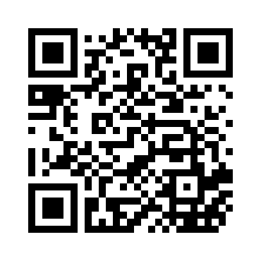
The research project continues- there are opportunities for people, chosen family/circle members, and facilitators/planners across Canada to still participate.
Especially looking to gather insights from diverse regions in Canada and those experiencing the intersection of disability with other lived experience.
Use the QR code below or follow to the research flyer using the link provided:
https://www.planningforagoodlife.ca/research-flyer

Slide 15
The Planning & Facilitation Collaborative is a national online community meant to build the capacity of facilitators, planning professionals and those engaged in planning to ultimately enhance the quality of life of people with disabilities and their families. Built upon foundational values including community belonging, self-determination and nurturing relationships, this community gathers together for a variety of learning opportunities, to share and network with one another, and to grow in their reflective practice.
To find out more or to become a member visit:
www.planningforagoodlife.ca

Slide 16
The Planning & Facilitation Collaborative and the Expanding the Capacity for Planning & Facilitation Supports in Canada Research Study is made possible in part by the funding provided by Employment and Social Development Canada (ESDC)

Slide 17
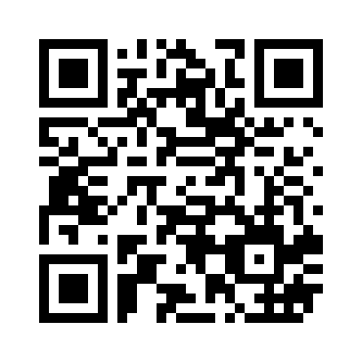
Thank you! Take a moment to share your feedback with us!

