Slide 1


Extend-A-Family Waterloo Region presents
Participants to Citizens:
Meaningful Individualized Planning
Chantelle Mann, Desiree Hinsperger, and Julie Mainland

Slide 2
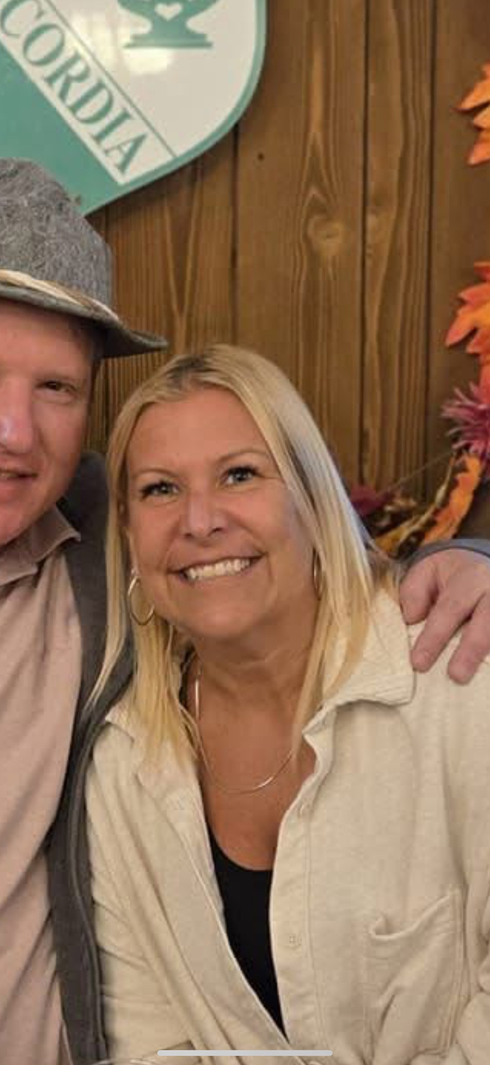
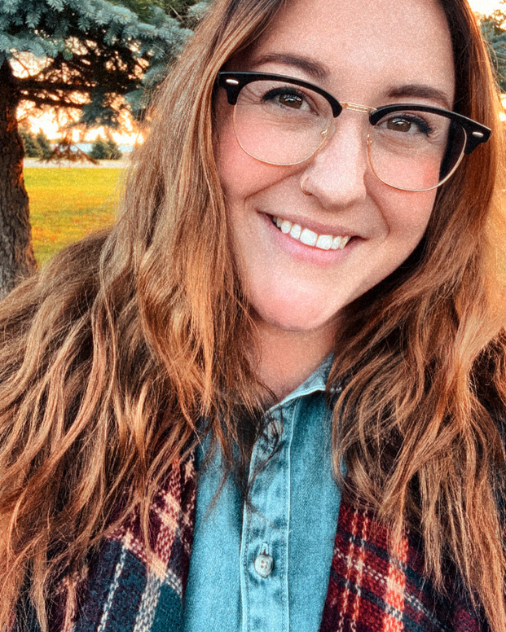
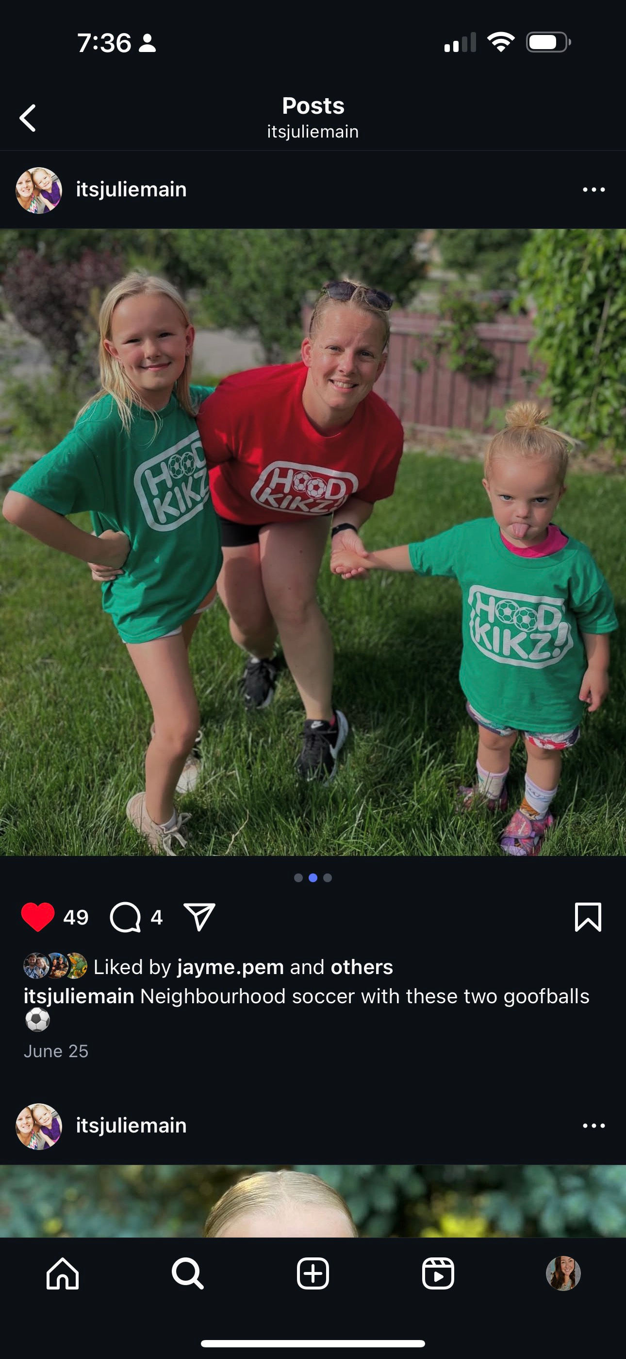
OUR SPEAKERS
Desiree Hinsperger
WALES Manager, EAFWR
Chantelle Mann
CPS Manager, EAFWR
Julie Mainland
Community Facilitator, EAFWR
Notes:
5min
Desiree Hinsperger - WALES Manager
- worked at EAF/WALES for _
Chantelle Mann - CPS Manager
- worked at EAF/WALES for 7 years
Julie Mainland - Community Facilitator
- worked at EAF/WALES for _

Slide 3

PRESENTATION ROADMAP
What is WALES?
Person-Directed Plans
Scheduling
The 5 Valued Experiences
The 5 A’s in People’s Networks
Hearing from WALES Members
Navigating Challenges
Changing Service Delivery
Summary & Questions
Notes:
5min (DES)
- Origins
- (next slide is present-day)

Slide 4

THE WALES GROUP
Group led by members, with the support of staff
Every person creates a plan for achieving their goals that can include
Employment
Independent Living Skills
Personal Development
Community Connections
Overarching goal is a greater connection between members and their community
Notes:
5min (DES)
- Origins
- (next slide is present-day)

Slide 5
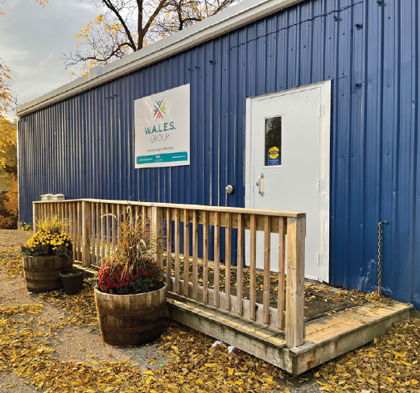
BEYOND THE PORTABLE
Notes:
5min (DES)
- where we're at now: doing group in community, virtual supports, family supports, etc

Slide 6

INDIVIDUALIZED PLANS: ROOTED IN OUR VALUES
Community, Belonging, Equity, Relationships
Always assume ability
Don’t think that someone can’t do something because they have a disability
Let people tell you the help that they need
We work with adults - they are treated as such!
Inclusion workshop
Inclusion doesn’t have to be a big production
Notes:
(Chantelle)
- explaining EAF values
- how they show up at WALES
- e.g. dignity of risk, interdependence, agreements of respect

Slide 7
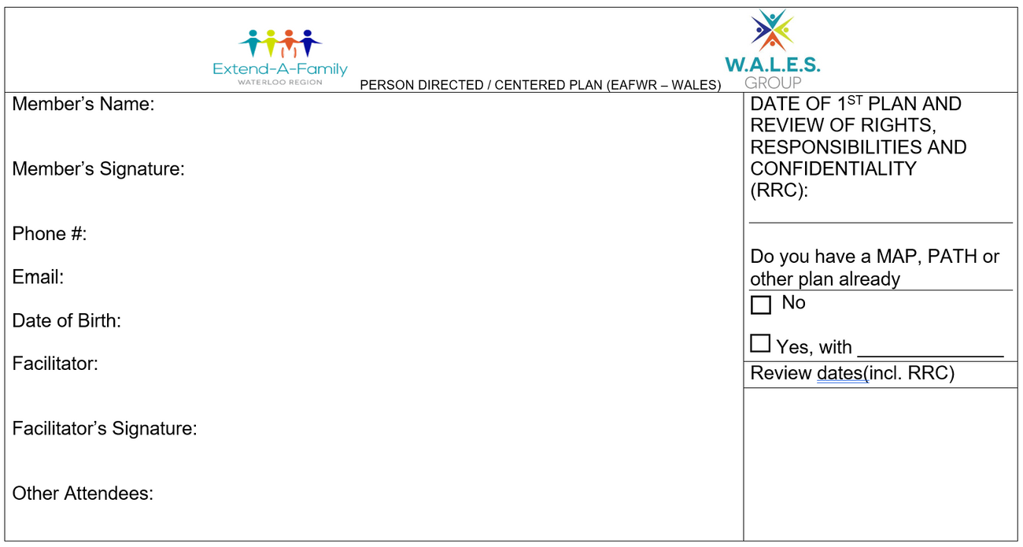
PERSON-DIRECTED PLANS
Focuses on meeting people where they are at AND where they want to go
Invites network in to collaborate and ensure continuity of goals and progress beyond WALES!
Empowers the person supported to decide who is invited “in” and who is able to be a support
Notes:
(Julie)
- explanation of what PDPs are, walk-through of the document

Slide 8
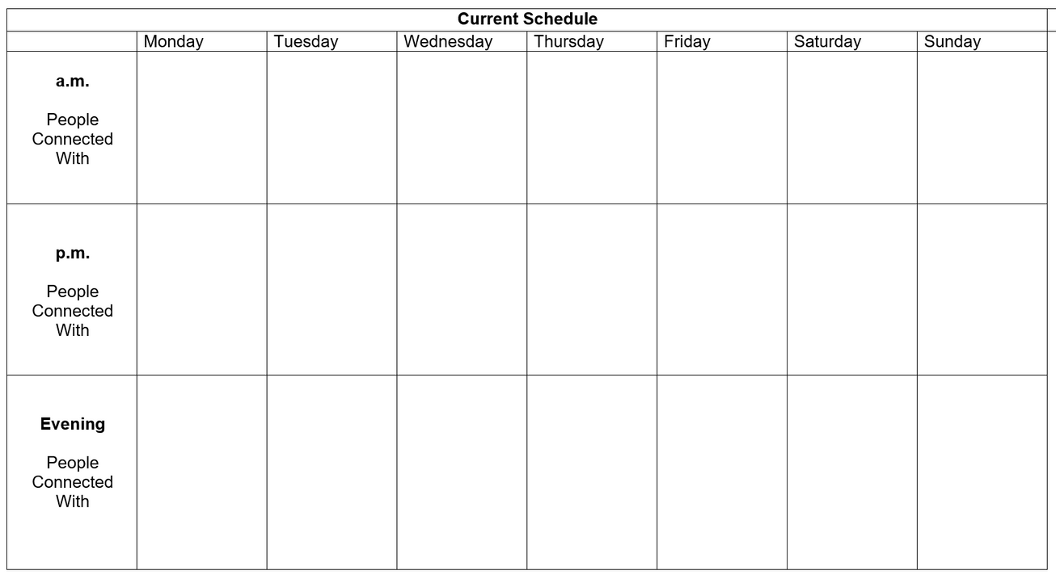
PERSON-DIRECTED PLANS
A quick glance at the weekly schedule for members
Looks at time at WALES
Includes evenings and weekends to really understand what the person’s life is like
With flexible support staff, we can support beyond the 9-3 window
Notes:
(Chantelle)
- weekly schedule (beyond just time at WALES)
- to better understand what peoples' lives look like

Slide 9
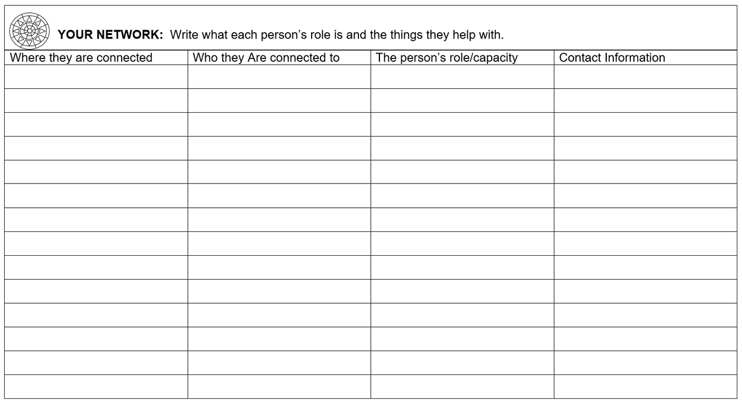
PERSON-DIRECTED PLANS
Looks more deeply and intentionally at who is in the person’s life
Allows better understanding for ways in which they support, and how they may support in new or other ways!
Examines where & how people are connected to the person!
Notes:
(Julie)
-

Slide 10
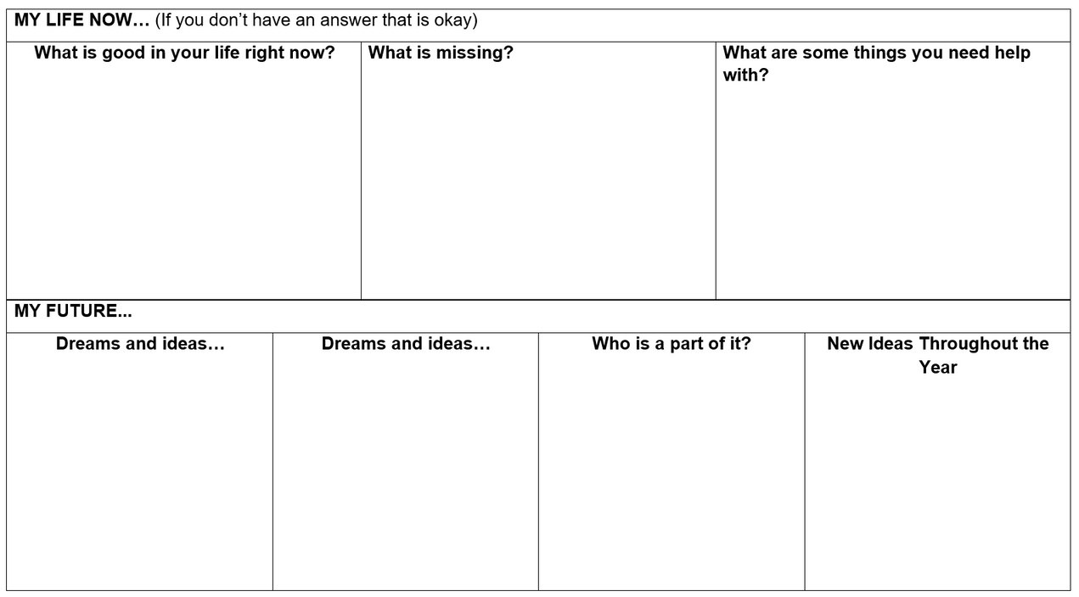
PERSON-DIRECTED PLANS
Quick glance at now vs. future
Gives space for the person to see what is good/they would like to “keep”
What is missing? What other things could be a new focus?
Helpful for network to weigh in as well, if there may be ideas or connections on the sidelines
Notes:
(Chantelle)
-

Slide 11
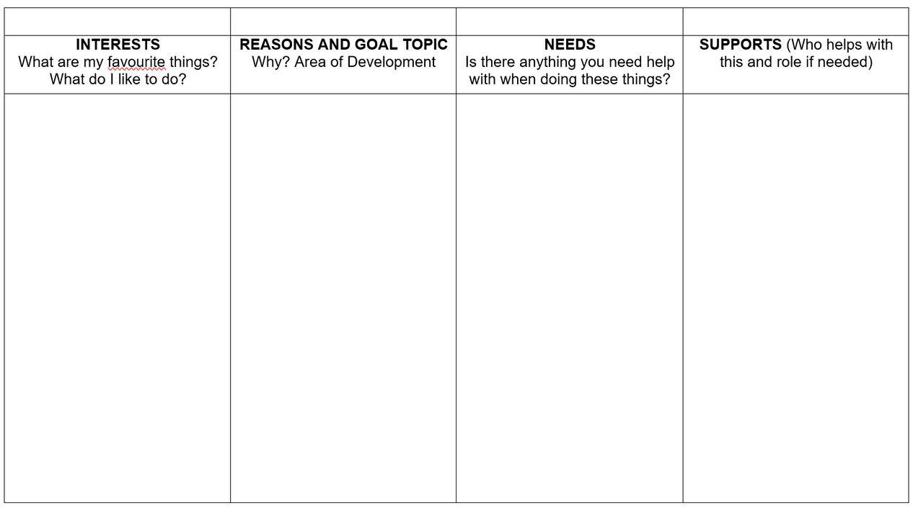
PERSON-DIRECTED PLANS
Organizes interests into achievable goals
Includes information about the
Why: Why do I want to focus on this?
How: How will I need some support achieving this?
Who: Who will support me if I need it?
Focus is on making things into smaller parts, meaning less overwhelm at new goals

Slide 12
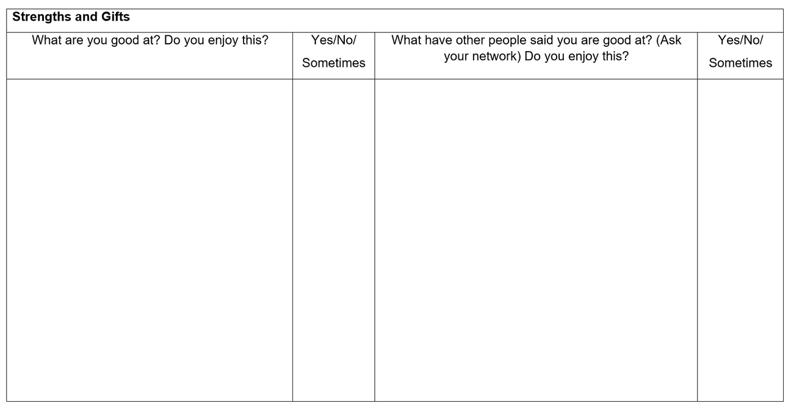
PERSON-DIRECTED PLANS
Great opportunity for network to really talk the person up
Allows people to focus on things they may be good at, but they may not actually enjoy
Focus is on empowering people to not get “stuck” in the things they typically shine at
Allows pivot if wanted

Slide 13
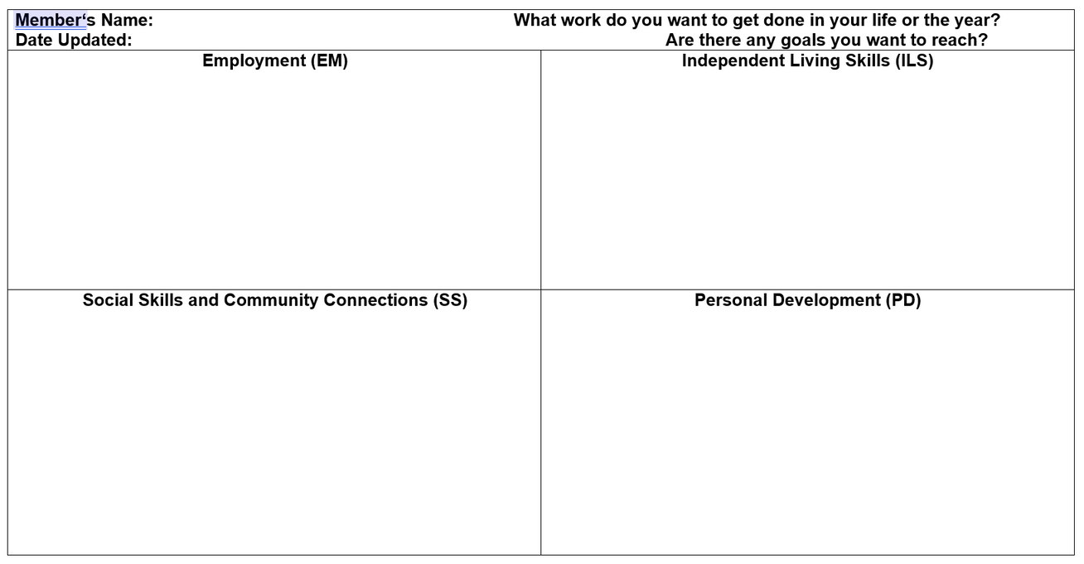
PERSON-DIRECTED PLANS
Quadrant of the 4 different goal groups:
Employment
Independent Living Skills
Community Connections
Personal Development
Try to have a holistic, well-rounded approach so that people have at least one goal in each of the categories
Variety
Seeing they are multi-faceted

Slide 14
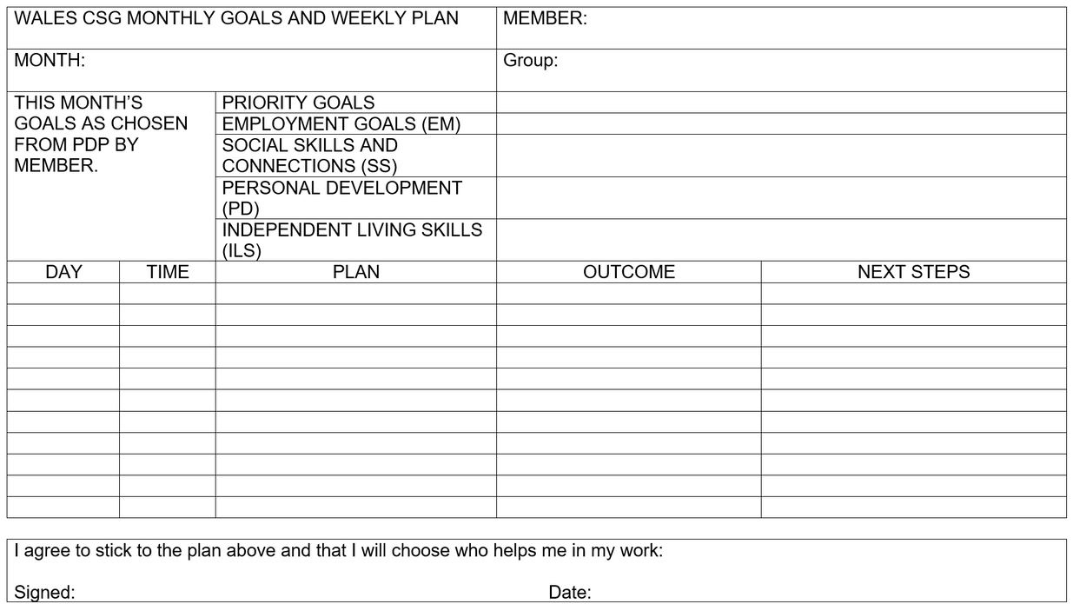
COMMUNITY SUPPORT GROUPS
Breakdown of WHY / HOW to use
CSG/CSG Sheet
Used to track members’
Plans
Goals
Progress
Filled out throughout the day with the completed work during each period of goal work & next steps

Slide 15

TYPICAL DAY AT WALES
8:30-9:00
Members arriving, Facilitators getting ready for their day
Announcements
Members go to their Group to plan their week / Do Goal Work
9:00-10:15
10:15-10:30
BREAK
10:30-11:30
Goal Work
11:30-12:30
LUNCH (Sometimes Facilitators meet)
12:30-1:30
Goal Work
1:30-1:45
BREAK
1:45-2:45
Goal Work
2:24-3:30
End of day tidy up, waiting for rides with members, debriefing the day if needed

Slide 16

WHAT IS “GOAL WORK”?
The hour long chunks of time that members use to schedule their days
Usually a smaller step that is part of a bigger goal will get scheduled for each section of the day
Facilitators support members to complete this work
Might include: emails, research, practicing cleaning skills, stress management

Slide 17
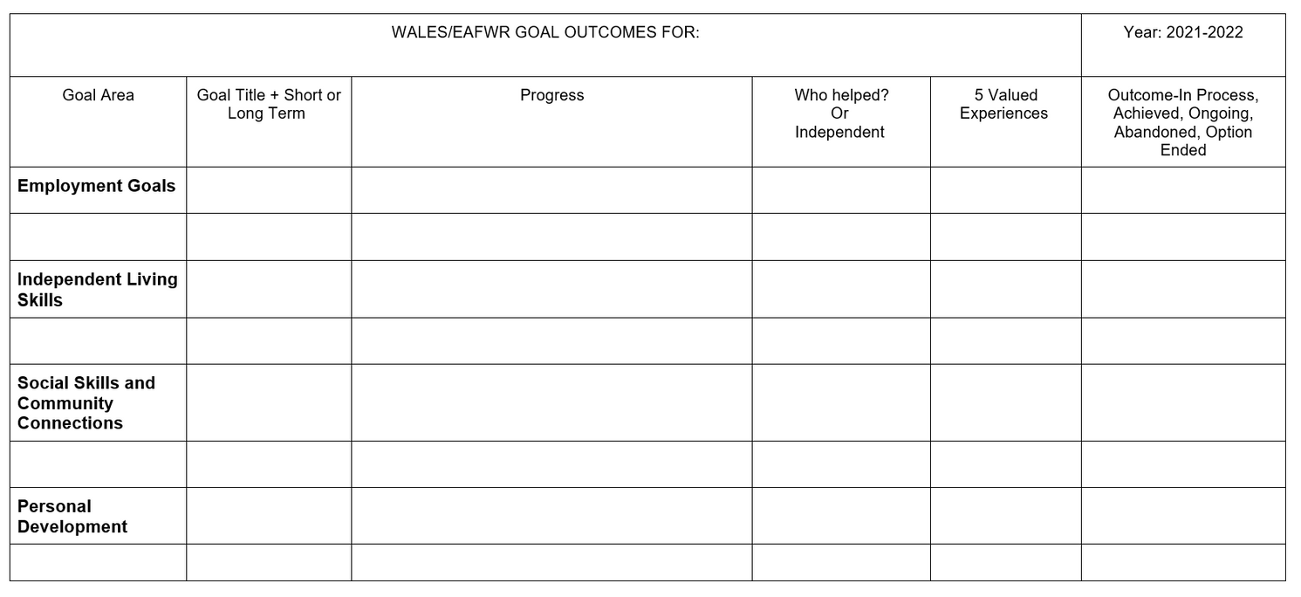
OUTCOMES & QAM
Outcomes are how we keep track of the work that we do with members
There is an Outcomes column on each CSG sheet that gets filled out throughout the day
At the end of each month these get transferred on to a larger Outcomes doc for the year (each member has their own)

Slide 18
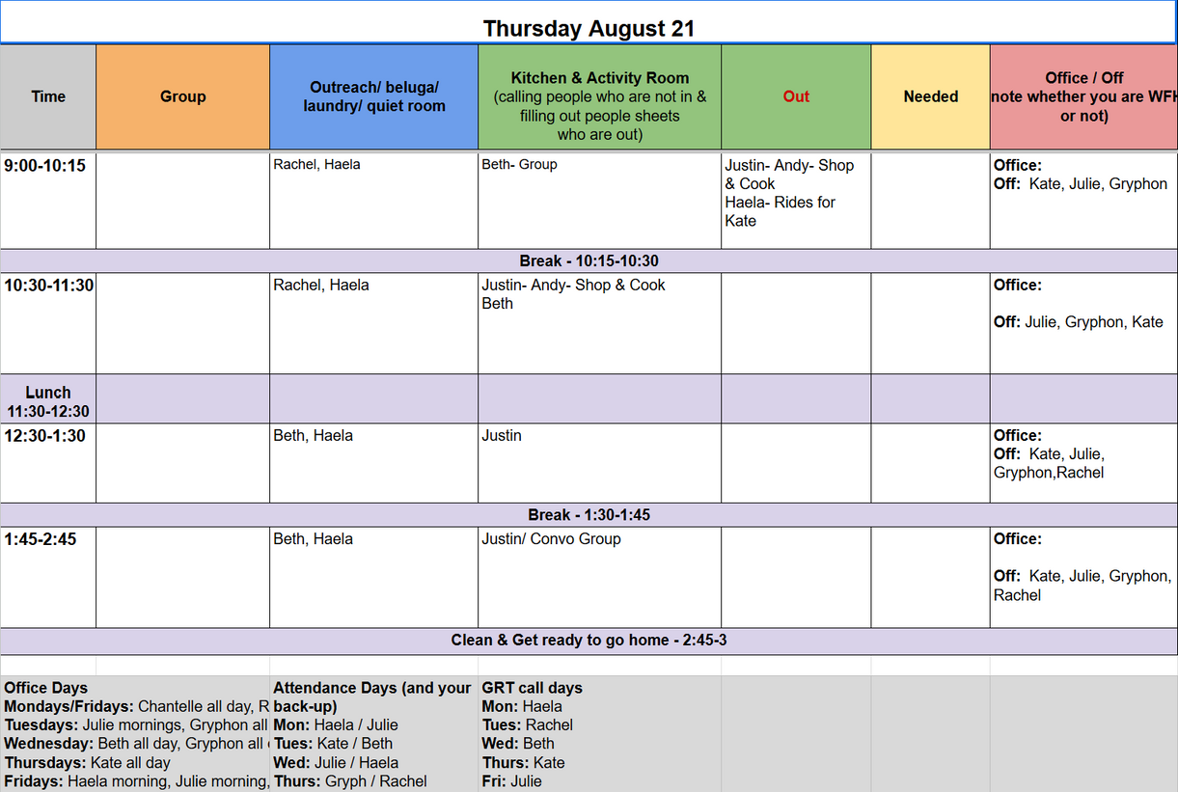
ZONES
Zones
We distinguish the different areas of our building and call them zones
Outreach
Kitchen
Out (Community)
Group
Office
Planned weekly with mid-week check-in to ensure sufficient coverage of building

Slide 19

THE 5 VALUED EXPERIENCES
Belonging
Promotes interdependence; assisting people to make & sustain connections, memberships & friendships
Questions to Guage Members Experiences for Outcomes
Do you have a friend who helps you, and with what?
Do you help your friend, and with what?
Where do you miss going? Why?
Do people miss you when you are not there?
Where do you feel like you belong?

Slide 20

THE 5 VALUED EXPERIENCES
Being Respected
Living inclusive stories; enhancement of person’s positive reputation
Questions to Guage Members Experiences for Outcomes
Do others appreciate when you share a skill you have?
Do others see your skill as important?
Where do you go where you are treated with respect?

Slide 21

THE 5 VALUED EXPERIENCES
Sharing Ordinary Places
Practicing hospitality; increasing people’s active involvement in the life of our communities
Questions to Guage Members Experiences for Outcomes
Where are you involved in the community and how?
Do you know anyone there?
Who do you go with?

Slide 22

THE 5 VALUED EXPERIENCES
Contributing
Seeing & supporting capacities; assisting people to develop & invest gifts & capacities
Questions to Guage Members Experiences for Outcomes
Where do you use your skills/ strengths to benefit others?
How do you do this?

Slide 23

THE 5 VALUED EXPERIENCES
Choosing
Resolving conflict; increase choice & control in people’s lives
Questions to Guage Members Experiences for Outcomes
Do you feel like you have choices about your life;
why or why not?
Do you feel like you have control about the decisions that
are happening in your life; why or why not?

Slide 24

THE 5 A’S
Associations
Who cares about the same agenda? What already exists in the community?
Are the social structures that represent the interests of groups of people?
May be structured in formal and informal ways; they are organized around different interests, causes or purposes
e.g. community centres

Slide 25

THE 5 A’S
Anchors
Who will always be there?
People who commit to anchor another person who love and have concern for the person’s well-being long term
They share their life with the person and are a constant in the person’s life
e.g. family members

Slide 26

THE 5 A’S
Allies
Who will play a strong role in getting behind us?
People who commit to share their time and resources to make progress towards meaningful change
They provide practical help, offer talents, skills and other useful resources
Bring others into alliance
Allies usually share a mutual interest with the person
e.g. support worker, cousin, sibling, trusted friend

Slide 27

THE 5 A’S
Assistants
What resources or help will we need to move forward?
Provide the help a person needs to deal with the impact of their disability or lack of freedoms
Those who commit to offer necessary help without taking over the person’s life
Assistants are respectful, creative, flexible and serve to reinforce the opportunity for the individual to make meaningful social contributions
e.g. friend, advocate/trusted person, facilitator, coordinator

Slide 28

THE 5 A’S
Agenda
PDP – Action plan
They provide a focus and direction for action and network building
The agenda establishes the climate for whom to invite into the circle to move the group forward towards meeting the goals
e.g. facilitator, coordinator

Slide 29

NEIGHBOURHOOD MAPPING
Focus is on organic connections and continuity of connections/familiarity
Public spaces
Third spaces
Places for everyone - who are they for?
Who are the people in your neighbourhood?
Neighbourhood Asset-Mapping
Questions for reflection on being in their neighbourhood spaces

Slide 30
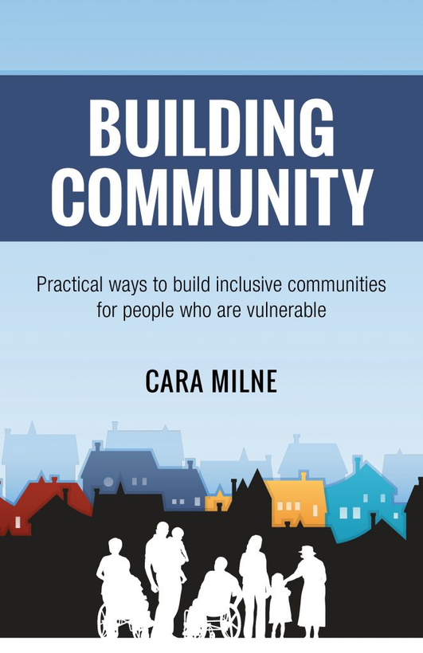
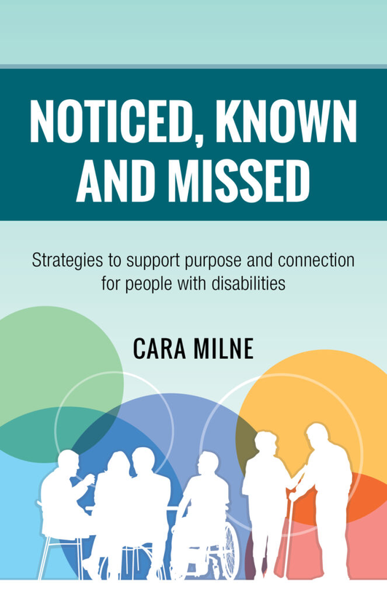
BEING GUESTS IN PEOPLES’ LIVES
Notes:
Share info about being a guest in someone's life, and the importance of cooperation and networking around someone.
Concept of known, noticed, and missed ***
Andy modelling as example

Slide 31

WHAT DOES WALES FOSTER?
Interdependence
Tai-chi connection
Member finding community on the bus when lost
Bus-ninja-ing to develop confidence
Curiosity
Safe space to learn on one’s own, or alongside peers
Confidence in setting boundaries and sharing aspirations
Deeper connections
Not just showing up and participating
Understanding what contribution looks like

Slide 32
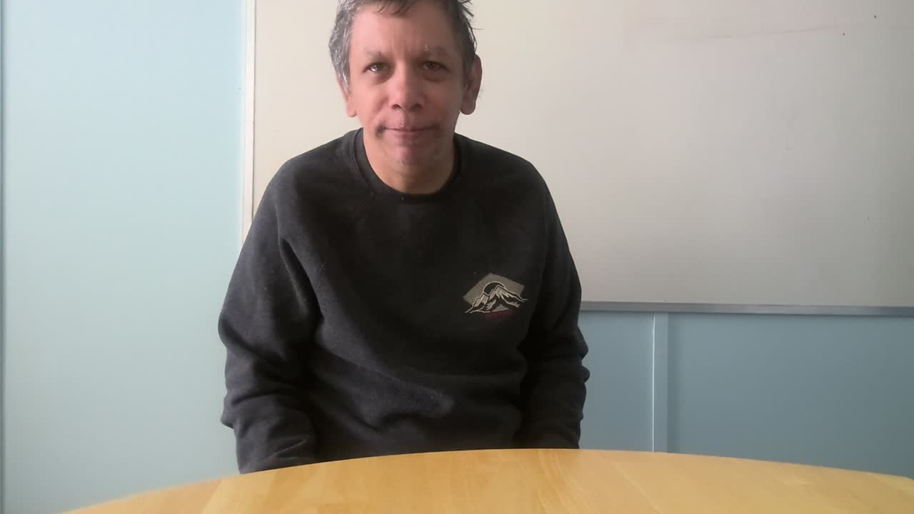
HEARING FROM OUR MEMBERS
Meet Les!
Connects with peers and develops deep friendships at WALES
Works on mindfulness
Enjoys the relational aspects most

Slide 33
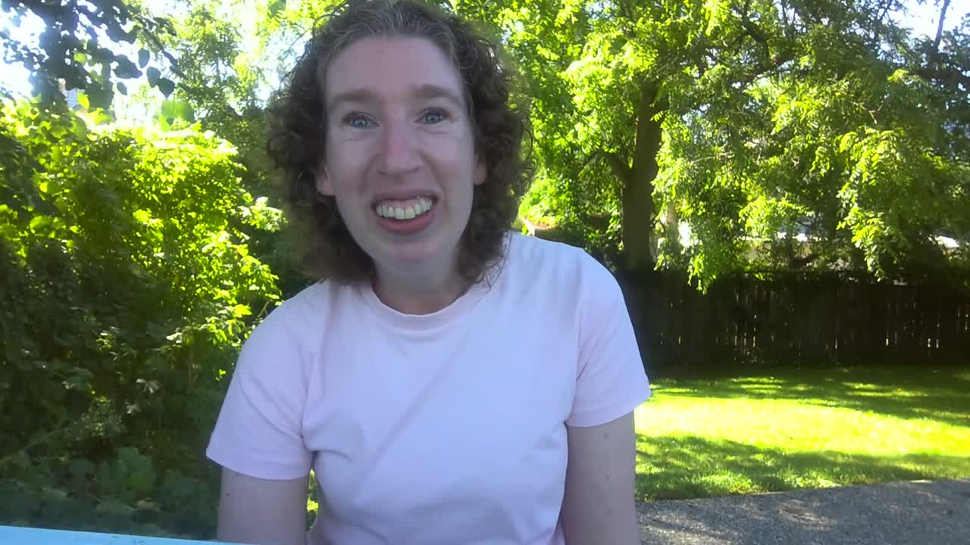
HEARING FROM OUR MEMBERS
Meet Meghan!
Has formed very tight friendships with a couple other members
Volunteers with the YMCA regularly
Enjoys working on ILS, specifically cooking

Slide 34
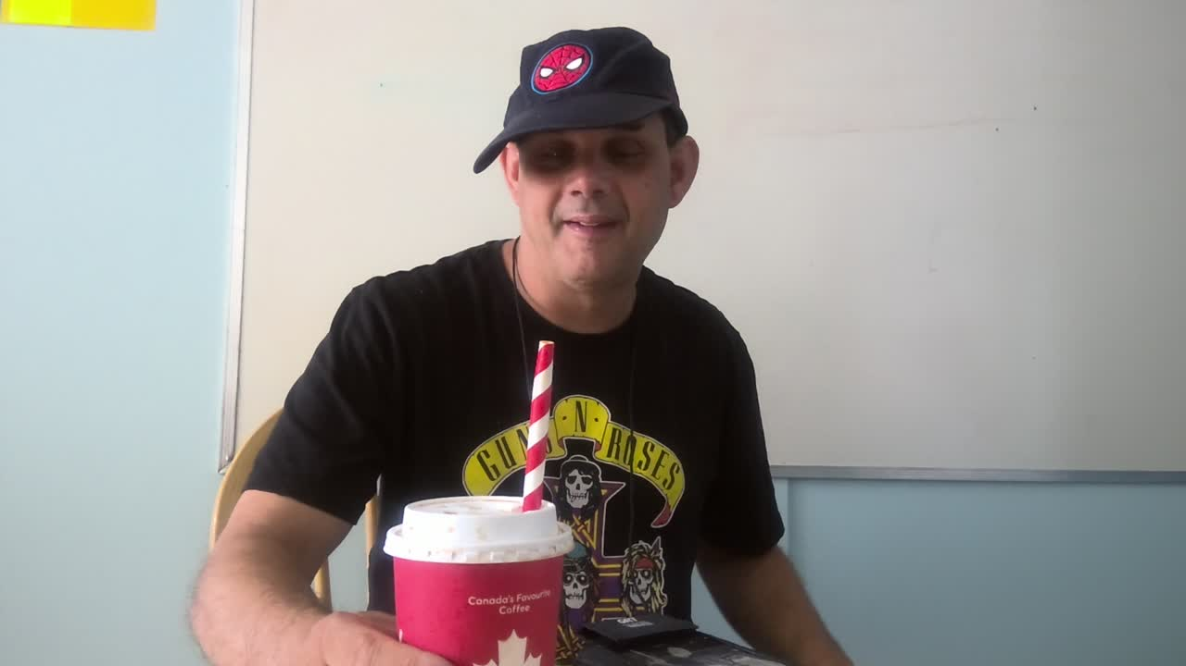
HEARING FROM OUR MEMBERS
Meet Clinton!
Meets with a small group at Tim Horton’s each week to hangout and create lists about ideas or goals
Enjoys anything focused on connecting with others

Slide 35
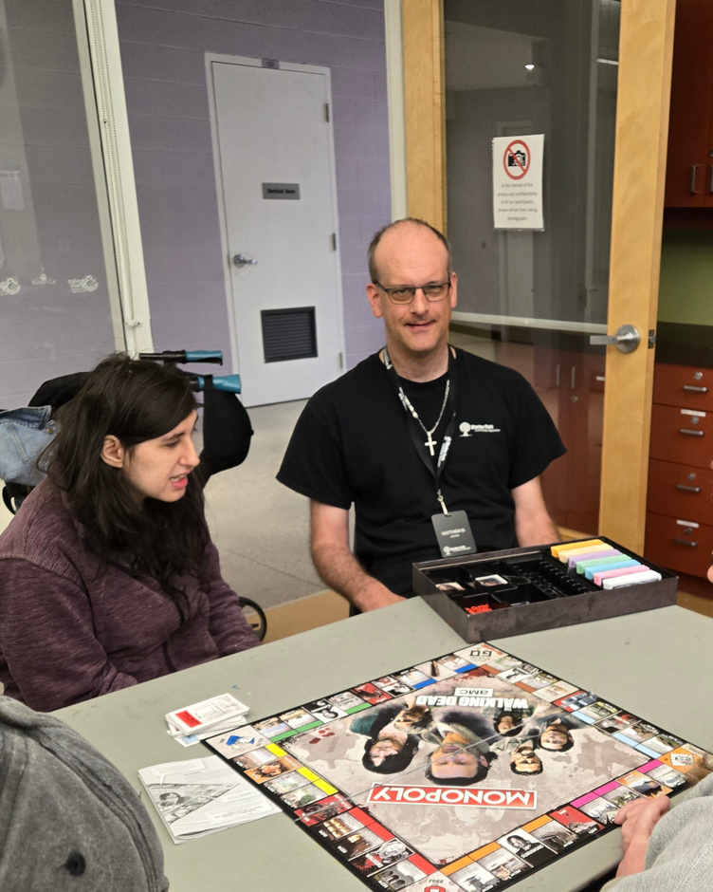
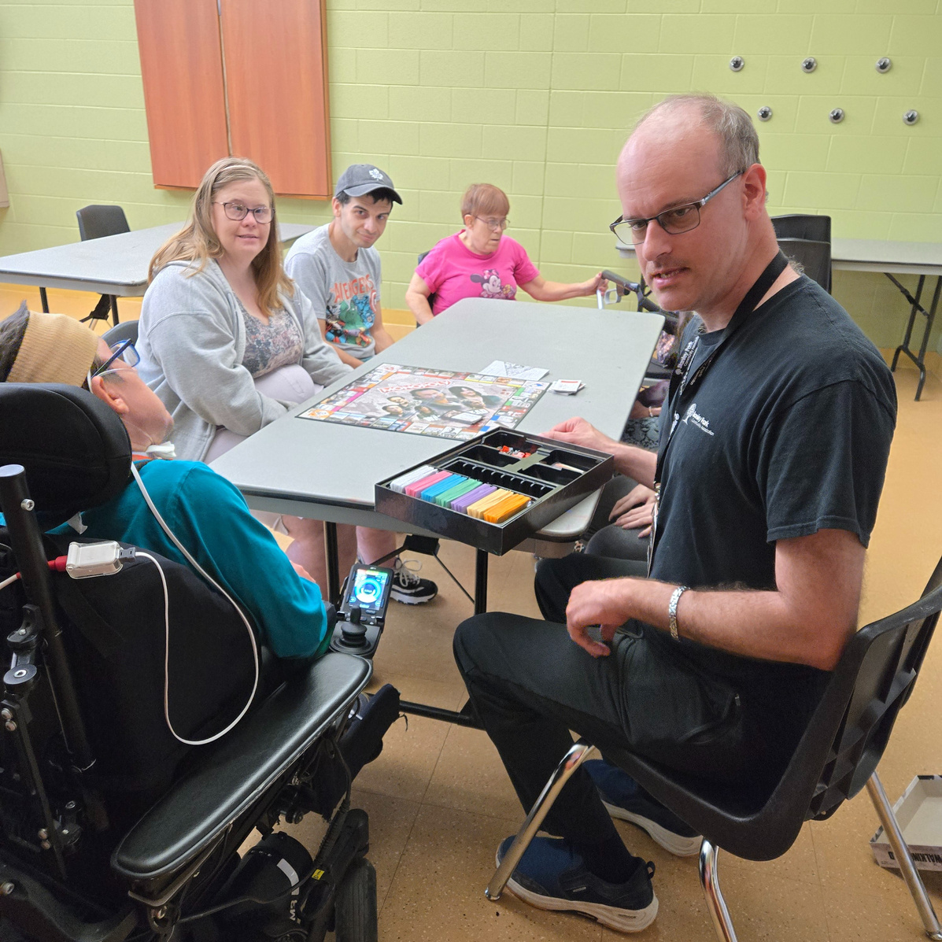
MATT’S GAMES GROUP
Hosted at local community centre
Matt moved from volunteer to now a paid staff member
Anyone is welcome, however Matt is very open about it being for people supported, and not for support people

Slide 36

NAVIGATING CHALLENGES
Creatively delivering service - truly meeting people where they are at
“Yes, And” approach
intentionality in how/where we provide support
“Working ourselves out of a job”
vs. growth & sustainability
Community education: what advocacy & supporting self-advocacy looks like to address and break down assumptions
Moving from protection to empowerment
the dignity of risk

Slide 37
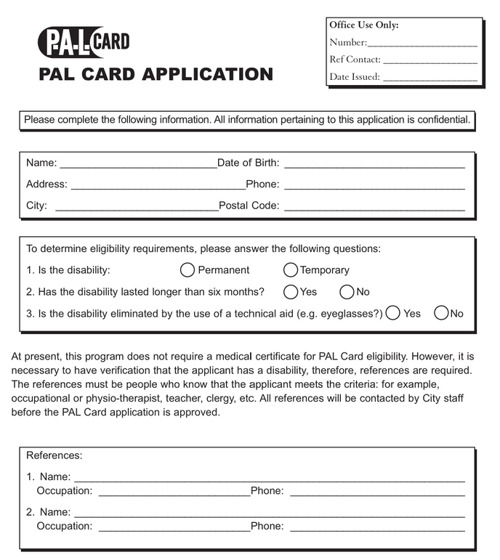
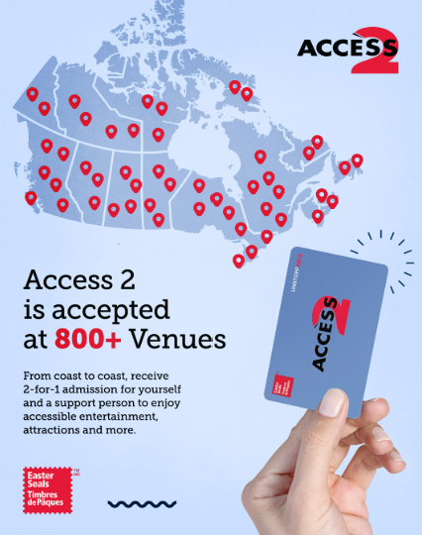
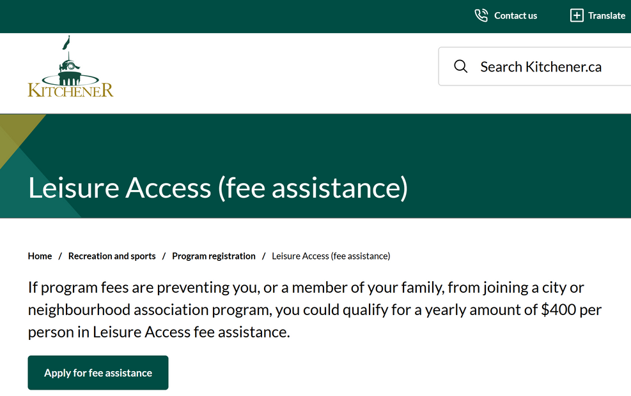
CITY CONNECTIONS AND SUPPORTS
Leisure Funding
INSERT BREAKDOWN

Slide 38

TRANSPORTATION
Intentionally don’t have a van
sustainability
individualized
fosters independence
Bus ninja-ing
Partnership with GRT with bus training
Bus cards for if lost
WALES phones

Slide 39

ADVOCACY & COMMUNITY EDUCATION
Advocating for age-overrides (eg 55+ programs which people want to attend, but are younger)
Assumptions being made at first sight that someone needs extra support to participate (employment, rec & leisure)
Respectful behaviour policies that are not discriminatory

Slide 40

RELATIONAL BASIS OF EMPOWERMENT
ACCEPTANCE
PROTECTION
EMPOWERMENT
HOPELESSNESS
OR PESSIMISM
HOPEFULNESS
OR OPTIMISM
PUNISHMENT
CONTROL
REJECTION

Slide 41

“YES, AND” APPROACH
Intentionality in how/where we provide support
Facilitation vs support worker
Assume ability
Holding space & being in the background
Example: Bus-Ninja
Notes:
Holding space & being in the background (bus ninja as example, supporting at library but doing own thing to be available if needed)

Slide 42

GROWTH & SUSTAINABILITY
Positives of “working ourselves out of jobs”
Creates more turnover, therefore more space for new people to come through
Provide more service and support to more people

Slide 43

CREATIVE, FLEXIBLE SERVICE DELIVERY
Navigating different support structure during mental health crisis
Working in a satellite form
Supporting members/families during times of crisis
Beyond regular supports
Hybrid facilitator hours for beyond the 9-3 so that flexibility is built into the role
Relief Facilitators offering stability for coverage

Slide 44

MITIGATING CHALLENGES WITH TRAINING
Fostering a strong, unified team using training as team-building time to cultivate:
Shared expectations
Healthy team “culture”
Space for open & honest dialogue
Trainings we have found invaluable:
Personality Dimensions
Core Competencies
Conflict & Communication

Slide 45

CHANGING OUR SERVICE DELIVERY
Reframing since COVID
Openness to expanding membership - knowing we’d also be able to expand staffing for continuous growth as a group
Reframe to view as an opportunity
Looking at spaces that already existed, and reimagining how to collaborate and share resources
Leveraging community as much as possible because it makes everything more sustainable for the people we work with

Slide 46

CHANGING YOUR SERVICE DELIVERY
Look to the community for organic supports
Bus trainings
Regional support staff
Potential partnerships
Sharing resources
Look for ways that people can participate independently/interdependently
Rather than conducting service out in community
Explore what opportunities and resources already exist that people can learn to access

Slide 47

DON’T FORGET THE STAKEHOLDERS!
Importance of involving ALL stakeholders
People supported
Families/Homes
Other external support staff
Use continuous feedback to evolve the way you:
Strategically plan for program development
Explore new ideas
Conduct service

Slide 48

Staff Structure
Relief or On-Call staff
Zoning schedules
Flexible hours of support
Individualized
Plans
Breakdown of Goal Work
PDPs (annual)
CSGs (monthly)
Group planning (weekly)
Outcomes (daily)
Finding natural overlap with peers, rather than group planning
Tracking what’s been accomplished & next steps
KEY TAKE-AWAYS
Considerations in Developing Individualized Supports
Organic Supports
Finding organic community connections
Fosters interdependence
Conserves resources over time and is more sustainable
Creates connections beyond work hours

Slide 49


