Slide 1

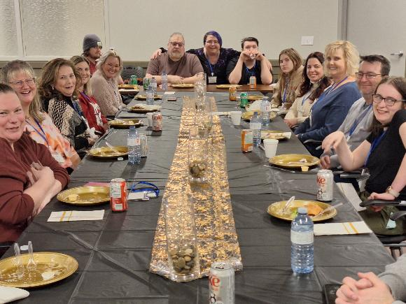

Supporting Families to Lead, Advocate, and Thrive
It Takes a Network
Tina Szymczak
Executive Director

Slide 2
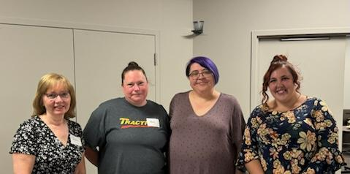
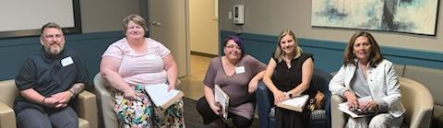
Welcome &
Session Objectives
What participants will learn:
  Importance of family-led networks
  Family perspectives
  Role of sponsoring agencies
  Practical takeaways for action

Slide 3
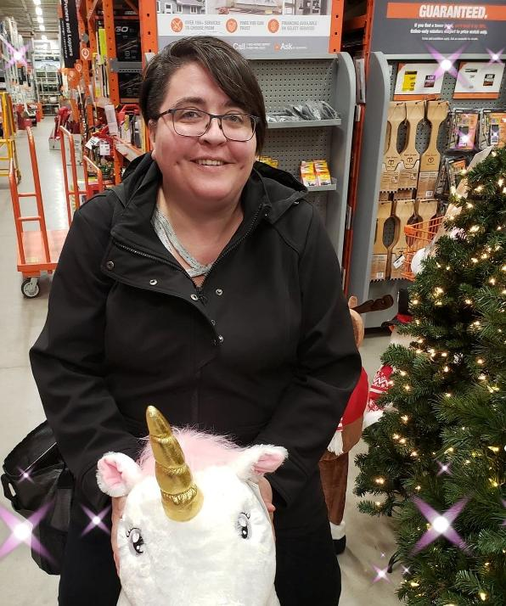
A Note Before We Begin
I am autistic — you may hear me alternate between first-person and identity-first language.
Please don’t hear what I’m not saying — I am being clear, there is no “read between the lines” with me.
I am sharing what I know about Family Networks from lived experience and community practice.
This presentation is not a criticism of agencies or government.
If you find yourself becoming defensive, I invite you to put aside your professional lens and listen to the family perspective.
A Note Before We Begin
I am autistic — you may hear me alternate between first-person and identity-first language.
Please don’t hear what I’m not saying — I am being clear, there is no “read between the lines” with me.
I am sharing what I know about Family Networks from lived experience, community practice and research.
This presentation is not a criticism of agencies or government.
If you find yourself becoming defensive, I invite you to put aside your professional lens and listen to the family perspective.

Slide 4
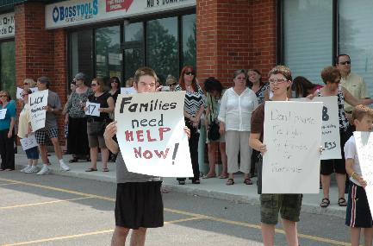
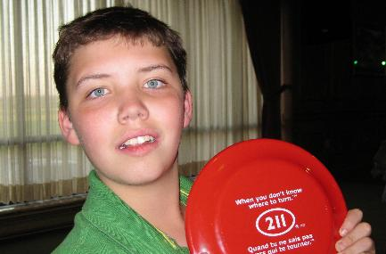
Windsor-Essex Family Network
Families Helping Families Open Doors
Since 1995
Vision
Stronger family voices – Positive change for people – Everyone belongs
Mission
Families supporting families by sharing their experiences, knowledge, and building skills to ensure people with disabilities and their families have an everyday life.
Community-based, family-led, independent/autonomous

Slide 5
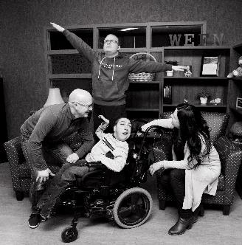
WEFN’s
Role in the Community
Family-to-Family Support
Connecting families with lived experience to one another.
Providing peer mentoring and encouragement in a safe and understanding space.
Information Sharing
Offering reliable information on services, supports, and resources.
Helping families navigate complex systems (education, health, disability supports, etc.).
Advocacy & Inclusion
Promoting the voices of people with disabilities and their families.
Working to reduce stigma and increase acceptance in schools, workplaces, and the wider community.
Capacity Building
Providing workshops, training, and opportunities for families to learn skills.
Building family confidence to advocate for themselves and others.

Slide 6
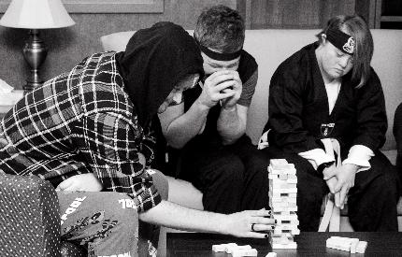
Our Role In the Community cont. . . .
Community Connector
Linking families to each other and to organizations, professionals, and resources.
Strengthening networks that reduce isolation and create belonging.
Autonomy & independent voice
Acting as a trusted, independent, family-led voice (not service-provider driven).
Ensuring that families’ perspectives shape community planning and decision-making.
Celebrating & Empowering Families
Creating safe spaces where families can share successes, challenges, and journeys.
Helping families see themselves as leaders and changemakers in the community.

Slide 7
What do we mean by autonomous?
Autonomy protects our ability to:
Be responsive – Families set the direction, so we can quickly adapt to emerging needs.
Create safe spaces – Families can share openly without fear of it affecting services or supports they receive.
Advocate freely – We can raise issues and challenge systems when necessary, without conflict of interest.
Uphold peer-to-peer values – Leadership comes from lived experience, ensuring families remain at the center.
In short, autonomy ensures WEFN remains a network by families, for families—a trusted and independent voice that strengthens community belonging and drives change.
Remaining autonomous allows Windsor-Essex Family Network (WEFN) to stay rooted in the voices and needs of families themselves. Because we are not governed by a service agency or tied to specific program mandates, families trust that our focus is on their priorities, not organizational agendas.
Notes:
Remaining autonomous allows Windsor-Essex Family Network (WEFN) to stay rooted in the voices and needs of families themselves. Because we are not governed by a service agency or tied to specific program mandates, families trust that our focus is on their priorities, not organizational agendas.
Autonomy protects our ability to:
Be responsive – Families set the direction, so we can quickly adapt to emerging needs.
Create safe spaces – Families can share openly without fear of it affecting services or supports they receive.
Advocate freely – We can raise issues and challenge systems when necessary, without conflict of interest.
Uphold peer-to-peer values – Leadership comes from lived experience, ensuring families remain at the center.
In short, autonomy ensures WEFN remains a network by families, for families—a trusted and independent voice that strengthens community belonging and drives change.

Slide 8
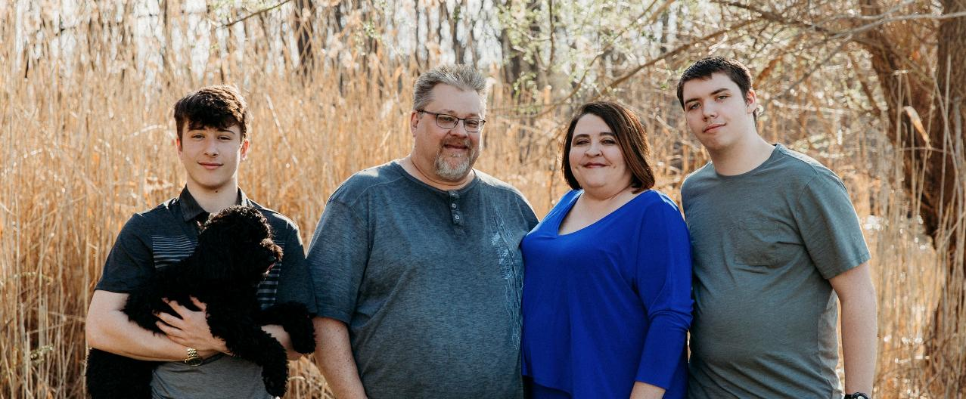
My Family’s Journey with WEFN
Notes:
Use of first person language

Slide 9
The Power of Family-Led Networks
Autonomous Family Networks
Agency-Led Initiatives
Led by families, for families
Independent, community-based
Priorities set by lived experience
Safe, judgment-free peer spaces
Flexible and responsive to emerging needs
Can advocate freely, even when it challenges systems
Build trust through shared experience
Run by staff within an organization
Guided by agency mandates, policies, or funder priorities
Families often invited to “consult,” not lead
May feel less safe to be fully open (power imbalance)
Bound by service rules or timelines
Advocacy may be limited by conflict of interest
Risk of tokenism or family voices being overshadowed
Notes:
Agencies removing support because they feel that the Network is advocating for families

Slide 10

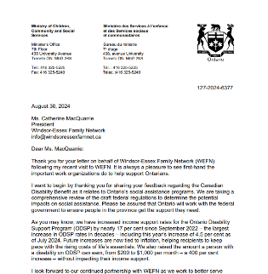
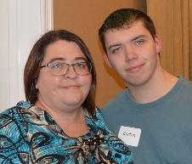
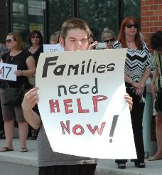
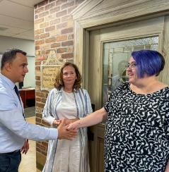
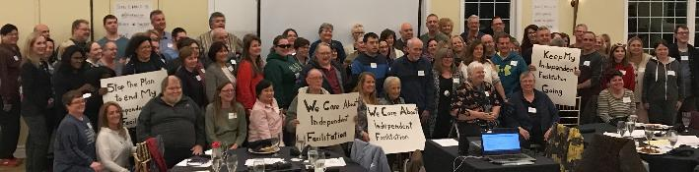
Collective Family Voice

Slide 11

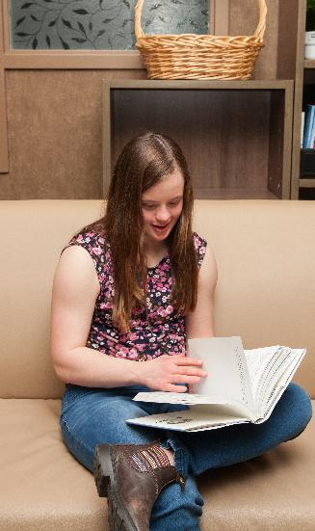
Meeting Families Where They Are:
Every family brings their own culture, history, and perspective
Inclusion means accepting people as they are, not expecting them to fit into a mold
Family networks create space where differences are respected and valued
Supporting diverse leadership ensures no voice is left out

Slide 12

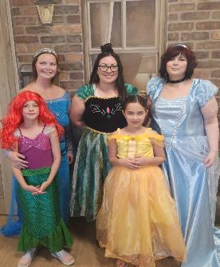
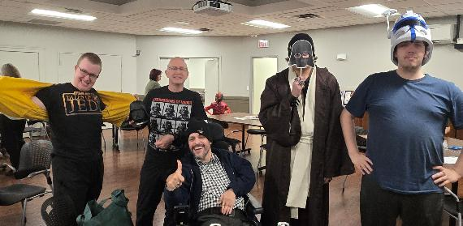
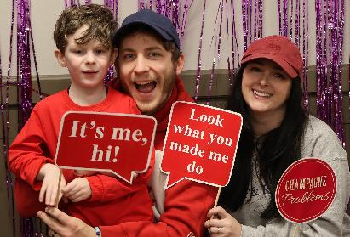
An Example of Building Community
Through Family Engagement Grant from

Slide 13


“Family Alliance Ontario (FAO) is a well-respected, family based, non-profit organization dedicated to supporting the family perspective and working toward positive social change. We came together in 1997 as a group of concerned families who wanted different lives for our family members than those offered by traditional services.”
Each Family Network is unique
There are Family Networks throughout Ontario but they tend to struggle
https://family-alliance.com/

Slide 14
What does the research show about peer mentoring?
“Several participants noted that peer support is provided in a reciprocal manner that is distinctly different from the often-hierarchical relationships that exist between parents and professional care providers. For some, this reciprocity contributes to ease in requesting support, knowing that there will be an opportunity to give back” (McCrossin, Jeffrey, and Lucyna Lach. “Parent‐To‐Parent Support for Childhood Neurodisability,2022)
“because peer supporters do not enter the relationship with an agenda, there is time and space to express the emotions without the pressure of resolving them.” (McCrossin, Jeffrey, and Lucyna Lach. “Parent‐To‐Parent Support for Childhood Neurodisability, 2022)
“Research shows that access to formal and informal supports, connections with other people, and having good relationships within and outside the family unit improves wellbeing of families with disabilities.” (Campbell, M. & The Vanier Institute of the Family,2024).
“People with disabilities and their families commonly experience social isolation.”(Campbell, M. & The Vanier Institute of the Family. 2024).

Slide 15
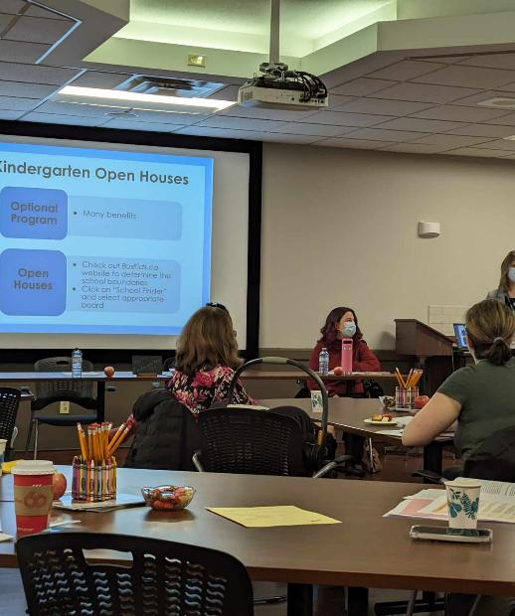
Research about peer mentoring continued
Having access to formal and informal supports, as well as an active and diverse social network, has a positive effect on family wellbeing. (Campbell, M. & The Vanier Institute of the Family. (2024)).
One parent reflected on her experience of sharing her story with someone who had a similar family experience, reporting that “it was like a homecoming […] like [meeting] a family I never knew I had” (McCrossin, Jeffrey, and Lucyna Lach. “Parent‐To‐Parent Support for Childhood Neurodisability, 2022)
“These groups provide a platform for parents to express their emotions and gain insights from one another’s experiences and accumulated knowledge. This intervention facilitates individuals’ ability to manage their daily responsibilities, mitigates the negative impact of social stigma, and strengthens their adaptive capacities.” (Lakhani, Arusa, et al. “Informal Social Support for Families with Children with an Intellectual Disability ,2024)

Slide 16
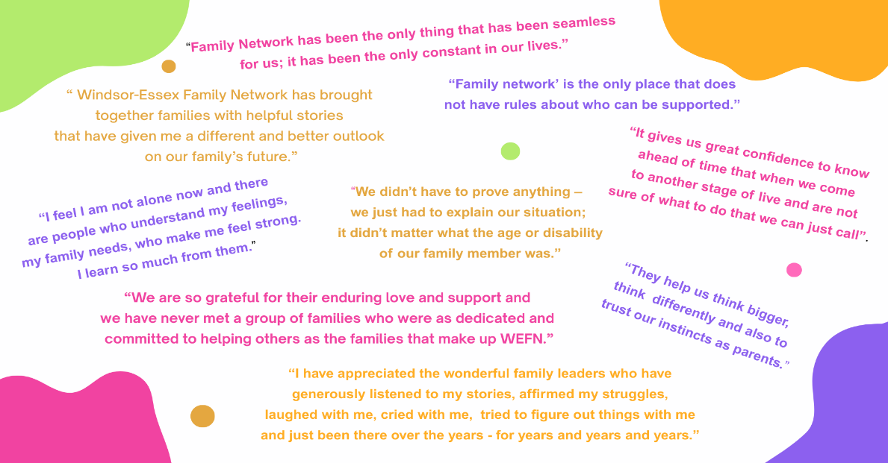

Slide 17

The Role of Sponsors & Partner Organizations
What meaningful support looks like (without control)
Examples of positive partnerships
Challenges and tensions
Tips for balancing trust and accountability
Notes:
“tone” of a brochure

Slide 18
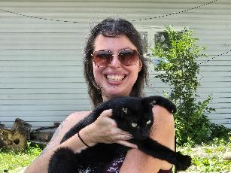
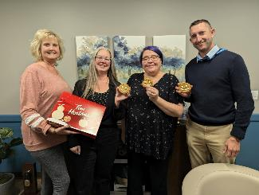
Grants at Work: Beyond Paperwork to Peoplework
Benefits of Grants
Start-up & project funding
Support for innovation
Builds credibility & partnerships
Capacity building
Drawbacks
Short-term & unstable
Risk of mission drift
Restricted use (not core costs)
Heavy admin burden
Dependent on funder priorities
At WEFN Grants have been used to:
Build family leadership capacity
Support mentorship & community connection
Host events amplifying family voices
Always maintaining family autonomy

Slide 19
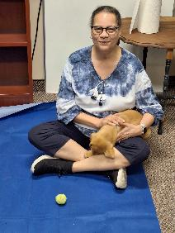
Challenges Facing Family Networks
Challenges Facing Family Networks Today
Sustainability & Funding
  Reliance On Short-term Project Grants (Instead Of Core Funding)
  Constant Pressure To “Prove Value” With Limited Resources
  Difficulty Planning Long-term When Funding Is Piecemeal
Maintaining Autonomy
  Risk Of Being Absorbed Or Controlled By Agencies/Funders
  Pressure To Align With Service Agendas Instead Of Family Priorities
  Balancing Partnerships While Protecting Independence
Leadership Capacity
  Heavy Reliance On A Small Group Of Family Leaders
  Risk Of Burnout For Those Carrying The Network
  Need To Recruit And Mentor The Next Generation Of Family Leaders
Notes:
Ex – no money for volunteers, agencies cut back resources and then WEFN has to pick up slack e.g. CRA/OAP?SSAH/DTC

Slide 20
Challenges Continued . . .
Diversity & Inclusion
  Ensuring networks reflect the voices of racialized, newcomer, 2SLGBTQIA+, rural, and low-income families.
  Overcoming barriers like language, access to transportation, or digital divide.
  Avoiding tokenism and building authentic representation.
Visibility & Recognition
  Family networks often undervalued or misunderstood by policymakers and service providers.
  Families seen as “participants” rather than leaders/experts.
  Constant need to explain “why autonomous networks matter.”
System Complexity
  Families face increasingly fragmented services and policies.
  Networks are left helping families “decode the system” without extra support.
Diversity & Inclusion
  Ensuring networks reflect the voices of racialized, newcomer, 2SLGBTQIA+, rural, and low-income families.
  Overcoming barriers like language, access to transportation, or digital divide.
  Avoiding tokenism and building authentic representation.
Visibility & Recognition
  Family networks often undervalued or misunderstood by policymakers and service providers.
  Families seen as “participants” rather than leaders/experts.
  Constant need to explain “why autonomous networks matter.”
System Complexity
  Families face increasingly fragmented services and policies.
  Networks are left helping families “decode the system” without extra support.
Diversity & Inclusion
  Ensuring networks reflect the voices of racialized, newcomer, 2SLGBTQIA+, rural, and low-income families.
  Overcoming barriers like language, access to transportation, or digital divide.
  Avoiding tokenism and building authentic representation.
Visibility & Recognition
  Family networks often undervalued or misunderstood by policymakers and service providers.
  Families seen as “participants” rather than leaders/experts.
  Constant need to explain “why autonomous networks matter.”
System Complexity
  Families face increasingly fragmented services and policies.
  Networks are left helping families “decode the system” without extra support.

Slide 21
Discuss One of the Following at Your Table:
Amplifying Voices
How can funders, partners, and families work together to ensure that family voices remain at the center of decision-making across Ontario?
Strengthening Networks
What supports, resources, or partnerships would help family networks thrive and continue to be safe, trusted spaces for families?
From Talk to Action
After today’s discussion, what is one practical step you (or your organization) could take to champion family-led initiatives in your community?

Slide 22
Final Thoughts
Families thrive when they feel connected, supported, and understood.
WEFN creates safe spaces where families can learn from one another and grow together.
Our role is not just to share information, but to build confidence, reduce isolation, and foster belonging.
Because we are family-led and independent, families trust us to amplify their voices without hidden agendas.
Strong families build stronger, more inclusive communities.

Slide 23
Call to Action
Invest in Families Across Ontario – Independent, family-led networks exist in communities across the province, offering safe spaces for families to connect, learn, and lead. Help fortify and increase
Amplify Without Strings – Your support strengthens families’ ability to speak for themselves, ensuring their voices remain authentic and not agency-driven.
Champion Inclusion Province-Wide – By supporting family networks, you help create stronger, more inclusive communities in every region.
Fuel Grassroots Change – Family networks build leadership, reduce isolation, and create lasting impact that no single program can achieve.
Stand With Families – Sponsorship and partnership ensure that families remain at the center of decisions that affect their lives—today and into the future.

Slide 24
Sources Cited
Lakhani, Arusa, et al. “Informal Social Support for Families with Children with an Intellectual Disability in Karachi, Pakistan: A Qualitative Exploratory Study Design.” Heliyon, vol. 10, no. 20, Oct. 2024, p. e39221, https://doi.org/10.1016/j.heliyon.2024.e39221. Accessed 27 Nov. 2024.
McCrossin, Jeffrey, and Lucyna Lach. “Parent‐To‐Parent Support for Childhood Neurodisability: A Qualitative Analysis and Proposed Model of Peer Support and Family Resilience.” Child: Care, Health and Development, vol. 49, no. 3, 18 Oct. 2022, https://doi.org/10.1111/cch.13069.
Campbell, M. & The Vanier Institute of the Family. (2024). Families, disability, and wellbeing in Canada. In The Vanier Institute of the Family. https://vanierinstitute.ca/wp-content/uploads/2024/05/2024-05-23_Issue-Brief-Families-Disability-Wellbeing-in-Canada.pdf
Duong, J., Pryer, S., Walsh, C., Fitzpatrick, A., Magill, J., Simmonds, S., Yang, D., Baird-Peddie, O., Rahman, F., Hayter, C., & Tavener, M. (2023). ‘Nothing About Us Without Us’: exploring benefits and challenges of peer support for people with disability in peer support organisations – protocol paper for a qualitative coproduction project. BMJ Open, 13(12), e073920. https://doi.org/10.1136/bmjopen-2023-073920

Slide 25
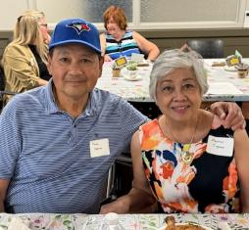
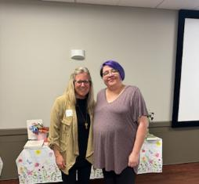
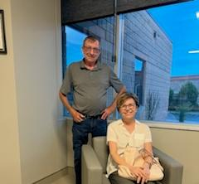
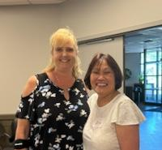
Thank you!
Windsor-Essex Family Network
windsoressexfamnet.ca
tina@windsoressexfamnet.ca
519-974-1008

