Slide 1
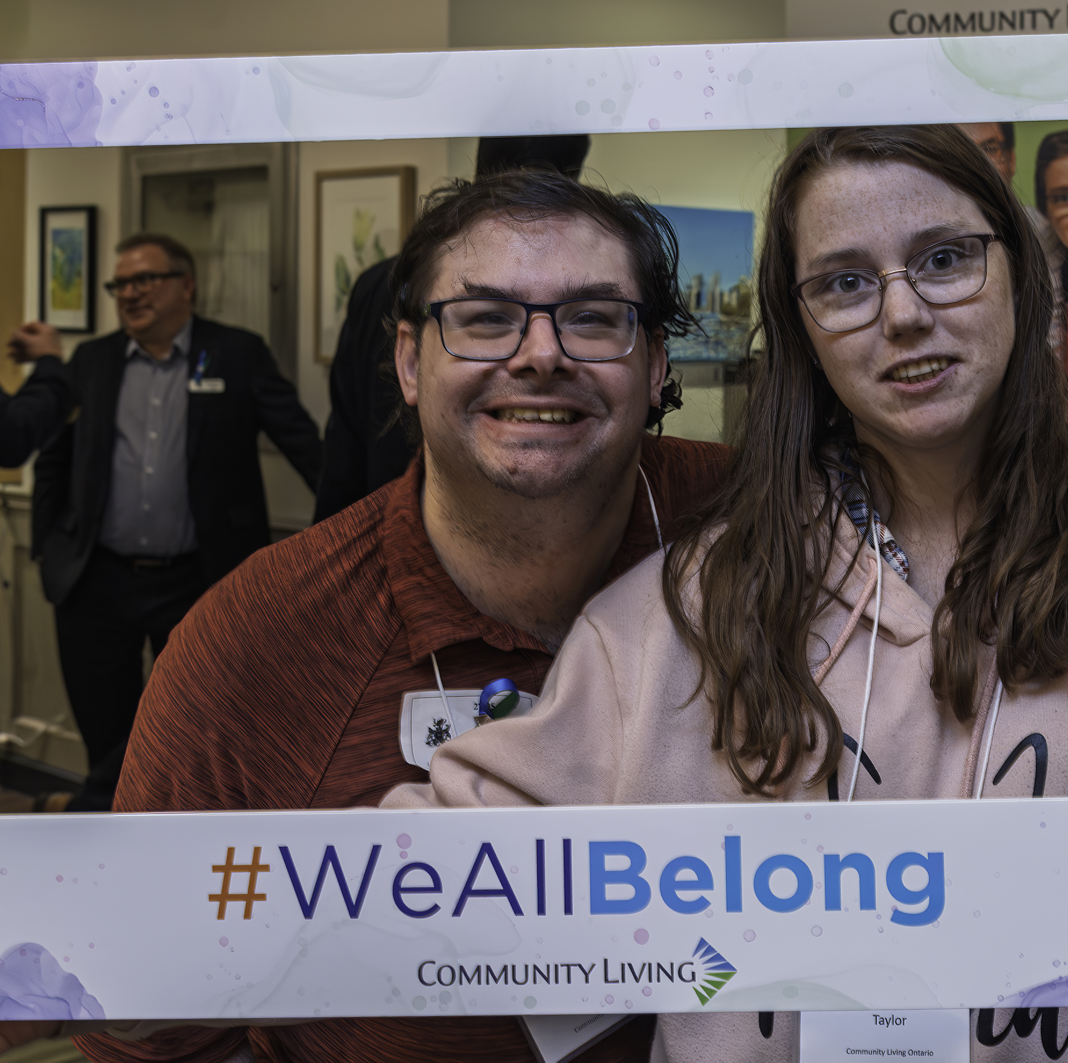
What Belonging Really Means
CLO Conference- London
September 17, 2025

Slide 2
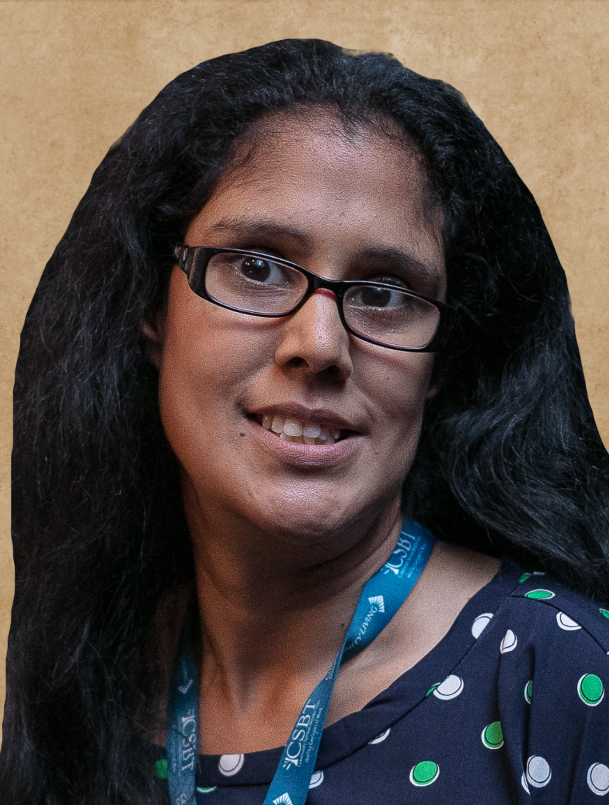
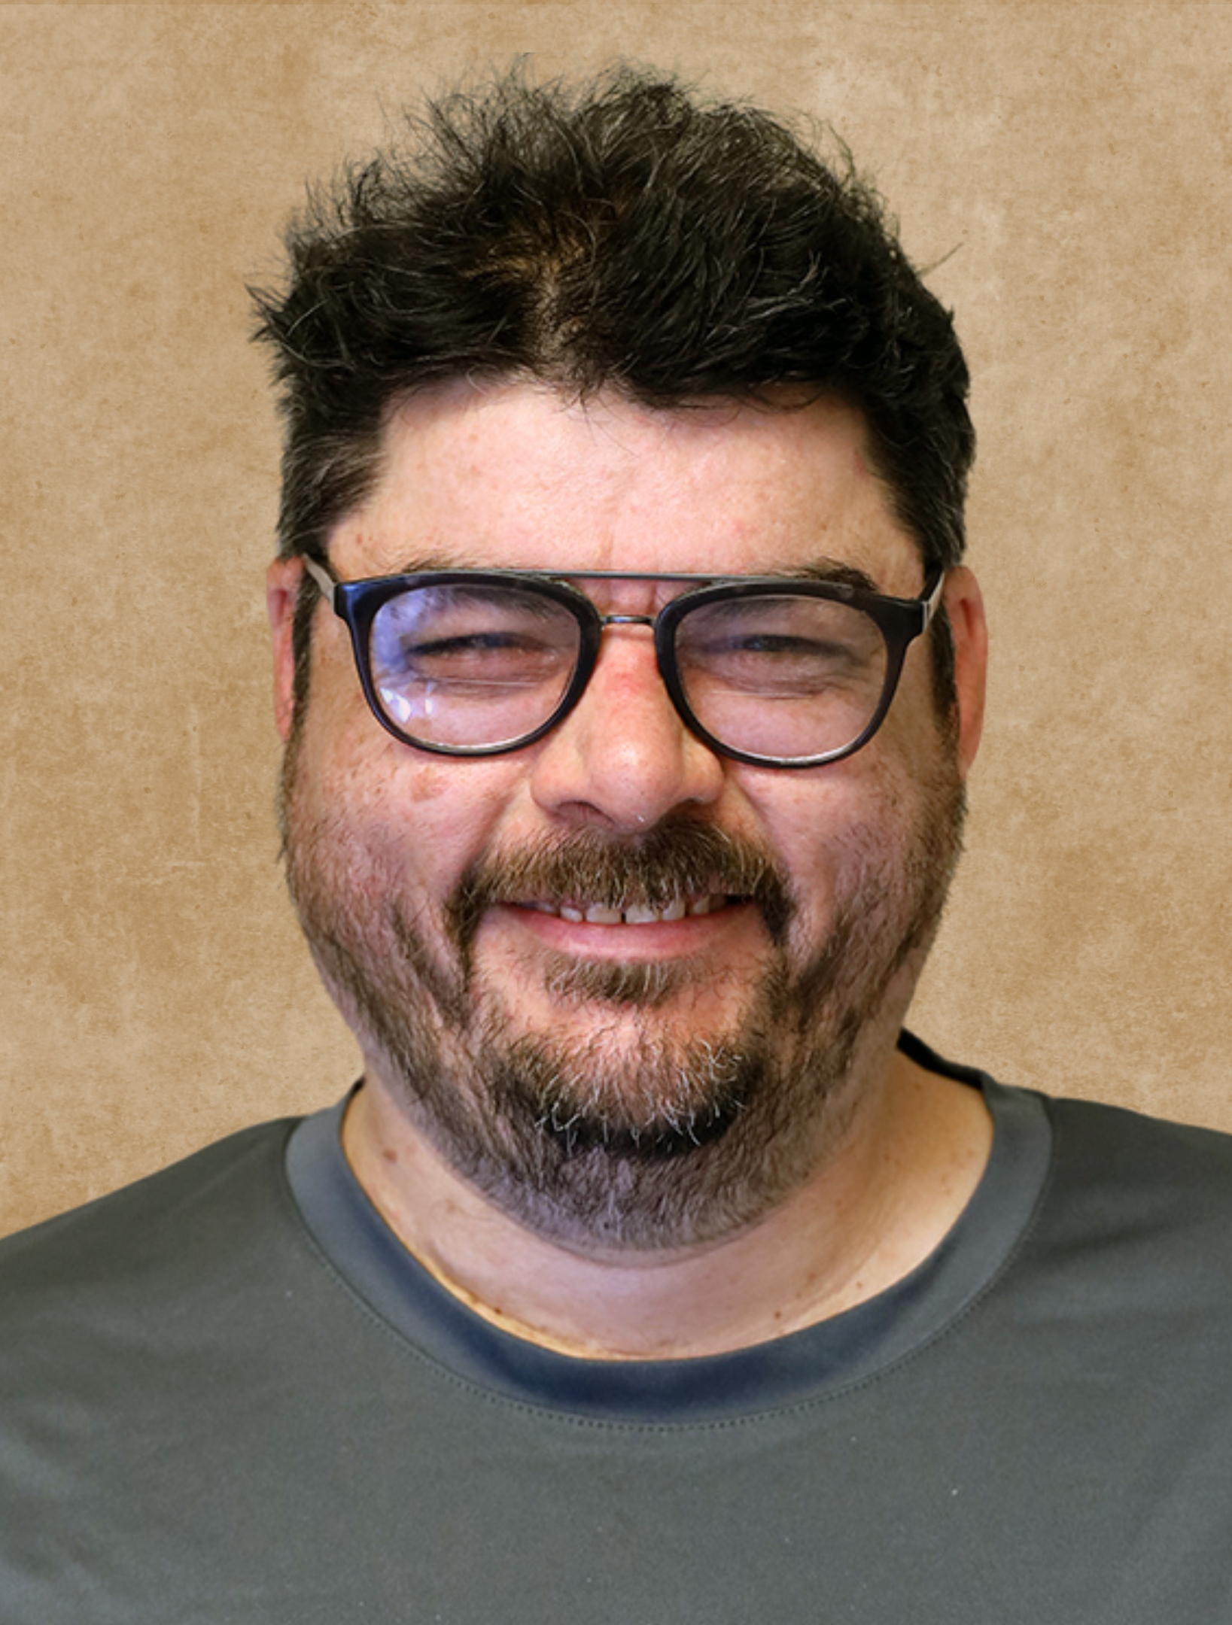
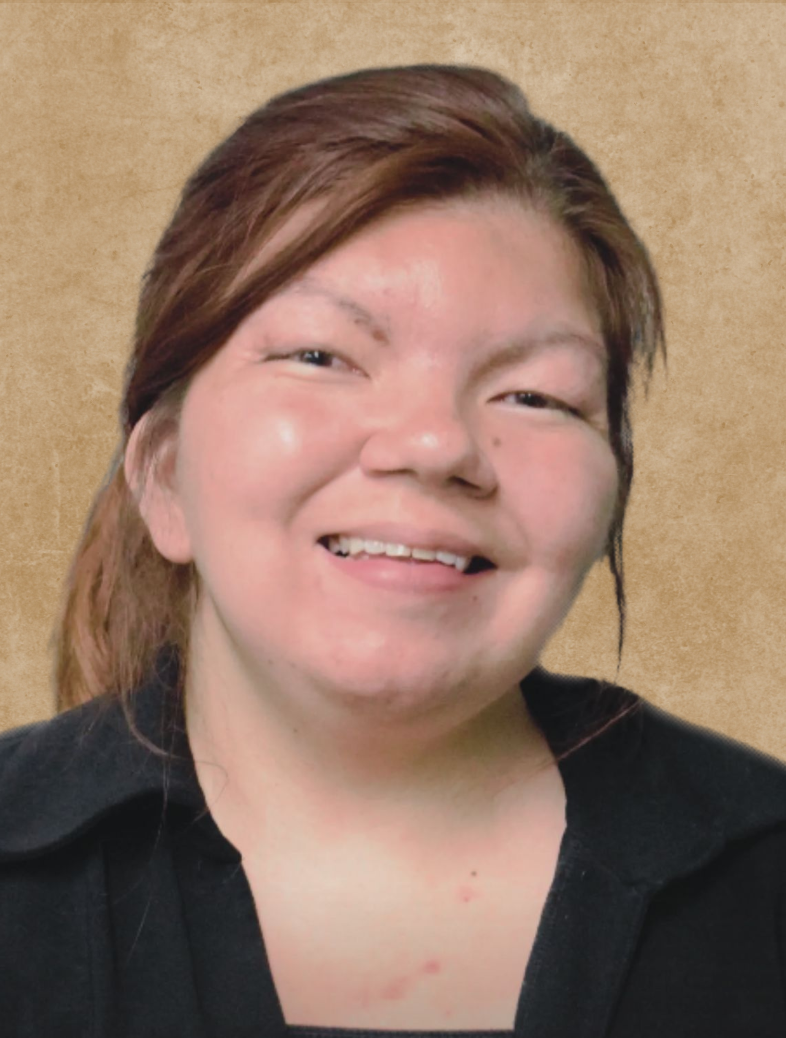
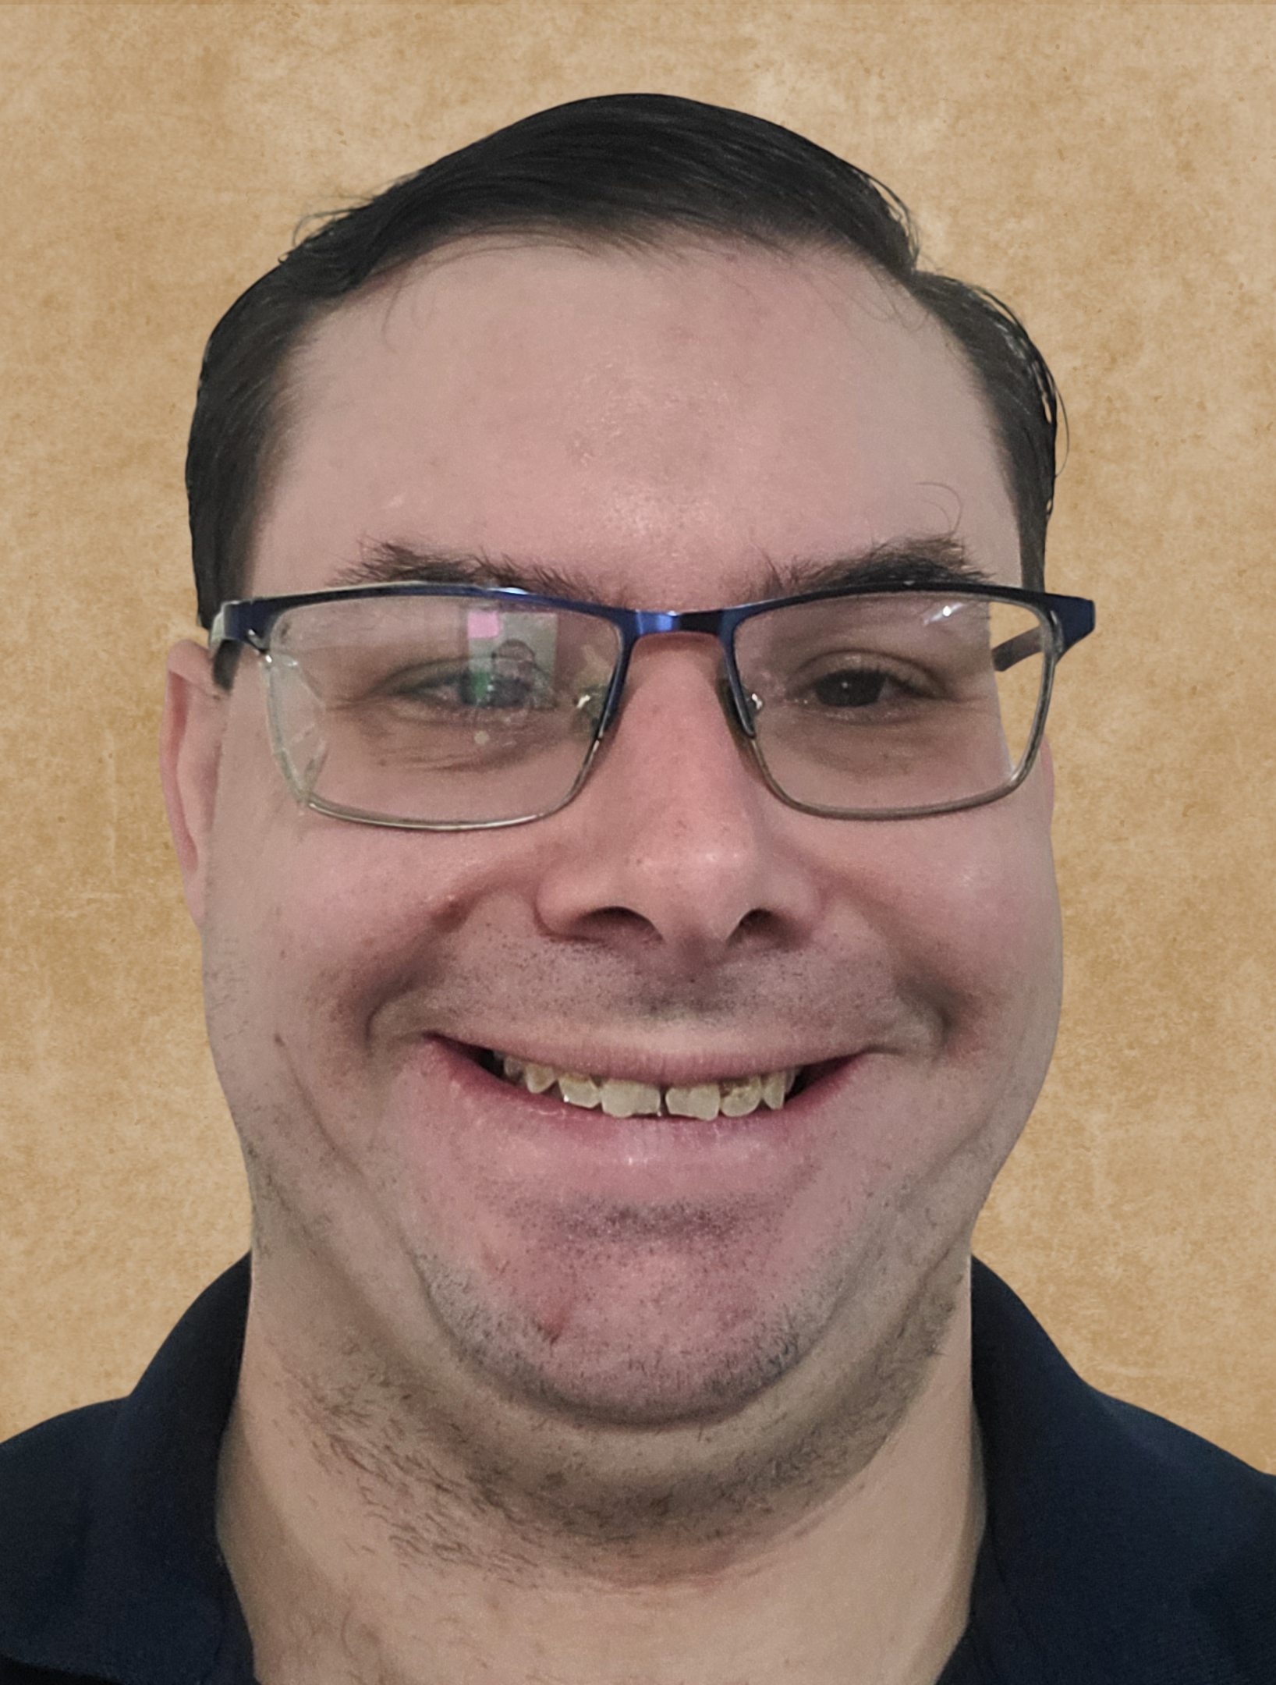
Meet the Speakers – Council of CLO
Farrah Sattaur
Keith Metcalf
Brianne Taggart
Niko Pupella

Slide 3
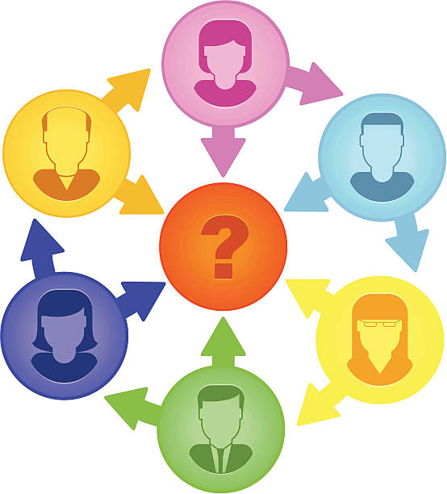
Icebreaker
Describe what belonging means to you in one word.
5 minutes
Notes:
Initial question: What does belonging mean to each of you?

Slide 4
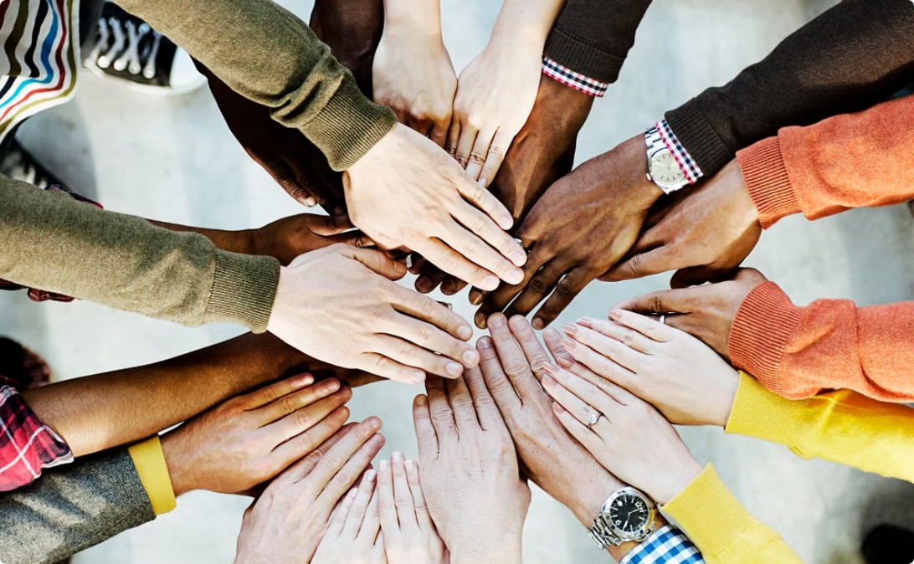
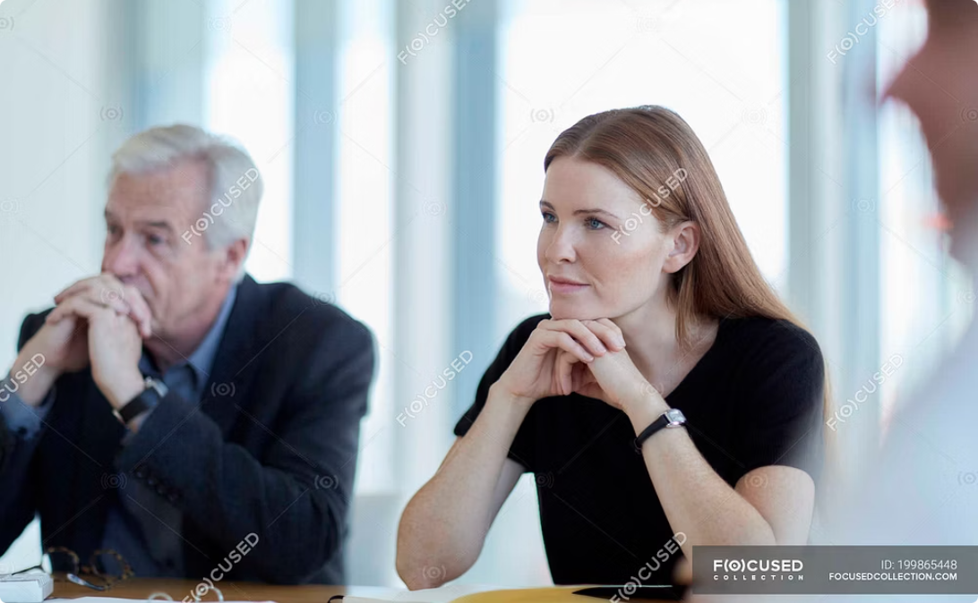
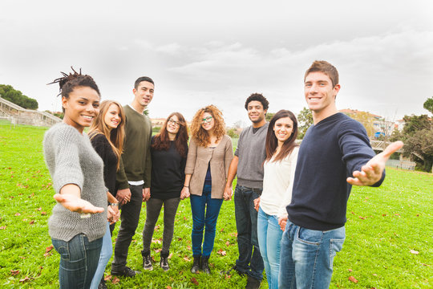
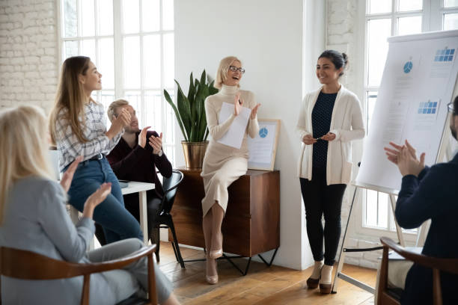

What is Belonging?
Acceptance
Inclusion
Respect

Slide 5
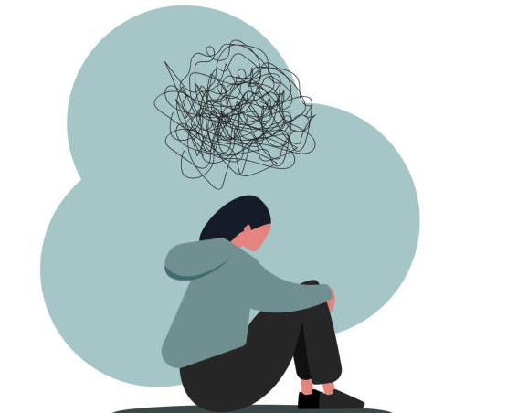
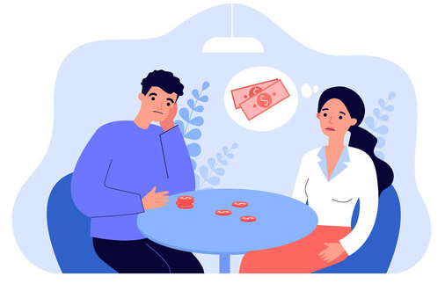
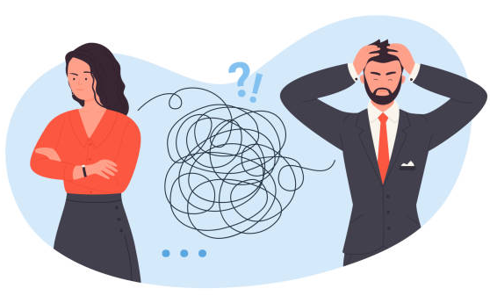
Barriers to Belonging
Lack of understanding
Impatience
Segregation in schools
Isolation
Poverty
Inaccessible workplaces
Not being heard or respected
What can we do to change this?
Notes:
What gets in the way?
Lack of understanding
Impatience
Segregation in schools
Isolation
Poverty
Inaccessible workplaces
Not being heard or respected

Slide 6


Listening to Our Voices
It’s important that people who have disabilities are listened to:
Talking at meetings and sharing stories.
Take the time to listen
Speaking up confidently
Ask for support if needed.
Support each other and build allies.
Being heard means being taken seriously—not just being present.
Notes:
People with disabilities must be part of decisions that affecttheir lives.
Speak up about what you want, need, and what matters toyou.
Use your voice—through speaking, writing, and telling yourstories.
Ask for support if needed.
Support each other and build allies.

Slide 7

Inclusive Meetings
Clear Communication
Meaningful Participation
Accessibility and Flexibility
Group Activity
Notes:
Inclusive Meeting?
Led by Brianne, Judy, and Dzidra
Clear Communication
– Use plain language
– Make space for all voices
– Repeat and check for understanding
Meaningful Participation
– Everyone’s input matters
– – Allow enough time for questions and answers
Next steps after the meeting include opinions from everyone
Accessibility & Flexibility
– Be mindful of physical, sensory, and communication needs
– Offer breaks, options, and supports
– Share details and documents in advance
Group Activity
To be co-designed with both groups — putting inclusion into practice!

Slide 8

Understanding Our Needs
Everyone's needs are different. For many, they need:
Safety
Support
Choices
Respect

Slide 9
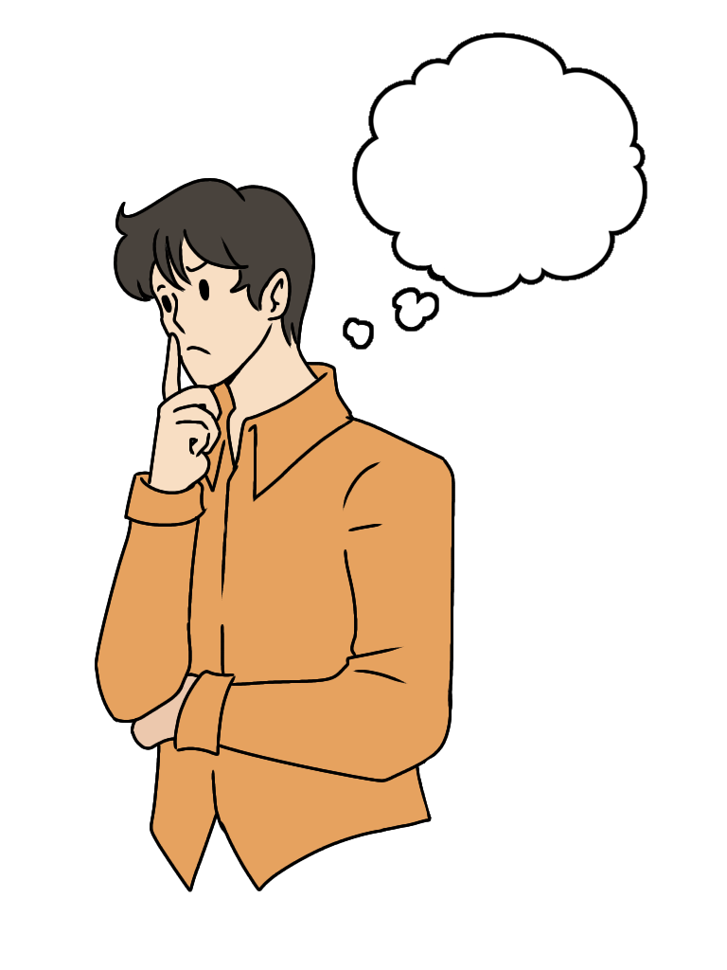
Here's the Challenge:
We need to consider the following:
Are we really meeting people’s needs?
Are we creating services and spaces that work for everyone?

Slide 10
Respecting Our Rights
Living in our Communities
Education
Right to live where we choose
Inclusive classrooms, proper support
Safety
Work
Protection from harm
Fair employment opportunities
Rights are not rewards - they belong to everyone.

Slide 11


Group Activity
Think of a word or a time when you felt like you belonged—and a time when you didn’t.
Belonging
Not Belonging
10 minutes

Slide 12
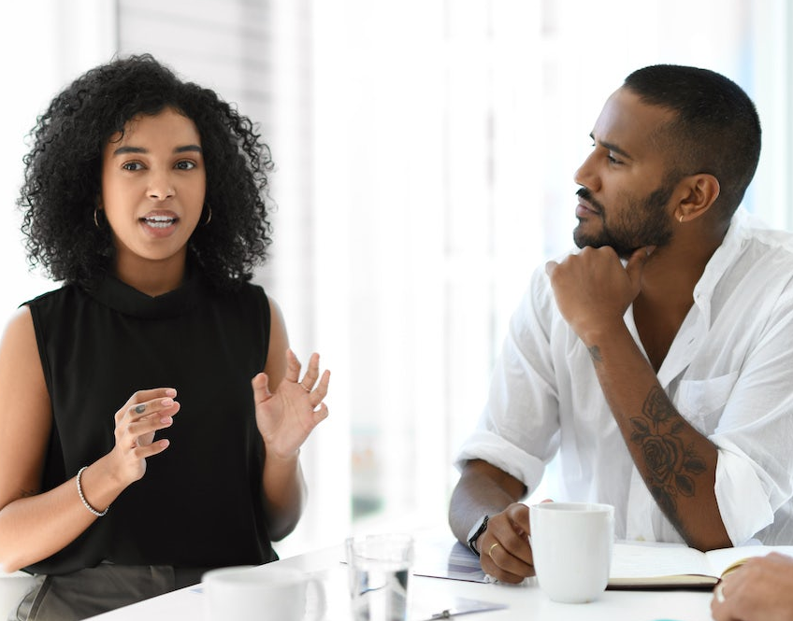
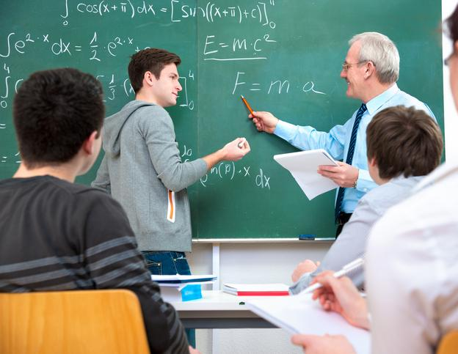
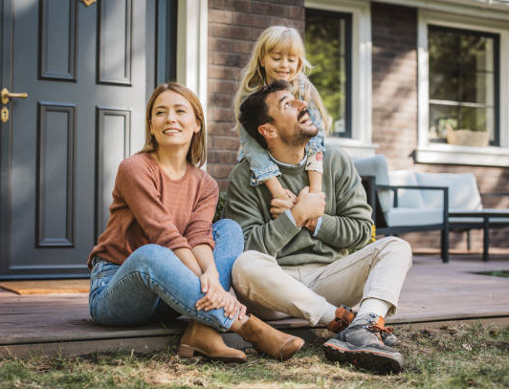
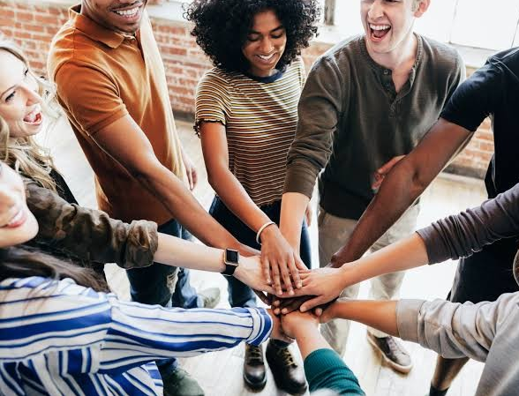
Recommendations
Listen to Lived Experiences
Inclusive Education For All
Better Access to Housing and Supports
Respect Rights in All Areas of Life
Notes:
Recommendations for Real Inclusion & Belonging
Listen to Lived Experience
Include self-advocates in all decisions—from programs to policy.
Inclusive Education for All
Every student belongs in regular classrooms with the right support.
Better Access to Housing & Supports
We need more affordable, accessible housing and services that respect choice and dignity.
Respect Rights in All Areas of Life
Put rights first—in safety, healthcare, education, and community living. No one should be excluded or mistreated.

Slide 13
Thank You!
We hope you enjoy the rest of the conference!

