Slide 1

Keeping EDIB Active in Today’s Climate
Notes:
Alison

Slide 2

Territorial Acknowledgement
Notes:
Alison

Slide 3

Who We Are
Notes:
Alison

Slide 4


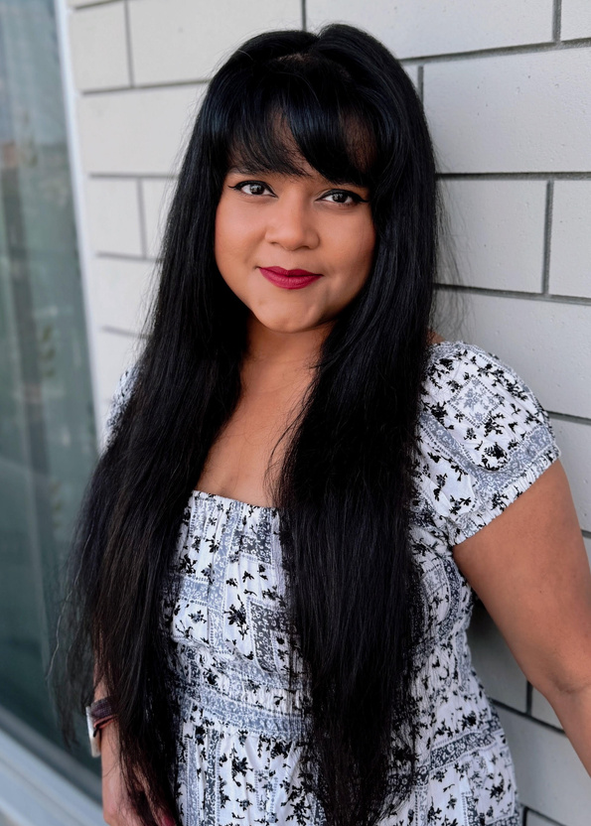
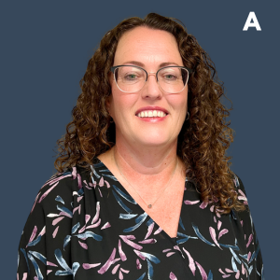
Meet the Speakers
Lee Smith
Mimi Mahmud
Tara Hyatt
Senior Manager of Anti-Racism, Equity, Diversity, and Inclusion Community Living Toronto
Equity Strategist
Extend-A-Family Waterloo Region
Quality Assurance, Integrity and Innovation Director
Parents for Community Living KW
Notes:
Alison

Slide 5

Embedding EDIB
Given the current social, economic, and political landscape, what compels organizations to embed EDIB into every layer of their structure and strategy?
Notes:
Alison

Slide 6




Why embedding EDIB matters
Reflects the communities we serve
Grounded in rights-based, community-centred principles
Builds trust, belonging, and accountability
Core organizational value; not an add-on
Notes:
All
Why now? Because the social, economic, and political landscape demands it. EDIB isn’t a side project—it’s a strategic imperative. Embedding it means moving beyond performative gestures to structural change. It’s about aligning our values with our operations, leadership, and service delivery. Organizations that fail to embed EDIB risk irrelevance and harm. Those that do build trust, resilience, and impact.
Embedding Equity, Diversity, Inclusion, and Belonging (EDIB) ensures our organizations reflect and respond to the communities we serve.
EDIB must be a core organizational value, not an optional initiative - integrated into every level of strategy, structure, and culture.
In today’s climate, where EDI efforts face scrutiny, backlash, and fatigue, grounding this work in rights-based and community-centered principles keeps it credible and relevant.
Sustained EDIB work is how we build belonging, accountability, and trust — for staff, the people we support, and the broader community.

Slide 7
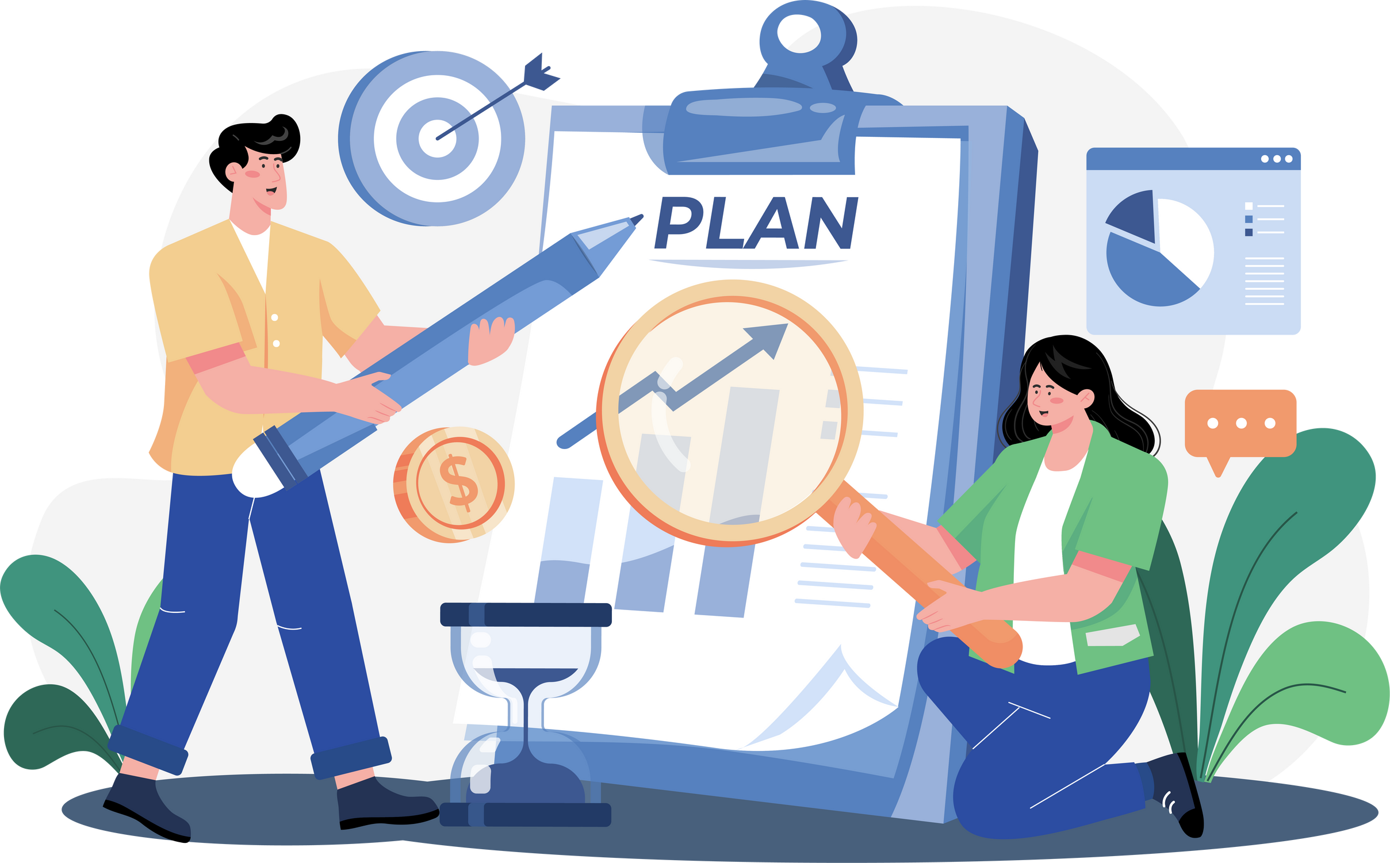
Strategic Integration and Practical Examples
How have your organizations embedded EDIB into everyday systems and practices – not just as a value, but as part of how the work gets done?
Notes:
Alison

Slide 8

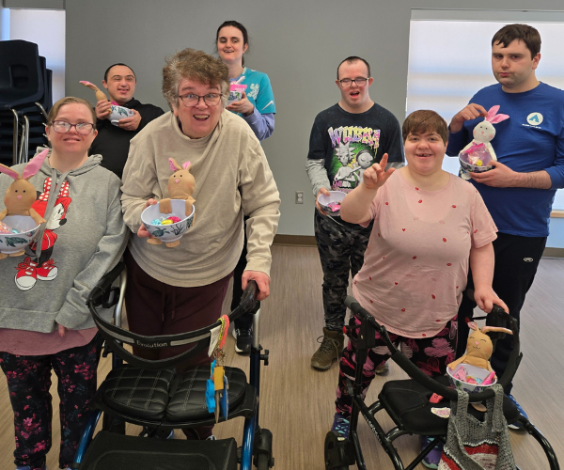
Embedding EDIB in practice - PCL’s Story
EDI is one of the 10 core competencies within the DSWI
Each program has a mentor championing EDI values
Woven into recruitment, mentorship, and daily practice
Builds inclusive leadership and stronger teams
Integrated EDI into HR practices
All HR and Operations policies reviewed through an anti-oppressive lens
Notes:
Tara

Slide 9
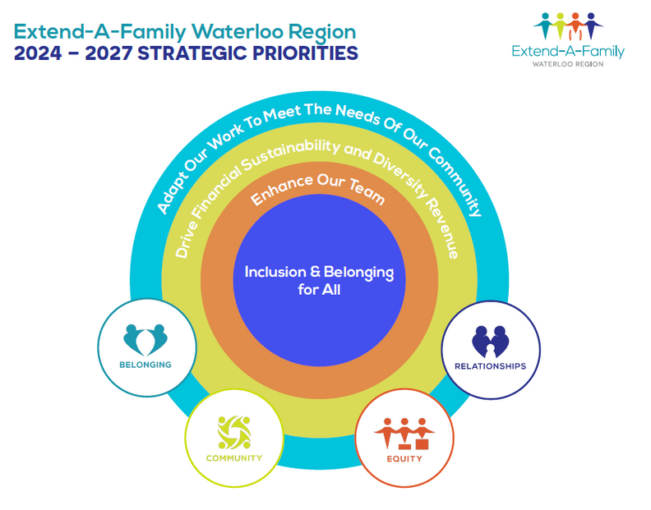
Strategic Integration and Leveraging Existing Frameworks at EAFWR
EDIB is a core priority in the 2024–2027 Strategic Plan
Working groups with embedded EDIB goals
Equity Strategist guiding implementation
Alignment across departments and initiatives
Using HR and wellness structures to support EDIB
Embedding equity into performance reviews, onboarding, and staff development
Notes:
Mimi
At EAFWR, EDIB is a strategic priority—not just a cultural value.
It’s embedded in the 2024–2027 Strategic Plan.
Working groups working on other strategic priorities have EDIB goals embedded into their action plans.
The Equity Strategist role guides implementation across departments.
We use existing HR and wellness structures to support EDIB outcomes, integrating it into performance reviews, onboarding, and staff development.

Slide 10
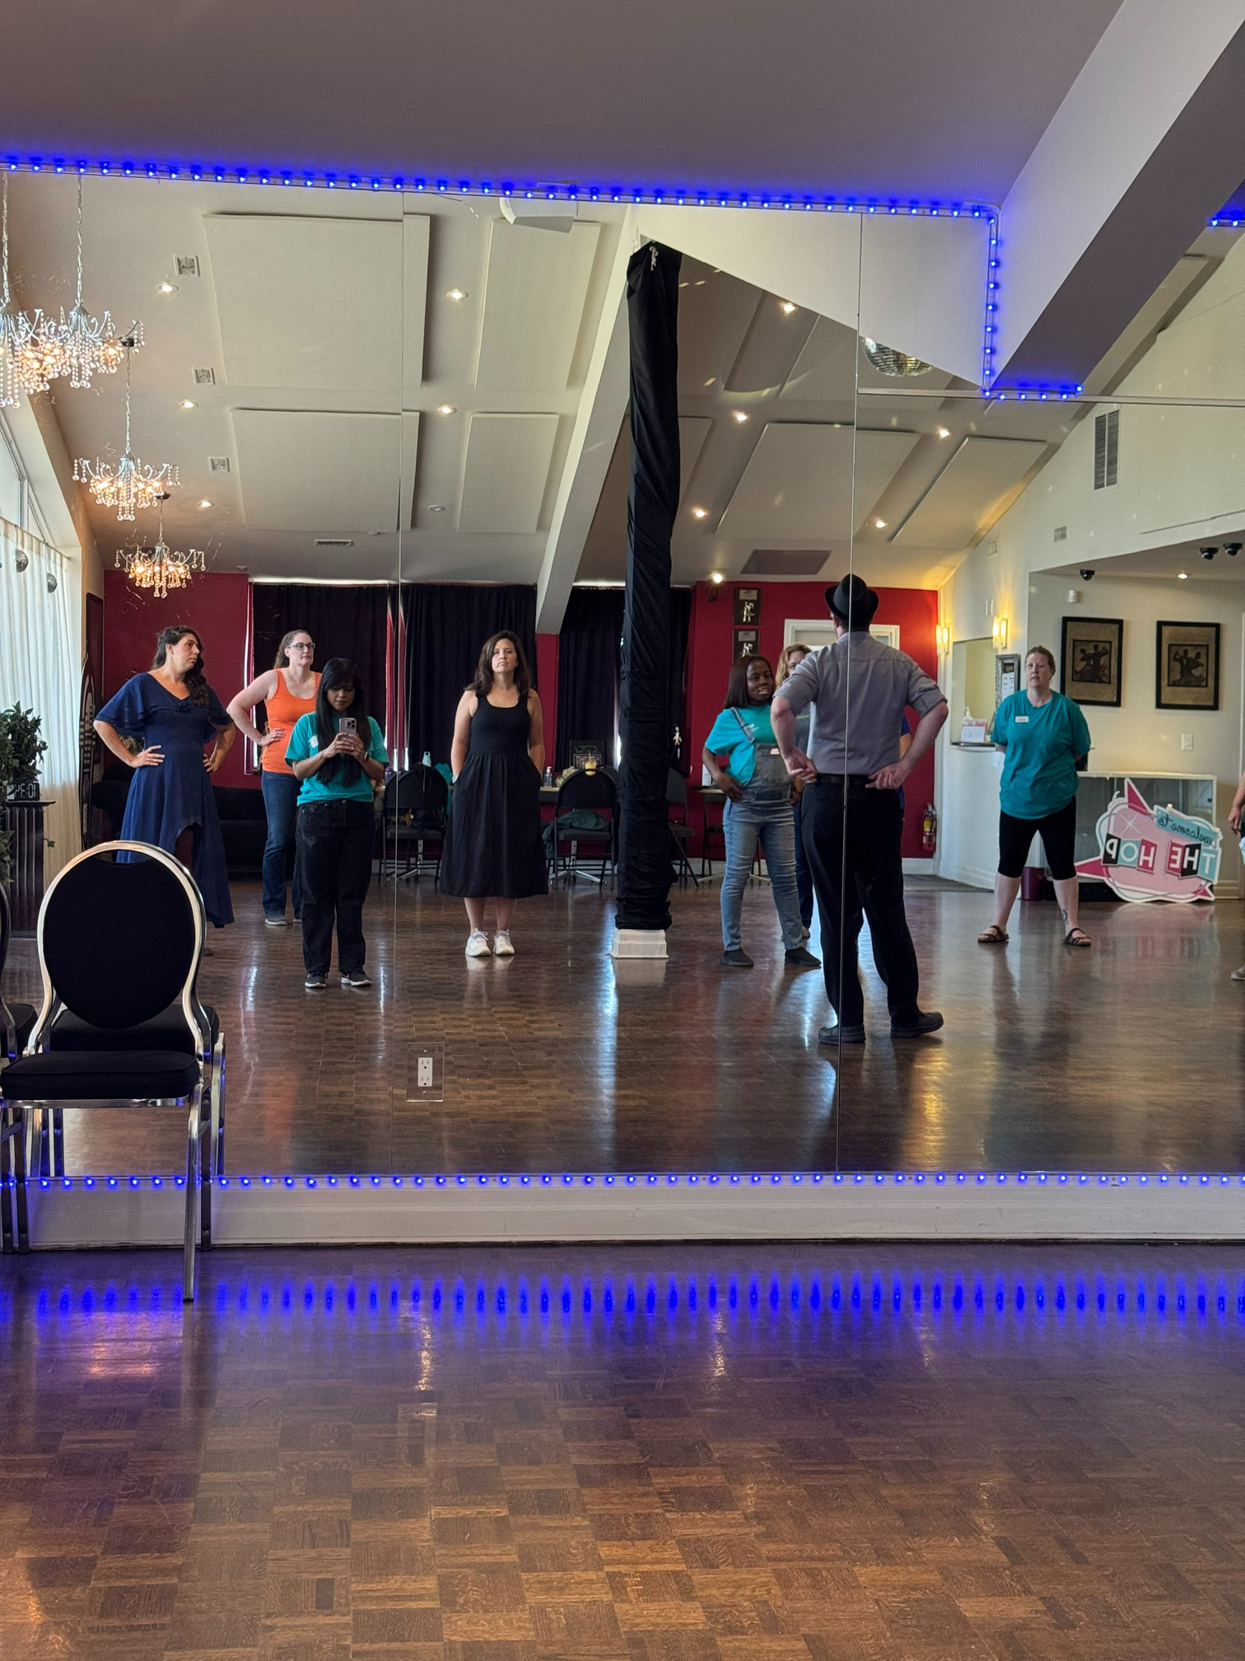

Practical Implementation at EAFWR
Days of Significance calendar
Holiday Substitution policies
Culturally inclusive wellness activities
Truth & Reconciliation Commitment Statement
Evolving Territorial Acknowledgments
Co-creating acknowledgments with Indigenous partners
Co-use of space for drum circles and cultural events
Incorporating Indigenous practices
Accessible resources for self-directed learning
Notes:
Mimi
This slide shows how EDIB shows tangible ways we honour diversity and foster belonging in practice at Extend A Family:
Days of Significance calendar to honor, acknowledge, or celebrate diverse cultural or rights-based occasions
Holiday substitution policies
Culturally inclusive wellness activities – henna and manicure to south Asian heritage month, movie screenings for Asian heritage month, office decorations for celebratory days
Truth & Reconciliation commitment statement published – created in consultation with indigenous community members.
Co-created territorial acknowledgments and shared cultural spaces – an indigenous community member using our space to host women’s drum circles

Slide 11

Sustaining The Work
What strategies or structures has your organization put in place to ensure EDIB efforts are sustained over time?
Notes:
Alison

Slide 12
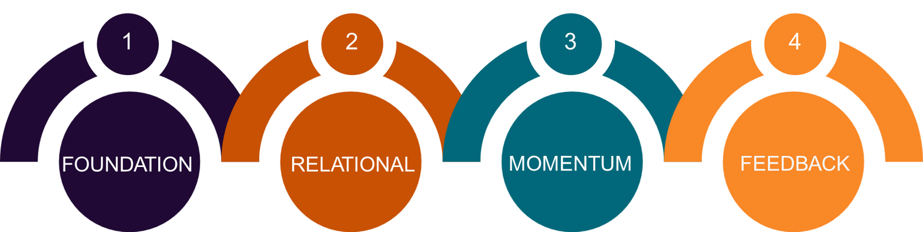
Committee Relational-Sustainability Model
Foundational Commitments
Relational Pillars
Sustaining Momentum
Feedback
Notes:
Lee

Slide 13
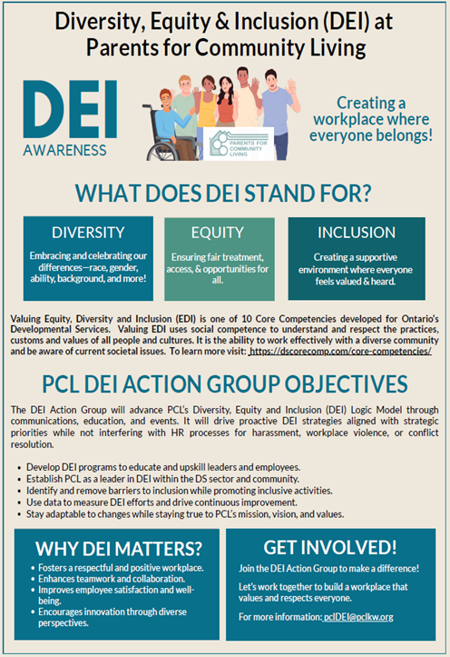
Collaborations
Building Sector Capacity Through Partnerships
PCL partners with EDI experts and community organizations across Ontario
Co-developed the EDI Logic Model with Wilfrid Laurier University; delivered training for leaders and DSPs
CEO and Board Members completed Capacity Canada’s Board Governance Boot Camp (2022)
PCL leaders contribute to the provincial EDI Community of Practice, Central Region ARDEI sub-committee, and REAL Xchange platform
Notes:
Tara

Slide 14

Resourcing Equity
Why EDIB Roles Matter
EDIB-specific roles remain rare in the sector
Dedicated roles signal long-term commitment and accountability
EDIB can be embedded without a formal role — but it takes intention
Tools and models for sector-wide adoption and sustainability
Notes:
Mimi
Dedicated EDIB roles are still rare. When they exist, they create accountability and capacity. But organizations can embed EDIB without a specialist if they intentionally distribute responsibilities and resource the work. “If you can fund a role, do it — it accelerates coordination and prevents extra burden on already marginalized staff. We need tools, models, and sector-wide strategies to make this work sustainable and scalable.

Slide 15
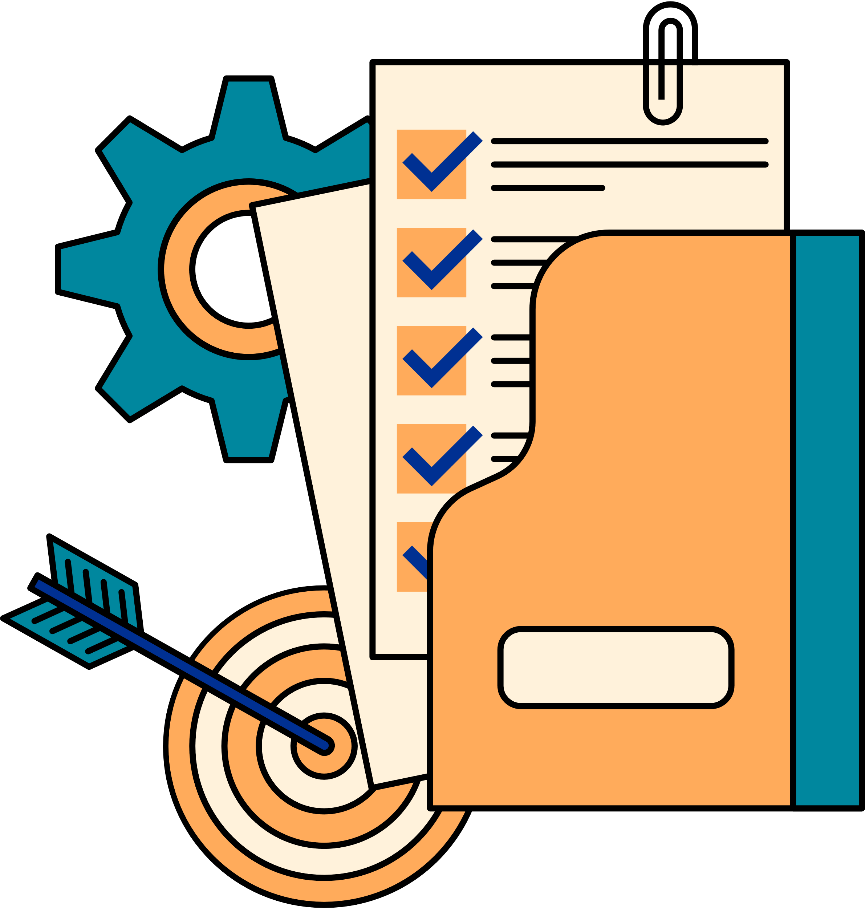
Measuring Impact
How does your organization measure the impact of EDIB initiatives and what outcomes have you seen so far?
Notes:
Alison

Slide 16
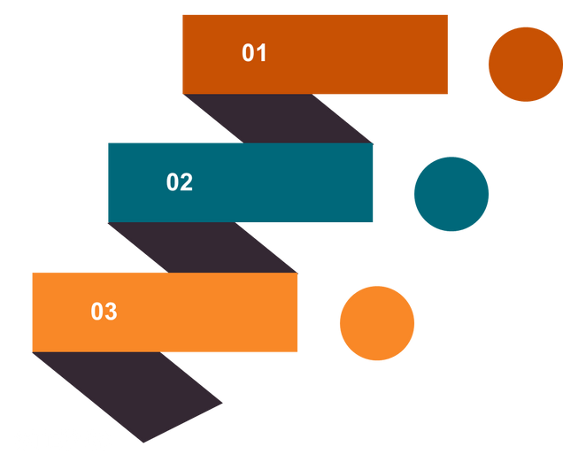
Measuring impact at CLTO
To assess the ongoing sustainability & effectiveness of our committee, we focus on three key areas:
Attendance: Tracking member engagement and consistency over time
Participation: Measuring active involvement in meetings, discussions, and learning opportunities
Project Completeness: Monitoring progress and successful delivery of strategic initiatives
Attendance
Participation
Project Completeness
Notes:
Lee

Slide 17
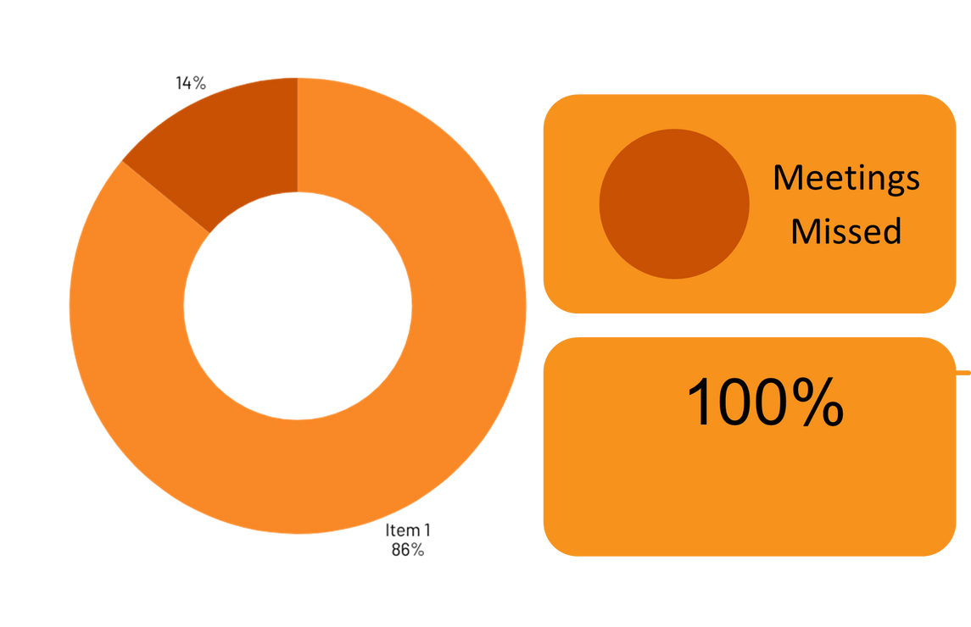
Participation: Engaging Members
100% participation in workshops and meetings
Only 2 meetings missed by 2 members in 7 months
Before framework: Over half missed 2+ meetings
2
86%
Meetings Attended
Participation in workshops/activities
Notes:
Lee

Slide 18
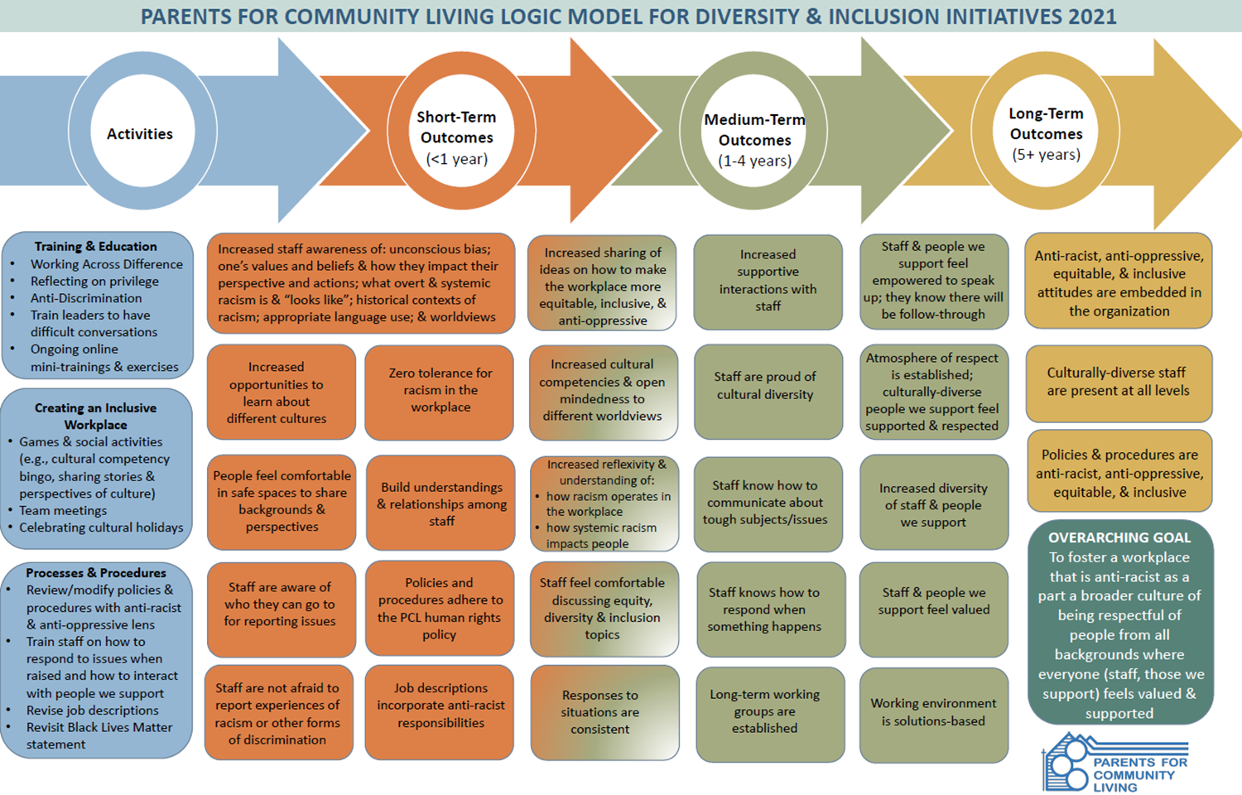
Measuring Impact at PCL
Notes:
Tara

Slide 19

This is how you change the world, the smallest circles first… That humble energy, the kind that says, ‘I will do what I can do right now in my own small way,’ creates a ripple effect on the world.
Richard Wagamese, One Drum: Stories and Ceremonies for a Planet
Notes:
Alison

Slide 20
Thank you
Speaker Contact:
Lee Smith, CLTO – lee.smith@cltoronto.ca
Mimi Mahmud, EAFWR – mimi.mahmud@eafwr.on.ca
Tara Hyatt, PCL-KW – tarah@pclkw.org

