Slide 1



EDI Unlocked: Reflect. Commit. Create Change.
Turning Awareness into Action

Slide 2

EDI Unlocked: Reflect. Commit. Create Change.
This session invites you to reflect on your current equity, diversity, and inclusion efforts and explore practical ways to contribute to more equitable spaces.

Slide 3

Where do you see EDI succeeding or stalling in your team, department, or organization?

Slide 4




Examples of Successes
Truth & Reconciliation
EDI Roles , Committees, and Employee Resource Groups
Pronoun Use in Signatures
New and updated policies

Slide 5


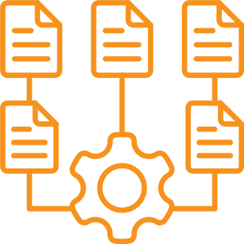

Examples of Stalls
It becomes a committee instead of culture
It focuses on statements instead of systems
It protects comfort over accountability
It centers intention over impact

Slide 6

Applied Reflection Exercises

Slide 7


For each scenario, reflect individually:
How does this show up in my environment?
What can I do within my own role to make a difference ?

Slide 8
Leadership Representation, Power, and Employee Relations
An organization with a highly racialized and diverse frontline workforce has a largely homogeneous senior leadership team. Employees have raised concerns about inequitable promotion pathways, lack of transparency in decision-making, and inconsistent responses to racial bias and discrimination complaints.
These dynamics have led to ongoing labour relations tensions, formal grievances, and decreased trust in leadership. While leaders state that decisions are merit-based, staff perceive systemic barriers and concentrated power within a small, demographically similar group.

Slide 9

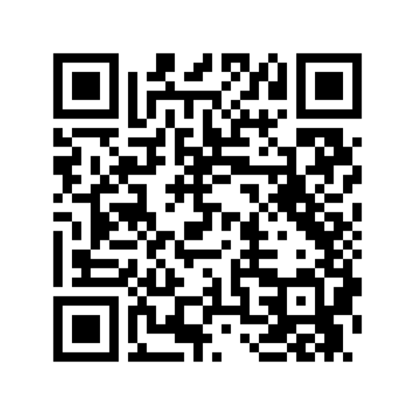
Tools & Resources
Organizational Self-Assessment Tool – Empower Simcoe
Diversity in Leadership – The 50-30 Challenge – Diversity Institute
Audit of Employment Equity Representation in Recruitment (Gov. of Canada)
Conflict Resolution and Trust Building Policy – Surrey Place (Feb 5, 2024)
Diversity and Inclusion Consultants – United Way Greater Toronto (May 11, 2023)

Slide 10
Good Intentions, Harmful Impact
A team is informed that their supervisor will be away and coverage has been arranged. Shortly after, they learn a different manager will be covering and may conduct a site visit the next day.
Historically, coverage meant being available for urgent matters — not additional oversight. No communication outlining a shift in expectations was shared.
In a home where most staff are Black and racialized, the sudden visit feels like heightened scrutiny rather than support.
Even if the intent is neutral, the impact may include anxiety, reduced psychological safety, and feelings of being watched or having competence questioned — shaped by broader histories of workplace bias and unequal surveillance.

Slide 11
Tools & Resources
Becoming Trustworthy White Allies – Melanie S. Morrison
Communication Guidelines for a Brave Space – Alliance of White Anti-Racists Everywhere
7 Ways You’re Committing Microaggressions and How to do Better! – Salam Debs
Inclusive Workplace Guide: Creating a Safe Space for Dialogue on Anti-Racism – Canadian Centre for Diversity and Inclusion
Calling In: How to Start Making Change with Those You’d Rather Cancel – Dr. Loretta Ross

Slide 12
Reflection
Responsibility
Equity work requires asking:
What’s within my control?
Where do I hold influence?
What am I tolerating that I could challenge?
What am I modelling?

Slide 13
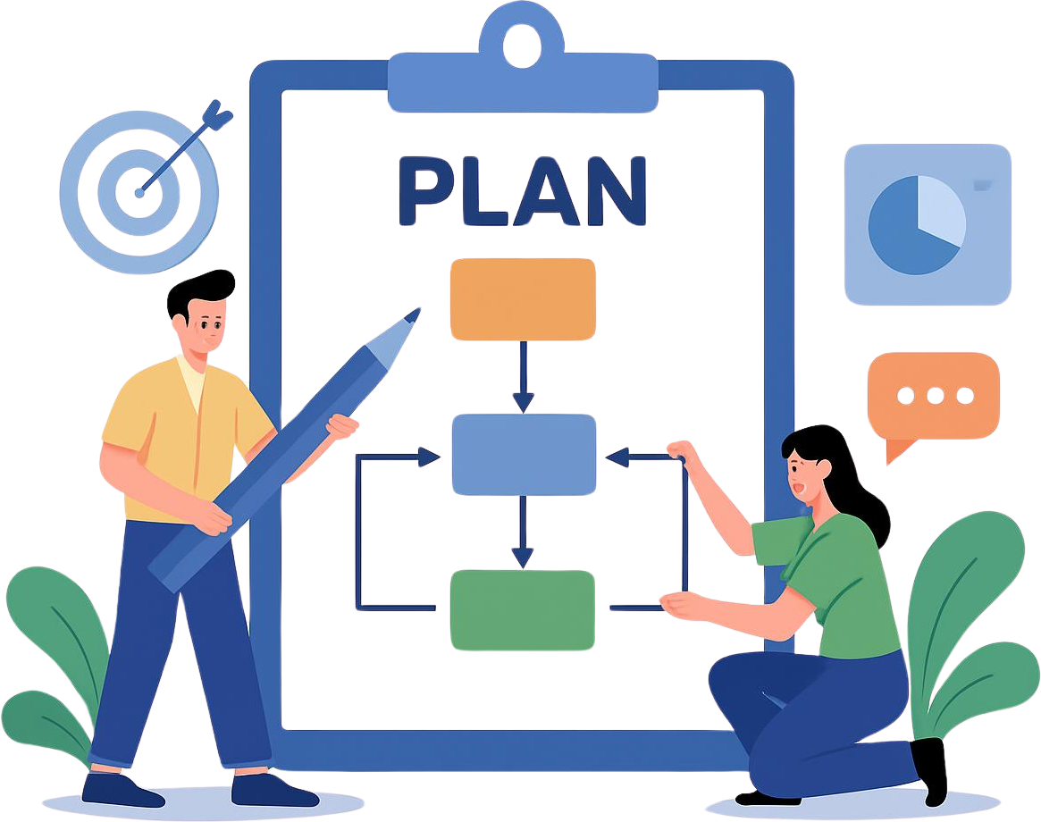
Action Mapping Framework

Slide 14



3-Level Action Lens:
Individual
Relational
Structural
Personal behaviours or habits to shift
Team interactions or norms to influence.
Processes, policies, or systems to impact.

Slide 15



My Action Blueprint - CLTO
Commit to visibly practicing one Action for Happiness behaviour weekly
Individual
Each team to create meeting norms that promote inclusion and psychological safety - ex. celebration segment, step up/step back, creative circle
Relational
Drawing on insights from our 2025 Equity Census, develop inclusive statutory holiday policies that reflect the diversity of our workforce
Structural

Slide 16
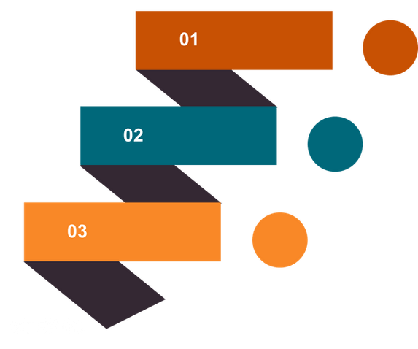
Your EDI Action Blueprint
Write down one concrete action per level for your own organization:
Individual: Personal behaviours or habits
Relational: Team interactions or norms influence
Structural: Processes, policies, or systems to impact
Individual
Relational
Structural

Slide 17

Public Commitment
Using your commitment card, write down one action you will begin to implement within your space

Slide 18


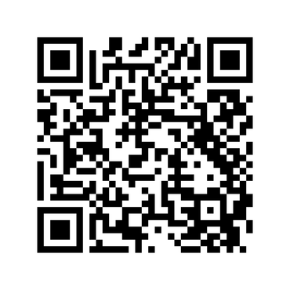
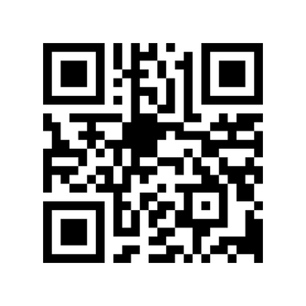
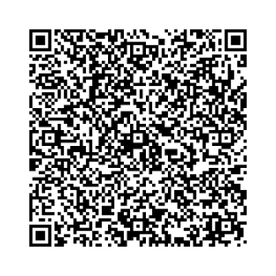
Resources for You
2

Slide 19
Thank you
Facilitator’s Contact:
Lee Smith – lee.smith@cltoronto.ca
Alison McLean - alisonmclean@sisonke.ca

