Slide 1




Module 1 of 4
Understanding Intellectual and Developmental Disabilities (IDD) and Dual Diagnosis
Notes:
Welcome to Module 1: Understanding Intellectual and Developmental Disabilities (IDD) and Dual Diagnosis. Thank you for joining us in this education series.

Slide 2

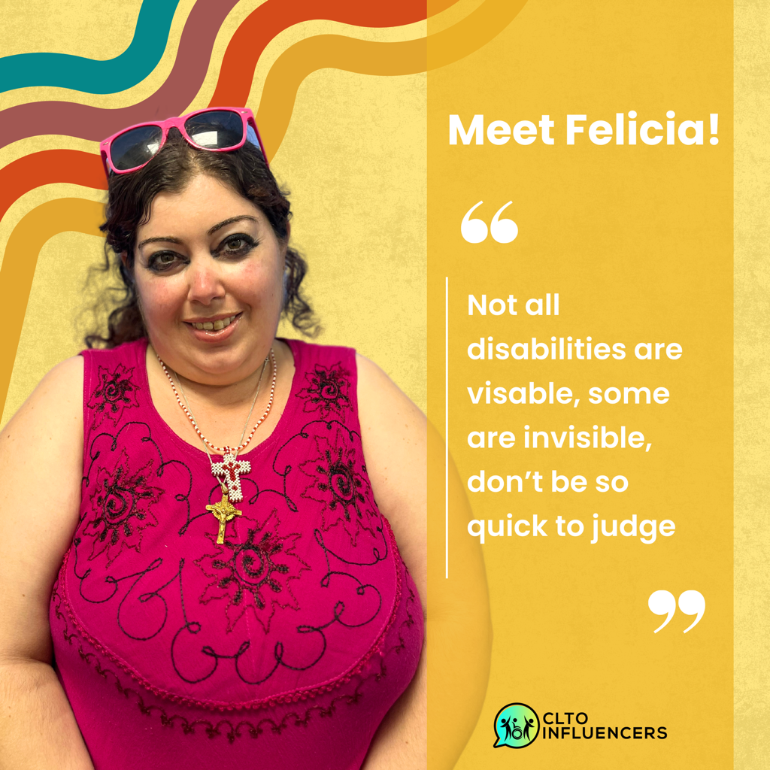

Meet the Presenters
Whitney Faragher, B.A., RPN
Felicia
Notes:
I will take a minute now to introduce myself Whitney Faragher as one of the presenters for this module. I am a full time Health Care Clinical Consultant with the Community Network of Specialized Care in Central East. I come from an extensive background in Community Nursing with a focus on advocating and educating in the developmental sector. I would also like to introduce Felicia who I want to thank for joining me in creating this module. Felicia is currently involved as a Community Living Toronto Influencer, and has been a part of the original self-advocates through Community Living Toronto. She joins us with invaluable lived experience perspectives throughout this module.

Slide 3
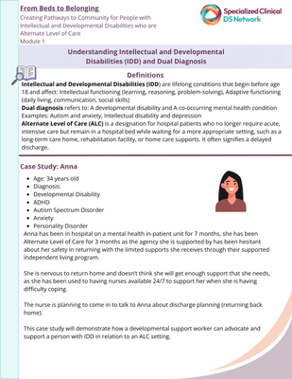

Find the worksheet in the module online
Preparing for Module 1
Indicates a definition
Indicates a link to an activity on your worksheet
Highlights a relevant related resource. Check the resources listed on worksheet for the module.
Notes:
Before we get started I would like to review some key points that will be helpful in your journey of navigating this module and will support your learning throughout our time together. You may want to find the Module 1 Worksheet that I will refer to which is located on the online platform. This worksheet is intended to encourage learning, reflecting and applying the content to the work that you do each day. You will also notice symbols throughout the module that will be used to identify key components such as definitions, links and important resources.

Slide 4

Module 1: Learning Outcomes
Understand Intellectual and Developmental Disabilities (IDD) and
Alternate Level of Care (ALC)
Explain Dual Diagnosis in the Developmental Services Sector
Learn about the complexity of co-occurring conditions and the revelant impact
Describe the importance of person-centered approaches
Identify key supports and resources available
Notes:
Looking at our learning outcomes for today, I want to acknowledge that many of you are supporting individuals with a developmental and/or intellectual disability so we will define the diagnostic criteria of a developmental and intellectual disability and keep in mind the information and how we might educate others when advocating for the people we support. I want to also note that throughout the module we may refer to this as IDD. We will also define Alternate Level of Care and Dual Diagnosis and highlight statistics that help us to better identify the increased risk the people we support. Understand why it’s important to learn about this and the complexities of some of the co-occurring conditions and what this means. In addition, there will be key takeaways, tools and resources provided to support person centred care planning and approaches and to also understand the importance of incorporating support strategies.

Slide 5



What is an Intellectual and Developmental Disability?
Notes:
I will now review the definition of intellectual and developmental disabilities also referred to commonly as IDD. For this module we will review the definitions and look at the diagnostic criteria as well as the importance, Many of you supporting this population may know the definition of the diagnosis already however we felt it was important to incorporate as a tool to help others also understand what a developmental and/or intellectual disability means. We can become champions together.

Slide 6
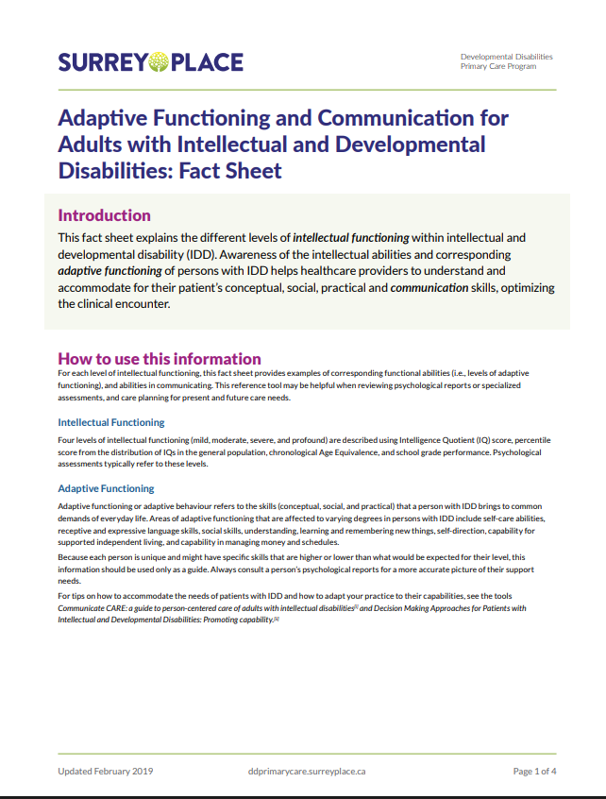


What is an Intellectual and Developmental Disability?
Intellectual and Developmental Disabilities (IDD)
Lifelong conditions that begin before age 18 and affect:
  🧩 Intellectual functioning (learning, reasoning, problem-solving)
  🏠 Adaptive functioning (daily living, communication, social skills)
Between 1 and 3 out of 100 people have an intellectual or developmental disability
Adaptive Functioning and Communication in Adults with Intellectual and Developmental Disabilities:
Fact Sheet. Edwards, B. & Temple, V., Developmental Disabilities Primary Care Program of Surrey Place, Toronto, 2019
Notes:
Intellectual and Developmental Disabilities (IDD) are lifelong conditions that begin before age 18 and affect: Intellectual functioning (learning, reasoning, problem-solving) Adaptive functioning (daily living, communication, social skills). If you wish to learn some more in-depth knowledge, please refer to the fact sheet provided below which will give a comprehensive overview of adaptive functioning and communication in adults with IDD particularly related to primary care. This can be a really important resource to use when supporting individuals with an IDD and helping to educate others on what this might mean, especially when they might not have any prior knowledge on the subject or are a primary care practitioner who can benefit from understanding the developmental diagnosis and how this might relate to their care planning. In regard to the importance of reviewing these definitions, I have noted that between 1-3 out of 100 people have been diagnosed with a developmental or intellectual disability so this makes up a significant part of our population. Some diagnoses can also not be identified physically which is important to understand as well. I encourage you to learn more by taking a look at the adaptive functioning fact sheet provided by the DD primary care guidelines through Surrey Place, which can also be a helpful tool in educating and supporting.

Slide 7
IDD Examples
  Autism Spectrum Disorder
  Epilepsy
  Intellectual Disability
  Down Syndrome
  Fragile X Syndrome
  Cerebral Palsy
  Attention Deficit Hyperactivity Disorder
  Fetal Alcohol Syndrome
Notes:
Some examples of developmental disabilities are; Autism Spectrum Disorder, Epilepsy, Intellectual disability, Down syndrome, Fragile X syndrome, Cerebral Palsy, Attention Deficit Hyperactivity Disorder, Fetal Alcohol Syndrome. It is important to note this is by no means an exhaustive list but can give an idea on how diverse the diagnosis can be under the same umbrella. This can help us to understand the diversity and how each diagnosis may mean different support needs.

Slide 8
Diagnostic Criteria
Clinical Assessment by Qualified Professionals
Diagnosis is completed by regulated professionals such as:
    Psychologists
    Psychiatrists
    Developmental pediatricians
They follow standardized frameworks like the Diagnostic and Statistical Manual of Mental Disorders (DSM-5-TR).
American Association on Intellectual and Developmental Disabilities. (n.d.). Definition of intellectual disability. https://www.aaidd.org/intellectual-disability/definition
Notes:
a diagnosis occurs typically with a combination of assessments completed by qualified practitioners comprised of a psychiatrist, psychologist, and developmental pediatricians. They follow standardized frameworks and will include assessment of intellectual functioning for example with a standardized IQ testing, assessment of adaptive functioning using common tools to evaluate how the person functions in daily life. After diagnosis, clinicians assess:
Level of support required
Functional limitations
Environmental needs
In Ontario, this feeds into eligibility for services through Developmental Services Ontario (DSO), based on legislation (SIPDDA).

Slide 9

What Could This Look Like in
Real Life Situations?
Needs support with:
  Cooking
  Hygiene
  Managing money
May have:
  Communication differences (verbal or non-verbal)
  different ways to receive information
May require:
  Structured routines
  Consistent environment
Often can benefit from:
  Trained staff
  Supportive housing
Notes:
A person with a developmental and/or intellectual disability may need support with: Cooking, hygiene, or managing money. They may have: Communication differences (verbal or non-verbal), they may also prefer to receive information in certain ways for example written, or with a support person present, with pictures, are just some examples. They may require: Structured routines and consistent environment Often benefits from: Trained staff or supportive housing. This list can be different for each unique individual, sometimes individuals with IDD may have all the support needs listed, some may have none, and some may have some. Which is why individualized support can be so crucial.

Slide 10

Let’s Now Hear Felicia’s Perspective
Notes:
We now have the opportunity to hear from Felicia our wonderful person with lived experience to explain what the definition of IDD means to her.

Slide 11
In Summary
People with IDD may have:
  Complex needs
  Communication barriers
  Co-occurring mental health conditions
These factors can impact:
  Care planning
  Discharge readiness
  Risk of hospitalization
Notes:
In summary, why it’s important to acknowledge these different diagnosis and understand the complexities and depths of what it means is helpful for us to understand that persons with IDD may have complex needs, they may have communication barriers and also have co-occurring mental health conditions which can impact how we consider care planning, and recognized their increased risk for physical and mental health diagnosis and subsequently hospitalizations.

Slide 12

Dual Diagnosis in the Developmental Services Sector
Notes:
Next we will explore Dual Diagnosis within the developmental sector

Slide 13

Reflection
What do you think of when you hear dual diagnosis?
Notes:
Now that we have an understanding of what a Developmental disability is, I would like you to take a minute to pause and think for a moment on what you think of when you hear Dual Diagnosis.

Slide 14
What is a Dual Diagnosis?
According to the Centre for Addiction and Mental Health, Dual Diagnosis refers to:
A developmental disability A co-occurring mental health condition
Intellectual Disability
Depression
Autism Anxiety
Notes:
for the purpose of this education series, we will be utilizing the definition According to the Centre for Addiction and Mental Health: Dual diagnosis refers to: A developmental disability and A co-occurring mental health condition Examples: Autism and anxiety, Intellectual disability and depression. It is important to note that the World Health Organization has a different definition for dual diagnosis and that is a mental health condition and a substance use disorder. So, this can be very relevant as you support persons with a dual diagnosis to ensure consistent messaging so that care planning is done through the same lens and all members of the care team are of the same understanding.

Slide 15
Key Considerations
Greater Risk
  Conditions are often interconnected
  Diagnosis may be complex
  Specialized supports are often required
Adults with IDD are at greater risk of developing psychiatric disorders
Centre for Addiction and Mental Health. (n.d.). Diagnosing psychiatric disorders in people with IDD.
Notes:
Again, we want to circle back to why it is important to understand and define dual diagnosis and according to a study completed by Friedman and Shedlack in 2011 this is because Individuals with IDD are 4 to 5 times more likely to also have a psychiatric diagnosis than the general population (Friedman & Shedlack, 2011). Which can mean that situations can often be complex, there may sometimes be more than 2 diagnosis and often times quite a few diagnosis, this can create complexities within diagnoses itself, and we may have to identify specialized supports to meet the needs of the complex diagnoses.

Slide 16
As a Result...
Adults with IDD may have:
Worse mental and physical health than adults without these disabilities
Health problems that can lead to
    The use of multiple medications - some with serious side effects
    Frequent doctor visits and visits to emergency departments
Potential repeated visits to hospitals, and unnecessarily long hospital admissions.
Notes:
As a result of these complexities adults with IDD have worse mental and physical health than adults without these disabilities and their health problems can lead to the use of many medications, some with very serious side effects, lots of doctor visits, as well as visits to the emergency departments and even hospitalizations for some people. There can be an increase risk repeated visits to hospitals, and unnecessarily long hospital admissions.

Slide 17
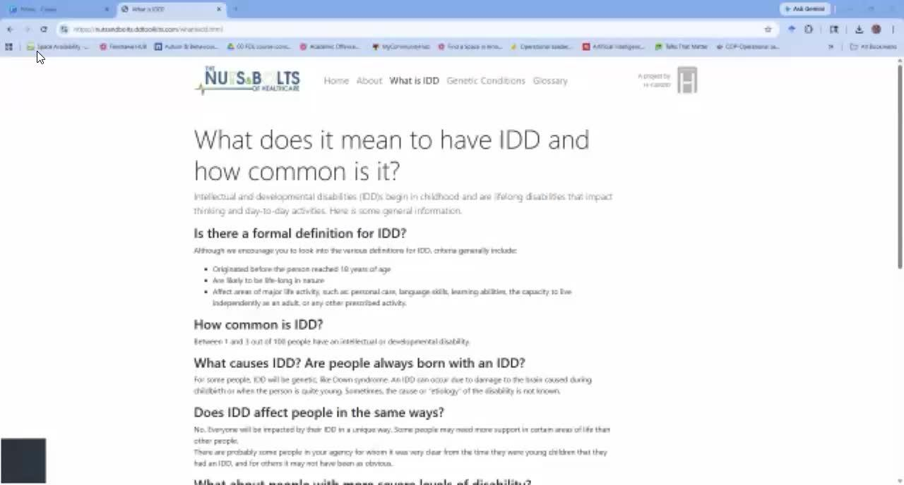
How to Support?
A toolkit “ The Nuts and Bolts of Healthcare ” has been prepared by the
H-CARDD team in partnership with Vita Community Living Services (CLS).
H-CARDD is a research program based in Ontario, Canada and has been studying health care outcomes for adults with intellectual and developmental disabilities (IDD).
It has both information for support professionals and tools that can be helpful for the people they support.
https://nutsandbolts.ddtoolkits.com/about.html
Notes:
There are many things that can be done to improve the health of adults with IDD and direct support professionals can play a very important role. But to make changes, direct support professionals need information about how to manage common health issues, how to talk health issues and health care, and how to navigate the health care system. A toolkit “ the nuts and. bolts of healthcare ” has been prepared by the H-CARDD team in partnership with Vita Community Living Services (CLS). H-CARDD is a research program based in Ontario, Canada, and has been studying health care outcomes of adults with intellectual and developmental disabilities (IDD) has both information for support professionals but also tools that can be helpful for the people they support. You can refer to the resources section on your REAL exchange platform for this module, and I encourage you to take a deep look into this toolkit that has a wealth of knowledge and concrete resources that support a fulsome approach to improve health outcomes for adults with IDD. This is a really great toolkit to share with medical professionals too and use as an advocacy tool when supporting the persons that you work with.

Slide 18
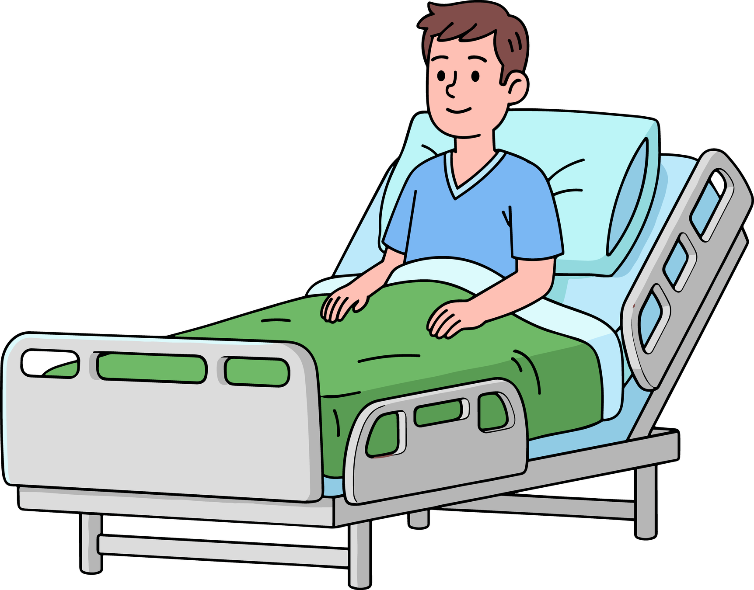
What is Alternate Level of Care?
Alternate Level of Care (ALC) is a designation for hospital patients who no longer require acute, intensive care but remain in a hospital bed while waiting for a more appropriate setting.
Examples of ALC are:
  Long-term care home
  Rehabilitation facility
  Home care supports
It often signifies a delayed discharge.
Notes:
Now that we have highlighted the increased risk that persons with an IDD have of having a dual diagnosis as well as being hospitalized and receiving unnecessarily long hospital admissions. We look to identify what Alternate Level of Care is. Alternate Level of Care (ALC) is a designation for hospital patients who no longer require acute, intensive care but remain in a hospital bed while waiting for a more appropriate setting, such as a long-term care home, rehabilitation facility, or home care supports. For example someone who may have been living in their own apartment and experienced a seizure that cause significant injury resulting in mobility changes and increased support needs, it may no longer be safe for them to return to their apartment as it no longer meets their environmental or support needs and they require additional support and a change in environment they may be identified as needing a supported living home or long term care. This often signifies a delayed discharge as a result because often these resources are not readily available and long wait lists exist. This can be in relation to a general hospital, a mental health hospital or other health care settings.

Slide 19
Complexity of Co-occurring Conditions and Relevant Impact

Slide 20
People with
Developmental Disabilities are:
6.5×
6.5× more likely to be ALC
Delayed discharge due to lack of supports and housing
Ontario Ombudsman. (2025). Lost in transition: Investigation into the inappropriate hospitalization of adults with developmental disabilities. Toronto, ON: Ombudsman Ontario.
Notes:
The Ontario Ombudsman report cited below identified that Individuals with developmental disabilities are: 6.5× more likely to be ALC and experience delayed discharge due to lack of supports and housing.

Slide 21
People who have IDD are at higher risk of ALC designation
~28% of long-stay patients had developmental disabilities
Why?
People with IDD are more likely to become ALC not because of their disability alone, but because systems are not designed to support complex, lifelong needs across intersecting areas like health, housing, and social care.
Of the 1,466 patients in Ontario mental health beds for over a year on September 30, 2023, 322 were people with IDD.
Compared with inpatients without IDD, a higher proportion of those with IDD were younger and had a psychotic disorder. Almost 40 per cent of these people were autistic.
Patients with IDD were more likely to be physically restrained or experience seclusion in hospital, and only 5% were in specialized units for people with IDD. The remainder were in other psychiatric units where providers were not trained to work with them.
More than half of long-stay patients with IDD lacked social or familial connections to support their discharge from hospital.
Notes:
Now that we have learned persons who have IDD are at higher risk of ALC designation
People with IDD are more likely to become ALC not because of their disability alone, but because systems are not designed to support complex, lifelong needs across health, housing, and social care.
Taking a look at the research cited below,
Of the 1,466 patients in Ontario mental health beds for over a year on September 30, 2023, 322 were people with IDD.
Compared with inpatients without IDD, a higher proportion of those with IDD were younger and had a psychotic disorder. Almost 40 per cent of these individuals were autistic.
Patients with IDD were more likely to be physically restrained or experience seclusion in hospital, and only five per cent were in specialized units for people with IDD. The remainder were in other psychiatric units where providers were not trained to work with them.
More than half of long-stay patients with IDD lacked social or familial connections to support their discharge from hospital.
~28% of long-stay patients had developmental disabilities

Slide 22
Key Considerations for Supporting People with a Dual Diagnosis who are ALC
People with dual diagnosis may experience:
  Communication challenges
  Behavioral challenges
  Mental health symptoms
  Difficulty accessing services
Why this matters:
  Needs may be misunderstood
  Misdiagnosis can occur
  Supports must be individualized
  Developmental support professionals may need to advocate and educate primary health care staff
Notes:
Here we’ve outlined some key considerations to get you thinking about supporting persons with IDD through ALC and discharge planning. This helps us to understand what role we can play when supporting someone in a hospital setting. This may include advocating, we will highlight tools that have been developed to support this, This may also include educating - educating hospital on IDD and different support, communication needs etc.. We might support behaviour strategies and helping them to understand what their support needs look like. This is crucial to support thoughtful care planning.

Slide 23
Advocate and Educate
“They can be really helpful, especially when you don’t know what to say or you have not a lot of time with your doctor"
Use tools to support persons with intellectual and developmental disability in a hospital setting
Collaborate with both developmental and health supports
Use person-centered approaches
https://ddprimarycare.surreyplace.ca/tools-2/general-health/
Notes:
You may now want to refer to your resources DD primary care guidelines; These tools were developed to support persons with IDD in health care systems. These tools are extremely helpful in preparing persons we support to have conversations with health care professionals, to have their specific support needs met and to help advocate and educate with supporting persons with IDD. I encourage you to spend some time looking through this resources, they have been reviewed by Felicia and she reports “they can be really helpful, especially when you don’t know what to say or you have not a lot of time with your doctor”
Another key component of advocating and educating is to ensure everyone is on the same page and working together towards a common goal. Including regular case conferencing including; the person supported, health supports and developmental sector supports can be essential to ensure collaboration and person centred approaches are being achieved.

Slide 24
The Importance of Person-Centered Approaches
Notes:
Research from Ontario (CAMH, ICES, and H-CARDD) shows that individuals with intellectual and developmental disabilities are significantly overrepresented among long-stay hospital patients and face substantial barriers to discharge. Delayed discharge is largely driven by a lack of appropriate community placements and coordination across health and developmental service systems, rather than ongoing medical need

Slide 25
Providing Person-Centered Approaches
Person-centered care includes:
Involving families and caregivers
Respecting individual needs
Understanding lived experience
Supporting independence
Communicate CARE: Guidance for person-centred care of adults with intellectual and developmental disabilities. McNeil, K., Bell, E., Boyd, K., Heng, J., Sullivan, W.F., Vogt, J., Developmental Disabilities Primary Care Program of Surrey Place, Toronto, 2019. Care Program of Surrey Place, Toronto, 2019.
Notes:
Alongside the tools located on the DD primary care guidelines you will note the Communicate Care tool also located in the resources section on your real exchange this helpful tip sheet can support person-centered care approaches and can help support staff with communicating the importance of this to health care professionals. Person centered care approaches will include; respecting individual needs, understanding lived experience, communication preferences, supporting independence and involving families and caregivers when requested. The communicate care tip sheet can be printed and shared, and is particularly helpful when you are supporting a person with IDD in a health care setting.

Slide 26

Support Strategies
Support strategies are essential tools for fostering a productive and inclusive environment.
These strategies typically involve providing:
  Resources
  Guidance
  Encouragement to help individuals overcome challenges and achieve their goals
Support strategies are essential for supporting persons with IDD within a hospital setting as well as planning
for discharge.
Support strategies that Felicia finds helpful:
  Understand trauma informed care
  Provide information and supports in different ways
  Listen, include and respect the person
  Learn more about person-centered approaches
Notes:
In addition to advocating, educating and using person centred approaches, it can be crucial to understand support strategies. Support Strategies Support strategies are essential tools for fostering a productive and inclusive environment. These strategies typically involve providing resources, guidance, and encouragement to help individuals overcome challenges and achieve their goals. Support strategies are essential for supporting persons with IDD within a hospital setting as well as planning for discharge.
Felicia has shared a few of her support strategies and this helps to identify that everyone’s support strategies may be different and understanding unique supports will support care planning in a more inclusive way

Slide 27

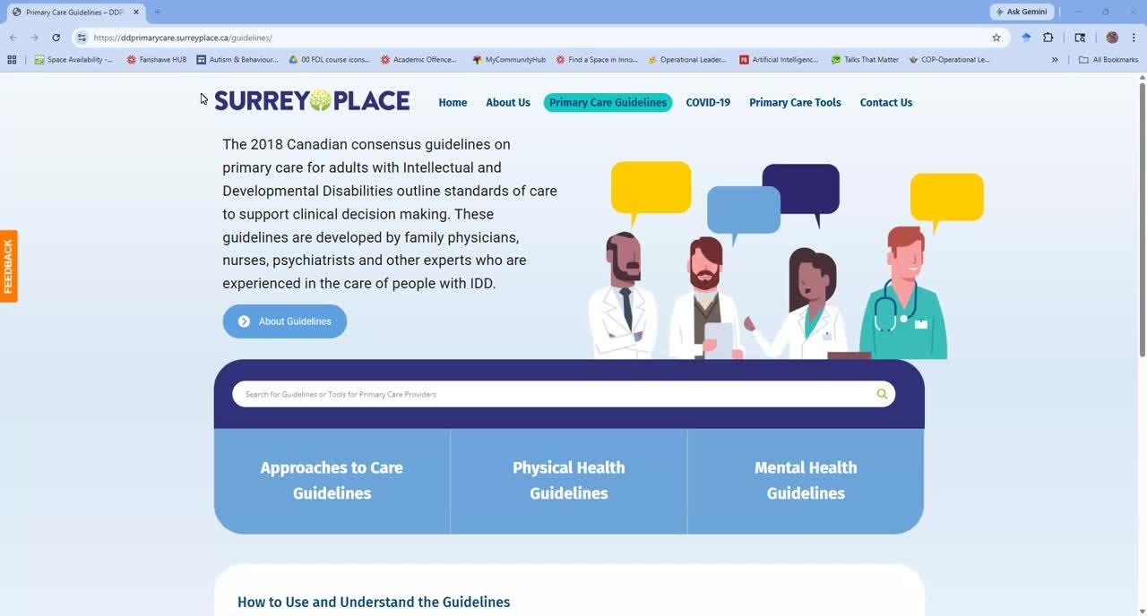
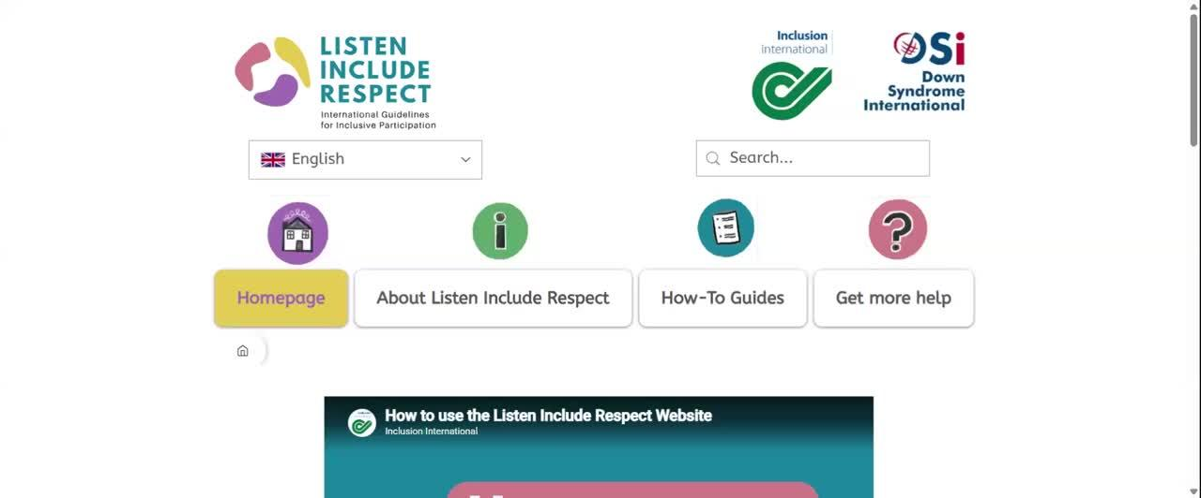
Key Resources
Notes:
In line with our learning objectives I will highlight some key resources that are helpful in supporting people with intellectual and developmental disabilities with dual diagnosis and through primary health care supports.

Slide 28
Primary Care Guidelines
The 2018 Canadian consensus guidelines on primary care for adults with Intellectual and Developmental Disabilities outlines standards of care to support clinical decision making.
These guidelines are developed by family physicians, nurses, psychiatrists and other experts who are experienced in the care of people with IDD.
https://ddprimarycare.surreyplace.ca/guidelines/

Slide 29
Listen, Include and Respect
This resource was provided by Felicia.
It can support organizations in providing inclusive care and offers support strategies.
Notes:
Felicia referenced this incredible resource in her list of support strategies, and felt it was important to share. Thiis is “listen, include and respect” which is a website accessible through your resources that supports organizations in more inclusive care and support strategies. This is a great resource to learn more about support strategies and broaden your knowledge in supporting persons with IDD in developing their own support strategies and providing care in an inclusive way.

Slide 30

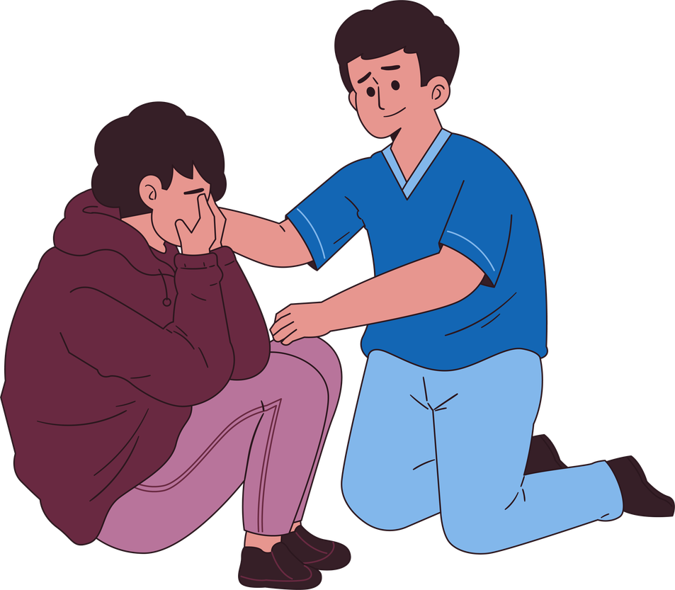
Summary of Support Strategies for People with IDD who are ALC and Preparing for Transition into Community
Advocate
Educate
Person-Centered Approaches
Support
Surrey Place. (n.d.). Aproaches to Care and General Considerations. Retrieved 2026, from Primary Care Tools: https://ddprimarycare.surreyplace.ca/tools-2/general-health/
Notes:
In summary, when using a combination of advocacy, education, person-centered care and support strategies we can support persons with an IDD through their health care visits in a more inclusive way and ensure equity as well as thoughtful discharge planning for those who have become ALC in a hospital setting and provide them with the tools to feel empowered and supported through transition from hospital back into a community setting.

Slide 31


Case Study
Notes:
We are now going to apply these strategies in a case study example using a role play to demonstrate how support staff can play a key role in supporting through transitions in a hospital setting. We will review Anna, 34 years old

Slide 32
Case Study: Anna
  Age: 34 years old
  Diagnosis:
    Developmental Disability
    ADHD
    Autism Spectrum Disorder
    Anxiety
    Personality Disorder
Anna has been in the hospital in a mental health in-patient unit for 7 months. She has been Alternate Level of Care for 3 months. The agency she is supported by provides limited supports through their supported independent living program, the agency has concerns about Anna’s safety and has been hesitant about her returning.
She is nervous to return home and doesn’t think she will get enough of the support that she needs. She is used to having nurses available 24/7 to support her when she is having difficulty coping. A interdisclipnary discharge planning meeting has been scheduled.
The video will demonstrate supporting Anna to prepare for the meeting. This case study will demonstrate how a developmental support worker can advocate and support a person with IDD in relation to an ALC setting.
Case study is also available on the worksheet provided
Notes:
Diagnoses of;
Developmental Disability
ADHD
Autism Spectrum Disorder
Anxiety
Personality Disorder
Anna has been in hospital on a mental health in-patient unit for 7 months, she has been Alternate Level of Care for 3 months as the agency she is supported by has been hesitant about her safety in returning with the limited supports she receives through their supported independent living program. She is nervous to return home and doesn’t think she will get enough support that she needs, as she has been used to having nurses available 24/7 to support her when she is having difficulty coping. The nurse is planning to come in to talk to Anna about discharge planning (returning back home). This case study will demonstrate how a developmental support worker can advocate and support a person with IDD in relation to an ALC setting.

Slide 33


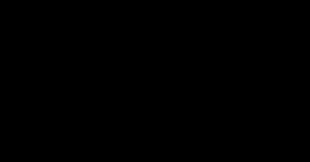
Role Play
Listen to a role play of Anna preparing for her Care Plan meeting
Notes:
Felicia and I have put together a role play scenario to demonstrate advocating and educating using person centred care approaches and individualized support strategies. ROLE PLAY VIDEO

Slide 34
Let’s Review Anna's Care Plan
Notes:
review care plan developed by Anna and her support worker - this can be a really helpful tool to use across transitions and include in everyone who supports Anna to help better understand her support strategies.

Slide 35
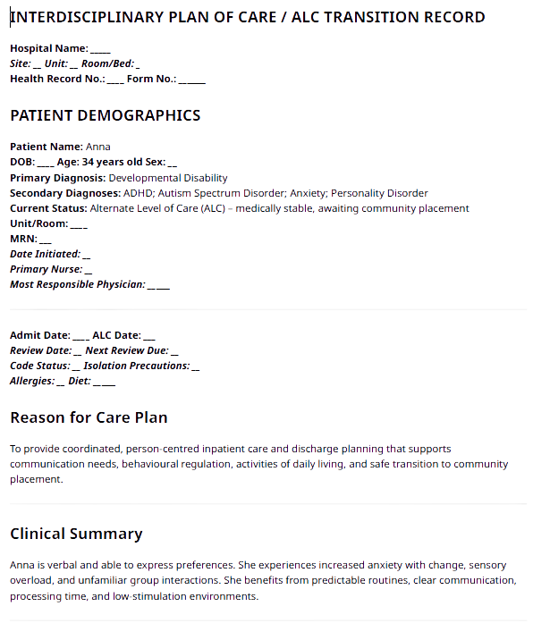
Example of Anna's Care Plan

Slide 36
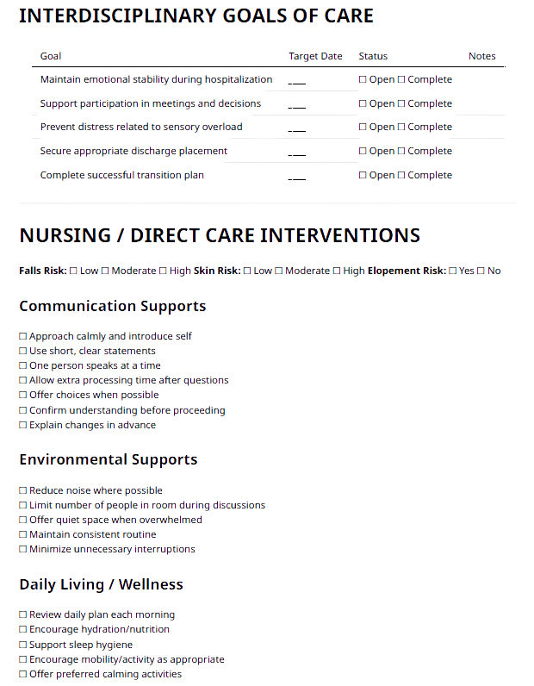
Example of Anna's Care Plan

Slide 37
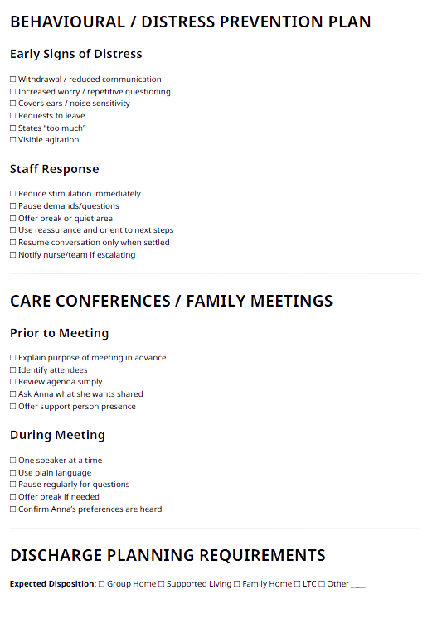
Example of Anna's Care Plan

Slide 38
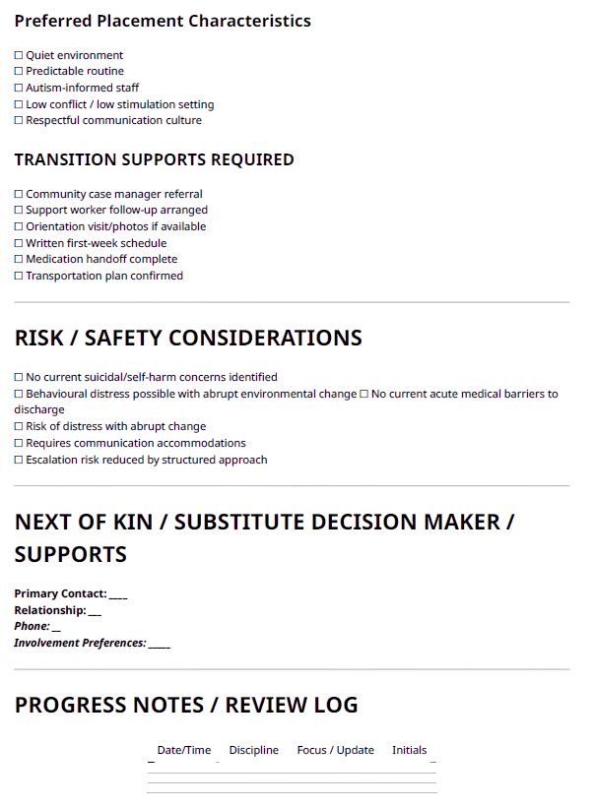
Example of Anna's Care Plan

Slide 39
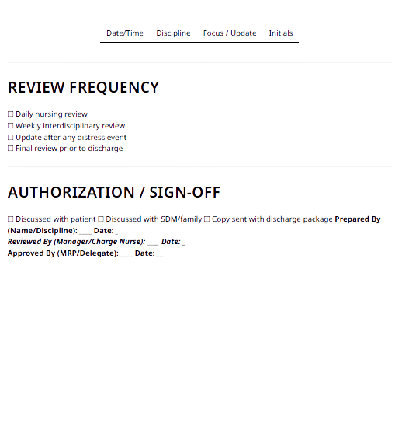
Example of Anna's Care Plan

Slide 40

Reflection
  What went well?
  What could have been improved on?
  Can you think of any additional tools that could be helpful in supporting this situation?
Reflection Questions
Capture your answer on the worksheet provided
Notes:
I invite you to take a minute or two to reflect on this case study. Maybe think about things that went well? Parts that could have been improved on? Or can you think of any additional tools that could be helpful in supporting this situation?
We will take a moment to check our knowledge, referring to your worksheet fill in the blanks to check your knowledge for this module and determine if we have met our learning objectives.

Slide 41
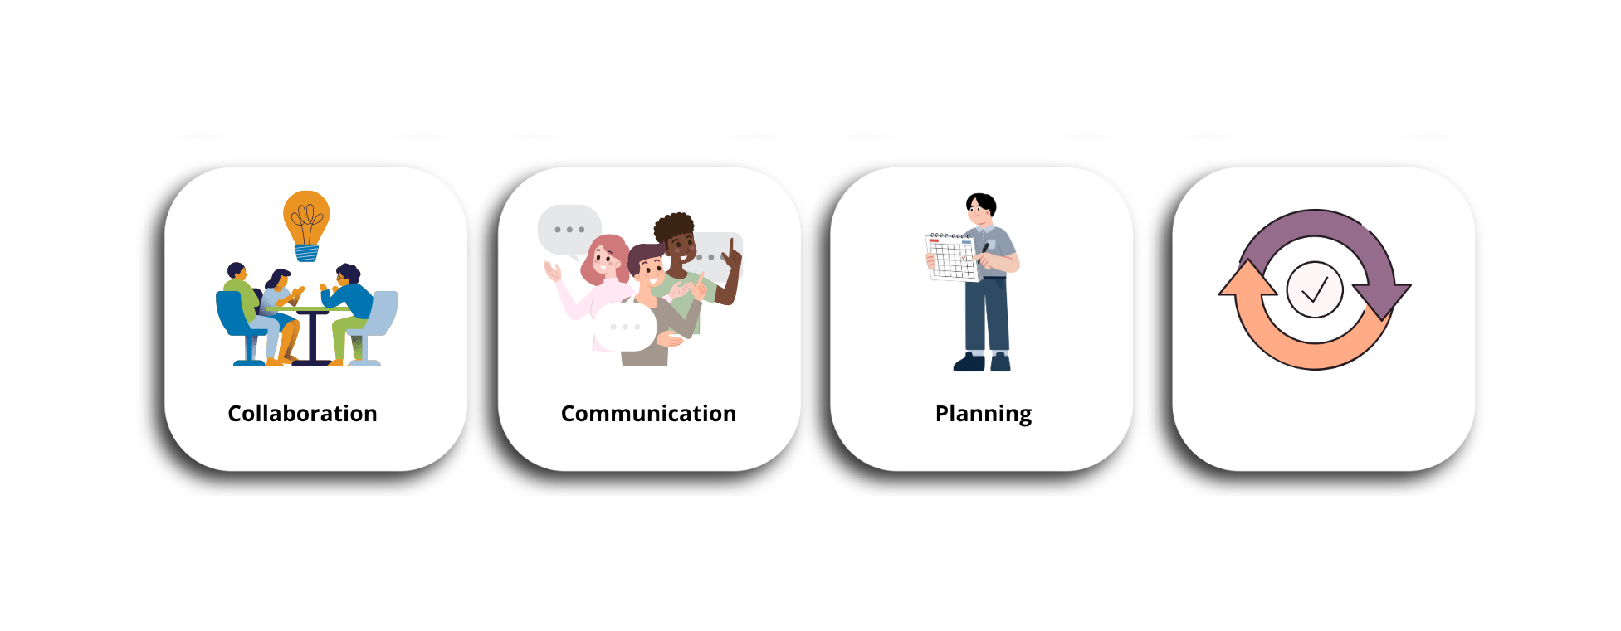
Key Takeaways
Effective support often requires:
Consistency
Notes:
So, for our key takeaways within this module in supporting persons with IDD through ALC transitions. We identified the higher risk that persons with IDD have at becoming ALC, we also reviewed support strategies and identified that Effective support often requires: Collaboration, Communication, Planning, and Consistency.

Slide 42
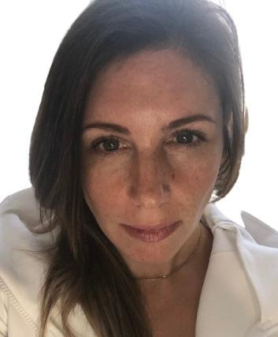
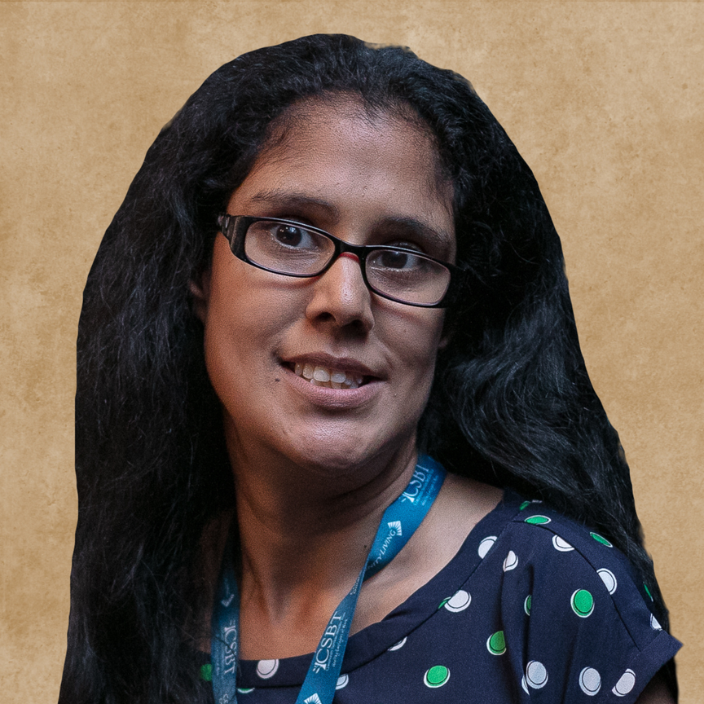

Up Next - Module 2: Crisis Prevention and
De-Escalation in Developmental Services
Lauri Angus, M.ADS., R.B.A (Ont.), BCBA, Coordinator, Centre for Behaviour Health Sciences, Mackenzie Health
Farrah
  Crisis in the context of developmental services
  Hospital to community transition
  Early warning signs of crisis in transition times
  Trauma-informed de-escalation strategies
  Other factors in crisis prevention
This module will build on the foundational knowledge from Module 1 and focus on practical strategies for supporting individuals safely and effectively.
Notes:
Module 2 is up next Crisis Prevention and De-Escalation in Developmental Services
This module will focus on proactive and reactive strategies to support individuals before and during crisis situations. Participants will learn how to:
Identify early warning signs
Recognize triggers and escalation patterns
Apply prevention strategies
Use de-escalation techniques
Apply trauma-informed approaches to reduce crisis situations
This module will build on the foundational knowledge from Module 1 and focus on practical strategies for supporting individuals safely and effectively.

Slide 43
Additional Resources
  Adaptive Functioning and Communication in Adults with Intellectual and Developmental Disabilities: Fact Sheet. Edwards, B. & Temple, V., Developmental Disabilities Primary Care Program of Surrey Place, Toronto, 2019 https://ddprimarycare.surreyplace.ca/wp-content/uploads/2019/06/2.2-Adaptive-Functioning-and-Communication-Fact-Sheet.pdf
  American Association on Intellectual and Developmental Disabilities. (n.d.). Definition of intellectual disability. https://www.aaidd.org/intellectual-disability/definition
  H-CARDD. (2019). About the H-CAARDD Program and Vita Community Living Services. Retrieved 2026, from The Nuts & Bolts of Healthcare: https://nutsandbolts.ddtoolkits.com/about.html
  Surrey Place. (2018). Approaches to Care and General Considerations. Retrieved 2026, from Primary Care Tools: https://ddprimarycare.surreyplace.ca/tools-2/general-health/
  Communicate CARE: Guidance for person-centred care of adults with intellectual and developmental disabilities. McNeil, K., Bell, E., Boyd, K., Heng, J., Sullivan, W.F., Vogt, J., Developmental Disabilities Primary Care Program of Surrey Place, Toronto, 2019. Care Program of Surrey Place, Toronto, 2019. https://ddprimarycare.surreyplace.ca/wp-content/uploads/2019/03/1.1CommunicateCare.pdf
  Surrey Place. (2018). Primary Care Guidelines. Retrieved 2026, from Developmental Disabilities Primary Care Program: https://ddprimarycare.surreyplace.ca/guidelines/
  Inclusion International & Down Syndrome International. (2022). Listen Include Respect https://www.listenincluderespect.com/

Slide 44
Thank-you for watching
Notes:
Thank you for joining me in this Module 1 of understanding Intellectual and Developmental Disabilities and Dual Diagnosis

Slide 45
References
  American Association on Intellectual and Developmental Disabilities. (n.d.). Definition of intellectual disability. https://www.aaidd.org/intellectual-disability/definition
  CAMH. (n.d.). Dual Diagnosis. Retrieved 2026, from CAMH: https://www.camh.ca/en/health-info/mental-illness-and-addiction-index/dual-diagnosis
  Ontario Ombudsman. (2025). Lost in transition: Investigation into the inappropriate hospitalization of adults with developmental disabilities. Toronto: Ombudsman Ontario. Retrieved from https://www.ombudsman.on.ca/en/our-work/investigations/lost-transition
  Selick, A., Volpe, T., Morris, S., & Lunsky, Y. (2025). Addressing delayed hospital discharges for patients with intellectual and developmental disabilities and a mental illness. Psychiatric Services, 76(2), 207–209. https://doi.org/10.1176/appi.ps.20230288
  Surrey Place. (n.d.). Aproaches to Care and General Considerations. Retrieved 2026, from Primary Care Tools: https://ddprimarycare.surreyplace.ca/tools-2/general-health/

