Slide 1




A program brought to you by March of Dimes Canada in Collaboration with

Slide 2
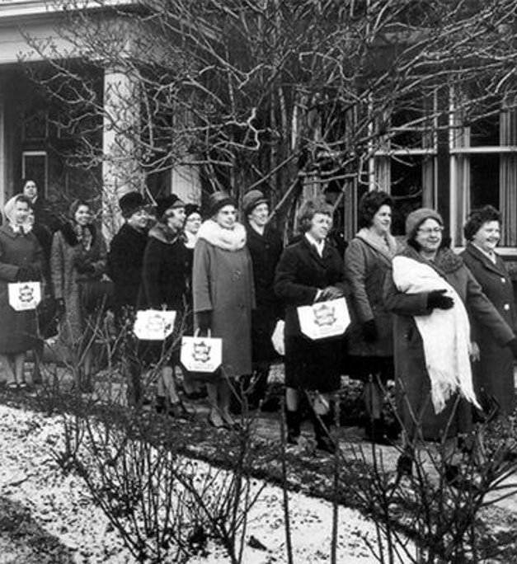
OUR HISTORY
We were founded in 1951 as the Canadian Foundation for Poliomyelitis, using the market name Ontario March of Dimes. Our original mission was to find a cure for the polio virus, with volunteers going door to door collecting dimes for research.
Following discovery of the Salk vaccine, our mandate evolved over the years to serve and support not only polio survivors, but adults with all forms of physical disability.
In 2006, we took on a national mandate and changed our name to March of Dimes Canada.

Slide 3



ABOUT MARCH OF DIMES CANADA
Purpose
Champion equity. Empower ability.
Vision
An inclusive, barrier-free society for people with disabilities.
Mission
To be Canada’s leading service provider, resource and advocate, empowering people with disabilities to live and thrive in communities nationwide.
March of Dimes Canada is a leading national charity committed to championing equity, empowering ability, and creating real change that will help the more than six million people living with disabilities across the country unlock the richness of their lives.
We serve, connect, and empower people living with disabilities to participate fully in life - on their own terms. Our work is grounded in the voices of the people we serve, built on a foundation of service, and backed by a 70-year history of success.

Slide 4

learn digital skills for life and work

Slide 5

Program offerings
Accessible Technology
Digital Fundamentals
Digital Skills and Jobs Readiness
* This program is corporately funded so it does not impact any other services or funding that your clients might be receiving.

Slide 6

Eligibility
Live in Canada
Have a mobile phone, tablet, laptop or computer
Stable Internet connection
Self-identify as having a disability or barrier to employment
16 years or older **
**please note the accessible technology and digital fundamentals program offerings are open to any age

Slide 7
Program delivery
Continuous intake. To access our program individuals will need to submit an online registration through the SkillingUp website (www.skillingup.ca)
Contact from MODC within 3 business days
Complete intake and set goals with the program staff
Customized training plan developed and delivered 1:1 or training pathways provided for self-directed learning

Slide 8
Digital skills assessment
Our free online assessment helps users identify their current digital skills and recommends the best SkillingUp program offering.
How it works:
1. Complete Assessment
Takes 5–10 minutes
Available at skillingup.ca
Answer simple skill-based questions
2. Get Personalized Results
Instant recommendations
Based on skills, experience & goals
3. Take the Next Step
Download results
Register for a program
Connect with our team

Slide 9
accessible Technology
(In partnership with Telus Tech for good)

Slide 10
accessible technology
A partnership with TELUS, Tech for Good offers customized one-to-one training and support on how to use a device’s accessibility features as well as related assistive technology.
The program is primarily educational in nature and provides support to help improve the quality of life, independence and personal empowerment of people who have disabilities.
Our Accessible Technology Specialists can also provide recommendations on assistive technology, including apps, software, and hardware for mobile phones, tablets, laptops and computers.

Slide 11
accessible technology
We also offer group workshops on request. Our most popular workshops include:
Android Accessibility
Apple Accessibility
Safety – Fall Protection Devices
Accessibility and Employment
Accessible Gaming
Apps for Health Management
Task and Reminder Apps
Smart Home Technology
Computer Accessibility
Brain and Cognition games
Sensory and Meditation Apps

Slide 12
accessible technology - virtual drop in session
First Thursday of every month at 1:00 PM ET
No registration required – join from www.skillingup.ca/accessible-technology
Explore assistive technology solutions tailored to specific challenges
Opportunity to ask Accessible Technology Specialists specific questions
General information about:
  Hearing Impairments
  Vision Impairments
  Cognitive Impairments
  Physical Impairments

Slide 13

AT Client Story

Slide 14
Learn digital fundamentals
Currently on a 2 month wait

Slide 15
Learn digital fundamentals
Ideal for very beginner learners who are new to technology
Explore and learn the basics of understanding devices and how to be safe while online through a range of digital fundamental topics​.
With help from our virtual tech savvy volunteer coaches, this program empowers people who have disabilities to build their digital skillset through one-to-one training sessions and bridge online connections with their communities​.
We also offer group workshops on request, email skillingup@marchofdimes.ca to book a session.

Slide 16
Digital fundamentals topics
*available for self-paced learning
Being safe online
Protecting your privacy
Recognizing scams
Managing use of technology (screen time, responsible use, etiquette, etc.)
Using applications
Buying things online
Artificial intelligence
Using social media
General tasks on your device (texting, calling, emailing, etc.)
Getting familiar with a new device and understanding general features
Using video platforms (zoom, teams, skype, facetime, etc.)
Using Microsoft 365 (Word, PowerPoint, etc.)
Using the internet

Slide 17
Digital skills and job readiness

Slide 18
Digital skills and job readiness
Learn new skills or upgrade existing digital skills and become qualified for a technology role or job requiring computer skills in a virtual self-paced environment.
Courses and certificates are available for individuals at any skill level including beginner, intermediate and advanced.
Our job development team can work collaboratively to compliment what you are working on

Slide 19
features
Program Content and Delivery
Learners progress at their own pace, no set time for completion.
Content delivered by on-demand videos and slide decks
No limit on certificates earned.
Access learning pathways from anywhere with a stable internet connection.
Accessibility
Compatible with assistive technology
Adjustable audio speed and closed captions.
Additional support from Accessible Technology Specialists.
Additional support from the SkillingUp Instructor.
LinkedIn Learning
SkillingUp uses LinkedIn Learning content for the AI and Cybersecurity learning pathways.
Learners enrolled in these pathways will need a LinkedIn account to access the learning content and assessments.

Slide 20
Learning pathways
Beginner​
Beginner learners can type, use a mouse, and navigate websites. They will follow the Digital Literacy for Work and Everyday Life pathway.​ This pathway covers the following topics:
Tech Etiquette Managing Your Digital Footprint Keeping Information Private and Secure Internet Safety | Collaborating Online Social Media Artificial Intelligence (AI) Microsoft 365

Slide 21
Learning pathways
Intermediate​ - Professional Certificates in AI and Cybersecurity
An intermediate learner has experience with programs that workplaces count on most and have used computers or technology at work. These learners will focus on the Professional Certificate learning pathways.
The Professional Certificate pathways are: ​ Generative AI (eligible for CEUs with CVRP) Productivity with Generative AI AI for Managers (eligible for CEUs with CVRP) AI for Organizational Leaders (eligible for CEUs with CVRP) Human Skills and AI (eligible for CEUs with CVRP) Microsoft Copilot for Productivity Microsoft Azure AI Essentials Microsoft Security Essentials Cybersecurity ​

Slide 22
Learning pathways
Advanced​
Advanced learners are proficient in MS Systems and have experience or training in ICT. They will focus on earning Microsoft Certifications.​
The MS Certification pathways are: ​ ​ ​ • Power Platform Fundamentals PL-900 ​ • Security, Compliance, and Identity Fundamentals SC-900 ​ • Teams Administrator Associate MS-700 • Microsoft Certified: Azure AI Fundamentals AI-901 • Microsoft Data Analyst Career Path PL-300

Slide 23
Learning pathways
Professional Soft Skills
Learners will build the skills employers value most and gain the tools they need to succeed in any workplace. This pathway covers the following topics:
Collaboration Adaptability Attitude Writing Accountability Digital Skills Problem Solving Motivation | Communication Creativity and Innovation Confidence Numeracy Reading Presentation Stress Management Time Management

Slide 24
Learning pathways
Entrepreneurship
Aspiring entrepreneurs can learn how to launch and grow a successful small business through business financing, recruitment planning, marketing fundamentals, networking strategies, and sales planning. This pathway covers the following topics:
Business Startup Funding Readiness Marketing Strategy | Sales Planning Networking Skills Business Tools

Slide 25

Dsjr Client story

Slide 26
Learning pathways
Job Readiness
Designed for any skill level, the Job Readiness learning pathway is designed to prepare individuals for success in the workforce by equipping them with the essential skills, knowledge, and confidence needed to thrive. This pathway covers the following topics:
Creating Your Brand Informational Interviews and Job Fairs Resumes and Cover Letters Online Job Search Using AI in Job Search | Overcome Frustration in Job Search Using Indeed Using LinkedIn Interview Skills Job Scams Disclosure

Slide 27
Digital skills and job readiness – job development support
We offer job development support which includes:
Resume review
Mock interview practice
Connection to job openings
Application support
Connect to job fairs/workshops
Connect to group info sessions
Access to remote job developers and virtual mentorships across Canada upon pathway completion
Compliments existing employment service provider job development work, no conflict due to corporate funding

Slide 28
Digital skills and job readiness - mentorship
Benefit from 5 hours virtual mentorship with mentor in field of interest
Mentors from across Canada
Variety of roles and backgrounds
Boost client confidence
Get insight and real-life advice
Increase networks
Improve communication skills
Gain industry knowledge
Conversation Topics Could Include:
How to create a technical portfolio
Resume review and interview practice
Disclose a disability
Identify transferrable skills
Become more employable
Define career goals
Identify further skill development needs

Slide 29
Mentorship testimonials
Aaron has been an amazing mentor. He cleared my doubts related to the job roles and certifications that I was interested in. His suggestions and advice provided a clear vision of how I can achieve recognition and excellence in my career. I would like to thank Aaron for being my mentor and March of Dimes for providing me an opportunity to join this mentorship program.
  I am getting to learn a lot through this mentorship program. I have been receiving great guidance from my mentor. It has helped me solve my doubts and see how to achieve my future goals. I'm really thankful for all the assistance I have received through this program. I look forward to learn more and achieve more through this mentorship.
  I’m grateful for the support and guidance provided by my mentor throughout the program. The sessions have been insightful, especially in helping me develop better communication skills and build confidence. My mentor provided practical advice tailored to my goals, which I found incredibly helpful. I also appreciate the structure of the program, allowing for flexibility while still keeping us on track.

Slide 30
Become a skillingup mentor
Support people with disabilities as they build new digital skills and career pathways.
What Mentors Do | How It Works
Share industry insights Answer questions and provide guidance Review progress and encourage growth Offer career advice Connect learners to networks and opportunities | Mentors are paired 1:1 with a learner Focus on building a meaningful connection Support individual goals and growth
A small time commitment can have a lasting impact on someone’s career journey.
Sign-up: www.skillingup.ca

Slide 31
Workshop collaboration
A flexible program that enables your team to deliver in-person digital skills and job readiness training using
SkillingUp content with full support from our team.
How It Works:
1. Plan | 2. Registration | 3. Delivery | 4. Wrap-Up
Intro call to confirm dates, content, and support needs | Submit participant list + confirm start date Participants complete online registration SkillingUp team enrolls learners + sends login details | You facilitate in-person sessions using our content. Live orientation session on Day 1 Ongoing support available | Final Q&A session with our team SkillingUp team sends completion certificates Participants can continue learning + access employment support

Slide 32
Workshop content
Workshop Options | Benefits of Collaboration
Core Workshops (9-10 hours) Digital Literacy for Work & Everyday Life Professional Soft Skills Job Readiness Digital Fundamentals Library (1.5 hours each) Tech Etiquette, Internet Safety, Digital Footprint Privacy & Security, Social Media, Online Collaboration Device Basics, iPad Basics, Device Settings LinkedIn, Online Applications WhatsApp, Zoom, Google Maps Employment Scams | Ready-to-use curriculum Flexible delivery options Live onboarding + support Enhances your existing programs Clients receive completion certificates Connects clients to job development supports and mentorship

Slide 33
The skillingup advantage
Free digital skills training for clients
Flexible Learning Options
Increased job readiness and employability
Free support from Accessible Technology Specialists
Accessible and inclusive
Leverage all program offerings within your existing services for free
Work collaboratively with the SkillingUp team to expand support for your client
Participation will not impact any other services or funding

Slide 34
Registration
Review program offerings and submit registration form on www.skillingup.ca
Receive confirmation from program team within 3 business days.
Program staff will complete an intake call for Digital Fundamentals or Accessible Technology .
Program staff will share information about how to login and start the independent learning pathway in Digital Skills and Job Readiness by email.
If you want to be included on your client’s communication with our team, please email skillingup@marchofdimes.ca and CC your client.
Contact skillingup@marchofdimes.ca for any support while participating in the program

Slide 35
QUESTIONS CONTACT: SKILLINGUP@MARCHOFDIMES.CA WEBSITE: WWW.SKILLINGUP.CA

